Slide 1
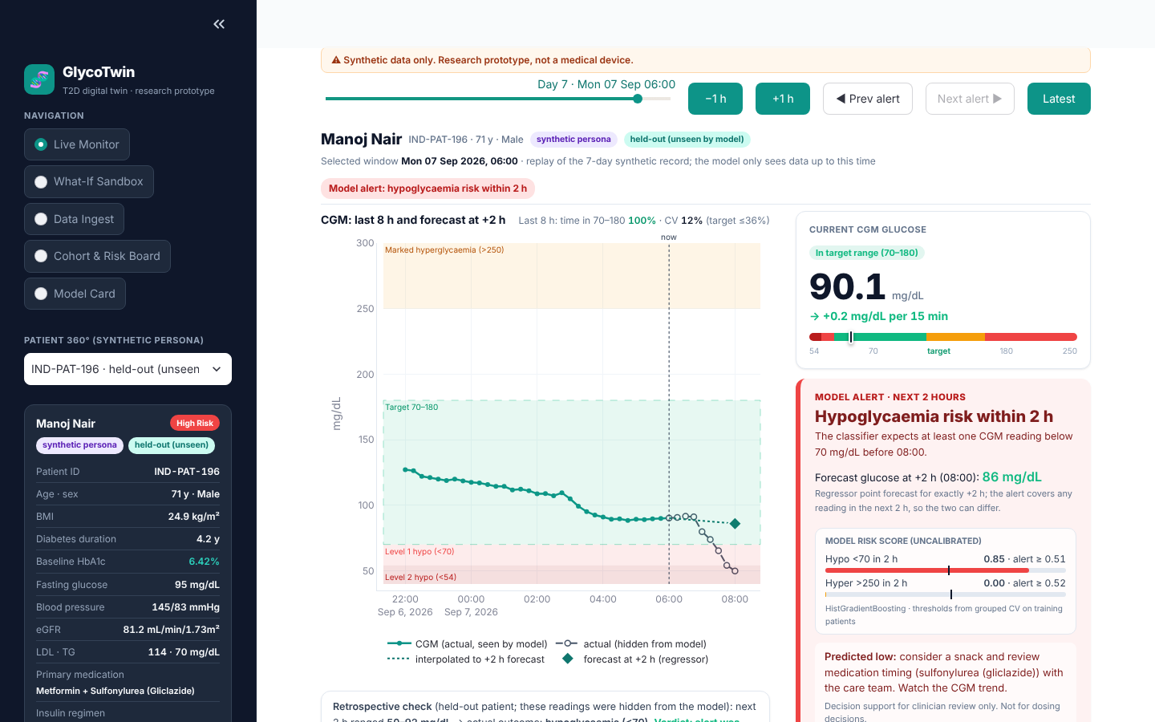
HAPPIEST HEALTH DIGITAL TWIN CHALLENGE 2026 · PHASE 1
GlycoTwin
A multimodal digital twin for Type 2 diabetes that forecasts hypoglycaemia (<70 mg/dL) and marked hyperglycaemia (>250 mg/dL) 2 hours ahead, by fusing a synthetic EHR with synthetic CGM and wearable data
Team Classy Leopards
Goa Institute of Management, Sanquelim, Goa
Shivam Raj (team leader)
Shubham Kumar · Shiva Kumar Bachatty · Yashita Dube
Held-out patient: CGM in range now, hypoglycaemia alert for the next 2 h
Synthetic data only · research prototype, not a medical device · not for dosing decisions
Notes:
Introduce the team and the one-line idea: a per-patient model that combines the static record with the live CGM and wearable stream and warns about lows and highs two hours ahead. Say up front that all data is synthetic and this is a research prototype, not a medical device.

Slide 2
THE PROBLEM IN INDIA
Diabetes is common in India, and dangerous glucose swings happen between clinic visits
101 million
What goes wrong between visits
Hypoglycaemia: Level 1 is <70 mg/dL, Level 2 is <54 mg/dL [3]. In Type 2 diabetes the main drug causes are sulfonylureas and insulin; risk rises with age and lower kidney function.
Marked hyperglycaemia: >250 mg/dL. The time-in-range consensus asks for more than 70% of readings in 70⁠–⁠180 mg/dL and fewer than 4% below 70 [4].
Care is episodic: clinic reviews happen every few months. A CGM shows the trend, but someone still has to notice a trend heading out of range and act before it gets there.
people in India had diabetes in 2021 (11.4% of adults), counted by testing, including undiagnosed cases [1]
136 million
had prediabetes (15.3%) [1]
BMI 23.9 ≈ 30
South Asian adults reach the diabetes incidence of white adults with BMI 30 at a BMI of about 23.9 [2]
[1] Anjana RM et al., ICMR-INDIAB-17, Lancet Diabetes Endocrinol 2023 · [2] Caleyachetty R et al., Lancet Diabetes Endocrinol 2021
[3] ADA Standards of Care in Diabetes 2025, section 6 · [4] Battelino T et al., Diabetes Care 2019
Synthetic data only · research prototype, not a medical device · not for dosing decisions
2 / 12
Notes:
Scale from ICMR-INDIAB-17; the South Asian phenotype at lower BMI; the ADA hypoglycaemia levels and the time-in-range consensus. The gap we target: events build up over hours between visits.

Slide 3
OUR SOLUTION
Every 15 minutes, one fused feature set and two models answer two questions per patient
Static EHR
Demographics, labs, medication, history, TCF7L2 genotype
1. Event alert
Will any reading in the next 2 h be <70 or >250 mg/dL? Risk score vs a set threshold
GlycoTwin
EHR joined to every 15-min window; two gradient-boosted tree models
Live wearable stream
CGM, heart rate, HRV, steps, sleep stage, carbs, insulin
2. Glucose forecast
What will the CGM read exactly 2 h from now (mg/dL)?
How a doctor uses the twin
Cohort risk board
patients ranked by current 2-h risk score
Live monitor
EHR card, last 8 h of data, forecast and alert
What-if sandbox
rule-based counselling tool, separate from the model
Model card
every number read from models/metrics.json
Synthetic data only · research prototype, not a medical device · not for dosing decisions
3 / 12
Notes:
Two outputs: an event alert for the next two hours and a point forecast of glucose at +2 h. The doctor stays in charge: the twin ranks who needs attention and explains why; the clinician decides the action.

Slide 4
DATA: TWO SYNTHETIC STREAMS
Two synthetic streams for the same 200 people, aligned every 15 minutes
Static EHR data/synthetic_ehr.csv
200 personas
Age, sex, diet pattern, BMI; HbA1c, fasting glucose, BP, eGFR, LDL, triglycerides
Medication, insulin regimen, risk tier, past diagnoses
Prior hypos (12 m), family history, TCF7L2 rs7903146 risk alleles
HbA1c 5.7–9.7% (mean 6.82%); 66 on a sulfonylurea, 3 on insulin
Live stream data/synthetic_wearables.csv
132,800 windows 200 × 7 days × 15 min
CGM glucose, heart rate, HRV, steps, sleep stage (Awake/Light/Deep/REM)
Logged meal carbohydrates and insulin units
Labels: any reading <70 or >250 in the next 2 h; glucose exactly 2 h ahead
Windows: 128,086 no event · 1,012 hypo · 3,702 hyper. 409 readings <70 (35 <54) in 37 patients
The simulator couples the streams on purpose
Sulfonylurea taken on a skipped breakfast causes lows; missed or extra insulin boluses
Low glucose raises heart rate and lowers HRV; short sleep raises next-day insulin resistance
TCF7L2 risk alleles raise post-meal peaks; eGFR <60 slows insulin clearance (no persona is below 60, so not exercised)
Caveat
Parameters are illustrative and not calibrated to any dataset. Population ranges are loosely informed by published Indian literature. Meal, walk and sleep times vary day to day.
Source: data/synthetic_*.csv, models/metrics.json · Synthetic data only · research prototype, not a medical device · not for dosing decisions
4 / 12
Notes:
Why a simulator: the task needs both streams for the same person, aligned in time, with a label for every window; Synthea has no CGM stream and MIMIC-IV cannot be redistributed. The cost is realism, so every result is labelled synthetic.

Slide 5
MODEL
Two gradient-boosted tree models on 34 fused features
34 features = 18 wearable + 16 EHR
Two scikit-learn HistGradientBoosting models
Classifier: 3 classes (no event / <70 / >250 in the next 2 h), class_weight="balanced" because events are rare
Regressor: CGM glucose exactly 2 h ahead
Max depth 6, learning rate 0.08, up to 150 iterations, native categorical splits
All computed from the current and past windows only
5
CGM current glucose, change over 15 and 30 min, 1 h mean and SD
4
Heart heart rate and HRV, now and 1 h means
Split by patient: tested on unseen people
150 training / 50 held-out patients, none in both; held-out = 33,200 windows never used for training or thresholds
3
Activity steps in the last 15 min, 1 h and 2 h
4
Meals, insulin carbohydrates and insulin units, now and 2 h sums
Alert rule
Hypo alert if score ≥ 0.51, else hyper alert if score ≥ 0.52; thresholds maximise F2 on 5-fold patient-grouped CV of the training patients
Scores are uncalibrated risk scores, not probabilities. About 15 ms per window on CPU
2
Context hour of day, sleep stage
16
EHR age, sex, BMI, diabetes duration, HbA1c, fasting glucose, BP, eGFR, diet, medication, insulin regimen, risk tier, prior hypos, family history, TCF7L2
Source: models/train_fusion_model.py, models/metrics.json · Synthetic data only · research prototype, not a medical device · not for dosing decisions
5 / 12
Notes:
Why gradient-boosted trees: tabular mixed data, rare events, trains in under a minute on a CPU, deterministic with a fixed seed. The split is by patient, so held-out patients are genuinely unseen. Thresholds were chosen on training patients only.

Slide 6
RESULTS · 2-HOUR GLUCOSE FORECAST
On 50 unseen patients the 2-hour forecast error is 11.0 mg/dL, 1.9× lower than assuming glucose stays the same
Mean absolute error at +2 h (mg/dL, lower is better)
Clarke error grid zones (% of forecasts)
Model | A | B | C | D | E
GlycoTwin | 91.8% | 7.6% | 0.0% | 0.6% | 0.0%
Persistence | 79.1% | 19.7% | 0.0% | 1.2% | 0.0%
Linear extrap. | 59.9% | 34.4% | 4.1% | 1.4% | 0.2%
99.4% in zones A+B
91.81% A + 7.58% B. Zone D 0.61%; none in C or E
R² 0.803 vs 0.428 for persistence. 5-fold patient-grouped CV over all 200 patients: MAE 11.08 mg/dL, R² 0.806.
Each forecast is compared with the CGM reading exactly 2 h later. Zones per Clarke et al., Diabetes Care 1987.
Source: models/metrics.json · Synthetic data only · research prototype, not a medical device · not for dosing decisions
6 / 12
Notes:
Two honest baselines: persistence (glucose stays the same) and linear extrapolation of the last 15-minute change. Held-out patients were never used for training or for choosing thresholds. Synthetic data, so this measures how well the model learns the simulator.

Slide 7
RESULTS · 2-HOUR EVENT ALERTS
Alerts warned of 34 of 39 lows and 42 of 43 highs in advance, but most alarms are false
Hypoglycaemia (<70 mg/dL within 2 h)
Marked hyperglycaemia (>250 mg/dL within 2 h)
34/39
73.4%
52.3%
42/43
86.2%
36.4%
episodes warned 15⁠–⁠120 min ahead
window sensitivity
window precision
episodes warned 15⁠–⁠120 min ahead
window sensitivity
window precision
PR-⁠AUC 0.621 · ROC-⁠AUC 0.990 · median lead time 120 min
If CGM is 70–250 now: sensitivity 63.2%, precision 39.3%
Simple rule (CGM <90 and falling): sensitivity 42.8%, precision 33.9%
0.36 alarms per patient-day; 69% not followed by the event within 2 h
PR-⁠AUC 0.774 · ROC-⁠AUC 0.988 · median lead time 120 min
If CGM is 70–250 now: sensitivity 77.9%, precision 24.0%
Simple rule (CGM >200 and rising): sensitivity 40.8%, precision 15.6%
0.58 alarms per patient-day; 88% not followed by the event within 2 h
Honest reading: thresholds favour sensitivity (F2), so alarm fatigue is the main weakness to fix with clinicians. 50 held-out patients, 458 hypo and 557 hyper windows; scores are uncalibrated.
Source: models/metrics.json · Synthetic data only · research prototype, not a medical device · not for dosing decisions
7 / 12
Notes:
Episode view: of the out-of-range episodes in held-out patients, how many got a warning 15 to 120 minutes before the first out-of-range reading. Window view: sensitivity and precision per 15-minute window. Be explicit about false alarms per patient-day and about the harder case where the patient is in range now.

Slide 8
FUSION EVIDENCE
Fusing the EHR helps modestly for the forecast and lows; highs are driven by the wearables
Forecast MAE by feature set (5-fold patient-grouped CV, mg/dL)
EHR-swap test
Held-out patients scored with another patient's EHR:
Forecast MAE 11.0 → 16.13 mg/dL
Hypo PR-⁠AUC 0.621 → 0.435
Hyper PR-⁠AUC 0.774 → 0.646
The model uses the EHR: the wrong record makes every score worse.
Small gains over wearables only: MAE 11.45 → 11.08, hypo PR-⁠AUC 0.530 → 0.548; hyper PR-⁠AUC is higher without the EHR (0.855 vs 0.820).
No measurable signal from HR, HRV and sleep (MAE 11.07 without them) or from history and genetics (hypo PR-⁠AUC 0.555 without them).
One CV run, no per-fold spread reported: gaps this small may be noise.
Lower is better; the shipped model uses all features.
Source: models/metrics.json · Synthetic data only · research prototype, not a medical device · not for dosing decisions
8 / 12
Notes:
Ablation retrains the whole model with feature groups removed, using patient-grouped CV. The EHR-swap test keeps the model fixed and gives each held-out patient someone else's record. The swap test is the stronger evidence; the fusion gains over wearables only are small and come from one CV run without per-fold spread. Be honest that HR, HRV, sleep, history and genetics add no measurable signal in this synthetic data.

Slide 9
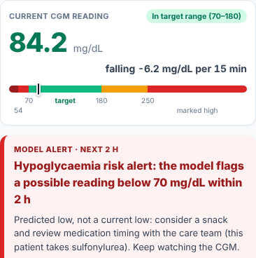
DOCTOR DASHBOARD · STREAMLIT AND HOSTED PAGE
The live monitor scores a held-out patient window by window, on a laptop or a phone
What the doctor sees
Last 8 h of CGM, the +2 h forecast and the alert, with both uncalibrated risk scores and their thresholds
Held-out patients: the readings that followed (hidden from the model) shown for comparison
Predicted low: “consider a snack / review medication timing with the care team”. Rescue-carb text only when CGM is <70 now
Scored live on CPU for each selected window
Hosted page on a phone
Same patient, an earlier alert. Outputs precomputed in Python; no model runs in the browser.
Source: dashboard/app.py, dashboard/index.html (screenshots) · Synthetic data only · research prototype, not a medical device · not for dosing decisions
9 / 12
Notes:
Demo patient IND-PAT-196 is held out (unseen in training). Use the replay slider to step to the hours before the first low and show the alert appearing while the CGM is still in range, then reveal what actually happened. The phone view is the hosted static page for the same patient at an earlier alert.

Slide 10
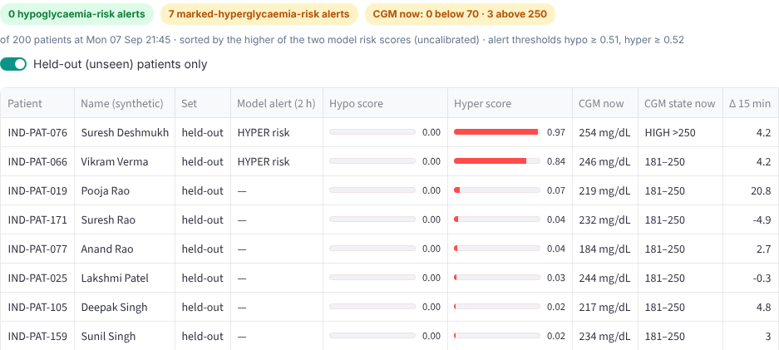
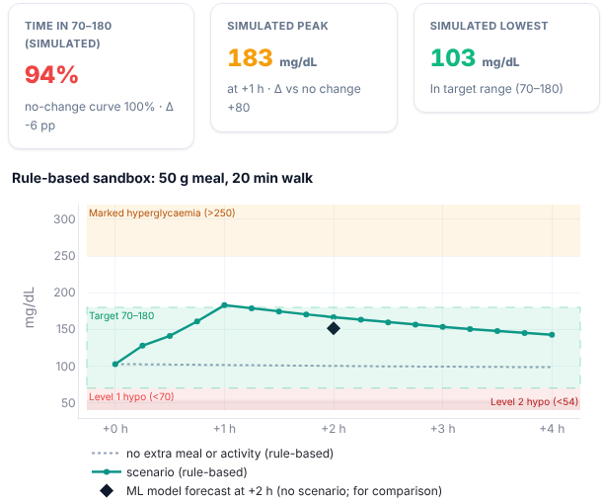
DOCTOR DASHBOARD · COHORT AND SANDBOX
A cohort risk board shows who needs attention; a rule-based sandbox supports counselling
Cohort risk board
Every patient scored in one batched call and ranked by the higher of the two risk scores (held-out patients shown)
What-if sandbox
Hand-written rules for counselling, not the ML model (its +2 h forecast is shown only for comparison); not a dosing tool
Source: dashboard/app.py (screenshots) · Synthetic data only · research prototype, not a medical device · not for dosing decisions
10 / 12
Notes:
The risk board scores every patient at the replay time in one batched model call and ranks them. The what-if sandbox is deliberately rule-based and separate from the ML model; it is a counselling aid, not a forecast. Both dashboards take every performance number from models/metrics.json: Streamlit at runtime, the hosted page at build time.

Slide 11
LIMITATIONS AND SAFETY
What this prototype does not show yet
Synthetic data only. The model learns our simulator, which is simpler than real physiology; high ROC-⁠AUC partly reflects that. No result transfers to real patients yet.
Uncalibrated simulator and scores. Simulator parameters are hand-set; classifier outputs are risk scores, meaningful only against the thresholds.
False alarms. 0.36 hypo and 0.58 hyper alarms per patient-day; 69% and 88% are not followed by the event.
Harder case: in range now. If CGM is 70⁠–⁠250 at the time of the alert, sensitivity is 63.2% (hypo) and 77.9% (hyper).
Thin coverage. 3 of 200 personas use insulin (0 in the held-out set); none has eGFR <60; only 35 readings <54, too few to evaluate Level 2 hypoglycaemia.
Regular routines. Hour of day is a strong feature (MAE 13.86 without it); real days vary more.
Safety statement
Synthetic data only. Research prototype, not a medical device. Not for diagnosis or dosing decisions.
Decision support for a clinician, who decides any action
A predicted low suggests a snack or a medication-timing review with the care team
Rescue text (15 g fast carbs, recheck in 15 min) only when CGM is <70 now; never insulin doses
Uses only synthetic data, so no personal health data is processed (designed with DPDP Act 2023 principles in mind)
Clinical use would need prospective validation and regulatory review
Source: data/synthetic_ehr.csv, models/metrics.json · Synthetic data only · research prototype, not a medical device · not for dosing decisions
11 / 12
Notes:
Read the safety statement aloud. Regulatory note: clinical use would fall under software as a medical device in India's Medical Devices Rules, 2017.

Slide 12
NEXT STEPS
From a synthetic twin to a clinic pilot
1
Real CGM data
Validate on open Type 2 diabetes CGM datasets (for example ShanghaiT2DM, CGMacros on PhysioNet) after licence checks
Thank you
Code and docs
github.com/kumarshubhammorya/
glycotwin-digital-twin
Hosted page
glycotwin-app.web.app
Video walkthrough (20+ min)
linked in README.md, section 5
Team Classy Leopards · Goa Institute of Management, Sanquelim, Goa
Shivam Raj · Shubham Kumar · Shiva Kumar Bachatty · Yashita Dube
2
Realistic EHR
Synthea with an India-adapted module; MIMIC-IV only where its data use agreement allows
3
Calibration and alarms
Calibrate risk scores on grouped CV; tune thresholds with clinicians to cut false alarms
4
Prospective pilot
Consented pilot with an Indian diabetes clinic; measure outreach and out-of-range time against usual care
Synthetic data only · research prototype, not a medical device · not for dosing decisions
12 / 12
Notes:
Close with the roadmap and the links. Once the unlisted video link is pasted into README.md section 5, rerun generate_summit_docs.py and the link replaces the pointer to the README on this slide.

