Slide 1
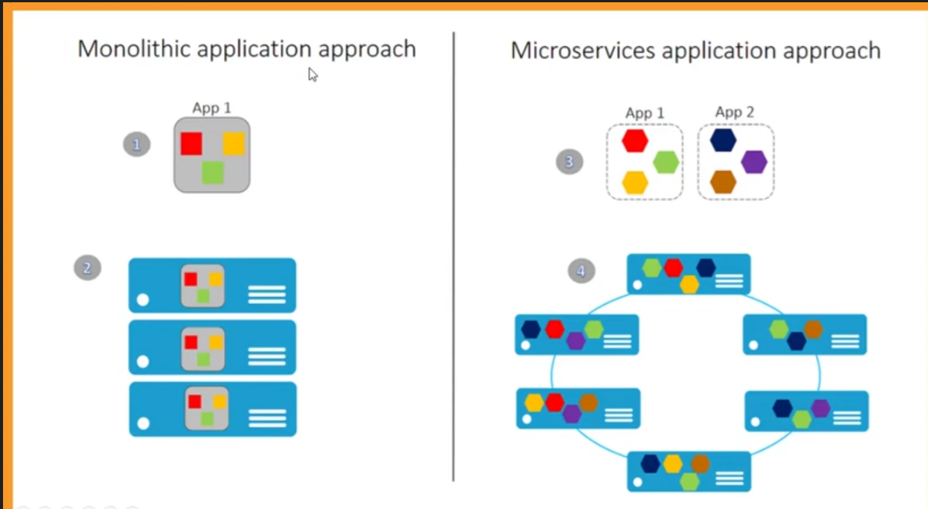

Slide 2
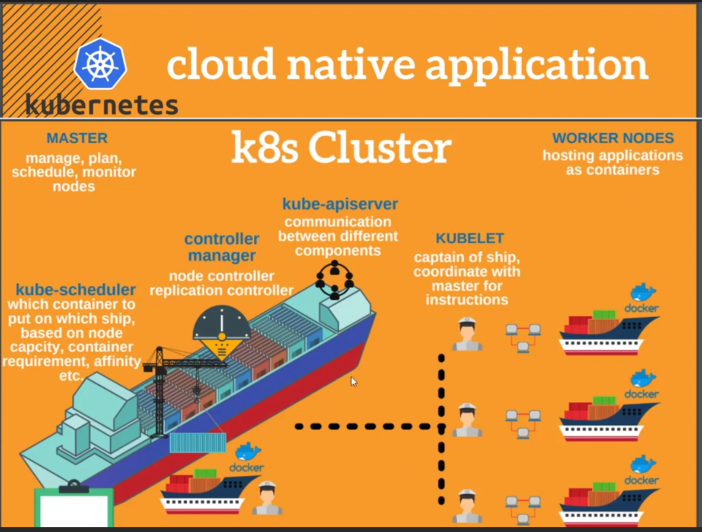
2

Slide 3
EKS
AWS
Control Plane
Data Plane
M
M
M
KOPS
M
M
M
W
W
W
W
W
W
Master
Master down
Worker
API
Certificate Expired
HA
ETCD
API Server slow
CNI
ETCD crashed
Scheduler
CR
Scheduler not working
DNS
Cloud Control Manager
Kube Proxy
Control Manager

Slide 4
AWS
M
M
M
HA
1. EC2
W
W
W
W
W
W
API
ETCD
2. Fargate
Scheduler
Cloud Control Manager
Control Manager

Slide 5
M
M
M
Cloud
W
W
W
Cloud
EKS
On-Premise Datacenter

Slide 6
Public
Elastic IP
Private
1. Cluster ip
2. Node port
M1
M2
M3
3. Load Balancer
W1
W2
POD
EKS

Slide 7
HELM
API Server
Public
Ingress Controller for ALB
ALB
Private
Ingress resource
Master
Worker
POD
example.com/abc
Service
POD

