Slide 1

Faculty Development Programme
Agentic AI & RAG
From Multi-Agent Systems to RAG Evaluation — hands-on with Google ADK, LangChain & GitHub Actions
Session 1
Session 2
Session 3
Multi-Agent ADK
Agentic CI/CD
RAG Deep Dive
Notes:
Welcome students. Today covers three hands-on sessions: multi-agent systems with Google ADK, agentic CI/CD with GitHub Actions, and the full RAG stack.

Slide 2



Today's Agenda
01
02
03
Multi-Agent
Systems
Agentic
CI/CD
RAG
Pipelines
Google ADK
GitHub Actions
LangChain · RAGAS
▸ Professor Assistant Agents
▸ LangChain + Gemini
▸ Modules 0–4
▸ Single agent tools
▸ AI deployment gate
▸ LangChain · LangGraph
▸ Multi-agent routing
▸ GO / RETRY / STOP
▸ FAISS · Qdrant
▸ PDF ingestion
▸ GitHub Actions YAML
▸ RAGAS evaluation
Notes:
High-level agenda. Three progressive sessions that build toward a complete understanding of agentic and RAG-based AI systems.

Slide 3
AGENTIC RAG and RAGAS
From Theory to Practice
Sirish Kumar · Professor of Practice, AI/ML Department

Slide 4



Gemini — Knowledge Cutoff vs. Live Search
What happens when you ask about events after the training cutoff
who won the norway chess 2026 championship?
Reply solely based on your training data only and do not search internet for answers
I cannot answer this. The 2026 Norway Chess championship takes place after my knowledge cutoff.
what is your training data cutoff date?
⚠️
My knowledge cutoff is January 2025. However, because I have access to the internet, I can look up real-time information beyond that date!
Refused Training-Only Query
Cutoff: January 2025
Live Search Available
Even when told not to search, Gemini correctly said it couldn't answer — because the event is after its cutoff.
Any event after Jan 2025 is outside training data. Norway Chess 2026 falls in this gap.
Gemini has internet access and can search for current results — but only when allowed to.

Slide 5
The Illusion of Authority
LLM training ≠ truth verification. Models hallucinate with confidence.
NODE 1 · TEMPORAL DRIFT
NODE 2 · MAJORITY BIAS
NODE 3 · AUTHORITY ILLUSION
Models don't know
what changed
100 wrong articles
outweigh 1 correct
Credible tone masks
fabricated facts
Root cause
Root cause
Root cause
Training data has a fixed cutoff. Models guess confidently about post-training events.
Models predict the most probable token sequence — rewarding confident guessing over admitting uncertainty.
Models learn authoritative style — and reproduce that tone even when the underlying content is wrong.
REAL INCIDENT
REAL INCIDENT
REAL INCIDENT
Google's Bard declared India winner of ICC ODI World Cup 2023 before the final was played.
Mata v. Avianca (678 F.Supp.3d 443, S.D.N.Y. 2023): $5,000 sanction for ChatGPT-fabricated case law. GPTZero: 100+ fake citations in 53 NeurIPS 2025 papers.
Lakera AI Hallucination Report, 2026
Nature doi:10.1038/s41586-026-10549-w
Mata v. Avianca (2023) · GPTZero / arXiv:2602.05930, Jan 2026
15–52%
hallucination rate across 37 LLMs (2026)
64%
in medical AI without mitigation
100+
fake citations at NeurIPS 2025
0.7%
even best model (Gemini 2.0) hallucinates

Slide 6
Why Do We Need RAG?
The key limitations RAG is designed to solve
Knowledge Cutoffs
LLMs are frozen in time. They cannot access information beyond their training date.
(GPT-3.5 Turbo September 2021, Llama 3: December 2023)
1
Hallucinated Facts
Without grounding, models confidently invent facts, citations, and data that don’t exist.
2
Domain-Specific Data
Proprietary and internal knowledge is absent from public.
3
Fine-Tuning is Expensive
Retraining a model to add new knowledge is slow, costly, and static once complete.
4
Transparency & Control
RAG makes the source of information explicit and auditable, enabling trust and compliance.
5

Slide 7
What is RAG?
Retrieval-Augmented Generation — a hybrid AI architecture
RAG = Retrieval + Augmented + Generation
A hybrid AI architecture that combines retrieval-based search with generative AI to produce accurate, up-to-date, and contextually grounded responses.
Goal: Ground responses in trusted knowledge sources to prevent hallucinations and extend knowledge.
RAG is NOT...
RAG is...
✗ Fine-Tuning
✓ Retrieval of relevant documents at query time
✗ Prompt Engineering Alone
✓ Augmentation of the prompt with context
✗ Simple Document Search
✓ Generation grounded in retrieved evidence
✗ Just API Calls to LLMs and Databases
✓ A living system that stays current

Slide 8
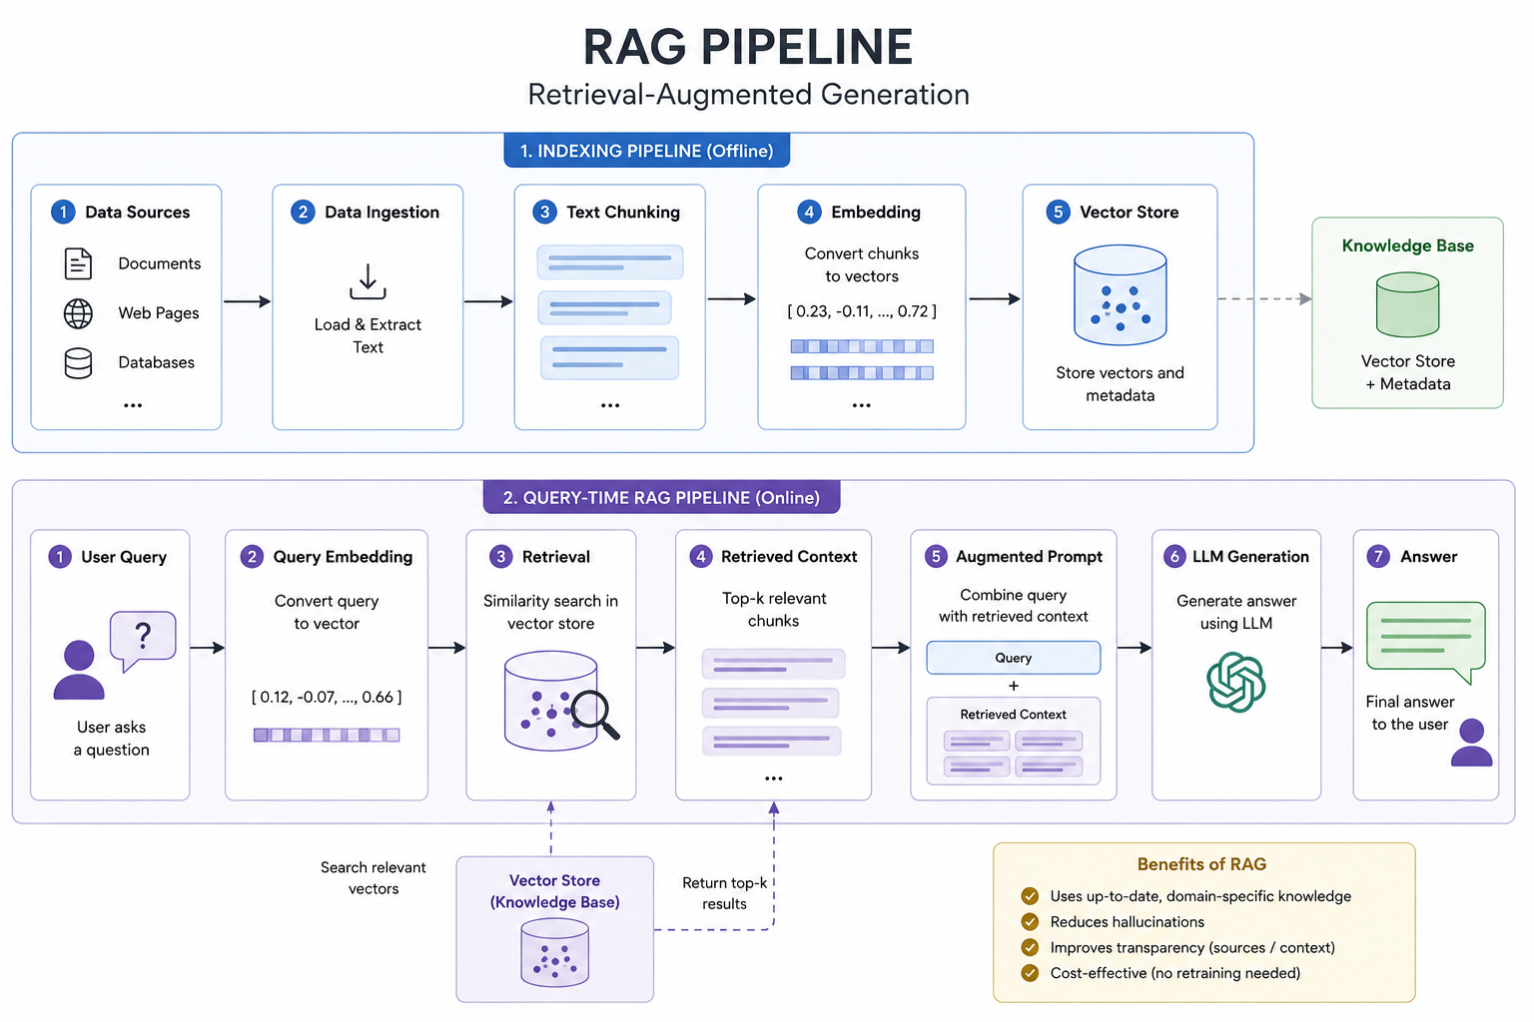

Slide 9
Ingestion — Document Collection
Key Goals
▸ Bring information into one centralized place
▸ Ensure data is clean, reliable, and complete
▸ Cover all relevant knowledge domains
PDFs & Docs
Web & Articles
Structured Data
Internal Content
Reports, books, manuals, research papers
Web pages, blogs, news, FAQs
Databases, CSV, JSON, APIs
Emails, tickets, Slack, wikis
RAG Systems are only as good as the data you feed them.

Slide 10
Ingestion — Pre-Processing & Chunking
Cleaning and splitting documents into retrievable units
Pre-Processing
Chunking Basics
▸ Remove headers, footers, and boilerplate
Typical chunk size:
300 – 1,000 tokens with 10–20% overlap
▸ Clean OCR noise and encoding errors
Trade-offs:
▸ Normalize spacing and unicode
▼ Too small → meaning lost, context fragmented
▸ Remove duplicates and near-duplicates
▼ Too large → irrelevant retrieval, token waste
▸ Retain metadata: title, source, page, date
Chunking is the art of choosing the right-size pieces of knowledge.

Slide 11
Ingestion — Chunking
Six chunking strategies from simple to intelligent
1
2
3
Paragraph-based
Sentence-based
Section-based
Split at paragraph breaks. Simple and fast.
Split at sentence boundaries for fine granularity.
Use document headers and sections as boundaries.
4
5
6
Semantic Chunking
Recursive Chunking
Sliding Window
Uses embedding similarity to detect topic shifts — no fixed token limit.
Recursively splits on multiple separators until size fits.
Fixed-size windows with configurable overlap for continuity.

Slide 12
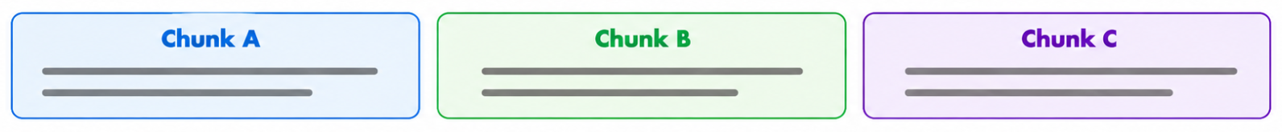
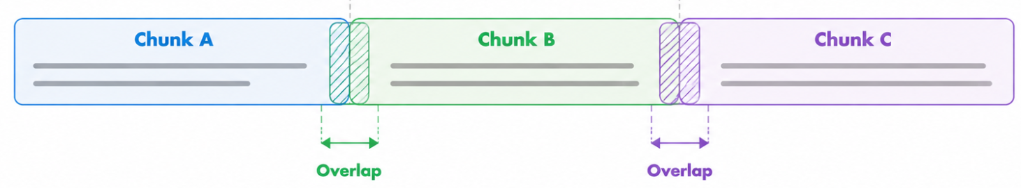
Chunking — With vs Without Overlap
Why overlap matters for retrieval quality
Without Overlap
With Overlap
Typical Failures:
Benefits:
✗ Sentences split across chunk boundaries
✓ Boundary information in both adjacent chunks
✗ Definitions cut in half, losing meaning
✓ Retrieval captures complete meaning
✗ Questions retrieve partial, incomplete answers
✓ LLM sees full, coherent context
In Practice:
Result:
▸ Incomplete policy explanations
▸ Higher recall on retrieval
▸ Wrong legal interpretation
▸ Fewer missing facts
▸ Hallucinated continuation
▸ Better answer grounding

Slide 13
Chunking Demo
Interactive visualizer — try different chunking strategies live
https://chunkviz.up.railway.app/

Slide 14
Ingestion — Embedding Creation
Converting text chunks into high-dimensional semantic vectors
Embeddings = Dense, multi-dimensional vector representations of text that capture semantic meaning
Text Chunk
Embedding Model
Dense Vector
"The leave policy
allows 12 days..."
text-embedding-3-small
(OpenAI / Sentence-BERT)
[0.23, -0.81, 0.14, ...
0.67, -0.22] (384-1536 dims)
High Dimensional
Semantically Aware
Language-Aware
Similarity-Searchable
384 to 1,536 numbers per chunk
Similar meaning = similar vectors
Works across languages and domains
Search by meaning, not keywords
Embeddings allow machines to search by meaning — not just by words.

Slide 15
Translating Text to Vectors
Embeddings Dense, multi-dimensional vector representations of text (384–1536 dimensions).
Key idea Similar meaning = nearby in space. Retrieval finds the nearest cluster using cosine similarity.
Vector output
Semantic space (3D projection of 1536-dim)
[0.6, 0.3, 0.1, …]
dim 1
dim 2
[0.8, 0.5, 0.3, …]
nearest → Animals
Animals
Royalty
cat
queen
dog
king
[0.4, 0.2, 0.9, …]
wolf
royal
Document
Chunk
Embedding Model
text-embedding-3-small
1 row per chunk · 1 number per dimension
model
GPU
LLM
Tech
dim 3…1536
Key insight: Text → numbers → geometry. Clusters form around meaning. Nearest-neighbour search retrieves semantically relevant chunks, not just keyword matches.

Slide 16
Ingestion — Vector Store & Indexing
Storing and indexing embeddings for efficient similarity search
Vector Store
Indexing
Stores all embeddings
One entry per chunk, linked to source
An index is a data structure enabling fast similarity search over embedding vectors.
Links to source documents
Metadata: file, page, section
FAISS
Supports similarity search
Finds nearest vectors by distance
Facebook AI Similarity Search — high-performance library for dense vector indexing
Enables filtering
By source, date, topic, access level
HNSW
Indexing for speed
ANN indexes reduce search from O(n) to O(log n)
Hierarchical Navigable Small World — graph-based ANN index, fast and accurate
IVF
Inverted File Index — partitions vector space for efficient coarse-to-fine search

Slide 17
Ingestion — Vector Databases
Production-grade systems for storing and searching embeddings
Chroma
Open Source
Weaviate
Cloud Native
Pinecone
Managed
Lightweight, open-source. Ideal for local dev and prototyping. Python-native API.
Cloud-native with GraphQL interface. Supports hybrid search (BM25 + vector) natively.
Fully managed, serverless vector DB. Production-ready with auto-scaling.
Qdrant
Workshop
Milvus
Enterprise
Rust-based, high-performance. Excellent filtering. Used in our demo.
Enterprise-scale open-source. Handles billions of vectors with distributed architecture.

Slide 18
Vector Database
https://www.youtube.com/watch?v=ebMkbWzFCnA
Embeddings - Visualization
https://vectors.nlpl.eu/explore/embeddings/en/
https://projector.tensorflow.org/

Slide 19
Retrieval — Search Strategies
Three approaches to finding relevant documents
Sparse Search (BM25)
Dense Search
Hybrid Search
Keyword-Based
Semantic / Vector
Best of Both
Strengths:
Strengths:
Strengths:
✓ Exact term matching
✓ Meaning-based retrieval
✓ Combines BM25 + Embeddings
✓ Handles IDs, codes, names
✓ Handles synonyms & paraphrases
✓ Maximizes recall & robustness
✓ Fast, interpretable
✓ Language-aware
✓ Most production deployments
Limitations:
Limitations:
Limitations:
✗ Cannot handle paraphrases
✗ Weak on exact numbers/rare tokens
✗ More complex pipeline
✗ Misses synonyms & semantic intent
✗ Requires embedding model
✗ Requires score normalization
Use: Exact term queries, IDs, baseline search
Use: Conceptual queries, NLU-heavy tasks
Use: Production RAG systems (recommended)

Slide 20
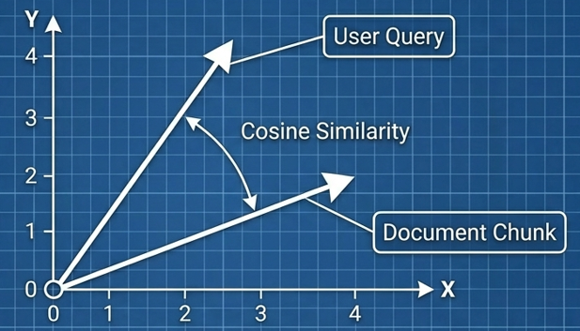
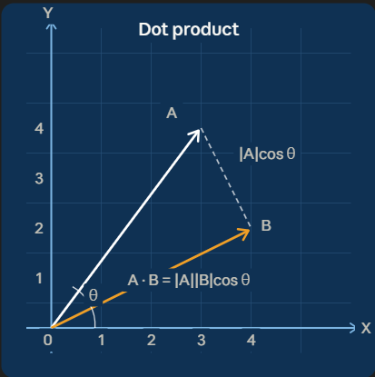
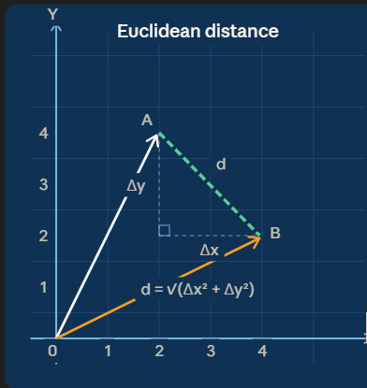
How similarity between vectors is measured
How closeness between vectors is measured
Cosine Similarity
Dot Product
Euclidean Distance (L2)
cos(θ) = A·B / (‖A‖ ‖B‖)
A · B = Σ aᵢbᵢ
d = √Σ(aᵢ - bᵢ)²
Measures the angle between two vectors. Ignores magnitude — perfect for text embeddings where length varies.
Measures alignment and magnitude. Often used in vector search; with normalized embeddings behaves similar to cosine similarity
Straight-line distance between two points in vector space. Smaller distance = more similar vectors.
Output: −1 to +1 (1 = identical direction)
Output: any real number (higher = more similar)
Output: 0 to ∞ (0 = identical vectors)
Most popular for text embeddings
Common in FAISS, fast retrieval
Clustering, Vector Retrieval, FAISS indexes

Slide 21
Retrieval — Re-Ranking
Reranking is the process of reordering initially retrieved documents based on their relevance to the query, using more sophisticated scoring than basic similarity search
User Query
Re-Ranker
Scoring
Filtered &
Re-Ordered
LLM
Context
Initial
Retrieval
(Top-K)
Position in pipeline: after Retrieval, before Augmentation · Applied on Top-K results only (not entire corpus — too expensive)
Filter Noise
Reduce Hallucinations
Save Tokens
Higher Precision
Removes irrelevant chunks that passed initial retrieval threshold.
Better context quality = fewer invented facts in the final answer.
Only top-quality documents reach the LLM, reducing prompt size.
Cross-encoder scoring is much more accurate than vector similarity alone.

Slide 22
Re-Ranking — Methods
Five approaches from simple to sophisticated
Keyword
Precision
Reasoning
Speed
Best of both
TF-IDF / BM25
Cross-Encoder
LLM Scoring
Fast / Distilled
Hybrid (BM25+Cross)
Term frequency scoring. Very fast, no ML needed.
Query + doc through transformer together. High precision via cross-attention.
LLM rates each doc for relevance. Handles ambiguity best.
Compressed re-ranker (FlashRank). Low latency, CPU-friendly.
Combines keyword + semantic scoring for best recall + precision.
+ Fastest
+ Best accuracy
+ Smartest
+ Low latency
+ Best recall+precision
− No semantics
− Slower & costly
− High latency & cost
− Slightly lower accuracy
− Complex pipeline
Use case
Use case
Use case
Use case
Use case
Keyword & ID queries
Most production RAG
Legal, medical QA
Chatbots, interactive
Mission-critical RAG

Slide 23
Augmentation — Prompt Formation
How retrieved context is assembled into a grounded prompt
Retrieved
Chunks
Rank &
Filter
Augment
Prompt
Add System
Instructions
Send to
LLM
Simple Augmentation (Naïve RAG)
Contextual Prompting
▸ Retrieved documents added directly to user query
▸ Retrieved content explicitly marked as context
▸ Combined prompt sent to the LLM
▸ LLM instructed to answer only from provided context
▸ Minimum viable augmentation strategy
▸ Instruction to refuse if answer not in context
▸ Works for simple, well-defined questions
▸ Grounding enforced through prompt design

Slide 24
Augmentation — System vs User Prompt
Two-prompt architecture for grounded, predictable responses
SYSTEM PROMPT
USER PROMPT
▸ Defines global rules and model behavior
▸ Contains retrieved context + user question
▸ Enforces grounding in retrieved context
▸ Changes with every query (dynamic)
▸ Prevents hallucinations by design
▸ Context delimited clearly (XML tags / backticks)
▸ Does NOT change per query (static)
▸ Source chunk IDs included for citation
▸ Sets domain expertise and tone
▸ Specifies output format expectations
Example:
"Answer only using the provided context. If the answer is not found, say 'I don’t know.'"
Format:
<context> [chunks] </context>
Question: [user query] · Cite sources by ID

Slide 25
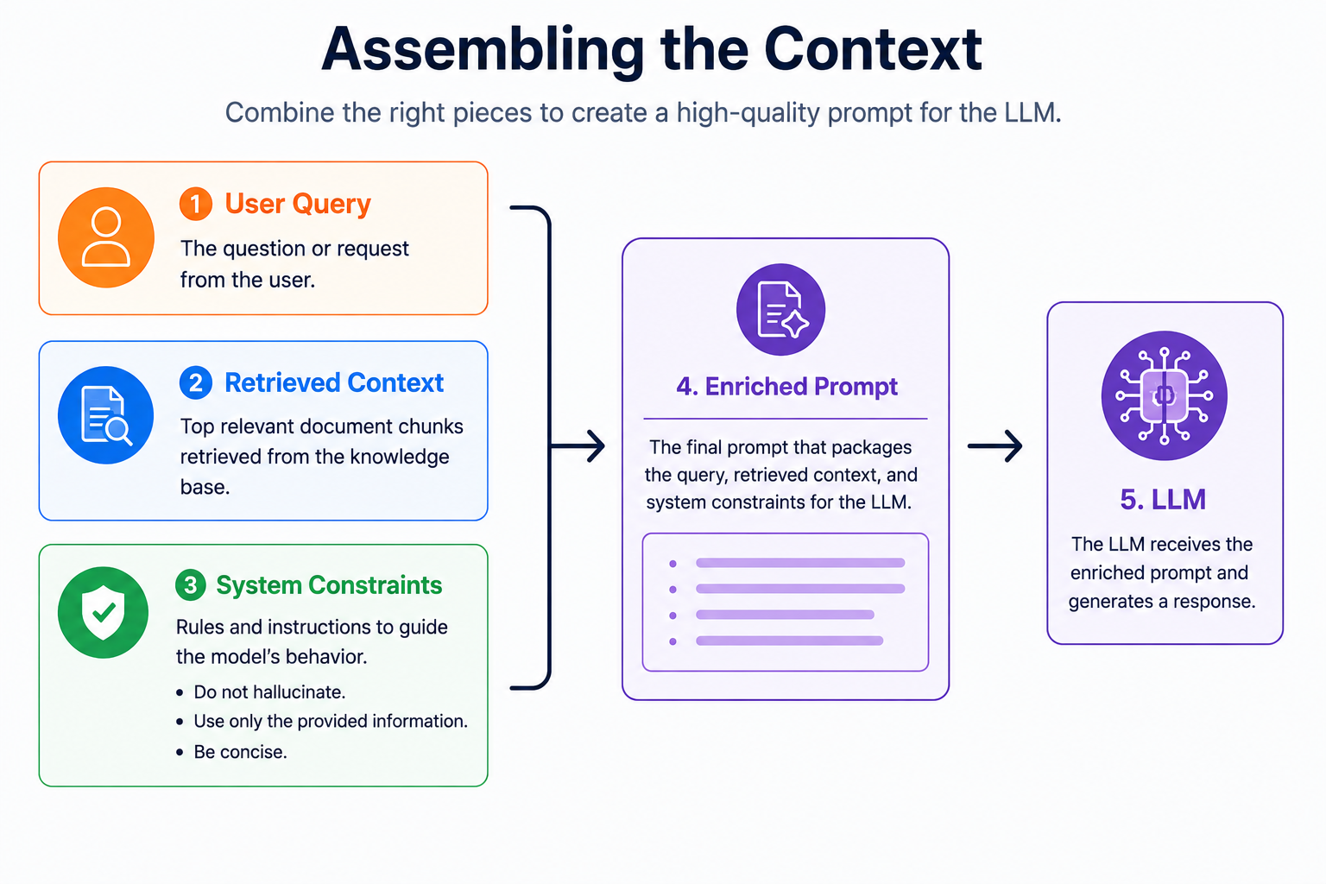

Slide 26
Hands-On Lab
Code: https://github.com/kumarsirish/FDP-AGENENTIC-AI-RAG/blob/main/rag-langchain-00/fictional-department-rag-langchain.ipynb
1
Basic RAG — Department of Quantum Engineering
A complete RAG system using a fictional department (DQE) as the knowledge source.
Demonstrates the core pipeline: chunking, embedding, retrieval, and generation.

Slide 27
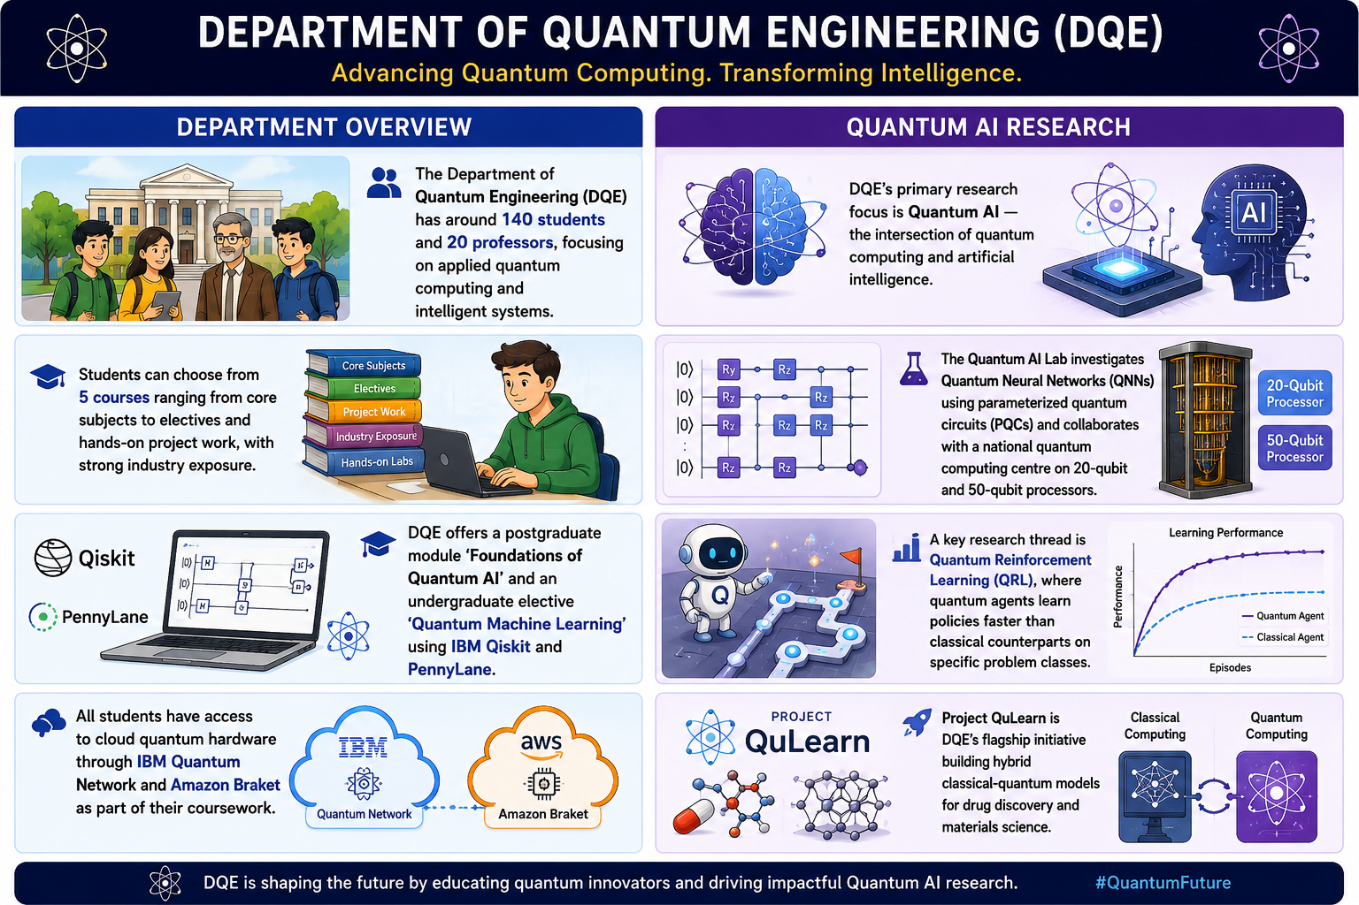

Slide 28
AGENTIC RAG
Simple Agentic RAG
How an LLM agent decides when to retrieve,
what to retrieve, and how to answer.
Autonomous Decision-Making
Tool Use
Reasoning Loop
Context-Aware Response
LangChain · FAISS · Qwen2.5-7B-Instruct · HuggingFace Embeddings

Slide 29
CONCEPT
RAG vs. Agentic RAG
📌 Traditional RAG
🤖 Agentic RAG
Always retrieves
Decides to retrieve
Every query goes to the vector store — no reasoning, no choice.
LLM reasons: 'I need external info' → calls the tool.
Fixed pipeline
Agent loop
Retrieve → stuff → generate. The LLM is passive.
Thought → Action (search) → Observation → Answer.
No tool awareness
Tool-bound search
The LLM sees chunks; it doesn't choose to search.
search_answers is invoked explicitly by the LLM.
Fragile to vague queries
Graceful handling
Bad retrieval = bad answer, with no fallback.
Can answer from memory if retrieval is unnecessary.

Slide 30
ARCHITECTURE
System Components of the Demo
1
2
3
4
5
Knowledge
Base
FAISS
Vector Store
Retriever
search_answers
Tool
GEMINI-2.5-FLASH
8 DQE facts
inlined at startup
all-MiniLM-L12-v2
chunk=250, overlap=50
similarity search
k=2 top chunks
@tool · docstring
= LLM instructions
Why FAISS?
Why all-MiniLM-L12-v2?
Why chunk_size=250, overlap=50?
Stores dense embedding vectors locally. No cloud database needed. save_local() persists the index; load_local() reloads it at query time — zero infrastructure overhead.
Lightweight 33M-parameter model. Encodes sentences into 384-dim vectors. Fast inference, high retrieval quality — ideal for local agentic RAG workloads.
Keeps each chunk within a single topic. Small enough to rank precisely; large enough to be self-contained. Overlap ensures no context is lost at boundaries.

Slide 31
ARCHITECTURE
The Agent Decision Loop
1
User Query
System Prompt
Natural language question (DQE department queries)
"You are a helpful assistant for the
Department of Quantum Engineering (DQE).
Rules:
- Always use search_answers when the
question is about DQE.
- Do NOT use the tool for general
knowledge questions.
- If the tool returns no results,
say you don't have that information.
- Answer concisely.
- Do not hallucinate details."
↗ skip if no retrieval needed
2
Thought
LLM reasons: 'Is this DQE-specific? Do I need the tool?'
3
Action
Calls search_answers(query) — only if retrieval is needed
4
Observation
Top-2 semantically matching chunks returned from FAISS
Key Insight
The LLM is not a passive pipeline step — it actively reasons about whether to call the tool. Three prompt sentences convert a chat model into a reasoning agent that controls its own retrieval strategy.
5
Final Answer
Synthesised reply grounded in retrieved evidence

Slide 32
INTERNALS
Scratchpad & MessagePlaceholder
The Agent Scratchpad
MessagePlaceholder
The scratchpad is the agent's working memory — a running record of every reasoning step in the current turn. It accumulates Thought, Action, and Observation triplets so the LLM can see its own chain of reasoning before producing a final answer.
A LangChain prompt placeholder that inserts a dynamic block of messages at runtime — typically used to feed the agent's scratchpad back into the prompt, letting the LLM pick up its reasoning from where it left off.
Scratchpad (in-memory · cleared each turn)
Prompt template structure
Thought:
DQE-specific question. I should search.
SystemMessage
"You are a helpful DQE assistant..."
Action:
search_answers(query='How many students DQE')
Observation:
DQE has around 140 students and 20 professors.
HumanMessage
{user question}
Thought:
I have enough context to answer now.
MessagesPlaceholder
Final Answer:
DQE has approximately 140 students.
variable_name='agent_scratchpad'
Cleared after each final answer is produced.
← scratchpad injected here
Why it matters: Without MessagesPlaceholder, each LLM call is stateless — the agent loses its reasoning chain mid-turn. It is the bridge that threads scratchpad history back into every call.

Slide 33
Hands-On Lab
Code: https://github.com/kumarsirish/FDP-AGENENTIC-AI-RAG/blob/main/rag-agentic-01/fictional-depatment-rag-agentic.ipynb
2
Agentic RAG — Department of Quantum Engineering
A complete RAG system using a fictional department (DQE) as the knowledge source.
Demonstrates the core pipeline: chunking, embedding, agentic retrieval, and generation.

Slide 34
CORRECTIVE AGENTIC RAG
Agentic LangGraph RAG
DEMO: A stateful, graph-based Corrective RAG pipeline with
5 nodes, 2 conditional edges, and self-healing retry loops.
✦ This is Agentic RAG
LangGraph
FAISS
Gemini 2.5 Flash
HuggingFace Embeddings
5-Node Graph
retrieve · grade_docs · rewrite_query · generate_answer · grade_answer

Slide 35
LangGraph — Node Graph – Demo
Nodes = processing steps · Solid edges = fixed · Dashed = conditional
hallucination · retry<2
relevant
grounded
START
retrieve
grade_docs
generate_answer
grade_answer
END
FAISS k=3
relevant?
Gemini 2.5 Flash
grounded?
not relevant
rewrite_query
LLM rewrites Q
rewrite → retrieve
question
retrieved_docs
doc_grade
answer
answer_grade
retries
query_rewrites

Slide 36
NODES
The Five Nodes — What Each One Does
1
retrieve
2
grade_docs
Fetch top-k chunks from FAISS
LLM judges relevance of retrieved docs
reads
question
reads
question + retrieved_docs
writes
retrieved_docs
writes
doc_grade
Runs similarity_search(question, k=3). Returns the top-3 most semantically similar chunks as concatenated text.
Asks LLM: 'Are these docs relevant?' Returns exactly 'relevant' or 'not_relevant'. First conditional decision point.
3
rewrite_query
4
generate_answer
LLM rewrites the question for better retrieval
LLM answers using retrieved context
reads
question
reads
question + retrieved_docs
writes
question (updated) · query_rewrites++
writes
answer · retries++
When docs are not relevant, LLM generates a semantically clearer reformulation. Rewritten question loops back to retrieve.
Calls Gemini 2.5 Flash with retrieved chunks as context. Produces a grounded answer. Tracks retries for loop control.
5
grade_answer
LLM checks answer for hallucination
reads
answer + retrieved_docs
writes
answer_grade
Asks LLM: 'Is this answer supported by the docs?' Returns 'grounded' or 'hallucination'. Triggers END or retry.

Slide 37
CONDITIONAL EDGES
Two Decision Points — The Brain of the Agent
Edge 1 — after grade_docs
Edge 2 — after grade_answer
route_after_grade_docs
route_after_grade_answer
doc_grade == 'relevant'
→ generate
answer_grade == 'grounded'
→ END
doc_grade == 'not_relevant'
→ rewrite
answer_grade == 'hallucination'
AND retries < 2
→ retry
Full Retry Flow — What Happens on a Bad Answer
retrieve
grade_docs
generate
grade_ans
generate
grade_ans
1
2
relevant
3
4
retry
3′
4′
END
k=3 chunks
relevant?
go generate
Gemini answers
hallucination?
retries++
2nd attempt
grounded?
accepted
The retry guard (retries < 2) prevents infinite loops. After 2 failed attempts, extend the graph to escalate, fallback to web search, or return a graceful 'I don't know' response.

Slide 38
Hands-On Lab
https://github.com/kumarsirish/FDP-AGENENTIC-AI-RAG/blob/main/rag-langgraph-02/fictional-depatment-rag-langraph.ipynb
3
Agentic RAG — Department of Quantum Engineering
A complete RAG system using a fictional department (DQE) as the knowledge source.
Demonstrates the core pipeline: chunking, embedding, agentic retrieval, decisions and generation.

Slide 39
EVALUATION
FRAMEWORK
RAG - RAGAS
Retrieval-Augmented Generation Assessment System
A multi-layered approach to measuring Retriever & Generator quality independently
3 Core Metrics
6 Formulas
4 Frameworks
RAGAS · DeepEval
LangSmith · Arize

Slide 40
Evaluation Frameworks
Automate evaluation as part of your CI/CD pipeline to prevent quality regression.
R
D
L
A
Ragas
DeepEval
LangSmith
Arize Phoenix
Reference-Free
Unit Testing
Tracing & Debug
Observability
Highly popular for evaluating without manually curated ground-truth datasets. Runs RAG Triad metrics automatically. Best for rapid iteration.
Treats evaluation like software testing. Supports custom G-Eval metrics defined in plain English. Excellent for CI/CD pipelines.
Best for visualizing exactly what was retrieved, what the prompt looked like, and where the generator went wrong. Debugging first.
Useful for embedding visualization — see if documents cluster correctly in your vector space. Drift detection over time.

Slide 41
RAG Quality — Key Dimensions
Four pillars of a high-quality RAG system
GROUNDED
ON-TOPIC
SENSITIVE
SAFE
Faithfulness
Relevancy
Low-Recall Detection
Refusal & Fallback
Answer must be fully supported by retrieved context. Enforced via grounding instructions. No invented facts.
Answer must directly address the user query. Improved by re-ranking and top-k filtering. No off-topic responses.
Detects when relevant documents were not retrieved. Signals: weak similarity scores or missing/empty context.
Model refuses to answer when evidence is insufficient. Returns 'I don't know' instead of hallucinating. Critical for high-risk domains.

Slide 42
Component-Level Metrics
Isolate failures — is the issue in Retrieval (finding the data) or Generation (synthesizing the answer)?
Retrieval Metrics
Generation Metrics
Measuring the Search
Measuring the LLM
1
Precision@K
1
Completeness
What proportion of the top-K retrieved documents are relevant? Penalizes noisy retrieval.
Does the answer cover all aspects of the user's prompt? Catches partial answers.
2
Recall@K
2
Utilization
Did the system retrieve all relevant documents in the knowledge base? Penalizes gaps.
To what extent does the response rely on retrieved context vs. the model's internal training data?
3
MRR (Mean Reciprocal Rank)
3
Faithfulness / Hallucination Rate
How high is the first relevant document? Critical because LLMs process context in order.
Are all generated claims traceable to the provided context? Zero tolerance for invented facts.

Slide 43
Hands-On Lab
https://github.com/kumarsirish/FDP-AGENENTIC-AI-RAG/blob/main/rag-ragas-03/fictional-department-rag-ragas.ipynb
3
Agentic RAG — Department of Quantum Engineering
A complete RAG system using a fictional department (DQE) as the knowledge source.
Demonstrates the core pipeline: chunking, embedding, agentic retrieval, generation and RAGAS

Slide 44
Hands-On Lab
https://github.com/kumarsirish/FDP-AGENENTIC-AI-RAG/blob/main/rag-langgraph-02/fictional-depatment-rag-langraph.ipynb
3
Agentic RAG — Department of Quantum Engineering
A complete RAG system using a fictional department (DQE) as the knowledge source.
Demonstrates the core pipeline: chunking, embedding, agentic retrieval, RAGAS.

Slide 45
Book Recommendation System
How AI understands your reading preferences and suggests the perfect next book
AI-Powered Recommendation System · LangChain + RAG

Slide 46
The Dataset — Real Book Data from Kaggle
We use the Kaggle Book Recommendation Dataset — a large, real-world collection of books, users, and ratings.
271,000+
1.1 Million+
278,000+
Books
Ratings
Users
Titles, authors, publishers, cover images
Scores from real readers (0–10 scale)
Anonymous reader profiles with demographics
💡 We sample the Top 1,000 most-rated books to keep processing fast while staying representative.

Slide 47
Loading Data — Making Books AI-Readable
Before an AI can help with book recommendations, it needs to read and understand the book data. We use a Document Loader to convert each row of the CSV into a structured 'document' the AI can process.
CSV File
Filter Top 1K
CSV Loader
992 Documents
Raw spreadsheet with 271K books
Select books with most ratings
Converts each row → Document
Ready for AI to read & search
Each Document looks like:
isbn: 0440234743
title: The Testament
author: John Grisham
year: 1999
publisher: Dell
✅ One document per book
✅ All metadata preserved
✅ Ready for vector embedding

Slide 48
Vector Search — Finding Books by Meaning, Not Just Keywords
Instead of exact-match keyword search, we convert books into numbers (vectors) that capture meaning. Similar books end up mathematically close together.
1
2
3
4
Book Text
Embedding Model
Qdrant Store
Similarity Search
Title, author, publisher, year
→
all-MiniLM-L6-v2
Converts text → 384 numbers
→
Cloud vector database
Stores all 992 book vectors
→
Query → vector → find
Top 5 closest books
📚 Analogy
A library organized by 'feeling' instead of alphabetical order — romantic novels from the 1990s are near each other even if the titles are completely different.

Slide 49
LCEL Chaining — Connecting AI Steps Like Building Blocks
LangChain Expression Language (LCEL) lets you connect AI steps into a pipeline using a simple pipe ( | ) syntax — just like a factory assembly line.
User Query
Retriever
Prompt
LLM
Output
"I want 1980s
American fiction"
→
Searches Qdrant
for top 5 books
→
Formats context
+ user question
→
Generates the
recommendation
→
Clean text
response
rag_chain = retriever | format_books | prompt | llm | output_parser
Each step passes its output to the next — clean, readable, and easy to modify.

Slide 50
Control Flow — Routing Requests to the Right Handler
Not all user requests are the same. We use RunnableBranch to detect what the user wants and send it to the appropriate AI chain.
User Query
🔀 RunnableBranch
(keyword router)
Contains 'recommend'
Contains 'analyze'
or 'compare'
Everything else
Recommendation Chain
Analysis Chain
Default Chain
Suggests books from catalog
Discusses themes and trends
Falls back to recommendations

Slide 51
System Architecture Summary
📊 Dataset
📄 Doc Loader
🧠 LLM
271K books → top 1K sampled
CSV → 992 Documents
TinyLlama / GPT-4o / Gemini
🔢 Embeddings
🗄️ Qdrant
🔍 RAG
all-MiniLM-L6-v2 model
Vector database (cloud)
Search 5 books → AI answers
🔀 Branching
💬 Memory
💾 Save/Load
Route recommend vs analyze
Multi-turn conversations
Serialize chains to JSON
All pieces work together: Data → Embed → Store → Retrieve → Generate → Respond

Slide 52
Q & A
Questions? Let’s discuss!
Center of Excellence – NLP | CMRIT | Sirish Kumar

