Slide 1
Customer Churn Prediction & Retention Strategy Optimization Machine Learning-Based Predictive Analytics
Presented by: Subodh Kumar

Slide 2
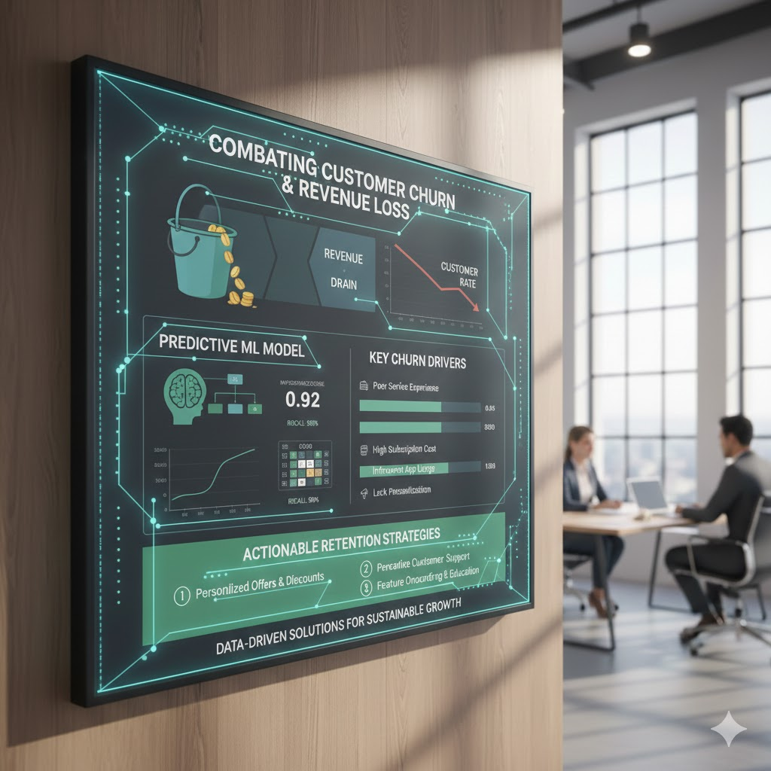
Executive Summary
• Customer churn leads to significant revenue loss • Built a predictive ML model to identify high-risk customers • Achieved strong performance (high Recall & ROC-AUC) • Identified key churn drivers • Provided actionable retention strategies

Slide 3

Business Problem
Telecom companies face:
High competition
Low switching barriers
Increasing acquisition costs
Problem: Identifying customers likely to churn before they leave.
Objective: Predict churn to enable proactive retention.

Slide 4
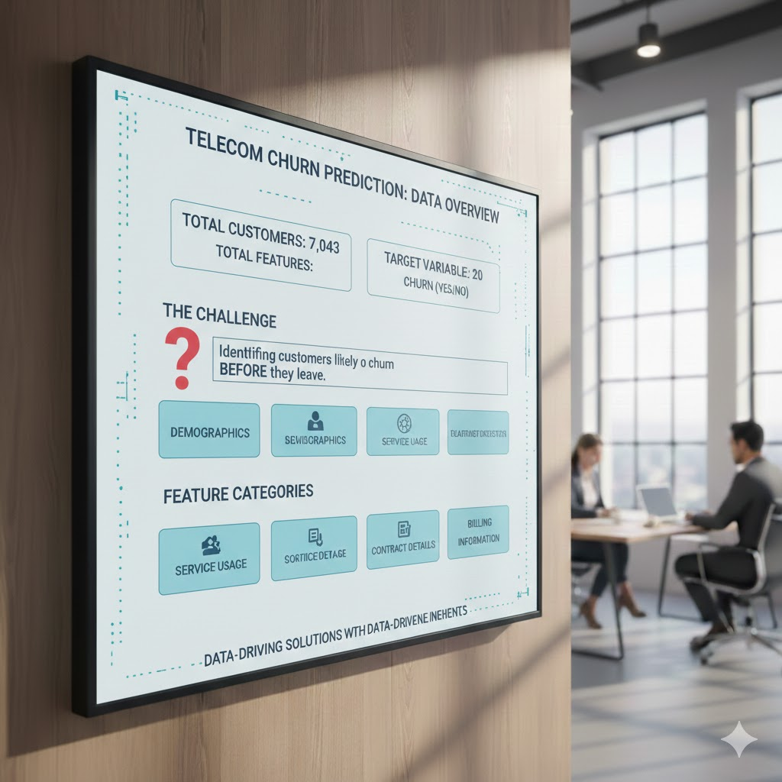
Dataset Overview
Total Customers: 7,043
Total Features: 20 (excluding target variable)
Target Variable: Churn (Yes/No)
Feature Categories:
• Demographics • Service Usage • Contract Details • Billing Information

Slide 5
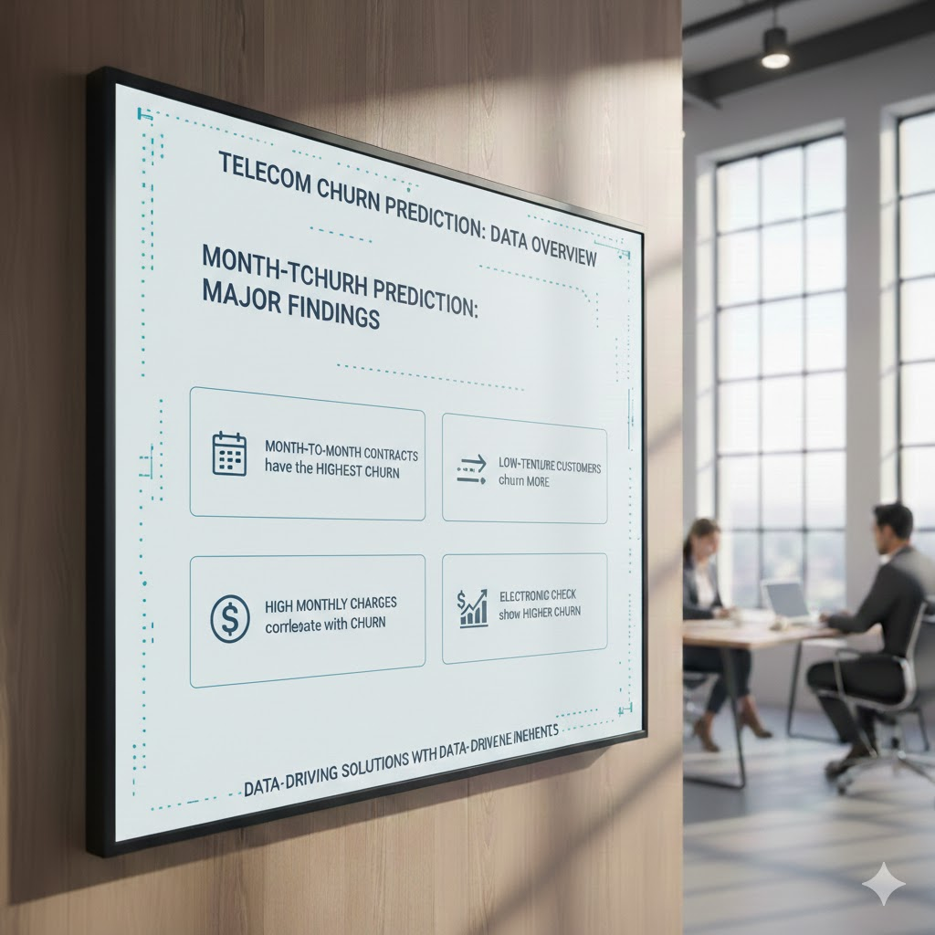
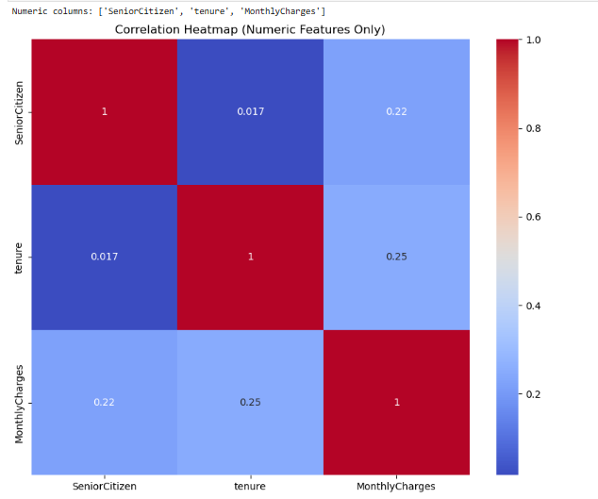
Key Insights from EDA
Major Findings:
• Month-to-month contracts show highest churn • Low tenure customers churn more • High monthly charges correlate with churn • Electronic check users show higher churn

Slide 6
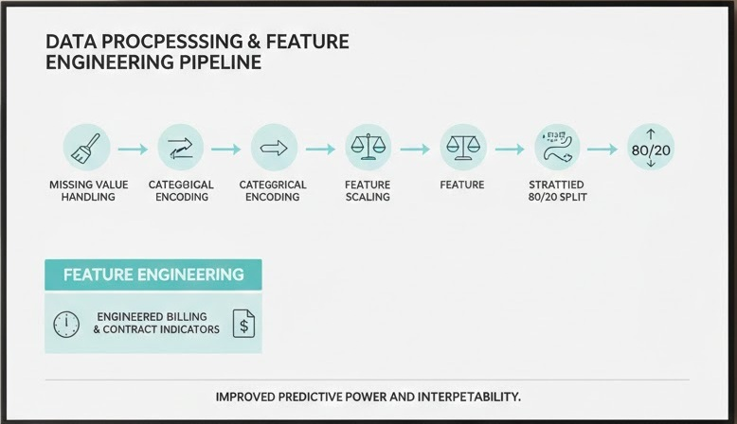
Data Preparation & Feature Engineering
Steps performed:
• Missing value handling • Categorical encoding • Feature scaling • Stratified 80/20 split • Created tenure groups • Engineered billing & contract indicators
Improved predictive power and interpretability.

Slide 7
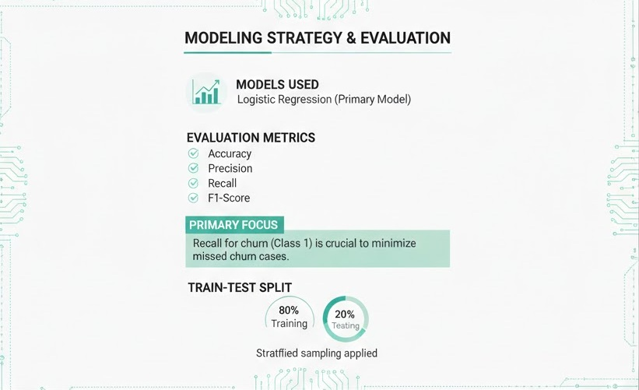
Modeling Approach
Modeling Strategy
Models Used:
Logistic Regression (Primary Model)
Evaluation Metrics:
Accuracy
Precision
Recall
F1-Score
Focus: Since churn prediction is a business problem, Recall for churn (Class 1) is especially important to minimize missed churn cases.
Train-Test Split:
80% Training
20% Testing
Stratified sampling applied

Slide 8
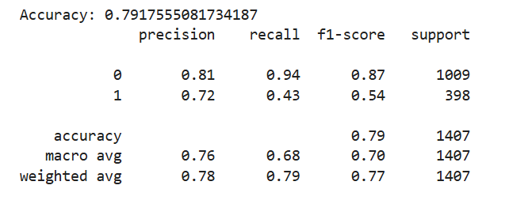
Model Performance
Model Performance Results
Overall Accuracy: 79%
Metric | Non-Churn (0) | Churn (1)
Precision | 0.81 | 0.72
Recall | 0.94 | 0.43
F1-Score | 0.87 | 0.54
Total Test Samples: 1407 Churn Cases in Test: 398
Key Observation: The model performs well in predicting non-churn customers but struggles in identifying churn customers.

Slide 9
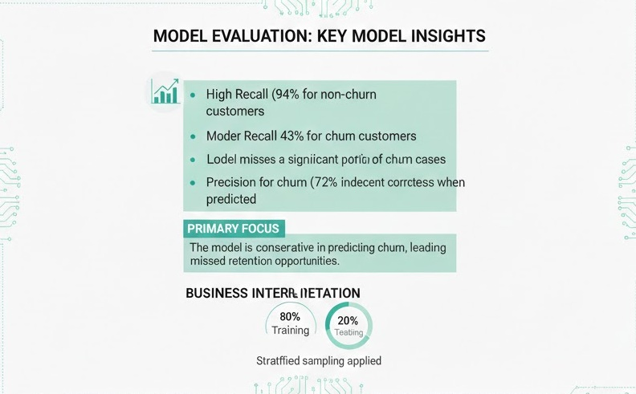
Performance Insights
Key Model Insights
• High Recall (94%) for non-churn customers • Lower Recall (43%) for churn customers • Model misses a significant portion of churn cases • Precision for churn (72%) indicates decent correctness when churn is predicted
Business Interpretation: The model is conservative in predicting churn, leading to missed churn opportunities.

Slide 10
Business Impact & Recommendations
Business Impact
• The model achieves 79% overall accuracy • Strong performance in identifying non-churn customers (94% recall) • Moderate precision (72%) for churn prediction • However, 43% churn recall indicates missed high-risk customers
Business Risk:
Missed churn customers (false negatives) may result in:
Revenue loss
Increased customer acquisition cost
Ineffective retention campaigns
The current model serves as a baseline predictive system, but improvement is needed for higher churn detection sensitivity.

Slide 11
Strategic Recommendations
1. Strengthen Predictive Performance
To improve churn detection capability:
• Apply class balancing techniques (SMOTE / Class Weights) • Tune decision threshold to increase recall • Implement advanced models (Random Forest / XGBoost) • Optimize model using recall-focused evaluation
Objective: Reduce missed churn cases (false negatives)
2. Focus on High-Risk Customer Segments
Retention efforts should prioritize:
• Month-to-month contract customers • Low-tenure customers • Customers with high monthly charges • Electronic check payment users
Objective: Target customers with highest churn likelihood
3. Implement Risk-Based Retention Strategy
Move from blanket campaigns to data-driven targeting:
• Rank customers by churn probability • Offer personalized loyalty incentives • Promote migration to long-term contracts • Provide proactive customer engagement
Objective: Maximize retention ROI while minimizing cost

Slide 12
Conclusion
• Built a machine learning model to predict customer churn using behavioral and billing data
• Achieved 79% overall accuracy with strong performance in identifying non-churn customers
• Identified key churn drivers:
Month-to-Month Contracts
Low Tenure
High Monthly Charges
Electronic Check Payment Method
• Established a predictive framework to support proactive retention strategies
• Delivered actionable insights to reduce churn risk and protect revenue

Slide 13
Thank You

