Slide 1
White-balance
White balancing aims at compensating for the color cast caused by the selective
absorption of colors with depth.
White-balancing aims at improving the image aspect, primarily by removing the
undesired color castings due to various illumination or medium attenuation
properties.
Aim is to compensate for the loss of the red channel for this green-channel is
used because it is well preserved in under-water.
The compensation should be proportional to the difference between the mean
green and the mean red values because, under the Gray world assumption.
Basically, the compensation of the red channel has to be performed only in
those regions that are highly attenuated
23-03-2019
Dept. of ECE, RVCE

Slide 2
Gaussian pyramid
Pyramid is a technique in which an image or signal is subjected to repeated
smoothing and subsampling.
The Gaussian pyramid is a technique in image processing that breaks down
an image into successively smaller groups of pixels, in repeated steps, for the
purpose of blurring it.
When a digital photograph is blurred in this way, edges of objects are much easier
to detect.
The "pyramid" is constructed by repeatedly calculating a weighted average of
the neighboring pixels of a source image and scaling the image down.
It can be visualized by stacking progressively smaller versions of the image on
top of one another.
This process creates a pyramid shape in which the base of the pyramid is the
original image, and the tip is a single pixel representing the average value of the
entire image.
23-03-2019
Dept. of ECE, RVCE

Slide 3
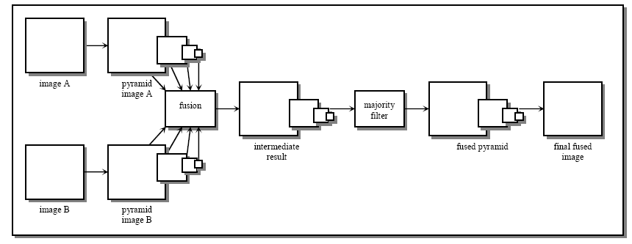
Laplacian pyramid
The Laplacian Pyramid implements a “pattern selective” approach to image fusion,
so that the composite image is constructed not a pixel at a time.
Perform a pyramid decomposition on each source image, then integrate all these
decompositions to form a composite representation, and finally reconstruct the
fused image by performing an inverse pyramid transform.
23-03-2019
Dept. of ECE, RVCE

Slide 4
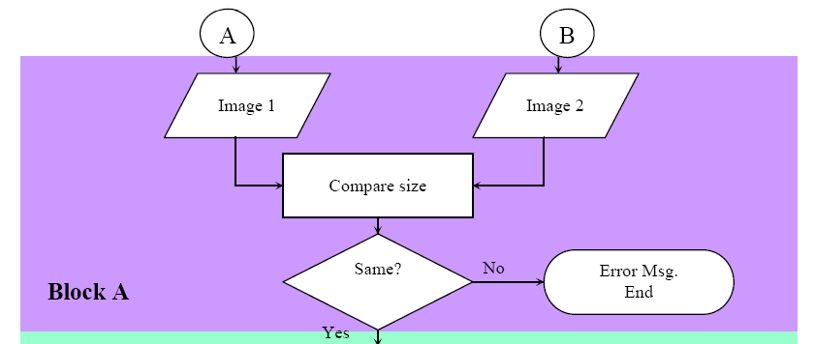

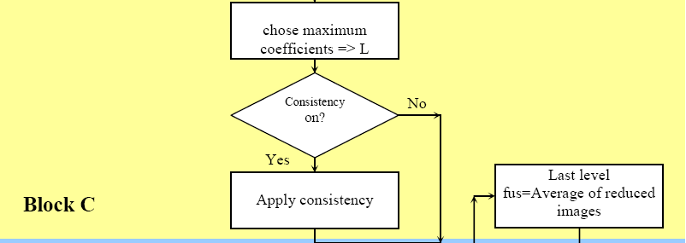
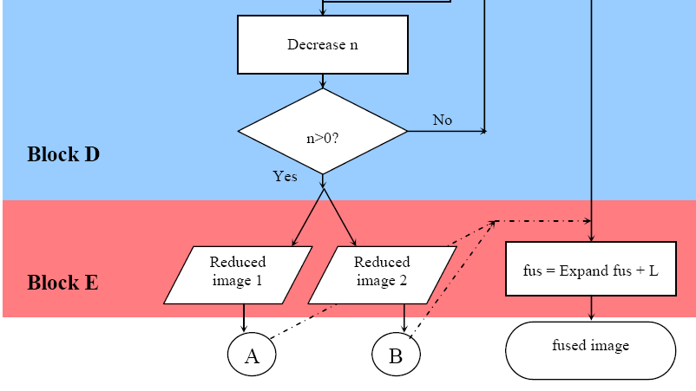
Laplacian fusion flowchart
source images (im1, im2): must have the
same size, and are suppose to registered.
number of scales (ns):is an integer that
defines the number of pyramid
decomposition levels.
consistency check: logical variable, the
consistency checking is applied if its
value is ‘1’.
Block A: images size checking.
Block B: construction of pyramid level n
Block C: pyramid level fusion
Block D: final level analysis
Block E: reconstruction of fused image

