Slide 1

http://flic.kr/p/6oP7x7
Version Control with Git

Slide 2
About Git
Created by Linus Torvalds, creator of Linux, in 2005
  Came out of Linux development community
  Designed to do version control on Linux kernel
Goals of Git:
  Speed
  Support for non-linear development (thousands of parallel branches)
  Fully distributed
  Able to handle large projects efficiently
  (A "git" is a cranky old man. Linus meant himself.)

Slide 3

Terminology
Git
  version control system
  Like SVN,StarTeam
Github
  repository site
  Bitbucket is an alternative among others

Slide 4
Why track/manage revisions?

Slide 5
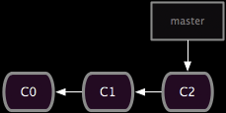
Backup: Undo or refer to old stuff
http://git-scm.com/book/en/Git-Branching-Basic-Branching-and-Merging

Slide 6
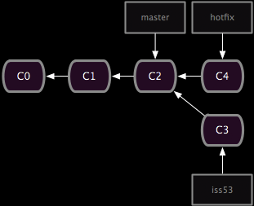
Branch: Maintain old release while working on new
http://git-scm.com/book/en/Git-Branching-Basic-Branching-and-Merging

Slide 7
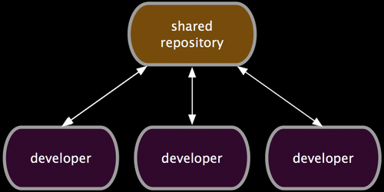
Collaborate: Work in parallel with teammates
http://git-scm.com/book/en/Distributed-Git-Distributed-Workflows

Slide 8
Version Control Systems (VCSs)
Help you track/manage/distribute revisions
Standard in modern development
Examples:
  Revision Control System (RCS)
  Concurrent Versions System (CVS)
  Subversion (SVN)
  Git
older
newer
Our focus

Slide 9

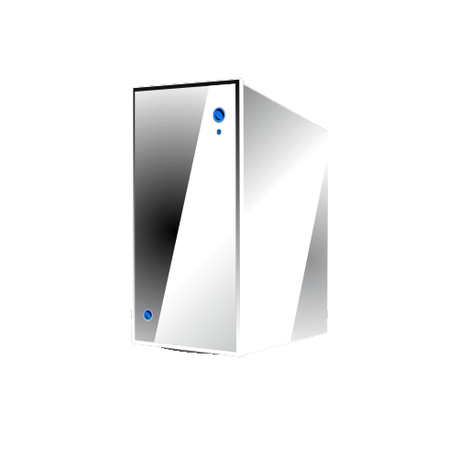
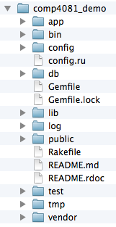
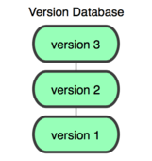
GitHub-User Perspective
You
GitHub
Working Dir
Local
Repos
Remote
Repos

Slide 10
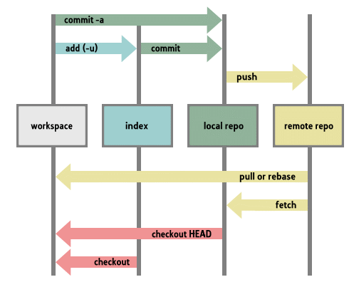
Lifecycle of Git

Slide 11
Let’s begin with an example…
You
GitHub

Slide 12
Configure your Git client
(Rails Tutorial 1.3.1)
Install Git
Check config info:
Fix if necessary:
$ git config --list
user.name=Scott Fleming
user.email=Scott.Fleming@memphis.edu
$ git config --global user.name "John Doe"
$ git config --global user.email jdoe@memphis.edu

Slide 13
Log into GitHub and create a repos
(with add README option)
You
GitHub
Remote
Repos

Slide 14
$ git clone https://github.com/sdflem/comp4081_demo.git
You
GitHub
Working Dir
Local
Repos
Remote
Repos

Slide 15
$ rails new comp4081_demo
You
GitHub
Working Dir
Local
Repos
Remote
Repos

Slide 16
$ cd comp4081_demo
$ git add -A
$ git commit –m "Created Rails project skeleton"
You
GitHub
Working Dir
Local
Repos
Remote
Repos

Slide 17
$ git push
You
GitHub
Working Dir
Local
Repos
Remote
Repos

Slide 18
Questions to answer
How organized?
You
GitHub
Working Dir
Local
Repos
Remote
Repos
What operations?

Slide 19
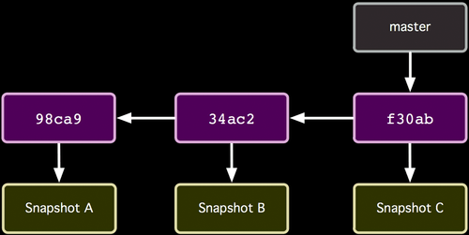
How the repos is organized
http://git-scm.com/book/

Slide 20
How the repos is organized
Commits (from oldest to newest; hashes as commit IDs)
http://git-scm.com/book/

Slide 21
How the repos is organized
Snapshot of all files at each commit
http://git-scm.com/book/

Slide 22
How the repos is organized
Branch (last commit)
http://git-scm.com/book/

Slide 23
How commit works
Before
http://git-scm.com/book/

Slide 24
How commit works
After
http://git-scm.com/book/

Slide 25
Common Workflow
Create temp local branch
Checkout temp branch
Edit/Add/Commit on temp branch
Checkout master branch
Pull to update master branch
Merge temp branch with updated master
Delete temp branch
Push to update server repos
Make changes in local branch
Merge with GitHub repos

Slide 26
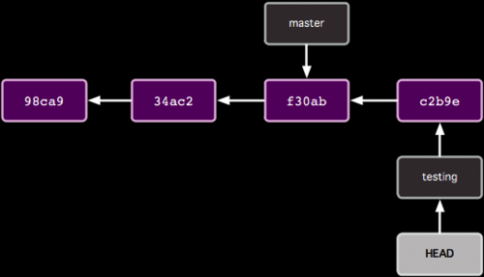
Organization with two branches

Slide 27
Organization with two branches
Last commit of each branch

Slide 28
Organization with two branches
Currently checked out branch

Slide 29
Common Workflow
Create temp local branch
Checkout temp branch
Edit/Add/Commit on temp branch
Checkout master branch
Pull to update master branch
Merge temp branch with updated master
Delete temp branch
Push to update server repos

Slide 30
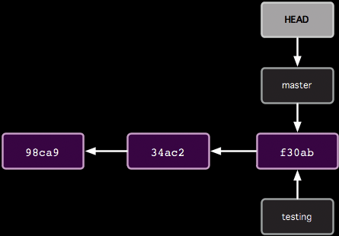
How git branch works
$ git branch testing
Before

Slide 31
How git branch works
$ git branch testing
After

Slide 32
Common Workflow
Create temp local branch
Checkout temp branch
Edit/Add/Commit on temp branch
Checkout master branch
Pull to update master branch
Merge temp branch with updated master
Delete temp branch
Push to update server repos

Slide 33
How git checkout works
$ git checkout testing
Before

Slide 34
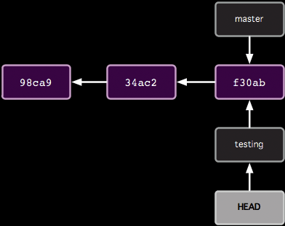
How git checkout works
$ git checkout testing
After

Slide 35
Common Workflow
Create temp local branch
Checkout temp branch
Edit/Add/Commit on temp branch
Checkout master branch
Pull to update master branch
Merge temp branch with updated master
Delete temp branch
Push to update server repos

Slide 36
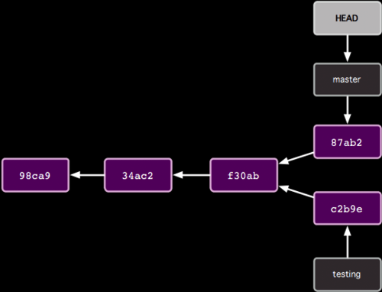
How git commit works with multiple branches
Edit some stuff
$ git add -A
$ git commit –m "blah"
Before

Slide 37
How git commit works with multiple branches
Edit some stuff
$ git add -A
$ git commit –m "blah"
After

Slide 38
Common Workflow
Create temp local branch
Checkout temp branch
Edit/Add/Commit on temp branch
Checkout master branch
Pull to update master branch
Merge temp branch with updated master
Delete temp branch
Push to update server repos

Slide 39
How git checkout works
$ git checkout master
Before

Slide 40
How git checkout works
$ git checkout master
After

Slide 41
Common Workflow
Create temp local branch
Checkout temp branch
Edit/Add/Commit on temp branch
Checkout master branch
Pull to update master branch
Merge temp branch with updated master
Delete temp branch
Push to update server repos

Slide 42
How git pull works
Someone else pushed
$ git pull
Before

Slide 43
How git pull works
Someone else pushed
$ git pull
After

Slide 44
Common Workflow
Create temp local branch
Checkout temp branch
Edit/Add/Commit on temp branch
Checkout master branch
Pull to update master branch
Merge temp branch with updated master
Delete temp branch
Push to update server repos

Slide 45
How git merge works
$ git merge testing
Before

Slide 46
How git merge works
$ git merge testing
e2b92
After

Slide 47
Common Workflow
Create temp local branch
Checkout temp branch
Edit/Add/Commit on temp branch
Checkout master branch
Pull to update master branch
Merge temp branch with updated master
Delete temp branch
Push to update server repos

Slide 48
How to delete branches
$ git branch -d testing
e2b92
Before

Slide 49
How to delete branches
$ git branch -d testing
e2b92
After

Slide 50
Common Workflow
Create temp local branch
Checkout temp branch
Edit/Add/Commit on temp branch
Checkout master branch
Pull to update master branch
Merge temp branch with updated master
Delete temp branch
Push to update server repos

Slide 51
How git push works
$ git push
e2b92
Should update server repos
(if no one else has pushed commits to master branch since last pull)

Slide 52
Tips
git output contains lots of hints
  git status is your friend!
Merging may not be as easy as I showed
  E.g.: Multiple collabs updated same parts of file
  See Pro Git 3.2
Pull before starting temp branch
Team communication important!

Slide 53
Pop Quiz
5 questions
Update diagram in each
  Commit nodes
  Branch nodes
Based on actions of Alice and Bob
  Collaborating via GitHub repo

Slide 54
Start like this
Scott Fleming
SF 1
GitHub
master
11111
master
Alice
11111
Bob

Slide 55
Question 1
Alice:
  $ git clone https://github.com/whatever.git
  $ cd whatever
Bob:
  $ git clone https://github.com/whatever.git
  $ cd whatever
(include the HEAD node)

Slide 56
Question 2
Alice:
  $ git branch myfix
  $ git checkout myfix
(Alternatively)
  $ git checkout -b myfix

Slide 57
Question 3
Alice:
  $ rails generate scaffold User …
  $ git add -A
  $ git commit -m "Added User" # 22222
Bob:
  $ rails generate scaffold Micropost …
  $ git add -A
  $ git commit -m "Added Micropost" # 33333

Slide 58
Question 4
Bob:
  git push

Slide 59
Question 5
Alice:
  git pull

Slide 60
Appendix

Slide 61
What if…
Alice did this:
app/models/micropost.rb
class Micropost < ActiveRecord::Base
validates :content, length: { maximum: 140 }
end
Bob did this:
app/models/micropost.rb
class Micropost < ActiveRecord::Base
validates :content, length: { maximum: 120 }
end

Slide 62
What if Alice did this?
master
33333
$ git checkout master
$ git merge myfix
11111
22222
myfix

Slide 63
$ git merge myfix
Auto-merging app/models/micropost.rb
Automatic merge failed; fix conflict and then commit result.
app/models/micropost.rb
class Micropost < ActiveRecord::Base
<<<<<<< HEAD
validates :content, length: { maximum: 140 }
=======
validates :content, length: { maximum: 120 }
>>>>>>> myfix
end
To resolve:
Manually fix the file; git add and commit

Slide 64
Go back to specific commit point
Git log
  Show me the logs git
See the commit id
  git reset --hard c1ac571d9af5fe1126ecdf64c57d6ef4a5990a60 && git clean -f
Destroys the local modifications!
Removes untracked files!

Slide 65
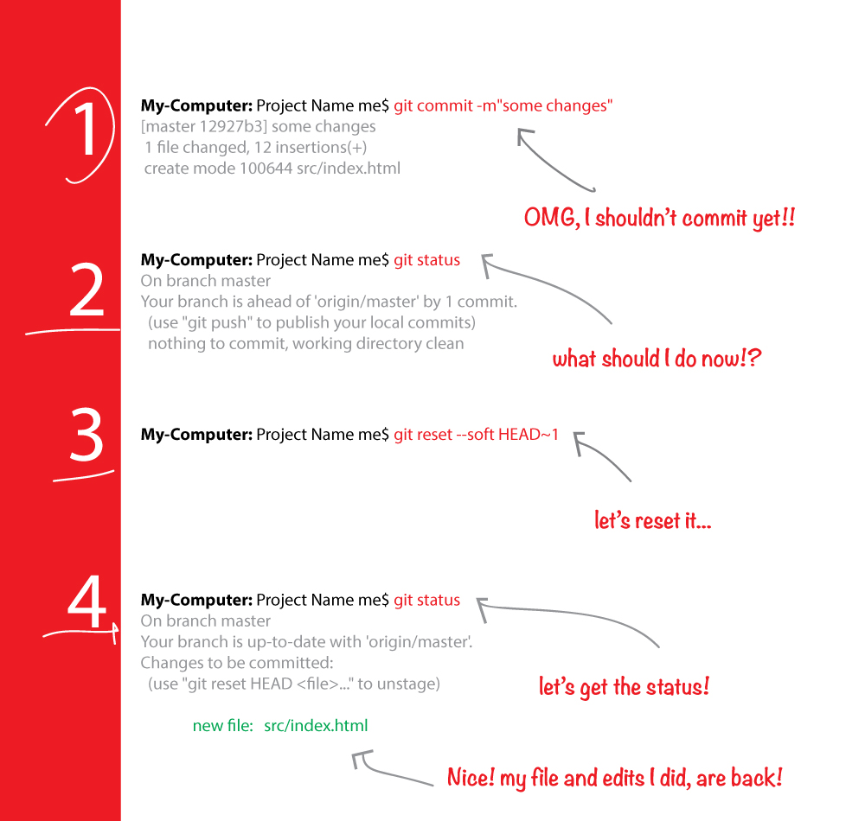
Undo Last commit

Slide 66
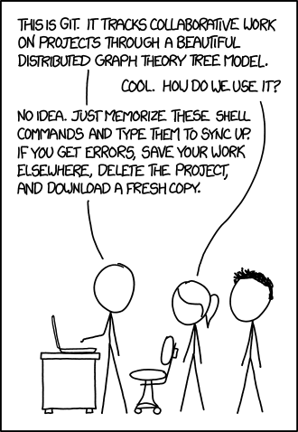
Thank You

Slide 67
One step back!
An easy way to revert last commit (1)
  git revert HEAD~1..HEAD
  git push origin

