Slide 1
Introduction to python

Slide 2



THE OFFERING
Training Offering
Will be helpful to get you started in writing Python Scripts with DB access
Will be able to start using Python modules/libraries
Will have sufficient understanding of Python to work with frameworks like Apache Spark, Apache Kafka etc.
Notes:
Vantage combines in a single platform descriptive, predictive, prescriptive analytics, autonomous decisioning, machine learning functions, and visualization tools.
So you can analyze anything, deploy anywhere, and deliver analytics that matter
Vantage offers choice and flexibility, deployed across public clouds, as well as on-premises, on optimized or commodity infrastructure, or as-a-service.
Get actionable answers faster
Operationalize analytics on an enterprise-ready platform to drive crucial business outcomes.

Slide 3
Training Agenda
Day 1
Day 2
Day 3
Python history
Python versions / Setup
Basic Semantics
Hello World
Introductory Code Sample and its understanding
Basic Datatypes/Whitespaces/Comments/Assignment
Operators/logical operators/special operators
Input from Key board
Sequence Type : Strings, List, Tuples
Dict
Iteration : While, For loop, Range
Flow Control : Break, Continue, Pass
Functions : return values, multiple argument, scope , Passing reference
Lambda
Advance Functions : map, filter, reduce, list comprehensions
Logging

Slide 4
Training Agenda
Day 4
Day 5
Exception Handling
Python Modules
Module: Import and Form ... Import
Class
File based operations
Introduction to Pandas : Series/Pandas
Database connection and operations ( MySql,Sql Lite, Teradata etc )

Slide 5
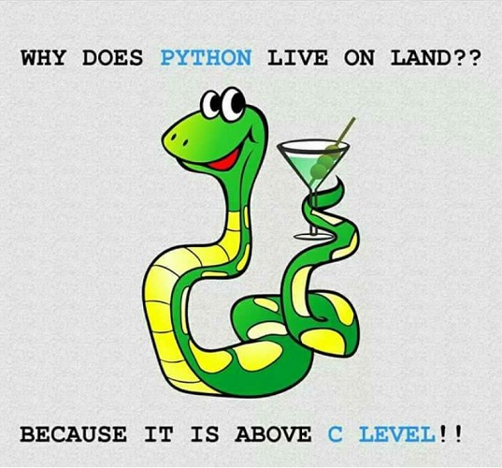
What is Python
“bridge the gap between C and the shell” - Guido Van Rossum
Python supports multiple programming paradigms
Object-oriented
Procedural
Imperative
Functional programming
It is a Dynamically Typed Language
Uses Indention for structuring code

Slide 6

Python Timeline/History
Python was conceived in the late 1980s.
Guido van Rossum, Benevolent Dictator For Life
Named after Monty python’s Flying Circus Tv Show
Descendant of ABC, he wrote glob() func in UNIX
In January of 1994 python 1.0 was released
Functional programming tools like lambda, map, filter, and reduce
comp.lang.python (Usenet newsgroup) formed, greatly increasing python’s userbase

Slide 7
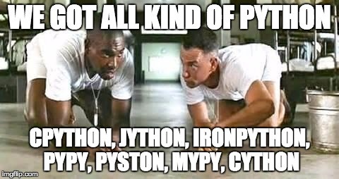
Python Timeline/History
Python 3.0
Wasn’t backwards compatible, they are
attempting to fix “perceived” security flaws.
Print statement became a print function.
All text strings are by default unicode.
Support of optional function annotation, that
can be used for informal type declarations
and other purposes.
Major implementation of Python are :
“Python” or “CPython” is written in C/C++
“Jython” is written in Java for the JVM
“IronPython” is written in C# for the .Net environment
Python 2.7 to lose continued support in 2020

Slide 8

Python setup/installation
By default its mostly installed on *nix systems
It can be manually downloaded from https://www.python.org/downloads/
Alternatively on can also choose Python distribution like Anaconda which comes bundled with more than 1,400 packages
Portable variants of Python are also available, http://portablepython.com/
Online IDEs are available too.
https://www.python.org/shell/
https://repl.it/languages/python3
http://ideone.com/

Slide 9
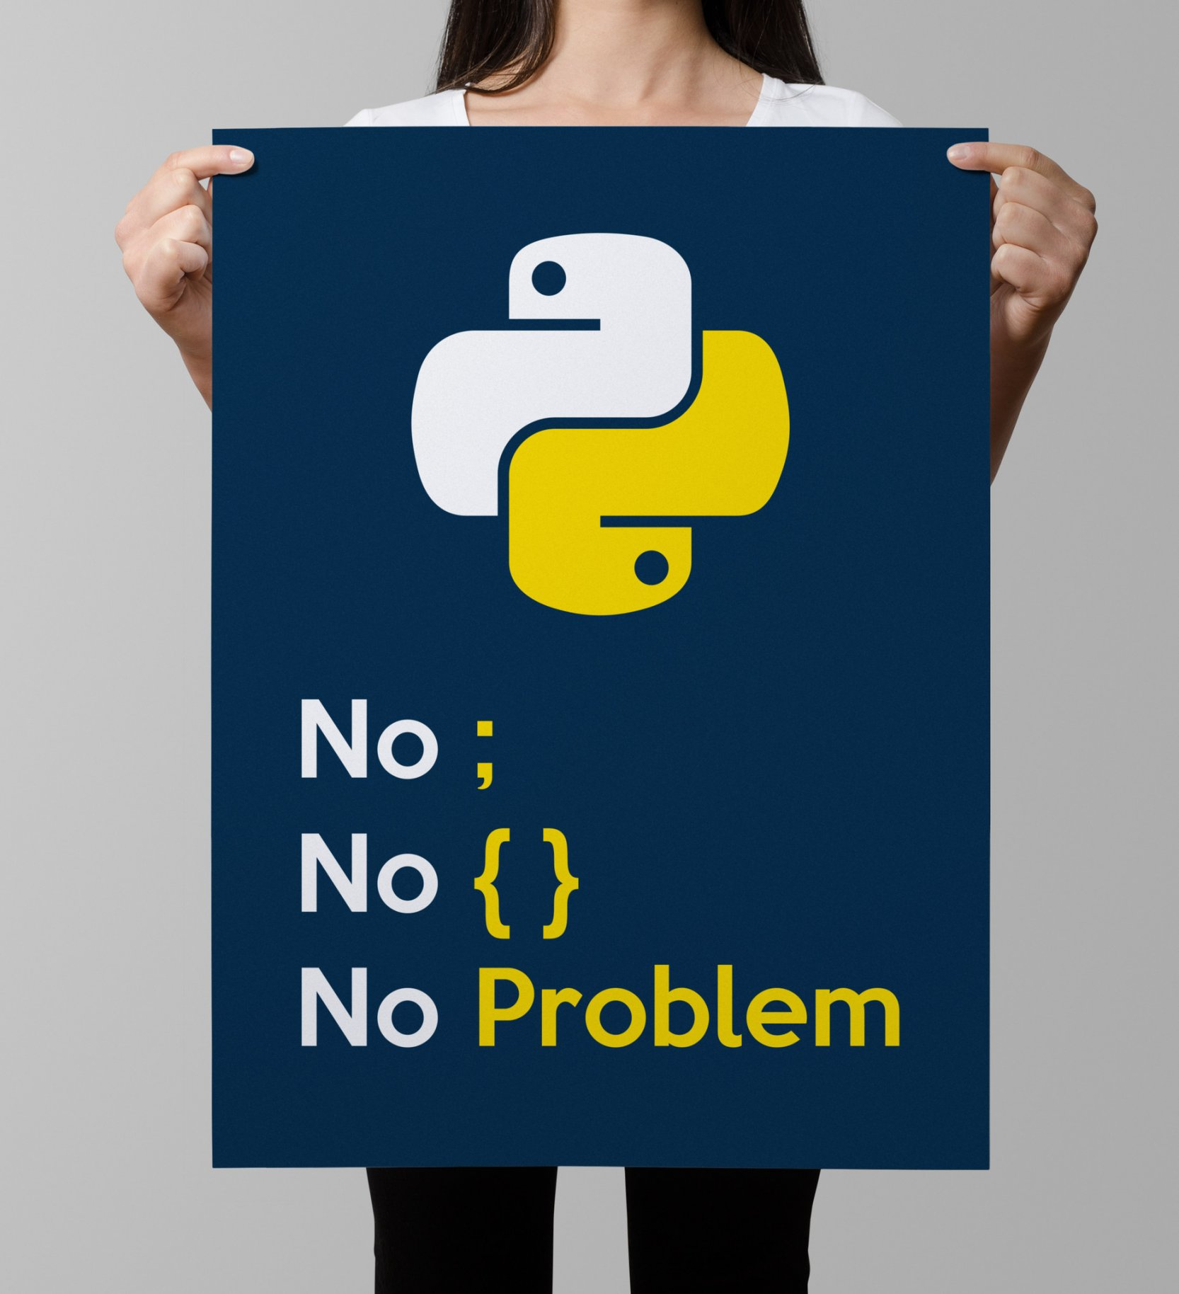
Basic Semantics
Indentation matters to code meaning
Block structure indicated by indentation
First assignment to a variable creates it
Variable types don’t need to be declared.
Python figures out the variable types on its own.
Assignment is = and comparison is ==
For numbers + - * / % are as expected
Special use of + for string concatenation and % for string formatting (as in C’s printf)
Logical operators are words (and, or, not) not symbols
The basic printing command is print()

Slide 10
Hello World !
print(“Hello World”)
You can run python programs from files, just like perl or shell scripts, by typing “python program.py” at the command line.
Or, one can invoke the program directly, if it has as a first line something like “#!/usr/bin/python” (like a shell script... works as long as the file has execute permissions set)‏
Alternatively, you can enter a python shell and run python commands interactively, by typing “python”

Slide 11
A Code Sample
x = 34 - 23 # A comment.
y = "Hello" # Another one.
z = 3.45
if z == 3.45 or y == "Hello":
x = x + 1
y = y + " World" # String concat.
print(x)
print(y)

Slide 12
Whitespace
Whitespace is meaningful in Python: especially indentation and placement of newlines
Use a newline to end a line of code
Use \ when must go to next line prematurely
No braces {} to mark blocks of code, use consistent indentation instead
First line with less indentation is outside of the block
First line with more indentation starts a nested block
Colons start of a new block in many constructs, e.g. function definitions, then clauses

Slide 13
Comments
Start comments with #, rest of line is ignored
A docstring i.e """triple double quotes""" is a string literal that occurs as the first statement in a module, function, class, or method definition. Such a docstring becomes the __doc__ special attribute of that object.
def fact(n):
“““fact(n) assumes n is a positive integer and returns facorial of n.””” assert(n>0)
return 1 if n==1 else n*fact(n-1)
Use r"""raw triple double quotes""" if you use any backslashes in your docstrings.
For Unicode docstrings, use u"""Unicode triple-quoted strings""".
Multi-line strings can be used as multi-line comments ( https://twitter.com/gvanrossum/status/112670605505077248 )

Slide 14
Assignments
Binding a variable in Python means setting a name to hold a reference to some object
Names in Python do not have an intrinsic type, objects have types
Python determines the type of the reference automatically based on what data is assigned to it
You create a name the first time it appears on the left side of an assignment expression: x = 3
A reference is deleted via garbage collection after any names bound to it have passed out of scope

Slide 15
Assignments
You can assign to multiple names at the same time
>>> x, y = 2, 3
>>> x
2
>>> y
3
This makes it easy to swap values
>>> x, y = y, x
Assignments can be chained
>>> a = b = x = 2

Slide 16
Assignment Naming Rules
Names are case sensitive and cannot start with a number. They can contain letters, numbers, and underscores.
bob Bob _bob _2_bob_ bob_2 BoB
There are some reserved words:
and, assert, break, class, continue, def, del, elif, else, except, exec, finally, for, from, global, if, import, in, is, lambda, not, or, pass, print, raise, return, try, while
Names starting with one underscore (_V) are not imported from the module import * statement
Names starting and ending with 2 underscores are special, system-defined names (e.g., __V__)‏
Names beginning with 2 underscores (but without trailing underscores) are local to a class (__V)‏

Slide 17
Operators
+ addition
- subtraction
/ division
* multiplication
** exponentiation
% modulus (remainder after division)‏
Python has incorporated operators like +=, but ++ (or --) do not work in Python

Slide 18
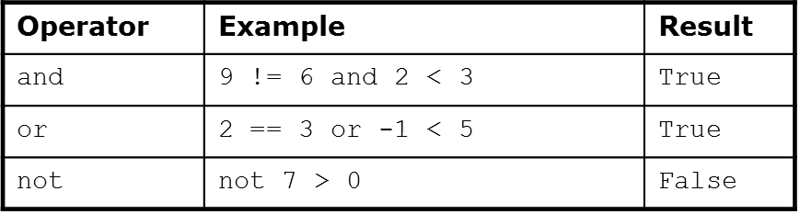
Logical Operators
Note: Python do NOT use &&, ||, !, as in C, Java etc

Slide 19
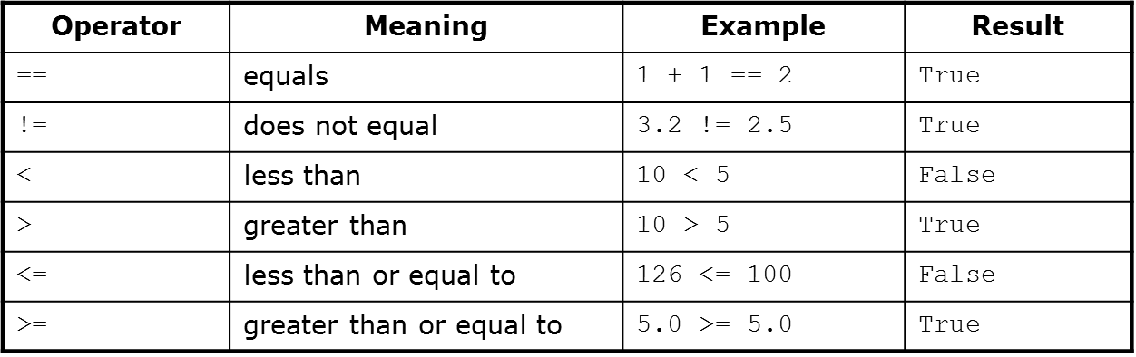
Relational Operators

Slide 20
A Code Sample – Input from Keyboard
i = input("Enter a math expression: ")
print(i)
# Equivalent to raw_input() in python < 3
j = eval(input("Enter the same expression: "))
print(j)
# Output:
# Enter a mathematical expression: 3+2
# 3+2
# Enter the same expression: 3+2
# 5

Slide 21
Python Type Hierarchy
Type Hierarchy
Numbers
None
Sequences
Mappings
Integral
Boolean
Floating Point
Complex
String
Tuple
List
Dictionary
Set
Frozen Set
Integer
Real
complex
Immutable
Bytes
Mutable
Byte Array
Sets
Immutable
Mutable
Immutable
Mutable
Counter
Default Dict
Ordered Dict
Deque
Named Tuple
Chain Map
Array
Decimal
Not part of Standard Type Hierarchy but has been categories due to similarities
 | Decimal module
 | Collections module
 | Array module

Slide 22
Feedback
Day 1

Slide 23
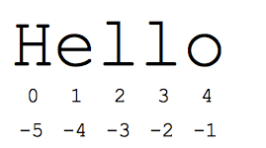
Sequence Type
Sequences are containers with items that are accessible by indexing or slicing.
Strings: “John Smith”
Immutable
Python uses Unicode, so strings are not limited to ASCII characters
Tuple: (‘john’, 32, [CMSC])
A simple immutable ordered sequence of items
Items can be of mixed types, including collection types
List: [1, 2, ‘john’, (‘up’, ‘down’)]
Mutable ordered sequence of items of mixed types

Slide 24
Sequence Type – Syntax Similarity
Operation | Result | Notes
x in s | True if an item of s is equal to x, else False | (1)
x not in s | False if an item of s is equal to x, else True | (1)
s + t | the concatenation of s and t | (6)(7)
s * n or n * s | equivalent to adding s to itself n times | (2)(7)
s[i] | ith item of s, origin 0 | (3)
s[i:j] | slice of s from i to j | (3)(4)
s[i:j:k] | slice of s from i to j with step k | (3)(5)
len(s) | length of s
min(s) | smallest item of s
max(s) | largest item of s
s.index(x[, i[, j]]) | index of the first occurrence of x in s (at or after index i and before index j) | (8)
s.count(x) | total number of occurrences of x in s

Slide 25
Mutable Sequence Type – Syntax Similarity
Operation | Result | Notes
s[i] = x | item i of s is replaced by x
s[i:j] = t | slice of s from i to j is replaced by the contents of the iterable t
del s[i:j] | same as s[i:j] = []
s[i:j:k] = t | the elements of s[i:j:k] are replaced by those of t | (1)
del s[i:j:k] | removes the elements of s[i:j:k] from the list
s.append(x) | appends x to the end of the sequence (same as s[len(s):len(s)] = [x])
s.clear() | removes all items from s (same as dels[:]) | (5)
s.copy() | creates a shallow copy of s (same as s[:]) | (5)
s.extend(t) or s += t | extends s with the contents of t (for the most part the same ass[len(s):len(s)] = t)
s *= n | updates s with its contents repeated ntimes | (6)
s.insert(i, x) | inserts x into s at the index given by i(same as s[i:i] = [x])
s.pop([i]) | retrieves the item at i and also removes it from s | (2)
s.remove(x) | remove the first item from s where s[i]is equal to x | (3)
s.reverse() | reverses the items of s in place | (4)

Slide 26
Dictionary
Unordered collections where items are accessed by a key, not by the position in the list
Like a hash in Perl
Collection of arbitrary objects; use object references like lists
Nestable
Can grow and shrink in place like lists
Concatenation, slicing, and other operations that depend on the order of elements do not work on dictionaries
Keys don't have to be strings; they can be any immutable data type, including tuples
Matrix = {} # start a blank dictionary
Matrix[(1, 0, 1)] = 0.5 # key is a tuple
Matrix[(1, 1, 4)] = 0.8

Slide 27
Dictionary Construction and Access
Example:
jobs = {"David": "Professor", "Sahan": "Postdoc", "Shawn": "Grad student"}
print(jobs["Sahan"])
#output : Postdoc
Can change in place
>>> jobs['Shawn'] = 'Postdoc’ >>> jobs['Shawn’] ‘Postdoc'
Lists of keys and values
>>> jobs.keys() ['Sahan', 'Shawn', 'David'] # note order is diff >>> jobs.values() ['Postdoc', 'Postdoc', 'Professor’] >>> jobs.items() [('Sahan', 'Postdoc'), ('Shawn', 'Postdoc'), ('David', 'Professor')]

Slide 28
Dictionary Construction and Access
Example:
jobs = {"David": "Professor", "Sahan": "Postdoc", "Shawn": "Grad student"}
print(jobs["Sahan"])
# output : Postdoc
Can change in place
jobs["Shawn"] = "Postdoc"
print(jobs["Shawn"])
# Ouput : Postdoc
Lists of keys and values
print(jobs.keys())
# Output : ['Sahan', 'Shawn', 'David'] # note order is diff
print(jobs.values())
# Output : ['Postdoc', 'Postdoc', 'Professor’]
print(jobs.items())
# Output : [('Sahan', 'Postdoc'), ('Shawn', 'Postdoc'), ('David', 'Professor')]

Slide 29
Common Dictionary Operations
Delete an entry (by key) del d['keyname’]
Add an entry
d['newkey'] = newvalue
See if a key is in dictionary (two ways) d.has_key('keyname’) #Python < 3.X
'keyname' in d
get() method useful to return value but not fail (return None) if key doesn't exist (or can provide a default value)
d.get('keyval', default)‏
update() merges one dictionary with another (overwriting values with same key)
d.update(d2) [the dictionary version of concatenation]

Slide 30
Iteration
while loops
for loops
range function
Flow control within loops: break, continue, pass, and the “loop else”

Slide 31
While loops
Example
count = 0
while count < 5:
print(count)
count += 1 # This is the same as count = count + 1

Slide 32
For Loops
Example for it in range(5):
print(it)
range(n) returns a list of integers from 0 to n-1. range(0,10,2) returns a list 0, 2, 4, 6, 8

Slide 33
Flow control within loops
General structure of a loop:
while <statement> (or for <item> in <object>): <statements within loop>
if <test1>: break # exit loop now
if <test2>: continue # go to top of loop now
if <test3>: pass # does nothing!
else:
<other statements> # if exited loop without # hitting a break

Slide 34
Using the “loop else”
An else statement after a loop is useful for taking care of a case where an item isn't found in a list. Example:
for i in range(4):
if i == 4:
print("I found 4!")
break
else:
print("Don't care about", i)
else:
print("I searched but never found 4!")

Slide 35
for ... in
Used with collection data types which can be iterated through (“iterables”): for name in ["Mutasem", "Micah", "Ryan"]:
if name[0] == "M":
print(name, "starts with an M")
else:
print(name, "doesn't start with M")

Slide 36
Parallel traversals
If we want to go through 2 lists (more later) in parallel, can use zip:
A = [1, 2, 3]
B = [4, 5, 6]
for (a,b) in zip(A,B):
print(a, "*", b, "=", a*b)
output: 1 * 4 = 4 2 * 5 = 10 3 * 6 = 18

Slide 37
Assignment
https://www.hackerrank.com/domains/python?filters%5Bsubdomains%5D%5B%5D=py-introduction

Slide 38
Feedback
Day 2

Slide 39
Functions
Define a function:
def <function name>(<parameter list>)
The function body is indented one level:
def computeSquare(x):
return x * x
# Anything at this level is not part of the function

Slide 40
Functions without return values
All functions in Python return something. If a return statement is not given, then by default, Python returns None
Beware of assigning a variable to the result of a function which returns None. For example, the append function changes the list but does not return a value:
a = [0, 1, 2]
b = a.append(3)
print(b)
Output : None

Slide 41
Multiple return values
Can return multiple values by packaging them into a tuple
def onetwothree(x):
return x*1, x*2, x*3
print(onetwothree(3))
Output: (3, 6, 9)

Slide 42
Default arguments
Like C or Java, can define a function to supply a default value for an argument if one isn't specified
def print_error(lineno, message="error"):
print("%s at line %d" % (message, lineno))
print_error(42) print_error(44,"WARN") print_error( message="Testing",lineno=66)

Slide 43
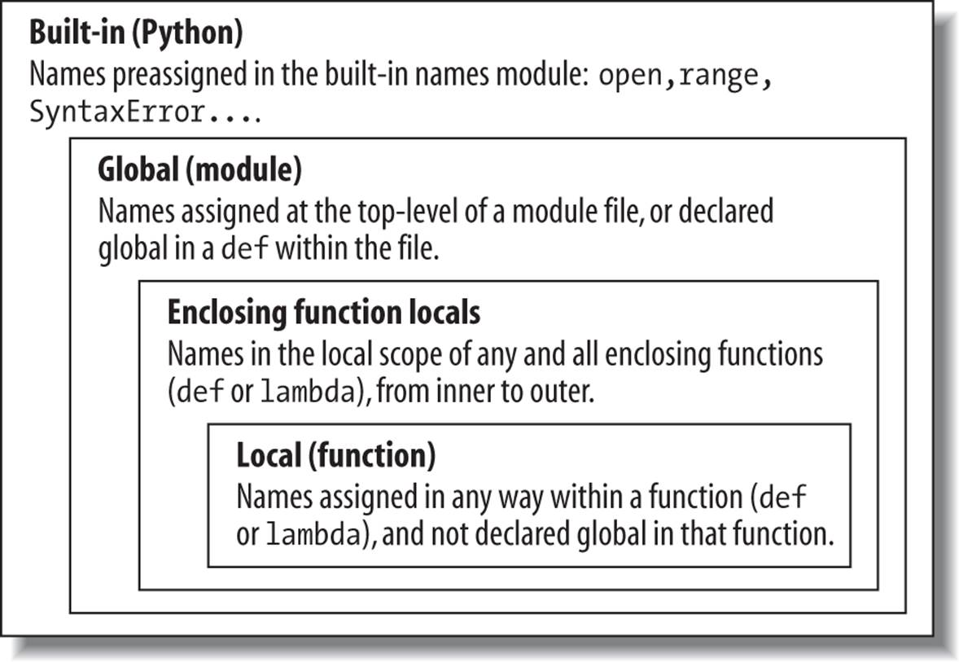
Scope : LEGB Rule
Notes:
The LEGB scope lookup rule. When a variable is referenced, Python searches for it in this order: in the local scope, in any enclosing functionsâ local scopes, in the global scope, and finally in the built-in scope. The first occurrence wins. The place in your code where a variable is assigned usually determines its scope. In Python 3.X, nonlocal declarations can also force names to be mapped to enclosing function scopes, whether assigned or not.

Slide 44
Scope example
a = 5 # global
def func(b):
c = a + b
return c
print(func(4)) # gives 4+5=9
print (c) # not defined
a = 5 # global
def func(b):
global c
c = a + b
return c
print(func(4)) # gives 4+5=9
print (c) # variable accessible

Slide 45
By value / By reference
Everything in Python is a reference. However, note also that immutable objects are not changeable --- so changes to immutable objects within a function only change what object the name points to (and do not affect the caller, unless it's a global variable)‏
For immutable objects (e.g., integers, strings, tuples), Python acts like C's pass by value
For mutable objects (e.g., lists), Python acts like C's pass by reference; in-place changes to mutable objects can affect the caller

Slide 46
Argument reference Example
def f1(x,y):
x = x * 1
y = y * 2
print(x, y) # 0 [1, 2, 1, 2]
def f2(x,y):
x = x * 1
y[0] = y[0] * 2
print(x, y) # 0 [2, 2]
a = 0
b = [1,2]
f1(a,b)
print(a, b) # 0 [1, 2]
f2(a,b)
print(a, b) # 0 [2, 2]

Slide 47
Passing variable arguments
Variable number of arguments can be passed to function as follows
def sum(*args):
result = 0
for arg in args:
result += arg
return result
print(sum(1,2,3) ) #6
print(sum(1,2,3,5,8) )

Slide 48
Keyword arguments
The caller of a function can place the arguments in the correct order (“positional arguments”), but alternatively, some arguments can be designated by keywords
Note: this example calls the function with the arguments in the wrong order, but the arguments are passed with keyword syntax so it doesn't matter:
def print_hello(firstname="", lastname=""):
print("Hello, %s %s" % (firstname, lastname))
print_hello(lastname="Sherrill",firstname="David")
Output
Hello, David Sherrill

Slide 49
Mixing keyword and positional arguments
When using both args and kwargs in the same function definition, *args must occur before **kwargs
def func(*args,**kwargs):
for arg in args:
print(arg)
for item in kwargs.items():
print(item)
func(1,x=7,u=8)

Slide 50
Mixing keyword and positional arguments
*args and **kwargs are special syntax that are used in functions to pass a variable number of arguments to a function.
*args occur before **kwargs in a function definition.
If the intent is to mix and match argument types the order of the declaration needs to work like this.
def example(arg_1, arg_2, *args, kw_1="shark", kw_2="blobfish", **kwargs):
…….
You can use any name you want; args and kwargs are only by convention and not a requirement. For example, you can use *foo instead of *args or **foo instead of **kwargs.

Slide 51
Mixing keyword and positional arguments
def myFun(arg0,arg1, arg2, arg3):
print("arg0:",arg0)
print("arg1:", arg1)
print("arg2:", arg2)
print("arg3:", arg3)
args = ("Testing", "Fucntions", "Arguments")
myFun("test",*args)
kwargs = {"arg1" : "Testing", "arg2" : "Fucntions", "arg3" : "Arguments"}
myFun("test",**kwargs)

Slide 52
Passing dictionaries to functions
Dictionaries will be discussed later dict-args.py: def print_dict(**kwargs): for key in kwargs.keys(): print "%s = %s" % (key, kwargs[key]) user_info = dict(name="David", uid=593, homedir="/home/users/david") print_dict(**user_info) # note: need ** here!! output: (note: dictionary entries are unordered) uid = 593 name = David homedir = /home/users/david

Slide 53
Dictionary arguments
Note: dictionaries can be passed as arguments even to “normal” functions wanting positional arguments! dict-args.py: def area(x, y, units="inches"): print x*y, "square %s" % units area_info = dict(x=2, y=3, units="centimeters") area(**area_info) output: 6 square centimeters

Slide 54
Advanced Functions : Lambda
Lambda functions are single-expression functions that are not necessarily bound to a name (anonymous).
Lambda functions can’t use regular Python statements and always include an implicit return statement.
Can only contain an expression in the function definition, not a block of statements (e.g., no if statements, etc)‏
The programmer can decide whether or not to assign lambda function a name
The following syntax is used to declare a lambda function:
lambda argument(s): expression

Slide 55
Advanced Functions : Lambda Code Example
Simple example: def addFunc(x, y):
return x + y
print(addFunc(5, 6))
#Lambda function
print((lambda x,y:x+y)(5,6))
#Lambda Fucntion can be assigned a name
addLambda = lambda x, y: x + y
print(addLambda(5, 6))

Slide 56
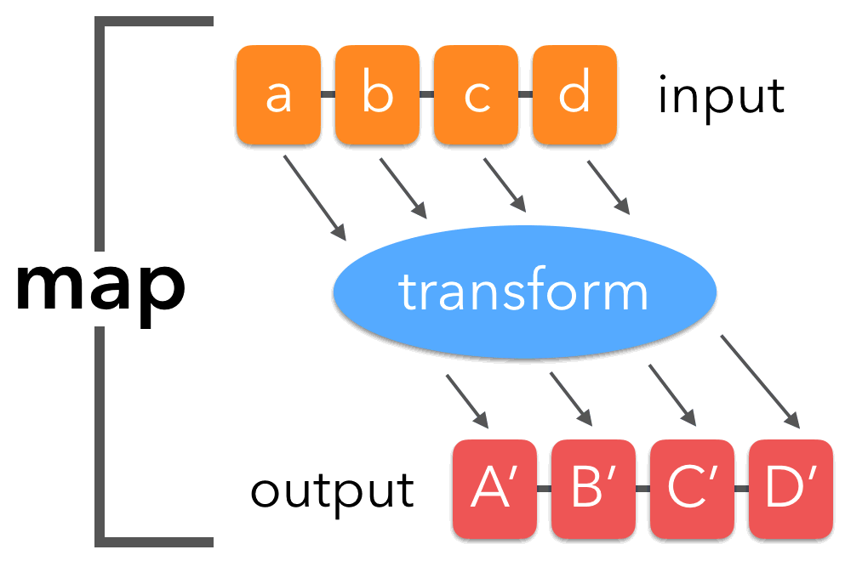
Advanced Functions : map
Map calls a given function on every element of a sequence.Basic syntax :
map(function_object, iterable1, iterable2,...)
def double(x):
return x*2
a = [1, 2, 3]
for mapElement in map(double, a):
print(mapElement) #[2, 4, 6]
#Alternatively using Lambda:
a = [1, 2, 3]
for mapElement in map((lambda x: x*2), a):
print(mapElement)

Slide 57
Advanced Functions : map
Can also apply a map to functions taking more than one argument, Such as in following example we are passing two lists to the lambda functions
for mapElement in map((lambda x, y: x+y), [1,2,3], [4,5,6]):
print(mapElement) #[5,7,9]

Slide 58
Advanced Functions : filter
Like map, the filter function works on iterable.
And unlike map,
It can only have one iterable as input
It returns only a selected list of items that matches some criterion.
Basic Syntax :
filter(function_object, iterable)
Example : Filter odd numbers: print(list(filter((lambda x: x%2==0), range(-4,4)))) #[-4, -2, 0, 2]
# recall range doesn't include last value given in range

Slide 59
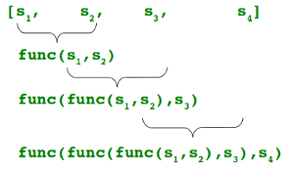
Advanced Functions : reduce
Like the map and filter functions, the reduce() function receives two arguments, a function and an iterable
Each operation acts on the result of the last operation and the next item in the iterable
Also, it doesn't return another iterable, instead it returns a single value.
In Python 2, reduce() was a built-in function. However, in Python 3, it is moved to functools module.
The syntax of the reduce() function is as follows:
reduce(function, sequence[, initial]) -> value
Example :
from functools import reduce
#Reduce Function
print(reduce((lambda x, y: x+y), [0, 1, 2, 3, 4]))

Slide 60
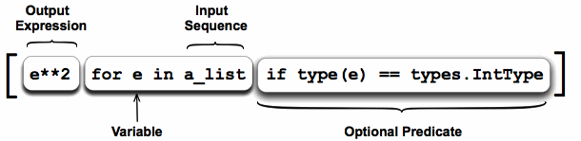
List comprehensions
Comprehensions are constructs that allow sequences to be built from other sequences.
A list comprehension consists of the following parts:
An Input Sequence.
A Variable representing members of the input sequence.
An Optional Predicate expression.
An Output Expression producing elements of the output list from members of the Input Sequence that satisfy the predicate.

Slide 61
List comprehensions
Find list of integers and square them
a_list = [1, "4", 9, "a", 0, 4]
squared_ints = [ e**2 for e in a_list if isinstance(e,int)]
print(squared_ints)
#Using Map and filter too the above problem can be solved
sqr_ints=list(map(lambda e: e**2, filter(lambda e: type(e) == int, a_list)))
print(sqr_ints)

Slide 62
Logging
Task you want to perform | The best tool for the task
Display console output for ordinary usage of a command line script or program | print()
Report events that occur during normal operation of a program (e.g. for status monitoring or fault investigation) | logging.info() (or logging.debug() for very detailed output for diagnostic purposes)
Issue a warning regarding a particular runtime event | warnings.warn() in library code if the issue is avoidable and the client application should be modified to eliminate the warning logging.warning() if there is nothing the client application can do about the situation, but the event should still be noted
Report an error regarding a particular runtime event | Raise an exception
Report suppression of an error without raising an exception (e.g. error handler in a long-running server process) | logging.error(), logging.exception() or logging.critical() as appropriate for the specific error and application domain

Slide 63
Logging Level
Level | When it’s used
DEBUG | Detailed information, typically of interest only when diagnosing problems.
INFO | Confirmation that things are working as expected.
WARNING | An indication that something unexpected happened, or indicative of some problem in the near future (e.g. ‘disk space low’). The software is still working as expected.
ERROR | Due to a more serious problem, the software has not been able to perform some function.
CRITICAL | A serious error, indicating that the program itself may be unable to continue running.

Slide 64
Logging
Logger: This is the class whose objects will be used in the application code directly to call the functions.
LogRecord: Loggers automatically create LogRecord objects that have all the information related to the event being logged, like the name of the logger, the function, the line number, the message, and more.
Handler: Handlers send the LogRecord to the required output destination, like the console or a file. Handler is a base for subclasses like StreamHandler, FileHandler, SMTPHandler, HTTPHandler, and more. These subclasses send the logging outputs to corresponding destinations, like sys.stdout or a disk file.
Formatter: This is where you specify the format of the output by specifying a string format that lists out the attributes that the output should contain.

Slide 65
Logging Demo

Slide 66
Feedback
Day 3

Slide 67
Exception Handling
An “exception” is a (recognized type of) error, and “handling” is what you do when that error occurs
General syntax: try: code-you-want-to-run except exception1 [as variable1]: exception1 block ... except exceptionN [as variableN]: exceptionN block
If an error occurs, if it's of exception type 1, then variable1 becomes an alias to the exception object, and then exception1 block executes. Otherwise, Python tries exception types 2 ... N until the exception is caught, or else the program stops with an unhandled exception (a traceback will be printed along with the exception's text)‏
The optional [as variable] will not work with older Python

Slide 68
Other exceptions
EOFError is raised at the end of a file
IndexError happens if we use an invalid index for a string/collection, e.g., if we try to get argv[1] if there is only one command-line argument (counting starts from zero)‏
TypeError happens when, e.g., comparing two incomparable types

Slide 69
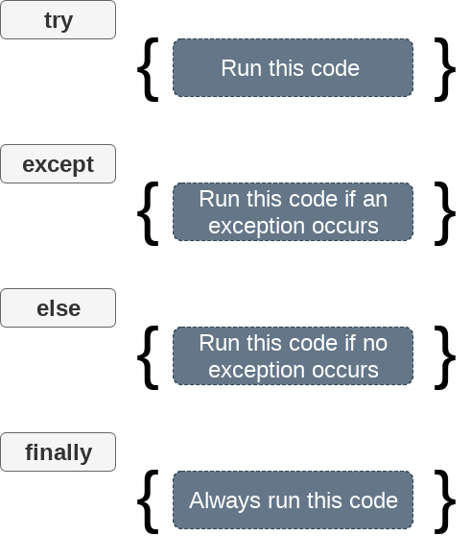
Exception example
try:
i = int("python")
print("the integer is", i)
except ValueError:
print("oops! invalid value")
else :
print("Try block got executed without exception")
finally :
print("This block will always be executed!")

Slide 70
Python Module Basics
Each file in Python is considered a module. Everything within the file is encapsulated within a namespace (which is the name of the file)‏
To access code in another module (file), import that file, and then access the functions or data of that module by prefixing with the name of the module, followed by a period
To import a module: import sys (note: no file suffix)‏
Can import user-defined modules or some “standard” modules like sys and random
Any python program needs one “top level” file which imports any other needed modules

Slide 71
Python standard library
There are over 200 modules in the Standard Library
Consult the Python Library Reference Manual, included in the Python installation and/or available at http://www.python.org

Slide 72
What “import” does
An import statement does three things: - Finds the file for the given module - Compiles it to bytecode - Runs the module's code to build any objects (top-level code, e.g., variable initialization)‏
The module name is only a simple name; Python uses a module search path to find it. It will search:
the directory of the top-level file,
directories in the environmental variable PYTHONPATH,
standard directories, and
directories listed in any .pth files (one directory per line in a plain text file); the path can be listed by printing sys.path

Slide 73
The “sys” Module
Printing the command-line arguments,
import sys
cmd_options = sys.argv
i = 0
for cmd in cmd_options:
print("Argument ", i, "=", cmd)
i += 1

Slide 74
Import Vs From … Import
Import brings in a whole module; you need to qualify the names by the module name (e.g., sys.argv)‏
“import from” copies names from the module into the current module; no need to qualify them (note: these are copies, not links, to the original names) from module_x import junk junk() # not module_x.junk() from module_x import * # gets all top-level # names from module_x

Slide 75
import …
import somefile
Everything in somefile.py gets imported.
To refer to something in the file, append the text “somefile.” to the front of its name:
somefile.className.method(“abc”)
somefile.myFunction(34)

Slide 76
from … import *
from somefile import *
Everything in somefile.py gets imported
To refer to anything in the module, just use its name. Everything in the module is now in the current namespace.
Take care! Using this import command can easily overwrite the definition of an existing function or variable!
className.method(“abc”)
myFunction(34)

Slide 77
from … import …
from somefile import className
Only the item className in somefile.py gets imported.
After importing className, you can just use it without a module prefix. It’s brought into the current namespace.
Take care! Overwrites the definition of this name if already defined in the current namespace!
className.method(“abc”) ⬅ imported
myFunction(34) ⬅ Not imported

Slide 78
Changing data in Modules
Reassigning a new value to a fetched name from a module does not change the module, but changing a mutable variable from a module does: from module_x import x,y x = 30 # doesn't change x in module_x y[0] = 1 # changes y[0] in module_x
This works just like functions
To actually change a global name in another file, could use import (without “from”) and qualify the variable: module_x.x = 30 (but this breaks data encapsulation)

Slide 79
Reloading Modules
A module's top-level code is only run the first time the module is imported. Subsequent imports don't do anything.
The reload function forces a reload and re-run of a module; can use if, e.g., a module changes while a Python program is running
reload is passed an existing module object reload(module_x) # module_x must have been # previously imported
reload changes the module object in-place
reload does not affect prior from..import statements (they still point to the old objects)‏

Slide 80
Module Packages
When using import, we can give a directory path instead of a simple name. A directory of Python code is known as a “package”:
import dir1.dir2.module or from dir1.dir2.module import x will look for a file dir1/dir2/module.py
Note: dir1 must be within one of the directories in the PYTHONPATH
Note: dir1 and dir2 must be simple names, not using platform-specific syntax (e.g., no C:\)‏

Slide 81
Package __init__.py files
In general __init__.py not required for packages from Python 3.3+
When using Python packages (directory path syntax for imports), each directory in the path needs to have an __init__.py file
The file could be blank
If not blank, the file contains Python code; the first time Python imports through this directory, it will run the code in the __init__.py file
In the dir1.dir2.module example, a namespace dir1.dir2 now exists which contains all names assigned by dir2's __init__.py file
The file can contain an “__all__” list which specifies what is exported by default when a directory is imported with the from* statement

Slide 82
Data Encapsulation
By default, names beginning with an underscore will not be copied in an import statement (they can still be changed if accessed directly)‏
Alternatively, one can list the names to be copied on import by assigning them to a list called __all__:
__all__ = [“x1”, “y1”, “z1”] # export only these this list is only read when using the from * syntax

Slide 83
__name__ and __main__
When a file is run as a top-level program, it's __name__ is set to “__main__” when it starts
If a file is imported, __name__ is set to the name of the module as the importer sees it
Can use this to package a module as a library, but allow it to run stand-alone also, by checking if __name__ == '__main__': do_whatever() # run in stand-alone mode

Slide 84
Import as
You can rename a module (from the point of view of the importer) by using:
import longmodulename as shortname
where shortname is the alias for the original module name
Using this syntax requires you to use the short name thereafter, not the long name
Can also do
from module import longname as name

Slide 85
Reload may not affect “from” imports
From copies names, and does not retain a link back to the original module
When reload is run, it changes the module, but not any copies that were made on an original from module import XX statement
If this is a problem, import the entire module and use name qualification (module.XX) instead

Slide 86
dir(), type() function
The dir() function lists all the attributes of a class
you can think of these as keys in a dictionary stored in the class.

Slide 87
Python Class
A “class” is a user-defined data type. It contains (or encapsulates) certain “data members” and it also has associated things it can do, or “member functions” also called methods
If a class is a specialization (or sub-type) of a more general class, it is said to inherit from that class; this can give a class access to a parent class' member data/functions
These general concepts are basically the same in C++, Java, etc.
Classes are built into Python from the very beginning.

Slide 88
Defining Classes
A class is defined by: class classname: suite-of-code
or class classname(base_classes): suite-of-code
The class definition suite (code block) can contain member function definitions, etc.
There is usually a special method called __init__ in most classes, which acts as its constructor.
There must be a special first argument self in all of method definitions which gets bound to the calling instance

Slide 89
Python Class definition : Student
class student: “““A class representing a student ”””
def __init__(self,n,a): self.full_name = n self.age = a
def get_age(self): return self.age

Slide 90
Instantiating an Object
There is no “new” keyword as in Java.
Just use the class name with ( ) notation and assign the result to a variable
__init__ serves as a constructor for the class. Usually does some initialization work
The arguments passed to the class name are given to its __init__() method
So, the __init__ method for student is passed “Bob” and 21 and the new class instance is bound to b:
b = student(“Bob”, 21)

Slide 91
Constructor : __init__
An __init__ method can take any number of arguments.
Like other functions or methods, the arguments can be defined with default values, making them optional to the caller.
However, the first argument self in the definition of __init__ is special

Slide 92
Python Class : Argument “self”
The first argument of every method is a reference to the current instance of the class
By convention, we name this argument self
Similar to this in Java but Python uses self more often than Java uses this
Although you must specify self explicitly when defining the method, you don’t include it when calling the method.
Defining a method: Calling a method:
(this code inside a class definition.)
def set_age(self, num): >>> x.set_age(23) self.age = num

Slide 93
Python Class : Types of Attributes
The non-method data stored by objects are called attributes
Data attributes
Variable owned by a particular instance of a class
Each instance has its own value for it
These are the most common kind of attribute
Class attributes
Owned by the class as a whole
All class instances share the same value for it
Similar to “static” variables in some languages
Good for
Class-wide constants and
Building counter of how many instances of the class have been made

Slide 94
Data Attributes
Data attributes are created and initialized by an __init__() method.
Simply assigning to a name creates the attribute
Inside the class, refer to data attributes using self :
for example, self.full_name
class teacher: “A class representing teachers.”
def __init__(self,n): self.full_name = n
def print_name(self): print self.full_name

Slide 95
Class Attributes
Because all instances of a class share one copy of a class attribute, when any instance changes it, the value is changed for all instances
Class attributes are defined within a class definition and outside of any method
Since there is one of these attributes per class and not one per instance, they’re accessed via a different notation:
Access class attributes using self.__class__.name notation -- This is just one way to do this & the safest in general.
class sample: >>> a = sample() x = 23 >>> a.increment() def increment(self): >>> a.__class__.x self.__class__.x += 1 24

Slide 96
Creating a Static Method
class Critter(object):
...
def status():
print "Total critters", Critter.total
status = staticmethod(status)
status()
Is static method
Doesn't have self in parameter list because method will be invoked through class not object
staticmethod()
Built-in Python function
Takes method and returns static method

Slide 97
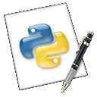
Invoking a Static Method
...
crit1 = Critter("critter 1")
crit2 = Critter("critter 2")
crit3 = Critter("critter 3")
Critter.status()
Critter.status()
Invokes static method status() defined in Critter
Prints a message stating that 3 critters exist
Works because constructor increments class attribute total, which status() displays
classy_critter.py

Slide 98
Private Data and Methods
Python takes the approach “We are all adults here”. No hard restrictions.
Any attribute/method with 2 leading under-scores in its name (but none at the end) is private and can’t be accessed outside of class
Names with two underscores at the beginning and the end are for built-in methods or attributes for the class
There is no ‘protected’ status in Python; so, subclasses would be unable to access these private data either.
https://mail.python.org/pipermail/tutor/2003-October/025932.html

Slide 99
Python Class : Special Methods
Classes contain many methods and attributes that are included by Python even if you don’t define them explicitly.
All built-in members have double underscores around their names: __init__ __doc__
You can redefine these as well:
__init__ : The constructor for the class
__repr__ : return a printable representation of the object
__str__ : a special method that returns string representation of object
__eq__ : Define how == works for class
__len__ : Define how len( obj ) works
__copy__ : Define how to copy a class

Slide 100
Python Class : Special Data members/items
These attributes exist for all classes.
__doc__ : Variable for documentation string for class
__class__ : Variable which gives you a reference to the class from any instance of it
__module__ : Variable which gives a reference to the module in which the particular class is defined
__dict__ :The dictionary that is actually the namespace for a class (but not its superclasses)
Useful:
dir(x) returns a list of all methods and attributes defined for object x

Slide 101
Feedback
Day 4

Slide 102
File I/O
You can read and write text files in Python much as you can in other languages, and with a similar syntax.
To open a file for reading:
try:
configFile = open(configName, "r")
except IOError as err:
print("could not open file: " + str(err))

Slide 103
Python File Modes
Mode | Description
'r' | Open a file for reading. (default)
'w' | Open a file for writing. Creates a new file if it does not exist or truncates the file if it exists.
'x' | Open a file for exclusive creation. If the file already exists, the operation fails.
'a' | Open for appending at the end of the file without truncating it. Creates a new file if it does not exist.
't' | Open in text mode. (default)
'b' | Open in binary mode.

Slide 104
Python File operations
Basic operations output = open('output.dat', 'w')
input = open('input.dat', 'r')
A = input.read() # read whole file into string
A = input.read(N) # read N bytes
A = input.readline() # read next line
A = input.readlines() # read file into list of strings
output.write(A) # Write string A into file
output.writelines(A) # Write list of strings
output.close() # Close a file

Slide 105
Example of File parsing
Whole thing at once:
infile = open("test.txt","r")
lines = infile.readlines()
infile.close()
for line in lines:
print (line)
Line-by-line (shortcut syntax avoiding readline calls):
infile = open("test.txt","r")
for line in infile:
print (line)
infile.close()
‏

Slide 106
Introduction to Pandas
Pandas is Python package for data analysis.
It Provides built-in data structures which simplify the manipulation and analysis of data sets.
It provides a flexible way to merge, concatenate or reshape the data
It uses Series for one-dimensional data structure and DataFrame for multi-dimensional data structure

Slide 107
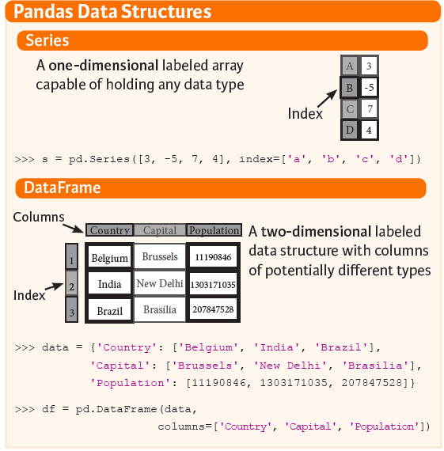
Panda
A Series is a named Python list (dict with list as value). { ‘grades’ : [50,90,100,45] }
A DataFrame is a dictionary of Series (dict of series): { { ‘names’ :[‘bob’,’ken’,’art’,’joe’]}
{ ‘grades’ : [50,90,100,45] }
}

Slide 108
Reading data using Pandas
#Read csv file
df = pd.read_csv("Salaries.csv")
Note: The above command has many optional arguments to fine-tune the data import process.
There is a number of pandas commands to read other data formats:
pd.read_excel('myfile.xlsx',sheet_name='Sheet1', index_col=None, na_values=['NA'])
pd.read_stata('myfile.dta')
pd.read_sas('myfile.sas7bdat')
pd.read_hdf('myfile.h5','df')

Slide 109
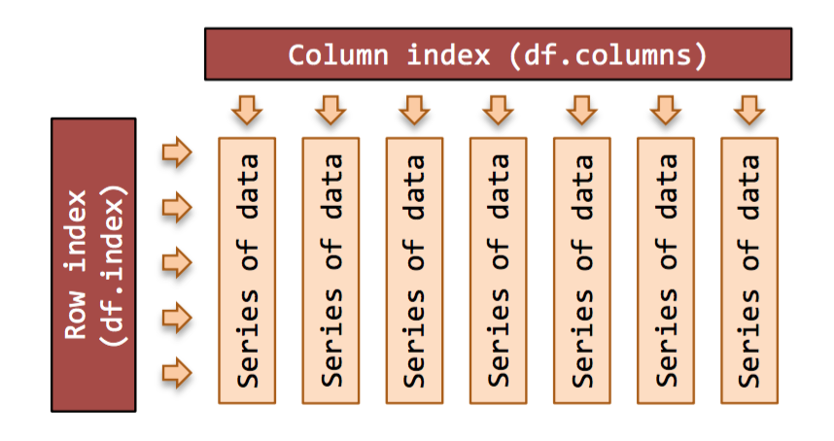
Exploring Data Frames
#List first 5 records
df.head()
# Display the last 5 records
df.tail()
#No of rows
df.index
#List of Columns
df.columns

Slide 110
Data Frame data types
Pandas Type | Native Python Type | Description
object | string | The most general dtype. Will be assigned to your column if column has mixed types (numbers and strings).
int64 | int | Numeric characters. 64 refers to the memory allocated to hold this character.
float64 | float | Numeric characters with decimals.
datetime64, timedelta[ns] | N/A (but see the datetime module in Python’s standard library) | Values meant to hold time data.

Slide 111
Data Frame data types
#Check a particular column type
df['salary'].dtype
#Check types for all the columns
df.dtypes
# the type of the object
type(df["salary"])
Note: If single brackets are used to specify the column (e.g. salary), then the output is Pandas Series object. When double brackets are used the output is a Data Frame

Slide 112
Data Frames attributes
Python objects have attributes and methods.
df.attribute | description
dtypes | list the types of the columns
columns | list the column names
axes | list the row labels and column names
ndim | number of dimensions
size | number of elements
shape | return a tuple representing the dimensionality
values | numpy representation of the data

Slide 113
Data Frames methods
Unlike attributes, python methods have parenthesis.
All attributes and methods can be listed with a dir() function: dir(df)
df.method() | description
head( [n] ), tail( [n] ) | first/last n rows
describe() | generate descriptive statistics (for numeric columns only)
max(), min() | return max/min values for all numeric columns
mean(), median() | return mean/median values for all numeric columns
std() | standard deviation
sample([n]) | returns a random sample of the data frame
dropna() | drop all the records with missing values

Slide 114
Selecting a column in a Data Frame
Method 1: Subset the data frame using column name:
df['gender']
Method 2: Use the column name as an attribute:
df.gender
Note: there is an attribute rank for pandas data frames, so to select a column with a name "rank" we should use method 1.

Slide 115
Data Frames groupby method
Using "group by" method we can:
Split the data into groups based on some criteria
Calculate statistics (or apply a function) to each group
#Group data using rank
df_rank = df.groupby(['rank'])
#Calculate mean value for each numeric column per each group
df_rank.mean()
#Calculate mean salary for each professor rank:
df.groupby('rank')[['salary']].mean()
Note: If single brackets are used to specify the column (e.g. salary), then the output is Pandas Series object. When double brackets are used the output is a Data Frame

Slide 116
Data Frames groupby method
groupby performance notes:
no grouping/splitting occurs until it's needed. Creating the groupby object only verifies that you have passed a valid mapping
by default the group keys are sorted during the groupby operation. You may want to pass sort=False for potential speedup:
#Calculate mean salary for each professor rank:
df.groupby(['rank'], sort=False)[['salary']].mean()

Slide 117
Data Frame: filtering
To subset the data we can apply Boolean indexing. This indexing is commonly known as a filter. For example if we want to subset the rows in which the salary value is greater than $120K:
#select observations whose salary > 120K :
df_sub = df[ df['salary'] > 120000 ]
#Select only those rows that contain female professors:
df_f = df[ df[‘gender'] == 'Female' ]
Note : Any Relational operator can be used to subset the data. [ see slide no . 19 ]

Slide 118
Data Frames: Slicing
There are a number of ways to subset the Data Frame:
one or more columns
one or more rows
a subset of rows and columns
Rows and columns can be selected by their position or label

Slide 119
Data Frames: Slicing
When selecting one column, it is possible to use single set of brackets, but the resulting object will be a Series (not a DataFrame):
#Select column salary:
df['salary']
When we need to select more than one column and/or make the output to be a DataFrame, we should use double brackets:
#Select column salary:
df[['rank','salary']]

Slide 120
Data Frames: Selecting rows
If we need to select a range of rows, we can specify the range using ":"
#Select rows by their position:
df[10:20]
Notice that the first row has a position 0, and the last value in the range is omitted:
So for 0:10 range the first 10 rows are returned with the positions starting with 0 and ending with 9

Slide 121
Data Frames: method loc and iloc
If we need to select a range of rows, using their labels we can use method loc:
#Select rows by their labels:
df_sub.loc[10:20,['rank’,’gender','salary']]
If we need to select a range of rows and/or columns, using their positions we can use method iloc:
#Select rows by their labels:
df_sub.iloc[10:20,[0, 3, 4, 5]]

Slide 122
Data Frames: method iloc (summary)
df.iloc[0] # First row of a data frame
df.iloc[i] #(i+1)th row
df.iloc[-1] # Last row
df.iloc[:, 0] # First column
df.iloc[:, -1] # Last column
df.iloc[0:7] #First 7 rows
df.iloc[:, 0:2] #First 2 columns
df.iloc[1:3, 0:2] #Second through third rows and first 2 columns
df.iloc[[0,5], [1,3]] #1st and 6th rows and 2nd and 4th columns

Slide 123
Pandas - Accessing and indexing
loc : only work on index
iloc : work on position
ix : this is the most general and supports index and position based retrieval
at : get scalar values , it ’s a very fast loc
iat: get scalar values , it ’s a very fast iloc

Slide 124
Data Frames: Sorting
We can sort the data by a value in the column. By default the sorting will occur in ascending order and a new data frame is return.
# Create a new data frame from the original sorted by the column Salary
df_sorted = df.sort_values( by ='service')
df_sorted.head()
We can sort the data using 2 or more columns:
df_sorted = df.sort_values( by =['service', 'salary'], ascending = [True, False])
df_sorted.head(10)

Slide 125
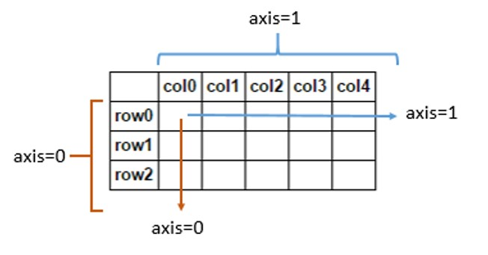
What does axis in pandas mean?
axis=0 means along "indexes". It's a row-wise operation.
axis=1 means along "columns". It's a column-wise operation.

Slide 126
Missing Values
Missing values are marked as NaN
There are a number of methods to deal with missing values in the data frame:
df.method() | description
dropna() | Drop missing observations
dropna(how='all') | Drop observations where all cells is NA
dropna(axis=1, how='all') | Drop column if all the values are missing
dropna(thresh = 5) | Drop rows that contain less than 5 non-missing values
fillna(0) | Replace missing values with zeros
isnull() | returns True if the value is missing
notnull() | Returns True for non-missing values

Slide 127
Missing Values
When summing the data, missing values will be treated as zero
If all values are missing, the sum will be equal to NaN
cumsum() and cumprod() methods ignore missing values but preserve them in the resulting arrays
Missing values in GroupBy method are excluded (just like in R)
Many descriptive statistics methods have skipna option to control if missing data should be excluded . This value is set to True by default (unlike R)
# Select the rows that have at least one missing value
flights[flights.isnull().any(axis=1)].head()

Slide 128
Aggregation Functions in Pandas
Aggregation - computing a summary statistic about each group, i.e.
compute group sums or means
compute group sizes/counts
Common aggregation functions:
min, max
count, sum, prod
mean, median, mode, mad
std, var

Slide 129
Aggregation Functions in Pandas
agg() method are useful when multiple statistics are computed per column:
flights[['dep_delay','arr_delay']].agg(['min','mean','max'])

Slide 130
Basic Descriptive Statistics
df.method() | description
describe | Basic statistics (count, mean, std, min, quantiles, max)
min, max | Minimum and maximum values
mean, median, mode | Arithmetic average, median and mode
var, std | Variance and standard deviation
sem | Standard error of mean
skew | Sample skewness
kurt | kurtosis

Slide 131
Python Pandas : Database Access
Pandas can be very useful in processing data from Databases.
Following pointers needs to followed for accessing DB using Pandas.
Make a connection with DB using DB connectors of respective DB or using ORM tools like SQLAlchemy or Django.
Pass the connection object to pandas :
# Reading Mysql table into a pandas DataFrame
data = pd.read_sql('SELECT * FROM helloworld’, DBConnection_Object)

Slide 132
Assignment
https://www.hackerrank.com/domains/python

Slide 133


Slide 134
https://www.cs.princeton.edu/courses/archive/fall15/cosIW05/Books

Slide 135

# Writing Dataframe to Mysql and replacing table if it already exists
pd.to_sql(name='helloworld', con=DBConnection_Object, if_exists = 'replace’, index=False)

