Slide 1



CSEN2011
COMPUTER ORGANIZATION AND ARCHITECTURE
G SANTHOSHI KUMARI
Assistant Professor
Dept of CSE
sgantla@gitam.edu

Slide 2
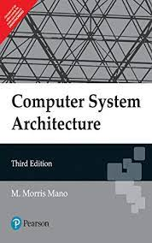
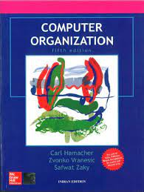
RECOMMENDED BOOKS
Prescribed Books
Reference Books

Slide 3
Why Study COMPUTER ORGANIZATION AND ARCHITECTURE?
Because you use it everyday,
Because you will likely use it for the rest of your life,
Because computer architecture is the most fundamental subject in computer science. Without computers, the field of computer science does not exist.
Whatever we do, be it surfing the web, sending email, writing a document, is on top of computer architecture, or computers. The subject explores how machines are designed, built, and operate.
Knowing what's inside and how it works will help you design, develop, and implement applications better, faster, cheaper, more efficient, and easier to use.

Slide 4
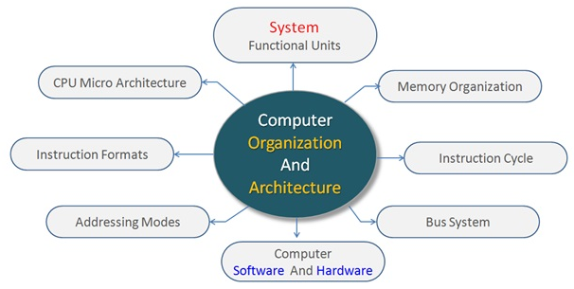

Slide 5
Topics to be covered
Preamble of the course
Overview of the Course
Course Objectives and Course Outcomes
Department of CSE, GST CSEN2011: COMPUTER ORGANIZATION AND ARCHITECTURE

Slide 6
Preamble of the Course
Computer Architecture and Organization provides a comprehensive knowledge on the structure and behaviour of computer hardware architecture and application of the design concepts. The basic concepts of this course can have a view as to how a computer system works.
This course enables the student to learn the basics of hardware components from basic gates to memory and I/O devices and instruction set architectures.
Department of CSE, GST CSEN2011: COMPUTER ORGANIZATION AND ARCHITECTURE

Slide 7
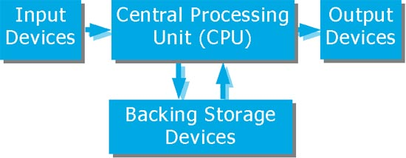
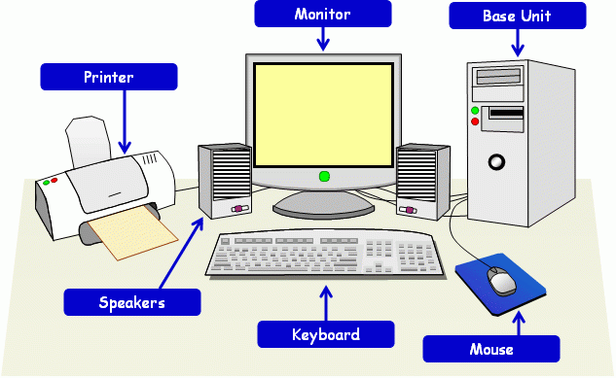
Computer System
The operations of a computer can be summarized as follows:
1. A set of instructions called a program reside in the main memory of computer.
2. The CPU fetches those instructions sequentially one-by-one from the main memory, decodes them and performs the specified operation on associated data operands in ALU.
3. Processed data and results will be displayed on an output unit.
4. All activities pertaining to processing and data movement inside the computer machine are governed by control unit.
Department of CSE, GST CSEN2011: COMPUTER ORGANIZATION AND ARCHITECTURE

Slide 8
Overview of the Course
UNIT I:
Register Transfer and Micro operations: Register transfer language, register transfer, bus and memory transfers, arithmetic micro operations, logic micro operations, shift micro operations, arithmetic logic shift unit
Learning Outcomes:
After completion of this unit, the student will be able to
demonstrate the register transfer language(L2)
learn different types of micro operations(L2)
Department of CSE, GST CSEN2011: COMPUTER ORGANIZATION AND ARCHITECTURE

Slide 9
Overview of the Course
UNIT II:
Basic Computer Organization and Design: Instruction codes, computer registers, computer instructions, timing and control, instruction cycle, memory-references instructions, input-output and interrupt, complete computer description. Design of the basic computer, design of accumulator logic.
Micro programmed Control: Control memory, address sequencing, micro program example, design of control unit.
Learning Outcomes:
After completion of this unit, the student will be able to
learn different types of memory-reference instructions(L2)
construct the micro programmed control unit (L3)
Department of CSE, GST CSEN2011: COMPUTER ORGANIZATION AND ARCHITECTURE

Slide 10
Overview of the Course
UNIT III:
Central Processing Unit: Introduction, general register organization, stack organization, instruction formats, addressing modes, data transfer and manipulation, program control.
Pipeline and Parallel Processing: Parallel processing, pipelining, arithmetic pipeline, instruction pipeline.
Computer Arithmetic: Introduction, addition and subtraction, decimal arithmetic unit, Booth’s multiplication algorithm.
Learning Outcomes:
After completion of this unit, the student will be able to
illustrate different types of addressing modes(L2)
understand the concepts of pipelining and parallel processing(L2)
solve and practice computer arithmetic algorithms(L3)
Department of CSE, GST CSEN2011: COMPUTER ORGANIZATION AND ARCHITECTURE

Slide 11
Overview of the Course
UNIT IV:
Input-Output Organization: Peripheral devices, I/O Interface, Asynchronous Data Transfer, Modes of Transfer, Priority Interrupt, DMA, I/O Processor, Serial Communication.
Learning Outcomes:
After completion of this unit, the student will be able to
understand the peripheral devices(L2)
explain the modes of data transfer(L2)
understand I/O interface(L2)
Department of CSE, GST CSEN2011: COMPUTER ORGANIZATION AND ARCHITECTURE

Slide 12
Overview of the Course
UNIT V:
Memory Organization: Memory Hierarchy, Main Memory, Auxiliary Memory, Associative Memories, Cache Memory, Virtual Memories, Memory Management Hardware.
Learning Outcomes:
After completion of this unit, the student will be able to
understand the memory hierarchy(L2)
analyze the organization of different types of memories(L4)
learn the memory management hardware(L2)
Text Book(s):
1. M. Morris Mano, Computer System Architecture, 3/e, Pearson education, 2008.
References
1.Carl Hamacher, ZvonkoVranesic, SafwatZaky,Computer Organization,5/e, McGraw Hill,2001.
2. John P. Hayes, Computer Architecture and Organization, 3/e, McGraw Hill, 1998.
3. William Stallings, Computer Organization and Architecture, 6/e, Pearson PHI, 2012.
Department of CSE, GST CSEN2011: COMPUTER ORGANIZATION AND ARCHITECTURE

Slide 13
Course Objectives and Course Outcomes
Course Objectives
Attain the knowledge of fundamental circuit components and techniques for designing the circuits
Describe and understand the processor memory hierarchy
Understand the concepts of interrupts and I/O devices
Attain the general knowledge of advances in microprogramming and their implementation in computer design
Experience the design process in the context of a reasonable size hardware system
Course Outcomes:
At the end of the course, the student will be able to
classify the machine's instruction set architecture (ISA) including basic instruction fetch and execute cycles, instruction formats, control flow, and operand addressing modes(L2)
build the design and functioning of a machines central processing unit (CPU) including the data path components (ALU, register file) and the control unit(L3)
understand the basic input/output functioning including program controlled I/O and interrupt I/O(L1)
analyze the organization of different types of memories (L4)
analyze the performance of processors and cache(L4)
Department of CSE, GST CSEN2011: COMPUTER ORGANIZATION AND ARCHITECTURE

Slide 14
What is Computer organization and Computer architecture
Computer Organization: Computer organization is concerned with the way the hardware components operate and the way they are connected together to form the computer system. The various components are assumed to be in place and the task is to investigate the organizational structure to verify that the computer parts to operate as intended.
The Process which involves proper arrangement and organization of the components(based on their use) to achieve the desired functionality comes under COMPUTER ORGANIZATION. i.e “HOW”.
Computer Architecture:
Computer architecture is concerned with the structure and behaviour of the computer as seen by the user. It includes the information formats, the instruction set, and techniques for addressing memory. The architectural design of a computer system is concerned with the specifications of the various functional modules such as processors and memories and structuring them together into a computer system.
Identification of functionality and its components which will lead to design of functionality comes under COMPUTER ARCHITECTURE. i.e “WHAT”.
Department of CSE, GST CSEN2011: COMPUTER ORGANIZATION AND ARCHITECTURE

Slide 15
Topics to be covered
UNIT I:
Register Transfer and Micro operations → Register transfer language, register transfer
Department of CSE, GST CSEN2011: COMPUTER ORGANIZATION AND ARCHITECTURE

Slide 16
MICROOPERATIONS
The operations on the data in registers are called microoperations.
The functions built into registers are examples of microoperations
  Shift
  Load
  Clear
  Increment
  …
Department of CSE, GST CSEN2011: COMPUTER ORGANIZATION AND ARCHITECTURE

Slide 17
MICROOPERATIONS
An elementary operation performed (during one clock pulse), on the information stored in one or more registers
1 clock cycle
Registers
(R)
ALU
(f)
R ← f(R, R)
f: shift, load, clear, increment, add, subtract, complement,
and, or, xor, …
Department of CSE, GST CSEN2011: COMPUTER ORGANIZATION AND ARCHITECTURE

Slide 18
Register Transfer Language
Digital systems are composed of modules that are constructed from digital components, such as registers, decoders, arithmetic elements, and control logic
The modules are interconnected with common data and control paths to form a digital computer system.
Digital modules are best defined by the registers they contain and the operations that are performed on the data stored in them.
The operations executed on data stored in registers are called microoperations.
A microoperation is an elementary operation performed on the information stored in one or more registers.
Examples are shift, count, clear, and load.
Some of the digital components like registers are used to implement microoperations.
The internal hardware organization of a digital computer is best defined by specifying
o The set of registers it contains and their functions.
o The sequence of microoperations performed on the binary information stored.
o The control that initiates the sequence of microoperations.
Department of CSE, GST CSEN2011: COMPUTER ORGANIZATION AND ARCHITECTURE

Slide 19
Register Transfer Language
Use of symbols instead of narrative explanation provides an organized and concise manner for listing the microoperation sequences in registers and the control functions that initiate them.
The symbolic notation used to describe the sequence of microoperations is called a register transfer language.
Register transfer implies the availability of hardware logic circuits that can perform a stated microoperations and transfer the result into the same or another register.
A programming language is a procedure for writing symbols to specify a given computational process.
Define symbols for various types of microoperations and describe associated hardware that can implement the microoperations.
Register transfer language:
A symbolic language
A convenient tool for describing the internal organization of digital computers in concise and precise manner.
Can also be used to facilitate the design process of digital systems.
Department of CSE, GST CSEN2011: COMPUTER ORGANIZATION AND ARCHITECTURE

Slide 20
Registers
Computer registers are designated by upper case letters (and optionally followed by digits or letters) to denote the function of the register.
➢ For example, the register that holds an address for the memory unit is usually called a memory address register and is designated by the name MAR.
➢ Other designations for registers are PC (for program counter), IR (for instruction register, and R1 (for processor register).
The individual flip-flops in an n-bit register are numbered in sequence from 0 through n-1, starting from 0 in the rightmost position and increasing the numbers toward the left.
Department of CSE, GST CSEN2011: COMPUTER ORGANIZATION AND ARCHITECTURE

Slide 21
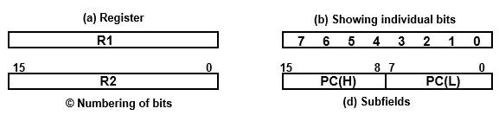
Registers
Figure shows the representation of registers in block diagram form.
The most common way to represent a register is by a rectangular box with the name of the register inside, as in Fig. (a).
The individual bits can be distinguished as in (b).
The numbering of bits in a 16-bit register can be marked on top of the box as shown in (c).
16-bit register is partitioned into two parts in (d). Bits 0 through 7 are assigned the symbol L (for low byte) and bits 8 through 15 are assigned the symbol H (for high byte). The name of the 16-bit register is PC. The symbol PC (0-7) or PC (L) refers to the low-order byte and PC (8-15) or PC (H) to the high-order byte.
Department of CSE, GST CSEN2011: COMPUTER ORGANIZATION AND ARCHITECTURE

Slide 22
Register Transfer
Information transfer from one register to another is designated in symbolic form by means of a replacement operator.
Copying the contents of one register to another is a register transfer.
A register transfer is indicated as R2 ← R1
In this case the contents of register R1 are copied (loaded) into register R2
A simultaneous transfer of all bits from the source R1 to the destination register R2, during one clock pulse
Note that this is a non-destructive; i.e. the contents of R1 are not altered by copying (loading) them to R2
Department of CSE, GST CSEN2011: COMPUTER ORGANIZATION AND ARCHITECTURE

Slide 23
Register Transfer with control condition
If we want the transfer to occur only under a predetermined control condition then it can be shown by an if-then statement -→ if (P=1) then R2 ← R1
where P is the control signal generated by a control section.
We can separate the control variables from the register transfer operation by specifying a Control Function. Control function is a Boolean variable that is equal to 0 or 1.
Control function is included in the statement as P: R2 ← R1
➢ Control condition is terminated by a colon implies transfer operation be
executed by the hardware only if P=1.
➢ Every statement written in a register transfer notation implies a hardware construction for implementing the transfer.
Department of CSE, GST CSEN2011: COMPUTER ORGANIZATION AND ARCHITECTURE

Slide 24
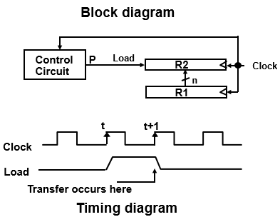
Hardware implementation of controlled transfer
Figure shows the block diagram for the Implementation of controlled transfer P: R2 ← R1
The n outputs of register R1 are connected to the n inputs of register R2. The letter n will be used to indicate any number of bits for the register. It will be replaced by an actual number when the length of the register is known.
Register R2 has a load input that is activated by the control variable P.
It is assumed that the control variable is synchronized with the same clock as the one applied to the register.
As shown in the timing diagram, P is activated in the control section by the rising edge of a clock pulse at time t.
The next positive transition of the clock at time t + 1 finds the load input active and the data inputs of R2 are then loaded into the register in parallel.
P may go back to 0 at time t+1; otherwise, the transfer will occur with every clock pulse transition while P remains active.
Even though the control condition such as P becomes active just after time t, the actual transfer does not occur until the register is triggered by the next positive transition of the clock at time t +1.
Department of CSE, GST CSEN2011: COMPUTER ORGANIZATION AND ARCHITECTURE

Slide 25
SIMULTANEOUS OPERATIONS
If two or more operations are to occur simultaneously, they are separated with commas
P: R3 ← R5, MAR ← IR
Here, if the control function P = 1, load the contents of R5 into R3, and at the same time (clock), load the contents of register IR into register MAR
Department of CSE, GST CSEN2011: COMPUTER ORGANIZATION AND ARCHITECTURE

Slide 26
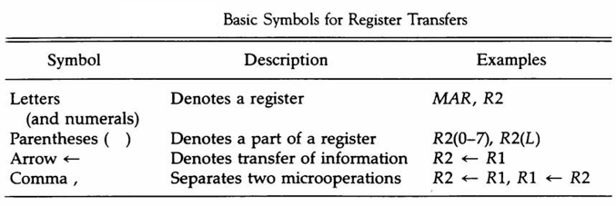
Basic symbols for
register transfer
Department of CSE, GST CSEN2011: COMPUTER ORGANIZATION AND ARCHITECTURE

Slide 27
Topics to be covered
UNIT I:
Bus and Memory transfer
Department of CSE, GST CSEN2011: COMPUTER ORGANIZATION AND ARCHITECTURE

Slide 28
Bus and Memory transfer
In a digital system with many registers, it is impractical to have data and control lines to directly allow each register to be loaded with the contents of every possible other registers
To completely connect n registers → n(n-1) lines
Instead, take a different approach
  Have one centralized set of circuits for data transfer – the bus
  Have control circuits to select which register is the source, and which is the destination
  Bus is a path(of a group of wires) over which information is transferred, from any of several sources to any of several destinations.
Department of CSE, GST CSEN2011: COMPUTER ORGANIZATION AND ARCHITECTURE

Slide 29
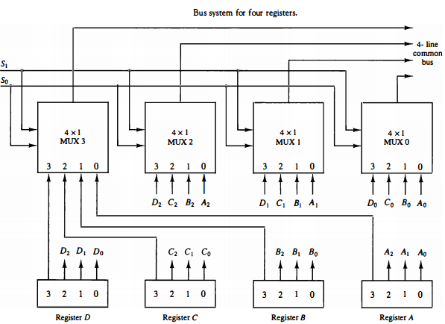
Common bus system using multiplexers
The multiplexers select the source register whose binary information is then placed on the bus.
The construction of a bus system for four registers is shown in figure.
Department of CSE, GST CSEN2011: COMPUTER ORGANIZATION AND ARCHITECTURE

Slide 30
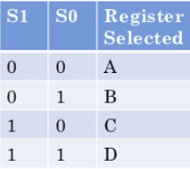
Common bus system using
multiplexers
The bus consists of four 4 x 1 multiplexers each having four data inputs, 0 through 3, and two selection inputs, S1 and S0.
For example, output 1 of register A is connected to input 0 of MUX 1 because this input is labelled A1.
The diagram shows that the bits in the same significant position in each register are connected to the data inputs of one multiplexer to form one line of the bus.
Thus MUX 0 multiplexes the four 0 bits of the registers, MUX 1 multiplexes the four 1 bits of the registers, and similarly for the other two bits.
The two selection lines S1 and So are connected to the selection inputs of all four multiplexers. The selection lines choose the four bits of one register and transfer them into the four-line common bus.
When S1S0 = 00, the 0 data inputs of all four multiplexers are selected and applied to the outputs that form the bus. This causes the bus lines to receive the content of register A since the outputs of this register are connected to the 0 data inputs of the multiplexers.
Similarly, register B is selected if S1S0 = 01, and so on.
Table shows the register that is selected by the bus for each of the four possible binary value of the selection lines.
Department of CSE, GST CSEN2011: COMPUTER ORGANIZATION AND ARCHITECTURE

Slide 31
Common bus system using
multiplexers
To construct n-bit common bus system by multiplexing k- registers of n- bits each
  no. of multiplexers required = n
  size of each multiplexer = k x 1
  No of selection lines log K (base 2)
  Ex: common bus system for 8- registers of 16-bit each → 16 multiplexers with 4 selection lines are required to construct 16-bit common bus system.
When the bus is includes in the statement, the register transfer is symbolized as follows:
BUS← C, R1← BUS
The content of register C is placed on the bus, and the content of the bus is loaded into register R1 by activating its load control input.
If the bus is known to exist in the system, it may be convenient just to show the direct transfer.
R1← C
Department of CSE, GST CSEN2011: COMPUTER ORGANIZATION AND ARCHITECTURE

Slide 32
Three-State Bus Buffers
A bus system can be constructed with three-state gates instead of multiplexers.
A three-state gate is a digital circuit that exhibits three states.
Two of the states are signals equivalent to logic 1 and 0 as in a conventional gate.
The third state is a high-impedance state. The high-impedance state behaves like an open circuit, which means that the output is disconnected and does not have logic significance.
Because of this feature, a large number of three-state gate outputs can be connected with wires to form a common bus line without endangering loading effects.
Department of CSE, GST CSEN2011: COMPUTER ORGANIZATION AND ARCHITECTURE

Slide 33

Three-State Bus Buffers
The graphic symbol of a three-state buffer gate is shown below.
It is distinguished from a normal buffer by having both a normal input and a control input.
The control input determines the output state. When the control input is equal to 1, the output is enabled and the gate behaves like any conventional buffer, with the output equal to the normal input.
When the control input is 0, the output is disabled and the gate goes to a high-impedance state, regardless of the value in the normal input.
Department of CSE, GST CSEN2011: COMPUTER ORGANIZATION AND ARCHITECTURE

Slide 34
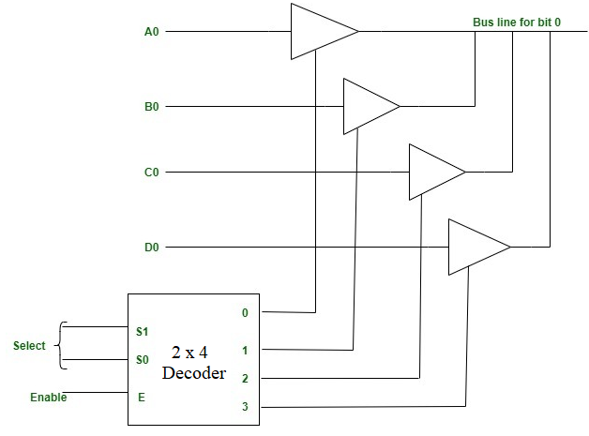
Three-State Bus Buffers
The construction of a bus system with three-state buffers is shown in Fig.
The outputs of four buffers are connected together to form a single bus line.
The control inputs to the buffer determine which of the four normal inputs will communicate with the bus line.
Not more than one buffer may be in the active state at any given time.
The connected buffers must be controlled so that only one three-state buffer has access to the bus line while all other buffers are maintained in a high-impedance state.
Department of CSE, GST CSEN2011: COMPUTER ORGANIZATION AND ARCHITECTURE

Slide 35
Three-State Bus Buffers
One way to ensure that not more than one control input is active at any given time is to use a decoder.
When the enable input of the decoder is 0, all of its four outputs are o and the bus line is in a high impedance state because all four buffers are disabled.
When the enable input is active, one of the three-state buffers will be active, depending on the binary value in the select inputs of the decoder.
To construct a common bus for four registers of n bits each using three-state buffers, we need n circuits with four buffers in each.
Each group of four buffers receives one significant bit from the four registers.
Each common output produces one of the lines for the common bus for a total of n-lines.
Only one decoder is necessary to select between the four registers.
Department of CSE, GST CSEN2011: COMPUTER ORGANIZATION AND ARCHITECTURE

Slide 36
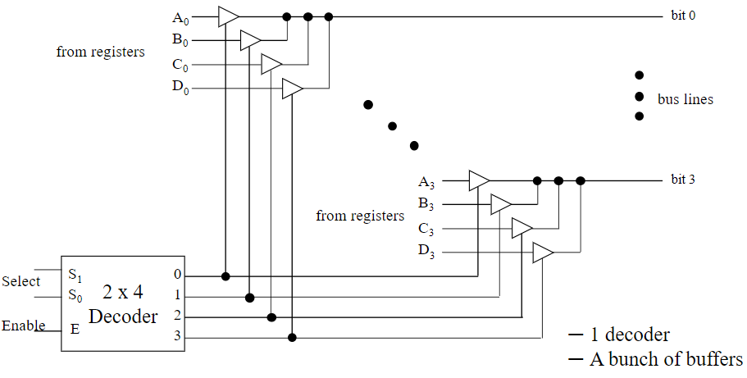
Three-State Bus Buffers
Department of CSE, GST CSEN2011: COMPUTER ORGANIZATION AND ARCHITECTURE

Slide 37
Memory transfer
The transfer of information from a memory word to the outside environment is called a read operation.
The transfer of new information to be stored into the memory is called a write operation.
A memory word will be symbolized by the letter M.
The particular memory word among the many available is selected by the memory address during the transfer.
It is necessary to specify the address of M when writing memory transfer operations. This will be done by enclosing the address in square brackets following the letter M.
Consider a memory unit that receives the address from a register, called the address register, symbolized by AR.
The data are transferred to another register, called the data register, symbolized by DR.
Department of CSE, GST CSEN2011: COMPUTER ORGANIZATION AND ARCHITECTURE

Slide 38
Memory transfer
The read operation can be stated as follows:
Read: DR ← M [AR]
This causes a transfer of information into DR from the memory word M selected by the address in AR.
The write operation transfers the content of a data register to a memory word M selected by the address. Assume that the input data are in register R1 and the address is in AR.
The write operation can be stated as follows:
        Write: M [AR] ← R1
This causes a transfer of information from R1 into the memory word selected by the address in AR.
Department of CSE, GST CSEN2011: COMPUTER ORGANIZATION AND ARCHITECTURE

Slide 39
Topics to be covered
UNIT I:
Arithmetic micro-operations
Department of CSE, GST CSEN2011: COMPUTER ORGANIZATION AND ARCHITECTURE

Slide 40
Types of Micro-operations
Register Transfer Micro-operations: Transfer binary information from one register to another.
Arithmetic Micro-operations: Perform arithmetic operation on numeric data stored in registers.
Logical Micro-operations: Perform bit manipulation operations on data stored in registers.
Shift Micro-operations: Perform shift operations on data stored in registers.
Register Transfer Micro-operation doesn’t change the information content when the binary information moves from source register to destination register.
Other three types of micro-operations change the information change the information content during the transfer.
Department of CSE, GST CSEN2011: COMPUTER ORGANIZATION AND ARCHITECTURE

Slide 41
Arithmetic Micro-operations
The basic arithmetic micro-operations are
  Addition
  Subtraction
  Increment
  Decrement
  Shift
The arithmetic Micro-operation defined by the statement below specifies the add microoperation.
R3 ← R1 + R2
It states that the contents of R1 are added to contents of R2 and sum is transferred to R3.
To implement this statement hardware requires 3 registers and digital component that performs addition
Subtraction is most often implemented through complementation and addition.
The subtract operation is specified by the following statement R3 ← R1 + R2’ + 1
  Instead of minus operator, we can write as R2 is the symbol for the 1’s complement of R2
  Adding 1 to 1’s complement produces 2’s complement
  Adding the contents of R1 to the 2's complement of R2 is equivalent to R1-R2.
Department of CSE, GST CSEN2011: COMPUTER ORGANIZATION AND ARCHITECTURE

Slide 42
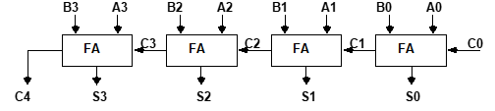
Binary Adder
Digital circuit that forms the arithmetic sum of 2 bits and the previous carry is called FULL ADDER.
Digital circuit that generates the arithmetic sum of 2 binary numbers of any lengths is called BINARY ADDER.
Figure shows the interconnections of four full-adders (FA) to provide a 4-bit binary adder
Department of CSE, GST CSEN2011: COMPUTER ORGANIZATION AND ARCHITECTURE

Slide 43
Binary Adder
Department of CSE, GST CSEN2011: COMPUTER ORGANIZATION AND ARCHITECTURE

Slide 44
Binary Adder
The augends bits of A and the addend bits of B are designated by subscript numbers from right to left, with subscript 0 denoting the low-order bit.
The carries are connected in a chain through the full-adders. The input carry to the binary adder is Co and the output carry is C4. The S outputs of the full-adders generate the required sum bits.
An n-bit binary adder requires n full-adders.
Department of CSE, GST CSEN2011: COMPUTER ORGANIZATION AND ARCHITECTURE

Slide 45
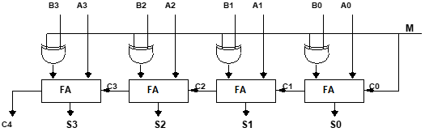
Binary Adder-Subtractor
The addition and subtraction operations can be combined into one common circuit by including an exclusive-OR gate with each full-adder.
The mode input M controls the operation. When M = 0 the circuit is an adder and when M = 1 the circuit becomes a subtractor.
Department of CSE, GST CSEN2011: COMPUTER ORGANIZATION AND ARCHITECTURE

Slide 46
Binary Adder-Subtractor
Each exclusive-OR gate receives input M and one of the inputs of B
When M = 0, we have B xor 0 = B. The full-adders receive the value of B, the input carry is 0, and the circuit performs A plus B.
When M = 1, we have B xor 1 = B' and Co = 1. The B inputs are all complemented and a 1 is added through the input carry. ➢ The circuit performs the operation A plus the 2's complement of B
Department of CSE, GST CSEN2011: COMPUTER ORGANIZATION AND ARCHITECTURE

Slide 47
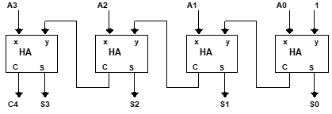
Binary Incrementer
The increment microoperation adds one to a number in a register.
For example, if a 4-bit register has a binary value 0110, it will go to 0111 after it is incremented.
This can be accomplished by means of half-adders connected in cascade.
Department of CSE, GST CSEN2011: COMPUTER ORGANIZATION AND ARCHITECTURE

Slide 48
Binary Incrementer
One of the inputs to the least significant half-adder (HA) is connected to logic-1 and the other input is connected to the least significant bit of the number to be incremented.
The output carry from one half-adder is connected to one of the inputs of the next-higher-order half-adder.
The circuit receives the four bits from A0 through A3, adds one to it, and generates the incremented output in S0 through S3.
The output carry C4 will be 1 only after incrementing binary 1111. This also causes outputs S0 through S3 to go to 0.
The circuit of above Fig. can be extended to an n -bit binary incrementer by extending the diagram to include n half-adders.
The least significant bit must have one input connected to logic-1. The other inputs receive the number to be incremented or the carry from the previous stage.
Department of CSE, GST CSEN2011: COMPUTER ORGANIZATION AND ARCHITECTURE

Slide 49
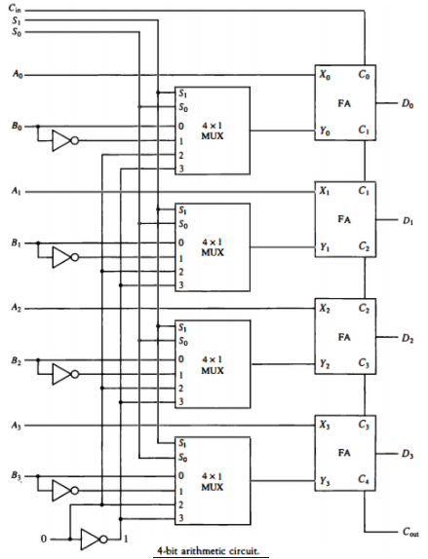
Arithmetic Circuit
The basic component of an arithmetic circuit is the parallel adder.
By controlling the data inputs to the adder, it is possible to obtain different types of arithmetic
operations.
The diagram of a 4-bit arithmetic circuit is shown in Fig. It has four full-adder circuits that
constitute the 4-bit adder and four multiplexers for choosing different operations.
Department of CSE, GST CSEN2011: COMPUTER ORGANIZATION AND ARCHITECTURE

Slide 50
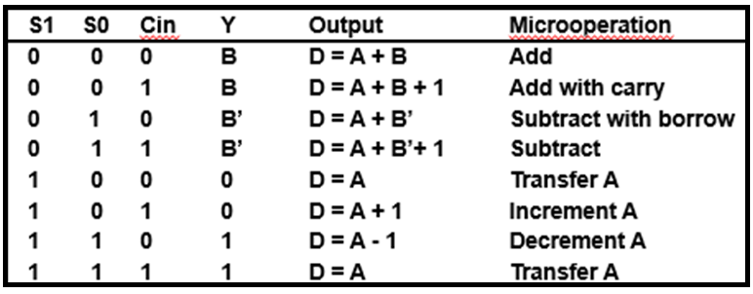
Arithmetic Circuit
There are two 4-bit inputs A and B and a 4-bit output D.
The four inputs from A go directly to the X inputs of the binary adder.
Each of the four inputs from B are connected to the data inputs of the multiplexers.
The multiplexers data inputs also receive the complement of B. The other two data inputs are connected to logic-0 and logic-1.
The four multiplexers are controlled by two selection inputs S1 and S0. The input carry Cin, goes to the carry input of the FA in the least significant position. The other carries are connected from one stage to the next.
By controlling the value of Y with the two selection inputs S1 and S0 and making Cin equal to 0 or 1, it is possible to generate the eight arithmetic microoperations listed in Table.
Department of CSE, GST CSEN2011: COMPUTER ORGANIZATION AND ARCHITECTURE

Slide 51
Arithmetic Circuit
Department of CSE, GST CSEN2011: COMPUTER ORGANIZATION AND ARCHITECTURE

Slide 52
Arithmetic Circuit
Addition:
  When S1S0= 00, the value of B is applied to the Y inputs of the adder.
  If Cir, = 0, the output D =A+B.
  If Cin = 1, output D=A+B + 1.
  Both cases perform the add microoperation with or without adding the input carry.
Subtraction:
When S1S0 = 01, the complement of B is applied to the Y inputs of the adder.
If Cin = 1, then D = A + B + 1. This produces A plus the 2's complement of B, which is equivalent to a subtraction of A -B.
When Cin = 0 then D = A + B. This is equivalent to a subtract with borrow, that is, A-B-1.
Department of CSE, GST CSEN2011: COMPUTER ORGANIZATION AND ARCHITECTURE

Slide 53
Arithmetic Circuit
Increment:
When S1S0 = 10, the inputs from B are neglected, and instead, all 0's are inserted into the Y inputs.
The output becomes D = A + 0 + Cin. This gives D = A when Cin = 0 and D = A + 1 when Cin = 1.
In the first case we have a direct transfer from input A to output D.
In the second case, the value of A is incremented by 1.
Decrement:
When S1S0= 11, all l's are inserted into the Y inputs of the adder to produce the decrement operation D = A -1 when Cin = 0. This is because a number with all 1's is equal to the 2's complement of 1 (the 2's complement of binary 0001 is 1111). Adding a number A to the 2's complement of 1 produces F = A + 2's complement of 1 = A — 1. When Cin = 1, then D = A -1 + 1=A, which causes a direct transfer from input A to output D.
Department of CSE, GST CSEN2011: COMPUTER ORGANIZATION AND ARCHITECTURE

Slide 54
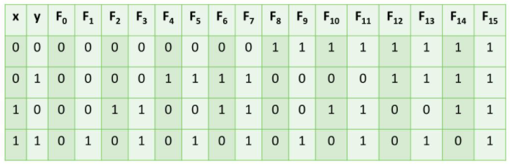
Logic Microoperations
Specify binary operations on the strings of bits in registers
Logic microoperations are bit-wise operations, i.e., they work on the individual bits of data
useful for bit manipulations on binary data, useful for making logical decisions based on the bit value
There are, in principle, 16 different logic functions that can be defined over two binary input variables.
Department of CSE, GST CSEN2011: COMPUTER ORGANIZATION AND ARCHITECTURE

Slide 55
Logic Microoperations
The 16 Boolean functions of two variables x and y are expressed in algebraic form in the first column of Table.
The 16 logic microoperations are derived from these functions by replacing variable x by the binary content of register A and variable y by the binary content of register B.
The logic micro-operations listed in the second column represent a relationship between the binary content of two registers A and B.
Department of CSE, GST CSEN2011: COMPUTER ORGANIZATION AND ARCHITECTURE

Slide 56
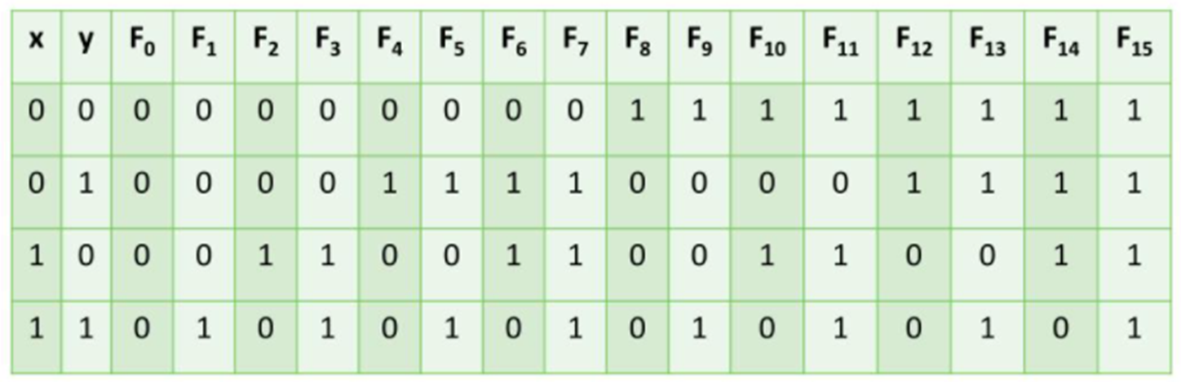
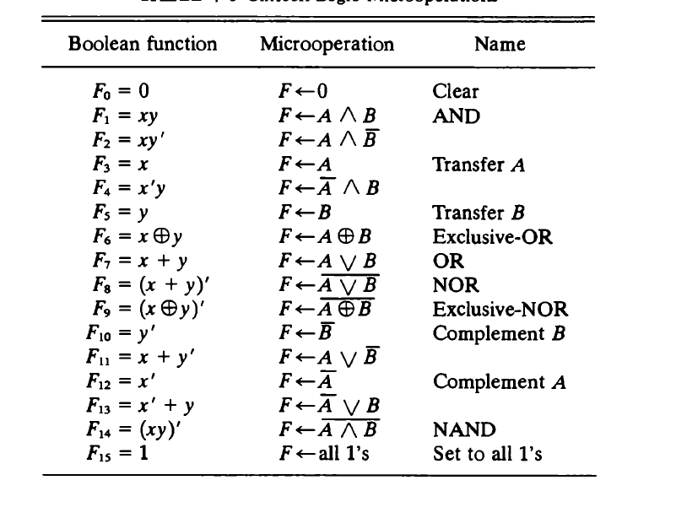

Slide 57
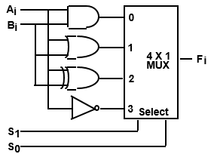
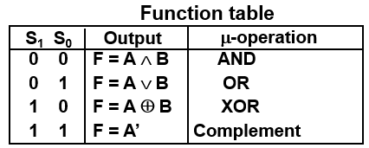
HARDWARE IMPLEMENTATION OF LOGIC MICROOPERATIONS
Department of CSE, GST CSEN2011: COMPUTER ORGANIZATION AND ARCHITECTURE

Slide 58
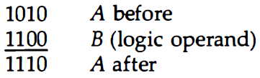
Applications of Logic Microoperations
Logic micro-operations are very useful for manipulating individual bits or a portion of a word stored in a register.
They can be used to change bit values, delete a group of bits or insert new bits values into a register.
The following example shows how the bits of one register (designated by A) are manipulated by logic micro operations as a function of the bits of another register (designated by B).
Selective set:
The selective-set operation sets to 1 the bits in register A where there are corresponding 1's in register B. It does not affect bit positions that have 0's in B.
The OR micro operation can be used to selectively set bits of a register.
Department of CSE, GST CSEN2011: COMPUTER ORGANIZATION AND ARCHITECTURE

Slide 59
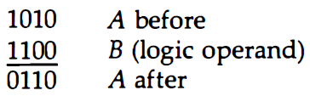
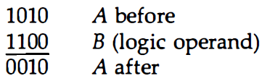

Applications of Logic Microoperations
Selective complement:
The selective-complement operation complements bits in A where there are corresponding 1's in B. It does not affect bit positions that have 0's in B. For example:
The exclusive-OR microoperation can be used to selectively complement bits of a register.
Selective clear:
The selective-clear operation clears to 0 the bits in A only where there are corresponding 1's in B.
Department of CSE, GST CSEN2011: COMPUTER ORGANIZATION AND ARCHITECTURE

Slide 60
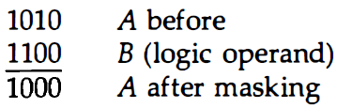
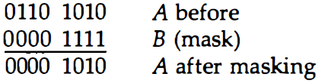
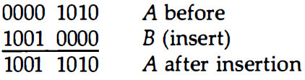
Applications of Logic Microoperations
Mask:
The mask operation is similar to the selective-clear operation except that the bits of A are cleared only where there are corresponding O's in B.
The mask operation is an AND micro operation as seen from the following numerical example:
Insert: The insert operation inserts a new value into a group of bits. This is done by first masking the bits and then ORing them with the required value. The mask operation is an AND microoperation and the insert operation is an OR microoperation.
Department of CSE, GST CSEN2011: COMPUTER ORGANIZATION AND ARCHITECTURE

Slide 61
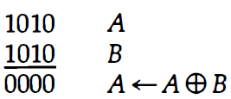
Applications of Logic Microoperations
Clear:
The clear operation compares the words in A and B and produces an all 0's result if the two numbers are equal. This operation is achieved by an exclusive-OR microoperation as shown by the following example.
Department of CSE, GST CSEN2011: COMPUTER ORGANIZATION AND ARCHITECTURE

Slide 62
Shift Microoperations
Shift microoperations are used for serial transfer of data.
The contents of a register can be shifted to the left or the right.
During a shift-left operation the serial input transfers a bit into the rightmost position.
During a shift-right operation the serial input transfers a bit into the leftmost position.
There are three types of shifts: logical, circular, and arithmetic.
Department of CSE, GST CSEN2011: COMPUTER ORGANIZATION AND ARCHITECTURE

Slide 63

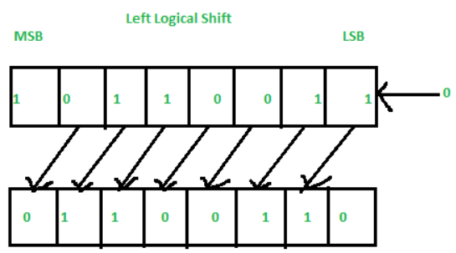
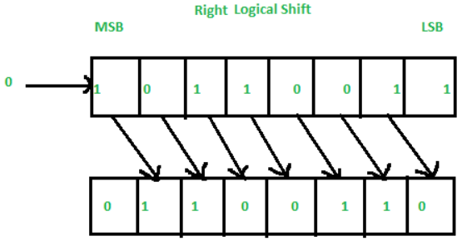
Shift Microoperations
Logical Shift:
A logical shift is one that transfers 0 through the serial input.
The symbols shl and shr for logical shift-left and shift-right microoperations.
The microoperations that specify a 1-bit shift to the left of the content of register R and a 1-bit shift to the right of the content of register R.
The bit transferred to the end position through the serial input is assumed to be 0 during a logical shift.
Department of CSE, GST CSEN2011: COMPUTER ORGANIZATION AND ARCHITECTURE

Slide 64

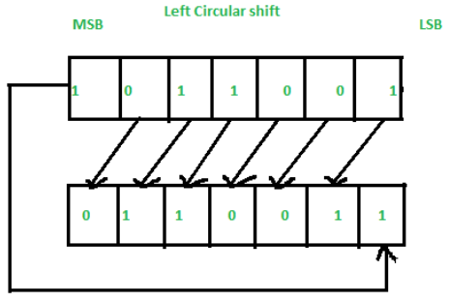
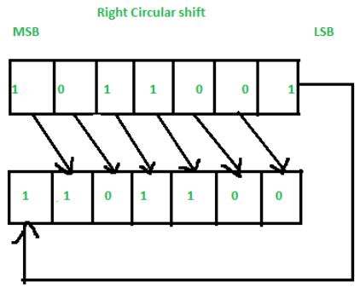
Shift Microoperations
Circular Shift:
The circular shift (also known as a rotate operation) circulates the bits of the register around the two ends without loss of information.
This is accomplished by connecting the serial output of the shift register to its serial input.
We will use the symbols cil and cir for the circular shift left and right, respectively.
Department of CSE, GST CSEN2011: COMPUTER ORGANIZATION AND ARCHITECTURE

Slide 65
Shift Microoperations
Arithmetic Shift:
An arithmetic shift is a microoperation that shifts a signed binary number to the left or right.
An arithmetic shift-left multiplies a signed binary number by 2.
An arithmetic shift-right divides the number by 2.
Arithmetic shifts must leave the sign bit unchanged because the sign of the number remains the same when it is multiplied or divided by 2.
Department of CSE, GST CSEN2011: COMPUTER ORGANIZATION AND ARCHITECTURE

Slide 66
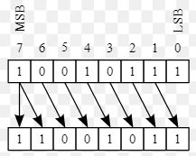
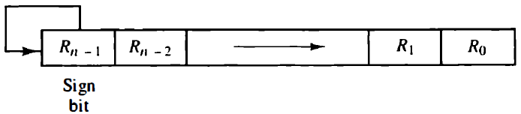
Shift Microoperations
Arithmetic Shift Right:
The leftmost bit in a register holds the sign bit, and the remaining bits hold the number. The sign bit is 0 for positive and 1 for negative. Negative numbers are in 2's complement form.
Below figure shows a typical register of n bits. Bit Rn-1 in the leftmost position holds the sign bit. Rn-2 is the most significant bit of the number and Ro is the least significant bit.
The arithmetic shift-right leaves the sign bit unchanged and shifts the number (including the sign bit) to the right. Thus Rn-1 remains the same, Rn-2 receives the bit from Rn-1 and so on for the other bits in the register. The bit in Ro is lost.
Department of CSE, GST CSEN2011: COMPUTER ORGANIZATION AND ARCHITECTURE

Slide 67

Shift Microoperations
Arithmetic Shift Left:
The arithmetic shift-left inserts a 0 into R0 and shifts all other bits to the left. The initial bit of Rn-1 is lost and replaced by the bit from Rn-2.
A sign reversal occurs if the bit in Rn-1 changes in value after the shift. This happens if the multiplication by 2 causes an overflow. An overflow occurs after an arithmetic shift left if initially, before the shift, Rn-1 is not equal to Rn-2. An overflow flip-flop Vs can be used to detect an arithmetic shift-left overflow.
If Vs = 0, there is no overflow, but if Vs = I, there is an overflow and a sign reversal after the shift. Vs must be transferred into the overflow flip-flop with the same clock pulse that shifts the register.
Department of CSE, GST CSEN2011: COMPUTER ORGANIZATION AND ARCHITECTURE

Slide 68
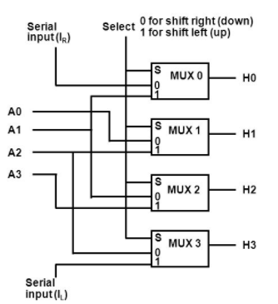
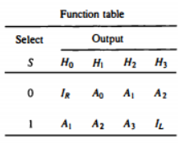
Hardware implementation of Shift Microoperations
A combinational circuit shifter can be constructed with multiplexers as shown in Fig.
The 4-bit shifter has four data inputs, A0 through A3, and four data outputs, H0 through H3.
There are two serial inputs, one for shift left (IL) and the other for shift right (IR).
When the selection input S=0 the input data are shifted right (down in the diagram).
When S = 1, the input data are shifted left (up in the diagram).
The function table in Fig. shows which input goes to each output after the shift.
A shifter with n data inputs and outputs requires n multiplexers.
The two serial inputs can be controlled by another multiplexer to provide the three possible types of shifts.
Department of CSE, GST CSEN2011: COMPUTER ORGANIZATION AND ARCHITECTURE

Slide 69
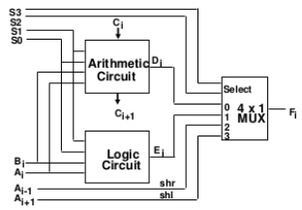
Arithmetic Logic Shift unit
Instead of having individual registers performing the microoperations directly, computer systems employ a number of storage registers connected to a common operational unit called an arithmetic logic unit, abbreviated ALU.
The ALU is a combinational circuit so that the entire register transfer operation from the source registers through the ALU and into the destination register can be performed during one clock pulse period.
The shift microoperations are often performed in a separate unit, but sometimes the shift unit is made part of the overall ALU.
The arithmetic, logic, and shift circuits introduced in previous sections can be combined into one ALU with common selection variables. One stage of an arithmetic logic shift unit is shown in Fig.
Department of CSE, GST CSEN2011: COMPUTER ORGANIZATION AND ARCHITECTURE

Slide 70
Arithmetic Logic Shift unit
Particular microoperation is selected with inputs S1 and S0. A 4 x 1 multiplexer at the output chooses between an arithmetic output in Di and a logic output in Ei.
The data in the multiplexer are selected with inputs S3 and S2. The other two data inputs to the multiplexer receive inputs Ai-1 for the shift-right operation and Ai+1 for the shift-left operation.
The circuit whose one stage is specified in Fig. provides eight arithmetic operation, four logic operations, and two shift operations.
Each operation is selected with the five variables S3, S2, S1, S0 and Cin.
The input carry Cin is used for selecting an arithmetic operation only.
Department of CSE, GST CSEN2011: COMPUTER ORGANIZATION AND ARCHITECTURE

Slide 71
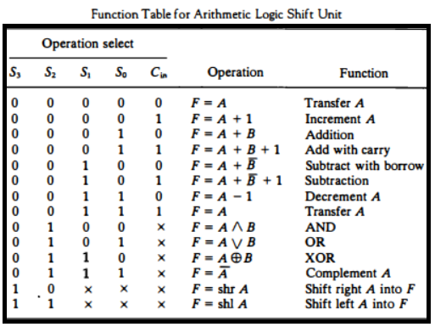
Arithmetic Logic Shift unit
Table lists the 14 operations of the ALU. The first eight are arithmetic operations and are selected with S3S2 = 00.
The next four are logic and are selected with S3S2 = 01. The input carry has no effect during the logic operations and is marked with don't-care x’s.
The last two operations are shift operations and are selected with S3S2= 10 and 11. The other three selection inputs have no effect on the shift.
Department of CSE, GST CSEN2011: COMPUTER ORGANIZATION AND ARCHITECTURE

Slide 72
THANK YOU

