Slide 1
MolFP-GCN
Learned molecular fingerprints with graph convolutional networks
Gurram Naga Kumaraswamy (S20230010101)
Simon Peter (S20230010171) · Rakesh (S20230010196)

Slide 2
The question
Solubility
Toxicity
Explanation
ESOL dataset
1,128 molecules
Regression on logS
Tox21 dataset
7,823 molecules, 12 assays
17% of labels missing, 7.5% toxic
Which atoms drove the prediction?
Saliency colours them in the demo app
MolFP-GCN
Notes:
Predict solubility and toxicity from structure, and show why.

Slide 3
Two ways to describe a molecule
Baseline: ECFP + RF
Ours: GCN
A fixed rule ticks 2048 bits
Same fingerprint whatever the task
Random forest on top
Atoms = nodes, bonds = edges
3 rounds of neighbour averaging
Pooled to a 256-number fingerprint, learned for the task
MolFP-GCN
Notes:
Fixed ECFP vs learned GCN fingerprint.

Slide 4
Honest evaluation
Scaffold split
3 seeds
Why it matters
Whole families stay together
Test = unseen structures
80 / 10 / 10 train / val / test
Mean ± std reported
Early stopping on validation
Test set used once
Random split: RMSE 0.80
Scaffold split: RMSE 1.06
The gap is leakage, not skill
MolFP-GCN
Notes:
Scaffold split, 3 seeds.

Slide 5
Results
Model | ESOL RMSE ↓ | ESOL R² ↑ | Tox21 ROC-AUC ↑
GCN (learned fingerprint) | 1.063 ± 0.163 | 0.709 ± 0.048 | 0.811 ± 0.009
ECFP4 + random forest | 1.694 ± 0.498 | 0.267 ± 0.248 | 0.756 ± 0.015
GCN ahead on 11 of 12 Tox21 assays (RF ahead only on SR-ARE).
Mean ± std over seeds 0, 1, 2 on a scaffold split.
MolFP-GCN
Notes:
GCN wins both; ESOL margin depends on test scaffolds.

Slide 6
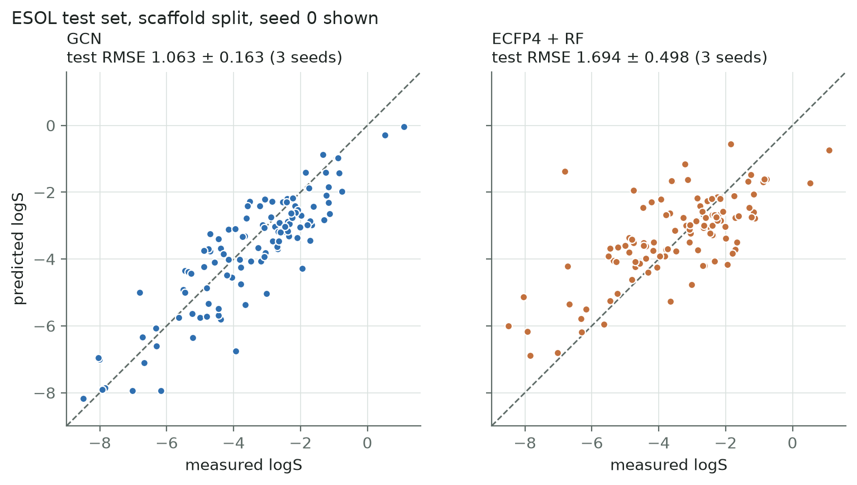
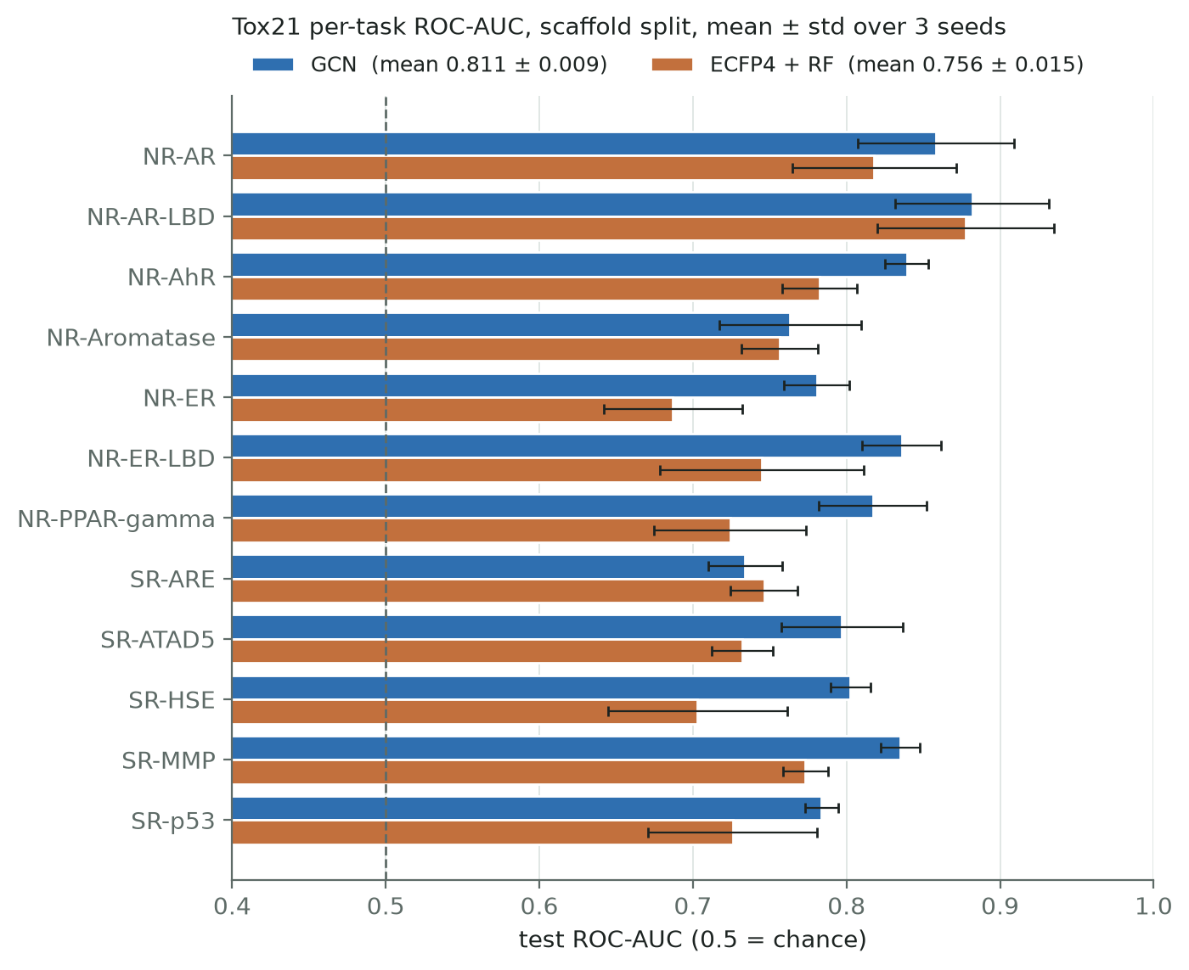
What the model learned
MolFP-GCN
Notes:
Parity plot and per-assay AUC.

Slide 7
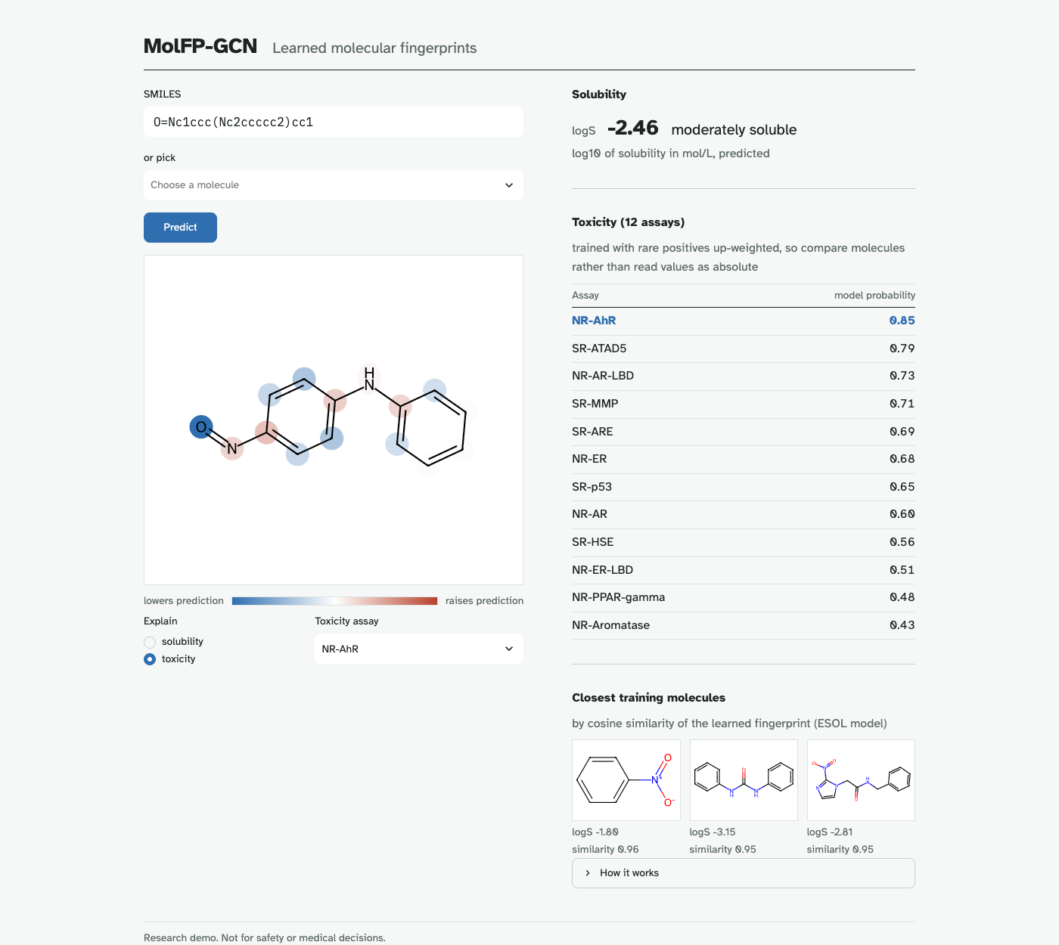
Explainability and demo
• Draw or paste a SMILES
• Predicts solubility and 12 toxicity scores
• Colours atoms that pushed a prediction up or down
• Run with: make demo
• Or open ?smiles=CCO
MolFP-GCN
Notes:
make demo opens the Streamlit app.

Slide 8
Limitations and next steps
Limitations
Next steps
Reproducible
GCNConv ignores bond types
ESOL is small: big seed-to-seed spread
Scaffold split here may be easier than DeepChem's
Edge-aware layers: GINE, D-MPNN
More seeds / cross-validation
Calibrate Tox21 probabilities
make all: 11 min on an M2 CPU
Results identical byte for byte
Tests + 12 invariants
MolFP-GCN
Notes:
Be upfront about caveats.

Slide 9
Who did what
Kumaraswamy
Simon Peter
Rakesh
GCN architecture
Featurisation: SMILES → graph
Saliency explanations
Data pipeline and checks
Scaffold split
Training, evaluation, reproducibility
ECFP + RF baseline
Ablations and figures
Demo app, limitations
MolFP-GCN
Notes:
Each member presents their own part.

Slide 10
Thank you
Questions?

