Slide 1
Fingerprint Recognition System
BY: GROUP 4
MOHD.MAAZ KHAN-072
M.ASHWIN-078
KUMAR VAIBHAV-079
M.SHRINIDHI-082
JASKIRAT SINGH-091

Slide 2
Before We Start The Process
We Import all necessary modules(mentioned in next slide), for the fingerprint recognizer and also import the images from the dataset available.
80 images (of 10 classes) are present in the dataset that are split into 3:1 ratio(60 for training, 20 for testing) using scikit.learn module.
Images are split in 3:1 ratio in order to optimize the classifier to perform well on the target distribution
It helps in to easily detecting if the classifier error on the dev set relative to the error on the training set is a variance error, a data mismatch error, or a combination of both.

Slide 3
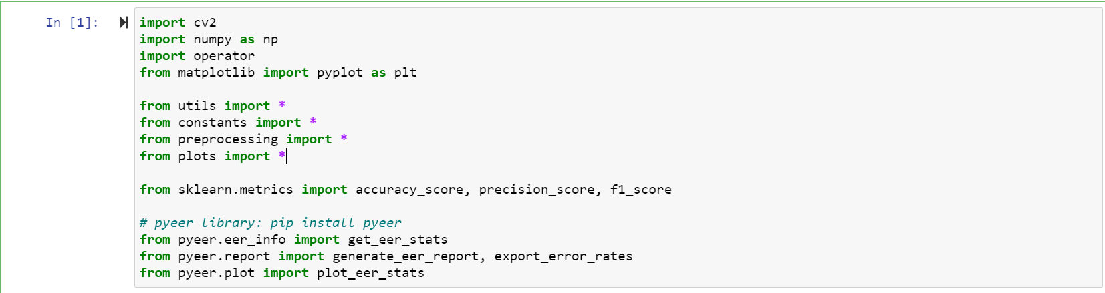
Before We Start The Process:Modules Used
Modules used in the machine learning model include

Slide 4
Preprocessing
We read the files and we prepare the dataset. Each image is converted to grayscale version and then enhancement is applied by using the following library for fingerprints enhancement in Python: Fingerprint-Enhancement-Python.
The images are pre processed through a series of steps mentioned below:
Gabor Filter: a linear filter in image processing used for texture analysis to enhance the fingerprint image

Slide 5
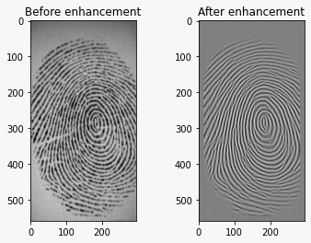
Preprocessing
Ridge Segmentation: It is used to normalise the image and find region of interest.
Ridge Orientation: It is used to find the orientation of every pixel by computation of gradient of each pixel and then computing the overall orientation for a block
Ridge Frequency: It is used to find overall frequency of ridges

Slide 6
Feature Extraction
A concept or library called ORB Descriptor is used, to extract all the features of the image/fingerprint that are required to match with the existing dataset.
ORB is basically a fusion of FAST keypoint detector and BRIEF descriptor with many modifications to enhance the performance.
Features from accelerated segment test (FAST) is a corner detection method, which could be used to extract feature points and later used to track and map objects in many computer vision tasks.
BRIEF is a faster method feature descriptor calculation and matching. It also provides high recognition rate unless there is large in-plane rotation.

Slide 7
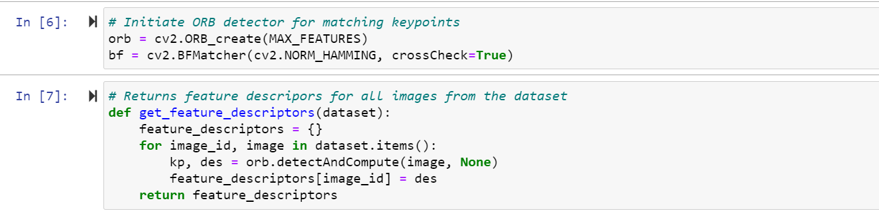
Feature Extraction
BFMatcher also known as Brute-Force matcher type is used to match features whose distance is below a given threshold, and gives us a set of images that closely represent the image in consideration.

Slide 8
Identification
Identification scenario corresponds to 1:M classification problem.
It is usually applied in a situation where an organization needs to identify a person. The organization captures a biometric from that individual and then searches in a database in order to correctly identify the person.
It is used to get the best fitting or closest matching images to the test image.

Slide 9
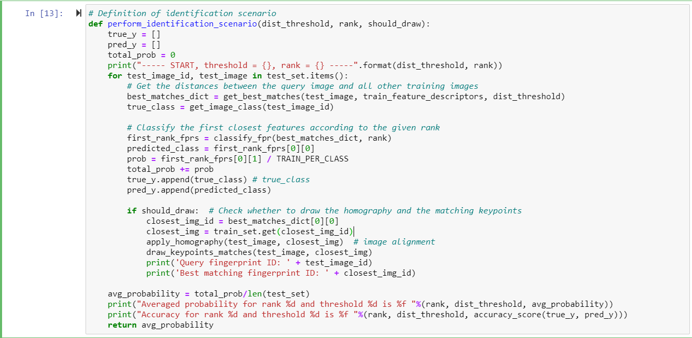
Identification

Slide 10
Identification
Rank used to rank amongst best images. Also used to restrict the closest images being in contention for having the test image classified.
Taking into account the size of the training set for each person, we take 3 as rank, which means that the first 3 closest fingerprints are considered when classifing the query image.

Slide 11
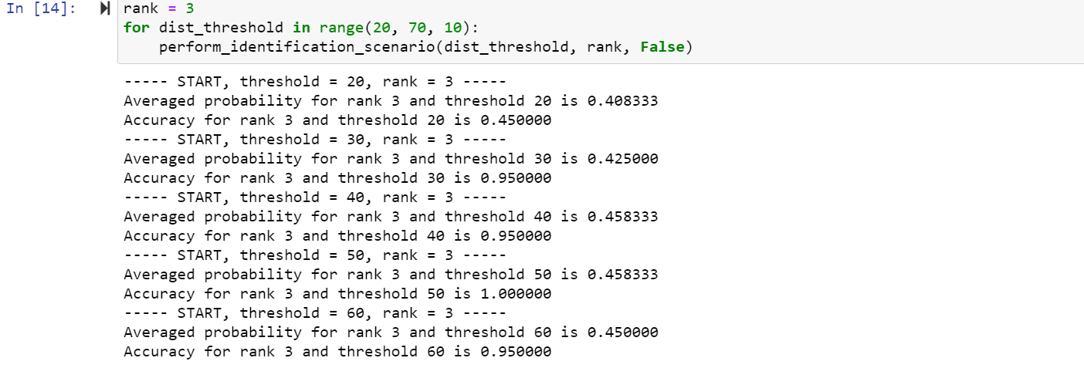
Identification
By analyzing the obtained results, we take distance threshold 50 for analyzing different rankings. Highest accuracy is obtained with ranks 1, 2 and 3, which means that usually the correct class for the query fingerprint is the same as the class of the first 3 closest fingerprint(s).

Slide 12
Authentication
Authentication scenario corresponds to 1:1 classification problem.
A system will challenge someone to prove their identity and the person has to respond in order to allow them access to a system or service.
For example, a person touches their finger on a sensor embedded in a smartphone, used by the authentication solution as part of a challenge/response system. "Is it my finger? Yes, then my smartphone is unlocked, or No it isn’t my finger and the smartphone remains locked."

Slide 13
Authentication
For the authentication scenario, the data structure for training is slightly different, whereas the test set remains the same.
For the training set, the already computed features are divided in separate dictionaries (that act as databases) where the key denotes the class (person), and then every image features for the corresponding class are set in the dictionary as a value.
We find the ratio between the no. of images that are literally similar and the total images available in that class.
Using the ratio derived, we make the prediction over genuine or imposter.

Slide 14
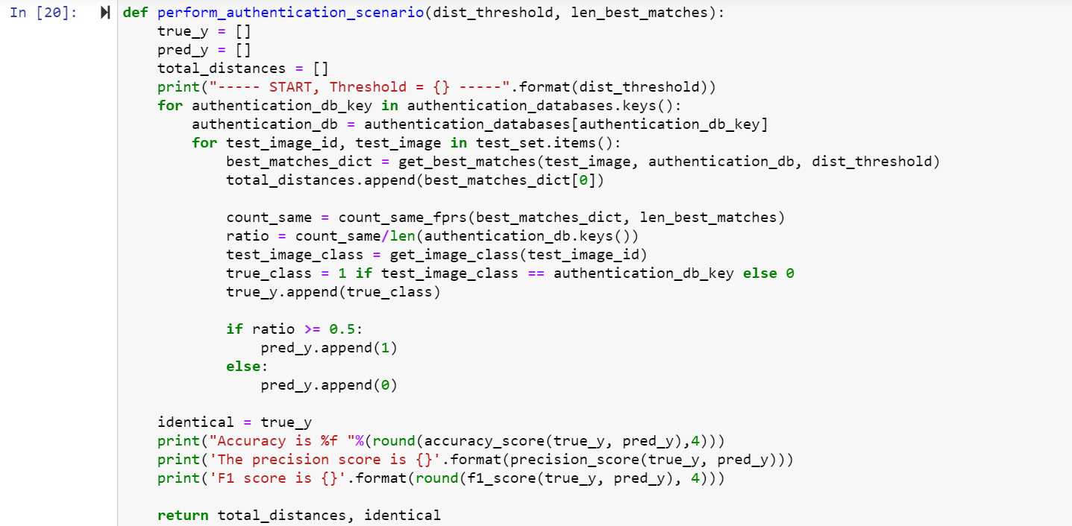
Authentication

Slide 15
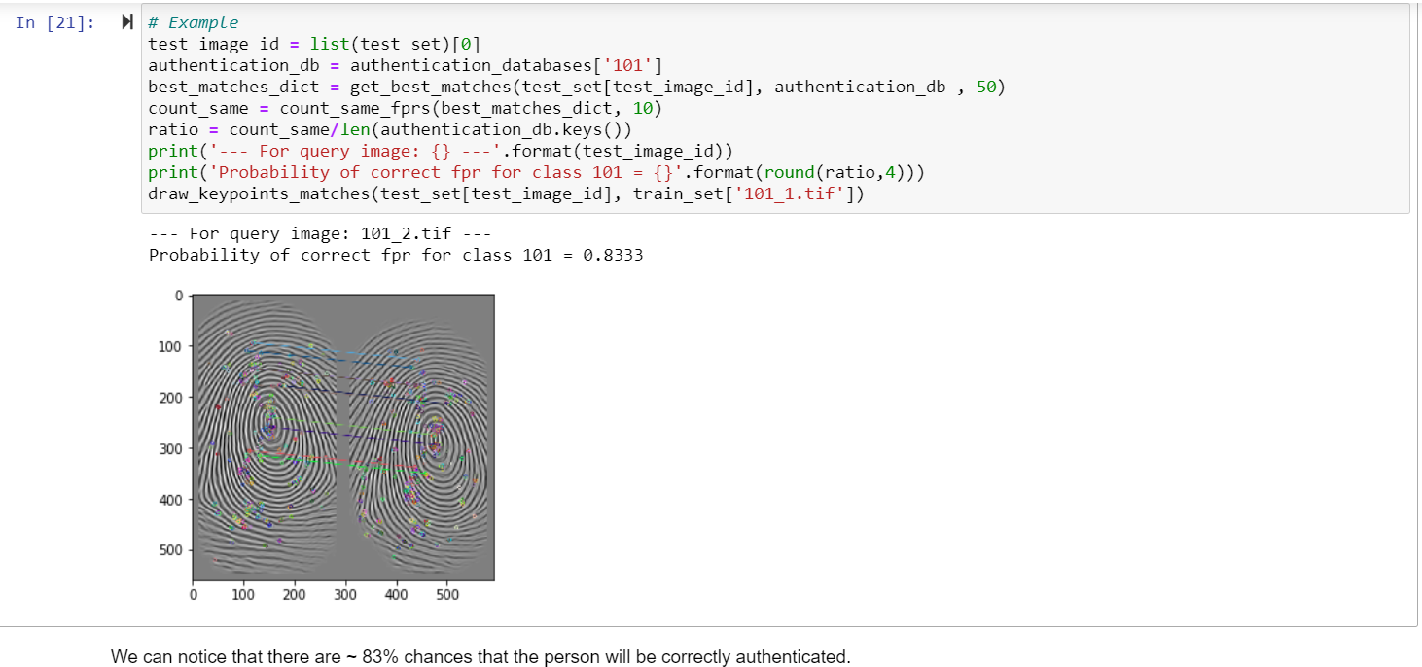
Authentication-Example

Slide 16
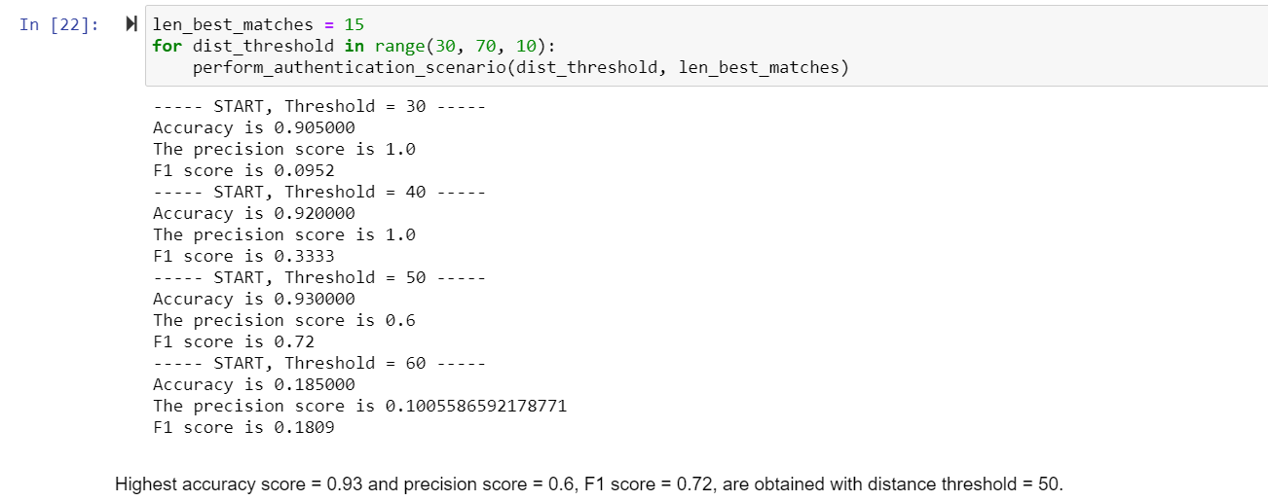
Conclusion
In the following code section, we iterate through different threshold values and we accumulate the TPR and FPR for each threshold.

Slide 17
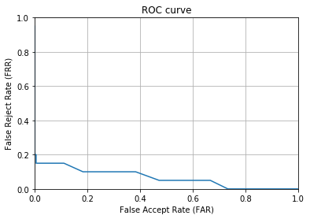
Conclusion
The evaluation of 1:1 biometric authentication systems is usually done by estimating False Accept Rate (FAR) and False Reject Rate (FRR). Using these estimates, a ROC curve is generated.
Compared to the standard ROC curve, where we plot the True Positive Rate (TPR) against the False Positive Rate (FAR), in the domain of biometric systems, instead of TPR, we plot FRR (or 1 - TPR).

Slide 18
References
R. M. Bolle, J. H. Connell, S. Pankanti, N. K. Ratha and A. W. Senior, "The relation between the ROC curve and the CMC," Fourth IEEE Workshop on Automatic Identification Advanced Technologies (AutoID'05), Buffalo, NY, USA, 2005, pp. 15-209 (https://ieeexplore.ieee.org/abstract/document/1544394)
Ridge-Based Fingerprint Recognition (https://link.springer.com/chapter/10.1007/11608288_37)

