Slide 1

VIJAY KUMAR

Slide 2


ABOUT
Atliq Hardwares (imaginary company) is one of the leading computer hardware
producers in India and well expanded in other countries too.

Slide 3
PROBLEM STATEMENT
The management has observed a need for quicker and more insightful data-driven decision-making. To address this, they plan to expand the data analytics team by hiring junior analysts. Tony Sharma, the Director of Data Analytics, is specifically looking for individuals skilled in both technical and soft aspects. In pursuit of this, he has introduced a SQL challenge to assess candidates comprehensively in SQL proficiency and soft skills. This approach aims to identify candidates with not only technical expertise but also effective communication and collaboration abilities, essential for the team's success.

Slide 4
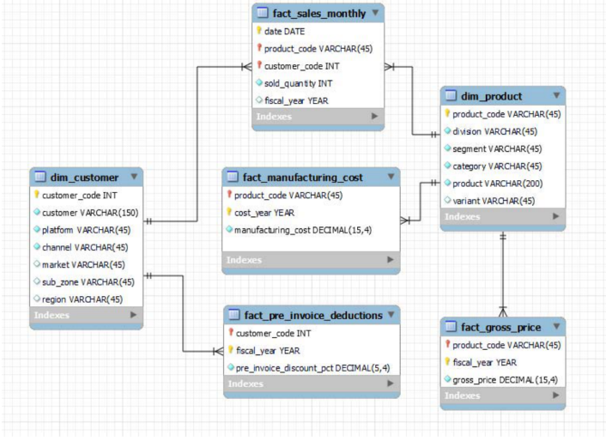
DATA MODEL

Slide 5
PROBLEM 01
Provide the list of markets in which customer "Atliq Exclusive" operates its business in the APAC region.
SELECT MARKET FROM DIM_CUSTOMER
WHERE CUSTOMER LIKE 'ATLIQ EXCLUSIVE'
AND REGION = 'APAC'

Slide 6
PROBLEM 02
What is the percentage of unique product increase in 2021 vs. 2020? The final output contains these fields, (unique_products_2020 unique_products_2021 ,percentage_chg)

Slide 7
ANSWER
WITH CTE AS (
SELECT
(SELECT COUNT(DISTINCT (PRODUCT_CODE)) FROM FACT_SALES_MONTHLY
WHERE FISCAL_YEAR = '2020')
AS UNIQUE_PRODUCTS_2020,
(SELECT COUNT(DISTINCT (PRODUCT_CODE)) FROM FACT_SALES_MONTHLY
WHERE FISCAL_YEAR = '2021')
AS UNIQUE_PRODUCTS_2021 )
SELECT UNIQUE_PRODUCTS_2020, UNIQUE_PRODUCTS_2021,
ROUND((UNIQUE_PRODUCTS_2021 - UNIQUE_PRODUCTS_2020) * 100/UNIQUE_PRODUCTS_2020,2 ) AS PERCENTAGE_CHG
FROM CTE

Slide 8
PROBLEM 03
Provide a report with all the unique product counts for each segment and sort them in descending order of product counts. The final output contains 2 fields, (segment product_count)
SELECT SEGMENT,COUNT(PRODUCT) AS PRODUC_COUNT FROM DIM_PRODUCT
GROUP BY 1
ORDER BY 2 DESC

Slide 9
PROBLEM 04
Which segment had the most increase in unique products in 2021 vs 2020? The final output contains these fields,(segment , product count 2020 ,product count 2021,difference)

Slide 10
ANSWER
WITH UNIQUE_PRODUCTS_YEAR2020 AS (
SELECT SEGMENT, COUNT(DISTINCT(DIM.PRODUCT_CODE)) AS UNIQUE_PRODUCTS_2020
FROM DIM_PRODUCT DIM
JOIN FACT_SALES_MONTHLY FSM ON DIM.PRODUCT_CODE = FSM.PRODUCT_CODE
WHERE FISCAL_YEAR = '2020'
GROUP BY 1),
UNIQUE_PRODUCTS_YEAR2021 AS (
SELECT SEGMENT, COUNT(DISTINCT(DIM.PRODUCT_CODE)) AS UNIQUE_PRODUCTS_2021 FROM DIM_PRODUCT DIM
JOIN FACT_SALES_MONTHLY FSM ON DIM.PRODUCT_CODE = FSM.PRODUCT_CODE
WHERE FISCAL_YEAR = '2021'
GROUP BY 1)
SELECT Y21.SEGMENT,UNIQUE_PRODUCTS_2020,UNIQUE_PRODUCTS_2021,
(UNIQUE_PRODUCTS_2021-UNIQUE_PRODUCTS_2020) AS DIFFIRENCEB
FROM UNIQUE_PRODUCTS_YEAR2020 Y20
JOIN UNIQUE_PRODUCTS_YEAR2021 Y21 ON Y20.SEGMENT = Y21.SEGMENT

Slide 11
PROBLEM 05
Get the products that have the highest and lowest manufacturing costs.The final output should contain these fields,product_code,product,manufacturing_cost
SELECT PRODUCT_CODE ,PRODUCT, MANUFACTURING_COST FROM DIM_PRODUCT DP
JOIN FACT_MANUFACTURING_COST FMC USING (PRODUCT_CODE)
WHERE MANUFACTURING_COST IN ((SELECT MAX(MANUFACTURING_COST) FROM FACT_MANUFACTURING_COST),
(SELECT MIN(MANUFACTURING_COST) FROM FACT_MANUFACTURING_COST)
)

Slide 12
PROBLEM 06
Generate a report which contains the top 5 customers who received an average high pre_invoice_discount_pct for the fiscal year 2021 and in the Indian market. The final output contains these fields(customer_code,customer,average_discount_percentage)
SELECT DC.CUSTOMER_CODE,DC.CUSTOMER, FID.PRE_INVOICE_DISCOUNT_PCT AS AVERAGE_DISCOUNT_PERCENTAGE FROM DIM_CUSTOMER DC
JOIN FACT_PRE_INVOICE_DEDUCTIONS FID ON DC.CUSTOMER_CODE = FID.CUSTOMER_CODE
WHERE DC.MARKET LIKE 'INDIA' AND FID.FISCAL_YEAR = '2021'
AND FID.PRE_INVOICE_DISCOUNT_PCT > (SELECT AVG(PRE_INVOICE_DISCOUNT_PCT) FROM FACT_PRE_INVOICE_DEDUCTIONS)
ORDER BY FID.PRE_INVOICE_DISCOUNT_PCT DESC
LIMIT 5

Slide 13
PROBLEM 07
Get the complete report of the Gross sales amount for the customer “Atliq Exclusive” for each month. This analysis helps to get an idea of low and high-performing months and take strategic decisions.The final report contains these columns:(Month,Year,Gross sales Amount)
SELECT EXTRACT(MONTH FROM DATE) DATE,FSM.FISCAL_YEAR,SUM(FSM.SOLD_QUANTITY * FSP.GROSS_PRICE) AS GROSS_SALES_AMOUNT
FROM DIM_CUSTOMER DC
JOIN FACT_SALES_MONTHLY FSM ON DC.CUSTOMER_CODE = FSM.CUSTOMER_CODE
JOIN FACT_GROSS_PRICE FSP ON FSP.PRODUCT_CODE = FSM.PRODUCT_CODE
WHERE DC.CUSTOMER= 'ATLIQ EXCLUSIVE'
GROUP BY 1,2
ORDER BY 2,1

Slide 14
PROBLEM 08
In which quarter of 2020, got the maximum total sold quantity? The final output contains these fields sorted by the total sold quantity,Quarter,total sold quantity)
SELECT EXTRACT(QUARTER FROM DATE) AS QUARTER, SUM(SOLD_QUANTITY) AS TOTAL_SOLD_QUANTITY FROM FACT_SALES_MONTHLY
WHERE FISCAL_YEAR = '2020'
GROUP BY 1
ORDER BY 2
LIMIT 1

Slide 15
PROBLEM 09
Which channel helped to bring more gross sales in the fiscal year 2021and the percentage of contribution? The final output contains these fields,(channel,gross sales mln,percentage)
WITH CTE AS(
SELECT DC.CHANNEL, SUM(FSM.SOLD_QUANTITY * FSP.GROSS_PRICE) AS GROSS_SALES_AMOUNT
FROM DIM_CUSTOMER DC
JOIN FACT_SALES_MONTHLY FSM ON DC.CUSTOMER_CODE = FSM.CUSTOMER_CODE
JOIN FACT_GROSS_PRICE FSP ON FSP.PRODUCT_CODE = FSM.PRODUCT_CODE
WHERE FSP.FISCAL_YEAR = '2021'
GROUP BY 1)
SELECT *, ROUND(GROSS_SALES_AMOUNT*100/SUM(GROSS_SALES_AMOUNT) OVER(),2) AS PERCENTAGE FROM CTE

Slide 16
PROBLEM 10
Get the Top 3 products in each division that have a high total sold quantity in the
fiscal year 2021? The final output contains these fields,(division,product ,code,product,total sold quantity,rank order).
WITH CTE AS(
SELECT DP.DIVISION, DP.PRODUCT_CODE,DP.PRODUCT, SUM(FSM.SOLD_QUANTITY) AS TOTAL_SOLD_QUANTITY FROM DIM_PRODUCT DP
JOIN FACT_SALES_MONTHLY FSM ON FSM.PRODUCT_CODE = DP.PRODUCT_CODE
WHERE FSM.FISCAL_YEAR = '2021'
GROUP BY 1,2,3),
ALL_RANK AS (
SELECT
*,DENSE_RANK() OVER(PARTITION BY DIVISION ORDER BY TOTAL_SOLD_QUANTITY DESC) AS RANK_ORDER
FROM CTE)
SELECT * FROM ALL_RANK
WHERE RANK_ORDER < 4

