Slide 1
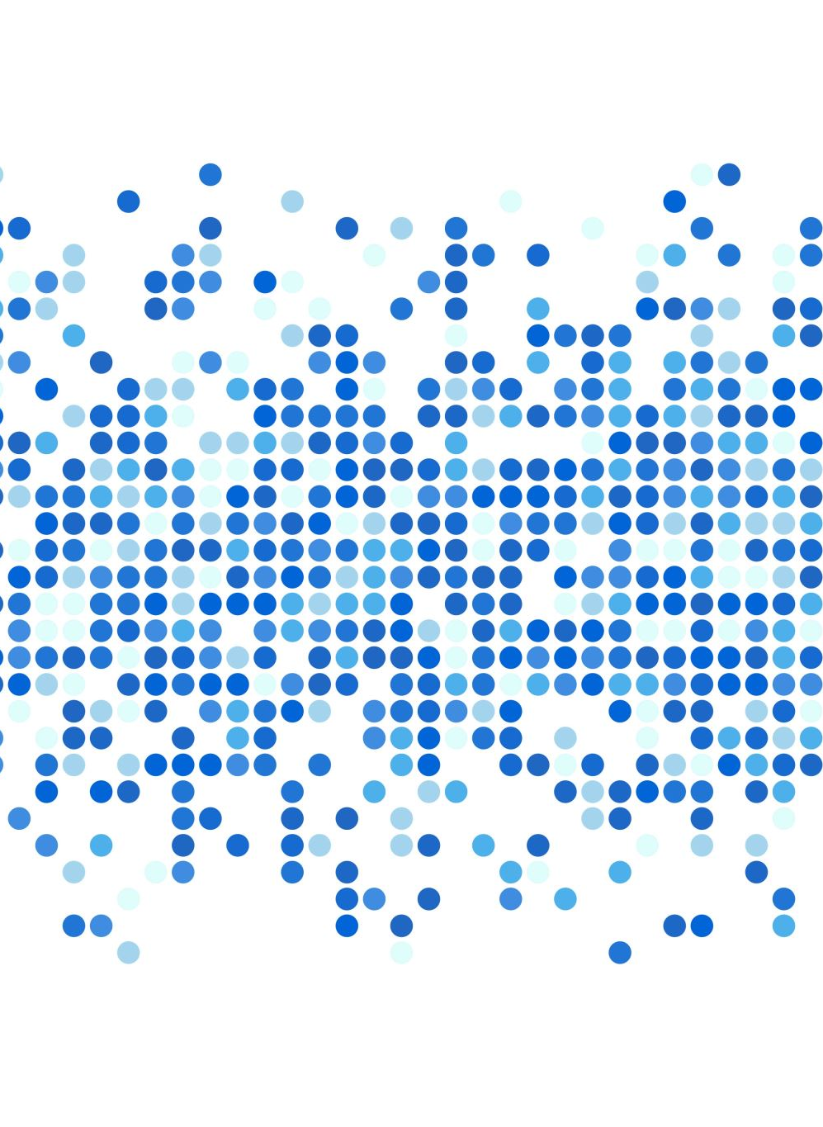
Deep Learning for 3D model completion

Slide 2
Overview
We have created an Encoder-Decoder mode to autocomplete an incomplete 3D .obj file.
The program converts the incomplete .obj mesh file in point clouds with 1000 point samples using Open3D library. The target output consists of complete .obj file with 2000 point samples.
The encoder part of the model encodes the incomplete point cloud to an intermediate tensor of size 1000, the decoder part of the model decodes the intermediate tensor to full size complete 3D point cloud.
The sample pointclouds are used to generated 3D mesh using Open3D library.

Slide 3
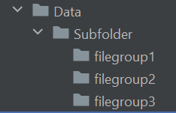
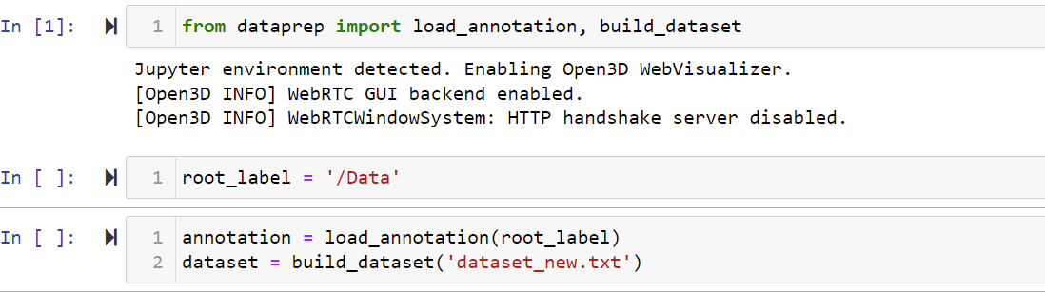
Custom Dataset Preparation (Optional)
Dump the .obj files in filegroup1, filegroup2 and filegroup3 folders, depending on the group of your part model (e.g. all washers can be placed in group 1, all couplings can be placed in group 2 and so on, you can create as many file groups as necessary)
Open ‘DataPrep’ notebook and run all the cells sequentially.

Slide 4
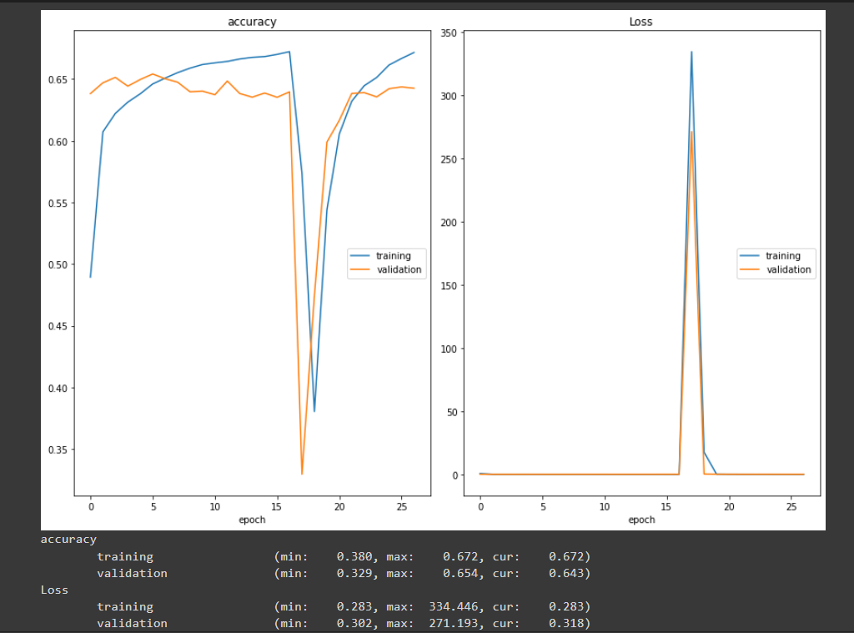
Training (optional)
Open ‘train’ notebook and run all the cells sequentially.
Once training starts you can see a graph showing the performance metrics as the training progresses.
Once training is completed, the model weight will be saved as ‘savedModel.h5’

Slide 5
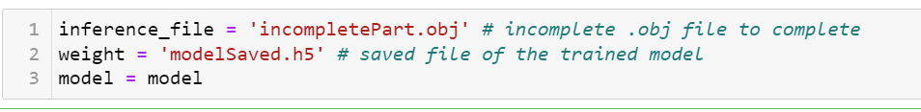
Inferencing
Open ‘Inference’ notebook.
Change the parameters in the screenshot as per your requirement. E.g. replace inference_file section with the file name of your choice.
The completed file is saved as outputfile.obj
Run visualize cells to see the reconstructed object.

Slide 6

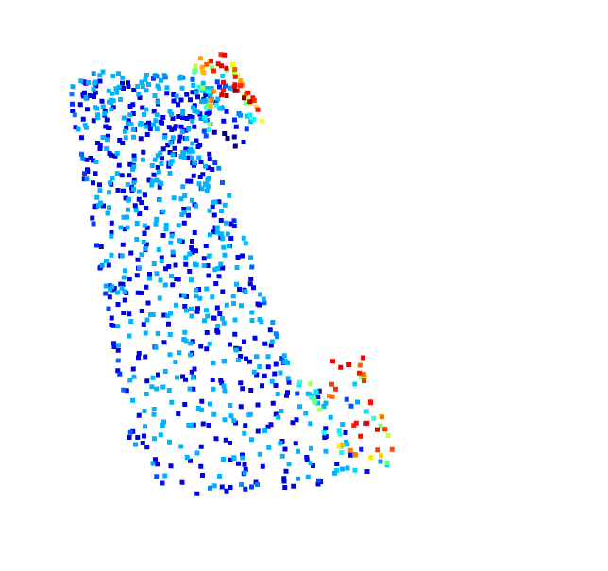

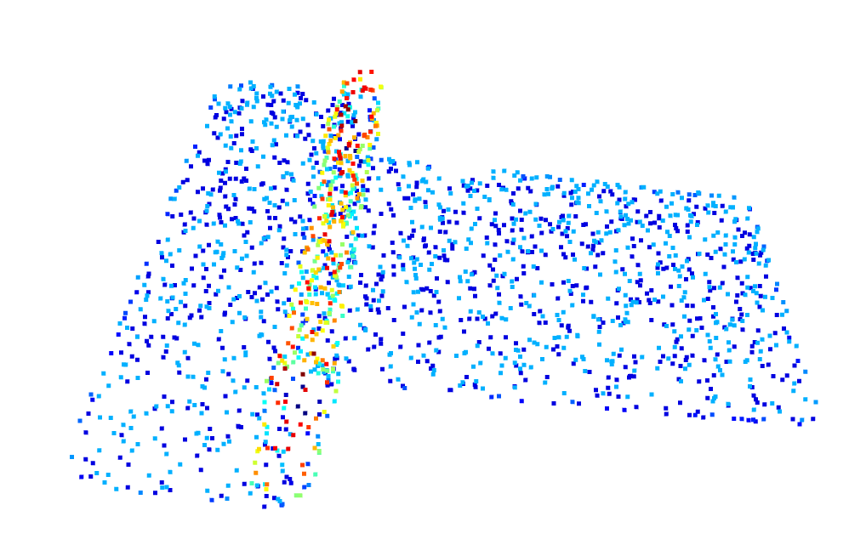
Result
Output 3D object
Rendered Point Cloud
Input 3D object
Predicted Point Cloud

Slide 7
To run the code on colab use below link
https://colab.research.google.com/drive/1C3MsxdXk_DGcTdrVtAYaH6rNB-1F44Zs?usp=sharing

