Slide 1

high-through put stock quotes

Slide 2
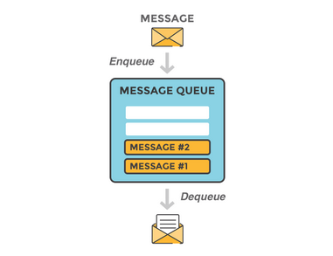
What is Rabbit MQ ?
RabbitMQ is a message-queueing software also known as a message broker or queue manager.
Simply said it is software where queues are defined, to which applications connect in order to transfer a message or messages.
The main features of RabbitMQ are mentioned below:
Asynchronous Messaging
Distributed Deployment
Management & Monitoring
Enterprise- and Cloud-Ready

Slide 3

Message Flow
The basic architecture of a message queue is simple - there are client applications called producers that create messages and deliver them to the broker (the message queue). Other applications, called consumers, connect to the queue and subscribe to the messages to be processed. Software may act as a producer, or consumer, or both a consumer and a producer of messages. Messages placed onto the queue are stored until the consumer retrieves them.

Slide 4
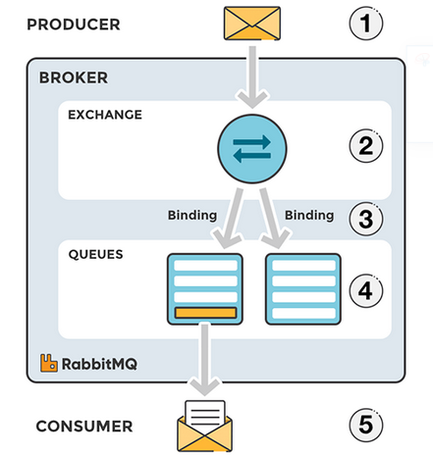
Exchanges
Messages are not published directly to a queue; instead, the producer sends messages to an exchange. An exchange is responsible for routing the messages to different queues with the help of bindings and routing keys. A binding is a link between a queue and an exchange.
Message flow in RabbitMQ
The producer publishes a message to an exchange. When creating an exchange, the type must be specified.
The exchange receives the message and is now responsible for routing the message. The exchange takes different message attributes into account, such as the routing key, depending on the exchange type.
Bindings must be created from the exchange to queues. In this case, there are two bindings to two different queues from the exchange. The exchange routes the message into the queues depending on message attributes.
The messages stay in the queue until they are handled by a consumer
The consumer handles the message.

Slide 5
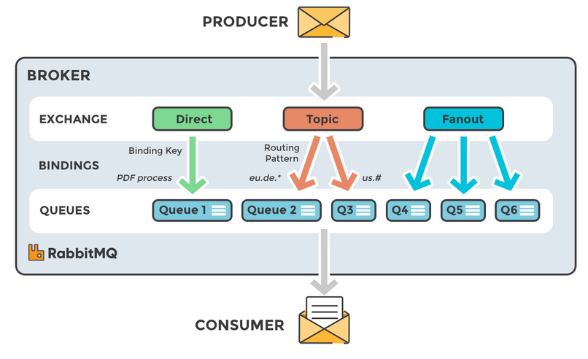
Types of Exchanges
Direct: The message is routed to the queues whose binding key exactly matches the routing key of the message.
Fanout: A fanout exchange routes messages to all of the queues bound to it.
Topic: The topic exchange does a wildcard match between the routing key and the routing pattern specified in the binding.
Headers: Headers exchanges use the message header attributes for routing.

Slide 6
RabbitMQ and server concepts :
Some important concepts need to be described before we dig deeper into RabbitMQ.
Producer : Application that sends the messages.
Consumer : Application that receives the messages.
Queue : Buffer that stores messages.
Message : Information that is sent from the producer to a consumer through RabbitMQ.
Connection : A TCP connection between your application and the RabbitMQ broker.
Channel : A virtual connection inside a connection. When publishing or consuming messages from a queue - it's all done over a channel.
Exchange : Receives messages from producers and pushes them to queues depending on rules defined by the exchange type. To receive messages, a queue needs to be bound to at least one exchange.
Binding : A binding is a link between a queue and an exchange.
Routing key : A key that the exchange looks at to decide how to route the message to queues. Think of the routing key like an address for the message.
AMQP : Advanced Message Queuing Protocol is the protocol used by RabbitMQ for messaging.
Users : It is possible to connect to RabbitMQ with a given username and password. Every user can be assigned permissions such as rights to read, write and configure privileges within the instance. Users can also be assigned permissions for specific virtual hosts.
Vhost, virtual host : Provides a way to segregate applications using the same RabbitMQ instance. Different users can have different permissions to different vhost and queues and exchanges can be created, so they only exist in one vhost.

Slide 7
RabbitMQ Installation guide :
For RabbitMQ, you first need to have ErLang (https://www.erlang.org/downloads) installed in your system as the RabbitMQ program is written in the ErLang programming language. After ErLang, you can download the latest version of RabbitMQ (https://www.rabbitmq.com/download.html).
UseFull Commands :
rabbitmq-plugins.bat enable rabbitmq_management (For UI enable purpose )
rabbitmq-server start
rabbitmqctl.bat stop
rabbitmqctl.bat status
rabbitmq-service.bat start
URL
http://localhost:15672/
Credentials:
UserName : guest
Password : guest
To move messages, the shovel plugin must be enabled below manner
rabbitmq-plugins enable rabbitmq_shovel rabbitmq_shovel_management

Slide 8
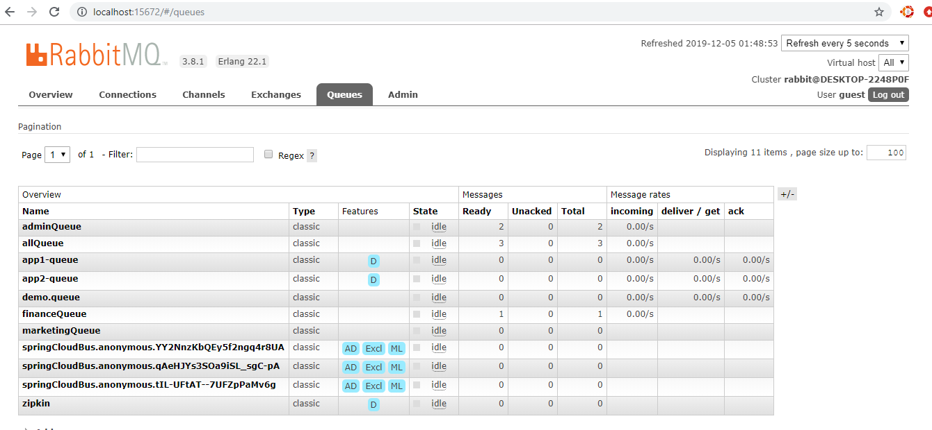
Sample UI for Rabbit MQ

Slide 9
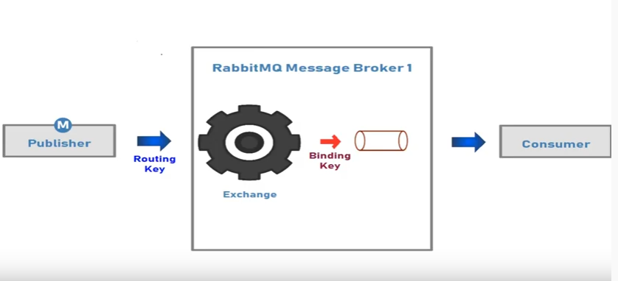
Shovel Process

Slide 10
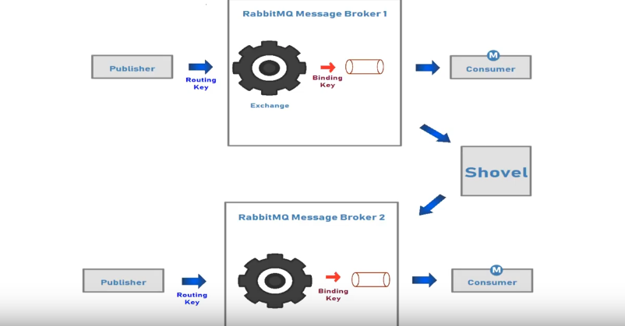
Shovel Process Message routing process
Loose coupling and Environment
WAN Friendly ( They use client connection to communicate brokers designed to handle intermittent connectivity without message loss.
Shovel acts as client application consumes message from source broker and publish to the destination broker .

Slide 11
Types of Shovels
Static shovels ( Once create the config file in ,we need to restart server )
Dynamic Shovels ( No need to restart server )
Shovel enable for UI Admin console
Go to installation path sbin location in cmd promt and type below commands
rabbitmq-plugins enable rabbitmq_shovel rabbitmq_shovel_management
rabbitmq-service.bat stop
rabbitmq-service.bat remove
rabbitmq-service.bat install
rabbitmq-service.bat start

Slide 12
