Slide 1

Bank Customer Churn Prediction

Slide 2

Introduction
The project is titled “Bank Customer Churn Prediction System”. It focuses on identifying customers who are likely to leave the bank, also known as churn. In the banking industry, customer retention is very important because gaining new customers is more expensive than keeping existing ones. This system uses machine learning models to analyze customer data such as age, credit score, balance, and activity level, and predicts whether a customer will leave or stay. The goal of the project is to help banks take timely actions to improve customer satisfaction and reduce churn. I have used technologies like Python, Streamlit, Power BI, and various ML algorithms to build an interactive, end-to-end solution. The system also includes features like login/signup, real-time prediction, feedback form, and a dashboard for easy data visualization.

Slide 3

Churn Overview
01
This project aims to develop an accurate customer churn prediction system for the banking industry to proactively retain the customers and mitigate the loss in revenue.

Slide 4

Input Features Explained

Slide 5

(a) Credit Score A numerical measure of a customer’s creditworthiness. Lower scores may indicate higher risk and higher likelihood of churn. (b) Country (Geography) Indicates the customer's country (France, Germany, Spain). Geographic location may impact churn behavior due to regional policies or services. (c) Gender The customer’s gender (Male or Female). Used to analyze demographic trends in churn behavior. (d) Age Age of the customer. Younger or older customers may have varying levels of engagement with bank services. (e) Tenure Number of years the customer has stayed with the bank. Longer tenure often implies loyalty, reducing churn chances.

Slide 6

(f) Account Balance
Total balance in the customer’s account. Customers with low or zero balances may be more likely to churn.
(g) Estimated Salary
Annual income estimate. It helps assess financial stability and segment customers accordingly.
(h) Number of Products
Total financial products the customer uses (e.g., loans, credit cards). More products typically indicate stronger customer retention.
(i) Has Credit Card
Indicates if the customer owns a credit card issued by the bank. Credit card holders may have deeper relationships with the bank.
(j) Is Active Member
Whether the customer is actively engaging with bank services. Inactive customers tend to be more at risk of leaving.

Slide 7

Frontend:- Streamlit
Backend:- Pandas, NumPy,Matplotlib,Seaborn,Scikit-learn, XGBoost, KNN,Joblib or Pickle

Slide 8
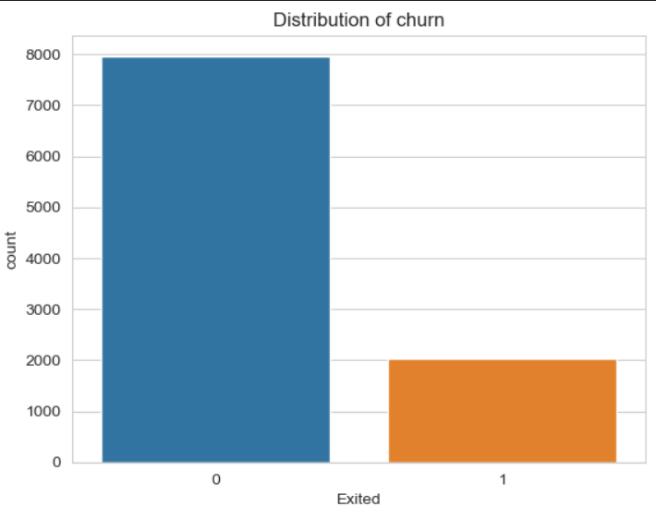
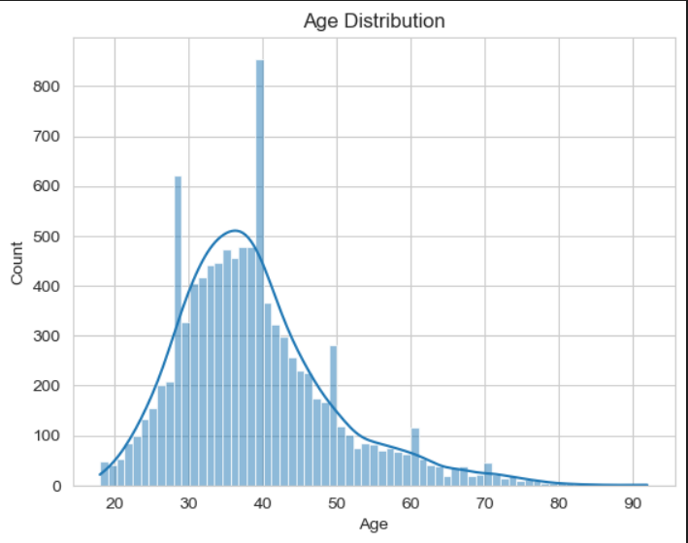
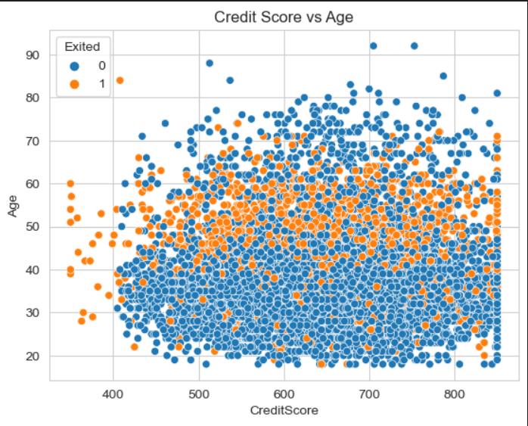
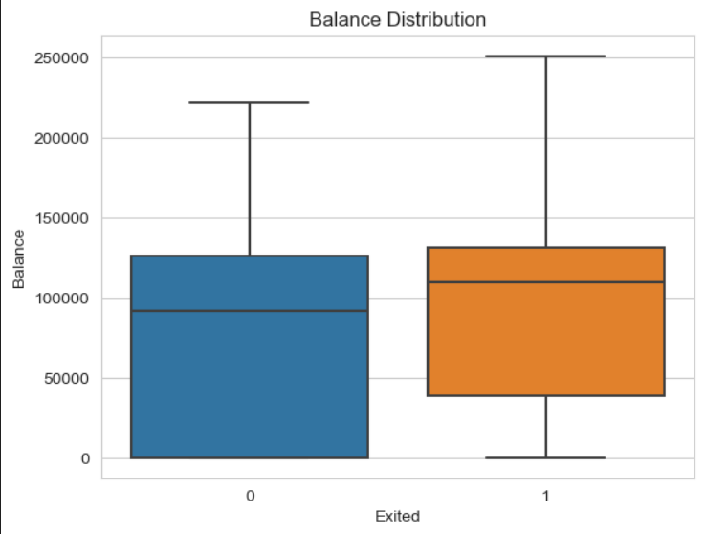
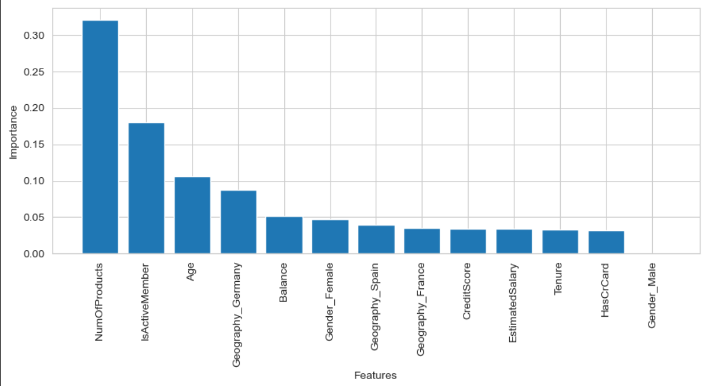
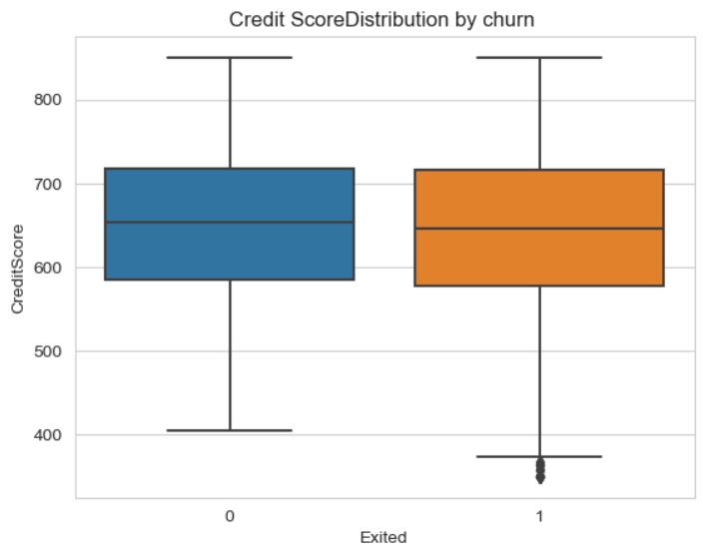
Feature Analysis by Customer Churn

Slide 9
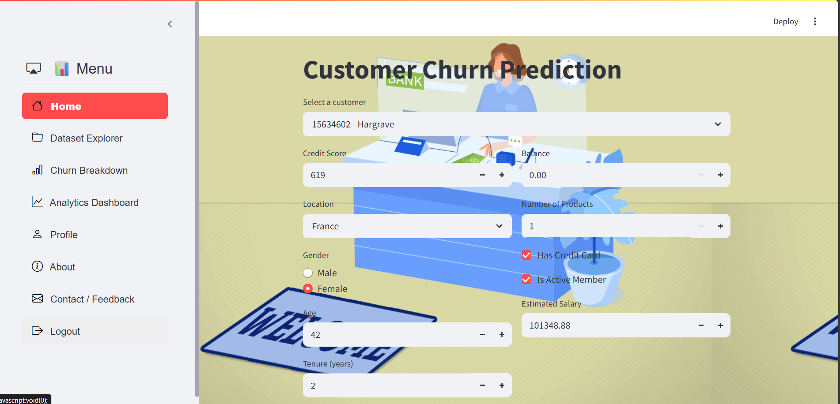

Slide 10
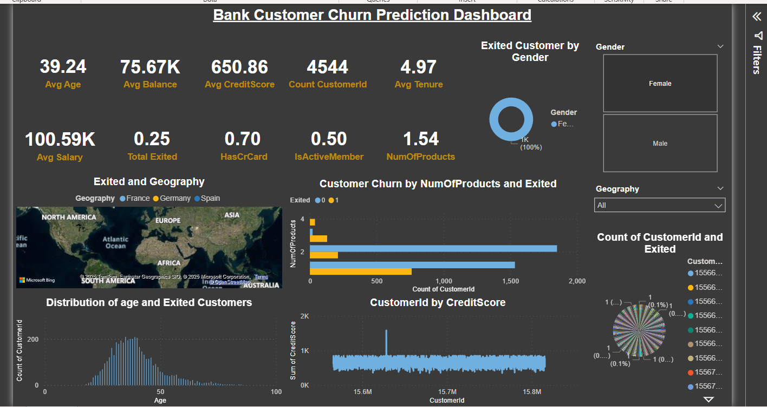

Slide 11

FUTURE SCOPE
Real-time Churn Alerts Implement live monitoring to instantly flag high-risk customers.
Personalized Retention Strategies Use AI to auto-suggest offers or messages to retain customers.
Integration with CRM Systems Seamless integration with tools like Salesforce or HubSpot for better action plans.
Multi-channel Data Usage Include social media, app usage, and call center data for deeper insights.
Churn Prediction Across Products Extend the model to predict churn for multiple services or products

Slide 12


