Slide 1

AN INDUSTRIAL TRAINING PRESENTATION ON “WEB DEVELOPMENT PROJECT”
Department Of Computer Science and Engineering RAJASTHAN TECHNICAL UNIVERSITY, KOTA
SUBMITTED BY-
Name : BHARAT
Roll No. : 24EUCCS023 College Roll No. : 24/137 Batch : A-2
Year/Sem : 2nd / 3rd
SUBMITTED TO -
Ms. RITU TIWARI

Slide 2

Contents
Introduction of “BOOKSOPEDIA” Web Development Project
Project Objective
Tools & Technologies Used
Deep Dive in Hyper Text Markup Language & Cascading Style Sheets
Admin Panel
Conclusion
Future Scopes
Certificate
1

Slide 3
BOOKSOPEDIA
2
2

Slide 4
What is BOOKSOPEDIA?
• Online platform for theme-based book selling.
• Helps users explore and buy books easily.
• Designed with a user-friendly interface.
3

Slide 5
Project Objective
2. Create an admin panel for managing books.
3.Focus on responsive and theme - based design.
1. Build a clean, structured book-selling website.
.
4

Slide 6




Tools and Technologies Used
• Hyper Text Markup Language –Structure of webpages.
• Cascading Style Sheets – Styling and layout.
• Visual Studio Code – Development editor.
• Web Browser – Testing and previewing.
5

Slide 7
Framework
Created CRUD operations (Create, Read, Update, Delete) operations in Admin Panel.
Designed web pages using only HTML and CSS.
Ensured clean and responsive layouts.
6

Slide 8
Deep Dive into Hyper Text Markup Language
• It is a markup language used to structure web pages and content for display in a web browser.
• HTML uses tags to structure a page.
• There are many tags and elements used in HTML:
<h1> to <h6> → Headings
<p> → Paragraph
<a href="..."> → Hyperlink
<img src="..." alt="..."> → Image
<ul>, <ol>, <li> → Lists
<table>, <tr>, <td> → Tables
<div> & <span> → Grouping content
7

Slide 9
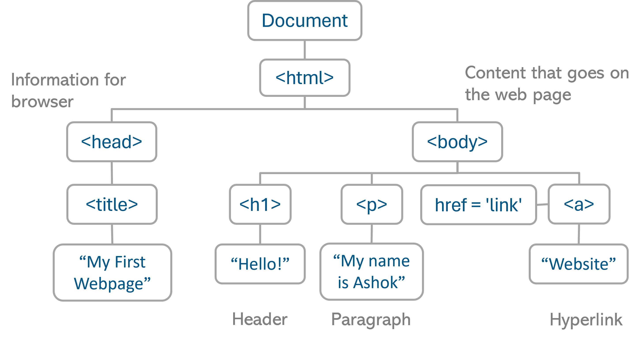
HTML Elements &Tags
Fig. HTML Elements &Tags
8

Slide 10
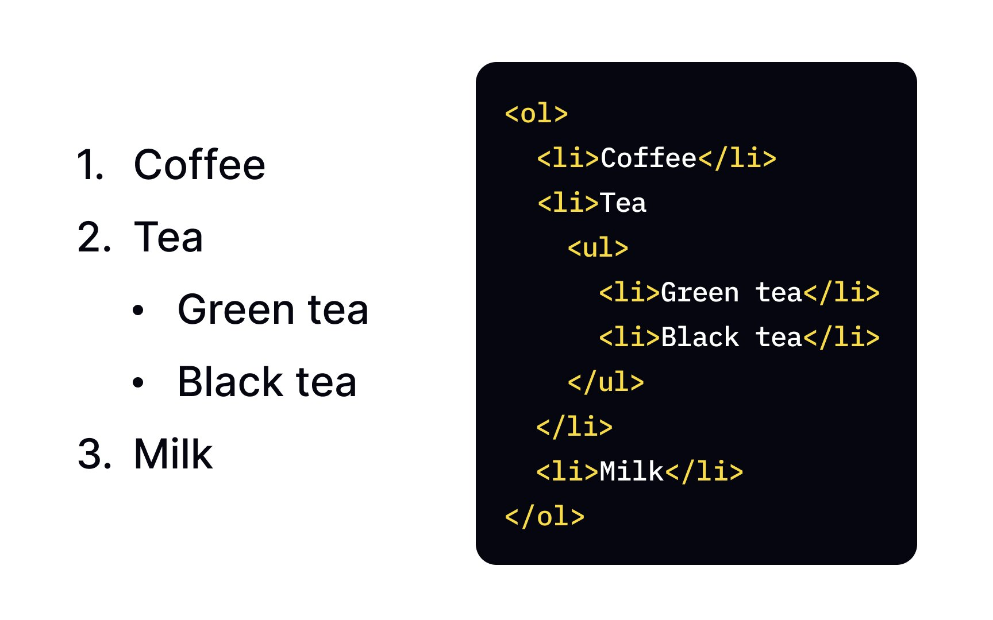
Semantic Elements & lists
🔹 Semantic Elements:-
Makes HTML code more meaningful.
Improves SEO (Search Engine Optimization).
Enhances accessibility for screen readers.
Easier for developers to read and maintain code.
Example of lists:
🔹 Types of Lists
Ordered List (<ol>)
Items are numbered automatically.
  Example: Steps, Rankings.
Unordered List (<ul>)
  Items are marked with bullets.
  Example: Features, Points.
Fig. Lists Structure
9

Slide 11
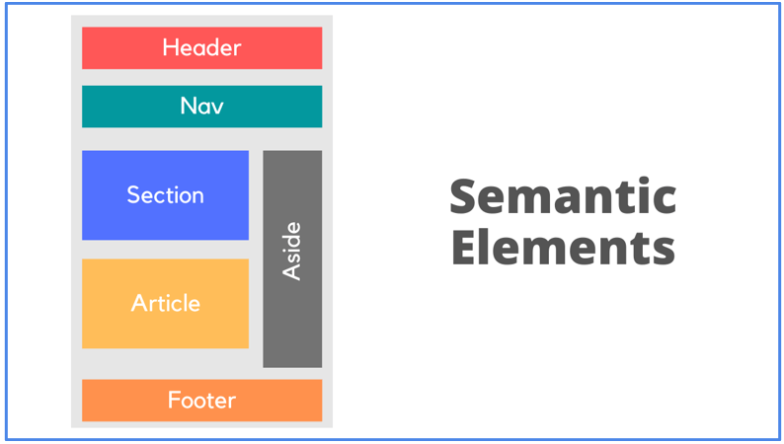
Semantic Elements
Fig. Semantic Elements Setup
10

Slide 12
Deep Dive into Cascading Style Sheets
• CSS is the language used to style and design web pages.
• It controls colors, fonts, spacing, layouts, animations, and responsiveness.
• HTML = Structure (skeleton)
• CSS = Style (clothes/looks)
🔹 Types of CSS:--
Inline CSS → Written inside the HTML element.
Internal CSS → Written inside <style> tag in HTML head.
External CSS → Written in a separate .css file and linked to HTML.
11

Slide 13
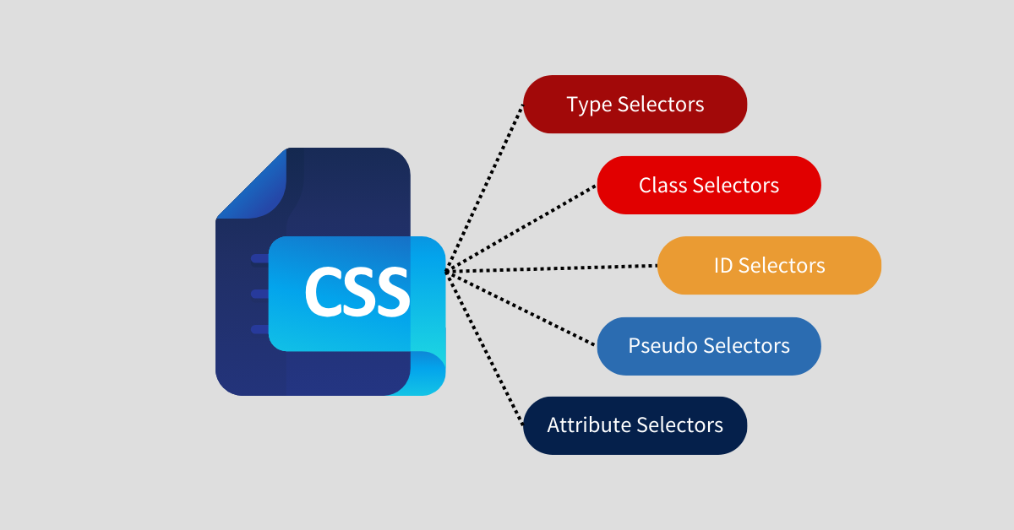
CSS Selectors
• CSS styles HTML using selectors and properties.
Universal Selector → *
Type Selector → element (e.g., p, h1)
Class Selector → .classname
ID Selector → #idname
Group Selector → selector1, selector2
Child Selector → A > B
• Responsive design using media queries.
• Layouts using flexbox, grid.
Fig. Different Types of Selectors
12

Slide 14
CSS Properties
🔹 Flex Container Properties
display: flex; → Activates Flexbox on a container.
flex-direction → Defines direction of items:
  row (default), row-reverse, column, column-reverse.
justify-content → Aligns items horizontally:
  flex-start, flex-end, center, space-between, space-around, space-evenly.
align-items → Aligns items vertically:
  flex-start, flex-end, center, stretch, baseline.
flex-wrap → Controls wrapping:
  No wrap (default), wrap, wrap-reverse.
.
11
13

Slide 15
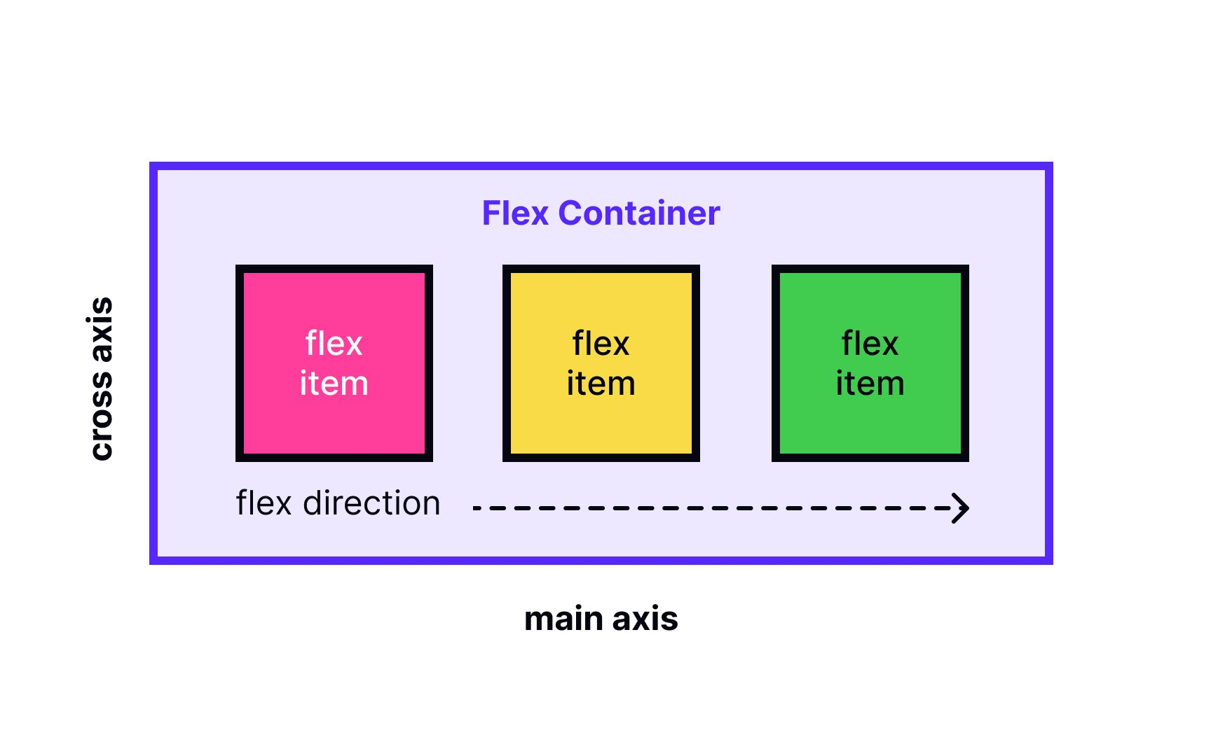
Flex box
Fig. Flex Box Setup
14

Slide 16
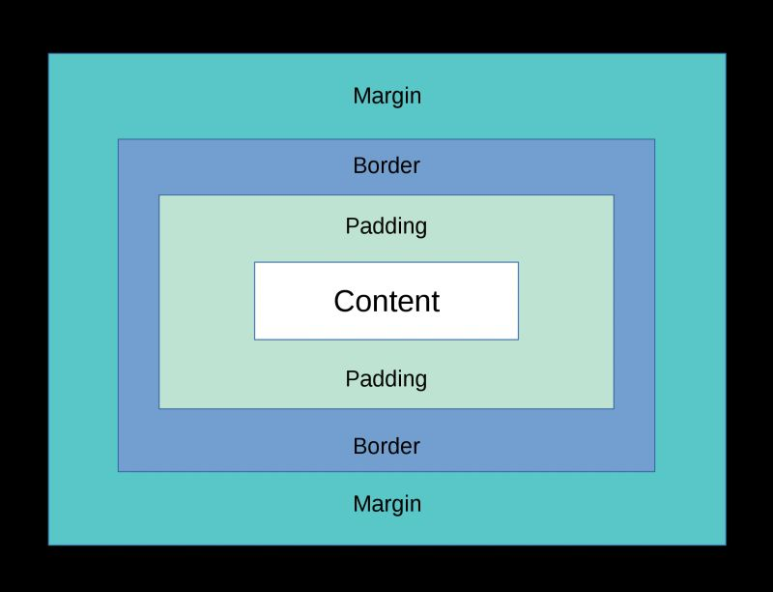
Box Model and Media Queries
• Styled forms with padding, borders, hover effects.
• Maintained design consistency.
• Responsive layout for desktop and mobile.
• Add colors and fonts. • Make pages responsive for all screen sizes.
Fig. CSS Box Model
13
15

Slide 17
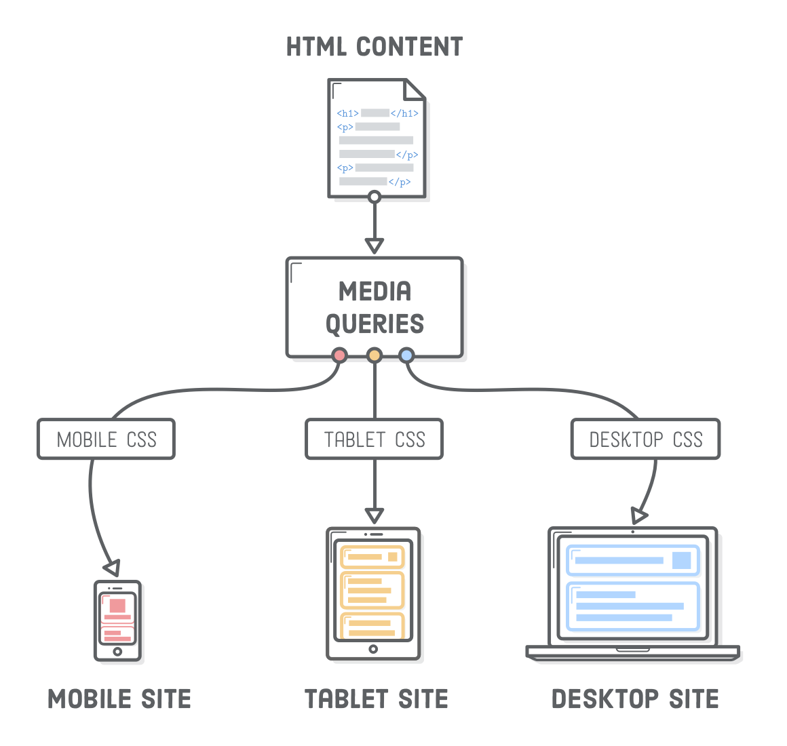
Media queries :-
Fig. Site in Different Screen
16

Slide 18
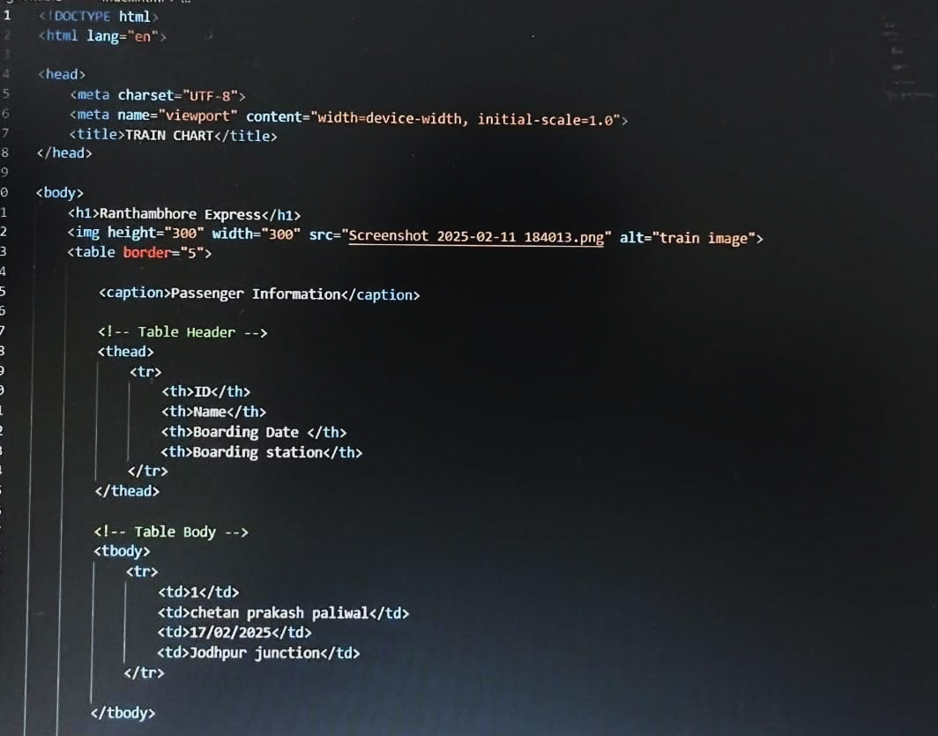
Source Code
Fig. Basic Structure of HTML including Properties
17

Slide 19
Admin Panel
  The Admin Panel is a backend control system for the website.
  It is used only by the administrator (you/owner), not by normal users.
  In this panel, the admin can manage books and data shown on the website.
Why It Is Important
Without the Admin Panel, the site cannot be easily updated.
It makes the project dynamic, not just a static website.
Gives full control to the owner for maintaining the online bookstore.
18

Slide 20
Challenges Faced
• Initial difficulty with layout.
• Making pages responsive was tricky.
• Ensuring form validation without JavaScript.
• Enhance visual design with animations.
• Add search and filter features for books.
19

Slide 21
Conclusion
• Gained hands-on experience in web design.
• Learned real-world application of HTML & CSS.
• Combined, they helped build a real admin panel.
• Gained confidence in front-end basics.
• Built confidence in creating live projects.
• Ready to explore JavaScript next.
20

Slide 22
Future Scopes
High Demand and Growth → Web development is in high demand and will continue to grow with new technologies like AI, Web3, AR, and VR.
Diverse Career Opportunities → Careers are vast, including roles such as front-end developer, back-end developer, full-stack developer, as well as opportunities in freelancing and passive income.
Evolving Role of Developers → The role of web developers will keep evolving, with more focus on rich, interactive user experiences and integration of advanced features like AI and automation.
Global Opportunities → Web development offers global opportunities, as businesses everywhere need websites and web apps to go digital.
21

Slide 23
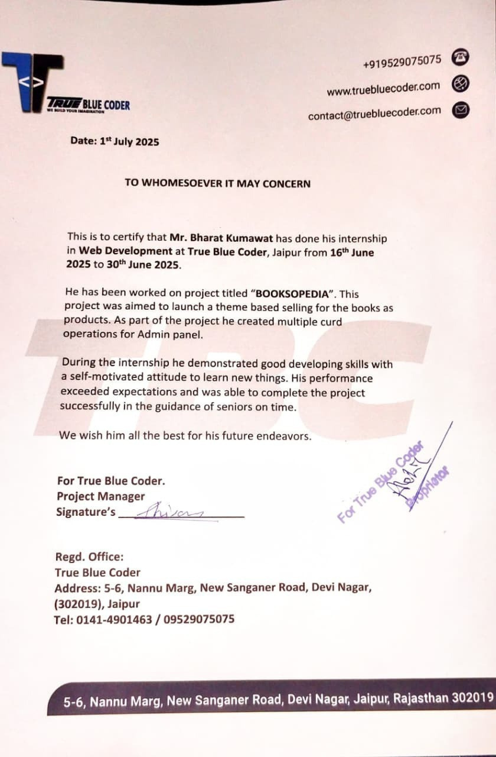
CERTIFICATE
22

Slide 24
THANK YOU
23

