Slide 1


Predictor App
Presented By: Collage:
Prateek Kumawat University Of Kota

Slide 2
OUTLINE
Problem Statement
Proposed System/Solution
System Development Approach
Result
Conclusion
Future Scope
References

Slide 3
Problem Statement
Dynamic market conditions affect car and house prices.
Traditional methods are often inaccurate and outdated.
Need for reliable, data-driven predictive models.
Aim: Develop accurate models to predict car and house prices.

Slide 4
Proposed System / Solution
System Components:
Data Acquisition and Preprocessing
Model Development (Machine Learning for Cars, Deep Learning for Houses)
User Interface for input and output
Solution:
Robust predictive models for car and house prices.
User-friendly interface for easy access and use.

Slide 5
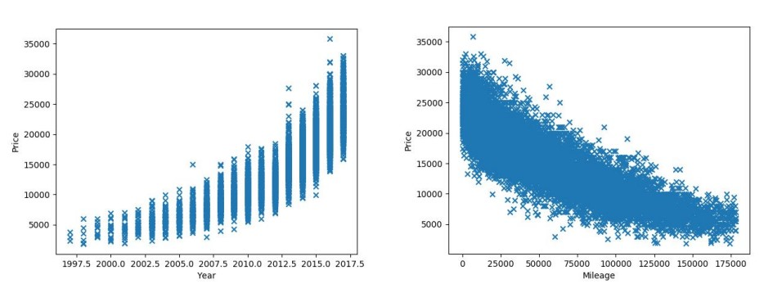
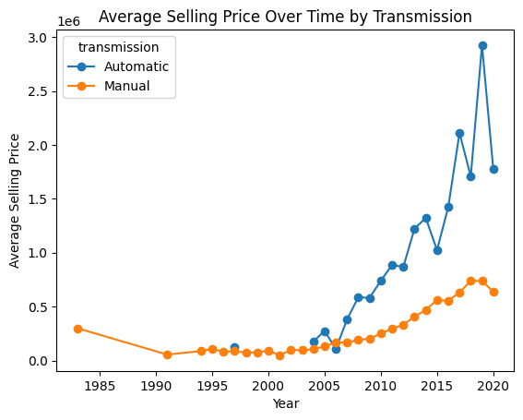
System Development Approach
Data Acquisition and Preprocessing:
Collecting datasets from reliable sources.
Data cleaning, normalization, and feature engineering.
For Car Price Prediction

Slide 6
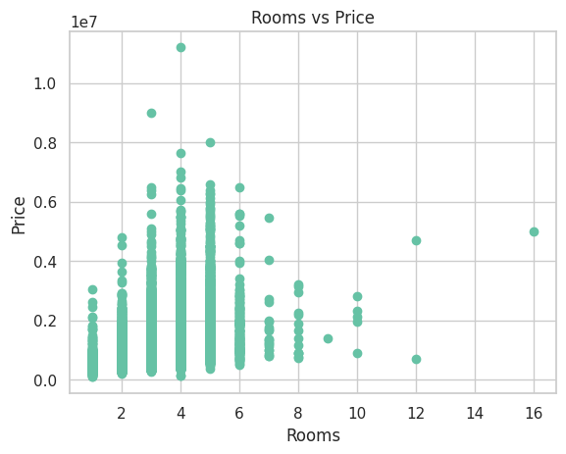
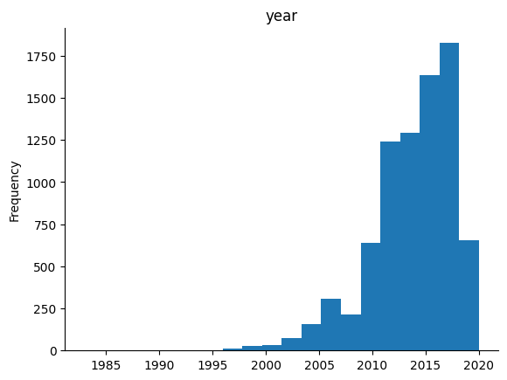
System Development Approach
For House Price Prediction

Slide 7
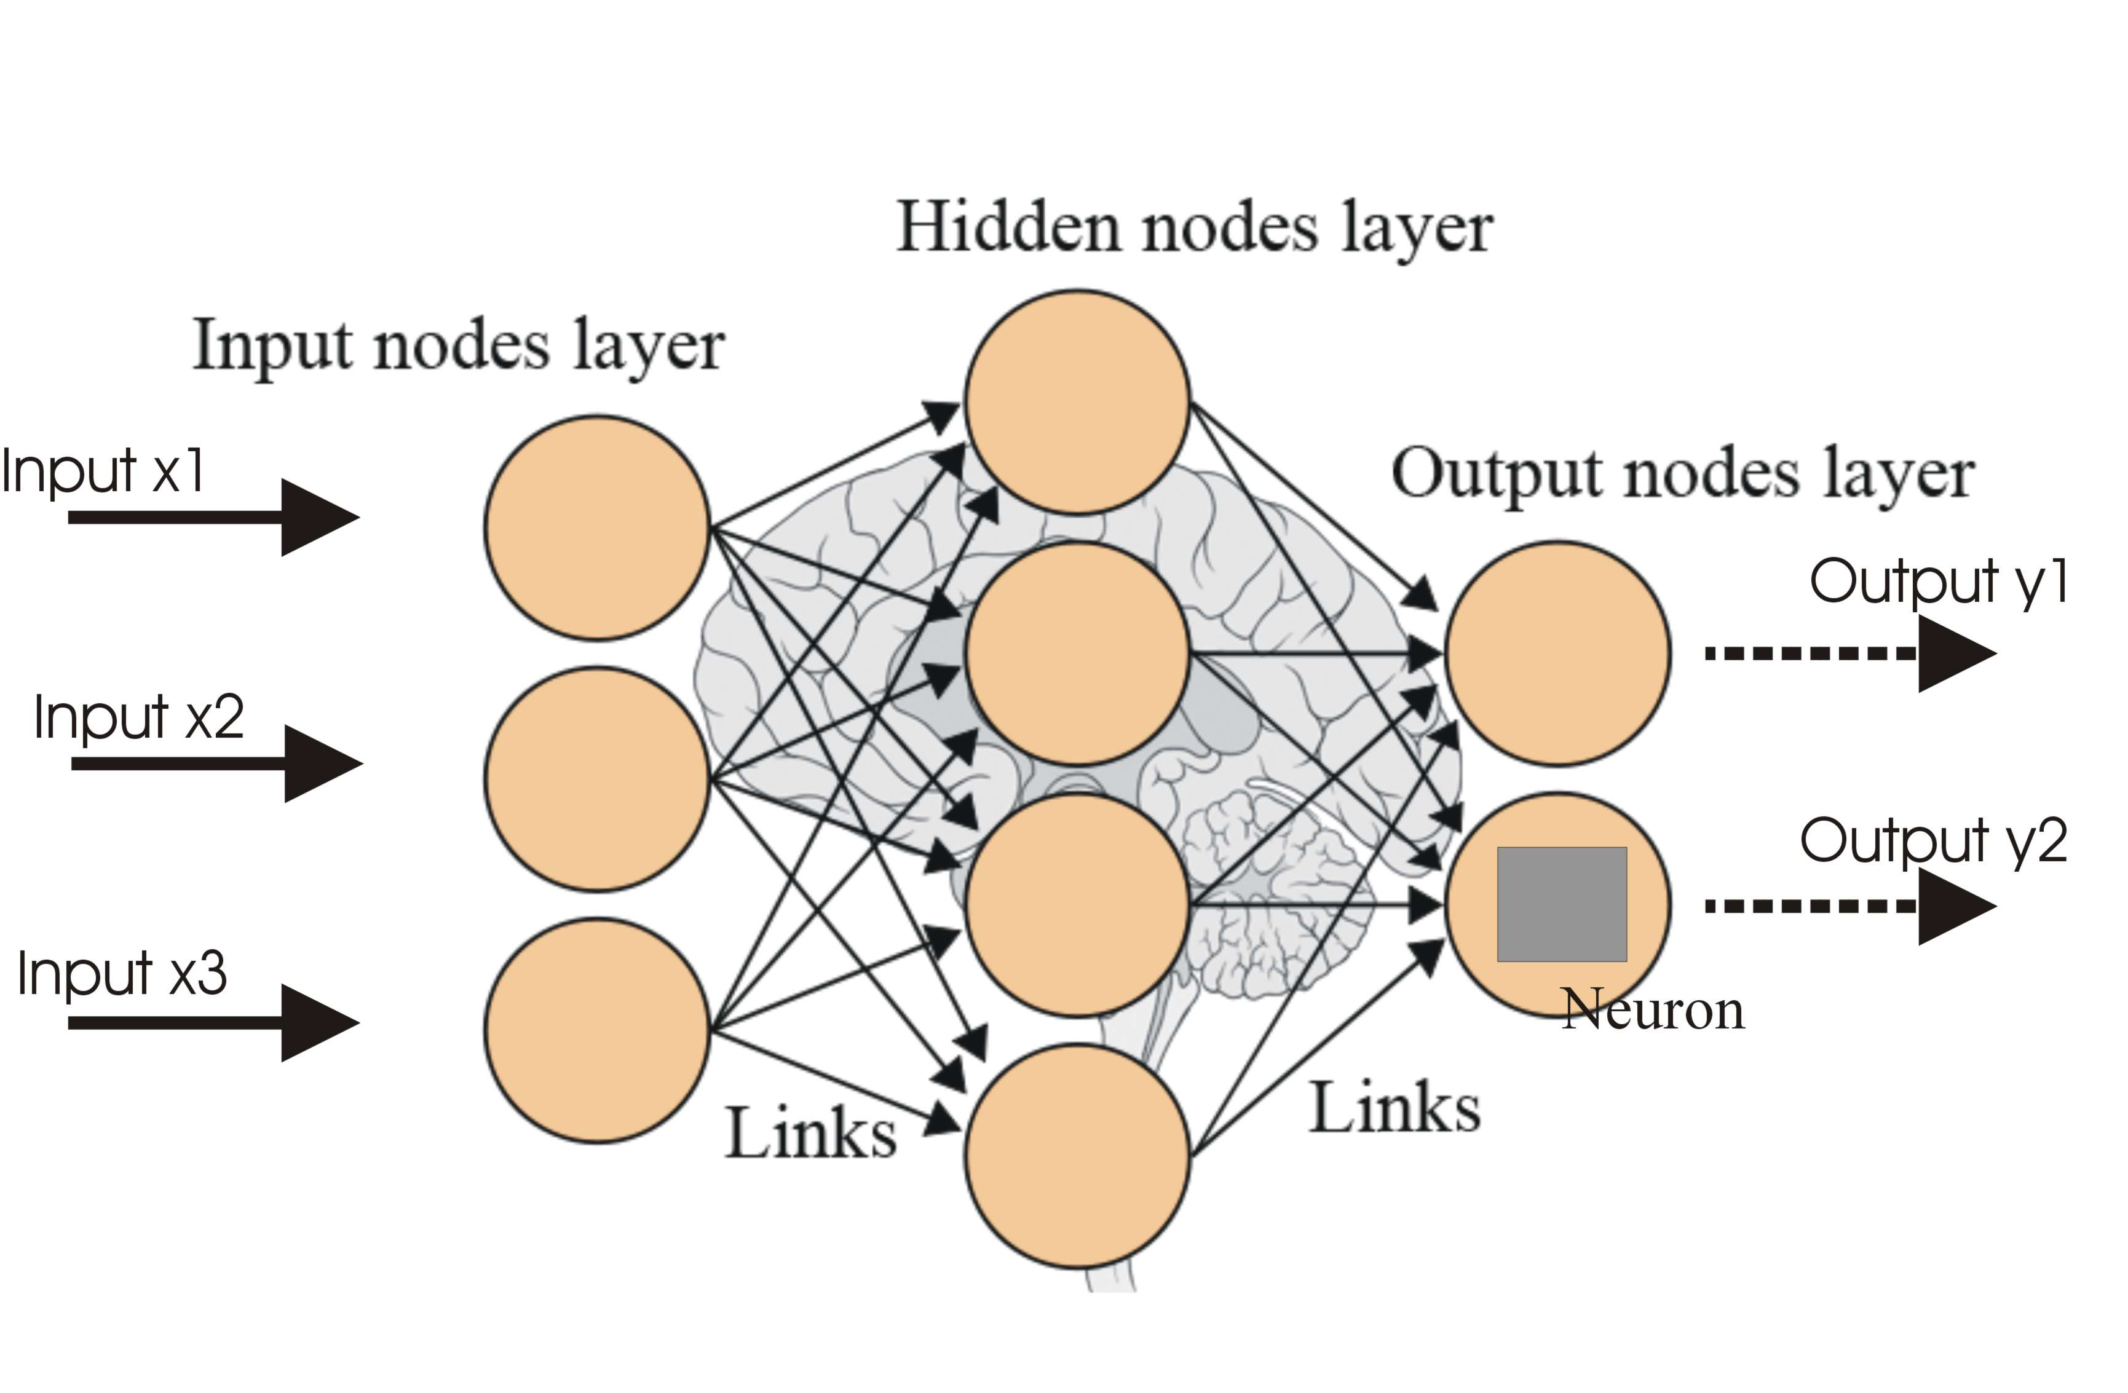
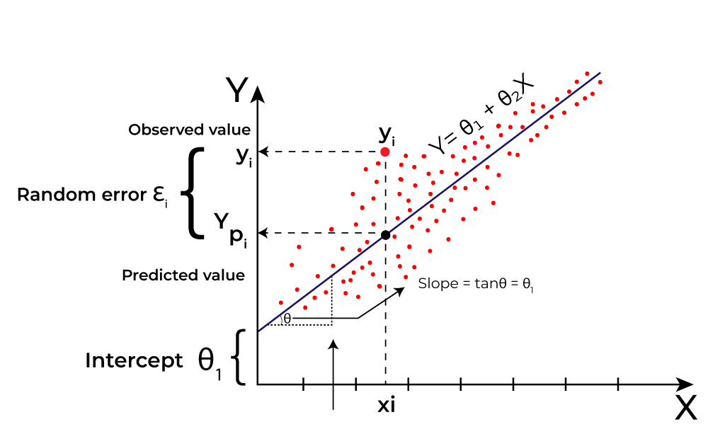
SYSTEM DEVELOPMENT APPROACH
Model Development:
Machine Learning (e.g., Linear Regression, Random Forest) for car prices.
Deep Learning (e.g., Neural Networks) for house prices.

Slide 8
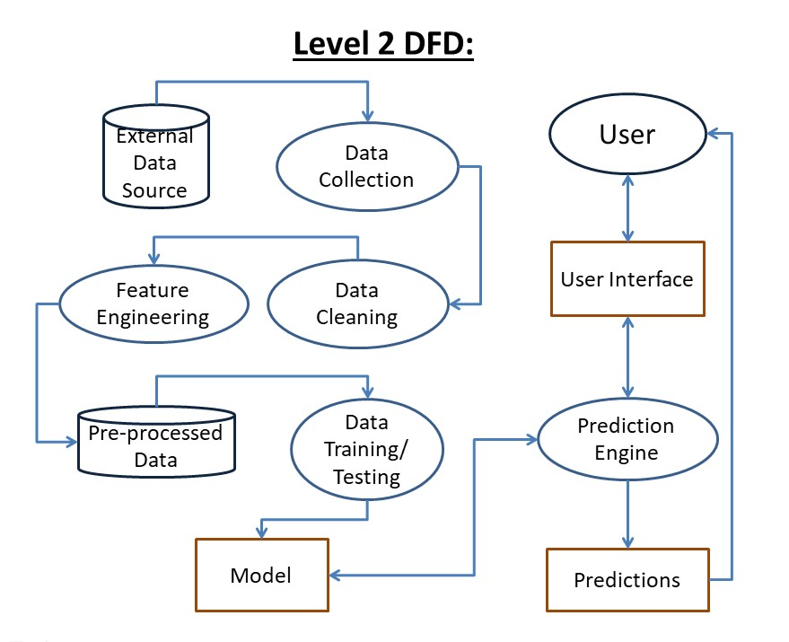
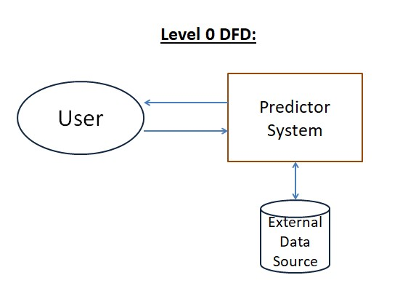
SYSTEM DEVELOPMENT APPROACH
Data Flow Diagram (DFD):

Slide 9
SYSTEM DEVELOPMENT APPROACH
Technology Stack:
Python, Pandas, Scikit-learn, TensorFlow/Keras
Database: CSV
Frontend: Kivy, KivyMD, Python

Slide 10
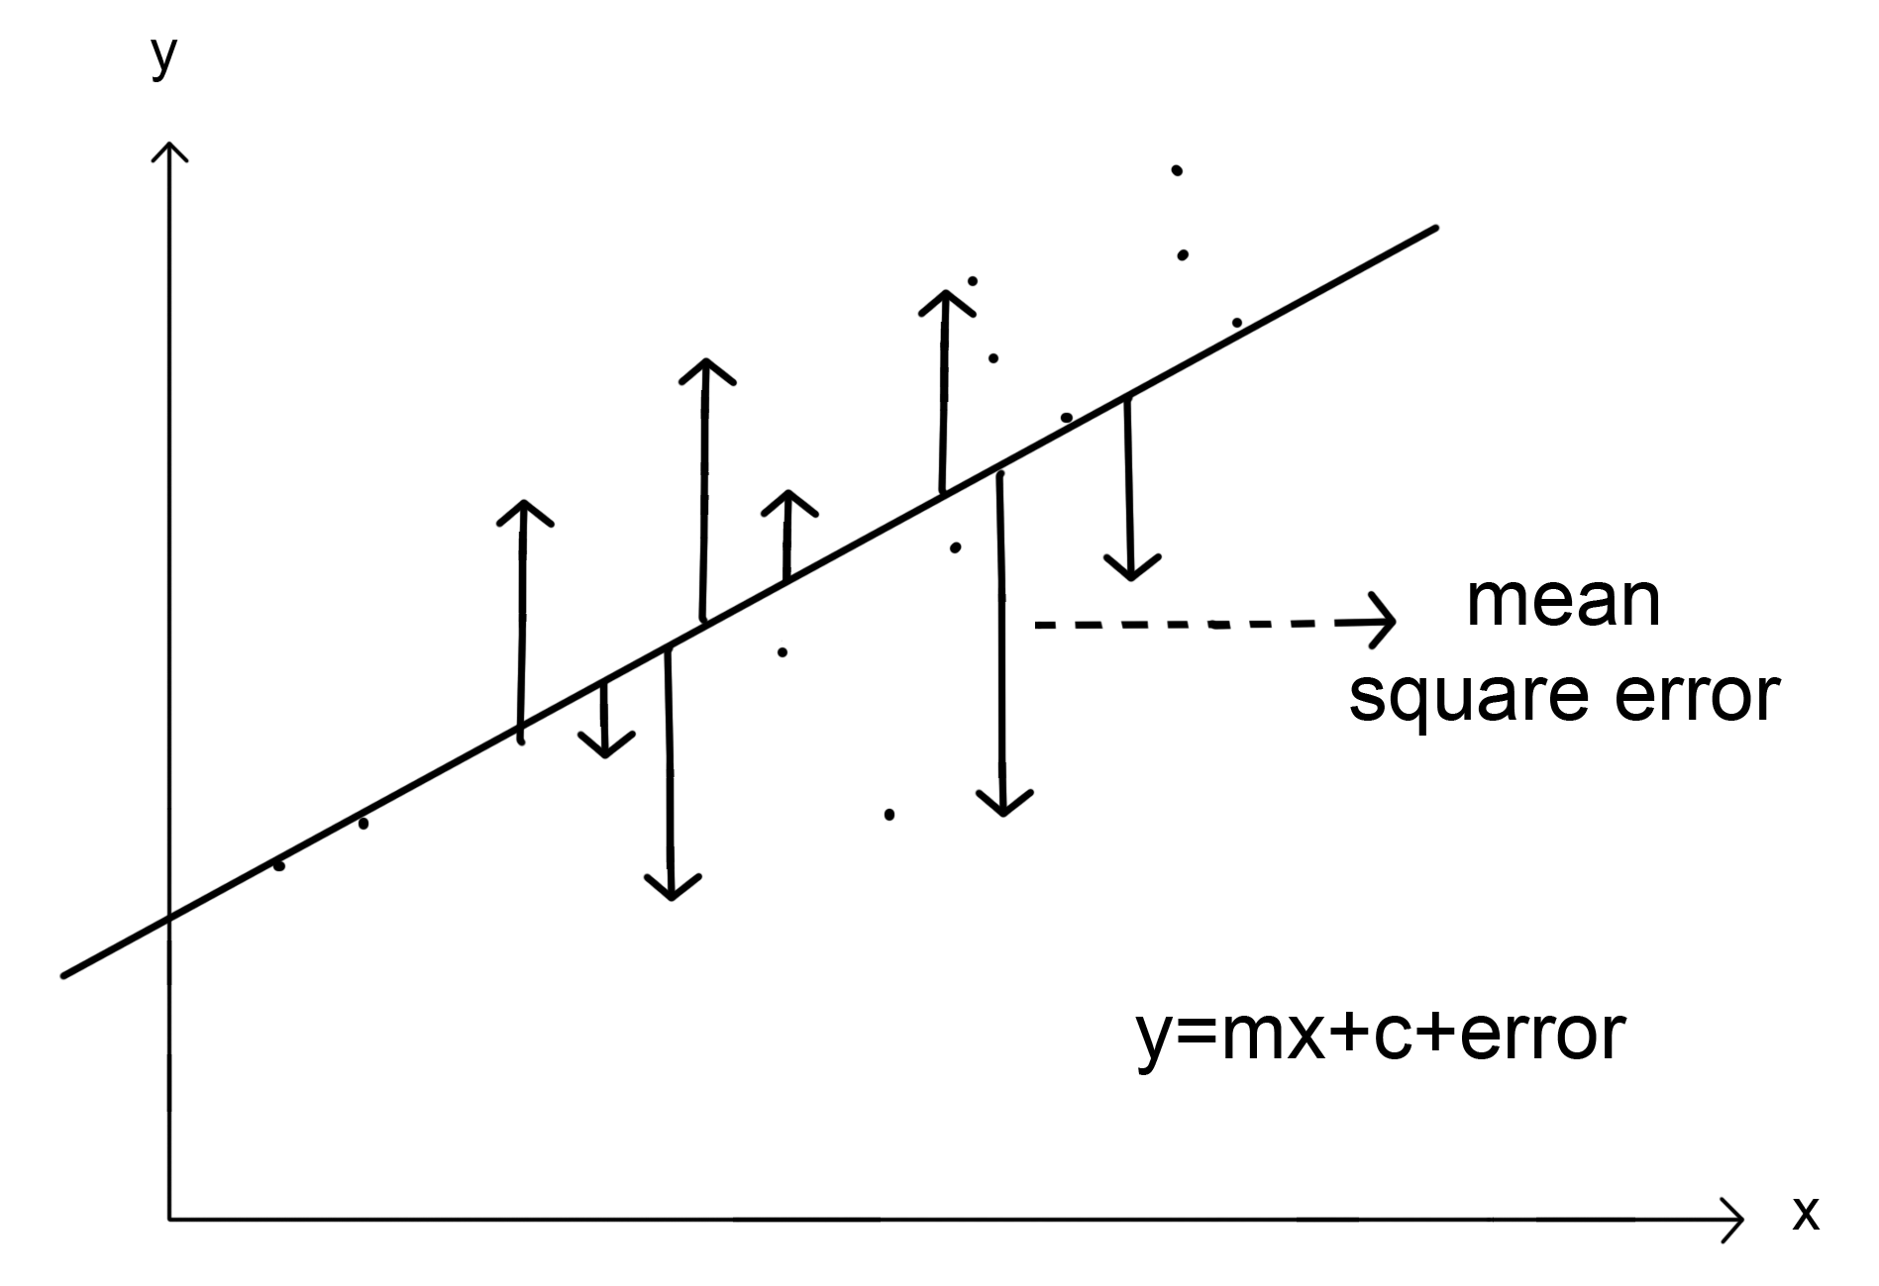
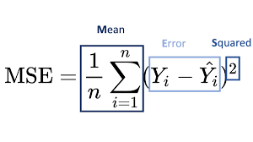
Result
Car Price Prediction:
High accuracy (99%) with machine learning models.
Key metrics: Mean Squared Error (MSE), Root Mean Squared Error (RMSE).

Slide 11
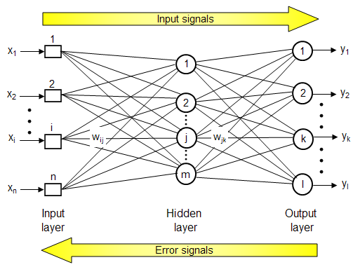
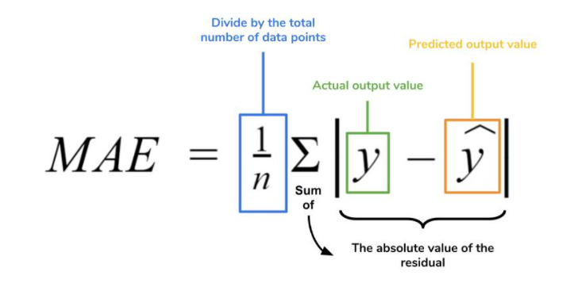
Result
House Price Prediction:
Effective deep learning models capturing complex relationships.
Key metrics: Mean Absolute Error (MAE), R-squared (R²).

Slide 12
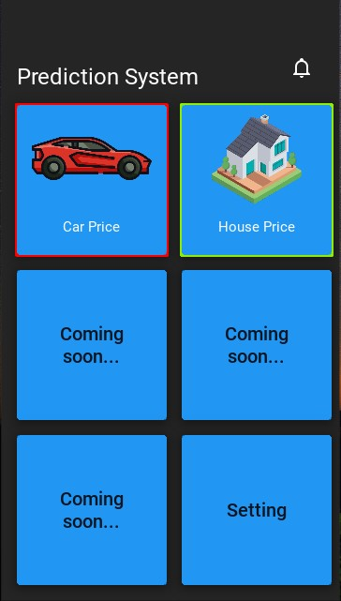
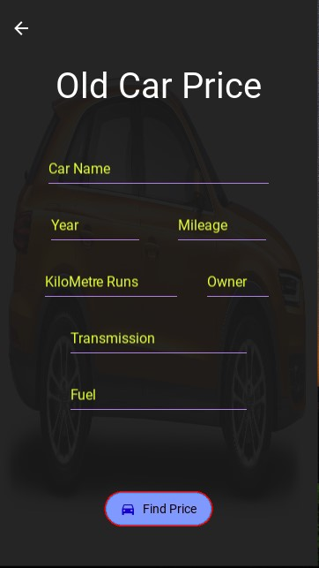
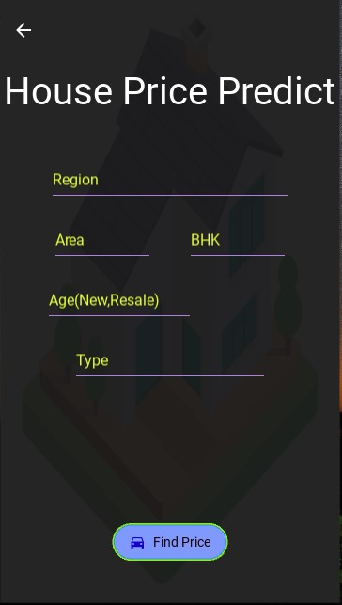
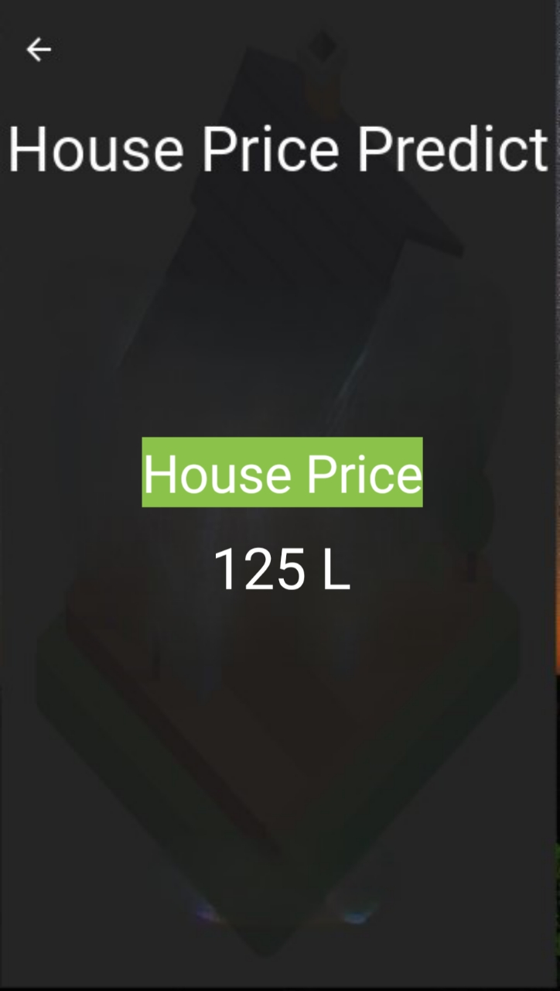
Result

Slide 13
Conclusion
Developed models successfully predict car and house prices.
Models provide valuable insights for users.
Positive impact on decision-making for buyers and sellers.
Demonstrates potential of machine learning and deep learning in price prediction.

Slide 14
Future Scope
Enhancements:
Include additional asset classes (e.g., rental properties, other vehicles).
Integrate advanced machine learning techniques.
Improve user interface for better user experience.
Real-time Data Integration:
Use real-time data for up-to-date predictions.
Ethical Considerations:
Address privacy and ethical issues in data usage.

Slide 15
References
List all the references used
Car Prices Dataset: https://www.kaggle.com/datasets/sidharth178/car-prices-dataset
Mumbai House Prices: https://www.kaggle.com/datasets/dravidvaishnav/mumbai-house-prices
Scikit-learn: https://scikit-learn.org/stable/
TensorFlow: https://www.tensorflow.org/
Codebasics YouTube Channel: https://www.youtube.com/c/codebasics

Slide 16
Thank you

