Slide 1
BASIC OF DEVICE DRIVER
By
Punam kumbhar

Slide 2
Agenda
Introduction
The Role of the Device Driver
System memory
Role of Linux kernel
Linux kernel modules
Disadvantages of building module as a static
Advantages of building module as a dynamic
Hello World Module
Difference between kernel module & application

Slide 3
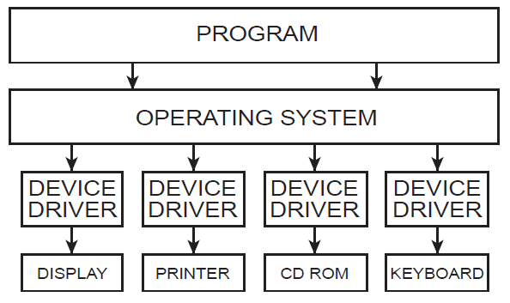
Introduction
Device drivers
  Black boxes to hide details of hardware devices
  Use standardized calls
    Independent of the specific driver
  Main role
    Map standard calls to device-specific operations
  Can be developed separately from the rest of the kernel
    Plugged in at runtime when needed

Slide 4
The Role of the Device Driver
User activities are performed by means of a set of standaridized calls that are independent of the specific driver, mapping those calls to device-specific operations that act on real hardware is then the role of the device driver.

Slide 5
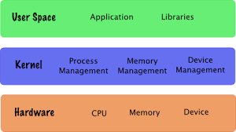
System memory
System memory in linux can be divided into two distinct regions.
- User space
- Kernel space

Slide 6
Role of Linux kernel
Process management
Memory management
File system
Device control
Networking

Slide 7
Linux kernel modules
What is module ?
- A piece of code that can be added to the base kernel is called a module.
What is base kernel ?
- kernel code which is compiled & loaded along with basic device drivers as a single entity is called base kernel.

Slide 8
Kernel Modules
1. Static module
2. Dynamic module
Static module
Kernel image
SM1
Core kernel
features
static modules
SM2

Slide 9
Kernel Modules
Dynamic module
Kernel image
DM1
SM1
SM1
dynamic modules
Core kernel
features
SM2
DM1
static modules

Slide 10
Disadvantages of building module as a static
If we 've written xyz static module for a device driver when we compile along with kernel the size of kernel image increases permanently.
Whenever we modify xyz device driver we need to recompile owr entire kernel to build it.
Also machine need to be rebooted for changes to take effect.

Slide 11
Advantages of building module as a dynamic
With this we don't have to rebuild our kernel as often. It can be compiled separately.
It saves times & spares you the possibility of introducing an error in rebuilding & reinstalling the base kernel.
It saves owr memory because we load them when we are actually using them.

Slide 12
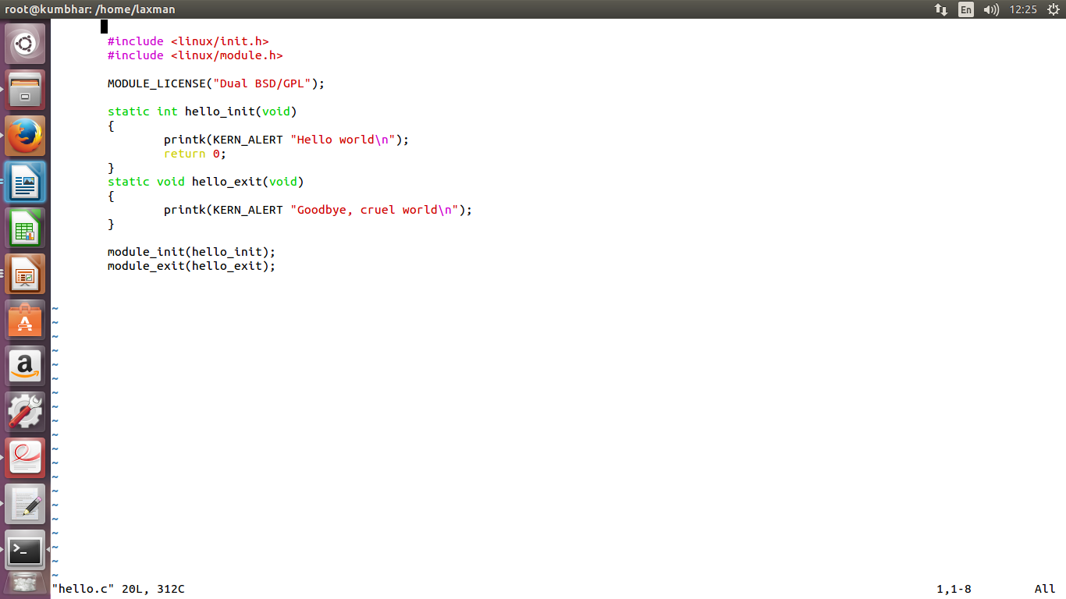
Hello World Module

Slide 13
Difference between kernel module & application
Initialization
Which are event driven KM's & AP's
About exit function in KM's & AP's
Ability to unload module
Linking stage

