Slide 1
Basics of I2c
              By
              Punam kumbhar

Slide 2
Contents
Serial Communication
- parallel vs Serial
- synchronous And Asynchronous Serial Interface:
What is i2c
Why i2c
How i2c works

Slide 3
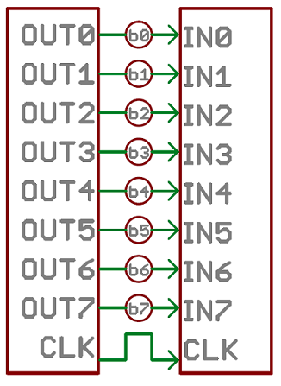
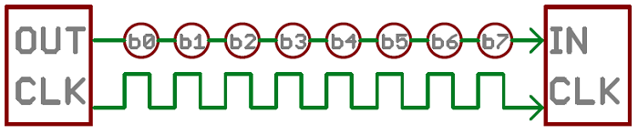
Serial Communication
Parallel vs Serial
Parallel
serial

Slide 4
Serial Communication
Synchronous And Asynchronous Serial Interface:
Sync Serial Interface always pairs its data lines with the clock signal
These make often faster serial transfer, but it aslo requires atleast one extra wire between communicating devices.
Eg:- I2C and SPI
Async means transferring without support from external clock signal
This transmission method is perfect for minimaizing the required wires and I/O pins

Slide 5
What is i2c ?
The Inter-integrated Circuit (I2C) Protocol is a protocol intended to allow multiple “slave” digital integrated circuits (“chips”) to communicate with one or more “master” chips. Like the Serial Peripheral Interface (SPI), it is only intended for short distance communications within a single device. Like Asynchronous Serial Interfaces (such as RS-232 or UART 's ), it only requires two signal wires to exchange information.

Slide 6
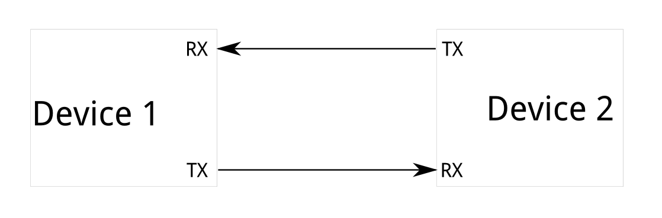
Why ?
To figure out why one might want to communicate over I2C, you must first compare it to the other available options to see how it differs.
What’s Wrong with Serial Ports?

Slide 7
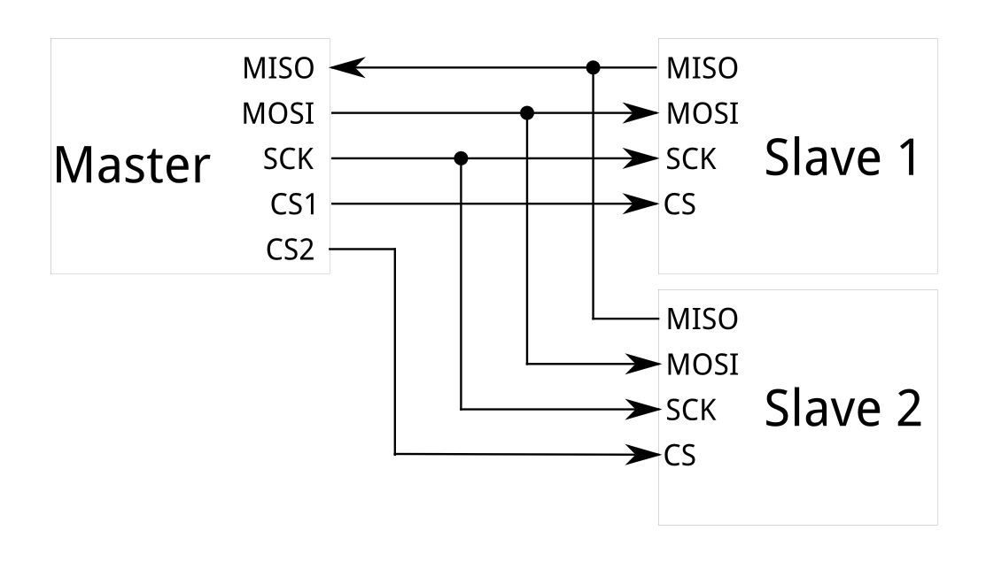
What’s Wrong with SPI ?

Slide 8
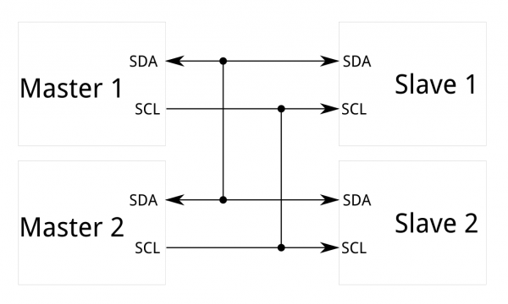
I2C - The Best of Both Worlds!

Slide 9
Features of i2c
It is 2 wired communication bus
I2c bus is multi master & multi slave communication bus
I2c bus is half duplex synchronous serial communication
I2c bus speed
100kbps - std speed mode
400kbpa - medium speed mode
1mbps - fast speed mode
3.4mbps - fast speed plus mode
5mbps - ultra high speed
I2c bus is ack based communication
Transmitt bit by bit from MSB to LSB
Slave address
- 7bit slave add
- 10 bit slave add

Slide 10
Ways to implement i2c protocol
1. Peripheral programming
2. Bit banging programming

Slide 11
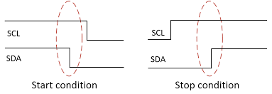
I2c activities
I2c start & stop

Slide 12
I2c write
MSB
LSB
11110010
SDA
SDA
1
SCL
SCL
master
slave

Slide 13
I2c read
1
SDA
SDA
1 | 1 | 1 | 0 | 1 | 0 | 1 | 0
1
SCL
SCL
7
0
master
slave

Slide 14
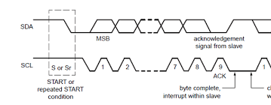
I2c ack

