Slide 1
BUGZILLA
By:-
Rashmi.D

Slide 2
Contents:-
5W's of Bugzilla.
Features of Bugzilla.
Life cycle of Bugzilla bug.
How do I use Bugzilla.
Recap.
References.

Slide 3

5W's of Bugzilla
Why
When
Who
What
Where

Slide 4
What is Bugzilla?
Bugzilla is an open-source issue/bug tracking system that allows developers effectively to keep track of outstanding problems with their product. It is written in Perl and uses MYSQL database.

Slide 5
When it came?
When mozilla.org first came on-line in 1998, one of the first products that was released was Bugzilla, an open source bug system implemented using freely available open source tools.

Slide 6
Why Bugzilla?
Bugzilla is very adaptable to various situations. Bugzilla provides a powerful, easy-to-use solution to configuration management and replication problems.

Slide 7
Who invented it?
Bugzilla was originally written in TCL by Terry Weissman for use at mozilla.org,use at Netscape. Before mozilla.org released it as open source, Terry decided to port Bugzilla to Perl, with the hopes that more people would be able to contribute to it, since Perl seemed to be a more popular language. Bugzilla 2.0 was the result of that port to Perl.

Slide 8
Where we will use Bugzilla?
Known uses currently include IT support queues, Systems Administration deployment management, chip design and development problem tracking (both pre-and-post fabrication), and software and hardware bug tracking for luminaries such as Red hat, NASA, Linux-Mandrake, and VA Systems.

Slide 9
Features of Bugzilla?
Bugzilla boasts many advanced features. These Key features of Bugzilla includes
Advanced search capabilities
E-mail Notifications
Modify/file Bugs by e-mail
Time tracking
Strong security
Customization
Localization

Slide 10
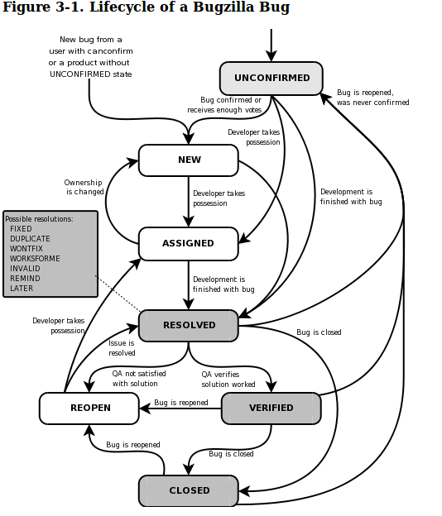
Life cycle of a Bugzilla bug:-

Slide 11
How do I use Bugzilla?
If you want to use Bugzilla, first you need to create an account. Consult with the administrator responsible for your installation of Bugzilla for the URL you should use to access it. If you're test-driving Bugzilla, use this URL: https://landfill.bugzilla.org/bugzilla-2.16.11/

Slide 12
Recap....
Bugzilla is an open-source issue/bug tracking system that is written Terry Weissman in TCL then to Perl and uses MYSQL database,came online in 1998.
Uses mainly include chip design and development problem tracking and software and hardware bug tracking for luminaries such as Red hat, NASA, Linux-Mandrake.etc
Features provided,Advanced search capabilities,E-mail Notifications, Modify/file Bugs by e-mail,Time trackin, Strong security
BUGZILLA bug lifecycle.
How to use BUZILLA...
.

Slide 13
References
https://www.bugzilla.org/docs/2.16/html/whatis.html
http://www.guru99.com/bugzilla-tutorial-for-beginners.html
https://wiki.mozilla.org/Bugzilla:FAQ#Is_it_possible_to_delete_bug_reports.3F
https://media.readthedocs.org/pdf/bugzilla/latest/bugzilla.pdf
https://landfill.bugzilla.org/bugzilla-5.0-branch/query.cgi?format=report-graph
https://www.bugzilla.org/status/roadmap.html
http://royal.pingdom.com/2009/03/19/10-historical-software-bugs-with-extreme-consequences/

Slide 14

https://wiki.mozilla.org/Bugzilla:FAQ#Is_it_possible_to_delete_bug_reports.3F

Slide 15


