Slide 1


SMART INDIA HACKATHON 2025
Problem Statement ID – SIH25031
Problem Statement Title- Crowd-Sourced Civic Issue Reporting and Resolution System
Theme - Clean and Green Technology
PS Category - Software
Team ID - 93
Team Name - NexUrban

Slide 2
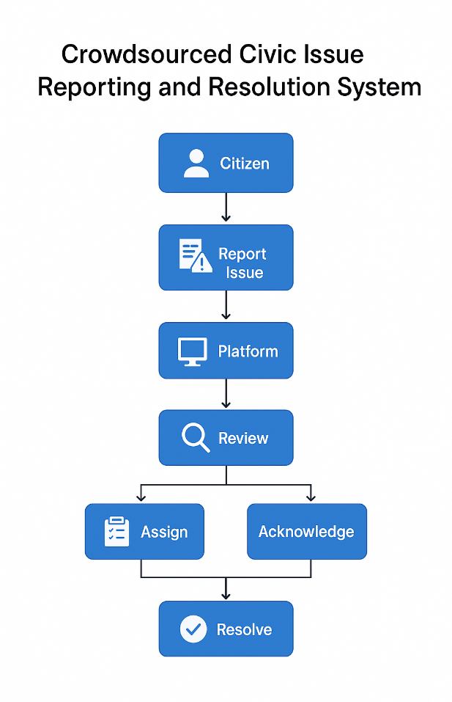
IDEA
NEXURBAN
Key Components:
Citizen Application: Application to report issues with photo, description & GPS, track status.
Authority Dashboard: Officials panel for auto-categorization, assignment, escalation & resolution.
Community Features: Public issue map, voting to prioritize, citizen feedback post-resolution.
Problem Solution:
Creating a user-friendly reporting & monitoring system.
Transparency via public dashboards & live tracking.
Faster response with auto-routing & escalation.
Data-driven governance & preventive planning.
Innovation & Uniqueness:
Crowdsourced Governance: Empowers citizens beyond inspections.
Transparency by Design: Public visibility ensures accountability.
Prioritization based on voting : Public voting for prioritization.
Community Voting: Citizens support boosts priority of urgent issues.

Slide 3
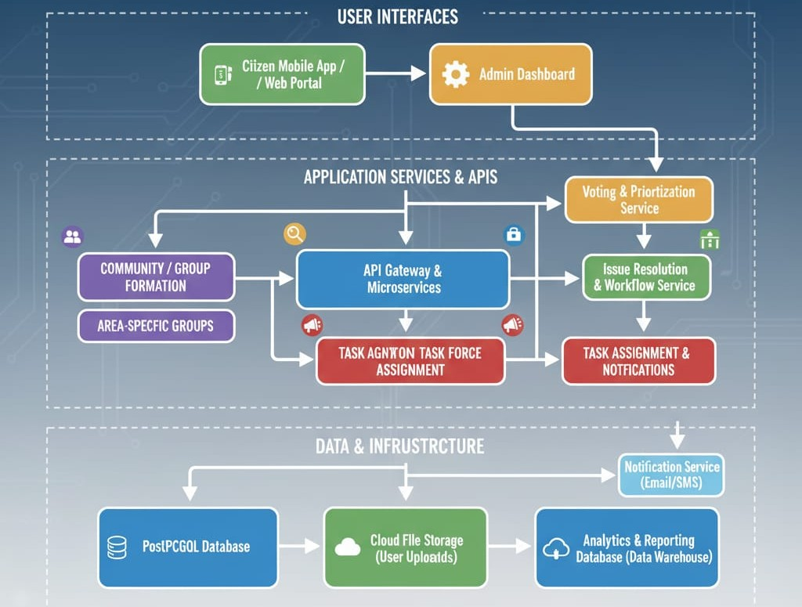
TECHNICAL APPROACH
NEXURBAN
Architecture :
Technologies Used :
Frontend
Flutter React.js Backend
Node.js
Storage and Database
RDS
S3
Services SNS
SES AWS Location

Slide 4
FEASIBILITY AND VIABILITY
NEXURBAN
Feasibility of the Idea
GPS & images
Cloud Platform
Smart City boost/digital adaption
User friendly design/transparent dashboard
Technical Risks/Challenges
Fake reports/GPS errors
Maintainance cost
Rural connectivity
Citizen engagement
Strategies/Method to Overcome
GPS validation
Cloud hosting
Offline support
Citizen reward

Slide 5
IMPACT AND BENEFITS
NEXURBAN
For Citizens
Quick reporting
Transparent Tracking
Citizen empowerment.
For Authorities / Government
Real-time insights
Complaint deduplication
Policy analytics
For Society
Cleaner cities
Better living
Smart India boost
Scalability & Future
Nationwide expansion
Centralized platform
Smart city integration
.

Slide 6
RESEARCH AND REFERENCES
NEXURBAN
References
[1] Walwadkar, Dnyanesh, Jayesh Patil, Mujahid Hussain, and Saurav Yadav. "Smart Civic Issue Reporting System.”
A mobile Android application through which citizens can report various infrastructure or environmental issues (road damage, street lights broken, trash overflow, etc.) to the relevant municipal authorities.
[2] Flores, Carla Cavichiolo, and Denis Alcides Rezende. "Crowdsourcing framework applied to strategic digital city projects." Journal of Urban Management 11, no. 4 (2022): 467-478.
The paper aims to develop an original crowdsourcing framework specifically designed for strategic digital city projects. The focus is on enhancing civic engagement and improving urban governance through collaborative digital platforms.
[3]Chakraborty, Dipanjan, Mohd Sultan Ahmad, and Aaditeshwar Seth. "Findings from a civil society mediated and technology assisted grievance redressal model in rural India." In Proceedings of the Ninth International Conference on Information and Communication Technologies and Development, pp. 1-12. 2017.
The paper aims to develop an original crowdsourcing framework specifically designed for strategic digital city projects. The focus is on enhancing civic engagement and improving urban governance through collaborative digital platforms.
[4] Martin, Daniela. “Crowdsourcing the Public Participation Process for Planning Projects,”
The paper explores the potential of clowd sourcing as a model to enhance public participation in urban planning projects it examines how web based platforms can harness collective intelligence to improve decision making processes.

