Slide 1
COLLECTION FRAMEWORK
Vijay Kumbhar

Slide 2
Java Collections Framework
Here’s what you’ll find in this Collection Framework session :
Interfaces
Lists – ArrayList, Linked Lists
Map - HashMap
Sorted Maps
Sets
Using Custom Objects in Sets and as Keys in Maps
Sorting Lists
Natural Ordering
Queues
Using Iterators
Implementing Iterable
Deciding Which Collection to Use
Complex Data Structures

Slide 3
Java Collections
Salient Features
Interface Implementations
Java Collections are the one-stop solutions for all the data manipulation jobs such as storing data, searching, sorting, insertion, deletion, and updating of data
The Collection interface is not directly implemented by any class. However, it is implemented indirectly via its subtypes or sub-interfaces like List, Queue, and Set.
Interfaces
Usefulness
The Collection interface is the root interface of the Java collections framework.
Collections are used in almost every programming language. Most of the programming languages support various type of collections such as List, Set, Queue, Stack, etc.

Slide 4
Introduction of journey of collection…
2006
JDK 6
2002
2004
JDK 4
JDK 5
2014
JDK 8

Slide 5
01
INTERFACES
The Collection interface is the root interface of the Java collections framework.
Lets explore here onward !!

Slide 6
Interfaces Hierarchy
Iterable
Introduced in JDK 1.5
forEach(), iterator(), spliterator()
Collection
Root interfaces of the Collection Hierarchy
add, addAll, remove, removeAll, retainAll, Size, toArray, clear, contains, equals, hashcode,
isEmpty, itegrator
List
Queue
Set
ordered collection
allows duplicate elements and multiple null elements
can be accessed by position
Implementation : ArrayList, LinkedList, Vector, Stack
FIFO
add, offer, remove, poll, element, peek
Implementation : PriorityQueue
Unordered, No Duplicates
Position access to elements is not allowed
null element can store once
Implementation : HashSet, LinkedHashSet
Deque
LIFO, Double ended
addFirst,addLast,getFirst,getLast,peekFirst,peekLast
Implementation : ArrayDeque
Sorted Set
Unordered, No Duplicates
Position access to elements is not allowed
Implementation : TreeSet

Slide 7
List
Class
Interface
Implements
Extends
ArrayList
Implements
List
Extends
Collection
Declaration :
public interface List<E> extends Collection<E> ;
Syntax :
List<Obj> list = new ArrayList<Obj> ();
Sample Code :
List<String> al = new ArrayList<>();
// Adding elements to object of List interface
al.add("Vijay");
al.add("Sandeep");
al.add(1, "For");
// Print all the elements inside the List interface object
System.out.println(al);

Slide 8
Method for LinkedList
Method Name | Description
boolean add(Object item) | It adds the item at the end of the list.
void add(int index, Object item) | It adds an item at the given index of the the list.
boolean addAll(Collection c) | It adds all the elements of the specified collection c to the list. It throws NullPointerException if the specified collection is null
boolean addAll(int index, Collection c) | It adds all the elements of collection c to the list starting from a give index in the list. It throws NullPointerException if the collection c is null and IndexOutOfBoundsException when the specified index is out of the range.
void addFirst(Object item) | It adds the item (or element) at the first position in the list.
void addLast(Object item) | It inserts the specified item at the end of the list.
void clear() | It removes all the elements of a list.
Object clone() | It returns the copy of the list.
boolean contains(Object item) | It checks whether the given item is present in the list or not. If the item is present then it returns true else false.
Object get(int index) | It returns the item of the specified index from the list.
Object getFirst() | It fetches the first item from the list
Object getLast() | It fetches the last item from the list.
int indexOf(Object item) | It returns the index of the specified item.
int lastIndexOf(Object item) | It returns the index of last occurrence of the specified element.
Object poll() | It returns and removes the first item of the list.
Object pollFirst() | same as poll() method. Removes the first item of the list.
Object pollLast() | It returns and removes the last element of the list.
Object remove() | It removes the first element of the list.
Object remove(int index) | It removes the item from the list which is present at the specified index.
Object remove(Object obj) | It removes the specified object from the list.
Object removeFirst() | It removes the first item from the list.
Object removeLast() | It removes the last item of the list.
Object removeFirstOccurrence(Object item) | It removes the first occurrence of the specified item.
Object removeLastOccurrence(Object item) | It removes the last occurrence of the given element.
Object set(int index, Object item) | It updates the item of specified index with the give value.
int size() | It returns the number of elements of the list.

Slide 9
Difference between ArrayList and LinkedList
ArrayList | LinkedList
1) ArrayList internally uses a dynamic array to store the elements. | LinkedList internally uses a doubly linked list to store the elements.
2) Manipulation with ArrayList is slow because it internally uses an array. If any element is removed from the array, all the other elements are shifted in memory. | Manipulation with LinkedList is faster than ArrayList because it uses a doubly linked list, so no bit shifting is required in memory.
3) An ArrayList class can act as a list only because it implements List only. | LinkedList class can act as a list and queue both because it implements List and Deque interfaces.
4) ArrayList is better for storing and accessing data. | LinkedList is better for manipulating data.
5) The memory location for the elements of an ArrayList is contiguous. | The location for the elements of a linked list is not contagious.
6) Generally, when an ArrayList is initialized, a default capacity of 10 is assigned to the ArrayList. | There is no case of default capacity in a LinkedList. In LinkedList, an empty list is created when a LinkedList is initialized.
7) To be precise, an ArrayList is a resizable array. | LinkedList implements the doubly linked list of the list interface.

Slide 10
1: When the rate of addition or removal rate is more than the read scenarios, then go for the LinkedList. On the other hand, when the frequency of the read scenarios is more than the addition or removal rate, then ArrayList takes precedence over LinkedList. 2: Since the elements of an ArrayList are stored more compact as compared to a LinkedList; therefore, the ArrayList is more cache-friendly as compared to the LinkedList. Thus, chances for the cache miss are less in an ArrayList as compared to a LinkedList. Generally, it is considered that a LinkedList is poor in cache-locality. 3: Memory overhead in the LinkedList is more as compared to the ArrayList. It is because, in a LinkedList, we have two extra links (next and previous) as it is required to store the address of the previous and the next nodes, and these links consume extra space. Such links are not present in an ArrayList.
Important Points :

Slide 11
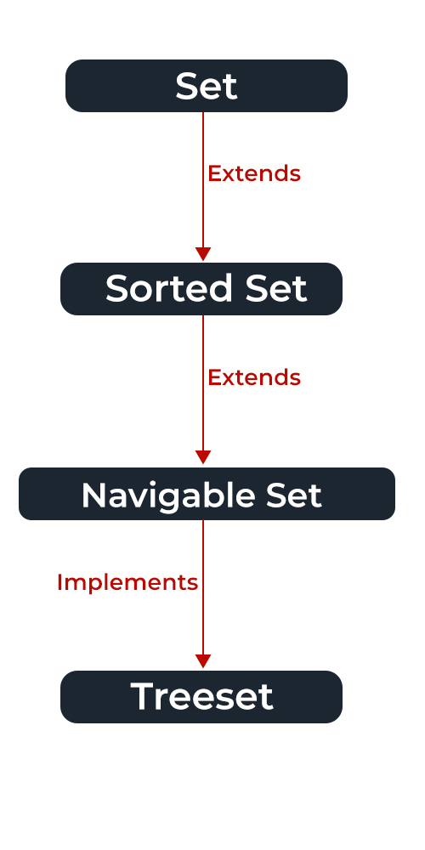
Set Implementation

Slide 12
Navigable Set
Navigable set extends the sorted set interface.
Since a set doesn’t retain the insertion order, the navigable set interface provides the implementation to navigate through the Set.
The class which implements the navigable set is a TreeSet which is an implementation of a self-balancing tree. Therefore, this interface provides us with a way to navigate through this tree.
Syntax: public interface Set extends Collection

Slide 13
Set is an Interface objects cannot be created of the typeset. We always need a class that extends this list in order to create an object. And also, after the introduction of Generics in Java 1.5, it is possible to restrict the type of object that can be stored in the Set.
Syntax : Set<Obj> set = new HashSet<Obj> ();

Slide 14
Methods:
Method | Description
add(element) | This method is used to add a specific element to the set. The function adds the element only if the specified element is not already present in the set else the function returns False if the element is already present in the Set.
addAll(collection) | This method is used to append all of the elements from the mentioned collection to the existing set. The elements are added randomly without following any specific order.
clear() | This method is used to remove all the elements from the set but not delete the set. The reference for the set still exists.
contains(element) | This method is used to check whether a specific element is present in the Set or not.
containsAll(collection) | This method is used to check whether the set contains all the elements present in the given collection or not. This method returns true if the set contains all the elements and returns false if any of the elements are missing.
hashCode() | This method is used to get the hashCode value for this instance of the Set. It returns an integer value which is the hashCode value for this instance of the Set.
isEmpty() | This method is used to check whether the set is empty or not.

Slide 15
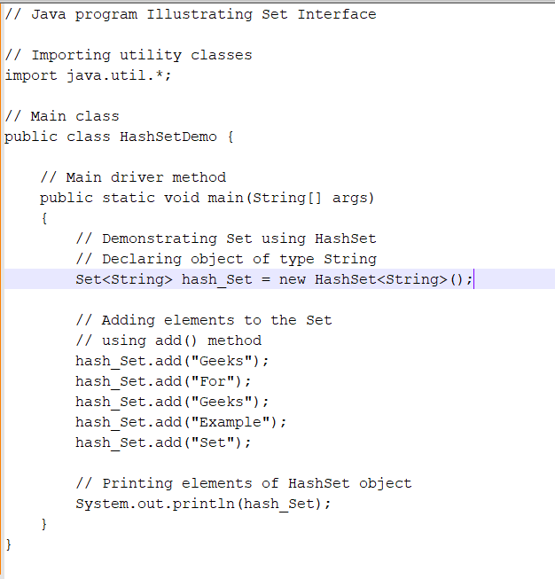
HashSet Example

Slide 16
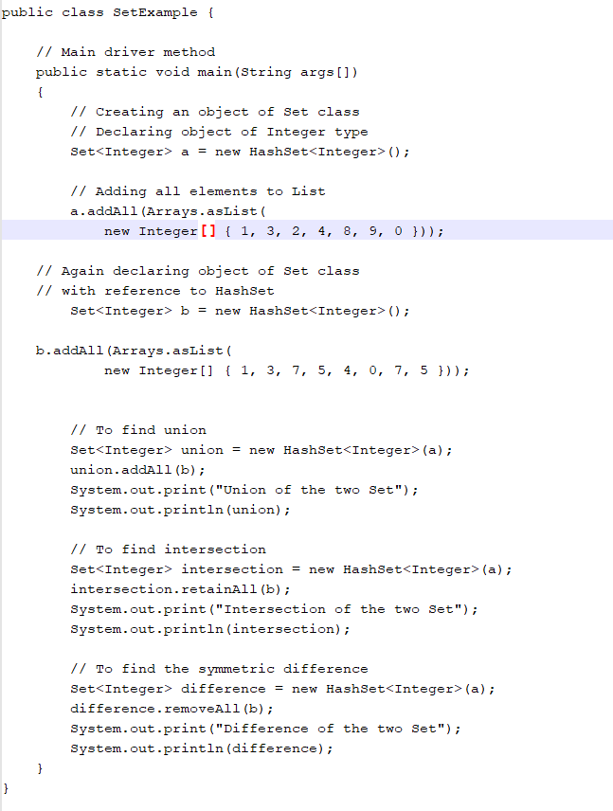

Slide 17
Types:
HashSet
EnumSet
LinkedHashSet
TreeSet

Slide 18
HashSet
HashSet class which is implemented in the collection framework is an inherent implementation of the hash table data structure.
The objects that we insert into the HashSet do not guarantee to be inserted in the same order.
The objects are inserted based on their hashcode. This class also allows the insertion of NULL elements.

Slide 19
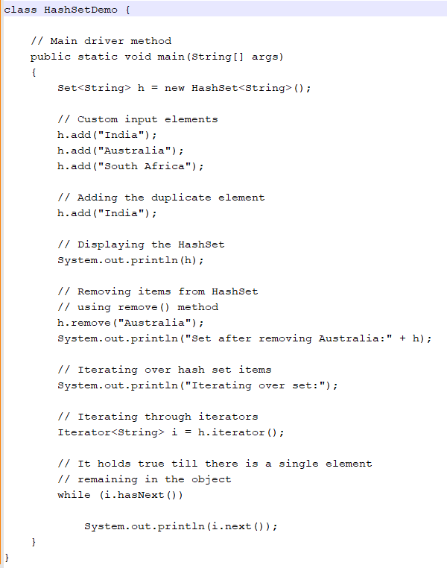

Slide 20
2: EnumSet
EnumSet class which is implemented in the collections framework is one of the specialized implementations of the Set interface for use with the enumeration type.
It is a high-performance set implementation, much faster than HashSet.
All of the elements in an enum set must come from a single enumeration type that is specified when the set is created either explicitly or implicitly

Slide 21
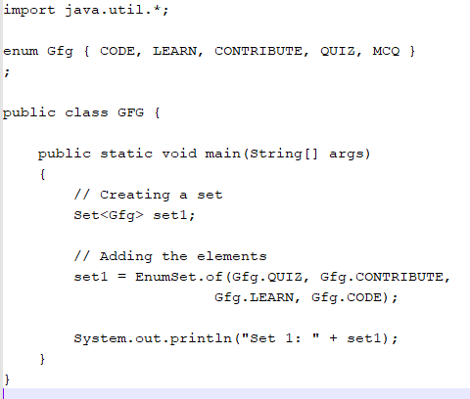
EnumSet Example

Slide 22
Queue:
The Queue interface is present in java.util package and extends the Collection interface is used to hold the elements about to be processed in FIFO(First In First Out) order. It is an ordered list of objects with its use limited to inserting elements at the end of the list and deleting elements from the start of the list, (i.e.), it follows the FIFO or the First-In-First-Out principle.
Being an interface the queue needs a concrete class for the declaration and the most common classes are the PriorityQueue and LinkedList in Java. Note that neither of these implementations is thread-safe. PriorityBlockingQueue is one alternative implementation if the thread-safe implementation is needed.
Syntax: Queue<Obj> queue = new PriorityQueue<Obj> ();
Queue<Integer> q = new LinkedList<>();

Slide 23
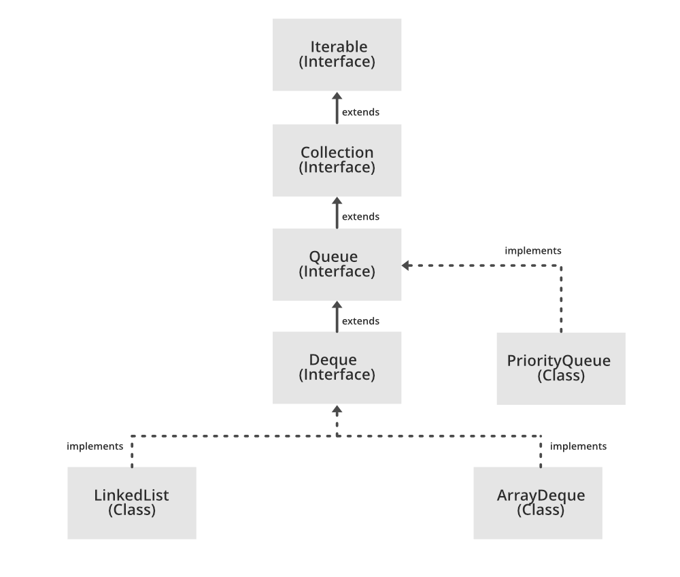

Slide 24
Method | Description
add(int index, element) | This method is used to add an element at a particular index in the queue. When a single parameter is passed, it simply adds the element at the end of the queue.
addAll(int index, Collection collection) | This method is used to add all the elements in the given collection to the queue. When a single parameter is passed, it adds all the elements of the given collection at the end of the queue.
size() | This method is used to return the size of the queue.
clear() | This method is used to remove all the elements in the queue. However, the reference of the queue created is still stored.
remove() | This method is used to remove the element from the front of the queue.
remove(int index) | This method removes an element from the specified index. It shifts subsequent elements(if any) to left and decreases their indexes by 1.
remove(element) | This method is used to remove and return the first occurrence of the given element in the queue.
get(int index) | This method returns elements at the specified index.
set(int index, element) | This method replaces elements at a given index with the new element. This function returns the element which was just replaced by a new element.
indexOf(element) | This method returns the first occurrence of the given element or -1 if the element is not present in the queue.
lastIndexOf(element) | This method returns the last occurrence of the given element or -1 if the element is not present in the queue.
equals(element) | This method is used to compare the equality of the given element with the elements of the queue.
hashCode() | This method is used to return the hashcode value of the given queue.
isEmpty() | This method is used to check if the queue is empty or not. It returns true if the queue is empty, else false.
contains(element) | This method is used to check if the queue contains the given element or not. It returns true if the queue contains the element.
containsAll(Collection collection) | This method is used to check if the queue contains all the collection of elements.
sort(Comparator comp) | This method is used to sort the elements of the queue on the basis of the given comparator.
boolean add(object) | This method is used to insert the specified element into a queue and return true upon success.
boolean offer(object) | This method is used to insert the specified element into the queue.
Object poll() | This method is used to retrieve and removes the head of the queue, or returns null if the queue is empty.
Object element() | This method is used to retrieves, but does not remove, the head of queue.
Object peek() | This method is used to retrieves, but does not remove, the head of this queue, or returns null if this queue is empty.

Slide 25
Characteristics of Queue
The Queue is used to insert elements at the end of the queue and removes from the beginning of the queue. It follows FIFO concept.
The Java Queue supports all methods of Collection interface including insertion, deletion, etc.
LinkedList, ArrayBlockingQueue and PriorityQueue are the most frequently used implementations.
If any null operation is performed on BlockingQueues, NullPointerException is thrown.
The Queues which are available in java.util package are Unbounded Queues.
The Queues which are available in java.util.concurrent package are the Bounded Queues.
All Queues except the Deques supports insertion and removal at the tail and head of the queue respectively. The Deques support element insertion and removal at both ends.

Slide 26
Iterator in Collection
Iterator iterator = pq.iterator();
while (iterator.hasNext())
{
System.out.print(iterator.next() + " ");
}

Slide 27

HASHMAP
HashMap is a part of Java’s collection since Java 1.2. This class is found in java.util package. It provides the basic implementation of the Map interface of Java. HashMap in Java stores the data in (Key, Value) pairs, and you can access them by an index of another type (e.g. an Integer). One object is used as a key (index) to another object (value). If you try to insert the duplicate key in HashMap, it will replace the element of the corresponding key.

Slide 28

Java HashMap is similar to HashTable, but it is unsynchronized. It allows to store the null keys as well, but there should be only one null key object and there can be any number of null values. This class makes no guarantees as to the order of the map. To use this class and its methods, you need to import java.util.HashMap package or its superclass.

Slide 29
Characteristics of HashMap:
Fast access time: HashMaps provide constant time access to elements, which means that retrieval and insertion of elements are very fast, usually O(1) time complexity.
Uses hashing function: HashMaps uses a hash function to map keys to indices in an array. This allows for a quick lookup of values based on keys.
Stores key-value pairs: Each element in a HashMap consists of a key-value pair. The key is used to look up the associated value.
Supports null keys and values: HashMaps allow for null values and keys. This means that a null key can be used to store a value, and a null value can be associated with a key.
Not ordered: HashMaps are not ordered, which means that the order in which elements are added to the map is not preserved. However, LinkedHashMap is a variation of HashMap that preserves the insertion order.
Allows duplicates: HashMaps allow for duplicate values, but not duplicate keys. If a duplicate key is added, the previous value associated with the key is overwritten.
Thread-unsafe: HashMaps are not thread-safe, which means that if multiple threads access the same hashmap simultaneously, it can lead to data inconsistencies. If thread safety is required, ConcurrentHashMap can be used.
Capacity and load factor: HashMaps have a capacity, which is the number of elements that it can hold, and a load factor, which is the measure of how full the hashmap can be before it is resized.

Slide 30

Example
import java.util.HashMap;
public class ExampleHashMap {
public static void main(String[] args) {
// Create a HashMap
HashMap<String, Integer> hashMap = new HashMap<>();
// Add elements to the HashMap
hashMap.put(“ABC", 25);
hashMap.put(“PQR", 30);
hashMap.put(“MNO", 35);
// Access elements in the HashMap
System.out.println(hashMap.get(" ABC ")); // Output: 25
// Remove an element from the HashMap
hashMap.remove("PQR");
// Check if an element is present in the HashMap
System.out.println(hashMap.containsKey("MNO")); // Output: false
// Get the size of the HashMap
System.out.println(hashMap.size()); // Output: 2
}
}

Slide 31

Internal Structure of HashMap
HashMap contains an array of Node and a node is represented as a class that contains 4 fields:
int hash
K key
V value
Node next

Slide 32
Methods
Method | Description
clear() | Removes all of the mappings from this map.
clone() | Returns a shallow copy of this HashMap instance: the keys and values themselves are not cloned.
compute(K key, BiFunction<? super K, ? super V,? extends V> remappingFunction) | Attempts to compute a mapping for the specified key and its current mapped value (or null if there is no current mapping).
computeIfAbsent(K key, Function<? super K,? extends V> mappingFunction) | If the specified key is not already associated with a value (or is mapped to null), attempts to compute its value using the given mapping function and enters it into this map unless null.
computeIfPresent(K key, BiFunction<? super K, ? super V,? extends V> remappingFunction) | If the value for the specified key is present and non-null, attempts to compute a new mapping given the key and its current mapped value.
containsKey(Object key) | Returns true if this map contains a mapping for the specified key.
containsValue(Object value) | Returns true if this map maps one or more keys to the specified value.
entrySet() | Returns a Set view of the mappings contained in this map.
get(Object key) | Returns the value to which the specified key is mapped, or null if this map contains no mapping for the key.
isEmpty() | Returns true if this map contains no key-value mappings.
keySet() | Returns a Set view of the keys contained in this map.
merge(K key, V value, BiFunction<? super V, ? super V,? extends V> remappingFunction) | If the specified key is not already associated with a value or is associated with null, associate it with the given non-null value.
put(K key, V value) | Associates the specified value with the specified key in this map.
putAll(Map<? extends K,? extends V> m) | Copies all of the mappings from the specified map to this map.
remove(Object key) | Removes the mapping for the specified key from this map if present.
size() | Returns the number of key-value mappings in this map.
values() | Returns a Collection view of the values contained in this map.

Slide 33
Advantages of HashMap:
Fast retrieval: HashMaps provide constant time access to elements, which means that retrieval and insertion of elements is very fast.
Efficient storage: HashMaps use a hashing function to map keys to indices in an array. This allows for quick lookup of values based on keys, and efficient storage of data.
Flexibility: HashMaps allow for null keys and values, and can store key-value pairs of any data type.
Easy to use: HashMaps have a simple interface and can be easily implemented in Java.
Suitable for large data sets: HashMaps can handle large data sets without slowing down.

Slide 34
Disadvantages of HashMap:
Unordered: HashMaps are not ordered, which means that the order in which elements are added to the map is not preserved.
Not thread-safe: HashMaps are not thread-safe, which means that if multiple threads access the same hashmap simultaneously, it can lead to data inconsistencies.
Performance can degrade: In some cases, if the hashing function is not properly implemented or if the load factor is too high, the performance of a HashMap can degrade.
More complex than arrays or lists: HashMaps can be more complex to understand and use than simple arrays or lists, especially for beginners.
Higher memory usage: Since HashMaps use an underlying array, they can use more memory than other data structures like arrays or lists. This can be a disadvantage if memory usage is a concern.

