Slide 1
Core Java
Prepared By Vijay

Slide 2
Agenda
What is JAVA?
Features of JAVA
History
Editions of JAVA
JVM Architecture
Hardware Specifications
Software Used

Slide 3
Introduction: Java - Overview
Java programming language was originally developed by Sun Microsystems which was initiated by James Gosling and released in 1995 as core component of Sun Microsystems' Java platform (Java 1.0 [J2SE]).
The latest release of the Java Standard Edition is Java SE 8. With the advancement of Java and its widespread popularity, multiple configurations were built to suit various types of platforms. For example: J2EE for Enterprise Applications, J2ME for Mobile Applications.
The new J2 versions were renamed as Java SE, Java EE, and Java ME respectively. Java is guaranteed to be Write Once, Run Anywhere.

Slide 4
History of Java

Slide 5
History of Java
James Gosling initiated Java language project in June 1991 for use in one of his many set-top box projects. The language, initially called ‘Oak’ after an oak tree that stood outside Gosling's office, also went by the name ‘Green’ and ended up later being renamed as Java, from a list of random words.
Sun released the first public implementation as Java 1.0 in 1995. It promised Write Once, Run Anywhere (WORA), providing no-cost run-times on popular platforms.
On 13 November, 2006, Sun released much of Java as free and open source software under the terms of the GNU General Public License (GPL).
On 8 May, 2007, Sun finished the process, making all of Java's core code free and open-source, aside from a small portion of code to which Sun did not hold the copyright.

Slide 6
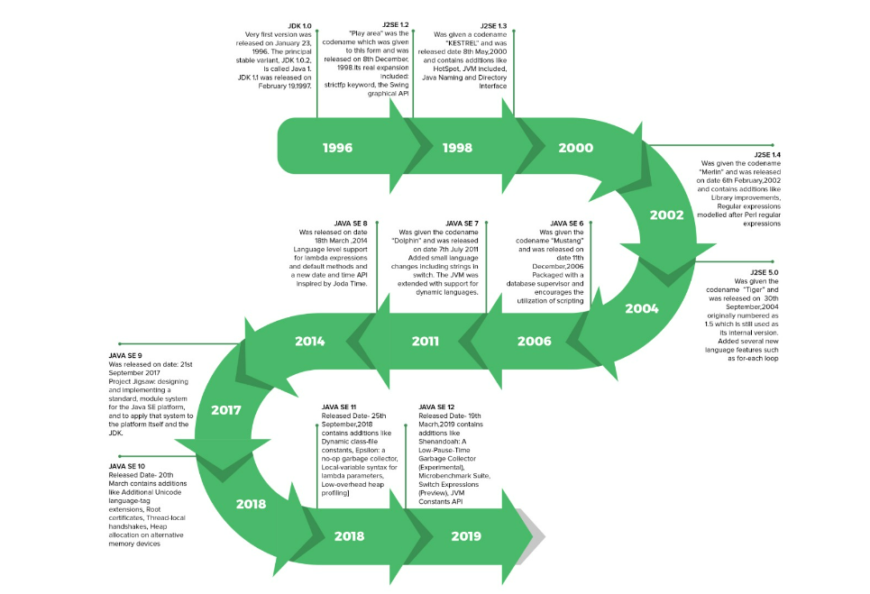

Slide 7
Java is − performance
Object Oriented − In Java, everything is an Object. Java can be easily extended since it is based on the Object model.
Platform Independent − Unlike many other programming languages including C and C++, when Java is compiled, it is not compiled into platform specific machine, rather into platform independent byte code. This byte code is distributed over the web and interpreted by the Virtual Machine (JVM) on whichever platform it is being run on.
Simple − Java is designed to be easy to learn. If you understand the basic concept of OOP Java, it would be easy to master.
Secure − With Java's secure feature it enables to develop virus-free, tamper-free systems. Authentication techniques are based on public-key encryption.
Architecture-neutral − Java compiler generates an architecture-neutral object file format, which makes the compiled code executable on many processors, with the presence of Java runtime system.
Portable − Being architecture-neutral and having no implementation dependent aspects of the specification makes Java portable. Compiler in Java is written in ANSI C with a clean portability boundary, which is a POSIX subset.
Robust − Java makes an effort to eliminate error prone situations by emphasizing mainly on compile time error checking and runtime checking.

Slide 8
Cont’d
Multithreaded − With Java's multithreaded feature it is possible to write programs that can perform many tasks simultaneously. This design feature allows the developers to construct interactive applications that can run smoothly.
Interpreted − Java byte code is translated on the fly to native machine instructions and is not stored anywhere. The development process is more rapid and analytical since the linking is an incremental and light-weight process.
High Performance − With the use of Just-In-Time compilers, Java enables high performance.
Distributed − Java is designed for the distributed environment of the internet.
Dynamic − Java is considered to be more dynamic than C or C++ since it is designed to adapt to an evolving environment. Java programs can carry extensive amount of run-time information that can be used to verify and resolve accesses to objects on run-time.

Slide 9
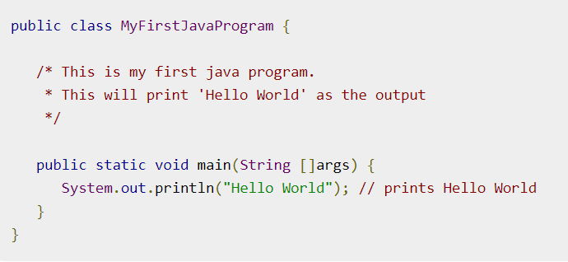
Sample Code

Slide 10
Local Environment Setup
Download Link: https://www.oracle.com/java/technologies/downloads/#java8
Go to Windows: Select Version depending on OS
Product/file description | File size | Download
x86 Installer | 161.54 MB | jdk-8u371-windows-i586.exe
x64 Installer | 175.54 MB | jdk-8u371-windows-x64.exe

Slide 11
Popular Java Editors
Notepad − On Windows machine, you can use any simple text editor like Notepad (Recommended for this tutorial), TextPad.
Netbeans − A Java IDE that is open-source and free which can be downloaded from https://www.netbeans.org/index.html.
Eclipse − A Java IDE developed by the eclipse open-source community and can be downloaded from https://www.eclipse.org/.
IntelliJ : A JAVA IDE developed by jetBrains https://www.jetbrains.com/idea/download/#section=windows

Slide 12
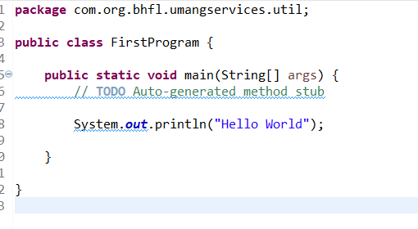

First Program

Slide 13
Fundamental of Programming:
Object −
Objects have states and behaviors. Example: A dog has states - color, name, breed as well as behavior such as wagging their tail, barking, eating. An object is an instance of a class.
Class −
A class can be defined as a template/blueprint that describes the behavior/state that the object of its type supports.
Methods −
A method is basically a behavior. A class can contain many methods. It is in methods where the logics are written, data is manipulated, and all the actions are executed.
Instance Variables −
Each object has its unique set of instance variables. An object's state is created by the values assigned to these instance variables.

Slide 14
Version | Release Date | Major changes
JDK Beta | 1995
JDK 1.0 | January 1996 | The Very first version was released on January 23, 1996. The principal stable variant, JDK 1.0.2, is called Java 1.
JDK 1.1 | February 1997 | Was released on February 19, 1997. There were many additions in JDK 1.1 as compared to version 1.0 such as A broad retooling of the AWT occasion show Inner classes added to the language JavaBeans JDBC RMI
J2SE 1.2 | December 1998 | “Play area” was the codename which was given to this form and was released on 8th December 1998. Its real expansion included: strictfp keyword the Swing graphical API was coordinated into the centre classes Sun’s JVM was outfitted with a JIT compiler out of the blue Java module Java IDL, an IDL usage for CORBA interoperability Collections system
J2SE 1.3 | May 2000 | Codename- “KESTREL” Release Date- 8th May 2000 Additions: HotSpot JVM included Java Naming and Directory Interface JPDA JavaSound Synthetic proxy classes
J2SE 1.4 | February 2002 | Codename- “Merlin” Release Date- 6th February 2002 Additions: Library improvements Regular expressions modelled after Perl regular expressions The image I/O API for reading and writing images in formats like JPEG and PNG Integrated XML parser and XSLT processor (JAXP) (specified in JSR 5 and JSR 63) Preferences API (java.util.prefs) Public Support and security updates for this version ended in October 2008.
J2SE 5.0 | September 2004 | Codename- “Tiger” Release Date- “30th September 2004” Originally numbered as 1.5 which is still used as its internal version. Added several new language features such as: for-each loop Generics Autoboxing Var-args

Slide 15
Version | Release Date | Major changes
JAVA SE 6 | December 2006 | Codename- “Mustang” Released Date- 11th December 2006 Packaged with a database supervisor and encourages the utilization of scripting languages with the JVM. Replaced the name J2SE with java SE and dropped the .0 from the version number. Additions: Upgrade of JAXB to version 2.0: Including integration of a StAX parser. Support for pluggable annotations (JSR 269). JDBC 4.0 support (JSR 221)
JAVA SE 7 | July 2011 | Codename- “Dolphin” Release Date- 7th July 2011 Added small language changes including strings in the switch. The JVM was extended with support for dynamic languages. Additions: Compressed 64-bit pointers. Binary Integer Literals. Upstream updates to XML and Unicode.
JAVA SE 8 | March 2014 | Released Date- 18th March 2014 Language level support for lambda expressions and default methods and a new date and time API inspired by Joda Time.
JAVA SE 9 | September 2017 | Release Date: 21st September 2017 Project Jigsaw: designing and implementing a standard, a module system for the Java SE platform, and to apply that system to the platform itself and the JDK.
JAVA SE 10 | March 2018 | Released Date- 20th March Addition: Additional Unicode language-tag extensions Root certificates Thread-local handshakes Heap allocation on alternative memory devices Remove the native-header generation tool – javah. Consolidate the JDK forest into a single repository.

Slide 16
Version | Release Date | Major changes
JAVA SE 11 | September 2018 | Released Date- 25th September, 2018 Additions- Dynamic class-file constants Epsilon: a no-op garbage collector The local-variable syntax for lambda parameters Low-overhead heap profiling HTTP client (standard) Transport Layer Security (TLS) 1.3 Flight recorder
JAVA SE 12 | March 2019 | Released Date- 19th March 2019 Additions- Shenandoah: A Low-Pause-Time Garbage Collector (Experimental) Microbenchmark Suite Switch Expressions (Preview) JVM Constants API One AArch64 Port, Not Two Default CDS Archives

Slide 17
JVM Architecture
JVM(Java Virtual Machine) acts as a run-time engine to run Java applications. JVM is the one that actually calls the main method present in a java code. JVM is a part of JRE(Java Runtime Environment).
Java applications are called WORA (Write Once Run Anywhere). This means a programmer can develop Java code on one system and can expect it to run on any other Java-enabled system without any adjustment. This is all possible because of JVM.
When we compile a .java file, .class files(contains byte-code) with the same class names present in .java file are generated by the Java compiler. This .class file goes into various steps when we run it. These steps together describe the whole JVM.

Slide 18
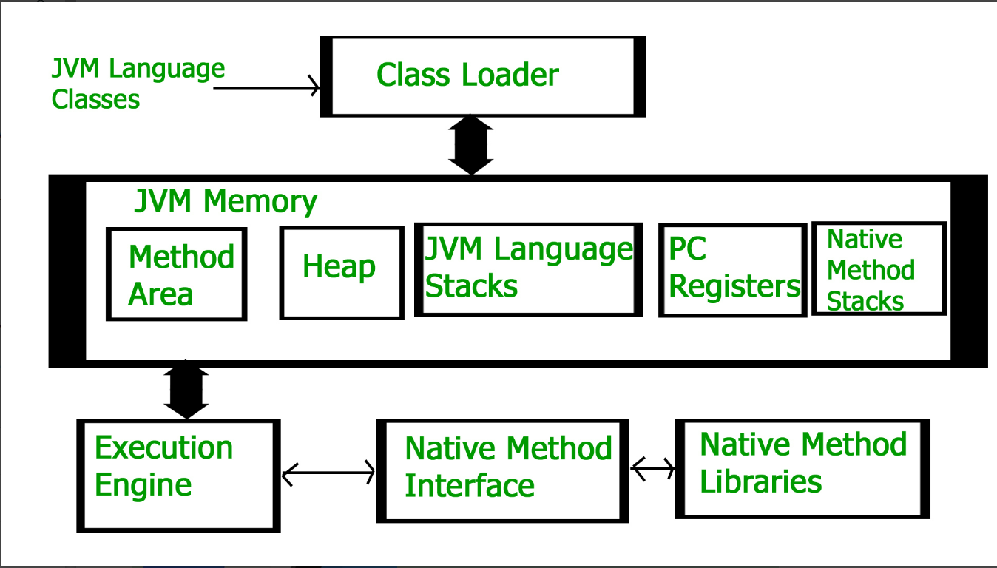

Slide 19
Linking :Performs verification, preparation, and (optionally) resolution
Verification: It ensures the correctness of the .class file i.e. it checks whether this file is properly formatted and generated by a valid compiler or not. If verification fails, we get run-time exception java.lang.VerifyError. This activity is done by the component ByteCodeVerifier. Once this activity is completed then the class file is ready for compilation.
Preparation: JVM allocates memory for class static variables and initializing the memory to default values.
Resolution: It is the process of replacing symbolic references from the type with direct references. It is done by searching into the method area to locate the referenced entity.

Slide 20
Initialization
In this phase, all static variables are assigned with their values defined in the code and static block(if any). This is executed from top to bottom in a class and from parent to child in the class hierarchy.
Bootstrap class loader:
Extension class loader:
System/Application class loader:

Slide 21
Bootstrap class loader:
Every JVM implementation must have a bootstrap class loader, capable of loading trusted classes. It loads core java API classes present in the “JAVA_HOME/jre/lib” directory. This path is popularly known as the bootstrap path. It is implemented in native languages like C, C++

Slide 22
Extension class loader:
It is a child of the bootstrap class loader. It loads the classes present in the extensions directories “JAVA_HOME/jre/lib/ext”(Extension path) or any other directory specified by the java.ext.dirs system property. It is implemented in java by the sun.misc.Launcher$ExtClassLoader class.

Slide 23
System/Application class loader:
It is a child of the extension class loader. It is responsible to load classes from the application classpath. It internally uses Environment Variable which mapped to java.class.path. It is also implemented in Java by the sun.misc.Launcher$AppClassLoader class.

Slide 24
// Java code to demonstrate Class Loader subsystem
public class Test {
public static void main(String[] args)
{
// String class is loaded by bootstrap loader, and
// bootstrap loader is not Java object, hence null
System.out.println(String.class.getClassLoader());
// Test class is loaded by Application loader
System.out.println(Test.class.getClassLoader());
}
}

Slide 25
JVM Memory
Method area: In the method area, all class level information like class name, immediate parent class name, methods and variables information etc. are stored, including static variables. There is only one method area per JVM, and it is a shared resource. From java 8, static variables are now stored in Heap area.
Heap area: Information of all objects is stored in the heap area. There is also one Heap Area per JVM. It is also a shared resource.
Stack area: For every thread, JVM creates one run-time stack which is stored here. Every block of this stack is called activation record/stack frame which stores methods calls. All local variables of that method are stored in their corresponding frame. After a thread terminates, its run-time stack will be destroyed by JVM. It is not a shared resource.

Slide 26
PC Registers: Store address of current execution instruction of a thread. Obviously, each thread has separate PC Registers.
Native method stacks: For every thread, a separate native stack is created. It stores native method information.

Slide 27
Execution Engine
Execution engine executes the “.class” (bytecode). It reads the byte-code line by line, uses data and information present in various memory area and executes instructions. It can be classified into three parts:
Interpreter: It interprets the bytecode line by line and then executes. The disadvantage here is that when one method is called multiple times, every time interpretation is required.
Just-In-Time Compiler(JIT) : It is used to increase the efficiency of an interpreter. It compiles the entire bytecode and changes it to native code so whenever the interpreter sees repeated method calls, JIT provides direct native code for that part so re-interpretation is not required, thus efficiency is improved.
Garbage Collector: It destroys un-referenced objects. For more on Garbage Collector, refer Garbage Collector.

Slide 28
Java Native Interface:
It is an interface that interacts with the Native Method Libraries and provides the native libraries(C, C++) required for the execution. It enables JVM to call C/C++ libraries and to be called by C/C++ libraries which may be specific to hardware.
Native Method Libraries :
It is a collection of the Native Libraries(C, C++) which are required by the Execution Engine

Slide 29
Bytecode
Bytecode in Java is a set of instructions for the Java Virtual Machine. Bytecode is a platform-independent code. Bytecode is a code that lies between low-level language and high-level language. After the Java code is compiled, the bytecode gets generated, which can be executed on any machine using JVM.

Slide 30
Unicode
Unicode is a universal international standard character encoding that is capable of representing most of the world's written languages.
ASCII (American Standard Code for Information Interchange) for the United States.
ISO 8859-1 for Western European Language.
KOI-8 for Russian.
GB18030 and BIG-5 for chinese, and so on.

Slide 31
Problem:
A particular code value corresponds to different letters in the various language standards.
The encodings for languages with large character sets have variable length.Some common characters are encoded as single bytes, other require two or more byte.
Solution:
To solve these problems, a new language standard was developed i.e. Unicode System.
In unicode, character holds 2 byte, so java also uses 2 byte for characters.
lowest value:\u0000
highest value:\uFFFF

Slide 32
Thank you

