Slide 1
Core Java (Casting in Java)
By Vijay Kumbhar

Slide 2
Java provides various data types just likely any other dynamic languages such as boolean, char, int, unsigned int, signed int, float, double, long, etc in total providing 7 types where every datatype acquires different space while storing in memory. When you assign a value of one data type to another, the two types might not be compatible with each other. If the data types are compatible, then Java will perform the conversion automatically known as Automatic Type Conversion, and if not then they need to be cast or converted explicitly. For example, assigning an int value to a long variable

Slide 3
Datatype | Bits Acquired In Memory
boolean | 1
byte | 8 (1 byte)
char | 16 (2 bytes)
short | 16(2 bytes)
int | 32 (4 bytes)
long | 64 (8 bytes)
float | 32 (4 bytes)
double | 64 (8 bytes)

Slide 4
Widening or Automatic Type Conversion
Widening conversion takes place when two data types are automatically converted. This happens when:
The two data types are compatible.
When we assign a value of a smaller data type to a bigger data type.
For Example, in java, the numeric data types are compatible with each other but no automatic conversion is supported from numeric type to char or boolean. Also, char and boolean are not compatible with each other.

Slide 5
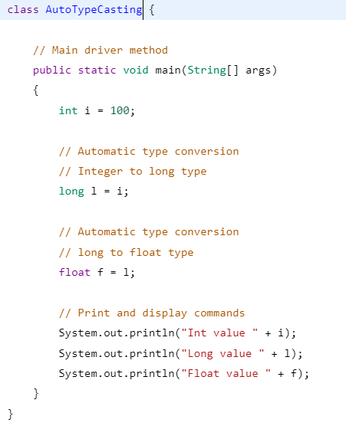
Eg:

Slide 6
Narrowing or Explicit Conversion
If we want to assign a value of a larger data type to a smaller data type we perform explicit type casting or narrowing.
This is useful for incompatible data types where automatic conversion cannot be done.
Here, the target type specifies the desired type to convert the specified value to.

Slide 7
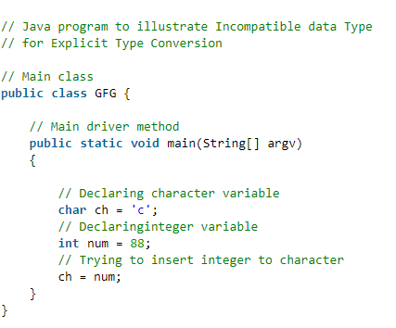
Eg: Incompatible data Type

Slide 8
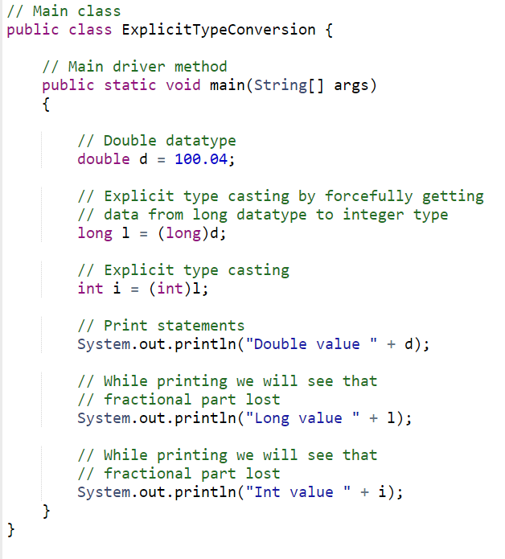
Eg:
Note: While assigning value to byte type the fractional part is lost and is reduced to modulo 256(range of byte).

Slide 9
Method Overloading:
If a class has multiple methods having same name but different in parameters, it is known as Method Overloading.
If we must perform only one operation, having same name of the methods increases the readability of the program.
You have to perform addition of the given numbers but there can be any number of arguments, if you write the method such as a(int, int) for two parameters, and b(int,int,int) for three parameters then it may be difficult for you as well as other programmers to understand the behavior of the method because its name differs.

Slide 10
Advantage of method overloading
Method overloading increases the readability of the program.
Different ways to overload the method
There are two ways to overload the method in java
By changing number of arguments
By changing the data type

Slide 11
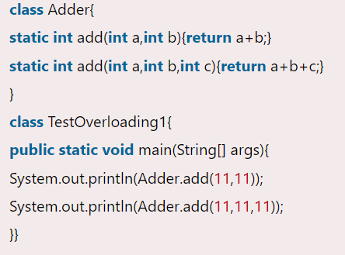
Method Overloading: changing no. of arguments:

Slide 12
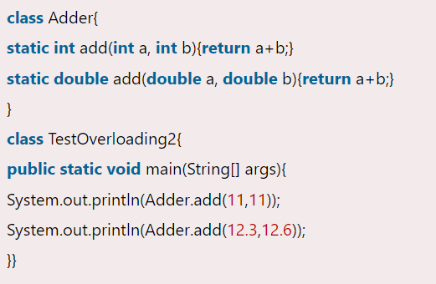
2) Method Overloading: changing data type of arguments

Slide 13
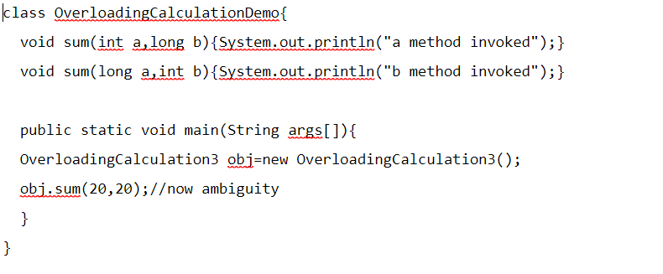
Method Overloading Ambiguity

Slide 14
Method Overriding:
In any object-oriented programming language, Overriding is a feature that allows a subclass or child class to provide a specific implementation of a method that is already provided by one of its super-classes or parent classes.
When a method in a subclass has the same name, same parameters or signature, and same return type(or sub-type) as a method in its super-class, then the method in the subclass is said to override the method in the super-class.

Slide 15
Rules for Java Method Overriding
The method must have the same name as in the parent class
The method must have the same parameter as in the parent class.
There must be an IS-A relationship (inheritance)

Slide 16
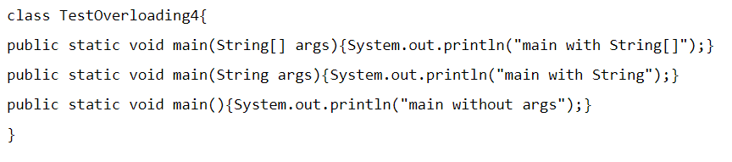
Interview Q:
Can we overload java main() method?:
Yes, by method overloading. You can have any number of main methods in a class by method overloading. But JVM
calls main() method which receives string array as arguments only.

