Slide 1
Thread in Java
By Vijay Kumbhar

Slide 2
Thread :
In java helps us to achieve multiprogramming where a program or process can operate more efficiently by executing more than one instruction at a time. A thread in java also helps a complicated or larger task to operate in the background without interrupting the main program. The Thread class and Runnable interface in java help us to create and control a thread in java.

Slide 3
Agenda
Thread and the life cycle of thread in java.
Different constructors and methods of the Thread class in java.
How to create threads in different ways (using Thread class and Runnable interface).
How to use different constructors of the Thread class for creation and implementation of thread in java.

Slide 4
What is a Thread in Java?
In terms of the Operating System, we can say that a thread is the smallest unit of processing (smallest unit of a process). A thread is an independent path of execution in a program.
Thread is a line of execution in a program. A thread in java is the direction or path taken by the program for its execution. Thread in java helps us to achieve multiprogramming where a program or process can operate more efficiently by executing more than one instruction at a time.
A thread in java also helps a complicated or larger task to operate in the background without interrupting the main program.

Slide 5
The main method is also known as the main thread of execution.
The JVM or Java Virtual Machine allows an application to execute multiple threads within a program concurrently.
When we start the JVM, a single thread (typically called as main thread) is started by the main() method.

Slide 6
Multi-threading is a concept in modern operating systems that refers to two or more tasks executing concurrently within a single program. We can achieve multithreading in java by using the Thread class and Runnable interface.

Slide 7
Thread Implemenation
The Thread class and Runnable interface in java help us to create and control a thread in java. The Thread class (java.lang.Thread) helps us to control a thread in java in two ways. 1. By creating our child class that extends the parent Thread class (java.lang.Thread). 2. By declaring a class that is implementing the Runnable Interface (java.lang.Runnable).

Slide 8
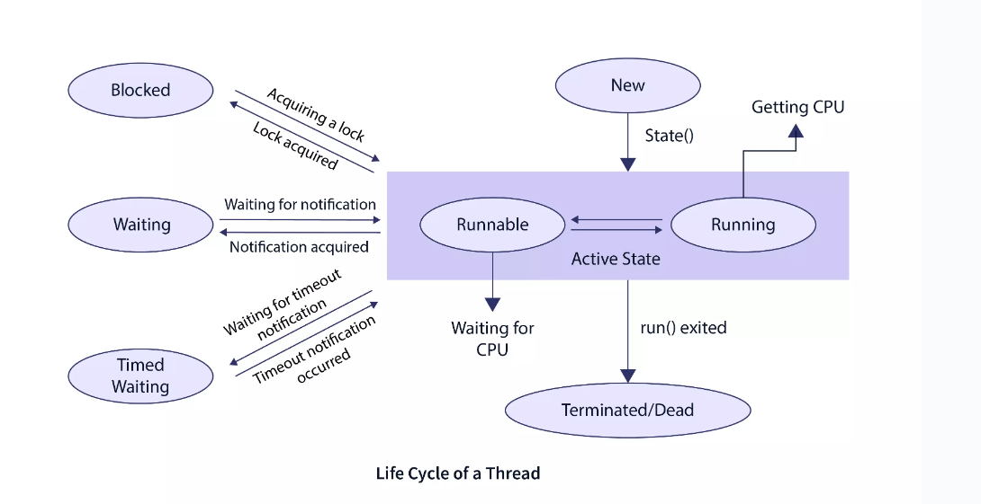
Lifecycle of a Thread in Java

Slide 9
Advantage of method overloading
Method overloading increases the readability of the program.
Different ways to overload the method
There are two ways to overload the method in java
By changing number of arguments
By changing the data type

Slide 10
States in Thread In detail
1. New state: As the name suggests, the new state resembles the state when a thread in java is just created.
2. Active state: A thread moves from the new state to the active state when the thread invokes the start() method. The thread in the active state can be in a runnable state or a running state. Runnable state: After the creation of thread in java, when the thread is ready to run, it is moved from the new state to the runnable state. During the runnable state, the thread may be running or may be ready to run at any given instant of time. In the runnable state, there is a queue where the threads lie. Running state: A thread is moved from the runnable state to the running state by the thread scheduler for its execution. By the running state, we mean that the thread gets the CPU for its execution. Always a fixed duration of execution time is allocated to a thread in java.

Slide 11
Cont’d
3. Waiting or blocked state: Whenever a thread in java goes to an inactive state for some time (period i.e. not permanently), then we say that the tread is present in the waiting or blocked state. Whenever the main thread calls the join() method (to attach itself with other thread(s)), then the main method or main thread goes into the waiting state. After invoking the join() method, the main thread waits for its child thread to be executed first. When the child thread completed its execution, it sends a signal back to the main thread. after getting the completion signal for the child thread, the main thread is moved from the waiting state to the active state.
Note: Sometimes when a thread is working on data that is being used by some other thread then the current thread waits to acquire a lock on the shared data. This state is referred to as the blocking state

Slide 12
Contd
4. Timed Waiting state: As we have discussed in the previous state when a process is waiting, and it continues to wait for a longer duration then the process is said to be in the timed waiting state. A thread can also move in the timed waiting state if the thread invokes a method with the time-out parameter. The thread exits the timed waiting state when the timeout is completed or the waiting resources are gained.
5. Terminated state: When the thread completes its instruction cycle (completes execution), the thread goes into the termination state. A thread may also go into the termination state due to some error. When the thread is not handled correctly or when some other execution(s) is raised by the thread then the thread is terminated as abnormal termination.

Slide 13
Rules for Java Method Overriding
When we start the JVM or the Java Virtual Machine, a single thread (typically called the main method) is started. This main thread continues and executed other threads until the following conditions are met:
The exit() method has been called up.
All the other threads have exited after executing their instructions

Slide 14
Note:
The allocation of time of execution to a thread is governed by a thread scheduler.
A thread in java is executed as per the priority. The thread with higher priority is executed first then the threads with lower priorities are executed.

Slide 15
Creating a Thread
The first one is by extending the Thread class. In this process, a child class is created that extends the java.lang.Thread class. The other one is by implementing the Runnable interface. In this process, a class implements the java.lang.Runnable interface.

Slide 16
By Extending Thread class
We declare a sub-class or a child class that inherits the Thread class.
The child class should override the run() method of the Thread class. After the sub-class has overridden the run() method, the new thread can be associated with the main thread by invoking the start() method. After invoking the start() method, the new thread can start its execution.
When the new thread starts its execution, the main thread is moved to the waiting state.

Slide 17
Eg:
class ChildClass extends Thread {
// overriding the run() method
public void run() {
System.out.println("Run method of the child class.");
}
}
public class Test {
public static void main(String args[]) {
// creating object of the sub class.
ChildClass cc = new ChildClass();
// starting the new thread execution.
cc.start();
}
}

Slide 18
By Implementing Runnable Interface
We can also create a thread in java by implementing the Runnable interface. We pass the reference of the Runnable implemented class to the Thread object's constructor to create a new thread. After passing the reference, we invoke the start() method to start the execution of the newly created thread

Slide 19
Implementing Runnable Interface
class ImplementingClass implements Runnable {
// overriding the run() method
public void run() {
System.out.println("Run method of the implementing class.");
}
}
public class Test {
public static void main(String args[]) {
// creating object of the implementing class.
ImplementingClass ic = new ImplementingClass();
// passing the reference to the Thread class constructor.
Thread t = new Thread(ic);
// starting the new thread execution.
t.start();
}
}

Slide 20
Running Threads
class ChildClass1 extends Thread {
// overriding the run() method
public void run() {
System.out.println("Run method of the first class.");
}
}
class ChildClass2 extends Thread {
// overriding the run() method
public void run() {
System.out.println("Run method of the second class.");
}
}

Slide 21
.
class ChildClass3 extends Thread {
// overriding the run() method
public void run() {
System.out.println("Run method of the third class.");
}
}
public class Test {
public static void main(String args[]) {
// creating object of the sub classes.
ChildClass1 cc1 = new ChildClass1();
ChildClass2 cc2 = new ChildClass2();
ChildClass3 cc3 = new ChildClass3();
// starting the new thread execution.
cc3.start();
cc2.start();
cc1.start();
}
}

