Slide 1
Set interface
By Vijay Kumbhar

Slide 2
Set :
The set interface is present in java.util package and extends the Collection Interface. It is an unordered collection of objects in which duplicate values cannot be stored. It is an interface that implements the mathematical set. This interface contains the methods inherited from the Collection interface and adds a feature that restricts the insertion of the duplicate elements. There are two interfaces that extend the set implementation namely SortedSet and NavigableSet.

Slide 3
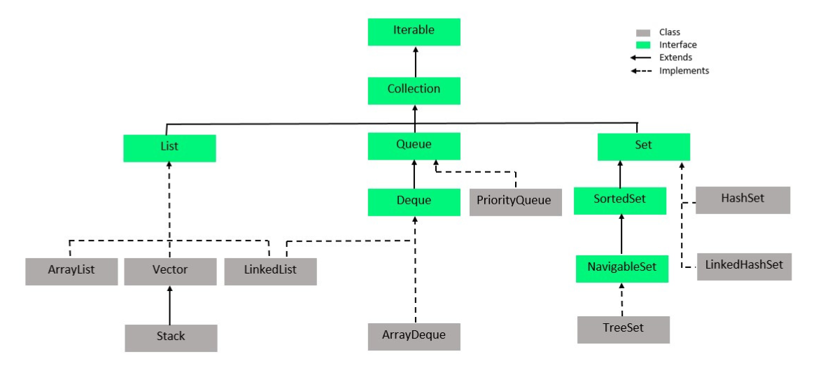
Collection

Slide 4
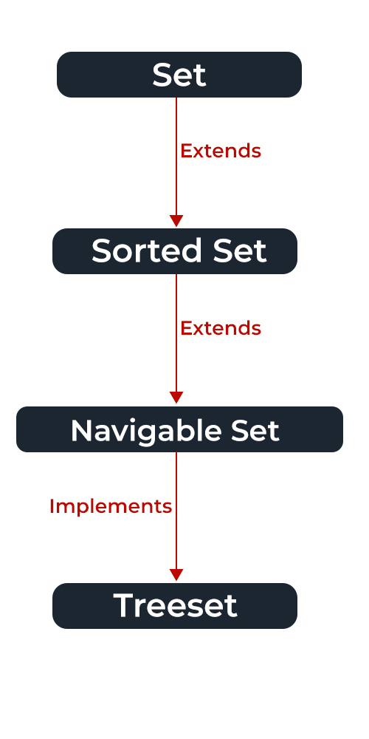
Set Implementation

Slide 5
Navigable Set
Navigable set extends the sorted set interface.
Since a set doesn’t retain the insertion order, the navigable set interface provides the implementation to navigate through the Set.
The class which implements the navigable set is a TreeSet which is an implementation of a self-balancing tree. Therefore, this interface provides us with a way to navigate through this tree.
Syntax: public interface Set extends Collection

Slide 6
Set is an Interface objects cannot be created of the typeset. We always need a class that extends this list in order to create an object. And also, after the introduction of Generics in Java 1.5, it is possible to restrict the type of object that can be stored in the Set.
Syntax : Set<Obj> set = new HashSet<Obj> ();

Slide 7
Methods:
Method | Description
add(element) | This method is used to add a specific element to the set. The function adds the element only if the specified element is not already present in the set else the function returns False if the element is already present in the Set.
addAll(collection) | This method is used to append all of the elements from the mentioned collection to the existing set. The elements are added randomly without following any specific order.
clear() | This method is used to remove all the elements from the set but not delete the set. The reference for the set still exists.
contains(element) | This method is used to check whether a specific element is present in the Set or not.
containsAll(collection) | This method is used to check whether the set contains all the elements present in the given collection or not. This method returns true if the set contains all the elements and returns false if any of the elements are missing.
hashCode() | This method is used to get the hashCode value for this instance of the Set. It returns an integer value which is the hashCode value for this instance of the Set.
isEmpty() | This method is used to check whether the set is empty or not.

Slide 8
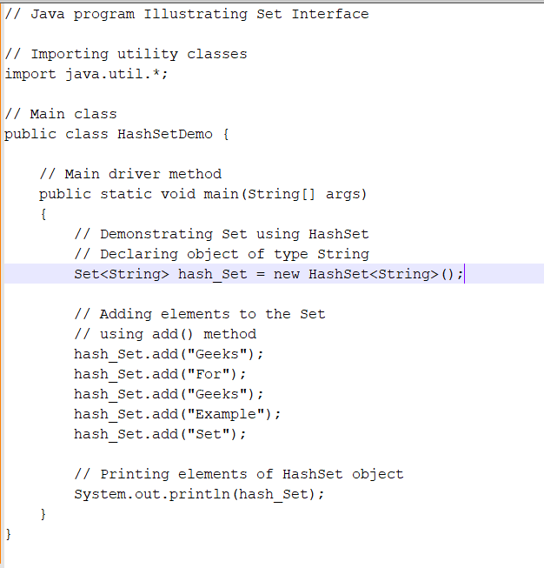
HashSet Example

Slide 9
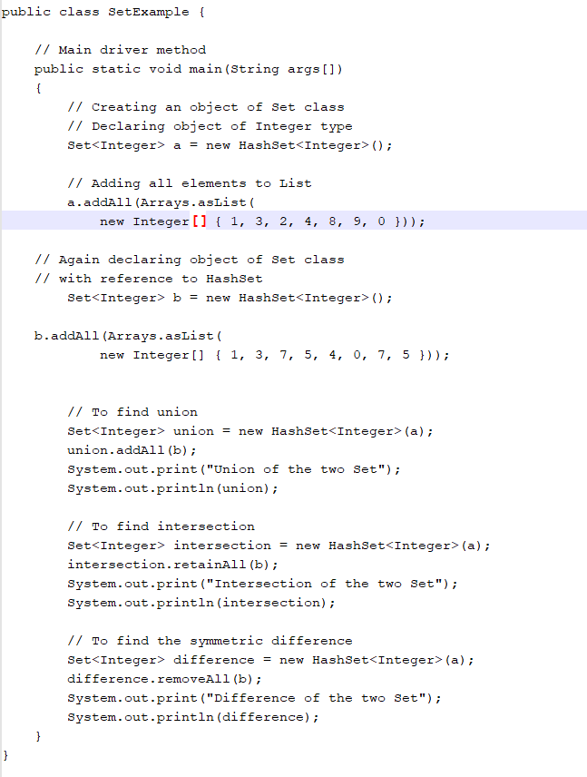

Slide 10
Types:
HashSet
EnumSet
LinkedHashSet
TreeSet

Slide 11
HashSet
HashSet class which is implemented in the collection framework is an inherent implementation of the hash table data structure.
The objects that we insert into the HashSet do not guarantee to be inserted in the same order.
The objects are inserted based on their hashcode. This class also allows the insertion of NULL elements.

Slide 12
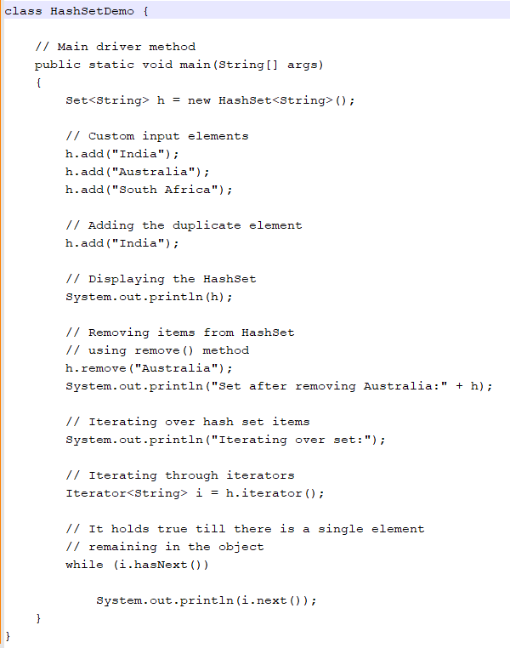

Slide 13
2: EnumSet
EnumSet class which is implemented in the collections framework is one of the specialized implementations of the Set interface for use with the enumeration type.
It is a high-performance set implementation, much faster than HashSet.
All of the elements in an enum set must come from a single enumeration type that is specified when the set is created either explicitly or implicitly

Slide 14
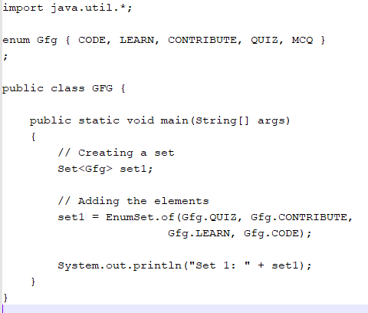
EnumSet Example

