Slide 1
Core Java
By Vijay

Slide 2
Fundamental of Programming:
Object −
Objects have states and behaviors. Example: A dog has states - color, name, breed as well as behavior such as wagging their tail, barking, eating. An object is an instance of a class.
Class −
A class can be defined as a template/blueprint that describes the behavior/state that the object of its type supports.
Methods −
A method is basically a behavior. A class can contain many methods. It is in methods where the logics are written, data is manipulated and all the actions are executed.
Instance Variables −
Each object has its unique set of instance variables. An object's state is created by the values assigned to these instance variables.

Slide 3
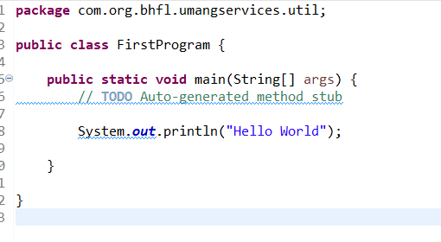

First Program

Slide 4

Software Needs to be downloaded for JAVA
Eclipse Download: https://www.eclipse.org/downloads/packages/
Click on Download Packages
NetBeans Download: https://www.apache.org/dyn/closer.cgi/netbeans/netbeans/15/netbeans-15-source.zip

Slide 5
Coding Standard to be followed
Case Sensitivity − Java is case sensitive, which means identifier Hello and hello would have different meaning in Java.
Class Names − For all class names the first letter should be in Upper Case. If several words are used to form a name of the class, each inner word's first letter should be in Upper Case.
Example: class MyFirstJavaClass
Method Names − All method names should start with a Lower Case letter. If several words are used to form the name of the method, then each inner word's first letter should be in Upper Case.
Example: public void myMethodName()
Program File Name − Name of the program file should exactly match the class name.
When saving the file, you should save it using the class name (Remember Java is case sensitive) and append '.java' to the end of the name (if the file name and the class name do not match, your program will not compile).
But please make a note that in case you do not have a public class present in the file then file name can be different than class name. It is also not mandatory to have a public class in the file.
Example: Assume ‘HelloWorld' is the class name. Then the file should be saved as ’Helloworld.java'
public static void main(String args[]) − Java program processing starts from the main() method which is a mandatory part of every Java program.

Slide 6
Java Identifiers
All Java components require names. Names used for classes, variables, and methods are called identifiers.
In Java, there are several points to remember about identifiers. They are as follows −
All identifiers should begin with a letter (A to Z or a to z), currency character ($) or an underscore (_).
After the first character, identifiers can have any combination of characters.
A key word cannot be used as an identifier.
Most importantly, identifiers are case sensitive.
Examples of legal identifiers: age, $salary, _value, __1_value.
Examples of illegal identifiers: 123abc, -salary.

Slide 7
JAVA Access Modifiers:
Two different access modifier available in JAVA Programming
Access Modifiers − default, public , protected, private
Non-access Modifiers − final, abstract, strictfp
Java Variables
Local Variables
Class Variables (Static Variables)
Instance Variables (Non-static Variables)
Arrays:
Arrays are objects that store multiple variables of the same type. However, an array itself is an object on the heap

Slide 8
JVM Architecture
JVM(Java Virtual Machine) acts as a run-time engine to run Java applications. JVM is the one that actually calls the main method present in a java code. JVM is a part of JRE(Java Runtime Environment).
Java applications are called WORA (Write Once Run Anywhere). This means a programmer can develop Java code on one system and can expect it to run on any other Java-enabled system without any adjustment. This is all possible because of JVM.
When we compile a .java file, .class files(contains byte-code) with the same class names present in .java file are generated by the Java compiler. This .class file goes into various steps when we run it. These steps together describe the whole JVM.

Slide 9
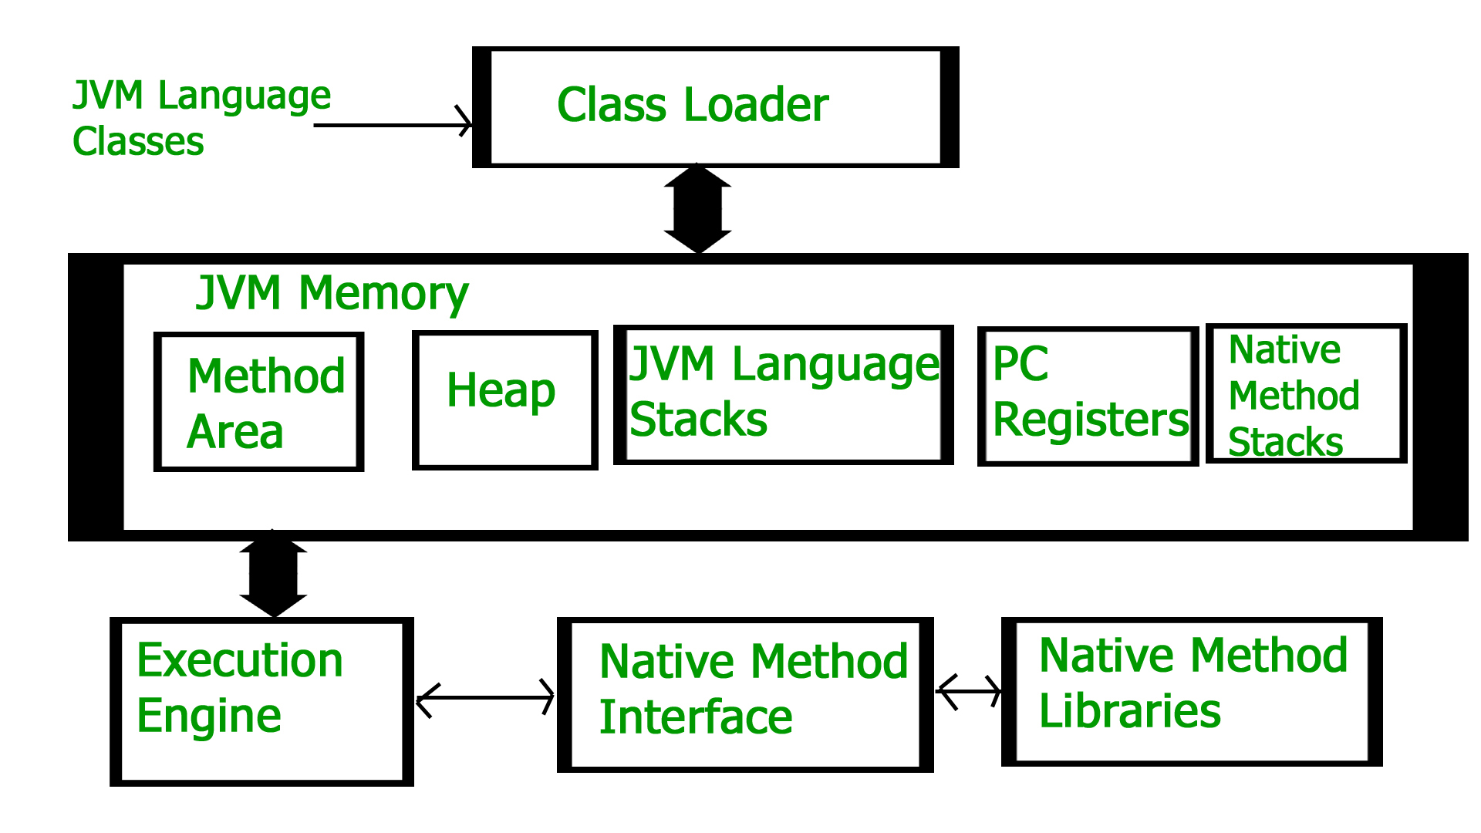

Slide 10
Class Loader Subsystem
It is mainly responsible for three activities.
Loading
Linking
Initialization
Loading: The Class loader reads the “.class” file, generate the corresponding binary data and save it in the method area. For each “.class” file, JVM stores the following information in the method area.
The fully qualified name of the loaded class and its immediate parent class.
Whether the “.class” file is related to Class or Interface or Enum.
Modifier, Variables and Method information etc.

Slide 11
After loading the “.class” file, JVM creates an object of type Class to represent this file in the heap memory. Please note that this object is of type Class predefined in java.lang package. These Class object can be used by the programmer for getting class level information like the name of the class, parent name, methods and variable information etc. To get this object reference we can use getClass() method of Object class.

Slide 12
Example

Slide 13
Java Keywords
abstract | assert | boolean | break
byte | case | catch | char
class | const | continue | default
do | double | else | enum
extends | final | finally | float
for | goto | if | implements
import | instanceof | int | interface
long | native | new | package
private | protected | public | return
short | static | strictfp | super
switch | synchronized | this | throw
throws | transient | try | void
volatile | while

Slide 14
Types of Programming Language
Procedural Programming | Object-Oriented Programming
Follows a top-down approach | Follows a bottom-up approach
Instruction Oriented | Data Oriented
The abstraction is at procedure (function) level. | The abstraction is at object (class) level.
The sequence of events in a large program is divided into functions. | Entire program is divided into objects.
Interaction with program is via direct function calls. | Interaction with program is via functions defined in the class only.
Real world is represented by 'procedures' operating on data. | Real world is represented by objects and the operations that can be performed on these objects.
Data and functions are separate. | Data and functions are encapsulated into a single unit.
Data security is less as it contains lesser features to protect the data. | It is more secure as one of its primary features include data hiding.
A function can access any other function's data by calling that function. | Only the data whose access has been granted can be accessed by another function.
Limited and difficult code reusability. | Versatile and easy code reusability.
Code is difficult to modify, extend and maintain. | Code is easy to modify, extend and maintain.
Some examples of Procedural Programming languages are C, COBOL, Pascal. | Some examples of Object Oriented languages are C++, Java, C#.

Slide 15
Employee
Attributes | Behaviours
Name | Take leave
Employee Number | Calculate Salary
Pan Number | Calculate Income Tax
Desgination
Address

Slide 16
Teacher
Attributes | Behaviours
Name | Teach Class
School Name | Conduct Tests
Subject | Maintain discipline in class
Class
Address

Slide 17
Radio
Attributes | Behaviours
Manufacturer | Select Band (AM/FM)
Model | Tune Station
Bands (AM/FM) | Adjust Volume
Antenna
Colour

Slide 18
Table
Attributes | Behaviours
Type | Put things on Table
Colour | Remove things from Table
Weight | Clean Table
Height
Width

Slide 19
Car
Attributes | Behaviours
Weight | drive
Model | Brake
Wheels
colour
Width

Slide 20
What is Abstraction?
Abstraction is one of the key concepts of object-oriented programming (OOP) languages. Its main goal is to handle complexity by hiding unnecessary details from the user. That enables the user to implement more complex logic on top of the provided abstraction without understanding or even thinking about all the hidden complexity.
That’s a very generic concept that’s not limited to object-oriented programming. You can find it everywhere in the real world.

Slide 21
Abstraction:
Making coffee with a coffee machine is a good example of abstraction.
You need to know how to use your coffee machine to make coffee. You need to provide water and coffee beans, switch it on and select the kind of coffee you want to get.
The thing you don’t need to know is how the coffee machine is working internally to brew a fresh cup of delicious coffee. You don’t need to know the ideal temperature of the water or the amount of ground coffee you need to use.
Someone else worried about that and created a coffee machine that now acts as an abstraction and hides all these details. You just interact with a simple interface that doesn’t require any knowledge about the internal implementation.

Slide 22
Different Types of Abstraction
Data Abstraction
Process Abstraction

Slide 23
1: Data Abstraction
Data abstraction is the simplest form of abstraction. When working with OOPS, you primarily work on manipulating and dealing with complex objects. This object represents some data but the underlying characteristics or structure of that data is actually hidden from you. Let’s go back to our example of making coffee.
Let’s say that I need a special hazelnut coffee this time. Luckily, there’s a new type of coffee powder or processed coffee beans that already have hazelnut in it. So I can directly add the hazelnut coffee beans and the coffee machine treats it as just any other regular coffee bean. In this case, the hazelnut coffee bean itself is an abstraction of the original data, the raw coffee beans. I can use the hazelnut coffee beans directly without worrying about how the original coffee beans were made to add the hazelnut flavour to it.
Therefore, data abstraction refers to hiding the original data entity via a data structure that can internally work through the hidden data entities. As programmers, we don’t need to know what the underlying entity is, how it looks etc.

Slide 24
2: Process Abstraction
Where data abstraction works with data, process abstraction does the same job but with processes. In process abstraction, the underlying implementation details of a process are hidden. We work with abstracted processes that under the hood use hidden processes to execute an action.
Circling back to our coffee example, let’s say our coffee machine has a function to internally clean the entire empty machine for us. This is a process that we may want to do every once a week or two so that our coffee machine stays clean. We press a button on the machine which sends it a command to internally clean it. Under the hood, there is a lot that will happen now. The coffee machine will need to clean the piston, the outlets or nozzles from which it pours the coffee, and the container for the beans, and then finally rinse out the water and dry out the system.
A single process of cleaning the coffee machine was known to us, but internally it implements multiple other processes that were actually abstracted from us. This is process abstraction in a nutshell.
Well, this process abstraction example really got me thinking of a very futuristic coffee machine!

Slide 25
How to Implement
Modern coffee machines have become pretty complex. Depending on your choice of coffee, they decide which of the available coffee beans to use and how to grind them. They also use the right amount of water and heat it to the required temperature to brew a huge cup of filter coffee or a small and strong espresso.

Slide 26
public class CoffeeMachine {
private Map<CoffeeSelection, CoffeeBean> beans;
public CoffeeMachine(Map<CoffeeSelection, CoffeeBean> beans) {
this.beans = beans
}
public Coffee brewCoffee(CoffeeSelection selection) throws CoffeeException {
Coffee coffee = new Coffee();
System.out.println(“Making coffee ...”);
return coffee;
}
}

Slide 27
public enum CoffeeSelection {
FILTER_COFFEE, ESPRESSO, CAPPUCCINO;
}

Slide 28
CoffeeBean and Coffee are simple POJOs (plain old Java objects) that only store a set of attributes without providing any logic.
public class CoffeeBean {
private String name;
private double quantity;
public CoffeeBean(String name, double quantity) {
this.name = name;
this.quantity;
}
}

Slide 29
POJO
public class Coffee {
private CoffeeSelection selection;
private double quantity;
public Coffee(CoffeeSelection, double quantity) {
this.selection = selection;
this. quantity = quantity;
}
}

Slide 30
public class CoffeeApp {
public static void main(String[] args) {
// create a Map of available coffee beans
Map<CoffeeSelection, CoffeeBean> beans = new HashMap<CoffeeSelection, CoffeeBean>();
beans.put(CoffeeSelection.ESPRESSO,
new CoffeeBean("My favorite espresso bean", 1000));
beans.put(CoffeeSelection.FILTER_COFFEE,
new CoffeeBean("My favorite filter coffee bean", 1000));
// get a new CoffeeMachine object
CoffeeMachine machine = new CoffeeMachine(beans);
// brew a fresh coffee
try {
Coffee espresso = machine.brewCoffee(CoffeeSelection.ESPRESSO);
} catch(CoffeeException e) {
e.printStackTrace();
}
} // end main
} // end CoffeeApp

