Slide 1
Core Java (JVM)
By Vijay Kumbhar

Slide 2
Java Keywords
abstract | assert | boolean | break
byte | case | catch | char
class | const | continue | default
do | double | else | enum
extends | final | finally | float
for | goto | if | implements
import | instanceof | int | interface
long | native | new | package
private | protected | public | return
short | static | strictfp | super
switch | synchronized | this | throw
throws | transient | try | void
volatile | while

Slide 3
Difference between JDK, JRE, and JVM
JVM:
VM (Java Virtual Machine) is an abstract machine. It is called a virtual machine because it doesn't physically exist. It is a specification that provides a runtime environment in which Java bytecode can be executed. It can also run those programs which are written in other languages and compiled to Java bytecode.
JVMs are available for many hardware and software platforms. JVM, JRE, and JDK are platform dependent because the configuration of each OS is different from each other. However, Java is platform independent. There are three notions of the JVM: specification, implementation, and instance.
JVM translates the byte-code into machine language, and since the machine language depends on the operating system being used, it is clear that the JVM is platform (operating system) dependent.
JVM is called virtual because it provides an interface that does not depend on the underlying operating system and machine hardware.

Slide 4
JRE
JRE is an acronym for Java Runtime Environment. It is also written as Java RTE. The Java Runtime Environment is a set of software tools which are used for developing Java applications. It is used to provide the runtime environment. It is the implementation of JVM. It physically exists. It contains a set of libraries + other files that JVM uses at runtime.
The implementation of JVM is also actively released by other companies besides Sun Micro Systems.

Slide 5
Architecture of JVM
JVM (Java Virtual Machine) is an abstract machine. It is a specification that provides runtime environment in which java bytecode can be executed.
JVMs are available for many hardware and software platforms (i.e. JVM is platform dependent).

Slide 6
What is JVM
A specification where working of Java Virtual Machine is specified. But implementation provider is independent to choose the algorithm. Its implementation has been provided by Oracle and other companies.
An implementation Its implementation is known as JRE (Java Runtime Environment).
Runtime Instance Whenever you write java command on the command prompt to run the java class, an instance of JVM is created.
The JVM performs following operation:
Loads code
Verifies code
Executes code
Provides runtime environment

Slide 7
Important thing to understand about JVM
Memory area
Class file format
Register set
Garbage-collected heap
Fatal error reporting etc.

Slide 8
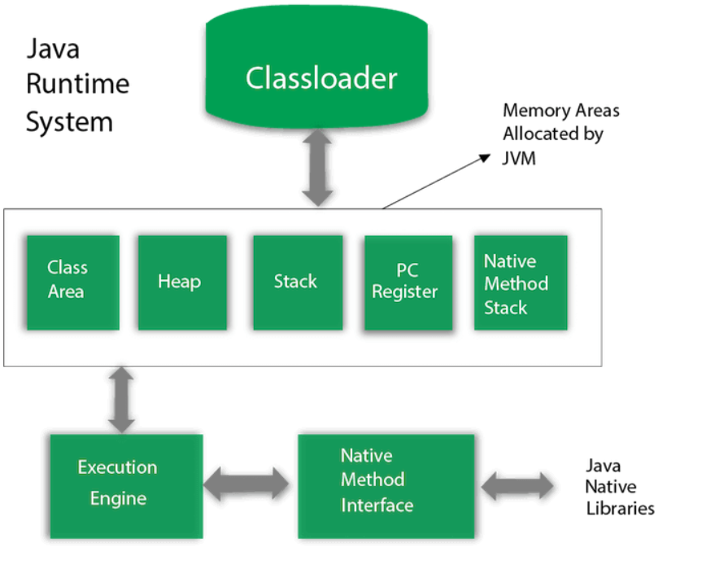
Architecture

Slide 9
Classloader
Classloader is a subsystem of JVM which is used to load class files. Whenever we run the java program, it is loaded first by the classloader. There are three built-in classloaders in Java.
Bootstrap ClassLoader: This is the first classloader which is the super class of Extension classloader. It loads the rt.jar file which contains all class files of Java Standard Edition like java.lang package classes, java.net package classes, java.util package classes, java.io package classes, java.sql package classes etc.
Extension ClassLoader: This is the child classloader of Bootstrap and parent classloader of System classloader. It loades the jar files located inside $JAVA_HOME/jre/lib/ext directory.
System/Application ClassLoader: This is the child classloader of Extension classloader. It loads the classfiles from classpath. By default, classpath is set to current directory. You can change the classpath using "-cp" or "-classpath" switch. It is also known as Application classloader.

Slide 10
2: Class(Method) Area
Class(Method) Area stores per-class structures such as the runtime constant pool, field and method data, the code for methods
3: Heap
It is the runtime data area in which objects are allocated.
4: Stack
Java Stack stores frames. It holds local variables and partial results, and plays a part in method invocation and return. Each thread has a private JVM stack, created at the same time as thread.
A new frame is created each time a method is invoked. A frame is destroyed when its method invocation completes.
5: Program Counter Register
PC (program counter) register contains the address of the Java virtual machine instruction currently being executed.
6: Native Method Stack
It contains all the native methods used in the application.

Slide 11
7: Execution Engine
A virtual processor
Interpreter: Read bytecode stream then execute the instructions.
Just-In-Time(JIT) compiler: It is used to improve the performance. JIT compiles parts of the byte code that have similar functionality at the same time, and hence reduces the amount of time needed for compilation. Here, the term "compiler" refers to a translator from the instruction set of a Java virtual machine (JVM) to the instruction set of a specific CPU
8: Java Native Interface:
Java Native Interface (JNI) is a framework which provides an interface to communicate with another application written in another language like C, C++, Assembly etc. Java uses JNI framework to send output to the Console or interact with OS libraries.
.

Slide 12
Thank you

