Slide 1
Core Java (Variables)
By Vijay Kumbhar

Slide 2
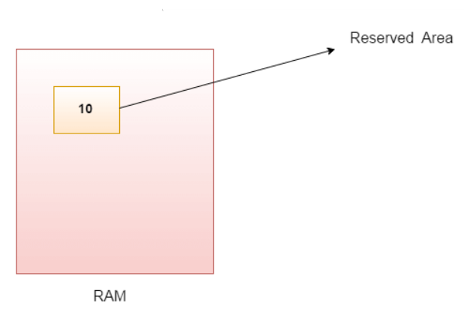
Java Variables
A variable is a container which holds the value while the Java program is executed. A variable is assigned with a data type.
Variable is a name of memory location. There are three types of variables in java: local, instance and static.
There are two types of data types in Java:
primitive
non-primitive.
Variable:
A variable is the name of a reserved area allocated in memory. In other words, it is a name of the memory location. It is a combination of "vary + able" which means its value can be changed.
int data=50;//Here data is variable

Slide 3
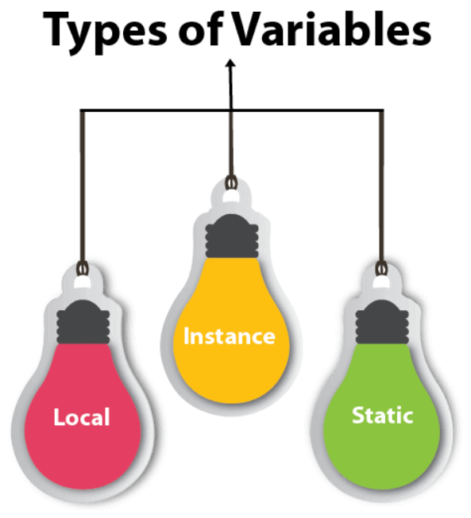
Types of Variables
There are three types of variables in Java:
local variable
instance variable
static variable

Slide 4
Cont’d
1: Local Variable:
A variable declared inside the body of the method is called local variable. You can use this variable only within that method and the other methods in the class aren't even aware that the variable exists.
A local variable cannot be defined with "static" keyword.
2: Instance Variable
A variable declared inside the class but outside the body of the method, is called an instance variable. It is not declared as static.
It is called an instance variable because its value is instance-specific and is not shared among instances.
3: Static variable:
A variable that is declared as static is called a static variable. It cannot be local. You can create a single copy of the static variable and share it among all the instances of the class. Memory allocation for static variables happens only once when the class is loaded in the memory.

Slide 5
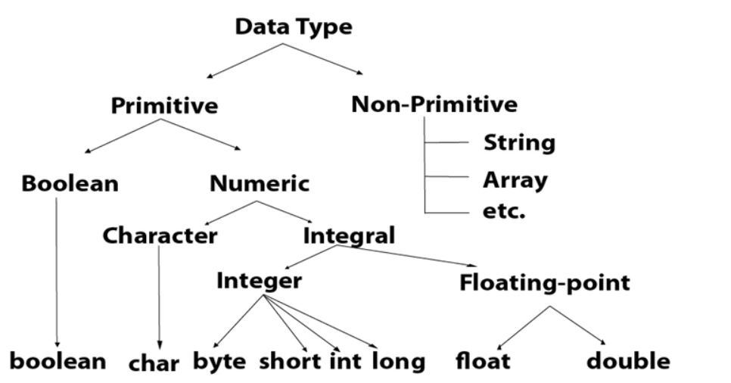
Data Types in Java
Primitive data types: The primitive data types include boolean, char, byte, short, int, long, float and double.
Non-primitive data types: The non-primitive data types include Classes, Interfaces, and Arrays.

Slide 6
Scanner
The Scanner class is used to get user input, and it is found in the java.util package.
To use the Scanner class, create an object of the class and use any of the available methods found in the Scanner class documentation. In our example, we will use the nextLine() method, which is used to read Strings:

Slide 7
Cont’d
Scanner is a class in java.util package used for obtaining the input of the primitive types like int, double, etc. and strings. It is the easiest way to read input in a Java program, though not very efficient if you want an input method for scenarios where time is a constraint like in competitive programming.
To create an object of Scanner class, we usually pass the predefined object System.in, which represents the standard input stream. We may pass an object of class File if we want to read input from a file.
To read numerical values of a certain data type XYZ, the function to use is nextXYZ(). For example, to read a value of type short, we can use nextShort()
To read strings, we use nextLine().
To read a single character, we use next().charAt(0). next() function returns the next token/word in the input as a string and charAt(0) function returns the first character in that string.

Slide 8
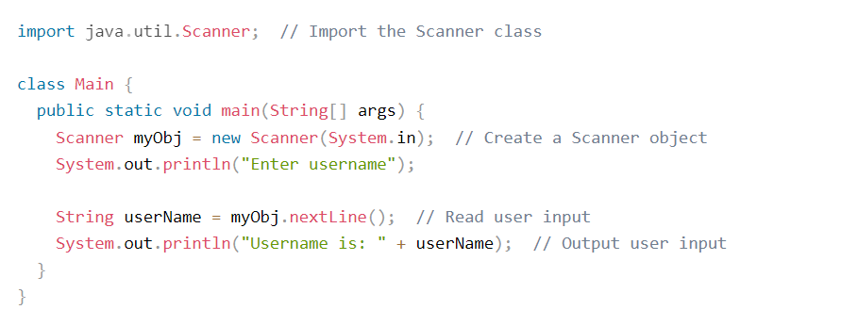
Example

Slide 9
Thank you

