Slide 1
Core Java (Constructors & Variables)
By Vijay Kumbhar

Slide 2
There are eight primitive datatypes supported by Java. Primitive datatypes are predefined by the language and named by a keyword. Let us now look into the eight primitive data types in detail.
byte
Byte data type is an 8-bit signed two's complement integer
Minimum value is -128 (-2^7)
Maximum value is 127 (inclusive)(2^7 -1)
Default value is 0
Byte data type is used to save space in large arrays, mainly in place of integers, since a byte is four times smaller than an integer.
Example: byte a = 100, byte b = -50
short

Slide 3
Short:
Short data type is a 16-bit signed two's complement integer
Minimum value is -32,768 (-2^15)
Maximum value is 32,767 (inclusive) (2^15 -1)
Short data type can also be used to save memory as byte data type. A short is 2 times smaller than an integer
Default value is 0.
Example: short s = 10000, short r = -20000

Slide 4
Int:
Int data type is a 32-bit signed two's complement integer.
Minimum value is - 2,147,483,648 (-2^31)
Maximum value is 2,147,483,647(inclusive) (2^31 -1)
Integer is generally used as the default data type for integral values unless there is a concern about memory.
The default value is 0
Example: int a = 100000, int b = -200000

Slide 5
Long:
Long data type is a 64-bit signed two's complement integer
Minimum value is -9,223,372,036,854,775,808(-2^63)
Maximum value is 9,223,372,036,854,775,807 (inclusive)(2^63 -1)
This type is used when a wider range than int is needed
Default value is 0L
Example: long a = 100000L, long b = -200000L

Slide 6
Float:
Float data type is a single-precision 32-bit IEEE 754 floating point
Float is mainly used to save memory in large arrays of floating point numbers
Default value is 0.0f
Float data type is never used for precise values such as currency
Example: float f1 = 234.5f

Slide 7
double
double data type is a double-precision 64-bit IEEE 754 floating point
This data type is generally used as the default data type for decimal values, generally the default choice
Double data type should never be used for precise values such as currency
Default value is 0.0d
Example: double d1 = 123.4

Slide 8
boolean
boolean data type represents one bit of information
There are only two possible values: true and false
This data type is used for simple flags that track true/false conditions
Default value is false
Example: boolean one = true

Slide 9
char
char data type is a single 16-bit Unicode character
Minimum value is '\u0000' (or 0)
Maximum value is '\uffff' (or 65,535 inclusive)
Char data type is used to store any character
Example: char letterA = 'A'

Slide 10
Primitive Data Types
Data Type | Size | Description
byte | 1 byte | Stores whole numbers from -128 to 127
short | 2 bytes | Stores whole numbers from -32,768 to 32,767
int | 4 bytes | Stores whole numbers from -2,147,483,648 to 2,147,483,647
long | 8 bytes | Stores whole numbers from -9,223,372,036,854,775,808 to 9,223,372,036,854,775,807
float | 4 bytes | Stores fractional numbers. Sufficient for storing 6 to 7 decimal digits
double | 8 bytes | Stores fractional numbers. Sufficient for storing 15 decimal digits
boolean | 1 bit | Stores true or false values
char | 2 bytes | Stores a single character/letter or ASCII values

Slide 11
Non Primitive Data Types
Non-primitive data types are called reference types because they refer to objects.
The main difference between primitive and non-primitive data types are:
Primitive types are predefined (already defined) in Java. Non-primitive types are created by the programmer and is not defined by Java (except for String).
Non-primitive types can be used to call methods to perform certain operations, while primitive types cannot.
A primitive type has always a value, while non-primitive types can be null.
A primitive type starts with a lowercase letter, while non-primitive types starts with an uppercase letter.
The size of a primitive type depends on the data type, while non-primitive types have all the same size.
Examples of non-primitive types are Strings, Arrays, Classes, Interface, etc.

Slide 12
Constructor in JAVA

Slide 13
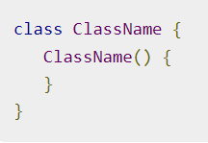
Java Constructors
A constructor initializes an object when it is created. It has the same name as its class and is syntactically similar to a method. However, constructors have no explicit return type.
Typically, you will use a constructor to give initial values to the instance variables defined by the class, or to perform any other start-up procedures required to create a fully formed object.
All classes have constructors, whether you define one or not, because Java automatically provides a default constructor that initializes all member variables to zero. However, once you define your own constructor, the default constructor is no longer used.

Slide 14
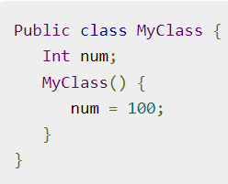
Types of Constructors
Java allows two types of constructors namely −
No argument Constructors
Parameterized Constructors
No argument Constructors:
As the name specifies the no argument constructors of Java does not accept any parameters instead, using these constructors the instance variables of a method will be initialized with fixed values for all objects

Slide 15
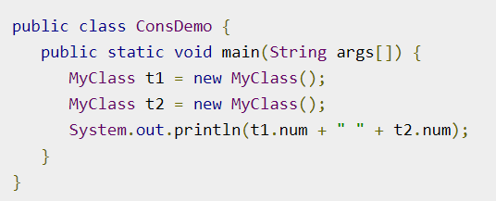
Example: Default Constructor

Slide 16
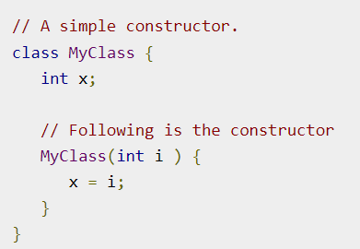
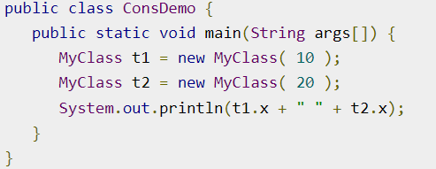
Parameterized Constructors
Most often, you will need a constructor that accepts one or more parameters. Parameters are added to a constructor in the same way that they are added to a method, just declare them inside the parentheses after the constructor's name.

Slide 17
Scanner
The Scanner class is used to get user input, and it is found in the java.util package.
To use the Scanner class, create an object of the class and use any of the available methods found in the Scanner class documentation. In our example, we will use the nextLine() method, which is used to read Strings:

Slide 18
Cont’d
Scanner is a class in java.util package used for obtaining the input of the primitive types like int, double, etc. and strings. It is the easiest way to read input in a Java program, though not very efficient if you want an input method for scenarios where time is a constraint like in competitive programming.
To create an object of Scanner class, we usually pass the predefined object System.in, which represents the standard input stream. We may pass an object of class File if we want to read input from a file.
To read numerical values of a certain data type XYZ, the function to use is nextXYZ(). For example, to read a value of type short, we can use nextShort()
To read strings, we use nextLine().
To read a single character, we use next().charAt(0). next() function returns the next token/word in the input as a string and charAt(0) function returns the first character in that string.

