Slide 1
Core Java (Control Statement & Control Flow)
By Vijay Kumbhar

Slide 2
1: Decision Making statements
if statements
switch statement
2: Loop statements
do while loop
while loop
for loop
for-each loop
3: Jump statements
break statement
continue statement

Slide 3
1) If Statement:
In Java, the "if" statement is used to evaluate a condition. The control of the program is diverted depending upon the specific condition. The condition of the If statement gives a Boolean value, either true or false. In Java, there are four types of if-statements given below.
Simple if statement
if-else statement
if-else-if ladder
Nested if-statement

Slide 4
Simple if statement:
It is the most basic statement among all control flow statements in Java. It evaluates a Boolean expression and enables the program to enter a block of code if the expression evaluates to true.
Sample Code
if(condition) {
statement 1; //executes when condition is true
}

Slide 5
2: if-else statement
The if-else statement is an extension to the if-statement, which uses another block of code, i.e., else block. The else block is executed if the condition of the if-block is evaluated as false.
Sample Code:
if(condition) {
statement 1; //executes when condition is true
}
else{
statement 2; //executes when condition is false
}

Slide 6
Switch Statement:
In Java, Switch statements are similar to if-else-if statements. The switch statement contains multiple blocks of
code called cases and a single case is executed based on the variable which is being switched.
The switch statement is easier to use instead of if-else-if statements. It also enhances the readability of the program.
Major Points to Understand
The case variables can be int, short, byte, char, or enumeration. String type is also supported since version 7 of Java
Cases cannot be duplicate
Default statement is executed when any of the case doesn't match the value of expression. It is optional.
Break statement terminates the switch block when the condition is satisfied. It is optional, if not used, next case is executed.
While using switch statements, we must notice that the case expression will be of the same type as the variable.
However, it will also be a constant value.

Slide 7
Syntax:
switch (expression){
case value1:
statement1;
break;
case valueN:
statementN;
break;
default:
default statement;
}

Slide 8
Example:
Student

Slide 9
Loop Statements
In programming, sometimes we need to execute the block of code repeatedly while some condition evaluates to true. However, loop statements are used to execute the set of instructions in a repeated order. The execution of the set of instructions depends upon a particular condition.
In Java, we have three types of loops that execute similarly. However, there are differences in their syntax and condition checking time.
for loop
while loop
do-while loop
Let's understand the loop statements one by one.
Java for loop
In Java, for loop is similar to C and C++. It enables us to initialize the loop variable, check the condition, and increment/decrement in a single line of code. We use the for loop only when we exactly know the number of times, we want to execute the block of code.
Syntax:
for(initialization, condition, increment/decrement) {
//block of statements
}

Slide 10
Example: For Loop
public class Sumof10
{
public static void main(String[] args)
{
int sum = 0;
for(int j = 1; j<=10; j++)
{
sum = sum + j;
}
System.out.println("The sum of first 10 natural numbers is " + sum);
}
}

Slide 11
ForEach
Java provides an enhanced for loop to traverse the data structures like array or collection. In the for-each loop, we don't need to update the loop variable. The syntax to use the for-each loop in java is given below.
Syntax:
for(data_type var : array_name/collection_name){
//statements
}

Slide 12
Example: forEach
public class StringForeach
{
public static void main(String[] args)
{
String[] names = {“ABC",“PQR",“MNP",“ddd",“xss"};
System.out.println("Printing the content of the array names:\n");
for(String name:names)
{
System.out.println(name);
}
}
}

Slide 13
Java while loop
The while loop is also used to iterate over the number of statements multiple times. However, if we don't know the number of iterations in advance, it is recommended to use a while loop. Unlike for loop, the initialization and increment/decrement doesn't take place inside the loop statement in while loop.
It is also known as the entry-controlled loop since the condition is checked at the start of the loop. If the condition is true, then the loop body will be executed; otherwise, the statements after the loop will be executed.
The syntax of the while loop is given below.
Syntax:
while(condition){
//looping statements
}

Slide 14
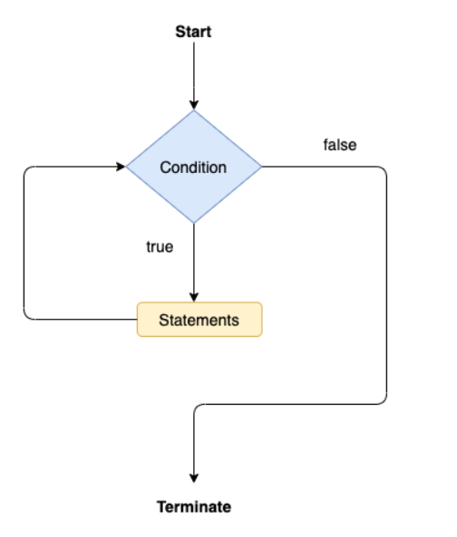
Flow

Slide 15
public class Calculation
{
public static void main(String[] args) {
int i = 0;
System.out.println("Printing the list of first 10 even numbers \n");
while(i<=10)
{
System.out.println(i);
i = i + 2;
}
}
}

Slide 16
Java do-while loop
The do-while loop checks the condition at the end of the loop after executing the loop statements. When the number of iteration is not known and we have to execute the loop at least once, we can use do-while loop.
It is also known as the exit-controlled loop since the condition is not checked in advance. The syntax of the do-while
Syntax:
do
{
//statements
} while (condition);

Slide 17
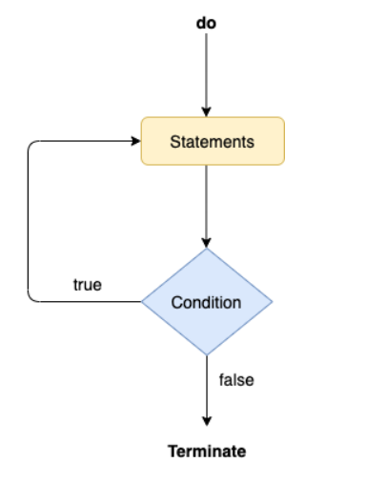
Flow for do While

Slide 18
Example:
public class doWhileDemo
{
public static void main(String[] args)
{
int i = 0;
System.out.println("Printing the list of first 10 even numbers \n");
do
{
System.out.println(i);
i = i + 2;
}while(i<=10);
}
}

Slide 19
Jump Statements:
Break:
As the name suggests, the break statement is used to break the current flow of the program and transfer the control to the next statement outside a loop or switch statement. However, it breaks only the inner loop in the case of the nested loop.
The break statement cannot be used independently in the Java program, i.e., it can only be written inside the loop or switch statement.

Slide 20
Example:
public class BreakPrintExample
{
public static void main(String[] args)
{
for(int i = 0; i<= 10; i++) {
System.out.println(i);
if(i==6)
{
break;
}
}
}
}

Slide 21
Java continue statement
Unlike break statement, the continue statement doesn't break the loop, where as, it skips the specific part of the loop and jumps to the next iteration of the loop immediately.
Consider the following example to understand the functioning of the continue statement in Java

Slide 22
Example:
public class ContinueExampleDemo {
public static void main(String[] args) {
for(int i = 0; i<= 2; i++) {
for (int j = i; j<=5; j++) {
if(j == 4)
{
continue;
}
System.out.println(j);
}
}
}
}

Slide 23
Java.lang package in Java
Boolean: The Boolean class wraps a value of the primitive type boolean in an object.
Byte: The Byte class wraps a value of primitive type byte in an object.
Character – Set 1, Set 2: The Character class wraps a value of the primitive type char in an object.
Character. Subset: Instances of this class represent particular subsets of the Unicode character set.
Character.UnicodeBlock: A family of character subsets representing the character blocks in the Unicode specification.
Class – Set 1, Set 2 : Instances of the class Class represent classes and interfaces in a running Java application.
ClassLoader: A class loader is an object that is responsible for loading classes.
ClassValue: Lazily associate a computed value with (potentially) every type.
Compiler: The Compiler class is provided to support Java-to-native-code compilers and related services.
Double: The Double class wraps a value of the primitive type double in an object.

Slide 24
Enum: This is the common base class of all Java language enumeration types.
Float: The Float class wraps a value of primitive type float in an object.
InheritableThreadLocal: This class extends ThreadLocal to provide inheritance of values from parent thread to child thread: when a child thread is created, the child receives initial values for all inheritable thread-local variables for which the parent has values.
Integer :The Integer class wraps a value of the primitive type int in an object.
Long: The Long class wraps a value of the primitive type long in an object.
Math – Set 1, Set 2: The class Math contains methods for performing basic numeric operations such as the elementary exponential, logarithm, square root, and trigonometric functions.
Number: The abstract class Number is the superclass of classes BigDecimal, BigInteger, Byte, Double, Float, Integer, Long, and Short.
Object: Class Object is the root of the class hierarchy.
Package: Package objects contain version information about the implementation and specification of a Java package.
Process: The ProcessBuilder.start() and Runtime.exec methods create a native process and return an instance of a subclass of Process that can be used to control the process and obtain information about it.

Slide 25
Process Builder: This class is used to create operating system processes.
ProcessBuilder.Redirect: Represents a source of subprocess input or a destination of subprocess output.
Runtime: Every Java application has a single instance of class Runtime that allows the application to interface with the environment in which the application is running.
RuntimePermission: This class is for runtime permissions.
SecurityManager: The security manager is a class that allows applications to implement a security policy.
Short: The Short class wraps a value of primitive type short in an object.
StackTraceElement: An element in a stack trace, as returned by Throwable.getStackTrace().
StrictMath- Set1, Set2: The class StrictMath contains methods for performing basic numeric operations such as the elementary exponential, logarithm, square root, and trigonometric functions.
String- Set1, Set2: The String class represents character strings.
StringBuffer: A thread-safe, mutable sequence of characters.

Slide 26
StringBuilder: A mutable sequence of characters.
System: The System class contains several useful class fields and methods.
Thread: A thread is a thread of execution in a program.
ThreadGroup: A thread group represents a set of threads.
ThreadLocal: This class provides thread-local variables.
Throwable: The Throwable class is the superclass of all errors and exceptions in the Java language.
Void: The Void class is an uninstantiable placeholder class to hold a reference to the Class object representing the Java keyword void.

