Slide 1
OOPS Concepts
BY Vijay kumbhar

Slide 2
Object Orientation

Slide 3
Objectives
Appreciate OOPs concepts

Slide 4
Table of Content
Object oriented programming | Class and Encapsulation
Object | Reuse in Object Oriented Language
Attributes and Operations | Inheritance
Class | Inheritance hierarchy
Abstraction | Generalization and Specialization
Encapsulation | Polymorphism

Slide 5
Feature: Object oriented programming
Object-oriented programming is a method of implementation in which programs are organized as cooperative collections of objects, each of which represents an instance of some class, and whose classes are all members of a hierarchy of classes united via inheritance relationships.
Grady Booch
Terms
Object
Class
Abstraction
Encapsulation
Inheritance
Notes:
Structured Approach
Based on functions
goto branching
C, C++, COBOL, Pascal
Some disadvantages: No constructs for encapsulation, chances of code repetition, No strong data hiding concept, difficult to debug
Object-oriented Approach
Smalltalk, Java, C#

Slide 6
Object
A thing in a real world that can be either physical or conceptual. An object in object oriented programming can be physical or conceptual.
Conceptual objects are entities that are not tangible in the way real-world physical objects are.
Bulb is a physical object. While college is a conceptual object.
Conceptual objects may not have a real world equivalent. For instance, a Stack object in a program.
Object has state and behavior.
What is the state and behavior of this bulb?

Slide 7
Attributes and Operations
The object’s state is determined by the value of its properties or attributes.
Properties or attributes → member variables or data members
The object’s behaviour is determined by the operations that it provides.
Operations → member functions or methods

Slide 8
Putting it together
object
A bulb:
It’s a real-world thing.
Can be switched on to generate light and switched off.
It has real features like the glass covering, filament and holder.
It also has conceptual features like power.
A bulb manufacturing factory produces many bulbs based on a basic description / pattern of what a bulb is.
methods
member variables
class

Slide 9
Class
A class is a construct created in object-oriented programming languages that enables creation of objects.
Also sometimes called blueprint or template or prototype from which objects are created.
It defines members (variables and methods).
A class is an abstraction.

Slide 10
Abstraction
Abstraction denotes essential characteristics of an object that distinguish it from all other kinds of objects and thus provide crisply defined conceptual boundaries, relative to the perspective of the viewer.
-Grady Booch
Abstraction is the process of taking only a set of essential characteristics from something.
Example
For a Doctor→ you are a Patient
Name, Age, Old medical records
For a Teacher→ you are a Student
Name, Roll Number/RegNo, Education background
For HR Staff→ you are ______________
___________,_____________,___________
You

Slide 11
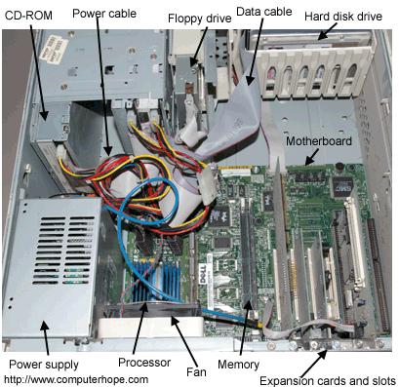
Encapsulation
Would you like it if your CPU is given to you like this?
What are the problems if it were given to you like this?
Encapsulation is the process of compartmentalizing the elements of abstraction that constitute its structure and behavior; encapsulation serves to separate the contractual interface of an abstraction and its implementation.
- Grady Booch
Encapsulation is binding data and operations that work on data together in a construct.
Encapsulation involves Data and Implementation Hiding.

Slide 12
Class and Encapsulation
Student
-roll: long
Rectangle
-length: int
LinkedList
-Node
+ add(Node n, int pos)
-name: String
+ display(): void
+ read(): boolean
-width:int
+area(): int
+ addFirst(Node n)
+ remove(Node n)
: private
+ : public

Slide 13
Reuse in Object Oriented Language
Object Oriented Languages also implements reuse in the same way that we do in real life.
Using
has-a
is-a
Has-a or composition relationship is implemented by having a class having another class as its member, or rather an object having another object as its member.
Car has a Stereo
College has Teachers and Students
Is-a is implemented through what we call inheritance relationship

Slide 14
Inheritance
Inheritance defines relationship among classes, wherein one class share structure or behavior defined in one or more classes.
- Grady Booch
Defines IS-A relationship between classes
Cat IS-A Animal
Car IS-A Vehicle
Rose IS-A Flower

Slide 15
Inheritance hierarchy
Animal
legs
tail
run()
Single -level
Multi-level
CatFamily
paddedClaws
whiskers
Dog
bark()
Tiger
growl()
Cat
meow()

Slide 16
Multiple inheritance
Mammal
Bird
Bat
Many Object-orientated language does not support this type of inheritance.
Java, C# are the examples of object-oriented language that does not support multiple inheritance through classes.

Slide 17
Generalization and Specialization
WildAnimal
legs
tail
run()
Generalization
Specialization
CatFamily
paddedClaws
whiskers
Tiger
growl()
Cat
meow()

Slide 18
Activity: match the following
Super class
Subclass
Fruit
Library
Cat
Bird
Parrot
Music
Tiger
Books
Apple
Mango

Slide 19
Activity
Given the following classes. Can you form inheritance hierarchy?
Person
Teacher
Student
HOD
Typist
Clerk
What are the common members shared ?

Slide 20
Polymorphism
A concept in type theory, according to which a name (such as a variable declaration) may denote objects of many different classes that are related by some common superclass; thus, any object denoted by this name is able to respond to some common set of operations in different ways.
- Grady Booch

Slide 21
Polymorphism example
Flower
fragrance()
Rose
fragrance()
Sunflower
fragrance()
FlowerVase
Flower f[]
smell()

Slide 22
You pick a rose from the vase and smell it?
What fragrance do you expect?
f[0]= rose;
f[1]= sunflower;
….
Flower
fragrance()
FlowerVase
Flower f[]
smell()
Rose
fragrance()
Sunflower
fragrance()
f[0]. fragrance();
f[1]. fragrance();
…

Slide 23
Exercise: Inheritance
Among the classes that you identified, are there any classes that you can relate via inheritance.
(Hint: are there any classes which have common attributes/methods that can be moved up the hierarchy)

Slide 24
Revisiting definition
Object-oriented programming is a method of implementation in which programs are organized as cooperative collections of objects, each of which represents an instance of some class, and whose classes are all members of a hierarchy of classes united via inheritance relationships.
Person
Rama
123
Course
-name: String
+ display(): void
-name: String
-year: Date
+ display(): void
+ enroll(Student): boolean
enroll()
Student
B.Tech
2010
-roll: long
+ read(): boolean

Slide 25
Object default Methods
Method | Description
public final Class getClass() | returns the Class class object of this object. The Class class can further be used to get the metadata of this class.
public int hashCode() | returns the hashcode number for this object.
public boolean equals(Object obj) | compares the given object to this object.
protected Object clone() throws CloneNotSupportedException | creates and returns the exact copy (clone) of this object.
public String toString() | returns the string representation of this object.
public final void notify() | wakes up single thread, waiting on this object's monitor.
public final void notifyAll() | wakes up all the threads, waiting on this object's monitor.
public final void wait(long timeout)throws InterruptedException | causes the current thread to wait for the specified milliseconds, until another thread notifies (invokes notify() or notifyAll() method).
public final void wait(long timeout,int nanos)throws InterruptedException | causes the current thread to wait for the specified milliseconds and nanoseconds, until another thread notifies (invokes notify() or notifyAll() method).
public final void wait()throws InterruptedException | causes the current thread to wait, until another thread notifies (invokes notify() or notifyAll() method).
protected void finalize()throws Throwable | is invoked by the garbage collector before object is being garbage collected.

Slide 26
Super Keyword
The super keyword in java is a reference variable that is used to refer to parent class objects. An understanding of Inheritance and Polymorphism is needed in order to understand the super keyword. The keyword “super” came into the picture with the concept of Inheritance. It is majorly used in the following contexts:
Use of super with variables
Use of super with methods
Use of super with constructors

Slide 27
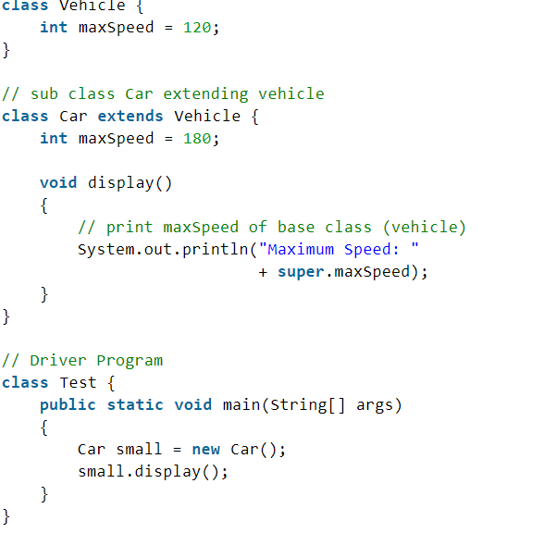
1. Use of super with variables
This scenario occurs when a derived class and base class has the same data members. In that case, there is a possibility of ambiguity for the JVM. We can understand it more clearly using this code snippet:
both base class and subclass have a member maxSpeed. We could access maxSpeed of base class in subclass using super keyword.

Slide 28
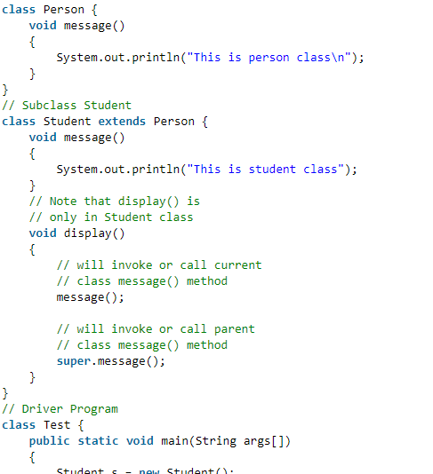
2. Use of super with methods
This is used when we want to call the parent class method. So whenever a parent and child class have the same-named methods then to resolve ambiguity we use the super keyword. This code snippet helps to understand the said usage of the super keyword.
In the above example, we have seen that if we only call method message() then, the current class message() is invoked but with the use of the super keyword, message() of superclass could also be invoked

Slide 29
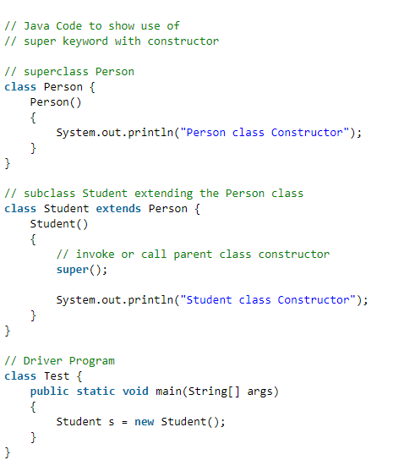
3. Use of super with constructors
The super keyword can also be used to access the parent class constructor. One more important thing is that ‘super’ can call both parametric as well as non-parametric constructors depending upon the situation. Following is the code snippet to explain the above concept:
we have called the superclass constructor using the keyword ‘super’ via subclass constructor.

Slide 30
Important Points to Remember while using Super Keyword
Call to super() must be the first statement in the Derived(Student) Class constructor because if you think about it, it makes sense that the superclass has no knowledge of any subclass, so any initialization it needs to perform is separate from and possibly prerequisite to any initialization performed by the subclass. Therefore, it needs to complete its execution first.
If a constructor does not explicitly invoke a superclass constructor, the Java compiler automatically inserts a call to the no-argument constructor of the superclass. If the superclass does not have a no-argument constructor, you will get a compile-time error. The object does have such a constructor, so if the Object is the only superclass, there is no problem.
If a subclass constructor invokes a constructor of its superclass, either explicitly or implicitly, you might think that a whole chain of constructors is called, all the way back to the constructor of Object. This, in fact, is the case. It is called constructor chaining.

Slide 31
Summary
Object-oriented programming is a method of implementation in which programs are organized as cooperative collections of objects.
The object’s state is determined by the value of its properties and its behavior is determined by the operations that it provides.
Abstraction is the process of taking only a set of essential characteristics from something.
Encapsulation is binding data and operations that work on data together in a construct.
Inheritance defines relationship among classes, wherein one class share structure or behavior defined in one or more classes.
Polymorphism is using a function in many forms. Poly means ‘many’, Morphism means ‘forms’.

