Slide 1
Core Java (Arrays)
By Vijay Kumbhar

Slide 2
Array
Java array is an object which contains elements of a similar data type. Additionally, The elements of an array are stored in a contiguous memory location. It is a data structure where we store similar elements. We can store only a fixed set of elements in a Java array.
Array in Java is index-based, the first element of the array is stored at the 0th index, 2nd element is stored on 1st index and so on.
Unlike C/C++, we can get the length of the array using the length member. In C/C++, we need to use the sizeof operator.

Slide 3
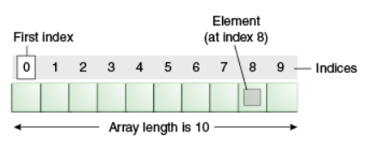
In Java, array is an object of a dynamically generated class. Java array inherits the Object class, and implements the Serializable as well as Cloneable interfaces. We can store primitive values or objects in an array in Java. Like C/C++, we can also create single dimentional or multidimentional arrays in Java.
Moreover, Java provides the feature of anonymous arrays which is not available in C/C++.

Slide 4
Advantages & Disadvantages:
Adv:
Code Optimization: It makes the code optimized, we can retrieve or sort the data efficiently.
Random access: We can get any data located at an index position
Dis Adv:
Size Limit: We can store only the fixed size of elements in the array. It doesn't grow its size at runtime. To solve this problem, collection framework is used in Java which grows automatically.

Slide 5
Types of Array in java
Single Dimensional Array
Multidimensional Array
Single Array : int a[]={33,3,4,5};//declaration, instantiation and initialization
Multi Multidimensional Array
int[][] arr=new int[3][3];//3 row and 3 column

Slide 6
class intArrayExample{
public static void main(String args[]){
int a[]=new int[5];//declaration and instantiation
a[0]=10;//initialization
a[1]=20;
a[2]=70;
a[3]=40;
a[4]=50;
//printing array
for(int i=0;i<a.length;i++)//length is the property of array
System.out.println(a[i]);
}}

Slide 7
Example
class MultiArray{
public static void main(String args[]){
//declaring and initializing 2D array
int arr[][]={{1,2,3},{2,4,5},{4,4,5}};
//printing 2D array
for(int i=0;i<3;i++){
for(int j=0;j<3;j++){
System.out.print(arr[i][j]+" ");
}
System.out.println();
}
}}

Slide 8
Method Overloading
If a class has multiple methods having same name but different in parameters, it is known as Method Overloading.
If we have to perform only one operation, having same name of the methods increases the readability of the program.
Suppose you have to perform addition of the given numbers but there can be any number of arguments, if you write the method such as a(int, int) for two parameters, and b(int, int, int) for three parameters then it may be difficult for you as well as other programmers to understand the behavior of the method because its name differs.
So, we perform method overloading to figure out the program quickly.

Slide 9
Advantage of method overloading
Method overloading increases the readability of the program.
Different ways to overload the method
There are two ways to overload the method in java
By changing number of arguments
By changing the data type

Slide 10
Method Overloading: changing no. of arguments
class Adder{
static int add(int a,int b){return a+b;}
static int add(int a,int b,int c){return a+b+c;}
}
class TestOverloading1{
public static void main(String[] args){
System.out.println(Adder.add(11,11));
System.out.println(Adder.add(11,11,11));
}}
we have created two methods, first add() method performs addition of two numbers and second add method performs addition of three numbers.
In this example, we are creating static methods so that we don't need to create instance for calling methods.

Slide 11
Method Overloading: changing data type of arguments
class Adder{
static int add(int a, int b){return a+b;}
static double add(double a, double b){return a+b;}
}
class TestOverloading2{
public static void main(String[] args){
System.out.println(Adder.add(11,11));
System.out.println(Adder.add(12.3,12.6));
}}
we have created two methods that differs in data type. The first add method receives two integer arguments and second add method receives two double arguments.

Slide 12
Interview Que:
Can we overload java main() method?
Ans: Yes, by method overloading. You can have any number of main methods in a class by method overloading. But JVM calls main() method which receives string array as arguments only
class MainExample{
public static void main(String[] args){System.out.println("main with String[]");}
public static void main(String args){System.out.println("main with String");}
public static void main(){System.out.println("main without args");}
}

Slide 13
Method Overriding in Java
If subclass (child class) has the same method as declared in the parent class, it is known as method overriding in Java.
In other words, If a subclass provides the specific implementation of the method that has been declared by one of its parent class, it is known as method overriding.

Slide 14
Usage:
Usage of Java Method Overriding
Method overriding is used to provide the specific implementation of a method which is already provided by its superclass.
Method overriding is used for runtime polymorphism
The method must have the same name as in the parent class
The method must have the same parameter as in the parent class.
There must be an IS-A relationship (inheritance).

Slide 15
Example
class Vehicle{
void run(){System.out.println("Vehicle is running");}
}
class Car extends Vehicle{
public static void main(String args[]){
Car car = new Car();
car.run();
}
}

Slide 16
Java String
In Java, string is basically an object that represents sequence of char values. An array of characters works same as Java string. For example:
char[] ch={'j','a','v','a'};
String s=new String(ch);
String s="java";
Both Are same

Slide 17
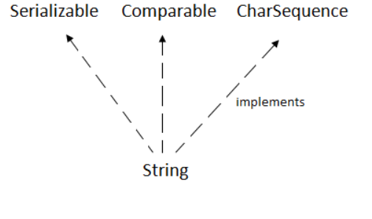
String function implements interfaces

Slide 18
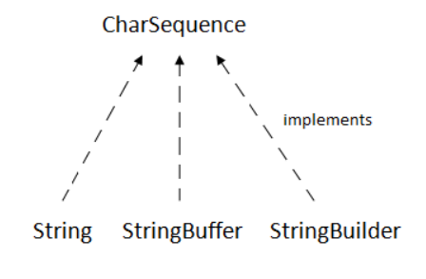
CharSequence Interface
The CharSequence interface is used to represent the sequence of characters. String,StringBuffer and StringBuilder classes implement it. It means, we can create strings in Java by using these three classes.

Slide 19
The Java String is immutable which means it cannot be changed. Whenever we change any string, a new instance is created. For mutable strings, you can use StringBuffer and StringBuilder classes.
We will discuss immutable string later. Let's first understand what String in Java is and how to create the String object.
Objects created for String are stored Heap Memory Block

