Slide 1
DevOps & Platform Engineering
Day 2 — Containers, Security, Observability, Platform Thinking & Workshops
Notes:
Welcome participants. These decks are shared with participants after the course; the speaker notes double as the written reference, so read them when reviewing. Modules 1-9 are theory with small demos; the three workshops and the capstone are the hands-on core. NAVIGATION: each core topic is a summary slide followed by one or two 'Deep Dive' slides that expand every bullet with mechanism, evidence, examples and anti-patterns. When running to time, present the summary slides and use the deep dives as the participant reference and for the discussion prompts; when the room wants depth, teach straight through them.

Slide 2
Module 6
Microservices and Containerization
Notes:
75 minutes theory; Workshop 2 (mid-morning) is the big hands-on: build, compose and deploy the microservice to Kubernetes. Theory goal: when microservices are worth their cost, what containers actually are, and the Kubernetes mental model.

Slide 3
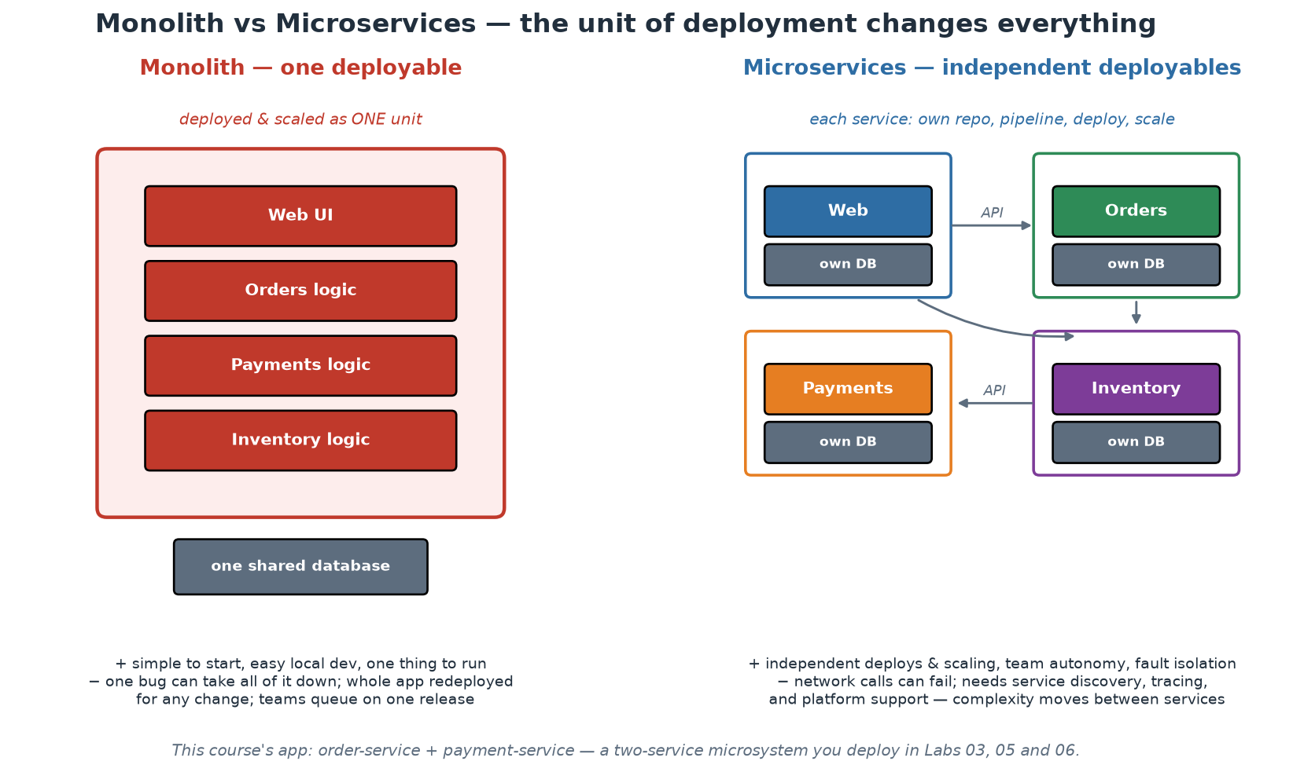
Monolith vs Microservices - the Real Trade-off
The unit of deployment changes everything - in both directions.
Notes:
Frame this as a genuine trade-off, not an upgrade path. A monolith is ONE deployable: simple to run, debug and test locally; transactions are easy; refactoring across the whole domain is an IDE operation. Its costs arrive with scale - of teams more than of traffic: every change redeploys everything, teams queue on one release train, one memory leak takes down all functionality, and technology choices are global. Microservices invert the trade: independent deploy/scale/fail per service and per team - but every arrow in the right-hand picture is a network call that can fail, be slow, or arrive out of order; transactions become sagas; debugging becomes distributed tracing; and 'run it locally' becomes a platform feature. Quote Martin Fowler's 'monolith first' honestly: most successful microservice systems were extracted from monoliths whose seams had become visible; starting greenfield with twenty services means guessing twenty boundaries you will guess wrong. And connect back to Conway (Module 2): the RIGHT reason to split is team autonomy along business domains - if one team owns everything, microservices give you distributed-systems pain with no autonomy payoff. Our two-service app is deliberately minimal: one seam (order calls payment), enough to exhibit every distributed-systems lesson without drowning in them.

Slide 4
Microservice Design Principles
Boundaries follow BUSINESS domains (bounded contexts), not technical layers.
Independent deployability is the acid test - if two services always ship together, they are one.
Database per service: no shared tables; integration through APIs and events only.
Smart endpoints, dumb pipes: logic in services, not in a clever bus.
Design for partial failure: timeouts, retries with backoff, circuit breakers, graceful degradation.
Notes:
Bounded context comes from Domain-Driven Design (Eric Evans): a boundary within which a model and its language are consistent - 'order' means one precise thing inside the ordering context. Services cut along these seams change for one business reason at a time; services cut along technical layers (a 'database service', an 'API layer service') change with every feature and force lockstep deploys. Independent deployability is the honest test of any decomposition: if releasing service A always requires releasing B, you have a distributed monolith - all of the network pain, none of the autonomy. Database-per-service is what makes independence real: shared tables are the tightest possible coupling (any schema change breaks unknown others); integration happens through published APIs or events, and yes, that means accepting eventual consistency at boundaries - a price, paid consciously. 'Smart endpoints, dumb pipes' (Fowler/Lewis) encodes the ESB lesson: burying business logic in a clever middleware recreated the monolith in the worst place; keep transport simple (HTTP, plain queues) and logic in owned services. Partial failure is the defining reality: our order service demonstrates the pattern minimally - a 2-second timeout on the payment call, and a degraded-but-alive answer (payment status 'unavailable') when the dependency is down. Participants SEE this behaviour in Workshop 2 and break it on purpose in the Module 8 demo.

Slide 5
Deep Dive: Where to Draw the Boundary
Boundaries follow BUSINESS domains, not technical layers
  A bounded context (Domain-Driven Design) owns one coherent business capability and its language.
  Good: orders, payments, accounts, settlement, reporting - each with its own vocabulary and rules.
  Bad: 'the API service', 'the worker service', 'the UI service' - one capability split across three deployments.
  The heuristic: if a single business change needs edits in three services, the boundary is wrong.
Independent deployability is the acid test
  Can this service be released today, alone, without coordinating another team's calendar? If not, it is not separate.
  Two services that always ship together are ONE service paying the full cost of being two.
  That cost is real: network calls, serialisation, partial failure, distributed tracing, more pipelines to run.
  So the question is never 'should we do microservices?' but 'does this boundary buy independence?'
Database per service - the rule people break first
  No shared tables. Integration happens through APIs and events, never through someone else's schema.
  A shared database is the tightest coupling that exists: any schema change is a multi-team release.
  It also destroys the failure isolation the split was supposed to buy - one bad query hurts everyone.
  Cost to accept honestly: data consistency becomes eventual, and reporting needs a deliberate answer.
Notes:
This is the slide that prevents the most expensive mistake in the module, so be direct: most disappointing microservice programmes failed at the boundary, not at the technology. Give the room the domain-versus-layer contrast and let them test their own systems against it - the split by technical layer is extremely common because it matches how teams are often organised, which is Conway's Law arriving on schedule. The independent-deployability test is the one sentence worth memorising, because it is falsifiable: participants can answer it today about their own services, and the answer is usually uncomfortable. On database-per-service, expect pushback - it is the hardest rule and the one most often broken for pragmatic reasons - so be balanced: the rule exists because a shared schema recreates the coupling the split was meant to remove, and if a team cannot accept it, that is a strong signal the boundary should not exist yet. Say plainly that a well-structured monolith with clear internal modules is a perfectly respectable architecture, and often the right one; the distributed version should be earned by a specific need (independent scaling, independent release cadence, or genuinely separate teams), not adopted as a default.

Slide 6
Deep Dive: Integration and Partial Failure
Smart endpoints, dumb pipes
  Business logic belongs in the services; the transport should be boring - HTTP, gRPC, a plain message broker.
  The anti-pattern is the clever bus: orchestration, transformation and routing rules living in middleware.
  That middleware becomes a shared, central, hard-to-change component owned by nobody and feared by everyone.
  Choreography (events) or thin orchestration in a service is easier to reason about and to change.
Synchronous or asynchronous - pick deliberately
  Synchronous request/response: simple, immediate, but couples availability - your caller inherits your downtime.
  Asynchronous events: decoupled in time, resilient to outages, but eventual and harder to trace.
  Rule of thumb: use sync when the caller genuinely needs the answer now; use events to notify that something happened.
  Version your contracts and events from day one - a schema change is a public API change to somebody.
Design for partial failure, because it is the normal state
  In a distributed system, something is always degraded somewhere - that is the operating condition, not an incident.
  Timeouts on every call, retries with backoff AND jitter, circuit breakers on unhealthy dependencies.
  Idempotency is essential once retries exist: the same request may genuinely arrive twice.
  Graceful degradation is a product decision as much as a technical one - decide what 'reduced service' means.
Notes:
Two ideas here that participants will meet immediately in the labs. First, smart endpoints and dumb pipes, which is a direct reaction to a generation of enterprise service buses that centralised logic and became change bottlenecks - a lesson worth naming carefully in institutions that still run integration platforms, because the point is not that middleware is bad but that BUSINESS logic in shared middleware is owned by nobody and slows everyone. Second, the sync/async decision: this is where distributed-system pain is decided, and the useful framing is availability coupling - a synchronous call means your service's availability is the product of everything downstream, whereas an event means the downstream can be down without you noticing. Introduce idempotency here rather than later, because it is the most commonly missed consequence of retries and it causes duplicate-processing incidents that are painful in any financial context: if a request can be retried, the receiver must be able to recognise and discard the duplicate, usually via a client-supplied key. Lab 07 makes graceful degradation concrete when the payment service is stopped and the order service keeps working with a reduced promise.

Slide 7
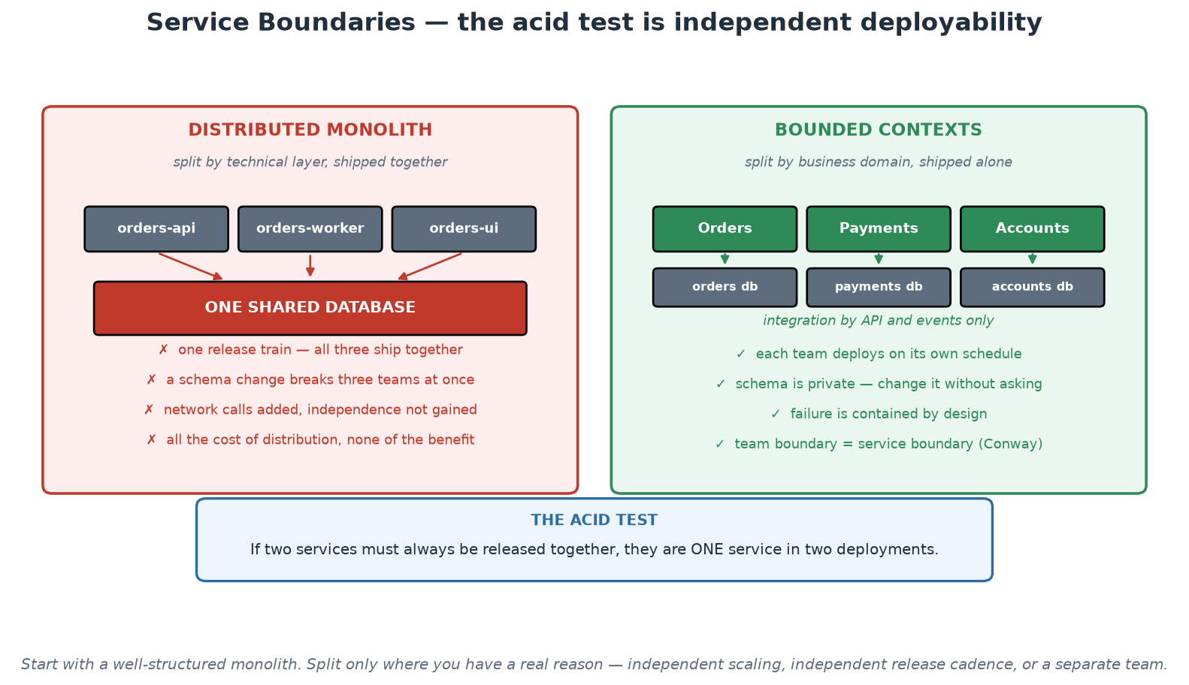
Service Boundaries - Bounded Contexts vs Distributed Monolith
Split by business domain and the split buys independence; split by layer and it buys only latency.
Notes:
Work the left panel first, because it is where most disappointing microservice programmes end up: services split by technical layer, sharing one database, released together. Every cost of distribution has been paid and no independence has been bought. Then the right panel: domains with private data, integrating through APIs and events, each team shipping alone. Land on the acid test in the blue box and let the room apply it to their own systems - if two services must always be released together, they are one service in two deployments. Close with the footnote, which is the responsible engineering advice: start with a well-structured monolith and split where you have a specific reason, because a distributed system is a permanent tax that should buy something concrete.

Slide 8
In Context: Service Boundaries in a Central Bank
Domains that suggest themselves in this environment
  Settlement and payment processing; participant and account management; collateral; reporting.
  Supervisory data intake, validation, and analysis - each a distinct capability with its own language.
  Statistics production and publication; currency and cash logistics; internal corporate services.
  The test remains: does each boundary let one team change and release without another team's calendar?
Where the boundary conversation gets difficult here
  Shared reference data (participants, instruments, calendars) that everything needs - resist a shared schema.
  Serve it as an owned service with an API and events, and let consumers keep their own read models.
  Regulatory reporting that cuts across every domain - integrate from events rather than by joining databases.
  Long-lived core systems that cannot be split - wrap them behind an API and split around them over time.
Honest guidance for a systemically important estate
  Do not distribute a system just to modernise it; distribution adds failure modes you must then operate.
  A well-structured monolith with clear internal modules is a legitimate and often superior choice.
  Where you do split, split at a seam that a single team can own end to end - Conway's Law, used deliberately.
  Every split must answer: what does independence buy us here, and can we operate the extra moving parts?
Notes:
This audience does not need encouragement to adopt microservices; they need help deciding where a split is justified and where it is a liability. Be explicit that in a systemically important environment the added failure modes of distribution - partial failure, network latency, eventual consistency, distributed debugging - are real operational obligations, and that adding them without a specific benefit is poor engineering. The shared-reference-data problem is the one that comes up in every institution: everything needs participants, instruments and calendars, and the temptation is a shared database that every service reads. Give them the alternative - one owning service with an API and published events, with consumers keeping their own read models - and be honest that it is more work up front and far cheaper afterwards. The strangler pattern deserves a mention for core systems that cannot be split: wrap the existing system behind an interface, build new capability around it, and migrate function by function rather than attempting a rewrite.

Slide 9
Twelve-Factor Apps - the Portability Contract
Config in the ENVIRONMENT, never in the artifact - one image runs everywhere.
Stateless processes: state lives in backing services, so replicas are interchangeable.
Logs to stdout as event streams - the platform aggregates, the app does not manage files.
Fast startup, graceful shutdown - disposability is what makes orchestration possible.
Dev/prod parity: the same artifact and shape from laptop to production.
Notes:
The Twelve-Factor App (Heroku, 2011) remains the practical contract between applications and platforms - highlight the five factors that carry the most weight and show where OUR app honours each. Config in environment: the same order-service image reports env 'production' under docker run, 'compose' in the Compose stack, and 'kubernetes' under kind, because APP_ENV and PAYMENT_SERVICE_URL are injected at runtime - the artifact never changes, only its environment does; participants verify this repeatedly via /health. Stateless processes: our in-memory order list is a DELIBERATE violation - in Workshop 2, scaling the payment service to two replicas visibly splits state between them, which is the most convincing statelessness lesson available: real state belongs in a backing service (database, cache), so any replica can serve any request and scaling/rescheduling is free. Logs to stdout: docker logs and kubectl logs work because the app writes to stdout and manages no log files - the platform owns aggregation. Disposability: fast boot and clean SIGTERM handling are what let orchestrators do rolling updates and self-healing - a service that takes three minutes to boot or corrupts on kill fights its platform. Dev/prod parity is the summary factor: identical images, same ports, same probes, laptop to production.

Slide 10
Deep Dive: The Factors That Actually Bite
CONFIG in the environment, not in the artifact
  One image, many environments: endpoints, credentials and tuning are injected at runtime.
  Test: could this exact image run in production and in test, with only the injected values differing?
  If a rebuild is needed to change a setting, you have lost build-once-promote-many and its evidence trail.
  Corollary: no environment names compiled into the code, and no 'if production' branches in business logic.
STATELESS processes and backing services
  No user session, uploaded file or cached truth on the container's local disk - replicas must be interchangeable.
  State goes to a declared backing service: database, cache, object store, message broker.
  This is what allows the platform to kill, move, scale and reschedule your process without asking you.
  Sticky sessions are a smell: they pin users to instances and quietly break rolling updates.
LOGS as event streams to stdout
  The application writes to stdout/stderr; the platform collects, ships, indexes and retains.
  Applications that manage their own log files fight the platform, fill disks, and lose data when a pod dies.
  Structured (JSON) logs with correlation IDs make the difference between searchable and merely stored.
  Retention, classification and access control then become platform concerns - handled once, correctly.
Notes:
Twelve-factor predates Kubernetes by years but describes precisely the contract Kubernetes assumes your application already honours - so present these as the preconditions for everything in Module 6 rather than as style advice. Config-in-the-environment is the factor with the clearest business consequence: it is what makes build-once-promote-many possible, which is what makes the artefact digest a meaningful piece of change evidence. Statelessness is the factor most often violated by older applications, and it is worth being explicit that the violation is usually invisible until the first rolling update, when users are silently logged out or an upload lands on a pod that is about to disappear. On logs, the point that lands with operations audiences is ownership: an application that writes and rotates its own log files is doing a job the platform does better, and doing it in a way that loses data exactly when a container dies - which is exactly when you need it. Recommend structured logs with correlation IDs early, because retrofitting them across services is far more expensive than starting with them.

Slide 11
Deep Dive: Disposability and Dev/Prod Parity
Fast startup, graceful shutdown
  Orchestrators start and stop processes constantly - scaling, rolling, rescheduling, draining nodes.
  Slow startup delays every rollout and every recovery; a 3-minute boot makes autoscaling useless.
  On SIGTERM: stop accepting new work, finish in-flight requests, close connections, then exit.
  Ignoring SIGTERM means the platform kills you mid-request - visible to users as random errors during deploys.
  Combine with a readiness probe so traffic is removed BEFORE shutdown begins.
Dev/prod parity - the gap that produces 'works in test'
  Same artefact, same shape, same backing-service types from laptop to production.
  Containers plus IaC are what make parity achievable rather than aspirational.
  Remaining differences must be deliberate and known: data volume, scale, network policy, real integrations.
  The lab pattern (Compose locally, kind for Kubernetes) is exactly this principle at training scale.
Using the contract as a review checklist
  Config injected, not baked? Stateless? Logs to stdout? Handles SIGTERM? Starts fast?
  Any 'no' predicts a specific operational failure - name it, and the fix becomes obvious.
  For legacy applications, treat the list as a migration backlog, not a pass/fail gate.
Notes:
Disposability is the factor that connects most directly to the deployment strategies from Day 1: a service that cannot start quickly and shut down cleanly cannot participate in a rolling update without dropping requests, which is why teams conclude that 'zero-downtime deployment does not work here'. Walk the SIGTERM sequence explicitly, because most developers have never written it: stop accepting new work, drain in-flight requests, close resources, exit - and pair it with a readiness probe that removes the pod from traffic first. On parity, be honest that perfect parity is impossible and undesirable - production has data volumes, real integrations and network policy that no laptop should have - so the goal is that differences are deliberate and enumerated rather than accidental and discovered. The last section is the practical takeaway for institutions with a large legacy estate: nobody is going to rewrite everything, so use the checklist to predict which specific operational pain a given application will exhibit, and to sequence remediation by what hurts most.

Slide 12
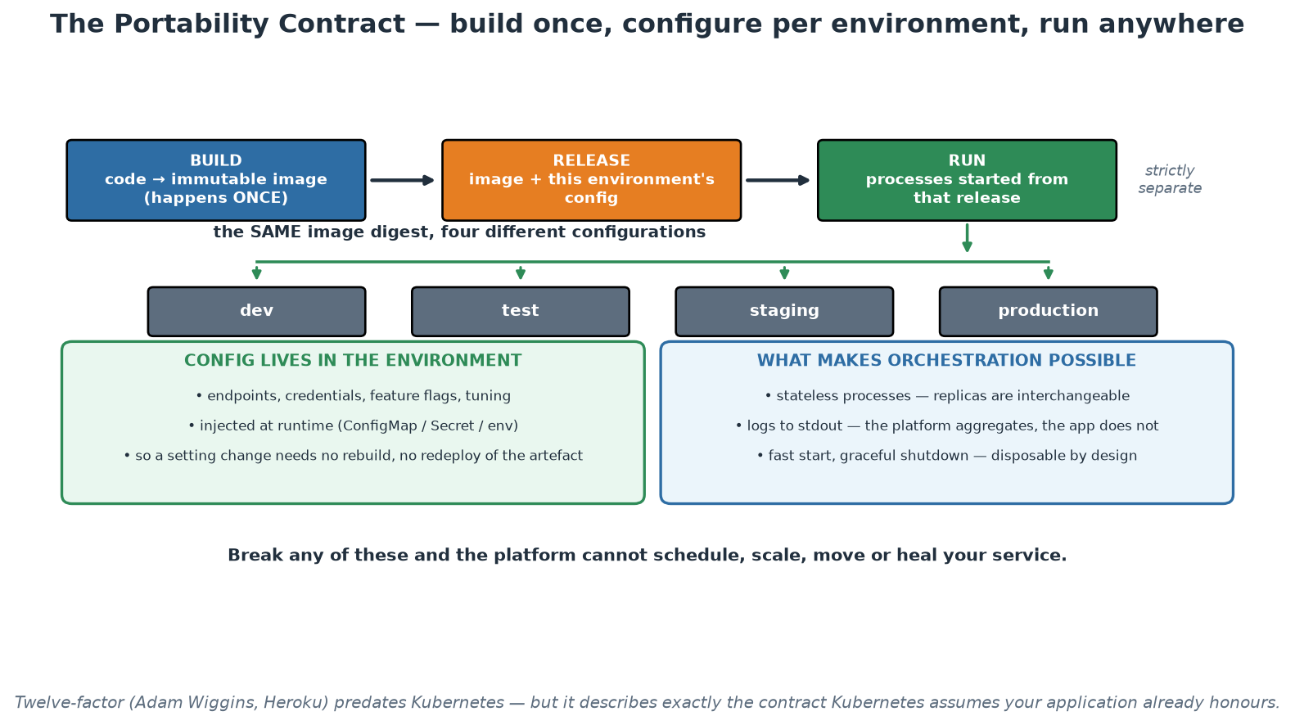
Build, Release, Run - the Portability Contract
One image digest, four configurations - and the properties that let a platform operate it.
Notes:
Use the top row to reinforce the Day 1 build-once-promote-many discipline, now with the reason spelled out: build produces the artefact, release binds it to an environment's configuration, and run starts processes from that release - strictly separate, so the artefact never changes as it moves. The fan-out to four environments is the payoff: the same digest everywhere, differing only in injected values, which is what makes a test result predictive and an artefact digest meaningful as change evidence. The two panels at the bottom are the properties Kubernetes assumes, so present them as prerequisites rather than advice - a stateful, slow-starting service that writes its own log files cannot be scheduled, scaled or healed, whatever the manifests say.

Slide 13
In Context: Twelve-Factor Against a Legacy Estate
What usually blocks older applications
  Configuration compiled into the artefact or read from a machine-specific path on a named server.
  Local state: sessions in memory, files on local disk, caches assumed to be warm and singular.
  Log files written and rotated by the application, on a volume somebody has to manage.
  Long start-up (minutes) and no signal handling, so restarts are disruptive and manual.
A pragmatic migration order
  1. Externalise configuration first - it is the least invasive and it unlocks one-artefact promotion.
  2. Move logs to stdout next; the platform then handles collection, retention and access control.
  3. Extract state to a backing service - the hardest step, and the one that enables scaling and healing.
  4. Add signal handling and health endpoints - small changes that make rollouts non-disruptive.
Judgement calls in a regulated estate
  Not every system should be modernised - some are stable, low-change, and best left alone deliberately.
  Prioritise by change frequency: applications that change often repay portability work fastest.
  Vendor products may not honour the contract at all; then containerise what you can and be honest about the rest.
  Record the decision (an ADR) so the next team knows what was chosen and why.
Notes:
Most participants are not starting with greenfield services, so the value of this slide is sequencing rather than aspiration. Externalising configuration first is deliberate: it is the least invasive change, it usually requires no architectural work, and it immediately unlocks the one-artefact-many-environments discipline that everything else depends on. Extracting state is genuinely hard and often needs design work, so it belongs later, when the earlier wins have built confidence and credibility. Be explicit that not everything should be modernised - a stable system that changes twice a year and works is a poor investment target, and saying so protects the credibility of the recommendations you do make. Prioritise by change frequency, because portability work pays back per change. And for vendor products that cannot honour the contract, the honest answer is to containerise what is possible, document what is not, and design the operational model around the constraint rather than pretending it away.

Slide 14
What a Container Actually Is
NOT a VM: no guest OS - processes on the host kernel, isolated by namespaces + cgroups.
Namespaces = what you can SEE (processes, network, filesystem); cgroups = what you can USE.
An image is a stack of immutable layers + metadata (OCI standard); a container is a running instance.
Layers are content-addressed and shared - 50 services on one base image store it once.
Registries distribute images by digest: the SHA is the identity, tags are mutable pointers.
Notes:
Demystify the technology - containers stop being magic in about three minutes. A VM virtualises hardware and boots a full guest OS (minutes, gigabytes); a container is ordinary Linux processes wearing isolation: NAMESPACES restrict what the process can see (its own PID tree, network stack, filesystem mounts, users) and CGROUPS meter what it can consume (CPU, memory - the numbers our Kubernetes limits set in Workshop 2). That is why containers start in milliseconds and share the host kernel - and why container security differs from VM security (Module 7: a kernel exploit escapes ALL containers on the host, hence non-root and seccomp defaults). Images: an immutable, content-addressed stack of filesystem layers plus metadata (entrypoint, env, ports), standardised by the OCI so any runtime runs any image. Layer sharing is the economic magic: every image FROM python:3.12-slim shares those base layers on disk and over the network - which is also why layer ORDER matters in Dockerfiles (dependencies before source code = cache hits on every code-only rebuild; participants see this in Workshop 2 when the second build takes seconds). Tags vs digests: a tag like :lab02 is a mutable pointer, the sha256 digest is the true identity - which is why production systems pin digests and why our no-latest-tag policy exists (Module 7).

Slide 15
Deep Dive: Processes, Not Machines
The mechanism, in one paragraph
  A container is just a process (or a few) on the host kernel, with a restricted view and a resource budget.
  NAMESPACES restrict what it can SEE: its own process tree, network stack, mounts, hostname, users.
  CGROUPS restrict what it can USE: CPU shares, memory limits, I/O - enforced by the kernel.
  There is no guest OS and no hypervisor, which is why start-up is milliseconds and overhead is negligible.
  The image supplies the filesystem the process sees - not a kernel, just userland files.
What follows from 'shared kernel'
  The kernel is the trust boundary: a container escape is a HOST compromise, not a VM breakout.
  So least privilege matters more, not less: non-root, dropped capabilities, read-only filesystem, seccomp.
  Sensitive multi-tenancy may still justify VM-level isolation, or hardened runtimes - it is a risk decision.
  Kernel patching remains a host responsibility that containers do not remove.
Images: layers, digests and tags
  An image is an ordered stack of immutable layers plus metadata, standardised by the OCI specification.
  Layers are content-addressed and shared: fifty services on one base image store that base once.
  The DIGEST (sha256:...) is the identity; a TAG is a mutable pointer that can be moved by anyone with push rights.
  So promote and deploy by digest, and treat 'latest' as meaning 'unknown' in any controlled environment.
Notes:
Get the mental model right here and everything in Module 7's hardening slide becomes obvious rather than arbitrary. The single most useful correction is that a container is not a small VM: it is a normal process with a restricted view, sharing the host kernel, which is why it starts in milliseconds and why its isolation is weaker than a hypervisor's. Say the security consequence plainly, because it is the reason the runtime-hardening controls exist: if a process escapes its namespace it is on the host, so non-root execution, dropped capabilities and seccomp profiles are baseline hygiene rather than paranoia. The tag-versus-digest point is the one that matters most operationally in a controlled environment: a tag is a pointer that someone can move, so 'we deployed version 1.4.2' is only true if nobody re-pushed that tag, whereas a digest is cryptographic identity. Recommend digest-based promotion in pipelines and digest recording in change records - it converts a claim into evidence.

Slide 16
Deep Dive: Registries, Promotion and What Containers Do Not Fix
Registries as the promotion boundary
  The registry stores the immutable artefact that moves, unchanged, from test to production.
  Access control, retention, immutability settings and scanning all belong at this boundary.
  Signing (cosign) and provenance attach 'who built this, from what commit' to the artefact itself.
  Private registries or pull-through caches also remove a dependency on an external service at deploy time.
What containers give you
  Environment parity: the dependency set travels with the application instead of living in a runbook.
  Density and speed: many workloads per host, starting in milliseconds, scaling in seconds.
  Immutability by default: you rebuild rather than patch, so instances stay identical to a reviewed definition.
  Portability across hosts and clouds - the workload is decoupled from the machine it happens to run on.
What containers do NOT give you
  They do not make an application stateless, well-designed, or safe to run twice - that is 12-factor work.
  They do not remove the need to patch: your base image ages, and yesterday's clean scan is not today's.
  They do not provide isolation equivalent to a VM - see the trust-boundary point on the previous slide.
  They do not fix data: databases, migrations and backups need the same care they always did.
Notes:
The registry deserves more attention than it usually gets, because it is where several controls naturally belong: access, immutability, retention, scanning, signing and provenance. Frame it as the promotion boundary - the physical embodiment of build-once-promote-many from Day 1 - and note that in a controlled environment the ability to state 'this exact digest, built from this commit, scanned with this result, signed by this pipeline' is a complete answer to a whole category of audit questions. The what-containers-do-not-give-you section is there to prevent overselling, which is how technology adoptions lose credibility: containers are a packaging and isolation mechanism, not an architecture, and a badly behaved application in a container is a badly behaved application that now starts faster. The patching point is worth dwelling on with security-minded participants: an image is a frozen snapshot of a distribution at build time, so a service that has not been rebuilt for six months is running six-month-old packages regardless of how clean its original scan was - which is the argument for regular automated rebuilds.

Slide 17
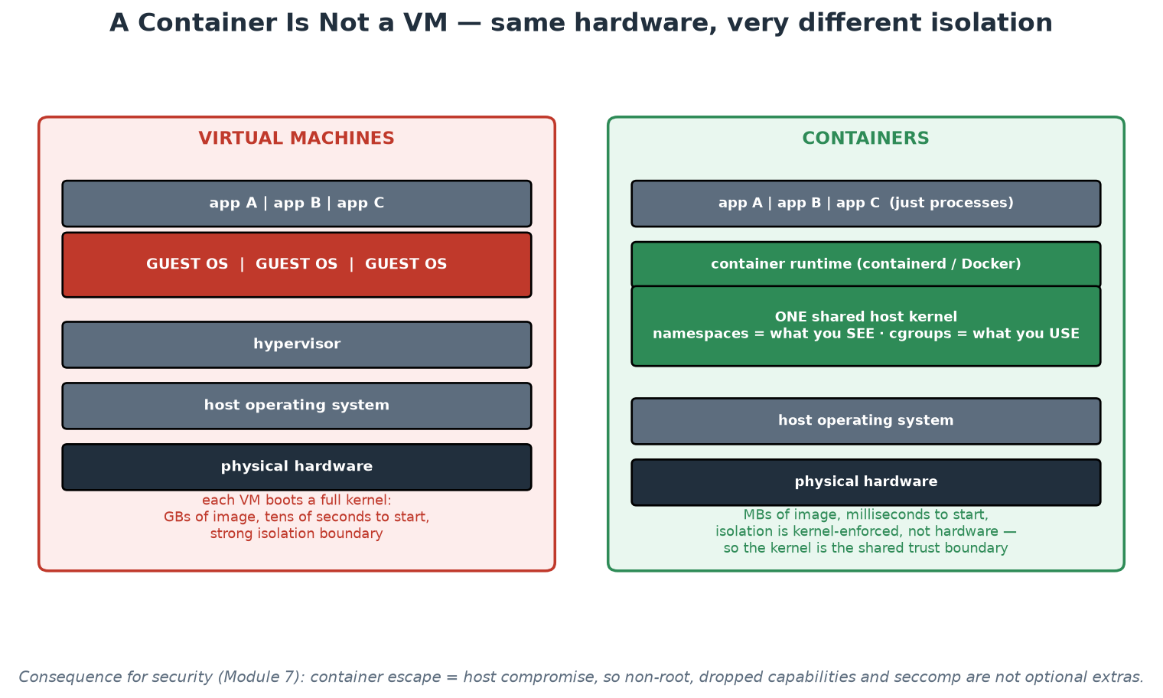
Container vs Virtual Machine
No guest OS: processes on a shared kernel, isolated by namespaces and cgroups.
Notes:
Put the two stacks side by side and let the missing layer do the teaching: there is no guest operating system in the container stack, which is why images are megabytes rather than gigabytes and why start-up is milliseconds rather than tens of seconds. Then make the security consequence explicit, because it is the reason for everything in Module 7's hardening slide: the kernel is shared, so it is the trust boundary, and a container escape means host compromise rather than a hypervisor breakout. In an institution that runs mixed workloads with different sensitivity, that is a genuine design input - VM-level isolation remains the stronger boundary, and choosing between them is a risk decision rather than a fashion decision.

Slide 18
In Context: Containers Under Institutional Controls
Questions your security colleagues will ask - and good answers
  'What is running?' - the image digest, its SBOM, and the commit it was built from. All machine-generated.
  'Who can change it?' - nobody: images are immutable, and a change means a new digest through the pipeline.
  'How do we patch?' - rebuild and redeploy on a schedule, not by logging in; patching becomes a pipeline run.
  'What is the isolation?' - namespaces and cgroups on a shared kernel, hardened by policy (Module 7).
Where containers genuinely improve control
  Environment parity: the dependency set travels with the application instead of living in a runbook.
  Immutability: no in-place patching, so no undocumented divergence between instances.
  Traceability: digest plus labels tie a running workload back to a commit and a pipeline run.
  Rebuild-to-patch replaces a manual estate-wide task with an automated, evidenced one.
Where you must be careful
  Registry governance: who may push, what is retained, is a tag immutable, are images signed?
  Base image provenance: prefer curated, internally mirrored bases over arbitrary public images.
  Ageing images: a service not rebuilt for months is running months-old packages - schedule rebuilds.
  Classification: an image can carry embedded data or credentials - scan for secrets, and control access.
Notes:
Frame containers in the language of the control conversations participants will actually have. The four questions in the first section are the ones security and audit colleagues ask, and containers answer them better than the alternative: what is running is a digest with an inventory, nobody can change it in place, patching is a rebuild through the reviewed path, and isolation is explicit and enforceable. Present that as a control improvement over long-lived mutable servers, because it is one. Then be balanced about the new obligations, which are real and often overlooked: registry governance (who can push, retention, tag immutability, signing), base image provenance - which in a supervised institution usually means an internally curated and mirrored set rather than pulling arbitrary public images - and the ageing problem, which needs a scheduled rebuild to solve. Ending on those obligations rather than on the benefits is what makes the recommendation credible to the people who have to approve it.

Slide 19
Building Good Images
Multi-stage builds: compile/install in a builder stage, ship only the runtime slice.
Run as non-root; smallest sensible base (slim/distroless); pin base versions.
Order layers for cache: dependency manifest first, source code last.
HEALTHCHECK + graceful shutdown make the image orchestrator-friendly.
.dockerignore: the build context is not your whole repository.
Notes:
Every line here is implemented in the course's two Dockerfiles - open Dockerfile in labs/app on screen and point as you talk. Multi-stage: the builder stage pip-installs with full tooling; the final stage copies only the installed packages - smaller images pull faster, cold-start faster, and expose fewer packages to CVE scanners (participants compare Trivy findings against slim bases in the Module 7 demo). Non-root: our images create appuser (UID 1001) and USER-switch before CMD, so a container escape lands unprivileged - participants verify with whoami in Workshop 2, and Kubernetes enforces it again via runAsNonRoot (defence in depth). Base choice: slim over full (fewer packages, fewer CVEs), distroless as the next step (no shell - harder to debug, harder to exploit), alpine with the musl caveat for Python wheels. Cache ordering is the daily-life win: COPY requirements.txt + install BEFORE COPY source means editing code never re-installs dependencies. HEALTHCHECK lets Compose gate startup ordering (our depends_on: service_healthy) and mirrors the probes Kubernetes will run. The .dockerignore keeps venvs, .git and caches out of the build context - build speed and no accidental secrets in layers.

Slide 20
Deep Dive: Small, Fast, Cacheable
MULTI-STAGE builds - ship the runtime, not the workshop
  Stage 1 (builder): compilers, headers, build tools, test dependencies - everything needed to produce the artefact.
  Stage 2 (runtime): a slim base plus the built artefact, copied across. Nothing else travels.
  Result: a smaller image, a much smaller CVE surface, and no compiler available to an attacker in production.
  This single practice usually removes more scanner findings than any triage effort.
LAYER ORDER decides your build time
  Layers are cached and invalidated in order: change one, and everything after it rebuilds.
  So copy the dependency manifest and install dependencies BEFORE copying source code.
  Reversed, every one-line code change reinstalls the full dependency tree - minutes wasted on every commit.
  Same reasoning applies to CI cache keys: cache on the manifest hash, not on the whole repository.
BASE IMAGE choice is a security decision
  Smallest sensible base: slim variants, or distroless where the language runtime allows it.
  Fewer packages = fewer CVEs to triage, and less for an attacker to use if they land inside.
  PIN the base version (and ideally the digest) - 'python:3' silently changes underneath you.
  Rebuild regularly on a schedule: an image that has not been rebuilt is accumulating known vulnerabilities.
Notes:
These are the practices with the largest measurable payoff in the whole containerisation module, so make them concrete with numbers where you can: a naive image often runs to several hundred megabytes and hundreds of scanner findings, while a multi-stage build onto a slim or distroless base commonly lands an order of magnitude smaller with a fraction of the findings - and the reduction costs nothing but a better Dockerfile. Link it directly to Module 7's triage discipline: the cheapest way to reduce vulnerability backlog is to ship less software, not to argue about severities. The layer-ordering point is what participants will feel first in the labs, because it is the difference between a ten-second and a three-minute rebuild loop, and that difference compounds across every commit of every team. On base images, the scheduled-rebuild recommendation is the one most organisations miss: images are frozen snapshots, so without an automated periodic rebuild your fleet's vulnerability posture degrades even when nobody changes any code.

Slide 21
Deep Dive: Orchestrator-Friendly and Safe by Default
Run as NON-ROOT, and mean it
  Create a user in the image and declare USER - root inside a container is root on the kernel it shares.
  Add a read-only root filesystem and writable volumes only where genuinely needed.
  Drop all Linux capabilities and add back only what is required - almost always nothing.
  These are image-level choices that make the runtime controls in Module 7 possible rather than aspirational.
Make the image easy for the platform to operate
  HEALTHCHECK / probe endpoints so the orchestrator can tell 'started' from 'actually serving'.
  Handle SIGTERM and shut down gracefully, or expect dropped requests on every rollout.
  Log to stdout, exit with meaningful codes, and keep start-up fast.
  Declare resource expectations honestly so requests and limits can be set from evidence, not guesswork.
Build hygiene that prevents leaks
  Use .dockerignore: the build context is not your whole repository, and secrets hide in .git and .env.
  A secret added in one layer and deleted in the next is STILL in the image history - never bake credentials.
  Use build secrets or runtime injection; scan images for secrets as part of the pipeline.
  Label images with the commit SHA and build metadata so a running container can be traced to its source.
Notes:
The non-root discussion connects straight back to the shared-kernel point: root in a container is root on the host kernel if anything escapes, so the image-level USER declaration is the foundation that the cluster-level security context enforces. Point out that this is a shared responsibility between the image author and the platform, which is why Module 7 argues for platform defaults - the golden path should make the safe configuration the default one, so teams inherit it. The build-hygiene section prevents a specific, common and painful incident: credentials committed into image layers. Say the layer-history point explicitly because it surprises people - deleting a file in a later layer does not remove it from the image, it merely hides it from the final filesystem view, and anyone who pulls the image can extract it. That is why secret scanning belongs in the pipeline and why credentials must be injected at runtime rather than built in. Finally, the labelling advice pays for itself the first time someone needs to know which commit produced the container currently misbehaving in production.

Slide 22
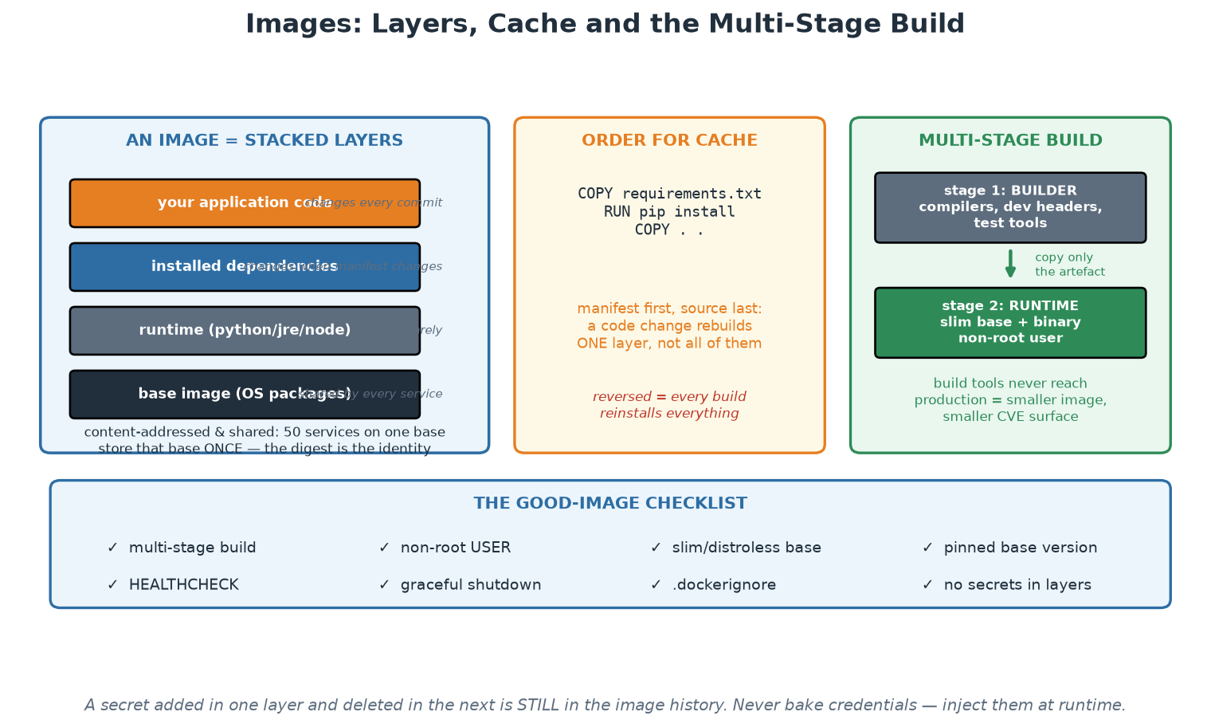
Image Layers, Cache Order and Multi-Stage Builds
Ship the runtime slice, not the workshop - and order layers so the cache actually works.
Notes:
Three ideas on one page. The layer stack explains sharing and why base image choice matters so much - fifty services on one base store that base once, and every CVE in it is inherited fifty times. The cache-ordering panel is the one participants feel immediately in the labs, because it is the difference between a ten-second and a three-minute rebuild on every commit. The multi-stage panel is the one with the largest security payoff: build tools, compilers and test dependencies never reach production, which both shrinks the image and removes the tooling an attacker would otherwise find waiting inside. Finish on the checklist, and point out the footnote about layer history - a secret added and then deleted is still in the image, which surprises almost everyone the first time.

Slide 23
In Context: An Institutional Base-Image Standard
What a curated base-image set gives the institution
  A small number of approved, internally mirrored bases - patched, scanned and rebuilt centrally.
  Teams inherit a hardened starting point instead of choosing from the whole internet.
  One place to fix a widespread vulnerability, rather than forty repositories to chase.
  Provenance: internally built and signed, so the supply chain starts inside the institution.
The operating discipline that keeps it useful
  Rebuild the bases on a schedule, and publish new versions with clear release notes.
  Notify consumers and track who is on which version - you cannot manage what you cannot see.
  Automate the downstream rebuild, or teams will pin an old base forever and the effort is wasted.
  Measure: what share of running images is on a base built in the last 30 days?
What each delivery team still owns
  Multi-stage builds, non-root user, .dockerignore, and no credentials baked into any layer.
  Health endpoints, graceful shutdown, fast start-up - the operability contract from twelve-factor.
  Honest resource declarations so requests and limits can be set from evidence.
  Keeping their own dependencies current - the base only covers the layers beneath them.
Notes:
The curated base-image set is one of the highest-value, lowest-controversy platform products a regulated institution can build, so make the case concretely. It converts a widespread vulnerability response from 'contact forty teams and hope' into 'rebuild the bases, trigger downstream rebuilds, measure coverage', which is a dramatic improvement in both response time and evidence quality. Stress the operating discipline, because a curated base set that is not rebuilt and not adopted is worse than none: it creates the appearance of control while teams quietly pin an old version. The metric on the slide - the share of running images on a recently built base - is the honest measure, and it is the kind of number that belongs in an operational risk pack. Close by keeping the division of responsibility clear: the platform owns the bases and the automation, and each team still owns its own dependencies, its Dockerfile discipline, and the operability of its service.

Slide 24
Why Orchestration - What Kubernetes Actually Does
One host + docker run does not: reschedule on failure, scale, roll out, load-balance, heal.
Kubernetes = a RECONCILIATION engine: you declare desired state, controllers converge reality.
Scheduling: pods placed by resource requests, spread and affinity across nodes.
Self-healing: failed pods replaced, failed probes remove pods from traffic - automatically.
The same declarative + converge model as Terraform, applied continuously at runtime.
Notes:
Motivate orchestration from the gap participants have personally felt by now: Compose runs a stack on one machine, but who restarts the container at 03:00, moves it when the node dies, adds replicas under load, or shifts traffic during an update? Kubernetes' core idea - the one that makes everything else make sense - is RECONCILIATION: you write desired state (a Deployment saying 'two replicas of this image'), and controllers run an endless loop of observe-diff-act until reality matches, forever. Delete a pod and it reappears; not because something restarted it as a special case, but because the controller noticed reality (1 pod) diverged from desire (2). Connect this explicitly to Module 4: it is Terraform's declare-and-converge model, running continuously at runtime instead of on demand - one mental model, two timescales. Scheduling uses the resource REQUESTS on each container (our manifests set them) to bin-pack pods across nodes; LIMITS cap consumption via cgroups from two slides ago. Self-healing goes beyond restarts: a failing READINESS probe removes a pod from Service load-balancing without killing it; a failing LIVENESS probe restarts it - participants configure both in Workshop 2 and watch them act during the rolling update.

Slide 25
Deep Dive: The Reconciliation Engine
What one host and 'docker run' cannot do
  Reschedule your workload when the machine dies - somebody has to notice and act.
  Scale out and back with demand, and place work where there is actually capacity.
  Roll out a new version gradually, verify it, and roll back without downtime.
  Load-balance across replicas, and remove unhealthy ones from traffic automatically.
The control loop, which is the whole idea
  You declare DESIRED state ('five replicas of this image, these limits, these probes').
  Controllers observe ACTUAL state, compute the difference, and act to close it. Forever.
  Self-healing is not a feature bolted on - it is that loop noticing a difference and correcting it.
  Same model as Terraform (Day 1), but running continuously instead of when a human types apply.
Why declarative APIs matter more than the scheduler
  Everything is an object with a spec and a status, reachable through one consistent API.
  So everything above it can be automated: GitOps agents, operators, autoscalers, policy admission.
  That extensibility - not container scheduling - is why the ecosystem consolidated on Kubernetes.
  And the honest caveat: this power costs real operational complexity, which the next slide prices.
Notes:
Land the reconciliation model rather than a feature list, because it explains behaviour participants will otherwise find surprising - why deleting a pod does not remove it, why editing a live object gets reverted by a controller, why the cluster keeps trying forever. Draw the loop on the flipchart: observe, compare, act, repeat. Then connect it explicitly to Terraform from Day 1: the same declarative-plus-converge idea, with the difference that Kubernetes runs the loop continuously rather than on demand, which is precisely what makes self-healing possible. The third section is the strategic point worth making to senior participants: Kubernetes won not because it schedules containers well but because it exposed everything as a uniform declarative API, which turned operations into programmable objects and allowed an ecosystem of controllers, operators and policy engines to grow on top. Finish by flagging the cost honestly - complexity is real and must be justified - because the next deep dive is precisely about when NOT to adopt it, and stating that early buys credibility for everything else in the module.

Slide 26
Deep Dive: What It Costs, and When Not to Use It
What the platform gives you, concretely
  Scheduling by declared resource requests, with spread, affinity and node selection rules.
  Self-healing: failed pods replaced, failed liveness probes restarted, unready pods pulled from traffic.
  Rollouts and rollbacks as first-class operations with revision history.
  Service discovery and load balancing without any application-level registry.
  A uniform place to apply policy, quotas, network rules and identity across every workload.
What it costs - say this out loud before adopting
  A cluster is production infrastructure: upgrades, certificates, capacity, backups, security patching.
  A steep vocabulary: every team must learn objects, probes, limits, RBAC, networking, storage classes.
  New failure modes: scheduling pressure, evictions, DNS, network policy, misconfigured probes.
  This is exactly the cognitive load a platform team exists to absorb (Day 1, Module 1).
When something simpler is the professional choice
  A handful of stable services on a few hosts: containers plus a managed runtime is often enough.
  One team, one deployable, predictable load: an orchestrator adds cost with little return.
  Adopt when you have real scale, real elasticity needs, or many teams needing a common runtime contract.
  If you do adopt, prefer managed control planes and let the platform team own the cluster, not each team.
Notes:
Being honest about cost is what makes the recommendation credible, and this audience will respect it. Kubernetes is production infrastructure with its own upgrade cycle, certificate expiries, capacity planning and security patching - adopting it means someone signs up to operate it forever, and 'the team that also builds our services' is usually the wrong answer. Give the room permission to conclude that they do not need it yet: a small number of stable services on managed container hosting is a perfectly professional architecture, and choosing it deliberately is better engineering than adopting an orchestrator because it is expected. Then give the conditions that genuinely justify it - multiple teams needing a common runtime contract, real elasticity, or a scale that makes manual placement untenable - and the adoption advice that follows: a managed control plane where available, and cluster operation owned centrally so that product teams consume a runtime rather than run one. That is the cognitive-load argument from Day 1 applied to the single biggest source of it.

Slide 27
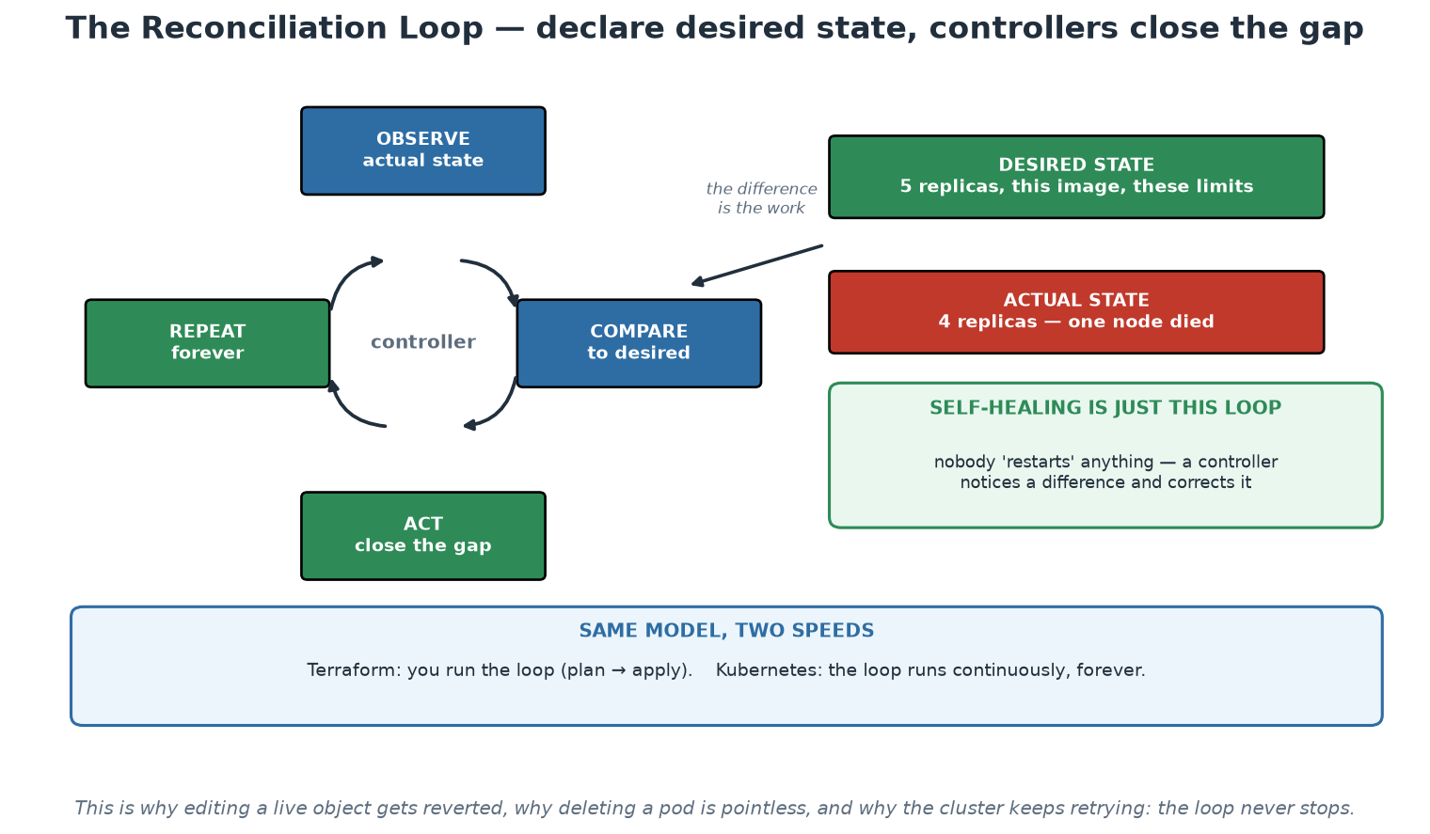
The Reconciliation Loop
Declare the desired state; controllers observe, compare and act - continuously, forever.
Notes:
This is the mental model that makes Kubernetes predictable rather than mysterious. Trace the loop, then use the right-hand example: desired is five replicas, actual is four because a node died, and the difference is the work the controller does without anyone being paged. Say explicitly that self-healing is not a feature bolted on top - it is this loop noticing a difference. The bottom panel ties it back to Day 1: Terraform runs the same model on demand when a human types apply, and Kubernetes runs it continuously. Once participants hold that model, the surprising behaviours become obvious: a manually edited object gets reverted, a deleted pod comes back, and the cluster keeps retrying because the loop has no end state.

Slide 28
In Context: Should a Central Bank Run Kubernetes?
The honest decision criteria
  Many teams needing a common runtime contract - that is the strongest argument for it.
  Genuine elasticity or density requirements that manual placement cannot serve.
  A platform team that can own cluster lifecycle properly - upgrades, certificates, capacity, patching, restores.
  If none of these hold, containers on a simpler managed runtime is the professional choice, not a lesser one.
What adopting it commits the institution to
  A cluster is production infrastructure with its own upgrade cadence and end-of-support dates.
  New operational skills and new failure modes: scheduling, evictions, DNS, network policy, storage.
  Security work that is genuinely different: RBAC, admission control, network policy, workload identity.
  A support model: when the cluster is unwell, every service on it is unwell at the same time.
If you do adopt - the sensible shape
  Managed control planes where available; keep cluster operation with the platform team, not with delivery teams.
  Separate clusters by blast radius: critical vs non-critical, production vs everything else.
  Start with internal, low-criticality workloads and build operational evidence before anything important moves.
  Rehearse the unglamorous paths early: upgrade, certificate rotation, node loss, and restore from backup.
Notes:
Give the room permission to say no, because a trainer who recommends Kubernetes universally loses credibility with an audience that carries real operational risk. Kubernetes is justified by multiple teams needing a common runtime contract and by real elasticity requirements, and it commits the institution to operating production infrastructure with a fast-moving upgrade cadence - which is a standing cost, not a project. Where the criteria are not met, containers on a simpler runtime deliver most of the portability benefit at a fraction of the operational burden, and choosing that deliberately is good engineering. If the institution does adopt, the shape on the slide matters: managed control planes reduce the hardest part, cluster operation belongs with a platform team rather than distributed across delivery teams, blast-radius separation should be designed rather than discovered, and the first workloads should be internal and low-criticality so that operational evidence accumulates before anything important depends on it. Rehearsing upgrades and restores early is the difference between a capability and a hope.

Slide 29
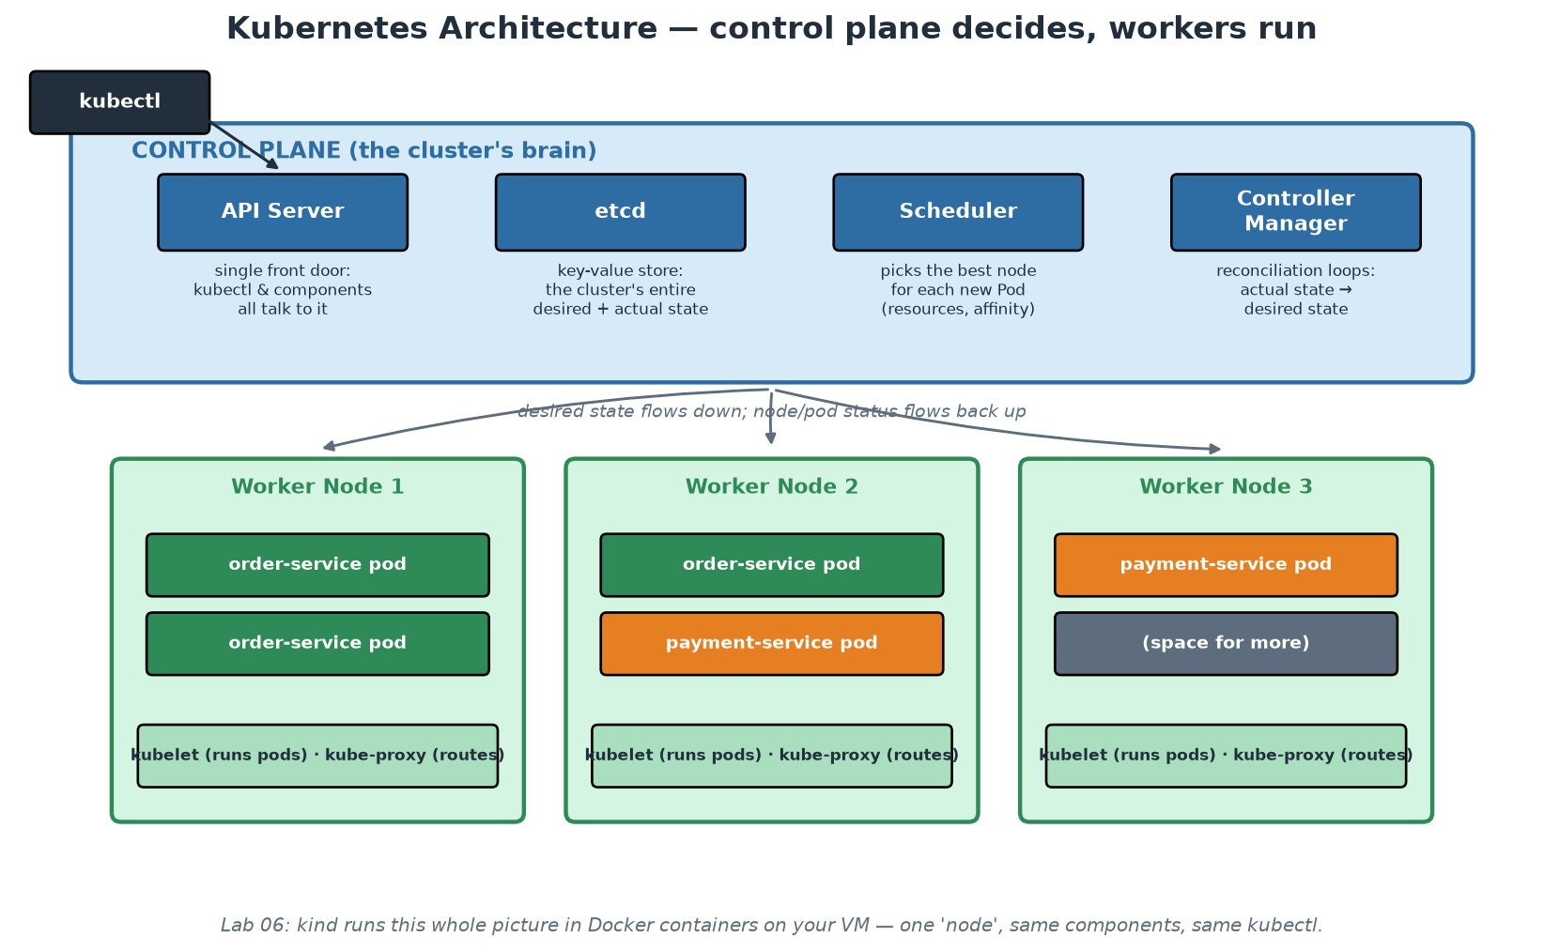
Kubernetes Architecture
Control plane decides; workers run; everything talks to the API server.
Notes:
Keep the tour tight and functional - the exam-level detail is less important than the shape. Control plane: the API SERVER is the single front door (kubectl, controllers, kubelets all speak to it - which is why RBAC on the API server is THE security boundary, Module 7); ETCD stores the entire cluster state (desired and observed - lose etcd without backup, lose the cluster's memory); the SCHEDULER assigns new pods to nodes; the CONTROLLER MANAGER runs the reconciliation loops from the previous slide. Workers: the KUBELET on each node makes assigned pods actually run and reports status back; KUBE-PROXY programs the routing that makes Services work. Emphasise the communication pattern: desired state flows down, observed status flows back up, and NOTHING talks directly to anything except through the API server - that uniformity is what makes Kubernetes extensible (operators, admission controllers) and auditable. Then the kind reveal: in Workshop 2, this entire picture runs inside one Docker container on the participant's VM - same API, same components, same kubectl; which is the course's fidelity claim: everything they practise transfers verbatim to EKS/AKS/GKE, where the control plane is simply someone else's problem (managed).

Slide 30
The Working Vocabulary: Objects You Will Touch
Pod: smallest unit - one or more containers sharing network/storage; mortal by design.
Deployment: desired replicas + template; owns rolling updates and rollback history.
Service: stable name + virtual IP load-balancing over pods selected by LABELS.
ConfigMap / Secret: configuration injected at runtime (12-factor, realised).
Probes + requests/limits: how the platform knows a pod is well and what it may consume.
Notes:
Five objects cover Workshop 2 completely. Pods are mortal - never hand-create them; they die and are replaced, and their IPs change, which is WHY Services exist. Deployments are what you actually write: replicas + pod template; kubectl set image triggers a rolling update (new ReplicaSet scaled up as old scales down, gated by readiness probes), and kubectl rollout undo is the one-command rollback - participants run both and watch build_id change and change back via /health. Services solve discovery: a stable DNS name (payment-service) and virtual IP, load-balancing across whatever pods currently match the label selector - the Compose DNS idea, made dynamic; label selectors are the glue, and a selector/label mismatch is the classic 'why is my service empty' bug (it is in the workshop's troubleshooting table). ConfigMaps/Secrets inject environment per-cluster while the image stays identical - our app-config supplies APP_ENV=kubernetes, and /health proves it. Probes: readiness gates traffic, liveness triggers restart - configure them differently or a slow startup becomes a restart loop. Requests/limits: requests inform scheduling, limits enforce via cgroups; both are set in our manifests and both are what Module 7's config scanner checks for.

Slide 31
Deep Dive: Pods, Deployments and Services
POD - the unit of scheduling, and mortal by design
  One or more containers that share a network namespace and can share volumes - always co-scheduled.
  Pods are cattle: replaced, never repaired. No stable IP, no stable identity, no attachment.
  Sidecar pattern: a second container for logging, proxying or secrets - powerful, but it is still one unit.
  You will rarely create pods directly; a controller creates them from a template.
DEPLOYMENT - desired replicas plus rollout behaviour
  Holds the pod template, the replica count and the update strategy (maxSurge / maxUnavailable).
  Creates a ReplicaSet per revision, which is what makes rollback a first-class operation.
  kubectl rollout undo returns to the previous ReplicaSet - seconds, not a rebuild.
  For stateful workloads, StatefulSet gives stable identity and ordered rollout - different rules apply.
SERVICE - a stable address over a moving set of pods
  Pods come and go; the Service name and virtual IP stay constant for the life of the service.
  Selection is by LABEL, which is why label discipline matters more than it first appears.
  ClusterIP for internal, NodePort for simple external access (our labs), LoadBalancer/Ingress in real clusters.
  Readiness probes decide membership: an unready pod is removed from the Service's endpoints automatically.
Notes:
Teach the ownership chain as a single sentence participants can repeat: a Deployment owns ReplicaSets, a ReplicaSet keeps N Pods running, and a Service load-balances over Pods selected by label. Almost every confusing Kubernetes behaviour becomes obvious once that chain is clear - why deleting a pod is pointless, why a rollback is instant, why a service silently returns nothing when a label is misspelled. The mortality of pods deserves emphasis for participants with a VM background, because the instinct to log in and fix a sick instance is exactly wrong here and produces state that the next reconciliation discards. Mention StatefulSet briefly so the room knows the stateful path exists and has different rules, without going deep - most first workloads are stateless, and stateful services in a cluster deserve their own careful conversation. In Workshop 2 participants create all of these objects and then deliberately break a label selector, which is the fastest way to internalise why the Service found no endpoints.

Slide 32
Deep Dive: Config, Probes and Resource Limits
ConfigMap and Secret - twelve-factor, realised
  Configuration injected as environment variables or mounted files, so one image serves every environment.
  Secrets are base64-ENCODED, not encrypted, by default - treat them as sensitive objects and control access.
  For real secret management, integrate a manager (Vault, cloud KMS, external-secrets) rather than committing values.
  Changing a ConfigMap does not restart pods by itself - roll the Deployment or use a checksum annotation.
PROBES - how the platform knows what is happening
  Readiness: 'send me traffic'. Fails -> removed from the Service, but NOT restarted.
  Liveness: 'I am alive'. Fails -> the container is restarted. Get this wrong and you get restart loops.
  Startup: for slow starters, so a long boot is not mistaken for a liveness failure.
  Probe endpoints must be cheap and must not depend on downstream systems, or one outage cascades everywhere.
REQUESTS and LIMITS - the resource contract
  Requests are what the scheduler reserves for you; limits are the ceiling you may not exceed.
  No requests means the scheduler is guessing, and your pod is first to be evicted under pressure.
  Exceeding a memory limit is an immediate kill (OOMKilled); exceeding CPU means throttling, not death.
  Set them from observed usage, revisit them, and let the platform default sensible values for new services.
Notes:
Three areas where mistakes are common and consequences are visible. On Secrets, correct the widespread misunderstanding immediately: Kubernetes Secrets are encoded rather than encrypted at rest by default, so they protect against accidental display, not against someone with cluster access - which is why a real secrets manager and tight RBAC belong in the golden path. On probes, the liveness-versus-readiness distinction causes more self-inflicted outages than almost anything else: a liveness probe that checks a downstream dependency will restart healthy containers during someone else's outage and turn a partial degradation into a full one, so probes must be cheap, local and honest about what they assert. On resources, give the practical guidance - set requests from observed usage, understand that memory limits kill instantly while CPU limits merely throttle, and expect to iterate. Note that all three of these are exactly the kind of thing the golden path should set sensible defaults for, so that a new service is well-behaved before anyone has read the documentation.

Slide 33
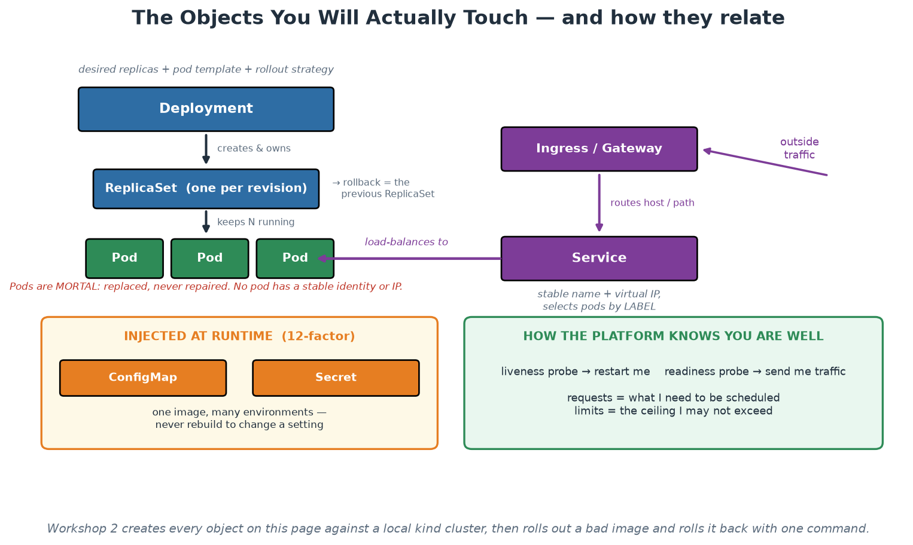
The Objects and How They Relate
Deployment owns ReplicaSets, ReplicaSets keep Pods, Services find Pods by label.
Notes:
Teach the ownership chain from this picture and have the room say it back: a Deployment owns ReplicaSets, a ReplicaSet keeps N Pods running, and a Service load-balances over Pods selected by label. Nearly every confusing behaviour becomes obvious from that chain - why rollback is instant (the previous ReplicaSet still exists), why deleting a pod achieves nothing, and why a Service silently serves nothing when a label is misspelled. The two bottom panels carry the operational content: configuration injected at runtime, and the probe/resource contract that tells the platform whether you are well and what you may consume. Workshop 2 creates every object on this page, and deliberately breaks a label selector, which is the fastest way to make the label-matching rule permanent.

Slide 34
In Context: Defaults Worth Setting Institution-Wide
Make these the template defaults, not per-team decisions
  Probes present and correct on every workload - readiness separate from liveness, both cheap and local.
  Resource requests and limits always set, with sensible starting values the team can tune from evidence.
  Labels that the institution needs: owner, service, environment, classification, cost centre.
  Security context (non-root, read-only root filesystem, dropped capabilities) already applied.
Secrets - the specific caution
  Kubernetes Secrets are base64-ENCODED, not encrypted by default - do not let anyone assume otherwise.
  Enable encryption at rest, restrict RBAC tightly, and integrate a real secrets manager for anything sensitive.
  Prefer short-lived credentials issued to a workload identity over long-lived stored values.
  Never dump the environment in logs or error pages - it is the most common accidental disclosure.
Why defaults beat documentation here
  A template that already sets these means a new service is well-behaved before anyone reads a standard.
  Admission policy then makes the baseline enforceable rather than advisory.
  Assurance can examine one path rather than sampling forty independently-configured services.
  And the delivery team spends its attention on the business problem, which is the entire point.
Notes:
This slide converts the vocabulary into a platform specification, which is how it becomes useful rather than academic. Everything in the first section is something that should arrive with a scaffolded service rather than being derived by each team, and each item maps to a real failure the institution would otherwise meet: missing probes cause traffic to unhealthy pods, missing limits cause noisy-neighbour incidents, missing labels make ownership and cost unanswerable, and a missing security context leaves workloads running as root. The Secrets caution is worth repeating even if you covered it earlier, because the base64 misunderstanding is widespread and consequential - people genuinely believe the value is protected. Push workload identity as the strategic direction, since it removes the standing credential rather than merely rotating it. Close by restating the platform argument in assurance terms, because that is what makes this list fundable: one enforced baseline is inspectable, and forty hand-configured services are not.

Slide 35
Managing Services at Scale
Autoscaling: HPA scales pods on metrics; cluster autoscaler scales nodes; VPA right-sizes.
Service mesh (Istio, Linkerd): mTLS, retries, traffic-splitting as platform features - at a cost.
GitOps deployment (Argo CD/Flux): the cluster converges on a Git repo; drift auto-corrects.
Multi-cluster/multi-region: blast-radius isolation before exotic scaling.
Scale problems are PLATFORM problems - product teams should inherit the answers.
Notes:
Close the module by sketching the horizon honestly - name what exists, what it costs, and who should own it. Horizontal Pod Autoscaler scales replicas on CPU or custom metrics (a direct payoff of Module 8's metrics work); the cluster autoscaler adds nodes when pods cannot schedule; note the interplay - HPA without cluster autoscaling hits a ceiling. Service meshes inject a proxy sidecar next to every pod and centralise mTLS between services, retries/timeouts, and percentage traffic-splitting (the canary mechanics from Module 5) - real capabilities with real operational cost; the honest guidance is to adopt a mesh when you need at least two of its features, not because a diagram looked good. GitOps (from Module 3) matures deployment at scale: clusters converge on declarative repos, so 'what is running in production' has a Git answer and manual drift self-corrects. Multi-cluster is usually about blast radius and data residency before raw scale. The last bullet is the module's platform thread: none of these decisions should be made twenty times by twenty teams - the platform decides once, encodes it in the golden path, and product teams inherit scale-readiness. Workshop 2 is next: build the image, compose the stack, deploy to kind, scale it, roll it, roll it back.

Slide 36
Deep Dive: Scaling, Meshes and Blast Radius
AUTOSCALING - three different levers
  HPA scales the number of pods on observed metrics (CPU, memory, or custom/business metrics).
  Cluster autoscaler adds and removes NODES when pods cannot be scheduled or capacity is idle.
  VPA right-sizes requests and limits from observed usage - useful, and it conflicts with HPA on the same metric.
  Autoscaling only works if start-up is fast and the app is stateless - twelve-factor is the prerequisite.
SERVICE MESH - real capability, real cost
  Gives you mTLS between services, retries and timeouts, traffic splitting and rich telemetry - without app changes.
  Costs: a sidecar per pod, another control plane to operate, upgrade cycles, and much harder debugging.
  Adopt when you have a specific need - zero-trust between services, or canary traffic control at scale.
  Do not adopt because the architecture diagram looks better with it; a handful of services rarely justifies it.
BLAST RADIUS before exotic scaling
  Multiple clusters or regions isolate failure long before they solve a scaling problem.
  Separate environments and, where justified, separate clusters for critical and non-critical workloads.
  Namespace, quota and network-policy boundaries are the cheap version of the same idea.
  Decide deliberately what shares fate with what - that decision IS your availability design.
Notes:
The theme of this slide is that scale problems are platform problems, and product teams should inherit answers rather than derive them. On autoscaling, the prerequisite deserves emphasis: horizontal scaling assumes interchangeable, fast-starting, stateless replicas, so an application that violates twelve-factor cannot be autoscaled no matter what the configuration says. Mention the HPA/VPA conflict because teams hit it and are baffled. On service mesh, take a clear position: it is a genuinely powerful capability with a genuinely large operating cost, and the honest test is whether there is a specific requirement - mutual TLS between services as a security control, or fine-grained traffic shifting for progressive delivery - that cannot be met more simply. In a supervised institution, service-to-service mTLS is often that requirement, so the conversation is legitimate; the mistake is adopting it before the basics are stable. The blast-radius section is the most valuable one for this audience: deciding what shares fate with what is an availability design decision, and it is usually made by accident.

Slide 37
Deep Dive: GitOps and the Platform's Share of the Work
GITOPS at runtime
  The desired state of each environment lives in Git; an in-cluster agent (Argo CD, Flux) reconciles continuously.
  Deployment becomes a merge, rollback becomes a revert, and the audit trail is the commit history.
  Drift is corrected automatically, so the emergency manual change does not quietly become permanent.
  No cluster credentials leave the cluster - the pipeline never needs production access.
What the platform should own, not each team
  Cluster lifecycle: version upgrades, certificates, node images, capacity, backups and restore drills.
  Baseline policy: pod security defaults, network policy, quotas, admission control, image provenance.
  Shared services: ingress, DNS, certificates, secrets integration, observability stack, log retention.
  Golden-path templates so a new service arrives with sane probes, limits, labels and dashboards.
What each product team should still own
  Their service's behaviour: probes, resource needs, dependencies, degradation strategy, runbook.
  Their SLOs and their alerts - reliability targets are a product decision, not a platform default.
  Their own rollout choices within the paved road, and the consequences of stepping off it.
  The pager for their service: ownership follows the code, and the platform makes that affordable.
Notes:
Close Module 6 by drawing the ownership line explicitly, because it is the question participants will face the moment they get back: who does what. The platform owns everything that is identical for every team and expensive to get right - cluster lifecycle, baseline policy, shared services, templates - and product teams own everything specific to their service's behaviour and reliability. Getting that line wrong in either direction causes predictable pain: platform teams that own service configuration become a ticket queue, and product teams that own cluster upgrades stop shipping features. On GitOps, repeat the two properties that matter in a controlled environment - credentials stay in the cluster, and drift is corrected rather than accumulated - and note the practical prerequisite that out-of-band changes genuinely stop working, which requires agreement before it is switched on. This slide also sets up Module 9 nicely: everything on the platform's list is a product with users, and the next module is about treating it that way.

Slide 38
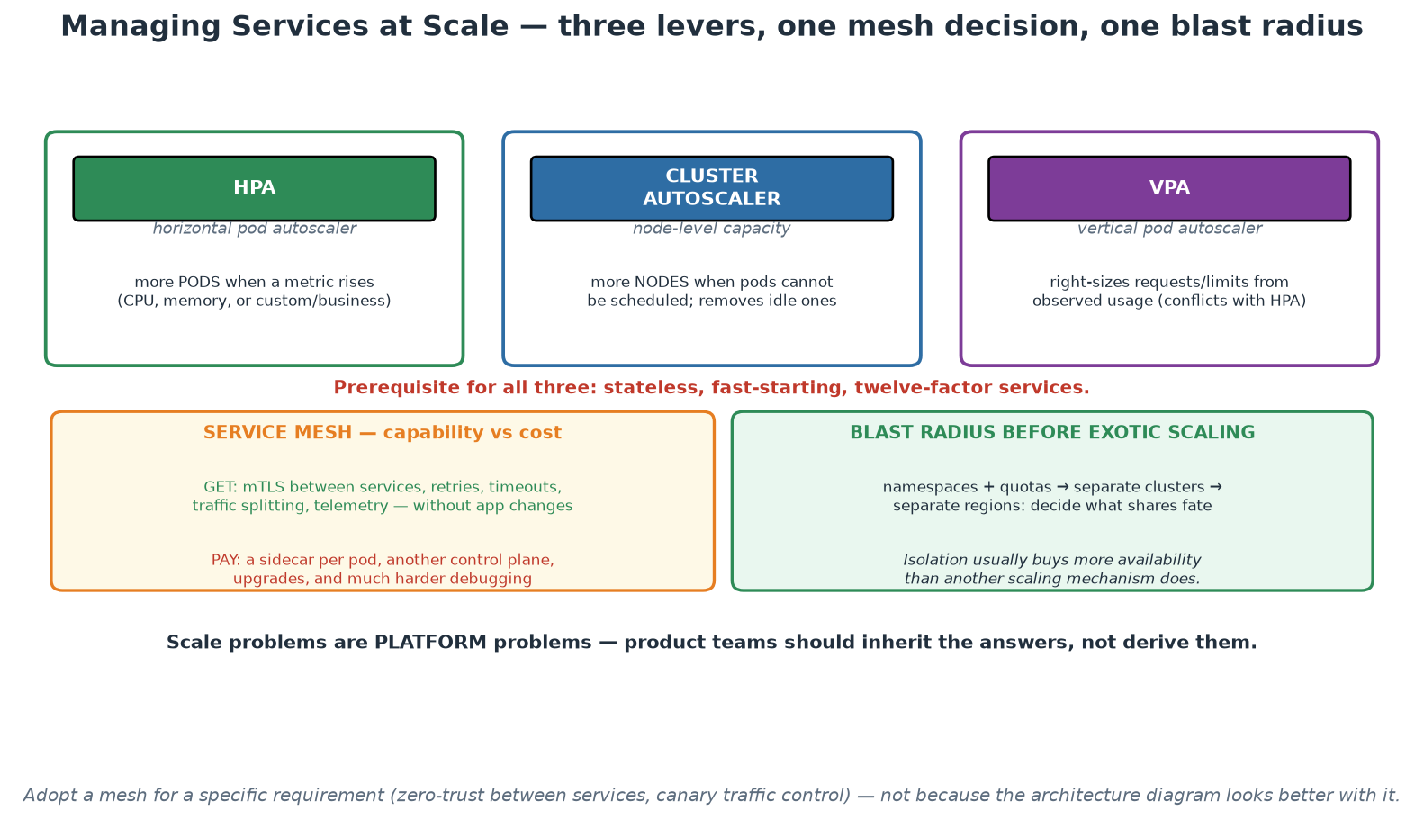
Scaling Levers, Mesh Trade-offs and Blast Radius
Three autoscaling levers, one expensive mesh decision, and isolation before exotic scaling.
Notes:
Take the three levers in turn and stress the shared prerequisite in red: none of them work on a service that is stateful or slow to start, so twelve-factor is the entry ticket to scaling. Mention the HPA/VPA conflict, because teams enable both on the same metric and are baffled by the result. On the mesh panel, keep the balance explicit - genuine capability on one side, a sidecar per pod and another control plane on the other - and give the decision rule: adopt for a specific requirement such as service-to-service mTLS or fine-grained traffic control, not for architectural completeness. The blast-radius panel carries the most valuable point for this audience: isolation usually buys more availability than another scaling mechanism, and deciding what shares fate with what is an availability design decision most institutions make by accident.

Slide 39
In Context: Scale, Isolation and Who Owns the Answers
Scale in a central bank is usually about PEAKS, not growth
  Predictable peaks: settlement cycles, month and year end, reporting deadlines, publication windows.
  So capacity planning and headroom often matter more than elastic autoscaling.
  Test at peak shape, not at average load - and rehearse the peak before it arrives.
  Where load is predictable, scheduled scaling is simpler and more reliable than reactive autoscaling.
Isolation decisions worth making deliberately
  Separate critical industry-facing services from internal workloads - at cluster or cell level.
  Separate environments completely; a lower environment must not be able to affect production.
  Namespace quotas so one team's workload cannot starve another's during a peak.
  Multi-region or multi-site is a resilience decision made with the business, not an engineering preference.
Who owns which answer
  The platform owns cluster lifecycle, baseline policy, shared services and the scaling mechanisms.
  The delivery team owns its service's resource profile, degradation behaviour and SLOs.
  Neither owns the other: platform teams that tune application resources become a ticket queue.
  Write the split down - ambiguity here produces gaps precisely during incidents.
Notes:
The peaks-not-growth observation is the most useful reframing for this audience, and it changes the technical answer: where load is predictable and cyclical, scheduled scaling with generous headroom is more reliable than reactive autoscaling, which always lags the event it is reacting to. Encourage testing at peak shape rather than average, and rehearsing before known peaks, which is the same 'practise the thing you fear' principle from Module 8. The isolation section is where participants can make genuinely consequential decisions: separating critical industry-facing services from everything else, at cluster or cell level, is a resilience choice with a clear rationale that risk colleagues understand immediately. Finish by writing down the ownership split, because the ambiguity between platform and delivery responsibilities is invisible during normal operations and extremely expensive during an incident, when nobody is sure who is supposed to act.

Slide 40
Module 7
Security and Compliance (DevSecOps)
Notes:
45 minutes theory + a 10-minute basic demo (Trivy scan + one Conftest policy). Goal: shift-left economics, the scanner taxonomy, supply-chain awareness, policy as code, and triage discipline - security as a platform default, not a checkpoint.

Slide 41
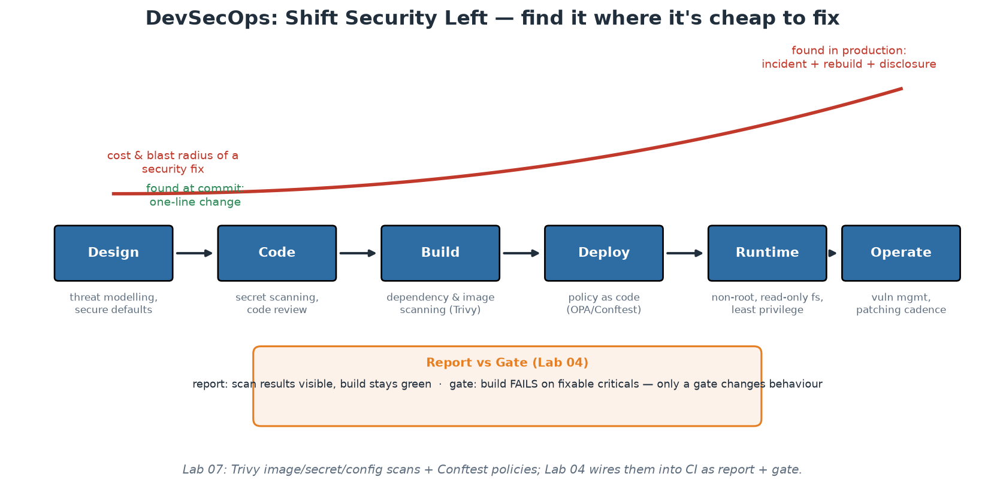
Shift Left - the Economics of Early
The later a flaw is found, the more it costs - and the bigger its blast radius.
Notes:
DevSecOps in one curve: a vulnerable dependency caught at commit time is a one-line bump chosen calmly; the same flaw found in production is an incident - emergency patching across a fleet, forensics on whether it was exploited, possibly disclosure. The traditional model (a security review before release) failed for a structural reason participants now understand from Module 5: it put a slow, manual, low-context checkpoint at the END of a fast pipeline - so security became the department of 'no', teams routed around it, and reviews happened too late to change designs anyway. Shift-left redistributes security along the whole lifecycle as fast, automated feedback: threat modelling at design ('what can go wrong here?' asked in planning - even 15 informal minutes pays), secret and dependency scanning at commit, image and IaC scanning at build, policy checks at deploy, and hardened defaults at runtime. Note what shift-left does NOT mean: it does not abolish security specialists - it changes their job from gatekeeping every release to building guardrails and platform defaults (curating rules, tuning gates, handling escalations), which scales in a way manual review never can. Every stage on this diagram maps to something concrete participants touch today.

Slide 42
The Scanner Taxonomy - What Checks What, When
SAST: reads your source for flaw patterns (injection, crypto misuse) - at PR time.
SCA: inventories dependencies against CVE databases - most real-world risk lives here.
Secret scanning: credentials in code/history - at commit AND continuously.
Container/image scanning: OS + language packages in the artifact (Trivy) - at build.
IaC/config scanning: misconfigurations in Terraform/K8s (trivy config) - at PR.
DAST: probes the RUNNING app from outside - staging, scheduled.
Notes:
Give participants the map so vendor noise cannot confuse them: each scanner class answers a different question at a different pipeline stage, and a mature setup layers several - they overlap little. SAST parses your first-party code for dangerous patterns; its curse is false-positive volume, so tune rulesets or teams learn to ignore it. SCA (software composition analysis) is where modern risk concentrates, because a typical service is overwhelmingly third-party code by volume - Log4Shell was an SCA problem, present in thousands of codebases that had written no vulnerable line themselves. Secret scanning runs twice: as a pre-commit/PR check (cheap prevention) and continuously over history, because a secret once pushed lives in Git history forever - the remediation is ROTATION, never just deletion; our demo plants a fake AWS key and watches Trivy catch it. Image scanning inspects the built artifact - base-image OS packages plus language dependencies - which is why slim bases (Module 6) directly shrink findings. IaC scanning catches the cloud-breach classics (public buckets, missing encryption, permissive roles, no resource limits) before anything exists; participants scan the course's own Terraform and manifests. DAST probes the running application from outside, catching what only manifests at runtime (auth flows, headers, injections through the real stack) - slower, so staging on a schedule rather than every commit.

Slide 43
Deep Dive: Six Scanners, Six Different Questions
Code and dependencies
  SAST reads YOUR source for flaw patterns - injection, unsafe deserialisation, crypto misuse. Runs at PR time.
  Its weakness is false positives: tune it, or developers learn to ignore the whole category.
  SCA inventories your DEPENDENCIES against vulnerability databases - and this is where most real risk lives.
  You write thousands of lines; you import millions. The imported millions are the larger attack surface.
Secrets and configuration
  Secret scanning finds credentials in code AND in history - run it on every commit and continuously.
  History matters: a key committed last year is still exposed today, and rotation is the only real fix.
  IaC/config scanning (trivy config, checkov) catches misconfiguration BEFORE the resource exists.
  Typical finds: public storage, missing encryption, permissive rules, containers without limits or as root.
Artefact and running system
  Image scanning (Trivy) inspects the built artefact's OS and language packages - at build, on every image.
  It sees what actually ships, including whatever the base image dragged along - which is why slim bases win.
  DAST probes the RUNNING application from outside: authentication, headers, injection against a live target.
  DAST belongs in staging on a schedule - it is slower, noisier, and needs a deployed environment.
Notes:
The point of the taxonomy is to stop the common failure of buying one scanner and believing security is handled. Each tool answers a different question about a different artefact at a different moment, and the gaps between them are where incidents live. Emphasise the SCA point hard, because it reallocates effort correctly: the overwhelming majority of exploitable vulnerability in modern applications arrives through dependencies rather than through code the team wrote, so an organisation with limited capacity should start with dependency and secret scanning rather than the most sophisticated static analyser on the market. On SAST, be honest about false positives - an untuned SAST rollout is the fastest way to teach an organisation to ignore security tooling, which is worse than not deploying it. On secret scanning, stress history: the default assumption must be that anything ever committed is compromised, so detection must be paired with a rotation process, not just an alert.

Slide 44
Deep Dive: Placing Scanners Where They Pay
Earlier is cheaper - the economics that drive shift-left
  At the keyboard: a linter or pre-commit hook costs seconds and nobody else ever sees the defect.
  At PR time: a comment and a fix in the same context the developer is already holding in their head.
  At build: a rebuild, which is minutes and mildly annoying.
  In production: an incident, a disclosure process, and everyone's afternoon. Same defect, wildly different cost.
Speed decides adoption
  Anything on the PR path must be fast - a scanner that adds ten minutes will be routed around.
  Put fast, high-signal checks in the PR gate; run the slow, thorough sweeps on a schedule.
  Cache vulnerability databases in CI (our labs pre-pull the Trivy DB) so scans are seconds, not minutes.
  Deduplicate: the same finding reported by three tools in three formats trains people to ignore all three.
Make the output usable, or it will be ignored
  Emit machine-readable results (SARIF/JSON), retained per build - that is your evidence trail.
  Route findings to owners automatically; an unowned finding is a finding nobody will fix.
  Report broadly, gate narrowly - the Day 1 rule, applied to every scanner in the taxonomy.
  Watch the TREND, not today's count: is the fixable backlog shrinking week on week?
Notes:
This slide is about making scanning stick rather than about scanning itself. The cost curve is the argument that funds the work, and it is worth stating in the room's own terms: the same defect costs seconds at the keyboard, minutes in a pull request and an incident in production, so every step earlier is a multiplier on the security budget you already spend. The speed point is the practical constraint everyone underestimates - developers experience the PR gate on every change, so a slow scanner is not merely irritating, it actively erodes the practice as people find ways around it. Give the concrete mitigations: cache the databases, split fast gates from scheduled deep sweeps, and deduplicate across tools. On output, repeat the report-versus-gate discipline from Day 1 and add the ownership point, which is where most programmes quietly fail: findings that arrive in a shared dashboard with no owner accumulate indefinitely, and the accumulating number then becomes an argument against the tooling rather than against the vulnerabilities.

Slide 45
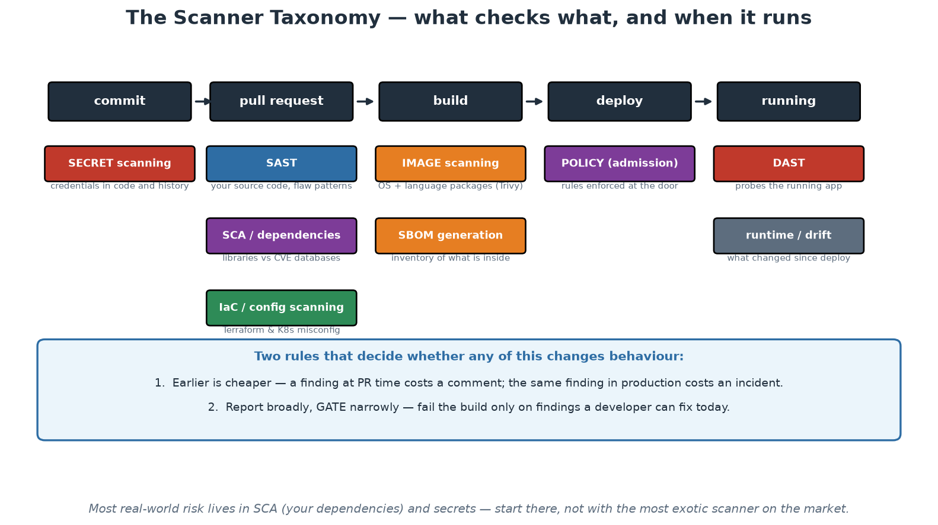
Where Each Scanner Runs
Six different questions, six different moments - and two rules that decide whether any of it matters.
Notes:
Read the pipeline left to right and place each scanner at the moment it answers its question. The two rules at the bottom are the ones to repeat: earlier is cheaper, and report broadly while gating narrowly. Point out that the taxonomy also exposes gaps - most institutions have image scanning because it is easy to buy, and are much weaker on secret scanning of history and on IaC scanning, which are cheaper and often catch more consequential problems. Use the footnote to redirect effort: dependencies and secrets carry most real-world risk, so an organisation with limited capacity should start there rather than with the most sophisticated tool available.

Slide 46
In Context: A Scanning Programme That Survives
Sequence the rollout by value and by cost of failure
  1. Secret scanning, including history - cheapest to run, and the findings are unambiguous.
  2. Dependency (SCA) scanning on every pull request - where most exploitable risk actually lives.
  3. Image scanning at build, with the report/gate split from Day 1.
  4. IaC scanning on infrastructure changes; then SAST, tuned, once the earlier backlogs are under control.
  5. DAST on a schedule against a staging environment - slower, noisier, still valuable.
Making the output count as evidence
  Retain machine-readable results per build, keyed to the artefact digest - not screenshots in a document.
  Route findings to the owning team automatically; unowned findings are never fixed.
  Record exceptions with owner, rationale, compensating control and expiry - the assurance conversation, prepared.
  Report the trend to leadership: fixable-critical backlog over time, per portfolio.
Institutional realities to plan around
  Air-gapped or restricted networks need mirrored vulnerability databases - plan the update path.
  False positives cost credibility fastest; budget tuning time from the start, not after the complaints.
  Third-party and vendor-supplied software needs its own answer - scanning what you cannot rebuild.
  Confirm specifics with your security and compliance colleagues - these are patterns, not policy advice.
Notes:
Sequencing is the practical content here: institutions that turn everything on at once generate thousands of findings, no capacity to act, and a rapid loss of faith in the whole programme. Starting with secret scanning is deliberate - the findings are unambiguous, the remediation is well-defined, and the risk is severe - and dependency scanning next puts effort where most exploitable risk lives. Leave SAST until the earlier backlogs are under control, because its false-positive burden is what most often discredits security tooling with developers. On evidence, keep pushing the point that machine-readable results retained per digest are both cheaper and more credible than manual evidence packs. The institutional realities section matters for this audience specifically: restricted network environments need a planned mirror for vulnerability databases, and vendor-supplied software that cannot be rebuilt needs a different answer - usually contractual, plus compensating controls - which is worth raising with procurement colleagues rather than discovering later.

Slide 47
Supply Chain Security - Your Pipeline Is a Target
SolarWinds: the BUILD SYSTEM was compromised - customers shipped the attacker's code.
Attack surface: dependencies, base images, CI actions, registries, build infrastructure.
SBOM: a machine-readable inventory of everything inside your artifact (Trivy can emit one).
Countermeasures: pin versions AND digests, sign artifacts (cosign), least-privilege tokens.
SLSA: a maturity ladder for build integrity - know which level you need.
Notes:
Supply chain attacks target the factory rather than the product, and they scale terrifyingly: compromise one build system or one popular package and you compromise every downstream consumer at once. SolarWinds (2020) is the canonical case - attackers modified the vendor's build process so signed, official updates carried the implant to ~18,000 organisations. The dependency-level versions arrive constantly: typosquatted packages, maintainer-account takeovers, malicious updates to abandoned libraries. Walk the attack surface as a checklist of what participants' own pipelines contain: third-party dependencies (SCA scanning), base images (pin them; prefer minimal), CI actions (our @master-vs-pinned-version lesson from Module 5 - an upstream compromise of an unpinned action runs with your repo's token immediately), registries (who can push to the image your cluster pulls?), and the build system itself. SBOMs (SPDX/CycloneDX formats) answer the Log4Shell-day question - 'which of our 400 services contains this library?' - in minutes instead of weeks, and are increasingly demanded contractually and by regulation (US EO 14028, EU CRA). Signing (Sigstore/cosign) plus admission-time verification closes the loop: only artifacts provably built by YOUR pipeline run in production. SLSA gives the maturity vocabulary; most organisations should first reach 'builds are scripted, provenance exists, tokens are least-privilege' before chasing higher levels.

Slide 48
Deep Dive: How Build Systems Get Compromised
The lesson of the SolarWinds compromise
  Attackers did not breach the customers - they breached the BUILD system of a trusted supplier.
  Legitimately signed updates then carried the attacker's code into thousands of environments.
  The insight: your build infrastructure has the same privilege as everything it can deploy to.
  So the pipeline deserves the protection you give production - because it effectively IS production.
The links in your own chain
  Dependencies: typosquatting, hijacked maintainer accounts, malicious post-install scripts.
  Base images: a tag that moves under you, or an unmaintained image nobody owns.
  CI actions and plugins: third-party code executing with your repository and registry credentials.
  Build infrastructure: runners, caches, and anything with push rights to your registry.
  Registries: a tag repointed to a different artefact after approval - which digests prevent.
Countermeasures in the order they pay off
  PIN everything - versions and digests. A moving reference is an unreviewed change with production access.
  LEAST PRIVILEGE - scope tokens per job, prefer short-lived federated credentials over stored secrets.
  SBOM on every build - a machine-readable inventory of what is actually inside the artefact.
  SIGN and VERIFY (cosign) - so the cluster accepts only artefacts your pipeline actually produced.
  SLSA levels give you a maturity ladder: decide which level each service needs, then work toward it.
Notes:
Use SolarWinds because it changed how the industry thinks: the attack succeeded by compromising a build system rather than any customer, and the resulting artefacts were legitimately signed, which defeated every downstream control that trusted the signature. The generalisable lesson for participants is that their pipeline holds production credentials and executes third-party code on every run, so it deserves production-grade protection and third-party risk assessment - the same scrutiny their institution applies to suppliers. Walk the links and ask the room which ones they could currently enumerate: most organisations cannot list the third-party actions running in their pipelines, which is itself the finding. Then give the ordered countermeasures, because sequencing matters when capacity is limited: pinning and least privilege are cheap and remove whole categories of risk today, SBOM makes the next widespread disclosure survivable, and signing plus verification closes the loop between what the pipeline built and what the runtime accepts. SLSA is worth naming as the maturity framework so participants have a vocabulary for setting targets rather than arguing about perfection.

Slide 49
Deep Dive: SBOM, Provenance and the Disclosure Test
SBOM - the inventory you will wish you had
  A machine-readable list of every component in an artefact, with versions - Trivy can emit one per build.
  Store it with the artefact, keyed by digest, so any historical image can be queried later.
  The test that proves its value: 'a critical flaw was announced this morning - where are we exposed?'
  With SBOMs, that is a query answered in minutes. Without them, it is a survey answered in weeks.
Provenance and signing
  Provenance records HOW an artefact was built: which commit, which pipeline, which inputs.
  Signing (cosign) binds identity to the artefact so consumers can verify origin cryptographically.
  Verification at admission means the cluster rejects anything not built by your pipeline - a real control.
  Together they answer 'is this artefact ours, and what is it made of?' without trusting a spreadsheet.
Where to start on Monday
  Pin your CI actions to digests - an afternoon of work, and it removes a standing exposure.
  Declare least-privilege permissions on every workflow - one line each, immediate risk reduction.
  Turn on SBOM generation and retention in the pipeline - cheap now, decisive during the next disclosure.
  Then, deliberately: signing on push, verification at admission, and a documented SLSA target.
Notes:
The disclosure test is the most persuasive thing on this slide for anyone who lived through a widespread vulnerability announcement: the organisations that answered 'are we exposed?' in hours were the ones with artefact inventories, and the ones that answered in weeks did so by emailing teams and reading build logs. Frame SBOM as insurance whose premium is a single pipeline step, and note the storage detail that makes it useful - keyed by digest, retained with the artefact, queryable for historical images, because the question always arrives about something built months ago. On signing and verification, emphasise that the value comes from the pair: signing alone is a claim, while verification at admission turns it into an enforced control that a compromised registry entry cannot bypass. Close with the Monday list, deliberately ordered by effort-to-value, so participants leave with two changes they can genuinely make this week and a longer-term direction that does not require a programme to start.

Slide 50
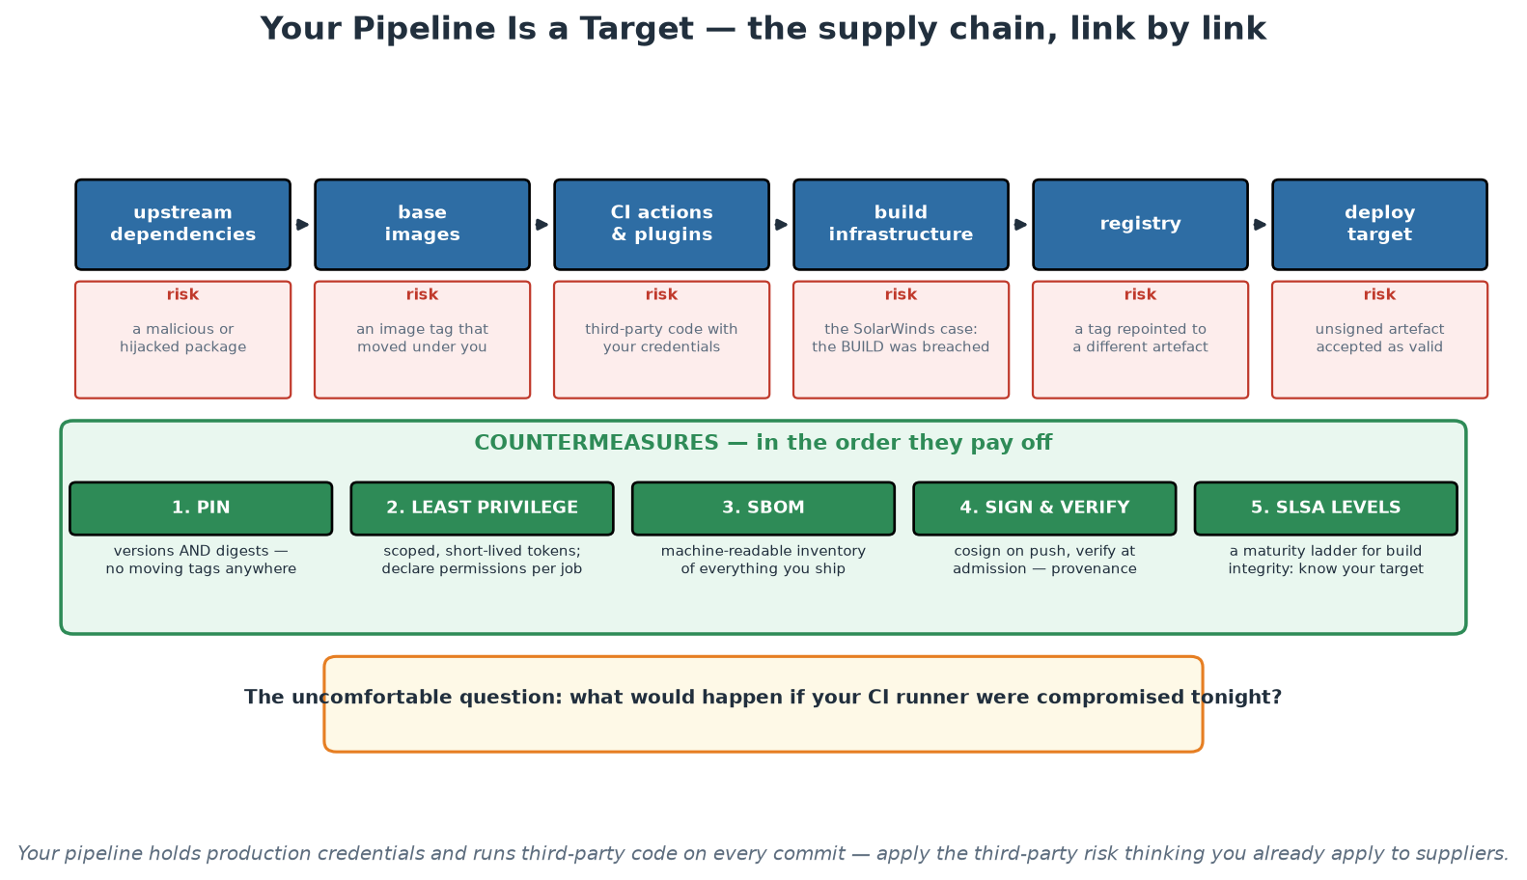
The Supply Chain, Link by Link
Every link is code you execute with production credentials - and five countermeasures in payoff order.
Notes:
Walk the links and ask the room, honestly, which ones they could enumerate today for one of their own pipelines - most institutions cannot list the third-party actions running in CI, and that inability is itself the finding. Then the countermeasures in payoff order: pinning and least privilege are cheap and remove standing exposure immediately, SBOM makes the next disclosure survivable, and signing with verification closes the loop between what the pipeline built and what the runtime will accept. The amber box at the bottom is the question to leave in the room: what would happen if your CI runner were compromised tonight? In a supervised institution, that is a legitimate third-party and operational risk question, and it usually has not been asked.

Slide 51
In Context: Supply Chain Risk as Third-Party Risk
Use the language the institution already has
  Your delivery toolchain is a third party with production access - assess it the way you assess suppliers.
  Concentration risk applies: what happens if one provider is unavailable during a critical window?
  Change management applies: an unpinned action is an unreviewed change entering production daily.
  Provenance and integrity are exactly the properties financial controls already care about.
Controls that map cleanly to institutional expectations
  Pinned dependencies and actions = controlled change; nothing enters without review.
  Least-privilege, short-lived pipeline credentials = access control and segregation of duties.
  SBOM retained per artefact = asset inventory, answerable during a disclosure event.
  Signing plus admission verification = only artefacts this institution built may run.
  Internal mirrors for packages and base images = availability and provenance, together.
Where to start given real constraints
  This week: pin actions to digests and declare least-privilege permissions per job.
  This quarter: SBOM generation and retention; internal mirroring of bases and critical packages.
  Next: signing on push and verification at admission; agree a target maturity level per service tier.
  Document the target and the gap - a stated, evidenced roadmap is itself a strong assurance position.
Notes:
The reframing on this slide is the one that gets supply-chain work funded in a regulated institution: the delivery toolchain is a third party with production access, and every concept the institution already applies to suppliers - concentration risk, change control, access control, asset inventory, provenance - maps directly onto it. Presenting the countermeasures in that vocabulary turns an engineering wish list into a recognisable control programme. Internal mirroring deserves specific mention here because it serves two institutional concerns at once: availability, since a build no longer depends on an external service being reachable during a critical window, and provenance, since the mirrored content is curated. Keep the starting advice modest and immediate - pinning and permissions are an afternoon's work - and stress that a documented target with an honest gap analysis is a far stronger assurance position than an aspiration, because it demonstrates that the institution understands its own exposure.

Slide 52
Compliance as Code (OPA, Rego, Conftest)
Wiki rules are wishes; encoded policies are guarantees - evaluated on every change.
OPA/Rego: a general policy engine - one language for K8s, Terraform, pipelines, APIs.
Conftest in CI tests rendered configs; admission controllers enforce at the cluster door.
Test what SHIPS: rendered output, not raw files (labels added at render time!).
Audit evidence becomes: the policy file + Git history + pipeline logs. Auditors love it.
Notes:
Compliance as code closes the gap between what the standards document says and what production does. The traditional cycle - write a standard, hope, audit annually, discover drift, remediate in a panic - fails because enforcement is manual and sampling is sparse. Encoding the rule makes enforcement continuous and total: every deployment must carry an owner label, no container may run as root, no image may use :latest - each becomes a policy evaluated automatically on every single change, and the standards document stops being fiction. OPA (Open Policy Agent, a CNCF-graduated engine) with its Rego language is the common denominator: the same policy skills apply to Kubernetes manifests, Terraform plans, CI pipelines and even application authorisation. Enforcement lives at two doors: Conftest in the pipeline (shift-left - developers get policy feedback at PR time, cheap to fix) and admission controllers in the cluster (Gatekeeper/Kyverno - nothing enters the API server unchecked, catching whatever bypassed CI). The render-time subtlety is today's demo punchline: our raw manifests FAIL the required-label policy while the Kustomize-rendered output PASSES, because labels are stamped at render time - so policies must test what actually ships. The audit story lands especially well with anyone who has suffered an audit: evidence stops being screenshots and interviews and becomes the policy file, its Git history, and pipeline logs showing every evaluation.

Slide 53
Deep Dive: From Wiki Rules to Enforced Guarantees
Why written standards decay
  A standard in a document is checked by humans, occasionally, under deadline pressure - so it drifts.
  Nobody knows the compliance rate; the honest answer to 'are we compliant?' is 'probably, mostly'.
  Encoded policy is evaluated on EVERY change, automatically, with a recorded result. The answer becomes exact.
  The standard stops being a document people should have read and becomes a check they cannot forget.
OPA and Rego - one engine, many targets
  Open Policy Agent evaluates rules written in Rego against any JSON/YAML input.
  That means one policy language for Kubernetes manifests, Terraform plans, pipeline configs and API requests.
  Policies are code: reviewed, versioned, TESTED with their own unit tests, and released deliberately.
  Write the failure message for a human: it must say what is wrong and how to fix it, or it will be resented.
Two enforcement points, one rule
  Conftest in CI evaluates the change before merge - the developer fixes it in context, cheaply.
  An admission controller in the cluster rejects non-conforming objects however they arrived - the backstop.
  CI alone governs only those who use CI; admission alone gives feedback far too late. Use both.
  Same policy file feeding both, so there is exactly one definition of the rule in the institution.
Notes:
The opening argument is the one that wins over governance colleagues: a standard written in a document has an unknown compliance rate, while an encoded policy has an exact one, evaluated on every change and recorded. That is a genuine improvement in control effectiveness, not merely an engineering convenience. On Rego, do not attempt to teach the language - participants only need to know that policies are code with tests and reviews, and that one engine covers manifests, infrastructure plans and pipelines, which avoids three separate policy tools with three separate rule sets. The advice about failure messages is small and disproportionately important: a policy that fails with an opaque expression evaluation error generates support tickets and resentment, while one that says 'container must set resource limits - add resources.limits.memory' generates a fix. On enforcement points, insist on both and on a single shared policy definition, because the failure mode is two drifting copies of the same rule that disagree at the worst moment.

Slide 54
Deep Dive: Test What Ships, and Evidence for Free
Evaluate the RENDERED output, not the source
  Helm, Kustomize and templating add labels, defaults and patches at render time.
  A policy run against raw templates is testing a draft that never reaches the cluster.
  So render first (helm template / kustomize build), then evaluate the result - that is what actually ships.
  Same principle for Terraform: evaluate the PLAN output, not the .tf source, for the same reason.
Rolling out policy without a revolt
  Start in warn/dry-run mode and publish the current violation count - measure before enforcing.
  Fix the backlog with the teams, or provide an automated migration, before you flip to blocking.
  Then enforce for NEW resources first, with a dated deadline for existing ones.
  Keep an explicit exception path: owned, time-limited, reviewed - never a permanent silent bypass.
The audit story writes itself
  What the rule is: the policy file, in Git, with its version history and reviewers.
  That it was enforced: the pipeline run and admission logs, per change, retained.
  What was excepted and why: the exception record, with owner and expiry date.
  That is a stronger control narrative than a document plus a sample-based annual review.
Notes:
The render-first point prevents a subtle and common failure where teams believe they are enforcing a rule while testing something that never ships - templating tools inject exactly the labels, defaults and security contexts that policies most often check, so evaluating raw templates produces false confidence. The rollout advice is what makes policy programmes survive contact with real teams: measure first in warning mode so you know the size of the problem, fix or migrate the backlog, then enforce for new resources with a dated deadline for the rest. Flipping a blocking policy on across an existing estate is how a security team spends its credibility in one afternoon. The exception path is non-negotiable in a regulated institution and should be presented as a control rather than a weakness: owned, time-limited and reviewed exceptions are visible and manageable, while the alternative is invisible workarounds. Close on the audit narrative, which is the reason this practice is worth the effort here: policy as code turns 'we have a standard' into 'here is the rule, here is every evaluation of it, and here is every exception with its expiry'.

Slide 55
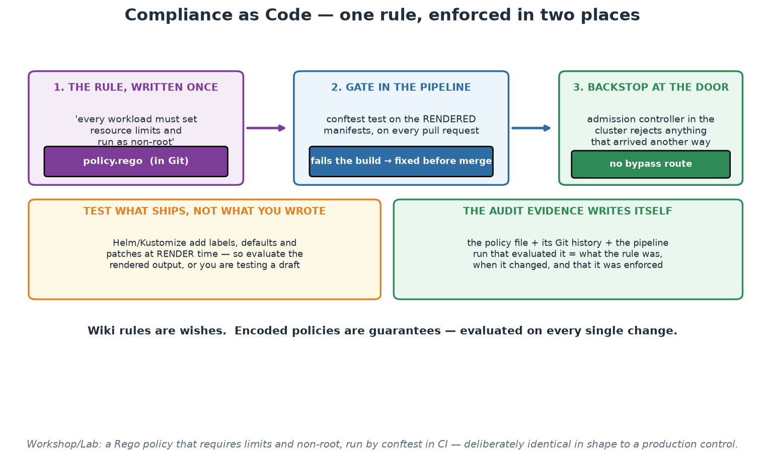
One Rule, Two Enforcement Points
Written once, gated in the pipeline, backstopped at the cluster door - and the evidence writes itself.
Notes:
Follow the rule from left to right: written once in Git, evaluated in CI against the rendered output so the developer fixes it cheaply, and enforced again at admission so nothing that arrived another way can bypass it. The two-enforcement-point design is what makes the control complete - CI alone governs only those who use CI, and admission alone gives feedback far too late. The render-first panel prevents a subtle false-confidence failure, since templating adds exactly the labels and defaults that policies check. Land on the evidence panel, which is the reason this practice is worth the effort in a supervised institution: the rule, its history, every evaluation of it, and every exception, all produced as a by-product of working rather than assembled for an audit.

Slide 56
In Context: Encoding the Institution's Own Rules
Rules that are natural candidates to encode
  Every workload sets resource limits, runs as non-root, and has probes.
  Required labels present: owner, service, environment, data classification, cost centre.
  Only images from approved internal registries, referenced by digest, and signed by our pipeline.
  Network policy present; no privileged containers, host mounts or host networking.
  Infrastructure: encryption enabled, no public exposure, tagging complete, retention configured.
How to introduce it without a revolt
  Run in warn mode first and publish the current violation count - measure before enforcing anything.
  Fix or automate the backlog with the teams, then enforce for NEW resources with a dated deadline for the rest.
  Write failure messages that state the fix, not just the violation - a good message prevents a support ticket.
  Keep exceptions owned, time-limited and reviewed; invisible workarounds are the alternative.
What this replaces, and why it is stronger
  It replaces a standards document with an unknown compliance rate and a sample-based annual review.
  It gives an exact, continuous answer: every change evaluated, every result recorded.
  The rule and its history are reviewable by the people accountable for the standard.
  Agree the mapping between institutional standards and policy files once - then reuse it everywhere.
Notes:
The candidate rules on this slide are deliberately mundane and universally applicable, because that is where policy as code produces value fastest: they are unambiguous, machine-checkable, and currently enforced - if at all - by human review. Encourage participants to pick two or three, encode them, and run in warning mode to see the real violation count, which is almost always higher than expected and makes the case by itself. The rollout advice protects the programme: measuring before enforcing, fixing the backlog with teams, enforcing for new resources first, and writing failure messages that state the fix. The last section is the argument to take to whoever owns the standards: this does not weaken the standard, it converts it from a document with an unknown compliance rate into a control with an exact and continuous one. Recommend agreeing the mapping between written institutional standards and policy files once, formally, so that every future service inherits an already-accepted control position rather than reopening the discussion.

Slide 57
Runtime Hardening - Platform Defaults, Not Team Chores
Containers: non-root user, read-only root filesystem, drop ALL capabilities, seccomp.
Cluster: RBAC least-privilege, NetworkPolicies (default-deny), no wildcard admin bindings.
Secrets: a manager (Vault/KMS/external-secrets), rotation, never env-dumped or committed.
Least privilege EVERYWHERE: pipeline tokens, service accounts, registry access.
The golden path ships hardened - teams inherit security instead of re-deriving it.
Notes:
Runtime hardening is defence in depth for the day the earlier layers miss something. Container level - and every item here is LIVE in the course manifests, so open deployment-order.yaml and point: runAsNonRoot (an escaped attacker lands unprivileged), readOnlyRootFilesystem (nothing can be written or planted - our own app runs happily under it, proving well-built services tolerate hardening), capabilities drop ALL (Linux root is a bundle of distinct powers; drop everything not needed), seccompProfile RuntimeDefault (filters the kernel syscall surface - the shared-kernel risk from Module 6, mitigated). Cluster level: RBAC on the API server is the security boundary that matters most - least-privilege service accounts, no default-namespace sprawl, and audit any cluster-admin binding; NetworkPolicies turn the flat pod network into default-deny with explicit allowed flows (our order->payment call would be an explicit rule). Secrets deserve their own breath: base64 in a manifest is encoding, not encryption - real setups use a manager with rotation, injected via CSI or external-secrets operators. The final bullet is the module's thesis and the platform thread again: none of this should be twenty teams' homework - the golden path's templates ship hardened, so the secure configuration is the DEFAULT configuration, and teams opt out with justification rather than opting in with expertise. BASIC DEMO (10 min, theory-demos.md): trivy image on the course's own image, then the raw-vs-rendered Conftest comparison.

Slide 58
Deep Dive: Hardening the Workload and the Cluster
Container-level defaults every workload should inherit
  runAsNonRoot with an explicit user - root in a container is root on the shared kernel if anything escapes.
  readOnlyRootFilesystem, with writable volumes only where genuinely required.
  drop ALL capabilities, then add back only what is proven necessary (usually nothing).
  allowPrivilegeEscalation: false, plus a seccomp profile to restrict available syscalls.
  No host mounts, no host network, no privileged containers - these are escapes with a friendly name.
Cluster-level controls
  RBAC with least privilege: no wildcard cluster-admin bindings, and service accounts scoped per workload.
  NetworkPolicies with a DEFAULT-DENY posture - without them, every pod can reach every other pod.
  Namespaces with quotas and limits so one workload cannot starve the rest.
  Admission control to enforce the above, so a non-conforming workload simply cannot be created.
Secrets, properly
  Use a manager (Vault, cloud KMS, external-secrets) rather than raw Kubernetes Secret objects.
  Kubernetes Secrets are base64-encoded, not encrypted by default - enable encryption at rest and tight RBAC.
  Rotate on a schedule and on every suspicion; never print secrets to logs or dump the environment.
  Prefer short-lived, workload-identity-based credentials over long-lived static ones wherever available.
Notes:
Present these as a specification for the golden path rather than as a checklist for every team, because that is the module's whole argument: expecting forty teams to independently derive and maintain the same security context guarantees inconsistency, while encoding it once in a template and enforcing it at admission guarantees the opposite. The default-deny network policy point deserves emphasis for anyone assuming cluster networking is segmented: by default every pod can reach every other pod, which surprises people whose mental model comes from network zones, and it is one of the highest-value controls to enable early. On secrets, correct the encoding-versus-encryption misunderstanding again if it did not land in Module 6, and push workload identity as the strategic direction: short-lived credentials issued to a workload identity remove the standing secret entirely, which is a stronger control than rotating a stored one. Note that everything here is verifiable by the policy engine from the previous slide, which is what turns this list from advice into an enforced baseline.

Slide 59
Deep Dive: Why Defaults Beat Documentation
The failure of the standards-document model
  Every team re-derives the same configuration, differently, with different mistakes.
  Under deadline pressure the security section is the first thing quietly dropped.
  Nobody can enumerate the resulting posture, so assurance is sampling rather than knowing.
  And the burden falls on the people with the least security context - the delivery teams.
What 'secure by default' looks like in practice
  The scaffolded service arrives with the security context, network policy and limits already set.
  Admission control enforces the baseline, so an unsafe workload cannot be created by accident.
  Deviations are explicit, owned and reviewed - visible instead of invented.
  The compliant configuration is also the easiest one, which is the only sustainable design.
Verify continuously, not annually
  Policy evaluation on every change; drift detection on what is actually running.
  Scheduled rebuilds so images do not silently age into vulnerability.
  Periodic RBAC and network-policy review - permissions accumulate quietly over time.
  Report the posture as a trend to leadership: coverage, exceptions, and their expiry dates.
Notes:
This slide is the security half of the platform argument, and it deserves to be made in control language: forty independently-configured services have forty different security postures and no affordable way to assess them, while one enforced baseline can be assessed once and inherited everywhere. That is a reduction in both risk and assurance cost, which is the combination that gets funded. The point about burden is worth saying out loud with delivery teams in the room: expecting product engineers to become security specialists is neither fair nor effective, and the platform's job is to make the secure configuration the path of least resistance so that doing the right thing requires no security expertise at all. On continuous verification, the scheduled-rebuild item is the one most often missing: a hardened image built six months ago is no longer hardened against six months of disclosures, and only automation fixes that. Close by suggesting the posture report - coverage, exceptions, expiries - as the artefact that makes this work visible to leadership without requiring them to read any YAML.

Slide 60
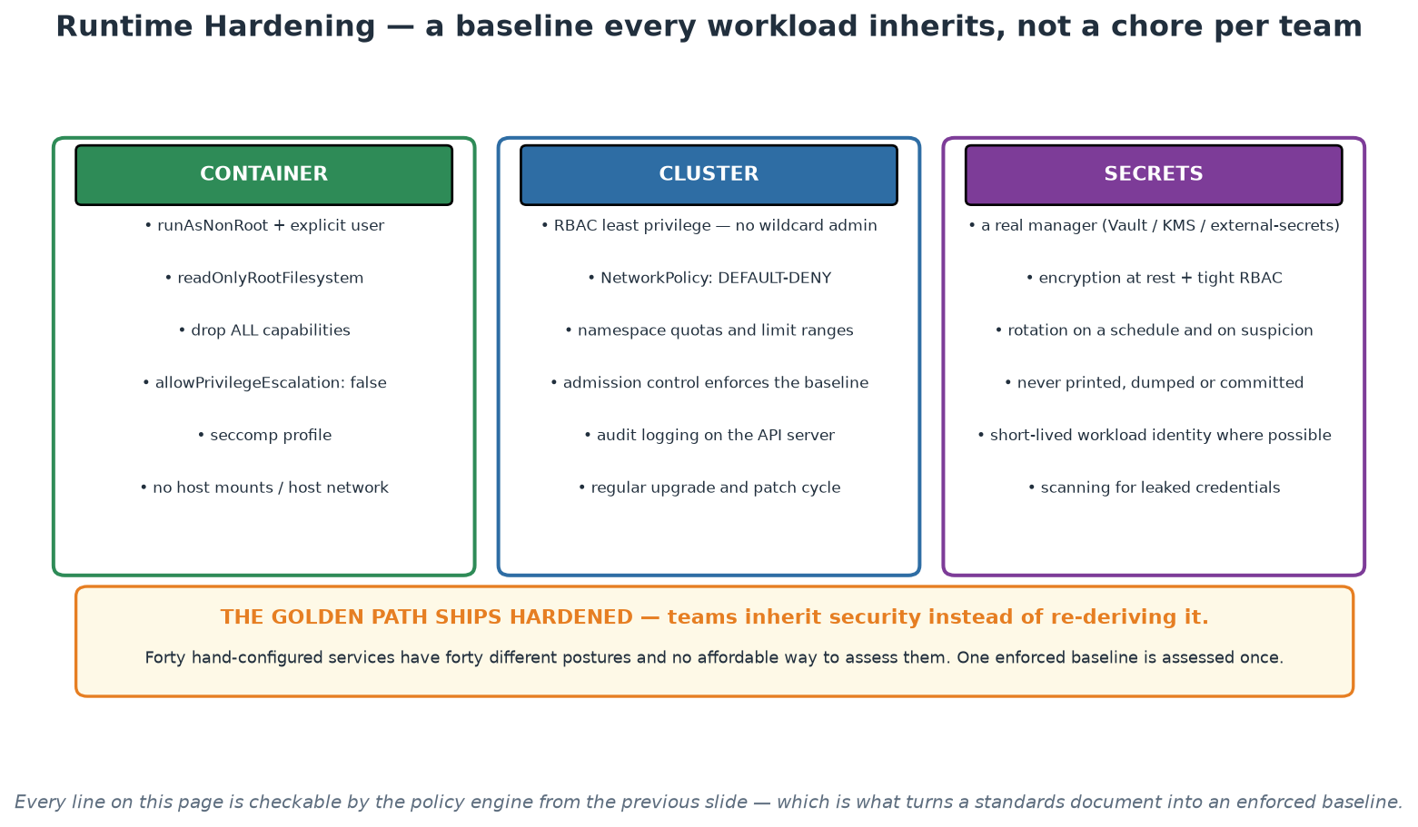
Hardening in Three Layers
Container, cluster and secrets - specified once, enforced by policy, inherited by every team.
Notes:
Present this as a specification for the golden path rather than a checklist for each team, because that is the argument: forty independently hardened services have forty different postures, and one enforced baseline is assessed once and inherited everywhere. Highlight two items that surprise people. Default-deny network policy: without it every pod can reach every other pod, which contradicts the mental model of anyone whose background is network zoning. And the secrets column, where the base64 misunderstanding lives - encoded is not encrypted, so encryption at rest, tight RBAC and a real secrets manager are all required. Everything on the page is checkable by the policy engine from the previous slide, which is what turns it from advice into an enforced baseline.

Slide 61
In Context: Hardening Under Supervisory Expectations
Map the technical controls to the institution's concerns
  Least privilege everywhere - workloads, service accounts, pipeline tokens, registry and cluster access.
  Segregation: network policy between environments and between critical and non-critical workloads.
  Cryptographic protection: encryption at rest and in transit, with keys managed by a proper service.
  Auditability: API server audit logs, immutable pipeline records, and change traceable to a person.
Operational hygiene that is easy to neglect
  Cluster and node patching on a schedule, with the upgrade path rehearsed before it is needed.
  Certificate lifecycle - expiries are a classic self-inflicted outage; automate issuance and renewal.
  Periodic RBAC review: permissions accumulate quietly, and nobody notices until an assessment.
  Scheduled image rebuilds so the hardened baseline does not silently age.
Getting it agreed rather than imposed
  Bring security colleagues in while designing the baseline, not at the approval gate afterwards.
  Show the enforcement mechanism, not just the intention - a policy that fails a build is persuasive.
  Agree the exception process up front, including who approves and how expiry is tracked.
  Then reuse the agreed baseline for every subsequent service - the second conversation is far shorter.
Notes:
The mapping in the first section is what lets participants have this conversation in their institution's language rather than in Kubernetes vocabulary: least privilege, segregation, cryptographic protection and auditability are concerns the organisation already has policies about, and the technical controls implement them. The operational hygiene section covers the things that cause real incidents and are easy to defer - certificate expiry in particular has taken down more services in this sector than any exotic attack, and it is entirely automatable. The final section is process advice worth stating plainly: security colleagues brought in during design become co-authors of the baseline and its strongest advocates, while the same people brought in at an approval gate become an obstacle, through no fault of their own. Showing a policy that actually fails a build is far more persuasive than describing an intention, and agreeing the exception process before it is needed prevents the first exception from becoming a precedent nobody tracks.

Slide 62
Triage Discipline - Living With Scanner Output
Severity (CVSS) is not risk: context - exposure, reachability, data - changes everything.
First questions: is it FIXABLE? is the vulnerable path even reachable in our usage?
--ignore-unfixed in gates: block only what a developer can action today.
Accepted risks get an owner and an EXPIRY date - never a permanent ignore file.
Track vulnerability debt like tech debt; watch the trend, not just today's count.
Notes:
The first real scan of any mature image returns dozens of findings, and the untrained reactions - panic, or numb dismissal - are equally wrong; triage is the professional skill, and it is teachable in one slide. CVSS scores measure theoretical severity in a vacuum; RISK is severity multiplied by context: a critical RCE in an internal batch tool behind a VPN is a different animal from a medium-severity flaw in your internet-facing auth service. The triage tree: Is a fixed version released? - upgrade, usually a one-line change caught at ideal cost (the shift-left curve). No fix yet? - assess reachability: is the vulnerable function even invoked in your usage? Vendor advisories and reachability analysis help; often the honest answer is 'not exploitable in our configuration', which is an ACCEPTANCE decision - and acceptances get an owner and an expiry date, because 'ignore forever' files rot into blindness. This is exactly why the Workshop 1 gate uses --ignore-unfixed on criticals: a gate must only block what someone can action today, or it gets bypassed and takes the team's respect for red builds with it (Module 5's lesson, applied). Finally, zoom out: individual findings matter less than the TREND of vulnerability debt - a platform that auto-bumps base images weekly beats any amount of heroic patching.

Slide 63
Deep Dive: Severity Is Not Risk
Why CVSS alone misleads
  CVSS scores the vulnerability in the abstract; risk depends on YOUR context.
  Exposure: is the component reachable from outside, or on an internal path behind three controls?
  Reachability: is the vulnerable function even called by your code, or is it dead weight in a library?
  Data: what would an attacker reach from there - public reference data, or sensitive records?
  A 'critical' in an unreachable path may matter less than a 'medium' on your front door.
The triage questions, in order
  1. Is it FIXABLE today? (an upgraded package or base image exists) - if yes, this is usually just a version bump.
  2. Is the vulnerable path REACHABLE in our usage? - reachability analysis removes a great deal of noise.
  3. What is the EXPOSURE and the data at stake? - this sets the deadline, not the CVSS number alone.
  4. Is there a compensating control already in place? - record it, do not merely assert it.
Gating on what people can action
  --ignore-unfixed in the gate: block only what a developer can resolve today.
  Unfixable findings go to the report and the backlog, with an owner watching for an upstream fix.
  Blocking on the unfixable teaches teams to bypass gates - and they will bypass the useful ones too.
  Widen the gate deliberately as the fixable backlog clears - narrow and trusted beats broad and ignored.
Notes:
This is the slide that keeps a security programme sustainable, because the alternative - treating every high-severity finding as an emergency - burns out teams and destroys the credibility of the whole practice within a quarter. Teach the distinction between severity and risk carefully: CVSS describes the flaw, not your exposure to it, and a mature programme applies context to prioritise. The reachability question is the one that removes the most noise in practice, since a large share of dependency findings are in code paths the application never calls. Be clear that context-based prioritisation is not an excuse to ignore findings - everything is recorded, owned and tracked - it is how limited capacity gets pointed at the things that actually matter. Repeat the gate discipline from Day 1 once more, because it is the operational expression of all of this: gate on the fixable, report the rest, and protect the meaning of a red build. In a supervised institution, add that documented compensating controls belong in the record rather than in someone's memory.

Slide 64
Deep Dive: Managing Vulnerability Debt
Treat it exactly like technical debt
  It accumulates silently, it has interest, and it must be budgeted - not handled in occasional panics.
  Reserve recurring capacity for remediation, or it will always lose to feature work.
  Track the TREND: is the fixable backlog shrinking? A rising count with a falling trend is progress.
  Report at portfolio level - which services carry the most, and are they the ones that matter most?
Accepted risks need owners and EXPIRY dates
  Every acceptance records: what, why, who owns it, what compensates for it, and when it is revisited.
  No permanent ignore files - a permanent exception is an undocumented decision waiting to be discovered.
  Expiry forces re-evaluation, which is exactly what should happen when an upstream fix appears.
  This is also precisely the evidence an assessor asks for, produced as a by-product of working.
Reduce the source, do not just triage faster
  Slimmer base images and multi-stage builds remove whole classes of findings at once.
  Automated dependency-update pull requests turn most findings into a reviewed, tested version bump.
  Scheduled rebuilds keep images current without anyone remembering to do it.
  Remove unused dependencies - the cheapest vulnerability is the library you deleted.
Notes:
The framing that makes this manageable is debt: vulnerability findings accumulate like technical debt, they have interest, and they need budgeted capacity rather than heroics. Recommend a standing allocation - a fixed share of each iteration - because remediation work that competes with features on a case-by-case basis always loses until it becomes an emergency. The expiry-dated acceptance is the single most important process detail on this slide, and it is worth insisting on: permanent ignores are how organisations end up carrying a known-critical vulnerability for years without any record of who decided that was acceptable or why. An expiry forces the decision back onto someone's desk when circumstances have changed. Finish with the reduction strategies, because they are where the leverage is: teams that slim their base images and automate dependency updates typically remove the majority of their findings without triaging them individually, which is a far better use of scarce security attention than a longer meeting about severities.

Slide 65
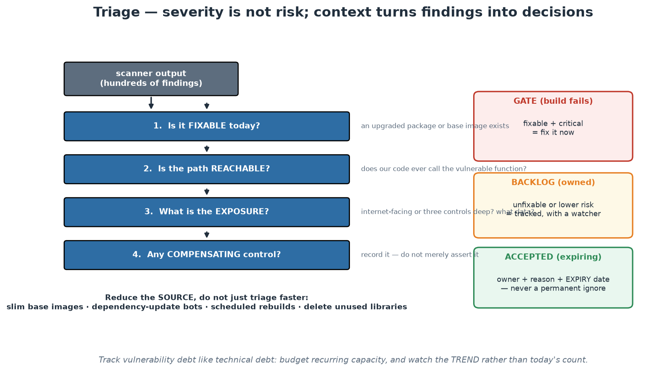
From Findings to Decisions
Four questions turn hundreds of findings into three actionable buckets.
Notes:
The funnel converts an unmanageable list into three decisions: fix now, track with an owner, or accept with an expiry. Walk the four questions in order and stress the first two, because they remove most of the noise - fixable findings are usually a version bump, and unreachable code paths are genuinely lower risk however alarming the score. The three outcome boxes are the operational content: the gate blocks only the fixable and critical, the backlog is owned and watched, and acceptances carry an owner, a reason and an expiry date. Finish on the reduction line at the bottom, because it is where the leverage is - slimmer bases, dependency bots and scheduled rebuilds remove more findings than any amount of triage meeting time.

Slide 66
In Context: Vulnerability Debt in a Supervised Institution
Reporting that stands up to scrutiny
  Report by service tier: critical industry-facing services held to tighter deadlines than internal tools.
  Show the trend and the ageing profile, not just today's count - direction of travel is the real signal.
  Name owners; an unowned finding on a report is an unowned risk in the estate.
  Publish the exception register with expiry dates, and review it on a fixed cadence.
Remediation deadlines that are actually achievable
  Set them by severity AND exposure AND tier - a single institution-wide deadline satisfies nobody.
  Budget standing capacity for remediation, or it will always lose to delivery until it becomes an emergency.
  Automate the routine path: dependency-update pull requests plus a reliable test suite do most of the work.
  Escalate on ageing, not only on severity - a medium finding open for a year is a process failure.
Third-party and unsupported software
  Vendor products you cannot rebuild need a different answer: contractual expectations plus compensating controls.
  Track end-of-support dates as a first-class risk - unsupported software is an accepted risk by default.
  Keep an inventory that includes what you did not build; SBOMs help, but procurement records matter too.
  Raise this with vendor management colleagues - it is their process, and it needs your technical input.
Notes:
This slide is about making vulnerability management sustainable and reportable in an environment where someone will eventually ask hard questions about it. Tiered reporting and tiered deadlines are the key ideas: a single institution-wide remediation deadline is either impossible for critical systems or absurdly lax for internal tools, and tiering by exposure and criticality is both more defensible and more achievable. The ageing-based escalation is worth emphasising because most programmes escalate on severity alone and therefore never notice the medium finding that has been open for eighteen months, which is exactly the pattern an assessor will find. The third-party section addresses the gap most technical discussions skip: a large share of a central bank's software is bought rather than built, cannot be rebuilt to fix a dependency, and needs contractual and compensating-control answers. Encourage participants to bring their technical inventory to the colleagues who own vendor management, because neither group can solve it alone.

Slide 67
Module 7 - Key Takeaway
"Make the secure path the easy path. Scanners inform, gates enforce, policies encode the rules, and the platform ships it all as the default - so security happens even on a deadline."
— Course synthesis
Notes:
Bridge to Module 8: hardening reduces the odds of failure; observability is how you find out anyway - because something always gets through.

Slide 68
Module 8
Observability and Reliability
Notes:
45 minutes theory + a 15-minute basic demo (Prometheus + Grafana on localhost, then a mini incident). Goal: pillars with real depth, SLI/SLO/error budgets, alerting that respects humans, and reliability patterns - measurement in service of learning.

Slide 69
Monitoring Asks Known Questions; Observability Answers New Ones
Monitoring: predefined checks for failures you ANTICIPATED (disk full, service down).
Observability: can you interrogate the system about failures you NEVER predicted?
Distributed systems fail in emergent ways - the interesting outage is always novel.
Property of the system: rich telemetry with labels/context you can slice ad hoc.
Test: 'orders from one customer segment are slow - why?' answerable without a new deploy?
Notes:
The distinction is practical, not pedantic. Monitoring is a set of questions you wrote down in advance - is the disk full, is the process up, is latency under 500ms - and it is necessary but bounded by your imagination at dashboard-design time. In a distributed system (Module 6's world), the failures that hurt are EMERGENT: a retry storm amplifying a slow dependency, one customer's pathological request pattern, a cache stampede after a deploy - none of which had a pre-built dashboard. Observability (the term borrowed from control theory: inferring internal state from outputs) is the property of emitting telemetry rich enough to answer questions you formulate DURING the incident: metrics with meaningful labels (endpoint, status, customer-tier), structured logs with correlation IDs, traces stitching a request across services. The litmus test on the slide is worth reading aloud twice - if answering a novel question requires adding instrumentation and redeploying, you have monitoring; if you can slice existing telemetry ad hoc, you have observability. High-cardinality labels are what make slicing possible, and also what makes naive metric systems explode - a real design tension to name honestly (metrics for aggregates, logs/traces for high-cardinality detail).

Slide 70
Deep Dive: Known Unknowns vs Unknown Unknowns
MONITORING - checks you designed in advance
  Predefined questions with predefined answers: is it up, is the disk full, is the queue growing?
  Excellent for failures you have already seen and can enumerate - and you should absolutely have it.
  Its limit is definitional: it can only tell you about conditions somebody thought to check for.
  Dashboards full of green while users are complaining is the classic symptom of monitoring-only.
OBSERVABILITY - the ability to ask NEW questions
  A property of the SYSTEM, not a product you buy: can you interrogate it about behaviour you never predicted?
  Requires rich telemetry with high-cardinality context: customer, tenant, endpoint, version, region, feature flag.
  The test: 'requests from one specific segment are slow' - can you answer that WITHOUT shipping new code?
  If the answer is 'we would need to add logging and redeploy', you have monitoring, not observability.
Why distributed systems force the change
  In a monolith, the failure is usually in the one process you are already watching.
  In a distributed system, failures are emergent: a slow dependency, a retry storm, one bad replica, a partial outage.
  The interesting outage is always the novel one - by definition nobody wrote a check for it.
  So invest in the ability to explore, not only in the list of things you already fear.
Notes:
Make the distinction operationally rather than philosophically, because participants will otherwise hear it as vocabulary. Monitoring answers questions you wrote down in advance; observability lets you ask questions you had not thought of, during the incident, without deploying code. The high-cardinality point is where the two genuinely diverge and where tooling cost appears: being able to slice by customer, tenant, version or feature flag is what turns 'the service is slow' into 'requests from this tenant on this version are slow', and that dimensionality is expensive for traditional metric systems, which is why tracing and structured events matter. Use the test on the slide as the diagnostic and let the room answer honestly for their own systems - most will admit that novel questions require a code change and a deploy, which is precisely the gap. Be clear that this is not an argument to discard monitoring: you need both, and the known checks are cheap, fast and often sufficient. The investment argument is about the incidents that matter most, which are always the ones nobody anticipated.

Slide 71
Deep Dive: Instrumentation That Makes It Possible
Structured, correlated telemetry
  Structured logs (JSON) with consistent field names - grep-able becomes query-able.
  A correlation/trace ID propagated across every service hop, and included in every log line.
  Metrics with meaningful labels, and traces that show where the time actually went.
  Context that matters to YOUR business: tenant, product, channel, version, feature flag.
OpenTelemetry as the strategic bet
  Vendor-neutral instrumentation: instrument once, then choose (and change) the backend later.
  Instrumentation is the expensive, invasive part - so keeping it portable protects the investment.
  It also standardises semantics across languages and teams, which is what makes data joinable.
  This is the 'exit cost' principle from Day 1, applied where the lock-in would otherwise be worst.
Costs and controls to plan for
  Telemetry volume is a real budget line: sample deliberately, and keep tail/error sampling high.
  Retention tiers: detailed data for days, aggregates for months, per what questions you must answer.
  Data protection: telemetry can carry personal data - classify it, scrub it, control access to it.
  Cardinality discipline: unbounded label values will melt a metrics backend - budget them consciously.
Notes:
Instrumentation is where the module becomes actionable, and the highest-value single practice is trace-ID propagation with structured logs: without it, an investigation across five services is manual archaeology; with it, one identifier reconstructs the whole request path. Recommend OpenTelemetry explicitly as the strategic choice, using the Day 1 exit-cost argument - the instrumentation work is expensive and invasive, so making it vendor-neutral keeps the backend decision reversible, which matters in an institution whose procurement cycles are long. The cost and control section is essential for this audience and is often skipped in observability talks: telemetry is a budget line that grows with traffic, retention must be designed rather than defaulted, and telemetry can carry personal data, so classification and scrubbing belong in the design rather than in a later remediation. Mention cardinality explicitly - an unbounded label such as a raw user identifier will overwhelm a metrics system - because it is the most common self-inflicted observability outage.

Slide 72
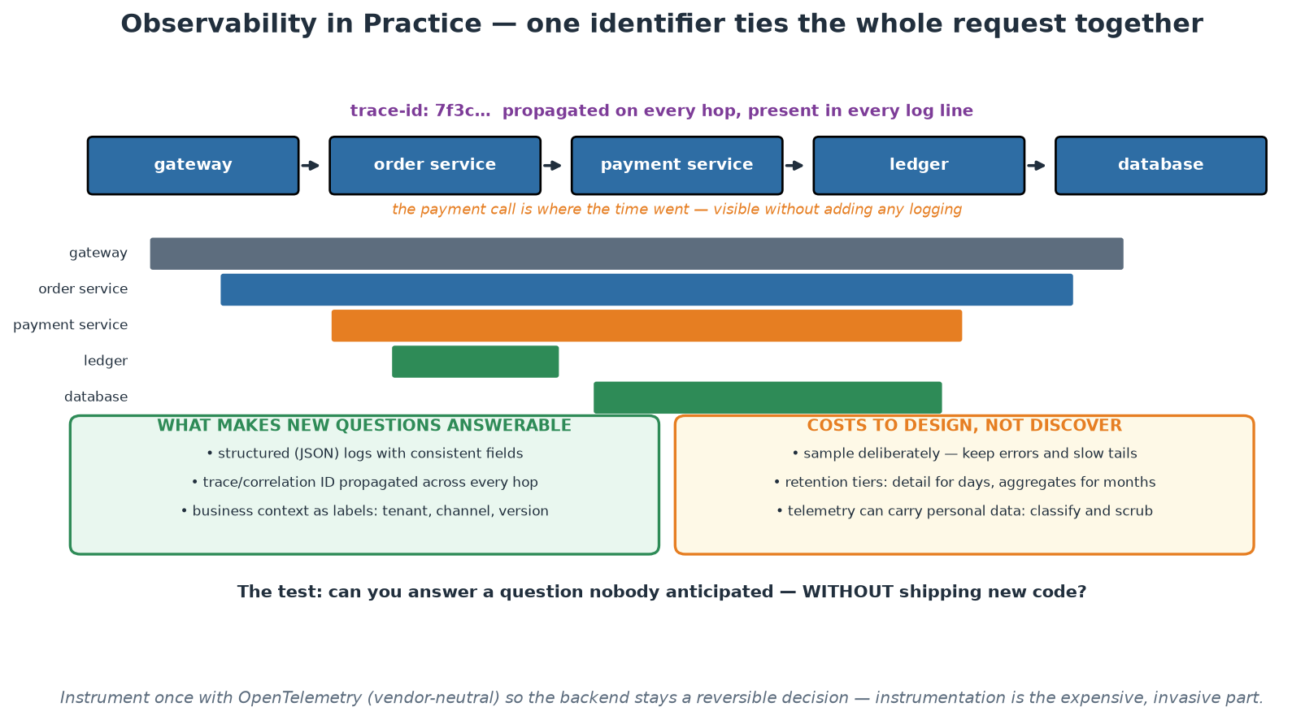
One Request, One Trace
A propagated trace ID turns five services' logs into one answerable story.
Notes:
The waterfall makes the value obvious in a way that no definition does: one identifier, propagated across every hop, shows exactly where the time went - and the answer required no new logging and no deploy. Ask the room how they would answer the same question today, and the usual honest answer is 'add logging and redeploy', which is precisely the gap. The two bottom panels split the work into what makes new questions answerable (structured logs, propagated IDs, business context as labels) and what must be designed rather than discovered (sampling, retention tiers, and personal data in telemetry). That last point matters here: telemetry carrying personal data is a data-protection question, and it is far cheaper to design for than to remediate.

Slide 73
In Context: Observability for Payments, Data and Publications
What 'the user experience' means for central-bank workloads
  For a transactional service: request success rate and latency, per participant and per channel.
  For settlement and batch: completion within the window, and the margin left before the cut-off.
  For data intake: submissions received, validation pass rate, and time to a usable dataset.
  For publications: readiness before the scheduled time, and correctness checks passing.
Context labels worth carrying from the start
  Participant or counterparty identifier, channel, message or instruction type, and service version.
  Business date and cycle - a great deal of this work is date-bound rather than continuous.
  Environment and data classification, so telemetry access controls can be applied automatically.
  Keep cardinality bounded deliberately: use identifiers as trace attributes, not as metric labels.
Data protection in telemetry
  Assume logs and traces will carry personal or confidential data unless you actively prevent it.
  Scrub or tokenise at the source; do not rely on downstream redaction you cannot verify.
  Apply retention and access control to telemetry as you would to the underlying records.
  Agree the approach with your data-protection colleagues before you instrument broadly, not after.
Notes:
The first section is the one that makes this module land for a central-bank audience, because most observability material assumes a web request-response world and a great deal of this institution's work is scheduled, batch and date-bound. Reframing the indicators accordingly - completion before a cut-off, margin remaining, validation pass rate, readiness before a publication time - turns observability from a web-service concept into something directly applicable to settlement windows, supervisory data intake and statistical releases. The context labels section is practical advice with a trap attached: business identifiers are exactly the dimensions you want to slice by, and putting high-cardinality identifiers into metric labels is the fastest way to overwhelm a metrics backend, so the guidance is to keep them as trace and log attributes. The data-protection section should be raised early and firmly: telemetry routinely carries personal data, scrubbing belongs at the source, and agreeing the approach with data-protection colleagues before broad instrumentation avoids an expensive retrofit.

Slide 74
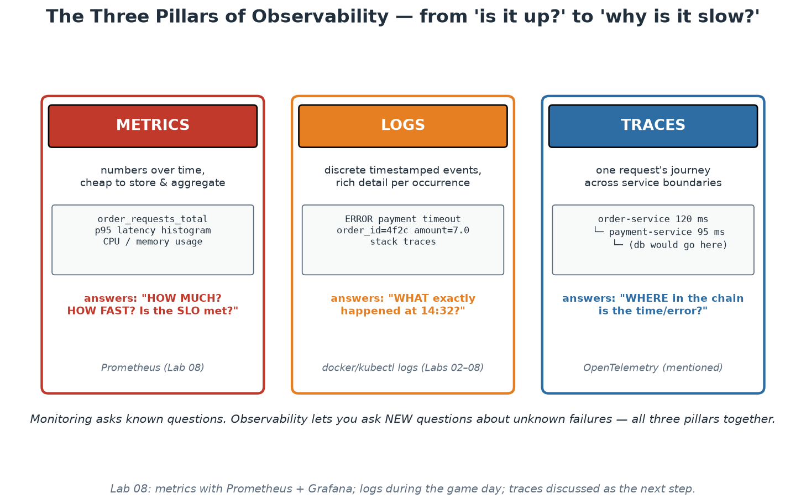
The Three Pillars in Depth
Metrics: how much/how fast. Logs: what exactly. Traces: where in the chain.
Notes:
Give each pillar its engineering personality, because they are complements, not alternatives. METRICS are cheap aggregates over time - counters and histograms whose cost is independent of traffic volume - perfect for dashboards, alerts and SLOs; our app's middleware counts every request into order_requests_total with method/endpoint/status labels and times it into a histogram; two method points worth teaching: RED (Rate, Errors, Duration) is the request-service checklist, USE (Utilisation, Saturation, Errors) the resource-level one - and averages LIE, which is why histograms exist: mean latency of 50ms is compatible with a p99 of 4 seconds, and your unluckiest users live in the tail, so we quantile from histogram buckets (participants build the p95 panel in the demo). LOGS are discrete events with unbounded detail - the place for stack traces and request context; structure them (JSON) and carry correlation IDs so one request's story is greppable across services; they answer 'what exactly happened at 14:32'. TRACES follow ONE request across service boundaries - spans with timing per hop - answering 'WHERE in the chain did the time or error come from'; OpenTelemetry is the vendor-neutral standard worth naming (one instrumentation, any backend). Workflow in practice: a metric alert says SOMETHING is wrong, traces localise WHERE, logs explain WHY - the demo walks exactly this path.

Slide 75
SLI, SLO, SLA - and the Error Budget
SLI: a measured indicator of user experience (success rate, p95 latency).
SLO: your internal target for it (99% of /orders requests succeed, 30-day window).
SLA: the external CONTRACT with penalties - always looser than the SLO.
Error budget: 100% minus SLO = permitted failure. 99% over 30 days = ~7.2 hours.
Budget healthy: ship fast. Budget spent: reliability work wins - by prior agreement.
100% is the wrong target: each nine multiplies cost, and users cannot tell past a point.
Notes:
This is SRE's crown jewel: it converts 'how reliable should we be?' from an emotional argument into an engineering budget. SLIs must measure USER experience, not machinery - 'successful responses to real requests' beats 'CPU below 80%' (users do not experience your CPU); choose 2-3 per service, typically availability and latency. Two subtleties participants hit in the course material: exclude health-check traffic from the SLI (it is high-volume and almost always succeeds, so it dilutes real user pain - our slo.md does this deliberately and says why), and measure at the point closest to the user you can. SLOs are internal targets with explicit windows; SLAs are contracts with lawyers and penalties, set LOOSER than the SLO so you breach internally before you breach contractually. The error budget reframes everything: a 99% monthly SLO GRANTS ~7.2 hours of failure - reliability stops being 'as much as possible' and becomes a resource to SPEND on velocity (deploys, experiments, migrations). The policy must be agreed BEFORE it is needed: budget healthy means ship; budget exhausted means feature work yields to reliability work - agreed in calm, enforced without a fight in crisis. The last bullet defuses the 100% instinct: each extra nine multiplies cost (redundancy, complexity, on-call) while user-perceived value flattens - your mobile user's network is less reliable than your 99.9% anyway. Ask the room what THEIR services' unwritten SLO currently is; the silence is the lesson.

Slide 76
Deep Dive: Choosing Indicators and Targets
Pick SLIs that reflect USER experience
  Good SLIs: request success rate, latency at p95/p99, freshness of data, completeness of a batch.
  Bad SLIs: CPU utilisation, memory, pod count - these are causes, and users do not experience them.
  Measure as close to the user as possible: at the edge or the client, not deep inside one component.
  For batch and data work, the right indicators are timeliness, completeness and correctness - not uptime.
Setting the SLO honestly
  Start from what users actually need, not from what sounds impressive in a steering pack.
  Use historical data: if you have been at 99.5% and nobody complained, 99.9% may be spending money for nothing.
  Each additional nine multiplies cost - in redundancy, in engineering time, and in operational restraint.
  State the WINDOW (rolling 30 days) and the measurement method, or the number means nothing.
  Different services deserve different targets: a settlement path and an internal report are not the same.
SLA is a different animal
  The SLA is the external commitment with consequences; the SLO is your internal target.
  Always set the SLO tighter than the SLA, so you find out you are in trouble before your counterparty does.
  Not every service needs an SLA, but every service that matters deserves an SLO.
Notes:
The most common mistake is choosing indicators that are easy to measure rather than ones that reflect what users experience, so spend time on the good-versus-bad SLI contrast. CPU utilisation is a cause, not an experience: a service can be at 90% CPU and perfectly healthy, or at 10% and failing every request. For this audience, add the batch and data dimension explicitly, because a great deal of central-bank work is not request-response: for a data pipeline or a scheduled publication, the meaningful indicators are timeliness, completeness and correctness, and framing those as SLIs is often a genuinely new idea. On target setting, push back against reflexive nines: each additional nine costs real money and real engineering restraint, and a target chosen because it looks good in a report will either be missed constantly or will over-constrain delivery. The SLO-tighter-than-SLA rule is simple, memorable and prevents the situation where the first indication of a contractual breach is the counterparty telling you about it.

Slide 77
Deep Dive: The Error Budget as a Decision Rule
The arithmetic, and why it is liberating
  Error budget = 100% minus the SLO. At 99% over 30 days, that is roughly 7.2 hours of permitted failure.
  Permitted, not accidental: it is a resource you may deliberately spend on change and experimentation.
  Budget healthy -> ship, take risks, run experiments. Budget exhausted -> reliability work takes priority.
  The policy is agreed IN ADVANCE, when everyone is calm - not negotiated during an incident.
What it changes in the organisation
  It ends the oldest argument in IT by converting 'faster vs safer' into one number both sides own.
  It makes reliability a shared, quantified goal rather than a matter of temperament or seniority.
  It gives engineers a defensible answer to 'why are you not shipping features this sprint?'
  It gives leadership an honest signal that is not a subjective status colour.
Making it real
  Publish burn on a dashboard everyone can see, including the people who set delivery priorities.
  Alert on BURN RATE, not on threshold breaches - fast burn pages, slow burn tickets (next slide).
  Review SLOs quarterly: consistently untouched budget means the target is too loose or too expensive.
  Consequences must be real - a budget policy nobody honours is worse than none, because it teaches cynicism.
Notes:
The error budget is the single most useful management idea in the observability module, so give it room. The framing that lands is that reliability becomes a spendable resource with an agreed policy rather than an argument between people with different instincts - and crucially, the policy is set while everyone is calm, which is why it survives contact with a bad week. Be honest that the mechanism only works if the consequences are real: an organisation that declares a budget policy and then ignores it when the budget is exhausted has taught its engineers that the whole framework is decorative, which is worse than never starting. For this audience, note that different services warrant genuinely different targets, and that having an explicit, evidenced conversation about how reliable something needs to be is itself valuable - many institutions have never had it, and default to an implicit and unfunded expectation of perfection. The quarterly review point matters too: an untouched budget is not a triumph, it usually means the target is set below what the system already delivers.

Slide 78
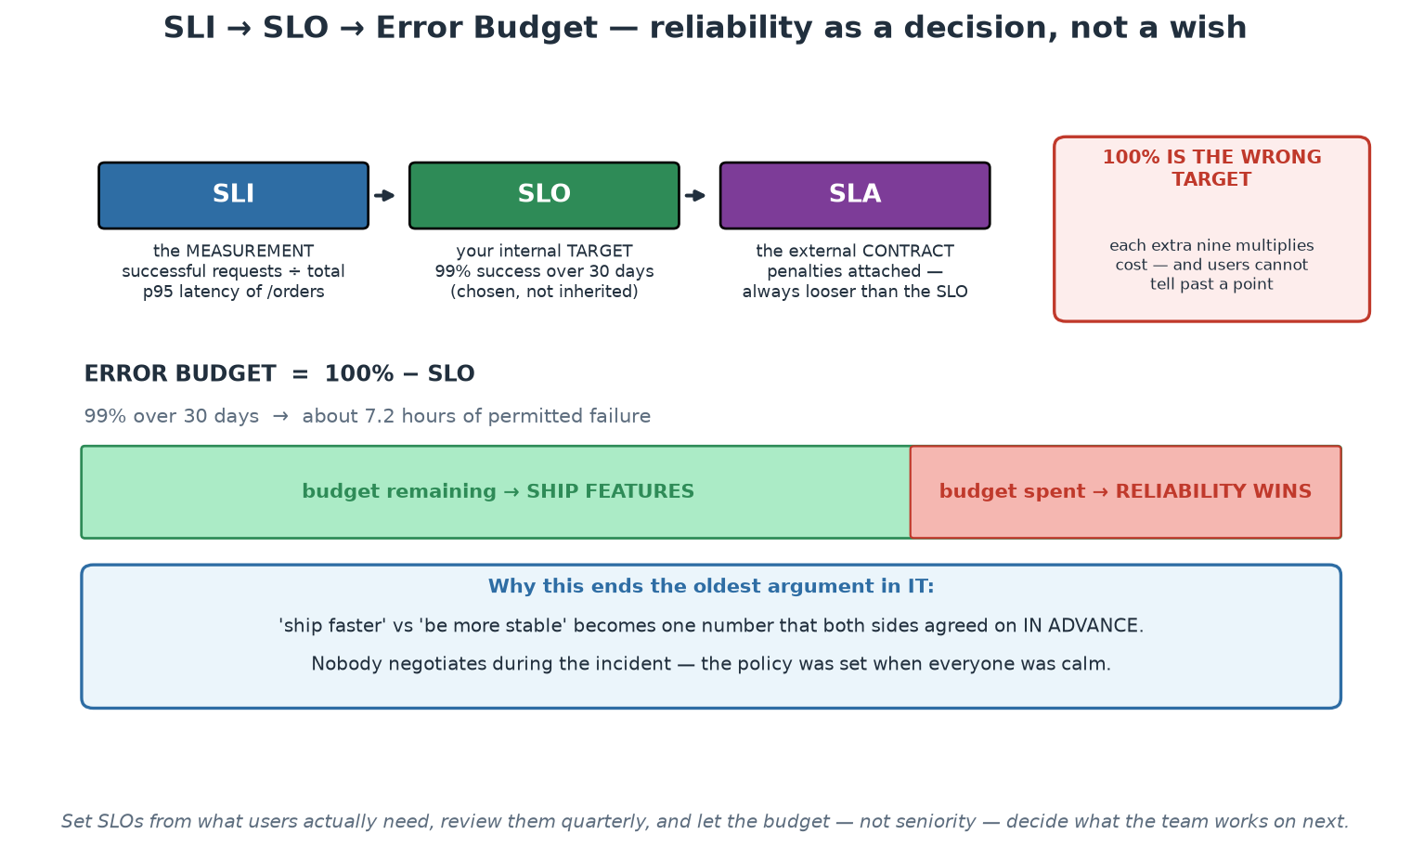
SLI, SLO and the Error Budget
Reliability becomes a spendable, agreed number instead of an argument between temperaments.
Notes:
Walk the ladder - measurement, internal target, external contract - and stress that the SLO is chosen rather than inherited, which is where most of the value lies. The budget bar is the idea to leave in the room: the gap between the target and 100% is a resource that may be deliberately spent on change, and when it is exhausted, reliability work takes priority by prior agreement. Emphasise 'prior agreement' - the policy is set while everyone is calm, so nobody negotiates during an incident. The red box on the right is worth arguing for explicitly in a risk-averse institution: 100% is not a target, it is an unfunded aspiration, and each additional nine multiplies cost while users often cannot perceive the difference.

Slide 79
In Context: SLOs Where the Deadline Is the Mandate
Time-bound obligations need time-bound indicators
  For a settlement or clearing window: proportion of cycles completed before the cut-off, and the margin left.
  For a scheduled publication: readiness at a fixed time, with correctness checks passed beforehand.
  For supervisory data: submissions processed within the agreed turnaround, and validation quality.
  'Availability' alone is a poor indicator when the real obligation is 'finished, correctly, before a time'.
Setting targets in a low-tolerance environment
  Differentiate by service tier: an industry-facing payment path and an internal dashboard are not comparable.
  Use history: what has the service actually delivered, and did anyone experience the gap?
  Where the obligation is absolute (a legal or industry deadline), the SLO is about MARGIN, not about failure.
  Then the budget conversation becomes: how much margin are we prepared to erode with change this month?
Using the budget without weakening the mandate
  The budget governs discretionary CHANGE, not the obligation - it is a change-risk policy, not a licence to fail.
  Exhausted budget means: freeze non-essential change, fix reliability, and say so openly.
  Healthy budget means: proceed with planned change, with the evidence to support that decision.
  Agree the policy in advance with the business owners - that agreement is what makes it usable under pressure.
Notes:
The reframing that makes SLOs work in this environment is margin rather than failure. Where an obligation is effectively absolute - an industry cut-off, a legally scheduled publication - it is unhelpful to talk about a permitted failure rate, and far more useful to define the indicator as margin before the deadline and the objective as maintaining that margin. The error budget then governs how much discretionary change the team is prepared to make against that margin, which is exactly the right conversation and one that business owners understand immediately. Be very clear about what the budget is not: it is not permission to miss a mandated obligation, it is a change-risk policy. Making that distinction explicit is what allows the practice to be adopted in a supervised institution rather than rejected as inappropriate. Encourage participants to define one indicator this way for a real service and take it to the business owner - the conversation itself usually surfaces that nobody had ever stated the reliability expectation quantitatively.

Slide 80
Alerting That Respects Humans
Page on SYMPTOMS (users hurting), ticket on causes (disk trending full).
Alert on error-budget BURN RATE, not raw thresholds - two windows: fast and slow.
Every page must be: actionable, urgent, and novel. Otherwise it is noise.
Alert fatigue is a safety failure: ignored pages are how big outages get missed.
Every alert links a runbook; every false page gets tuned or deleted - budget your alerts too.
Notes:
Alerting is where observability meets human factors, and most organisations get it wrong in the direction of MORE. The symptom/cause split: page a human when users are hurting (error rate up, latency exploding) because that always deserves urgency; causes that are not yet symptoms (a disk filling over days, a certificate expiring next week) become tickets - urgent-but-async work. Naive threshold alerts ('availability below 95% for 5 minutes') fail in both directions: too slow for a total outage, too twitchy for a brief blip that self-heals. Burn-RATE alerting fixes this by asking 'how fast is the error budget being consumed?': a fast-burn rule (e.g. burning at 14x budget rate over 1 hour AND 5 minutes - the two windows suppress flapping) pages because the monthly budget dies in days; a slow-burn rule (3x over 24 hours) tickets because there is time to think. Our slo.md contains these exact rules with the arithmetic worked out - point participants at it. The 'actionable, urgent, novel' test kills most existing alerts on contact, and that is the point: alert fatigue is not an annoyance but a SAFETY failure - the on-call who silences their tenth false page tonight is the one who sleeps through the real one; Module 2's psychological safety applies to machines paging humans, too. Runbook links and a standing rule that every false page produces a tuning change keep the alert set trustworthy over time.

Slide 81
Deep Dive: Symptoms, Causes and Burn Rate
Page on symptoms, ticket on causes
  Symptom: users cannot complete payments; the journey is broken NOW. That is worth waking someone.
  Cause: disk will be full in six days, one replica restarted, a certificate expires in three weeks. That is a ticket.
  Cause-based paging produces alerts that fire when nothing is wrong and stay silent when something is.
  A useful filter: if the user experience is unaffected and it can wait until morning, it is not a page.
Burn-rate alerting on the error budget
  Alert on how fast the budget is being consumed, not on a raw threshold crossing.
  Two windows: a fast one (high burn over a short period) pages; a slow one (moderate burn over hours) tickets.
  This catches both the sudden outage and the slow leak, without paging for a brief harmless blip.
  It also ties every page directly to something the organisation already agreed matters.
The three tests every page must pass
  ACTIONABLE: there is something a human can do right now. If not, it is a notification.
  URGENT: it genuinely cannot wait until working hours.
  NOVEL: it is not the fifth copy of a known condition - deduplicate and group.
  Fail any test and the alert should be downgraded, tuned or deleted - not tolerated.
Notes:
This slide protects people, and it is worth saying that plainly: alert design is an occupational-health issue as much as an engineering one. The symptom-versus-cause rule is the most valuable single heuristic, because most legacy alerting is cause-based, which produces the worst possible combination - frequent pages that do not matter, and silence during the failures that do. Burn-rate alerting is the modern refinement and connects the pager directly to the error budget from the previous slide, which means every page is tied to something the organisation already agreed was important. Give the three tests as a review tool participants can apply to their existing alert set this month: take the alerts that fired last quarter, ask which were actionable, urgent and novel, and delete or downgrade the rest. That exercise routinely removes a large share of an organisation's pages and improves detection, because the remaining signal is trusted. In a supervised institution, add that alert quality is genuinely an operational-resilience control - an on-call engineer who has learned to ignore the pager is a control failure with a human face.

Slide 82
Deep Dive: Alert Fatigue Is a Safety Failure
How organisations get here
  Every incident adds an alert; almost nothing is ever removed. The set only grows.
  Alerts are added for reassurance rather than for action - 'so we know it happened'.
  Thresholds are copied between services without checking whether they mean anything there.
  Result: hundreds of alerts, most ignored, and the important one arrives in the same noisy channel.
The discipline that fixes it
  Every alert links a RUNBOOK that says what to check and what to do - no runbook, no page.
  Every false page is a defect: tune it or delete it, in the week it happened.
  Budget your alerts like any other finite resource - a rising page count is a regression, not a sign of diligence.
  Review the alert set with the same seriousness as the code: quarterly, with deletions.
Measure the human side
  Pages per on-call shift, and how many arrived outside working hours - track it, publish it.
  Time to acknowledge and time to resolve, split by alert type, shows where the runbooks are failing.
  Fair, compensated, adequately staffed rotations - fatigue is a control weakness, not a badge of honour.
  Feed the numbers into retrospectives: on-call health is a team metric, not an individual's problem.
Notes:
The purpose of this slide is to give participants permission and a method to delete alerts, which most organisations find surprisingly hard. Name the accumulation mechanism honestly - every incident adds an alert and nothing is ever removed - because once people see the ratchet they can argue against it. The no-runbook-no-page rule is the most enforceable discipline available: it forces the author to articulate what the responder should actually do, and if they cannot, the alert was never actionable. On measurement, pages per shift and the out-of-hours split are the numbers that make the problem visible to leadership, and they belong alongside the other operational indicators rather than in a private team spreadsheet. Be explicit that alert fatigue is a safety failure: an engineer who has been trained by months of noise to dismiss pages will dismiss the one that matters, and every large outage retrospective in the industry contains a version of that sentence. Finish by placing on-call health in the retrospective, so it becomes a system to improve rather than an endurance test individuals are expected to pass.

Slide 83
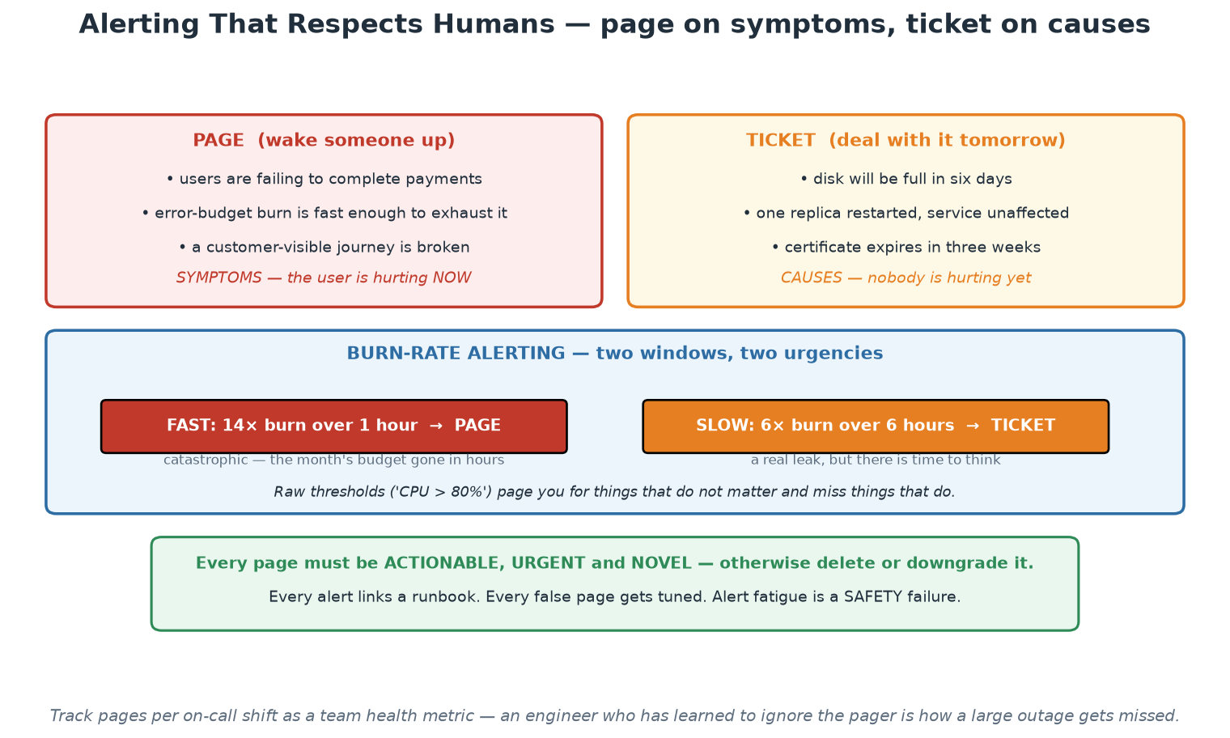
Page on Symptoms, Ticket on Causes
Two windows, two urgencies - and three tests every page must pass.
Notes:
The left/right split is the heuristic to take home, and the burn-rate panel is the modern refinement: a fast window catches the sudden outage and pages, a slow window catches the steady leak and raises a ticket, and neither fires for a brief harmless blip. Tie each page back to the error budget so that every interruption is connected to something the organisation already agreed matters. The three tests at the bottom - actionable, urgent, novel - are a review tool participants can apply to their existing alert set this month, and the exercise typically removes a large share of their pages while improving detection. Close on the last line and mean it: alert fatigue is a safety failure, not a personal resilience problem.

Slide 84
In Context: On-Call in a 24-Hour Obligation Environment
Design the rotation before the alerts
  Follow the obligation: cover the hours the service actually matters, including settlement and batch windows.
  Adequate depth: a rotation with two people is not a rotation, it is two people with no holidays.
  Compensate on-call, cap consecutive shifts, and track load - fatigue is an operational risk, not a virtue.
  Developers in the response path for their own services, with execution following the institution's access rules.
What every alert needs before it is allowed to page
  A runbook: what this means, what to check first, what to do, and who to escalate to.
  A named owning team, so nobody receives a page for a system they do not own.
  An escalation path with a time limit, and a documented decision authority for out-of-hours action.
  A statement of business impact, so the responder knows what is actually at stake.
Measure the human side and report it
  Pages per shift, out-of-hours share, and time to acknowledge - published alongside other operational metrics.
  Every false page reviewed in the following week: tuned or deleted, never merely tolerated.
  Rising page volume is a regression to be investigated, not evidence of diligence.
  Review on-call health in retrospectives - it is a system property, not an individual's endurance.
Notes:
In an institution with time-critical obligations, on-call is a real operational capability and deserves to be designed rather than improvised. The rotation-depth point is worth making bluntly: a rotation resting on two people is a single point of failure with a holiday calendar attached, and it will fail at the worst moment. The requirement that every alert carries a runbook, an owner, an escalation path and a statement of business impact is what turns a page into an actionable event, and the out-of-hours decision authority is specific to this environment - a responder at 03:00 needs to know what they are permitted to do without waking three managers, and that should be written down in advance. On measurement, publishing pages per shift and the out-of-hours share alongside other operational indicators makes an invisible burden visible, and it is usually the fastest route to getting the alert-tuning work funded.

Slide 85
Designing for Failure - Reliability Patterns
Assume dependencies WILL fail; the design question is what happens then.
Timeouts everywhere (no infinite waits) + retries with backoff AND jitter - budgeted.
Circuit breakers: stop hammering a sick dependency; probe for recovery.
Graceful degradation: reduced service beats no service (our 'payment unavailable').
Redundancy + fast rollback: recovery speed often beats failure prevention.
Notes:
Reliability is designed, not hoped for - and every pattern here is visible in the course's tiny app, which is the teaching trick: point at labs/app/main.py on screen. Timeouts: our payment call carries timeout=2.0 - without it, a hung dependency consumes order-service threads until IT dies too, which is how failures cascade upward. Retries help with transient blips but are dangerous at scale: a thousand clients retrying immediately is a self-inflicted DDoS on a recovering service - hence exponential backoff with JITTER (randomisation so retries do not synchronise into waves), and retry budgets to cap amplification. Circuit breakers formalise 'stop asking': after N failures the breaker opens and calls fail fast without touching the sick dependency, then a half-open probe tests recovery - protecting both caller (no wasted waits) and callee (breathing room). Graceful degradation is the design PHILOSOPHY the mechanisms serve: decide per feature what reduced service looks like - our order service accepts the order with payment status 'unavailable' rather than erroring, a product decision (accept-and-reconcile vs reject) that engineering alone cannot make; participants watched this behaviour in Lab 00 without the payment service and will trigger it deliberately in the incident demo. The last bullet reframes the goal with DORA's stability metrics: since failure is inevitable, RECOVERY TIME is often the better investment than ever-more prevention - which is why rollback practice (Workshop 2) matters as much as tests.

Slide 86
Deep Dive: The Patterns, and How They Fail
TIMEOUTS - the one nobody sets until it hurts
  Every network call needs a bounded wait; the default in most libraries is effectively forever.
  Without them, one slow dependency exhausts your threads or connections and takes YOU down with it.
  Budget them: the caller's timeout should be shorter than its own caller's, or the chain is pointless.
  Slow is worse than down - a dead dependency fails fast, a sick one holds every resource you have.
RETRIES - useful, and dangerous
  Retry transient faults only, with exponential backoff AND jitter so callers do not synchronise.
  Cap total attempts and total time - unbounded retries are a self-inflicted denial of service.
  The receiver must be idempotent, or a retry becomes a duplicate transaction.
  Never retry on a definite failure (a 400-class response) - you are just repeating the same mistake faster.
CIRCUIT BREAKERS and BULKHEADS
  Circuit breaker: after N failures, stop calling for a cooling period, then probe cautiously.
  It protects both sides - you fail fast, and the sick dependency gets room to recover.
  Bulkheads: separate connection pools and thread pools per dependency, so one failure cannot drain everything.
  Together they turn a cascading outage into a localised, visible degradation.
Notes:
The sentence to leave with the room is that slow is worse than down: a dead dependency fails immediately and your circuit breaker handles it, while a sick one holds your connections, threads and memory until you fall over too - which is why timeouts are the foundational pattern and why 'no timeout' is a latent outage in every service that lacks one. On retries, be equally blunt about the danger: naive retry logic has turned many minor incidents into major ones by multiplying load precisely when a dependency was struggling, and the jitter detail matters because synchronised retries from many clients arrive as a coordinated wave. Idempotency deserves its own emphasis in any financial context - if a request can be retried, the receiver must be able to detect and discard the duplicate, usually with a client-supplied key - because the failure mode here is not an outage but a duplicated transaction, which is far more expensive to unwind. Circuit breakers and bulkheads are the containment layer, and the framing that helps is that they convert cascading failure into localised, observable degradation.

Slide 87
Deep Dive: Degradation, Recovery and Practice
GRACEFUL DEGRADATION is a product decision
  Decide in advance what reduced service means for each dependency failure - and who decides.
  Our lab example: payments unavailable, so the order is accepted and queued, with an honest message.
  Serve cached or stale data with a clear indication, rather than an error page, where that is acceptable.
  The wrong time to invent the degraded mode is during the incident, at 03:00, under pressure.
RECOVER FAST usually beats PREVENT HARDER
  Prevention has diminishing returns; recovery speed compounds across every incident you will ever have.
  Redundancy plus a rollback measured in seconds returns more availability than another layer of checks.
  This is why Day 1's immutable artefacts and one-command rollback are reliability engineering, not just delivery.
  Measure recovery, not just failure: time-to-restore is one of the four metrics for good reason.
PRACTISE, or none of this is real
  Game days: schedule the failure at 10:00 on a Tuesday instead of waiting for 03:00 on a Sunday.
  Start small and safe: stop a dependency in a lower environment and watch what the system actually does.
  Restore drills: an untested backup is a hope. Time the restore and record the number.
  Every drill produces either confidence or a defect - both are worth more than the plan document.
Notes:
Graceful degradation is presented as a product decision on purpose: engineers cannot unilaterally decide that an order may be accepted without a payment confirmation, so the degraded modes must be designed with the business owner, in advance, and written down. That conversation is often the most valuable output of this module for a regulated institution, because it forces an explicit answer to 'what may we still do when this dependency is unavailable?' - a question that otherwise gets answered improvised, at 03:00, by whoever is on call. The recover-fast argument is the one that reframes Day 1's content as reliability engineering: immutable artefacts, small batches and one-command rollback are what make recovery measured in seconds possible, and recovery speed compounds across every future incident while prevention has diminishing returns. Close on practice, and make the ask concrete and small: stop one dependency in a lower environment this month and watch what happens, then time a restore. Lab 08's game day is exactly this rehearsal, and it usually surprises people - which is the point of doing it on a Tuesday.

Slide 88
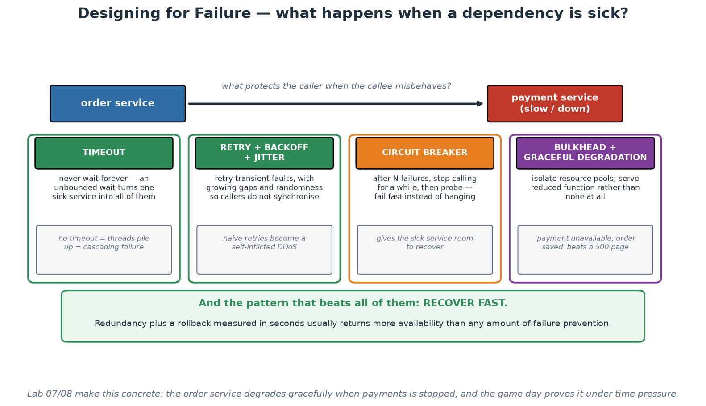
Patterns for Partial Failure
Timeouts, retries with jitter, circuit breakers, bulkheads - and recovering fast beats all of them.
Notes:
Take the four patterns in order and give each its failure mode as well as its purpose, because each one can make things worse when applied naively - especially retries, which have turned many minor incidents into major ones by multiplying load on a struggling dependency. The sentence to repeat is on the first card: slow is worse than down, because a dead dependency fails fast while a sick one holds your threads and connections until you fall over too. The green panel at the bottom is the strategic point and connects Day 1 to Day 2: redundancy plus a rollback measured in seconds returns more availability than another layer of prevention, which is why immutable artefacts and one-command rollback are reliability engineering rather than merely delivery convenience.

Slide 89
In Context: Degradation and Recovery Where Correctness Is Absolute
Idempotency is not optional in financial flows
  Once retries exist, the same instruction WILL arrive twice - design for it explicitly.
  Client-supplied idempotency keys, deduplication windows, and durable records of what was already processed.
  The failure mode here is not an outage, it is a duplicate transaction - far more expensive to unwind.
  Test it deliberately: replay the same request and assert that nothing happens twice.
Degradation modes must be agreed with the business
  Decide in advance what reduced service is permitted: queue and confirm later, read-only mode, reject cleanly.
  Where correctness is absolute, the right degraded mode is often an honest, immediate rejection - not a guess.
  Write it down per dependency, and make the behaviour visible to operators and to counterparties.
  The wrong time to invent this is at 03:00 during the incident, by whoever happens to be on call.
Recovery is the capability worth rehearsing
  Time your restore, your failover and your rollback - a plan without a measured time is a hope.
  Rehearse before the peaks you already know about: settlement cycles, month end, publication dates.
  Game days on a scheduled Tuesday morning surface the gaps while everyone is awake and calm.
  Record what you learned and fix one thing after each drill - that is the Third Way, made concrete.
Notes:
Idempotency deserves the most airtime here because the consequence in this environment is different from a typical web application: a duplicated instruction in a financial flow is not an availability incident, it is a correctness incident, and unwinding it is expensive and visible. Make the requirement explicit - client-supplied keys, deduplication windows, durable processing records - and recommend testing it by deliberate replay rather than assuming it. The degradation section carries a nuance worth stating carefully: in domains where correctness is absolute, graceful degradation often means refusing cleanly and immediately rather than accepting work you cannot complete, and that is a business decision the engineering team must not make alone. The rehearsal section is the practical close: participants can time a restore this month without any tooling investment, and the number they get is the most useful reliability metric they do not currently have.

Slide 90
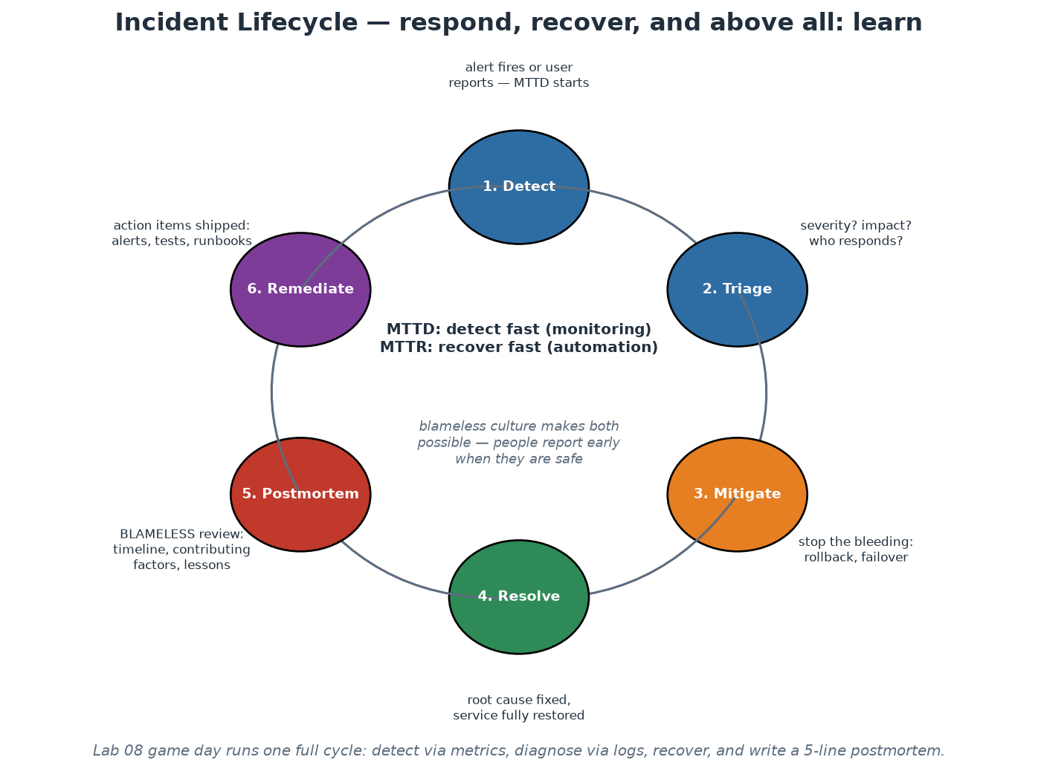
The Incident Lifecycle - and Practising It
Detect, triage, mitigate, resolve - then the learning half: postmortem, remediate.
Notes:
Walk the ring with emphasis on the two clocks and the learning half. MTTD (detection) is bought with Module 8's alerting - the gap between 'users hurting' and 'we know' should be minutes, not a customer email later. Triage assigns severity and a clear incident-commander role (someone coordinates, others investigate - structure beats heroics). MITIGATE before you understand: stop the bleeding with rollback, failover or a flag flip - root cause can wait; this ordering feels wrong to engineers who want to understand first, and is right anyway. Resolve fixes the cause properly. Then the half most organisations skip: the blameless POSTMORTEM (Module 2's practice, now in context) and REMEDIATE - action items shipped as real backlog work, closing the loop back to 'detect' with better alerts, runbooks and guards. This is the Third Way from Module 1: incidents as the system teaching you about itself. BASIC DEMO NOW (15 min, theory-demos.md): bring up the observability stack on localhost, generate traffic, see the dashboard - then the instructor quietly stops the payment container; the room notices via payment status flipping to 'unavailable' and the Prometheus target going down, localises it, restarts it, watches recovery, and writes a 5-line postmortem together. One full lifecycle lap, at lab scale, on localhost. Game days (rehearsed versions of exactly this) are the habit to take home.

Slide 91
Module 9
Platform as a Product
Notes:
45 minutes theory + the platform canvas exercise (25 min, instructor/platform-canvas.md). This module converts the whole course's platform thread into product discipline: users, golden paths, metrics, ROI - and what to deliberately NOT build.

Slide 92
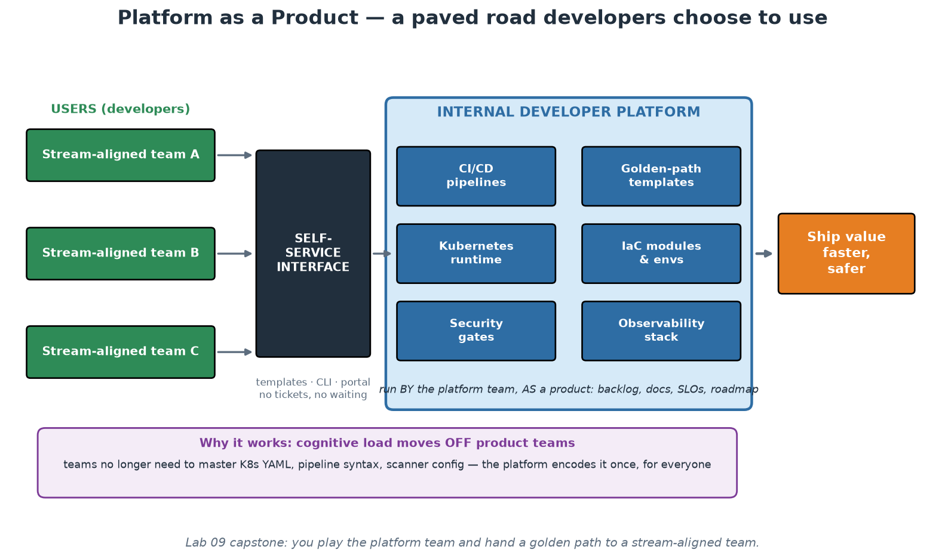
The Internal Developer Platform
A paved road developers CHOOSE - because it is genuinely the best way to ship.
Notes:
Anchor the module: an Internal Developer Platform is the productised sum of everything this course covered - templates, pipelines, runtime, IaC modules, security gates, observability - behind a self-service interface, so stream-aligned teams consume capabilities instead of building them. The product framing is the load-bearing idea: a platform has USERS (your developers), COMPETITORS (do-it-yourself, shadow IT, that one team that loves its own Jenkins), and it lives or dies by voluntary ADOPTION. The moment a platform must be mandated, it has failed as a product - mandates breed resentful compliance and workarounds; attraction breeds pull. Contrast the two failure modes participants have likely met: the rebranded ops team (a ticket queue with a new name - no self-service, no product thinking, just the old bottleneck) and the ivory-tower platform (built in isolation for a year, launched to users who never asked for it - Field of Dreams engineering). The healthy pattern, via Team Topologies' interaction modes from Module 2: COLLABORATE with two or three pilot teams to discover what is actually painful, productise that into X-as-a-Service, repeat. Cognitive load (Module 1) is the value proposition throughout: every capability the platform absorbs is capacity returned to product teams for their actual domain.

Slide 93
User-Centric Design for Internal Platforms
Your users are developers - so do real product discovery: interviews, journey maps, personas.
Measure the journey: time-to-first-deploy for a NEW team is the flagship UX metric.
Documentation IS the interface: quickstarts, copy-paste examples, honest error messages.
Golden paths (Spotify's term): the supported, delightful default - with escape hatches.
Start from the Thinnest Viable Platform; grow by demand, not by roadmap fantasy.
Notes:
Treat developers with the same UX seriousness a product team gives customers - it feels strange the first time and pays immediately. Discovery: interview teams about their path to production and map the journey (idea -> repo -> pipeline -> deploy -> observe); every wait, ticket and confusion point is a product opportunity - Module 1's cognitive-load pains, now itemised. Time-to-first-deploy is the flagship metric because it compresses the whole experience into one number a CTO understands: from 'new team formed' to 'hello-world serving in production' - weeks in ticket-driven organisations, minutes on a good platform (our capstone's golden path is a working miniature: template + pipeline + runtime, and participants time it). Documentation as interface is literal: for most consumers the platform IS its docs and templates - a capable platform with poor docs is, from the user's chair, a poor platform; invest accordingly (quickstarts over reference dumps, tested copy-paste examples, error messages that say what to DO next). Golden paths, Spotify's coinage: the blessed path is supported, maintained and delightful, but not a cage - teams can step off it, accepting they then own what they leave behind; escape hatches prevent the mandate failure mode. TVP (Team Topologies): start with the smallest platform that helps - maybe one great template and one pipeline - and let real demand pull the roadmap; platforms built big-bang from imagined requirements join the ivory-tower graveyard.

Slide 94
Deep Dive: Your Users Are Developers - Treat Them Like Users
Do real product discovery
  Interview delivery teams about their actual workflow - do not design from an architecture diagram.
  Map the journey from 'we need a new service' to 'it is serving traffic', and time every step.
  Build personas honestly: the experienced platform-native team and the team maintaining a 12-year-old system.
  Watch someone use your platform for the first time, in silence. It is uncomfortable and it is the best data you get.
Measure the journey, not the components
  Time-to-first-deploy for a NEW team is the flagship UX metric - end to end, including access and approvals.
  Instrument the funnel: aware -> tried -> running in production -> would recommend. Every drop-off is a defect.
  Count the steps a developer must perform, and the number of different systems they must touch.
  Ask what they did INSTEAD when they gave up - the workaround tells you what your product is missing.
Documentation IS the interface
  A quickstart that works, verbatim, in under 30 minutes - tested in CI like any other product feature.
  Copy-pasteable examples over prose descriptions; a working sample beats three pages of explanation.
  Honest, actionable error messages: what failed, why, and the exact next step.
  Test with a real newcomer each quarter: can they succeed unaided? If not, the platform failed, not the person.
Notes:
The mindset shift is the whole slide: platform teams that treat their output as infrastructure build things that are technically correct and unused, while teams that treat it as a product build things people choose. Push the discovery point hard, because engineers find it unnatural - interviewing colleagues about their workflow feels like overhead until the first session reveals that half the golden path is unused because of one confusing step. The silent-observation technique is worth recommending explicitly: watch a developer attempt the quickstart without helping them, and write down every place they hesitate. On measurement, time-to-first-deploy must be measured end to end including access requests and approvals, because that is what the user experiences - a platform that provisions in five minutes but sits behind a three-week access request has a three-week time-to-first-deploy. The documentation point deserves emphasis in an institution with strong documentation culture: the difference is that platform docs are a product surface, tested in CI, owned, and measured by whether newcomers succeed - not a deliverable that was completed once.

Slide 95
Deep Dive: Golden Paths and the Thinnest Viable Platform
What a golden path actually is
  The supported, opinionated, genuinely delightful default route for the most common service shape.
  Not the only way - the SUPPORTED way, with escape hatches that are documented and legitimate.
  It should be the fastest route to production, or teams will rationally go around it.
  One path per common shape (web API, batch job, data pipeline) - not one path for every conceivable need.
Start from the Thinnest Viable Platform
  The smallest thing that removes real pain for real teams - often a documented way plus one template.
  A wiki page that describes the one good way IS a platform, and it is a legitimate first version.
  Automate where the pain actually is, evidenced by the journey map - not where the architecture looks elegant.
  Grow by demand: the second team asking for the same thing is the signal to productise it.
Failure modes to avoid on purpose
  Building the complete platform before anyone uses it - two years of work, no users, no feedback.
  Copying a big tech company's platform without their scale, teams, or problems.
  Mandating adoption instead of earning it - producing compliance plus invisible shadow practice.
  Solving the platform team's interesting problems rather than the delivery teams' painful ones.
Notes:
Spotify's term 'golden path' is useful because it carries the right connotation - a route that is pleasant to walk, not a fence. Be precise that it is the supported way rather than the only way, and that escape hatches must be legitimate and documented, because an unofficial escape hatch is just shadow infrastructure with extra steps. The Thinnest Viable Platform idea, from Team Topologies, is the antidote to the most expensive failure mode in this space: a platform team disappearing for two years to build a comprehensive system that nobody asked for and nobody adopts. Give participants permission to start embarrassingly small - a documented standard way plus one working template is a real first version, and it produces feedback immediately. The 'copying big tech' warning is worth stating for this audience: the platforms published by very large technology companies solve the problems of hundreds of teams and enormous scale, and importing that design into an institution with a dozen delivery teams imports the cost without the benefit.

Slide 96
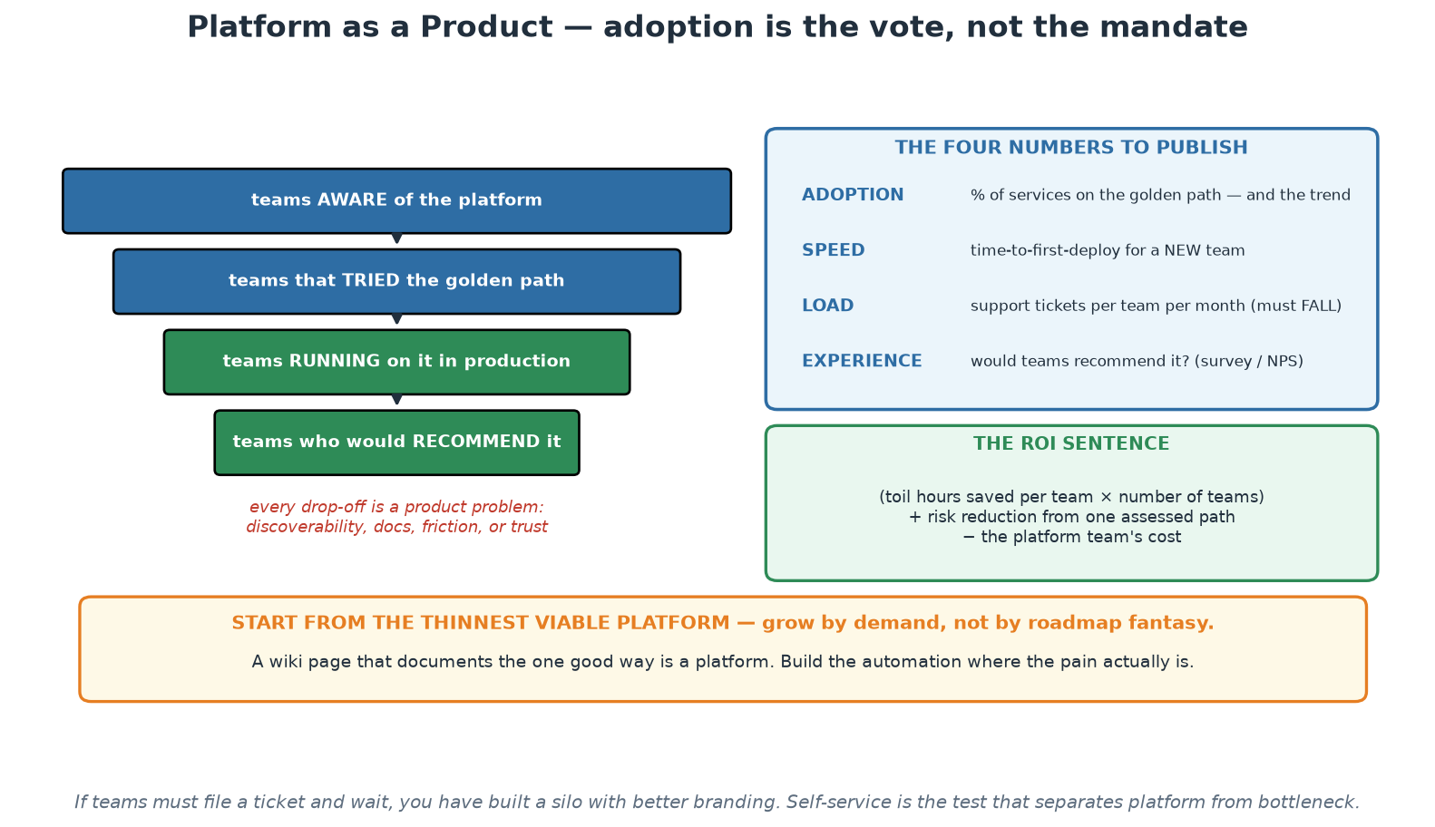
Platform as a Product
An adoption funnel, four published numbers, and the ROI sentence.
Notes:
The funnel is the frame: aware, tried, running in production, would recommend. Every drop-off between those stages is a product problem with a specific cause - discoverability, friction, documentation or trust - and locating the drop-off tells the platform team what to fix next, which is far more useful than a roadmap written from architectural preference. The four numbers on the right are what a platform team should publish every quarter, and the ROI sentence underneath is how the work gets funded. Close on the orange band: start from the thinnest viable platform, because the most expensive failure in this space is two years of building followed by no adoption.

Slide 97
In Context: Discovering What SARB Teams Actually Need
Where to look for the real pain
  Time a real change end to end with one team, marking every hour as work or wait (the Day 1 exercise).
  Count the systems a developer must touch to get a new service into a test environment.
  Ask what they built themselves because nothing existed - shadow tooling is a requirements document.
  Ask what they gave up on. The abandoned attempt is usually the most valuable story you will hear.
Likely first golden paths in this environment
  A standard internal web service or API: repository, pipeline, environments, dashboard, alerts.
  A scheduled batch or data-processing job with logging, retries, monitoring and evidence built in.
  A reporting or publication pipeline with validation, approval and an auditable release step.
  Pick the shape that the most teams need - the second team asking for the same thing is the signal.
Documentation as the interface, here specifically
  A quickstart that works verbatim, tested in CI, and reachable without asking anyone where it is.
  Explicit statements of what the path guarantees: which controls it satisfies, and what the team still owns.
  That control statement is what lets a team adopt the path without reopening the assurance conversation.
  Test it with a genuine newcomer each quarter: can they succeed unaided in one sitting?
Notes:
Discovery advice tailored to this environment: the pain in a supervised institution is rarely in writing code, it is in the surrounding process - environments, access, test data, approvals, evidence - so the value-stream timing exercise is the right instrument, and it produces numbers rather than opinions. The question about what teams built themselves is the most productive one in any platform interview, because shadow tooling is a precise statement of unmet need. On golden paths, note that a batch or data-processing path may serve more teams here than a web service path, which is a genuine difference from the typical technology-company platform and worth checking rather than assuming. The documentation point has a specific twist for this audience that is worth emphasising: the docs should state which institutional controls the path satisfies and what the consuming team still owns, because that statement is what allows a team to adopt without re-running the whole assurance conversation - and it is the single feature that most accelerates adoption in a regulated organisation.

Slide 98
Measuring Success and ROI
Adoption: % of services on the golden path - and the trend. Voluntary adoption is the vote.
Speed: time-to-first-deploy; DORA metrics OF CONSUMING TEAMS (the platform's real output).
Load: support tickets per team per month should FALL as self-service rises.
Experience: developer NPS / quarterly surveys - would they recommend the platform?
ROI story: (per-team toil hours saved x teams) + risk reduction vs platform team cost.
Notes:
A platform consumes real headcount, so it must demonstrate value in numbers leadership respects - give participants the funding conversation on one slide. Adoption is the honest north star precisely because your platform is optional: teams choosing the paved road is a continuous referendum on whether it is actually better than DIY; falling adoption is user feedback, not user disloyalty. Speed: measure DORA metrics (Module 3) of the TEAMS USING the platform - the platform's output is not its own uptime but its customers' delivery performance; if consuming teams do not deploy more often with fewer failures, the platform is decoration. Support load falling while adoption rises is the self-service proof - a rising ticket count means you built a ticket queue with extra steps. Developer NPS and lightweight quarterly surveys catch what metrics miss; the free-text answers are roadmap gold. The ROI arithmetic is simple enough for a slide and strong enough for a budget meeting: hours of infrastructure toil saved per team per month, times number of teams, priced at loaded cost - typically dwarfing a platform team's cost at even modest scale - plus the harder-to-price but very real risk term (one prevented breach or one halved recovery time). Close the loop with Module 9's warning label: measure the SYSTEM, never individuals, and never let platform metrics become team report cards - Module 3's gaming lesson applies doubly here.

Slide 99
Deep Dive: The Four Numbers Worth Publishing
ADOPTION - the honest vote
  Percentage of services on the golden path, and the trend over quarters.
  Voluntary adoption is the strongest signal a platform team can produce - people chose it.
  If adoption is mandated, measure SATISFACTION instead, because the choice signal is gone.
  Segment it: which kinds of team adopt, which do not, and what the non-adopters chose instead.
SPEED - the output that matters
  Time-to-first-deploy for a new team or service, measured end to end.
  The DORA metrics OF CONSUMING TEAMS - the platform's real output is their delivery performance.
  Compare adopters with non-adopters; the gap is your value proposition, in numbers.
  Track lead-time contribution: how much of a team's lead time is spent in platform-owned steps?
LOAD and EXPERIENCE
  Support tickets per team per month should FALL as self-service rises - a rising count is a product defect.
  Categorise tickets: each recurring category is a missing feature or a documentation failure.
  Developer satisfaction or NPS, surveyed quarterly, with the verbatim comments read by the whole team.
  Time-to-answer for platform support - the platform is production, and its users are waiting.
Notes:
The reason to publish these four numbers is that platform teams are chronically bad at demonstrating value and therefore chronically vulnerable at budget time. Adoption is the headline because it is the honest vote, and the nuance about mandated adoption matters in institutions that can compel usage: once you mandate, adoption stops being evidence of quality and satisfaction becomes the only trustworthy signal. The DORA-metrics-of-consuming-teams point is the conceptual core - a platform team produces no customer value directly, so its output is measured in what its users can now do, and the comparison between adopters and non-adopters is the most persuasive chart available. On load, reframe rising ticket volume correctly: it is not a sign of a busy, useful team, it is a sign that self-service is failing somewhere specific, and categorising tickets turns that into a roadmap. Recommend that the whole platform team reads the survey verbatims rather than a summary, because the summary always loses the sentence that changes someone's mind.

Slide 100
Deep Dive: Building the ROI Case
The arithmetic, stated plainly
  Toil hours saved per team per month × number of teams × loaded cost per hour.
  Plus risk reduction: one assessed path instead of N hand-built ones - fewer, and cheaper, assurance findings.
  Plus opportunity: capacity returned to product work, expressed in what that capacity delivered.
  Minus the platform team's fully loaded cost, including the infrastructure it operates.
Evidence that survives scrutiny
  Baseline BEFORE you build: time-to-first-deploy, setup steps, tickets, incident counts. You cannot re-measure the past.
  Use the journey map's timings as the before-picture, agreed with the teams themselves.
  Prefer conservative numbers you can defend over impressive ones you cannot.
  Report trends quarterly in the same format - consistency is what makes the story believable.
Framing that works in a regulated institution
  Lead with control uniformity and assurance cost, not developer happiness - it is the stronger argument here.
  One path assessed deeply beats forty assessed by sampling; that is a genuine risk reduction.
  Automated evidence lowers the cost of every audit cycle, permanently, for every consuming team.
  Then add the delivery numbers - they land better once the risk case has been accepted.
Notes:
The single most common mistake platform teams make is failing to baseline before they start, so say it early and firmly: measure time-to-first-deploy, the number of setup steps, ticket volume and incident counts BEFORE the platform exists, because you cannot reconstruct those numbers afterwards and without them every claim is an assertion. Agreeing the baseline with the delivery teams also makes the later comparison credible rather than self-reported. On the arithmetic, advise conservatism - a defensible modest number survives a finance review, while an impressive one invites a challenge that undermines the whole case. The framing section is specific to this audience and matters: in a supervised institution, the risk and assurance argument is stronger than the productivity argument, because it speaks to obligations the institution already carries, and it converts the platform from a cost centre into a control investment. Lead with that, then present the delivery numbers as the additional benefit.

Slide 101
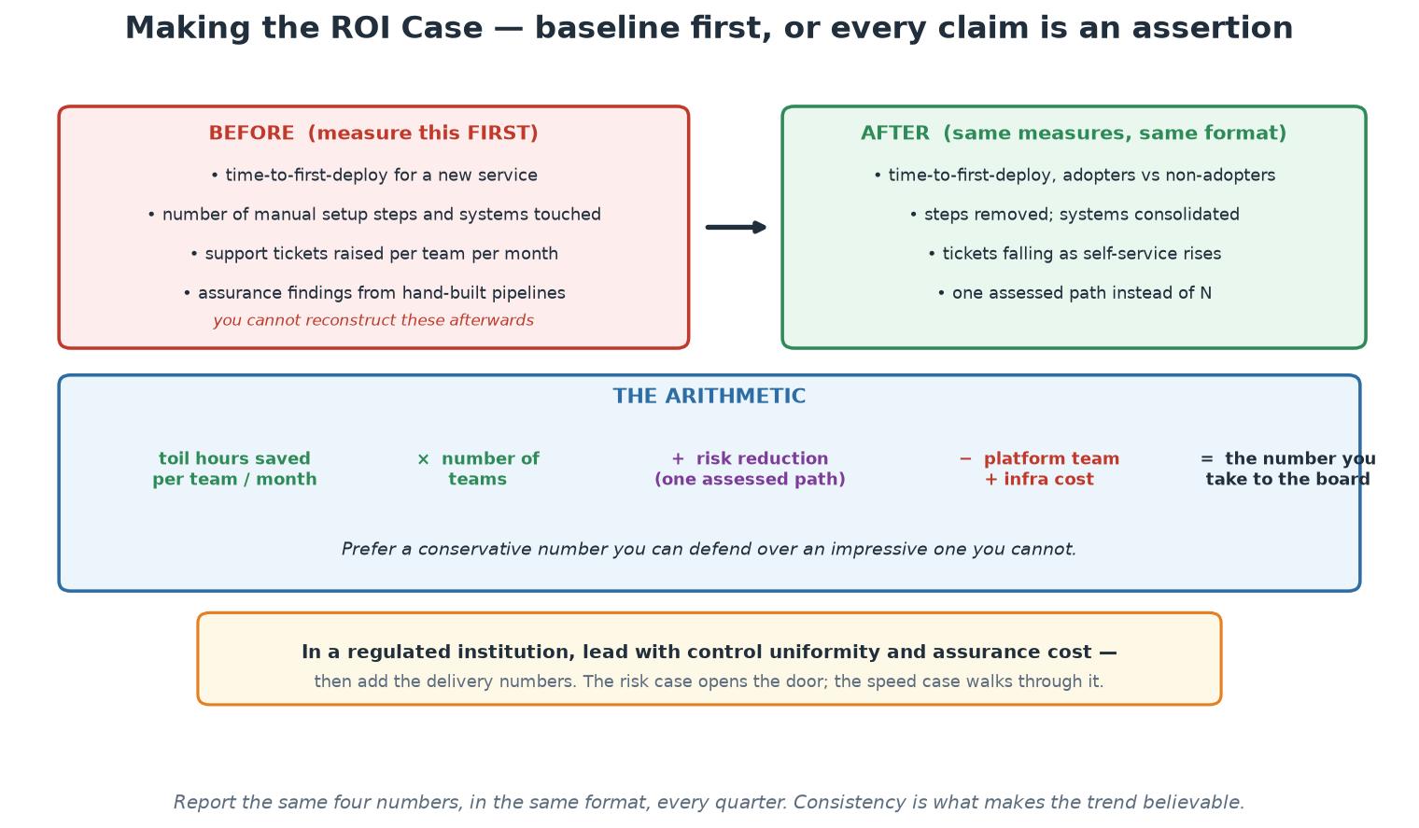
Baseline First, Then Prove It
You cannot reconstruct the before-picture afterwards - measure it while it still exists.
Notes:
The single most important instruction on this slide is the red panel: measure the before-picture now, because it cannot be reconstructed later and without it every subsequent claim is an assertion. Agreeing those numbers with the delivery teams themselves also makes the later comparison credible rather than self-reported. The arithmetic band is deliberately simple so it survives a finance conversation, and the advice to prefer a conservative defensible number over an impressive fragile one is worth repeating. Close on the amber band, which is the framing for this institution: lead with control uniformity and assurance cost, then add the delivery numbers - the risk case opens the door, and the speed case walks through it.

Slide 102
In Context: Proving Platform Value to a Central Bank
Numbers this institution will find persuasive
  Time-to-first-deploy for a new internal service, before and after - measured end to end, including access.
  Number of independently-built pipelines reduced to one assessed path - an assurance-scope reduction.
  Audit evidence produced automatically versus assembled by hand - hours saved every cycle, every service.
  Consistency: percentage of services meeting the security baseline, measured continuously rather than sampled.
Risk-framed benefits, stated in the institution's own terms
  Fewer distinct control implementations means a smaller assessment surface and fewer findings.
  Continuous evidence replaces point-in-time sampling - a genuine improvement in control assurance.
  Faster, rehearsed recovery paths reduce operational risk exposure in a measurable way.
  Reduced key-person dependency: the path is documented, automated and inspectable rather than remembered.
Keeping the story honest
  Report the same measures in the same format every quarter; consistency is what builds belief.
  Include what is NOT working - a platform report that is entirely positive is not read as credible.
  Segment by team so you can see who is not adopting and find out why, rather than averaging it away.
  Tie the numbers to decisions: what will you build next because of what this told you?
Notes:
Adapt the ROI argument to what this institution values. Delivery speed matters, but assurance scope and control consistency matter more to the people who approve budgets and carry the risk, so lead with them: reducing forty independently-built pipelines to one assessed path is a direct reduction in assessment surface, and continuous evidence replacing point-in-time sampling is a genuine improvement in control assurance rather than a productivity claim. The key-person dependency point also lands well here, because it is a risk category the institution already tracks in other contexts. On honesty, the advice to include what is not working is practical rather than moral: entirely positive internal reports are discounted by experienced readers, while a report that names its own gaps and shows the trend earns credibility - and credibility is what secures the next quarter's funding.

Slide 103
Operating Model - and What NOT to Build
Product-fund the platform (a team with a roadmap), not project-fund (a deliverable that 'ends').
The platform has SLOs and support hours - it is production, with customers.
Deprecation policy: versioned templates, migration windows, no rug-pulls.
Say NO deliberately: exotic needs stay with the teams that have them (escape hatch, not feature).
The platform team is a stream-aligned team whose product is the platform.
Notes:
Operating-model failures kill more platforms than technical ones - four traps and their answers. Funding: a project-funded platform 'finishes', its team disbands, and the artifact rots into the legacy it was meant to replace; product funding (a standing team, a roadmap, ongoing discovery) matches the reality that a platform is never done. Production discipline: the platform sits under every team's delivery path, so it needs SLOs (Module 8, applied to yourself), an on-call story, and honest support hours - a platform that goes dark at 17:00 while its consumers are on call is not a product, and eating your own dog food here builds credibility faster than any roadshow. Deprecation: platform churn is a tax on every consumer, so version templates, announce windows, provide migration tooling - trust, once rug-pulled, does not return. Saying no is a product skill: the platform serves the COMMON 80% brilliantly; the exotic 20% uses the escape hatch and owns its choice - a platform that chases every request becomes an unmaintainable everything-store (this is canvas box 9, and it is the box groups struggle with most, which is exactly why it is there). EXERCISE NOW (25 min + debrief, instructor/platform-canvas.md): groups design a platform for an organisation someone at the table knows - then present in two minutes; debrief on boxes 8 and 9, and on whether developers would CHOOSE their platform.

Slide 104
Deep Dive: Fund It and Run It Like a Product
Product funding, not project funding
  A project ends, hands over a deliverable, and the team disperses - leaving an unmaintained platform.
  A product is funded continuously, has a roadmap, an owner, and improves in response to users.
  Platforms decay faster than most software: dependencies move, clusters upgrade, needs change.
  If the funding model cannot support a standing team, build something smaller that a standing team can keep.
The platform is production - with customers
  It needs its own SLOs, monitoring, on-call and incident process. When it is down, every team is blocked.
  Publish support hours and response expectations - and meet them, because trust is the product.
  Run change management on the platform itself: your users experience your outages as their outages.
  Communicate proactively: planned changes, deprecations and incidents, in a channel users actually read.
Deprecation without rug-pulls
  Version everything teams depend on: templates, modules, pipeline workflows, base images.
  Announce deprecation with a real migration window, migration guidance and, ideally, automated migration.
  Never change shared behaviour silently - one surprise breakage costs more trust than a year of good work.
  Track who is on which version, so you know exactly who a change affects before you make it.
Notes:
Funding model is the structural point that decides whether a platform survives, so make it explicit: project funding produces a deliverable and then leaves it to rot, and a rotting platform is worse than none because teams built on it. If the institution genuinely cannot fund a standing team, the right response is to build something smaller and more durable rather than a large system with no maintainer - that is honest engineering advice, not defeatism. The 'platform is production' framing is the one that changes behaviour inside the platform team: their outages are everyone's outages, so they need the same SLOs, alerting, on-call and change discipline they are advocating to everyone else, and nothing damages credibility faster than a platform team that does not practise its own advice. On deprecation, the versioning and migration-window discipline is what preserves trust over years: teams will accept change they can plan for, and will not forgive silent breakage. The knowledge of who is on which version is the operational prerequisite for all of it.

Slide 105
Deep Dive: Saying No, and the Team's Place in the Org
Say NO deliberately - it is a product skill
  Every exotic request served becomes permanent surface area the platform must maintain forever.
  The test: how many teams need this? One team's unique need belongs with that team, via the escape hatch.
  Offer the alternative rather than a flat refusal: here is the escape hatch, here is what you take on.
  A platform that says yes to everything becomes an unmaintainable custom-integration department.
Where the platform team sits
  It is a stream-aligned team whose stream is the platform, and whose users are internal delivery teams.
  Interaction with teams evolves: collaborate while discovering, then X-as-a-Service once the path exists.
  A platform stuck in permanent collaboration mode has not productised; one that never collaborated built the wrong thing.
  It is NOT the team that deploys everyone's code - that is the third-silo anti-pattern from Day 1.
Staffing and skills that make it work
  Needs product skills as much as engineering: discovery, prioritisation, documentation, communication.
  Needs enough operational depth to run production infrastructure credibly.
  Rotate delivery engineers through it - the best user research is a former user on the team.
  Accept contributions (InnerSource) so the platform can grow faster than its own headcount.
Notes:
Saying no is the skill that separates a sustainable platform from an internal consulting queue, and engineers generally find it uncomfortable, so give them the framing and the language: every accepted exotic request is permanent maintenance surface, the test is how many teams share the need, and the answer is not a refusal but a redirection to the documented escape hatch with a clear statement of what the team then owns. On organisational placement, reuse the Team Topologies vocabulary from Day 1 and stress the evolution of interaction modes - close collaboration while discovering what teams need, moving deliberately to a self-service relationship once the path exists. Repeat the anti-pattern one final time because it is the most consequential structural mistake in this whole course: a platform team that deploys everyone's code is the wall of confusion rebuilt with better tooling. On staffing, the product-skills point is worth arguing for in an engineering-heavy institution - a platform team without someone doing discovery, prioritisation and documentation will build technically excellent things that nobody adopts, and InnerSource is how the platform grows beyond the headcount it will realistically be given.

Slide 106
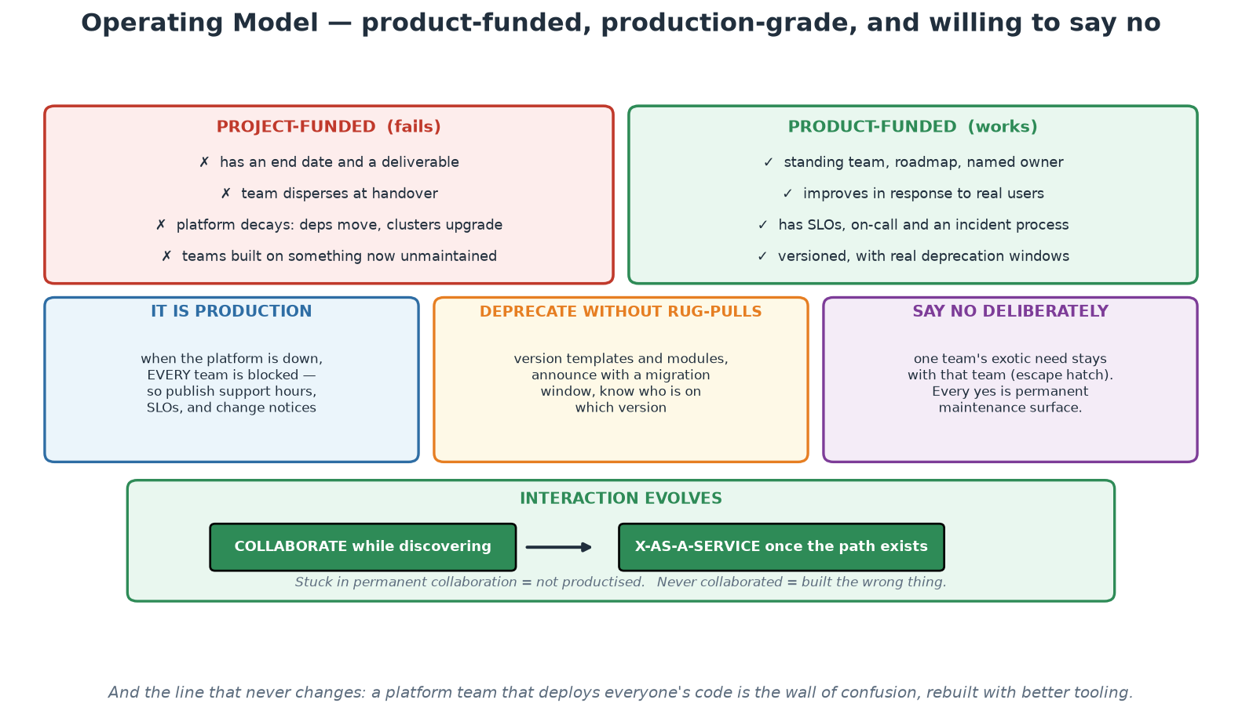
Funding, Running and Evolving the Platform
Product-funded, production-grade, deprecating carefully, and willing to say no.
Notes:
The left/right comparison at the top is the structural decision that determines whether a platform survives: project funding produces a deliverable and then leaves it to decay, while product funding sustains a team that keeps it alive. The three middle panels are the operating disciplines - the platform is production, deprecation needs versioning and migration windows, and saying no is a product skill rather than unhelpfulness. The bottom band is the Team Topologies point: the relationship with each team should evolve from collaboration during discovery to a self-service relationship once the path exists, and being stuck at either end is a diagnosable failure. Close on the footnote - a platform team that deploys everyone's code has rebuilt the wall with better tooling.

Slide 107
In Context: A Platform Operating Model That Fits SARB
Funding and mandate
  Fund it as a standing product team with an owner and a roadmap, not as a time-boxed project.
  Give it an explicit mandate covering the golden paths, and an explicit list of what it will NOT own.
  Include the assurance relationship in the mandate: the platform maintains the agreed control mapping.
  If a standing team cannot be funded, build something smaller that a small team can genuinely sustain.
Running it as production
  SLOs, monitoring, on-call and an incident process for the platform itself - its outages are everyone's outages.
  Published support hours and response expectations, and a change calendar users can see.
  Versioned templates and modules with real migration windows - never silent breaking changes.
  Its own disaster-recovery position: if the pipeline and registry are unavailable, what can still be deployed?
Relationship with the rest of the institution
  Collaborate closely while discovering; move deliberately to self-service once the path is proven.
  InnerSource so delivery teams can contribute capability instead of queueing for it.
  Rotate engineers through the platform team - former users make the best platform product decisions.
  And keep the test in view: if teams file tickets and wait, it is a silo, whatever the org chart calls it.
Notes:
Three points specific to this institution. First, the mandate should state what the platform will NOT own as clearly as what it will, because in an organisation with many specialised departments an unbounded platform mandate becomes an internal consulting queue within a year. Second, the disaster-recovery question for the platform itself is one almost nobody asks and this audience will appreciate: if the pipeline, registry or cluster control plane is unavailable during an incident, what can still be deployed, and by what route? That question deserves a documented answer, and rehearsing it is a legitimate resilience exercise. Third, the assurance relationship belongs in the mandate: the platform team maintaining the agreed mapping between institutional standards and enforced controls is what allows every consuming team to inherit an accepted control position, and it is arguably the platform's single most valuable output in a supervised environment.

Slide 108
Module 10
Hands-On Workshops
Notes:
This module IS the hands-on core of the course, exactly as the outline promises: a basic DevOps pipeline, a microservice built and deployed, and IaC implemented - all on the participant's Ubuntu VM, all on localhost, tied together by the capstone golden path.

Slide 109
The Three Workshops - Map
W1 (Day 1 pm): Setting up a basic DevOps pipeline - GitHub Actions: test, build, scan+gate.
W2 (Day 2 am): Building and deploying a microservice - Docker -> Compose -> Kubernetes.
W3 (Day 2 pm): Implementing IaC - Terraform init/plan/apply/destroy + drift, on local Docker.
Same application throughout: the order+payment services you know from the demos.
Finale: the capstone runs all three as ONE golden path (workshops/ folder has the guides).
Notes:
Set expectations before the first workshop: these three blocks are where theory becomes muscle memory, and they use one continuous application so context never resets. Workshop 1 realises Module 5: participants copy the CI workflow into place, read it critically (job graph, permissions, pinned actions, the report-vs-gate Trivy pair), run it locally with act (act -l, then job by job, then the whole graph), deliberately make the security gate fail and restore it, and watch it go green - Day 1 ends with a working pipeline on every participant's VM, which matters emotionally as much as technically. Pushing it to GitHub is an optional extra part for anyone with an account. Workshop 2 realises Module 6 end-to-end: build the image and inspect its layers, compose the two-service stack and watch service discovery work, then kind-deploy with probes and limits, scale, roll forward, roll back - the complete container journey in one morning. Workshop 3 realises Module 4: the full Terraform loop against local Docker including the drift experiment, plus the Ansible idempotence bonus - and the explicit read-through of what changes for cloud (one provider block). Timing guidance for the instructor: each workshop guide (workshops/ folder) marks a core path sized to fit the slot and stretch parts for fast finishers; insist on the verification checklists - done means checked, not time elapsed.

Slide 110
Deep Dive: What Each Workshop Proves
W1 - a basic DevOps pipeline (Day 1 afternoon)
  Build: GitHub Actions workflow triggered by a pull request - test, build the image, scan, gate.
  Proves: automated verification on every change, and the difference between a report and a real gate.
  Concepts made real: small batches, fast feedback, build-once, least-privilege tokens, pinned actions.
  Transfers to: any CI engine - the job graph, gates and artefact promotion are universal.
W2 - build and deploy a microservice (Day 2 morning)
  Build: Dockerfile -> Compose stack -> Kubernetes manifests on a local kind cluster.
  Proves: the same artefact runs everywhere, and the orchestrator heals and rolls back on command.
  Concepts made real: twelve-factor config, probes, limits, Services, rolling update and rollback.
  Transfers to: any conformant Kubernetes - the API and manifests are identical on managed clusters.
W3 - infrastructure as code (Day 2 afternoon)
  Build: Terraform against the local Docker provider - init, plan, apply, drift, destroy.
  Proves: declarative infrastructure, plan-as-review, state as the map of reality, drift detection.
  Concepts made real: idempotence, immutability, blast radius, the plan diff as change evidence.
  Transfers to: any provider - swap the provider block; the workflow does not change.
Notes:
Set the workshops up by saying what each one PROVES rather than what participants will type, because the typing is in the guide and the proving is what they take home. One application runs through all three - the order and payment services from the demos - which is deliberate: by the end of Day 2 participants have taken a single service from source, through a pipeline, into a container, onto an orchestrator, with its infrastructure declared as code, which is the whole DevOps loop walked once with their own hands. Emphasise the transfer statement in each block, because that is the answer to 'this is a local toy' - the pipeline concepts, the Kubernetes API and the Terraform workflow are the same at any scale and on any provider. Mention that the capstone at the end runs all three as a single golden path, which is the module 9 idea made concrete: a new service reaching production through one assessed route. Point participants at the workshops folder for the guides and the troubleshooting tables before they start.

Slide 111
Deep Dive: How to Work Through Them
Working method
  Read the whole exercise first, then start - the context makes the individual steps make sense.
  Type the commands rather than pasting them where you can; muscle memory is part of the point.
  When something fails, READ the error before searching - the message is usually the answer.
  Check the troubleshooting table in the workshop guide next; the common failures are already documented.
The three-then-me rule
  Stuck? Ask three neighbours before you ask the instructor - explaining the problem often solves it.
  Struggling is not a sign the material is too hard; it is where the learning actually happens.
  Pair up if you prefer - one drives, one navigates, swap at each checkpoint.
  If you finish early, help someone else; teaching it is the strongest way to retain it.
Afterwards
  Keep everything: the repo runs on any Ubuntu 24.04 machine via the setup script, at no cost.
  Re-run the capstone unaided within two weeks - the second, unassisted repetition is what makes it stick.
  Then rebuild it for something in your own environment, starting with a low-criticality internal service.
  Record what you had to add for your institution - that list is the start of your own golden path.
Notes:
This slide is facilitation, so keep it brief in the room and let it do its work in the deck. The read-first instruction genuinely matters: participants who dive into step one without context ask far more questions about why they are doing something. The three-then-me rule protects the instructor's attention and, more importantly, builds the habit of explaining a problem out loud, which resolves a surprising share of them. Be explicit that struggling is expected and is the point - in a room of senior people there is real reluctance to appear stuck, and naming that up front makes the afternoon far more productive. The 'afterwards' section is the highest-value part: retention comes from the second, unaided repetition, so ask participants to diary an hour within two weeks to re-run the capstone from scratch. And the last line sets up their real work - the list of what they had to add for their own environment (identity, zoning, evidence, approvals) is the first specification of their institution's own golden path.

Slide 112
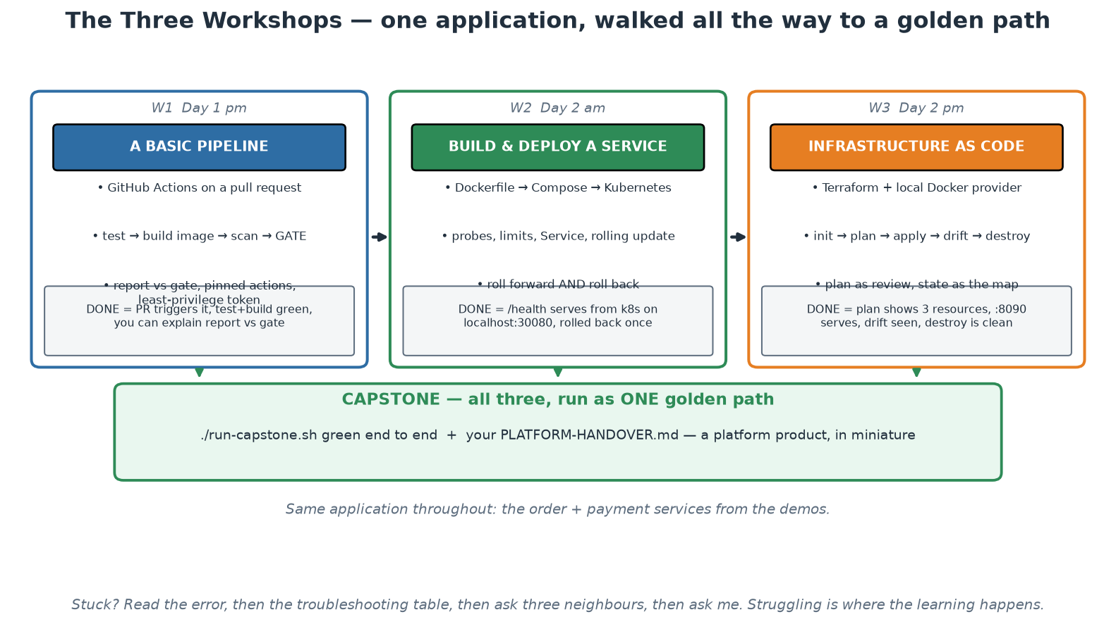
The Three Workshops and the Capstone
One application, three workshops, one golden path at the end.
Notes:
Use this as the map for the rest of the course. Each column states what participants build, the concepts it makes real, and the explicit success criterion - and the criteria are deliberately observable, because 'done' in this course means demonstrable rather than 'I ran the commands'. The arrows into the capstone are the point: the three workshops are not separate exercises but the three halves of one delivery path, assembled at the end into something that resembles a golden path with a handover document. Remind the room of the working method in the footnote before they start - read the error, check the troubleshooting table, ask three neighbours, then ask you.

Slide 113
In Context: Mapping the Workshops to Your Own Estate
As you work, keep a second list
  For every step, note what your own environment would additionally require - access, zoning, approval, evidence.
  That list is the gap between this lab and your institution's first real golden path.
  It is also the agenda for your first conversation with risk, security and audit colleagues.
  Two participants doing this for different departments will produce a strikingly similar list.
Candidate first services back at work
  Internal, low-criticality, changed reasonably often, with a team willing to try it.
  Avoid anything on a settlement, publication or supervisory-deadline path for the first attempt.
  Prefer a service where you already control the repository, the pipeline and the target environment.
  Success here buys the mandate for the second, more consequential one.
What to capture for the handover
  What the path does automatically, and which institutional controls that satisfies.
  What the consuming team still owns - explicitly, so nothing falls between the two.
  How to run it, how to roll back, and who to call when it misbehaves.
  What you would build next, and why - the beginning of a platform roadmap.
Notes:
This slide turns the workshops from an exercise into preparation for real work. The second list - what your own environment would additionally require at each step - is the single most useful artefact participants can produce today, because it converts a vague sense that 'this would be harder at work' into a specific, discussable inventory: identity integration, network zoning, masked test data, change records, evidence retention, approval gates. Encourage them to write it in the margin as they go rather than trying to reconstruct it afterwards. The candidate-service guidance is deliberately conservative, and worth saying plainly: the first attempt should not be on a critical path, both because the risk is unnecessary and because the conversation with assurance colleagues is far easier when the stakes are low and the evidence is real. The handover capture list is what makes the difference between a personal experiment and something the institution can build on.

Slide 114
Workshop Success Criteria
W1 done = PR triggers pipeline; test+build green; you can explain report vs gate.
W2 done = /health serves from Kubernetes on localhost:30080; rolled forward AND back.
W3 done = plan shows 3 resources; apply serves on :8090; drift detected; destroy leaves nothing.
Capstone done = ./run-capstone.sh green end-to-end + your PLATFORM-HANDOVER.md.
Struggling is the point - use the troubleshooting tables, then ask three, then ask me.
Notes:
Publish the definition of done up front so nobody optimises for 'got to the end of the page'. Each criterion is testable by the participant themselves - the pipeline is green or it is not, localhost:30080 answers or it does not, terraform destroy leaves zero tf- containers or it does not - which mirrors the whole course's philosophy: verification is automated, not vibes. The capstone at Day 2's end is the integration test of the human, not just the system: running the golden path script exercises every workshop's material in sequence (tests -> images -> scan -> cluster -> deploy -> smoke test), and the PLATFORM-HANDOVER.md document forces the platform-as-product thinking of Module 9 into writing. The last bullet sets lab culture deliberately: hitting errors is designed-in learning, the troubleshooting tables in each guide resolve the common 90%, the ask-three-before-me rule builds peer debugging habits, and instructors circulate rather than lecture. Fast finishers take the stretch goals (they are real: GHCR push, ingress, Terraform modules) rather than idling.

Slide 115
Deep Dive: Done Means Verified, Not Finished
Why explicit criteria matter
  'Done' in this course means an observable, verifiable outcome - not 'I ran all the commands'.
  This mirrors the professional discipline: a deploy that 'succeeded' but serves errors has not succeeded.
  Each criterion is something you can demonstrate to a colleague in under a minute.
  If you cannot demonstrate it, something is genuinely not working - and finding out now is the point.
The checks, and what each one proves
  W1: a PR triggers the pipeline, test and build are green, and you can explain report versus gate in your own words.
  W2: /health responds from Kubernetes on localhost:30080, and you rolled forward AND back.
  W3: plan shows 3 resources, apply serves on :8090, drift is detected, destroy leaves nothing behind.
  Capstone: run-capstone.sh is green end to end, and your PLATFORM-HANDOVER.md is written.
The handover document is the real deliverable
  Writing down what you built, how to run it and what it guarantees is the platform-as-product skill.
  It is also the artefact you can show a colleague, a manager or an auditor back at work.
  Keep it short and honest: what works, what does not, what you would do next.
  A capstone that runs but is undocumented is a demo; documented, it is a platform.
Notes:
The pedagogical point behind explicit success criteria is that they replace the vague feeling of having finished with a demonstrable outcome, and they mirror exactly the discipline the course teaches - a smoke test after deployment, because a green pipeline is not proof that anything serves. Encourage participants to actually run the checks and, better, to demonstrate them to a neighbour, which catches the case where something appears to work only in the participant's own terminal history. Give particular attention to the handover document in the capstone: it is the artefact that turns a working setup into a product, it is the deliverable they can show their own organisation, and writing it is the skill Module 9 has been arguing for all afternoon. Encourage brevity and honesty - what works, what does not, what is next - because an honest one-page handover is more useful and more credible than an aspirational ten-page one.

Slide 116
In Context: What 'Done' Should Mean Back at Work
Carry the verification habit home
  A pipeline that is green is not proof - a smoke test against the deployed thing is.
  A backup that exists is not proof - a timed restore is.
  A policy that is written is not proof - a build it actually failed is.
  A runbook that exists is not proof - someone unfamiliar completing it unaided is.
What to demonstrate to your own stakeholders
  Show the pipeline failing on purpose, then passing - controls are more convincing when seen to bite.
  Show a rollback performed live, and state the measured time it took.
  Show the evidence trail: commit, review, approval, scan result, artefact digest, deployment record.
  Show the drift detection reporting a manual change - that one lands with auditors immediately.
Write it down while it is fresh
  Your handover document is the deliverable, not the running system - systems without documents do not transfer.
  Short and honest: what works, what does not, what you would do next.
  Include the gap list from the previous slide - it makes the next conversation concrete.
  Then diary an hour within two weeks to run the whole thing again, unaided.
Notes:
The verification habit is the durable skill in this course, so state it in the four forms on the slide - green is not proof, a backup is not proof, a written policy is not proof, an existing runbook is not proof. Each pair names a specific complacency that causes real incidents. The demonstration advice is practical politics: technical stakeholders and assurance colleagues are far more convinced by seeing a gate fail and then pass, a rollback timed live, and drift detection catching a manual change, than by any slide describing those capabilities. Encourage participants to prepare exactly those three demonstrations for their own organisation. Close by pushing the handover document and the diarised unaided repetition, because those two habits are what determine whether this course produces a changed practice or a pleasant memory.

Slide 117
Module 11
Summary and Next Steps
Notes:
Close the course deliberately: recap what was built, hand participants a learning roadmap, and make the first week back at work concrete.

Slide 118
What You Built in Two Days
A microservice tested, containerised and orchestrated (demos + Workshop 2).
A CI pipeline with a real security gate (Workshop 1).
Infrastructure declared as code, with drift detection (Workshop 3).
A Kubernetes deployment with probes, limits and rolling updates - rolled back on command.
Policies, scans, dashboards, an SLO - and one survived incident (module demos).
A golden path handed over as a platform product (capstone).
Notes:
Walk the list slowly - this is the payoff slide. Every item ran on the participant's own VM and every artifact is in the course repository they keep. Invite one or two participants to say which module or workshop changed how they think about their current work.

Slide 119
Deep Dive: The Loop You Walked, End to End
Plan and code -> build and test
  Version control as the single source of truth, with change proposed and reviewed as a pull request.
  A pipeline that runs on every change: tests, build, scan, gate - feedback in minutes, not weeks.
  One immutable, SHA-tagged artefact produced once and promoted unchanged.
  Concepts proven: small batches, fast feedback, build-once-promote-many, report versus gate.
Package and run
  A twelve-factor service containerised with a multi-stage build, running as non-root.
  Deployed to a real Kubernetes API with probes, resource limits, a Service and a rolling update.
  Rolled forward and rolled BACK on command - recovery demonstrated, not assumed.
  Concepts proven: portability, disposability, reconciliation, blast-radius thinking.
Secure, observe, operate - and hand over
  Infrastructure declared in Terraform, with plan-as-review, drift detection and clean destroy.
  Policy as code, image and IaC scanning wired into the path, gated on what is fixable.
  Metrics, a dashboard, an SLO, an alert - and one incident survived in the game day.
  All of it assembled as ONE golden path, documented in your handover: a platform product, in miniature.
Notes:
Close the course by making the achievement concrete, because participants routinely under-estimate what they covered. Walk the loop in the same order as the Day 1 infinity-loop diagram and name the module each piece came from - it converts two days of separate exercises into one coherent story they can retell to a manager. The line worth saying out loud: in two days they took a service from source to production through an automated, scanned, policy-checked, observable, reversible path, and then documented it as a product. That is the full DevOps loop, and most organisations take a year to assemble it for the first time. Emphasise the rolled-back and survived-an-incident items specifically, because recovery demonstrated is the difference between a demo and a capability. Then set up the last two slides: what to learn next, and what to do in week one.

Slide 120
Deep Dive: What Transfers, and What You Must Still Add
Transfers directly to your workplace
  The workflow and its discipline: propose, review, verify automatically, promote, observe, roll back.
  Pipeline concepts across any engine; Kubernetes API skills on any conformant cluster.
  Terraform's plan/apply/state/module workflow against any provider.
  The reasoning: batch size, gates that are trusted, SLOs and error budgets, blameless learning.
You must still add, in your own environment
  Identity, access model, network zoning and whatever segmentation your environments require.
  Data protection in practice: classification, masked or synthetic test data, retention rules.
  Change records and evidence retention wired into the pipeline instead of assembled by hand.
  Availability expectations and windows that the institution genuinely cannot move.
The bridge between the two
  Prove the pattern on a low-criticality internal service first - never on a critical path.
  Bring evidence, not enthusiasm, to your risk, security and audit colleagues: a working path they can inspect.
  Agree the control mapping once, then reuse it for every subsequent service on that path.
  That agreed path IS your institution's first golden path - and Module 9 told you how to run it as a product.
Notes:
Honesty about the gap is what makes the course useful rather than inspiring. Be explicit that the labs deliberately omit the institutional wrapping - identity, zoning, classification, evidence, windows - and that adding it is the real work waiting for them. Then give the bridge, which is the most actionable advice in the closing module: prove the pattern end to end on something genuinely low-risk, then take the working artefact to the colleagues who own control assurance and agree the mapping once. Teams that argue from principle spend months in meetings; teams that arrive with a running pipeline, a reproducible environment, automatically generated evidence and a demonstrated rollback have a much shorter conversation. Note that the mapping, once agreed, is reusable for every subsequent service - which is exactly why the golden-path idea compounds, and why the platform framing from Module 9 is the right way to run it.

Slide 121
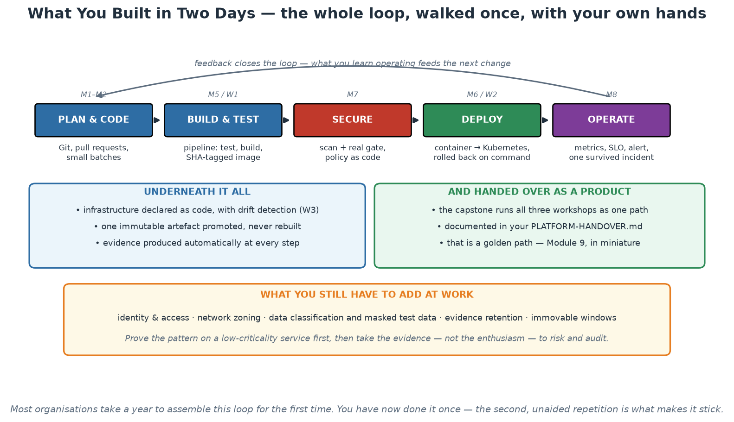
The Loop You Walked
Plan, build, secure, deploy, operate - once, end to end, with your own hands.
Notes:
Walk the loop and name the module and workshop behind each step, so two days of separate exercises become one coherent story participants can retell. Emphasise the two items people undersell: they rolled a deployment back on command, and they survived a deliberately induced incident - recovery demonstrated rather than assumed, which is the difference between a demo and a capability. The amber band at the bottom is the honest part, and it should not be skipped: identity, zoning, data classification, evidence retention and immovable windows are the institutional wrapping this lab deliberately omitted, and adding them is the real work waiting at home. Finish on the advice in the band - prove the pattern on something low-criticality, then bring evidence rather than enthusiasm to the assurance conversation.

Slide 122
In Context: Turning Two Days Into an Institutional Capability
What one person can start alone
  Baseline your own team's deployment frequency and lead time - no permission needed.
  Add a real gate to one pipeline you already own, starting narrow so it is trusted.
  Write one ADR and run one blameless review after the next incident.
  Automate one repeated manual task, finish it completely, and time the before and after.
What needs two or three people
  An end-to-end proof on one low-criticality service: pipeline, IaC, scan, deploy, dashboard, rollback.
  The control mapping conversation with risk, security and audit - bring the working thing, not a proposal.
  A shared base image or pipeline template that a second team can reuse without asking you.
  A short written record of the pattern so the next team does not start from zero.
What needs institutional backing
  A standing platform team with a product mandate and funding.
  Shared services operated once: registry, secrets, observability, runners, environments.
  An agreed control mapping that every service on the path inherits.
  Consistent measurement across value streams, reported like any other operational indicator.
Notes:
This slide answers the question that determines whether the course changes anything: what can I actually do, given my position? The three tiers are deliberate. Almost everyone in the room can do everything in the first column alone, this month, without asking permission - and the baseline in particular costs nothing and changes every later conversation. The second column needs a small coalition and produces the artefact that unlocks the third: a working, evidenced, low-risk implementation that assurance colleagues can inspect. The third column needs leadership backing, and the way to get it is not a proposal document but the evidence produced by the second column plus the measurements from the first. Say that sequence explicitly, because the common failure is to start at the third tier with a strategy paper, which stalls, rather than at the first tier with a measurement, which compounds.

Slide 123
Continuing the Journey
Kubernetes: CKAD / CKA certifications; kind and minikube for practice.
IaC: HashiCorp Terraform Associate; Ansible for configuration management.
CI/CD: GitHub Actions docs and the act local runner you already installed.
Reading: Accelerate (DORA), Team Topologies, The Phoenix Project, Google SRE books (free online).
Communities: platformengineering.org, CNCF projects, local DevOps meetups.
Notes:
Participants keep the slides, the labs and the sample application - everything reruns on any Ubuntu 24.04 machine via lab-setup/install-ubuntu24.sh. Encourage them to re-run the capstone from scratch within two weeks; retention comes from the second unaided repetition. The reading list is ordered deliberately: Phoenix Project for narrative buy-in (give it to managers), Accelerate for the evidence, Team Topologies for org design, SRE books for depth on Module 8.

Slide 124
Deep Dive: A Sequenced Learning Path
Next 30 days - consolidate what you have
  Re-run the capstone from scratch, unaided, on a clean VM. The second repetition is what makes it stick.
  Read Accelerate (Forsgren, Humble, Kim) - it is short, evidence-based, and it arms you for the conversations.
  Practise Kubernetes daily in small doses with kind or minikube; kubectl fluency comes from repetition.
  Write one ADR and one blameless postmortem in your real work - the habits matter more than the tools.
Next 90 days - go deeper where you will actually work
  Kubernetes: CKAD if you deploy applications, CKA if you will operate clusters.
  IaC: HashiCorp Terraform Associate, plus Ansible for configuration management on existing estates.
  CI/CD: your own engine's documentation end to end, and the act runner for local iteration.
  Observability: instrument one real service with OpenTelemetry and build one honest SLO.
Beyond - the books and communities that repay the time
  Team Topologies for org design; The Phoenix Project for the narrative to hand a manager.
  The Google SRE books - free online, and the definitive treatment of SLOs and error budgets.
  platformengineering.org, CNCF project documentation, and local DevOps or SRE meetups.
  Follow the annual DORA State of DevOps report - it is the evidence base that keeps updating.
Notes:
Sequence the advice rather than listing resources, because an unordered list of twenty things produces no action. The 30-day items are deliberately small and habit-forming, and the most important one is the unaided repetition of the capstone - retention research and everyone's experience agree that the second, unassisted run is where the material moves from recognition to capability. Recommend Accelerate first among the books because it is short and because it gives participants evidence rather than opinion when they are challenged internally, and The Phoenix Project as the one to hand to a sceptical manager because it works as a story. Steer certification advice by role: CKAD for people deploying applications, CKA for those who will operate clusters, and be honest that certifications demonstrate baseline knowledge rather than capability. The observability item - instrument one real service and set one honest SLO - is the single highest-value 90-day action for most participants, because it changes how their team talks about reliability.

Slide 125
In Context: Building Depth Where This Institution Needs It
Skills this environment will reward most
  Reliability engineering: SLOs for time-bound obligations, error budgets, incident practice.
  Policy as code and automated evidence - the intersection of engineering and assurance is scarce and valuable.
  Data-aware delivery: masked test data, classification, retention, and pipelines that respect them.
  Resilience engineering: rehearsed recovery, failover, and capacity for known peaks.
Learn together, not alone
  Start an internal community of practice - a monthly hour to share what worked and what did not.
  Publish internally: a short write-up of your first pipeline is worth more to colleagues than any external blog.
  Pair across departments; the second team to try something goes far faster than the first.
  Bring risk, security and audit colleagues into the community - shared understanding beats negotiation.
External anchors worth the time
  The DORA State of DevOps reports for evidence that keeps updating.
  The Google SRE books for SLOs, error budgets and incident practice - free online.
  Team Topologies for org design, and platformengineering.org for the platform conversation.
  Vendor-neutral standards: OpenTelemetry, OCI, SLSA - they outlast individual products.
Notes:
Point participants at the skills this specific environment rewards, which are not always the ones that get the most attention online: reliability engineering for time-bound obligations, policy as code and automated evidence, data-aware delivery, and rehearsed recovery. The intersection of engineering and assurance is genuinely scarce and is where someone in this institution can become disproportionately valuable. The community-of-practice advice is the highest-leverage item on the slide, because a single trained person usually reverts to the surrounding norms while a small group changes them - and explicitly including risk, security and audit colleagues in that community turns the most common source of friction into shared context. On external material, steer toward the evidence base and the vendor-neutral standards, since those retain their value as products come and go.

Slide 126
Your First Week Back at Work
Pick ONE painful manual path and automate it end to end - small and finished beats big and abandoned.
Add a real gate to an existing pipeline: tests or a fixable-critical scan.
Write the first blameless postmortem after your next incident - and share it.
Measure a baseline: your team's deployment frequency and lead time this month.
Start the platform conversation: which golden path would help the most teams?
Notes:
End with commitments: ask each participant to write down the one action they will take in the first week and share it with the room - spoken commitments stick. Hand out the feedback survey, answer final questions, and run the Day 2 quiz if not already done.

Slide 127
Deep Dive: Five Actions, Sized to Actually Finish
1. Automate ONE painful manual path, end to end
  Choose by frequency × pain, not by how interesting it is - the boring repetitive one wins.
  Finish it completely, including the documentation, before starting anything else.
  Small and finished beats large and abandoned; the finished one earns you the mandate for the next.
  Time the before and after - that number is your evidence for the following conversation.
2 and 3. Add a real gate, and write a real postmortem
  Add tests or a fixable-critical scan as an actual gate on an existing pipeline - exit code 1, not 0.
  Start narrow so it is trusted; widen deliberately once the backlog clears.
  After your next incident, run a blameless review before the formal record, and publish what you learned.
  Both are small, visible changes that demonstrate the practices rather than describing them.
4 and 5. Baseline, and start the platform conversation
  Measure deployment frequency and lead time for ONE service this month - no tooling purchase required.
  A baseline changes the conversation from opinions to evidence, permanently.
  Ask around: which golden path would help the most teams? Two teams with the same need is a product signal.
  Bring that answer, plus your baseline, to whoever funds platform work.
Notes:
End with commitment rather than summary. Ask each participant to write down the ONE action they will take in their first week and to say it out loud to the room - spoken commitments are kept far more often than intended ones, and hearing five colleagues commit makes the sixth more likely to follow through. Push them toward the smallest finishable version of each item, because the most common failure after training is an ambitious initiative that stalls in week three and quietly discredits everything the person learned. Emphasise the baseline as the highest-leverage and cheapest action: measuring deployment frequency and lead time for a single service costs nothing, requires no approval, and permanently changes the quality of every subsequent discussion about delivery. Then hand out the feedback survey, answer the last questions, and close by reminding them that the package runs anywhere and is theirs to keep.

Slide 128
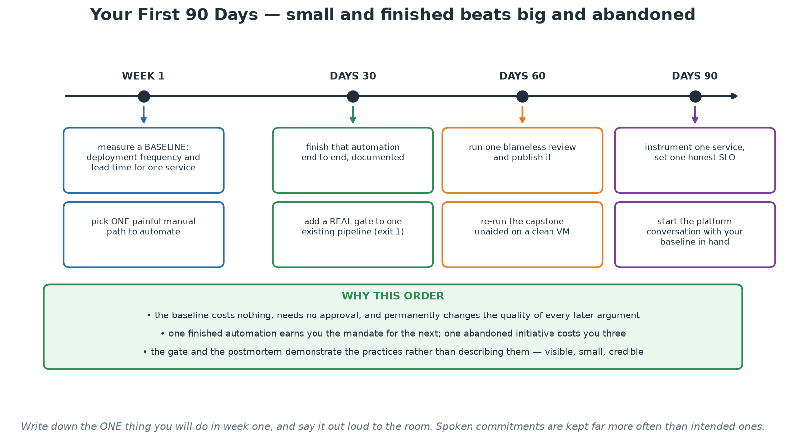
Your First 90 Days
Baseline, automate one thing, gate one pipeline, publish one review, then start the platform conversation.
Notes:
Close the course on this. The sequence is deliberate and the reasoning is in the green band: the baseline costs nothing and permanently improves every later argument, one finished automation earns the mandate for the next while one abandoned initiative costs three, and the gate plus the published review demonstrate the practices rather than describing them. Ask each participant to pick the ONE item they will start in week one and say it out loud - spoken commitments are kept far more often than intended ones, and hearing colleagues commit makes the next person more likely to follow through. Then hand out the feedback survey and close.

Slide 129
In Context: Your First Week at SARB, Concretely
Day one back - things you can do without asking anyone
  Count deployments and measure lead time for one service over the last month, from the repository history.
  List every wait in your team's last significant change, and mark the longest one.
  Check one pipeline: is any scanner running with exit code 0 and being described as a control?
  Check one repository: are third-party pipeline actions pinned, and are token permissions declared?
The first conversation to have
  With your team: agree the ONE improvement for this month and who owns it.
  With your manager: present the baseline, not an opinion - numbers change the tone immediately.
  With risk, security and audit: ask what evidence they currently receive by hand that a pipeline could produce.
  That last question is often where the whole programme starts, because the answer is usually 'most of it'.
Then keep it going
  Re-run the capstone unaided within two weeks - the second repetition is what makes the skill durable.
  Write the gap list from the workshops into a short internal note and share it.
  Find the second person in another department doing the same thing, and compare notes monthly.
  Revisit your baseline in 90 days. The trend is the story you will tell to get the next thing funded.
Notes:
End with something each participant can do on Monday morning without anyone's permission, because the gap between training and practice is almost always the first step rather than the ambition. The four checks in the first section take under an hour combined and each one typically produces an actionable finding - the exit-code-zero scanner in particular is present in a surprising number of pipelines that are described as gated. The question to ask assurance colleagues is the most strategically useful sentence in the whole closing module: asking what evidence they currently assemble by hand that a pipeline could produce automatically reframes the relationship from negotiation to collaboration, and the answer usually reveals a large amount of manual work that everyone would be glad to eliminate. Close by asking for the spoken commitment, thanking the room, and reminding them that the entire package is theirs to keep and rerun.

