Slide 1
DevOps & Platform Engineering
Day 1 — Foundations, Culture, Tools, IaC & CI/CD
Notes:
Welcome participants. These decks are shared with participants after the course; the speaker notes double as the written reference, so read them when reviewing. Modules 1-9 are theory with small demos; the three workshops and the capstone are the hands-on core. NAVIGATION: each core topic is a summary slide followed by one or two 'Deep Dive' slides that expand every bullet with mechanism, evidence, examples and anti-patterns. When running to time, present the summary slides and use the deep dives as the participant reference and for the discussion prompts; when the room wants depth, teach straight through them.

Slide 2
Module 1
Introduction to DevOps and Platform Engineering
Notes:
75 minutes of theory with one 5-minute demo. Goal: participants can define DevOps precisely (not 'a team' or 'a tool'), explain why platform engineering emerged, and describe how the two relate. The depth lives in these notes - they are the participant reference.

Slide 3
Where DevOps Came From
Pre-2009: Dev measured on change delivered, Ops measured on stability.
Opposing incentives created the 'wall of confusion' - throw releases over it.
Result: quarterly big-bang releases, weekend war rooms, mutual blame.
2009: '10+ Deploys per Day' (Flickr) and the first devopsdays (Patrick Debois).
The insight: the conflict is a SYSTEM problem, not a people problem.
Notes:
Spend time on the incentive conflict - it explains everything that follows. Developers were rewarded for shipping change; operations for preventing change (uptime). Both behaved rationally and the organisation suffered: infrequent, enormous, risky releases, handled by ticket queues and handoffs. The 2009 Velocity talk by John Allspaw and Paul Hammond showed Dev and Ops at Flickr cooperating to deploy more than ten times a day - unthinkable then, and it reframed frequent deployment as a SAFETY practice: small changes are easier to review, test and roll back. Patrick Debois coined 'DevOps' with the first devopsdays conference in Ghent the same year. Ask the room: how long does a change take to reach production in your organisation today, and how much of that is waiting?

Slide 4
Deep Dive: The Incentive Conflict That Built the Wall
Two mandates that could not both win
  Dev was appraised on change delivered: features per quarter, projects closed, scope signed off.
  Ops was appraised on stability: uptime %, incident count, SLA breaches, audit findings.
  Change is the single largest cause of incidents - so for Ops, 'safe' rationally meant 'slow' or 'no'.
  Nobody was lazy or obstructive: two rational actors, one badly designed measurement system.
What the handoff physically looked like
  A release was a document event: a build artefact, an install runbook, a change ticket, a war room.
  Ops received software they had never run, at night, on infrastructure Dev had never seen.
  Environment drift: laptop != test != production, so 'works on my machine' was literally true.
  The Change Advisory Board was the only risk control - approval as a substitute for automated proof.
The measurable cost of that design
  Lead time in months; feedback from real users arrived long after the code was written.
  A release carrying 200 changes turns root-cause analysis into a combinatorial search.
  Rollback meant restoring backups at 03:00 - MTTR in hours or days, not minutes.
  Each side collected evidence proving the other was at fault; the system itself was never the defendant.
Notes:
Slow down here - if participants internalise only one thing from Module 1, make it this: the wall of confusion was an INCENTIVE artefact, not a personality clash. Draw the two appraisal forms on the flipchart side by side; ask the room which behaviours each one rewards. The key mechanism to state explicitly: because change causes most incidents, an organisation that measures Ops purely on stability has paid them to resist the very thing Dev is paid to produce. Every downstream symptom follows from that - CAB meetings, ticket queues, quarterly release trains, environment drift, weekend deployments. Useful probe for the room: 'who here has an approval step that has never once rejected a change?' - that is approval theatre, a control that costs delay and buys no safety. Second probe: 'when did your last production issue get fixed, and how much of that time was diagnosis versus waiting for permission or for a person?' Capture the answers; you reuse them in the DORA metrics discussion in Module 3 and in the value-stream framing of the Three Ways.

Slide 5
Deep Dive: 2009 - the Year the Frame Flipped
Velocity 2009: '10+ Deploys per Day' (Allspaw & Hammond, Flickr)
  A dev and an ops lead presented TOGETHER - the format was itself the argument.
  Enablers: automated infrastructure, shared version control, a one-step build and deploy, shared metrics.
  Plus chat robots announcing every deploy, and an explicit no-blame norm when one went wrong.
  The claim that shocked the industry: frequent deployment makes systems SAFER, not riskier.
devopsdays, Ghent, October 2009 (Patrick Debois)
  Debois wanted the Agile community to include operations; the conference gave the movement a room.
  The word 'DevOps' spread as a hashtag from that event - a community label, never a vendor product.
  It grew bottom-up from practitioners, which is why it has practices but no certification authority.
The insight, stated precisely
  Small batch: 50 lines can be reviewed properly, tested meaningfully, and reverted in one command.
  Small batch: when it breaks, the suspect list is one change, not two hundred.
  Frequency builds muscle: a deploy done 30 times a week is automated, rehearsed and boring.
  So the conflict dissolves: speed and stability stop being a trade-off and start reinforcing each other.
The evidence that followed (DORA / Accelerate, 2014-present)
  Multi-year survey research found speed and stability POSITIVELY correlated across thousands of teams.
  High performers deploy far more often AND fail less often AND recover faster - all at once.
Notes:
The historical detail matters because it is the participants' evidence when they go home and someone says 'deploying more often is reckless'. Tell the Flickr story properly: John Allspaw (Ops) and Paul Hammond (Dev) at O'Reilly Velocity 2009, presenting jointly, listing the mechanics that made ten deploys a day possible - automated infrastructure, a shared repository, a one-step deploy, shared metrics, chat-based transparency, and a culture where a broken deploy triggered investigation rather than punishment. Note how many of those are things this course builds: version control everywhere (Module 3), automated infrastructure (Module 4), one-step pipeline deploys (Module 5), shared metrics (Module 8), transparency (Module 2). Patrick Debois then created the venue and the vocabulary at devopsdays in Ghent, Belgium, in October 2009. Emphasise the counter-intuitive reframing with a physical analogy: a surgeon who performs one operation a year is not safer than one who performs ten a week. Rehearsal, small increments and rapid feedback are the safety mechanisms. Finally, point at Accelerate (Forsgren, Humble, Kim) as the empirical backbone: the speed-versus-stability trade-off that everyone assumed exists does not appear in the data - the same practices drive both.

Slide 6
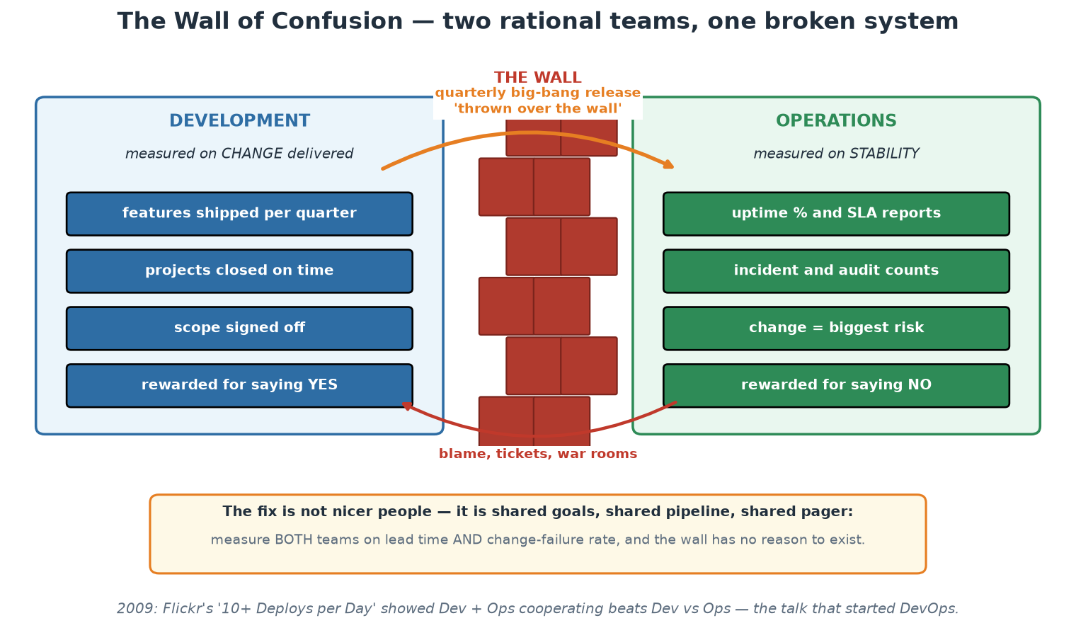
The Wall of Confusion
Two teams behaving rationally under opposing measures - the system is the problem.
Notes:
Use the picture to make the incentive argument physical. Point at the two measurement lists and ask the room which of the two they are measured on today - in most institutions the split is real and visible in the KPIs. Then point at the orange arrow: the release crossing the wall is where all the risk concentrates, because it is large, rare, rehearsed nowhere, and handled by people who did not build it. Finally the red arrow back: blame is the only feedback that crosses in the other direction, and it carries no information anyone can act on. Close on the amber panel - the fix is structural (shared measures, shared pipeline, shared pager), not attitudinal.

Slide 7
In Context: the Wall Inside a Central Bank
Where the wall shows up in a central-bank estate
  Payments and settlement platforms: changes touch a system the whole banking industry depends on daily.
  Supervisory data (returns submitted by banks): a delayed schema change delays the analysis it feeds.
  Published statistics and market-sensitive releases: timing is fixed, so engineering absorbs all the slack.
  Currency and cash operations: physical logistics with software behind them - failure is visible in branches.
What the pre-2009 pattern looks like here
  Quarterly or window-bound releases: one large change set, weekend cutover, standby war room.
  The delivery team hands over an install pack; the operations team runs it in an environment it owns alone.
  Every environment differs, so 'it passed in test' does not predict production behaviour.
  After an incident, the reflex is a new approval step - process grows, lead time grows, causes remain.
The honest counter-argument, and the answer
  'We are systemically important - we cannot deploy casually.' Correct, and unchanged by anything today.
  The claim is narrower: LARGE, RARE changes are the risky ones; small, automated, reversible ones are safer.
  So the goal is not 'deploy fast', it is 'make each change small enough to reason about and undo'.
  Criticality raises the bar for evidence and rollback - it is an argument FOR automation, not against it.
Notes:
This is the slide where the room decides whether the course applies to them, so handle the objection head-on and early. Every participant in a central bank knows their systems are systemically important, and they are right to be sceptical of anything that sounds like 'move fast and break things'. Make the distinction explicit: DevOps as taught here is not an argument for less control, it is an argument about the SHAPE of change - many small verified changes with automated evidence and a tested rollback, instead of few large ones with manual evidence and a restore-from-backup plan. Ask the room to name where their own wall sits: between a delivery function and an operations function, between an internal team and a vendor, between two departments that share a system, or between the institution and the industry participants it serves. Capture two or three concrete answers on the flipchart - they get reused in the Module 3 toolchain mapping and again in Module 9's platform canvas. Remind the room that these SARB examples are teaching scenarios built from public information, so nobody should treat them as statements about internal systems, and invite participants to correct them with their own reality - that correction IS the value of the discussion.

Slide 8
What DevOps Is (and Is Not)
A set of practices + a culture that unify development and operations around flow of value.
Goal: shorten lead time from idea to production WITHOUT sacrificing stability.
It is NOT: a job title, a team you hire, a tool you buy, or 'Ops with Jenkins'.
'You build it, you run it' (Werner Vogels, Amazon 2006) - ownership follows the code.
DevOps applies lean manufacturing thinking to software delivery.
Notes:
Definitions matter because 'DevOps' is the most abused word in IT. The common anti-pattern is creating a third silo called 'the DevOps team' that owns pipelines and becomes a new bottleneck between Dev and Ops - the exact problem DevOps set out to remove. The Amazon principle 'you build it, you run it' captures the ownership shift: the team that writes a service carries the pager for it, which closes the feedback loop between code quality and operational pain. The lean lineage is real, not decorative: small batch sizes, limiting work in progress, pulling quality forward, and reducing handoffs come directly from manufacturing (Toyota Production System) via the book 'The Phoenix Project'. When someone in the room says 'we have a DevOps engineer', explore what that person actually does - often they are a platform engineer (Module 1, later) or a build engineer.

Slide 9
Deep Dive: A Working Definition You Can Defend
The definition, unpacked
  PRACTICES: CI, CD, IaC, automated testing, observability, incident review - the visible mechanics.
  CULTURE: shared ownership, blameless learning, information flow - what makes the practices stick.
  FLOW OF VALUE: the unit of interest is a customer-visible change, not a ticket or a deployment.
  Both halves are required: tools without culture become expensive theatre; culture without tools stalls.
The goal, stated as a measurable pair
  Shorten lead time (idea -> production) WITHOUT increasing change failure rate - both, or it does not count.
  Optimising speed alone gives you fast outages; optimising stability alone gives you frozen systems.
  This is why Module 3 introduces the four DORA metrics as a BALANCED set - two speed, two stability.
Five things DevOps is not - and what people usually mean instead
  'A DevOps engineer' - usually a platform, build or infrastructure engineer; ask what they actually do.
  'The DevOps team' - usually a renamed sysadmin team, and often a brand new third silo.
  'We bought a DevOps tool' - a pipeline engine is a means; nothing about outcomes is guaranteed.
  'Ops with Jenkins' - automating a broken handoff makes the handoff faster, not the system better.
  'It means no ops people' - operations work does not vanish, it becomes a product other teams consume.
Notes:
This slide is armour for the participants' first week back. They WILL sit in a meeting where 'DevOps' means something incoherent, and they need a precise, non-arrogant way to redirect it. Give them the reframing question rather than the correction: instead of 'that is not DevOps', ask 'what outcome are we trying to move - lead time, failure rate, recovery time?' Nobody argues with that question, and it converts a vocabulary fight into a measurement conversation. Work the anti-patterns concretely. The third-silo failure is the most common and the most damaging: an organisation creates a central 'DevOps team' that owns all pipelines and environments, product teams file tickets to it, and within a year the queue is the new wall of confusion - the exact structure DevOps exists to remove. Note the important nuance for Module 9: a PLATFORM team looks superficially similar but is defined by self-service - teams consume it without filing tickets - and that difference is the whole thing. Also handle the 'no ops people' fear honestly and early, because someone in the room is quietly worried about their job: operational work grows in a cloud-native world; what changes is its shape - from manual execution to building the systems that make execution unnecessary.

Slide 10
Deep Dive: Ownership and the Lean Lineage
'You build it, you run it' - what it really commits you to
  Werner Vogels, Amazon (2006 ACM Queue interview): the team that writes a service also operates it.
  The mechanism is the feedback loop - the person paged at 03:00 is the person who can fix the cause.
  It changes code: better error handling, useful logs, health checks, timeouts, graceful degradation.
  The fair-deal caveat: ownership without authority, tooling or headcount is just blame with a pager.
  So the platform (Module 9) exists to make ownership affordable, not to take ownership away.
What software borrowed from lean manufacturing
  Small batches: reduce the size of the thing moving through the system, and everything else improves.
  Limit work in progress: more parallel work means more context switching and longer queues, not more output.
  Little's Law: lead time = WIP / throughput - so cutting WIP shortens lead time with no extra capacity.
  Andon cord: anyone may stop the line when quality breaks; fixing it outranks new work.
  Build quality in: inspect at the source (tests, review, scans) instead of a QA phase at the end.
The biggest waste in software is WAITING
  Value-stream maps of real delivery pipelines typically show most elapsed time as queue time, not work time.
  Waiting for review, for a test environment, for a CAB slot, for an ops ticket, for the release window.
  So the first improvement is almost never 'code faster' - it is 'delete or automate a wait'.
  Exercise back at work: map one change end to end and mark each hour as WORK or WAIT. Attack the waits.
Notes:
Two ideas here that participants tend to under-rate. First, 'you build it, you run it' is not a slogan about accountability - it is a deliberately constructed feedback loop. The team feels the operational consequence of its own design decisions, at the moment those consequences occur, which is the only reliable way design quality improves. But be balanced and say the caveat out loud, because participants will be asked to implement this: giving developers the pager while withholding production access, tooling, dashboards or time to fix things creates burnout and resentment, not learning. Ownership must arrive with authority, capability and capacity - that is precisely the bargain the internal platform underwrites. Second, the lean lineage is mechanical, not metaphorical. Little's Law is the one piece of maths in this course and it is worth writing on the board: lead time = work in progress divided by throughput. It says that if a team has 12 things in flight and finishes 3 per week, work takes 4 weeks - and that halving WIP halves lead time without anyone working harder. That is the single most persuasive argument a participant can take to a manager who wants faster delivery. Then the waiting point: when teams map their real value stream, the coding is a small fraction of elapsed time; the rest is queues. Improvement effort spent anywhere other than the biggest queue is, by definition, not improving the system (Theory of Constraints - Module 1's flow discussion continues this).

Slide 11
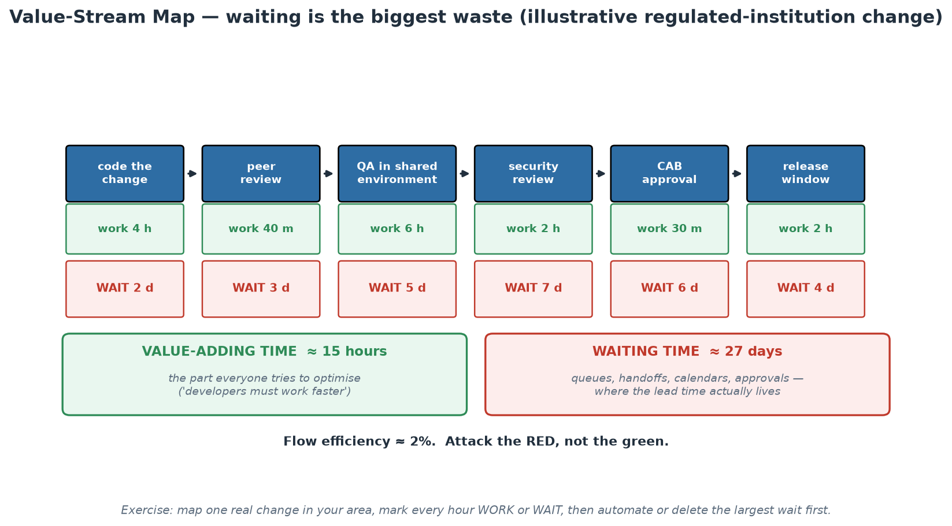
Where the Lead Time Actually Goes
Flow efficiency around 2% - the improvement is in the red boxes, not the green ones.
Notes:
Walk the map left to right and let the arithmetic do the work: roughly 15 hours of value-adding effort spread across roughly 27 elapsed days, giving a flow efficiency of about 2%. Then make the point that changes behaviour: pressure is almost always applied to the green boxes ('developers must deliver faster'), which are already the smallest term in the equation. Halving all coding time saves under a day; removing one seven-day queue saves a week. Ask the room to estimate their own numbers roughly - people usually guess their flow efficiency is around 30-40% and are startled when the map lands at single digits. The follow-up question is the useful one: which of these waits exists because of a genuine control requirement, and which exists because of calendars, capacity and habit? Controls can usually be automated into the pipeline (evidence produced continuously); calendars usually cannot be defended once they are visible on a chart like this.

Slide 12
In Context: Ownership and Flow at SARB
'You build it, you run it' where segregation of duties applies
  The principle is about FEEDBACK, not about handing production access to everyone who writes code.
  Compatible pattern: the team owns the service's health, alerts, error budget, runbooks and postmortems...
  ...while the pipeline (not the person) holds deployment rights - people approve, the machine executes.
  That satisfies segregation of duties AND closes the loop: the builder feels the operational consequence.
  Anti-pattern to avoid: pager without authority - accountability handed over with no ability to fix causes.
Lean thinking on a regulated value stream
  Little's Law still holds: lead time = WIP / throughput - cutting parallel work shortens delivery, free.
  Batch the CONTROLS, not the changes: run evidence generation continuously, ship the change small.
  Every handoff between department, vendor and operations is a queue - count them before optimising code.
  Waiting for a shared test environment is the classic wait that IaC (Module 4) deletes outright.
Language that travels well inside the institution
  Say 'change failure rate' and 'time to restore' rather than 'move fast' - they are risk words, and true.
  Say 'evidence produced automatically on every change' rather than 'less governance'.
  Say 'smaller blast radius per change' rather than 'more deploys' - the same fact, heard correctly.
Notes:
Two things to land here. First, the segregation-of-duties reconciliation, because it is the most common blocker in supervised institutions and it has a clean answer: modern practice separates the AUTHOR of a change from the EXECUTOR by making the executor a pipeline rather than a person. The developer proposes, a reviewer approves, the automation applies, and every step is logged immutably - which is stronger, not weaker, than a human with production credentials and a checklist. Say plainly that this reading is compatible with typical supervisory expectations around change management, and that participants should validate the specifics with their own risk, audit and compliance colleagues rather than take a trainer's word for it. Second, coach the room on vocabulary. Engineers lose these arguments by using words that sound like recklessness to a risk committee. The third section is deliberately phrased as translations: the same practice, framed in the institution's own risk language, is usually approved rather than resisted. Encourage participants to write their next proposal in that vocabulary and see how differently it is received.

Slide 13
The Three Ways (The Phoenix Project / DevOps Handbook)
1. FLOW: optimise the whole left-to-right stream - small batches, limit WIP, remove handoffs.
2. FEEDBACK: fast right-to-left signals - tests, monitoring, pager, customer telemetry.
3. CONTINUAL LEARNING: experiment safely, practise failure, turn incidents into improvement.
Every practice in this course implements one of the Three Ways.
Notes:
The Three Ways (Gene Kim) are the theoretical backbone; use them as a classification tool all week. Flow: CI/CD pipelines, trunk-based development, IaC - anything that moves change left-to-right faster and in smaller pieces. Feedback: automated tests, security scans, observability, SLOs - anything that tells you quickly that something is wrong, as close to the cause as possible. Continual learning: blameless postmortems, game days, error budgets - anything that converts failure into system improvement rather than fear. A good exercise: name any practice ('code review?', 'canary deploys?', 'chaos engineering?') and have the room place it. Code review is feedback; canary is flow AND feedback; chaos engineering is learning. If a practice serves none of the three ways, question why you do it.

Slide 14
Deep Dive: The First Way - Flow (Left to Right)
What flow optimises
  The unit of analysis is the whole value stream: idea -> code -> build -> test -> release -> operate.
  Local optimisation is the trap: a team that doubles its coding speed changes nothing if QA is the constraint.
  Make work VISIBLE first (a board with real queue states), because invisible queues cannot be attacked.
The four flow levers, in the order they usually pay off
  1. Reduce batch size: smaller PRs, smaller releases, smaller migrations - risk falls faster than size.
  2. Limit WIP: fewer things at once finishes more things sooner (Little's Law); stop starting, start finishing.
  3. Remove handoffs: every handoff adds a queue, a context loss and a chance to lose knowledge.
  4. Eliminate rework: defects found downstream cost multiples of defects found at the keyboard.
How this course implements flow
  Trunk-based development and small PRs (Module 5) attack batch size directly.
  IaC (Module 4) removes the 'wait for an environment' handoff - environments become self-service.
  The pipeline (Workshop 1) replaces a chain of human handoffs with one automated path.
  The platform golden path (Module 9) removes the biggest handoff of all: the ticket to another team.
Notes:
Teach the Three Ways as a diagnostic instrument, not as trivia. The First Way asks: where does work slow down? Insist on the systems-thinking point that local optimisation is often value-destroying - speeding up a step that is not the constraint just grows the queue in front of the real constraint (Goldratt's Theory of Constraints, which is the intellectual ancestor of The Phoenix Project's plot). Practical facilitation: ask the room to name their constraint out loud. Common answers - 'test environments', 'the single person who knows the deploy', 'security review', 'the DBA team' - and every one of them is a handoff or a queue, not a typing-speed problem. Emphasise making work visible: teams cannot manage a queue they cannot see, which is why kanban boards with explicit WIP limits are a DevOps practice and not just an Agile ritual. Then connect each course module to the lever it pulls, so participants leave with the mapping rather than a list of tools.

Slide 15
Deep Dive: The Second and Third Ways
SECOND WAY - Feedback (right to left)
  Principle: shorten the distance, in TIME and in PEOPLE, between causing a problem and learning about it.
  Fast and cheap first: linting and unit tests in seconds, integration tests in minutes, then the slow suites.
  Feedback at every altitude: type checker, test, code review, scanner, canary metrics, pager, customer telemetry.
  Swarm on failure: a red mainline or a failing canary stops the line - that is the andon cord in software.
  Anti-pattern: signals nobody acts on (muted alerts, ignored dashboards, skipped flaky tests) - noise trains blindness.
THIRD WAY - Continual learning and experimentation
  Assume the system will fail; design for cheap failure instead of pretending failure is preventable.
  Practise failure deliberately: game days, chaos experiments, restore-from-backup drills, incident simulations.
  Convert incidents into system changes via blameless postmortems (Module 2) - the incident is the tuition fee.
  Make improvement work first-class: reserve capacity for it, or it is always postponed by feature work.
  Share what you learn: internal postmortems published widely turn one team's outage into org-wide immunity.
Using the Three Ways as a checklist
  For any proposed practice ask: does it improve flow, speed feedback, or build learning? If none - why do it?
  Classify examples with the room: code review (feedback), feature flags (flow + feedback), game day (learning).
  The Ways are ordered on purpose: flow without feedback ships faster failures; both without learning stagnates.
Notes:
Second Way: the crucial nuance is that feedback has to be fast AND trusted. A test suite that takes 90 minutes is technically feedback, but developers context-switch away and return to a stale result, so its practical value collapses - which is exactly why the test pyramid (Module 5) puts seconds-fast unit tests first. Equally, a signal that is routinely ignored is worse than no signal, because it teaches the team that red things are survivable; that is why Module 5 has an entire slide on report-versus-gate and Module 8 has one on alert quality. Third Way: the framing that lands with managers is insurance - a game day is a rehearsal you schedule at 10:00 on a Tuesday instead of one that schedules itself at 03:00 on a Sunday. Mention the classic examples: Netflix's Chaos Monkey terminating instances in production to force resilient design, Google's DiRT exercises, and the humble but powerful restore-from-backup drill (an untested backup is a hope, not a backup). Then close with the ordering argument: the Ways build on each other - fast flow without feedback means you ship defects faster, and both without learning means you keep re-solving the same incident. Participants run a miniature of the Third Way in Lab 08's game day.

Slide 16
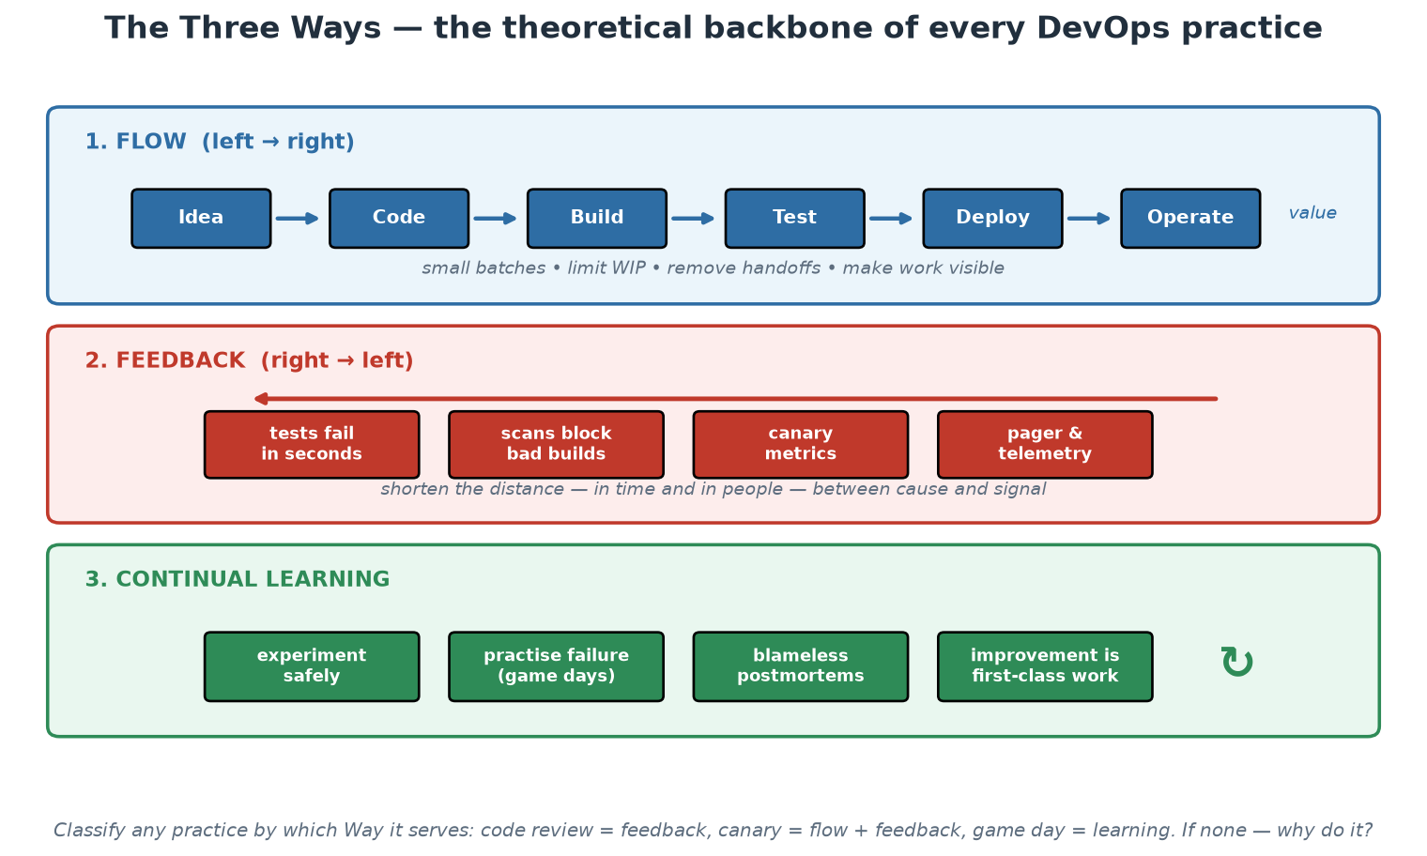
The Three Ways at a Glance
Flow left to right, feedback right to left, learning around the whole loop.
Notes:
Use this as the classification exercise rather than a lecture slide. Call out practices at random - code review, canary release, error budget, change advisory board, game day, dependency scanning, on-call rotation - and have the room place each one in a band. Two answers are worth arguing about deliberately. A change advisory board is intended as feedback but usually functions as a queue, so it belongs in the flow band as a constraint; that is a useful, non-confrontational way to discuss it. And a canary release is both flow and feedback, which shows the bands are lenses rather than boxes. Finish with the footnote question: if a practice serves none of the three, why does the institution pay for it? Ask that gently - the point is to examine inherited process, not to attack colleagues who maintain it.

Slide 17
In Context: the Three Ways on SARB Work
FLOW - what to attack first in a central bank
  Environment provisioning: if a test environment takes weeks, that queue dwarfs every coding improvement.
  Data for testing: masked, POPIA-compliant test data as a self-service capability removes a standing wait.
  Approval choreography: replace document-based approval with reviewed pull requests carrying plan diffs.
  Vendor handoffs: contracted deliverables that arrive as artefacts, not tickets, keep the stream moving.
FEEDBACK - signals that matter in this setting
  Automated checks on data-quality rules before supervisory or statistical data is published anywhere.
  Reconciliation and settlement checks running continuously, not only at end of day.
  Availability and latency SLOs on industry-facing services, alerting on burn rate rather than on spikes.
  Security signals: dependency and image scanning, secret detection, and drift alerts on infrastructure.
CONTINUAL LEARNING - practising failure safely
  Game days on the recovery path: restore a database, fail over a service, rehearse the DR runbook.
  Blameless postmortems feeding a shared, readable archive across departments, not one team's folder.
  Time-boxed technical experiments with a written decision at the end - the same discipline as a proof of concept.
  Publish the learning: an incident understood by one team should immunise every team that shares the pattern.
Notes:
Make this the practical bridge between theory and their Monday. For FLOW, the two highest-value targets in most regulated institutions are environments and test data - both are usually multi-week queues, both are solvable with the IaC and containerisation work in Modules 4 and 6, and both unblock everything downstream. Mention POPIA explicitly when discussing test data, because the compliant answer (masked or synthetic data provisioned automatically) is both safer and faster than the common informal alternatives, and that is a rare win-win worth naming. For FEEDBACK, steer the room toward signals tied to the institution's actual obligations - data quality before publication, reconciliation, availability of industry-facing services - rather than generic infrastructure metrics, because those are the failures that matter to the mandate. For LEARNING, the restore drill is the recommendation to push hardest: almost every institution has backups, far fewer have recent evidence of a successful restore under time pressure, and the gap between those two is where disaster-recovery plans fail. Lab 08's game day is a small rehearsal of exactly this.

Slide 18
CALMS - the Five Dimensions of DevOps
Culture - shared ownership, psychological safety, blameless learning (Module 2).
Automation - pipelines, IaC, tests: make the machine do the repeatable work (Modules 4-5).
Lean - small batches, limit WIP, eliminate waste (waiting is the biggest waste).
Measurement - DORA metrics, SLOs: decide with data, not anecdotes (Modules 3, 8).
Sharing - internal open source, documentation, demos, postmortems published widely.
Notes:
CALMS (Jez Humble, building on Damon Edwards and John Willis) is a health-check model: organisations routinely over-invest in Automation and under-invest in Culture and Measurement, then wonder why the tooling did not change outcomes. Walk each letter with a concrete failure mode. Culture failure: pipelines exist but every deploy still needs a change-approval board meeting. Automation failure: 'we automated the deploy' but test coverage is so thin nobody trusts it, so deploys still happen quarterly. Lean failure: one release train carrying 200 changes - when it derails, which change caused it? Measurement failure: teams argue from anecdotes ('deploys feel risky') with no data. Sharing failure: three teams each build their own deployment scripts, solving the same problem three times. This course touches every letter and the notes say where.

Slide 19
Deep Dive: CALMS as a Health Check (C, A, L)
CULTURE - the multiplier on everything else
  What good looks like: shared goals across Dev and Ops, bad news travels fast, failure triggers inquiry.
  Diagnostic questions: who gets paged? who may say 'stop'? what happened after the last serious incident?
  Failure mode: a fully automated pipeline whose output still waits three weeks for an approval board.
  Covered in Module 2 - Westrum typology, psychological safety, blameless postmortems.
AUTOMATION - make the machine do the repeatable work
  Automate what is repetitive, error-prone, or done under time pressure at 03:00 - in that order.
  Test: can a new engineer take a change to production on day one using only documented, automated paths?
  Failure mode: 'we automated the deploy' but tests are thin, so nobody trusts it and deploys stay quarterly.
  Second failure mode: automating a bad process faithfully - fix the process first, then encode it.
  Covered in Modules 4 and 5 - IaC, pipelines, automated tests and scans.
LEAN - flow, small batches, less waste
  Waste categories in delivery: waiting, handoffs, partially done work, rework, task switching, unused features.
  Waiting dominates: most of a change's elapsed life is spent in a queue, not being worked on.
  Test: what is the median size of a merged pull request, and how long was it open?
  Failure mode: one release train carrying 200 changes - when it derails, root-causing is guesswork.
Notes:
Use CALMS as an assessment framework the participants can actually run at home, not as an acronym to memorise. The observation that carries the slide: organisations over-invest in the A and under-invest in C, L, M and S - because automation is purchasable and the others require organisational change. Ask the room to privately score their organisation 1-5 on each letter, then show hands per letter. In almost every class the shape is the same: Automation is highest, Measurement and Sharing are lowest. That shape IS the diagnosis, and it explains the common complaint 'we bought all the tools and nothing got faster'. For each letter give them a single sharp diagnostic question they can ask in their own organisation - those questions are on the slide deliberately, so the deck functions as a workbook. On Automation, spend a moment on the second failure mode: encoding a broken process in Terraform makes it faster and permanent. Simplify the process, THEN automate it - otherwise you have industrialised the waste.

Slide 20
Deep Dive: CALMS as a Health Check (M, S)
MEASUREMENT - decide with data, not anecdotes
  Baseline the four DORA metrics: deployment frequency, lead time for change, change failure rate, time to restore.
  Two speed and two stability metrics, always read as a SET - improving one by wrecking another is not progress.
  Add flow metrics (WIP, queue time) and reliability metrics (SLO attainment, error budget burn - Module 8).
  Measure the system, never the individual: metrics used for appraisal become metrics that get gamed.
  Failure mode: 'deploys feel risky' as the basis for policy, with no data on whether they actually are.
SHARING - how one team's learning becomes everyone's
  Internal open source: any team may raise a PR on another team's repo, platform repos included.
  Publish postmortems widely - an incident read by 200 engineers immunises 200 engineers.
  Documentation as a product: owned, reviewed, versioned in Git, and measured by whether people succeed with it.
  Cheap high-value rituals: demo days, internal tech talks, README-first design, ADRs in the repo.
  Failure mode: three teams independently build three deployment scripts - the same problem, paid for three times.
Running CALMS as a workshop back home
  Score each letter 1-5 with the team, anonymously, then discuss only the biggest gap.
  Pick ONE improvement per quarter with a named owner and a metric that would move if it worked.
  Re-score every quarter; the trend matters more than the absolute number.
Notes:
Measurement is where most participants can make progress fastest, because a baseline costs nothing and changes the conversation immediately. Stress the balanced-set discipline: a team told to raise deployment frequency will find a way, possibly by splitting deploys meaninglessly; the change failure rate and restore time keep them honest. Also stress the Goodhart's Law warning - the moment a metric is attached to individual appraisal it stops measuring reality and starts measuring compliance; DORA metrics are for the delivery SYSTEM, presented at team or value-stream level. Sharing is the letter people skip because it has no product to buy, yet it is where compounding happens: the same problem solved once and shared beats the same problem solved five times in five teams. Give the practical minimum: a published postmortem archive anyone can read, an internal package or template registry, and a documented expectation that platform repositories accept external PRs. Close with the workshop instructions on the slide - participants can run this in their own team within two weeks, and it makes Module 9's platform canvas exercise easier because the pain points are already listed.

Slide 21
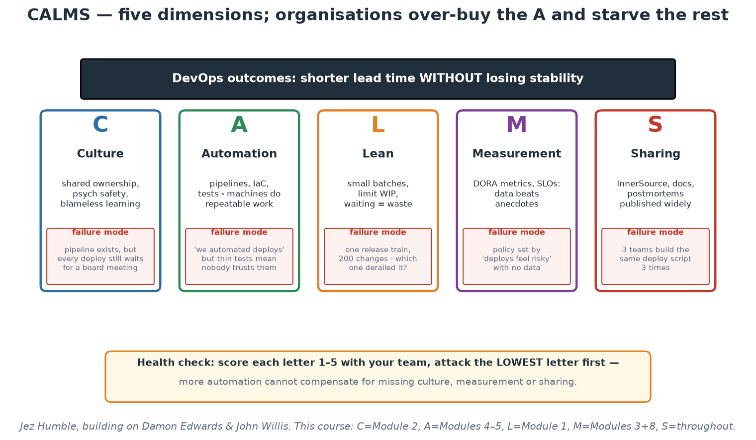
CALMS - Five Dimensions, Five Failure Modes
Score each pillar honestly; the lowest letter is your constraint, not the one you are buying.
Notes:
Run the scoring live if time allows: read each letter, ask for a private 1-5, then show of hands per band. The near-universal pattern - Automation highest, Measurement and Sharing lowest - is the diagnosis, and it explains the complaint that tooling investment did not change outcomes. Note the failure-mode boxes are deliberately drawn as the SAME size as the virtues: each pillar fails in a specific, recognisable way, and naming the failure is how a team spots itself on the chart. In a central-bank context, the Culture failure mode on the slide - a fully automated pipeline whose output still waits weeks for an approval meeting - is the one that lands hardest, because it is so common and so measurable.

Slide 22
In Context: CALMS Read for a Central Bank
What each letter looks like when it is healthy here
  CULTURE: risk, audit and delivery in the same conversation early, rather than as a late gate.
  AUTOMATION: controls executed and evidenced by machines - the same run produces the change and the proof.
  LEAN: the shortest safe path from approved intent to running change, with queues measured and attacked.
  MEASUREMENT: DORA metrics per value stream, plus availability and data-quality SLOs on public obligations.
  SHARING: one internal catalogue of reusable pipelines, modules and runbooks across departments.
Where regulated institutions typically score lowest
  MEASUREMENT: change volumes are counted, but lead time and change-failure rate are rarely baselined.
  SHARING: several departments solve the same delivery problem in isolation, with no shared artefacts.
  LEAN: WIP is high because everything is in flight waiting for something else - nothing is finished.
  Automation is usually the strongest letter, which is exactly why more of it changes so little.
A first-quarter plan you could actually run
  Baseline the four DORA metrics for ONE service - no tooling purchase required, just the numbers.
  Pick the single largest queue from your value-stream map and remove or automate it.
  Publish one blameless postmortem widely enough that another department reads it.
  Re-score CALMS at quarter end and show the trend, not the absolute numbers, to your leadership.
Notes:
The value of CALMS in a supervised institution is that it gives engineers a language leadership already understands - a balanced scorecard across five dimensions, with a clear statement that over-investing in one produces no return. Push the Measurement point hardest, because it is both the cheapest to start and the most persuasive: an institution that can state its lead time and change-failure rate per value stream can have an evidence-based conversation about risk appetite, and one that cannot is guessing in both directions - it may be accepting far more risk than it thinks in some places while blocking harmless changes in others. On Sharing, the central-bank angle is strong: departments often have genuinely similar delivery needs (a service, a pipeline, a database, a dashboard, an audit trail), and a shared internal catalogue is exactly the platform argument the course builds toward in Module 9. Keep the first-quarter plan modest and finishable - the failure mode of assessment frameworks is a 30-item improvement backlog that nobody starts.

Slide 23
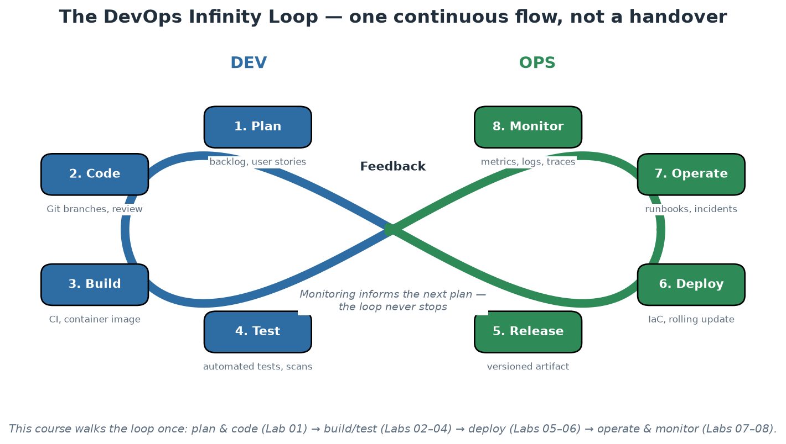
The DevOps Infinity Loop
Eight phases, one continuous flow - monitoring feeds the next plan.
Notes:
Walk the loop phase by phase and stress two things. First, it is a loop, not a pipeline with an end: what you learn operating and monitoring the system feeds the next planning cycle - that closing of the loop IS DevOps. Second, in a handover organisation this picture is cut in the middle: Dev owns the left half, Ops the right half, and information dies at the boundary. During the course participants traverse the whole loop once with the same small application, so by Day 2 afternoon this diagram describes what they have personally done, not an abstraction.

Slide 24
Why Platform Engineering Emerged
'You build it, you run it' collided with the cloud-native explosion (CNCF landscape: 1000+ tools).
Every product team needed Kubernetes + Terraform + pipelines + observability + security skills.
COGNITIVE LOAD became the bottleneck: too much to know before shipping any value.
Platform engineering: a dedicated team builds an Internal Developer Platform (IDP)
so product teams get golden paths instead of blank YAML files.
Notes:
The theory here is cognitive load (from cognitive psychology, applied by Team Topologies): intrinsic load is the essence of the team's actual problem (their business domain); extraneous load is everything else they must wrestle with to ship (cluster setup, pipeline syntax, scanner configuration); germane load is productive learning. Pure DevOps taken literally means every team carries all the extraneous load themselves - eight teams each becoming Kubernetes experts is waste, and worse, it crowds out the intrinsic work you actually hired them for. A platform team absorbs the extraneous load ONCE and serves it as a product: templates, pipelines, runtime, observability, security defaults. Important framing: platform engineering is not a rejection of DevOps but its industrialisation - the goal (teams own their services end to end) is unchanged; the platform makes that ownership affordable.

Slide 25
Deep Dive: Cognitive Load - the Real Bottleneck
What every product team was suddenly expected to know
  Runtime: containers, Kubernetes objects, networking, ingress, storage classes, resource limits.
  Delivery: pipeline syntax, artifact registries, image signing, environment promotion, rollback mechanics.
  Infrastructure: Terraform, state management, cloud IAM, networking, cost controls.
  Operations: metrics, logs, traces, dashboards, alert rules, SLOs, on-call process.
  Security: dependency and image scanning, secrets management, policy, least privilege, compliance evidence.
The three kinds of load (Sweller, applied by Team Topologies)
  INTRINSIC: the essential difficulty of the team's own domain - payments, orders, pricing. Reduce by training.
  EXTRANEOUS: everything the environment forces on them - YAML dialects, cluster quirks, ticket queues.
  GERMANE: effort that builds durable expertise - the load you actually WANT to protect.
  A team's capacity is finite: extraneous load is paid for out of the intrinsic budget, i.e. out of the product.
Why 'every team learns everything' does not scale
  Eight product teams each becoming Kubernetes experts is the same work paid for eight times.
  Depth is diluted: eight part-time experts produce eight subtly different, subtly wrong configurations.
  Onboarding stretches from days to months, because the prerequisite stack is enormous.
  The best engineers spend their time on infrastructure yak-shaving instead of the business problem.
Notes:
This is the intellectual core of the platform half of the course, so make the mechanism vivid rather than abstract. Do the arithmetic with the room: list on the flipchart everything a team must know today to take a new service to production safely, and count it. In most organisations the list runs to 20-30 distinct technologies and processes; the CNCF landscape alone contains well over a thousand projects. Then make the economic point: that knowledge is not free, and it is paid for out of the same finite team capacity that was supposed to be building the product. Cognitive load theory gives the vocabulary to say this to leadership without sounding like complaining engineers - intrinsic load is the work you hired the team for, extraneous load is the toll the environment charges, and the platform's entire reason to exist is to collapse the toll. Useful framing question for the room: 'what fraction of your last sprint went into things a customer would recognise as your product?' The gap between that number and 100% is the extraneous load, and it is the platform's addressable market. Anticipate the objection 'so developers stay ignorant of infrastructure' - the answer is that golden paths have escape hatches, teams remain accountable for what they run, and the platform removes the obligation to REBUILD the knowledge, not the permission to have it.

Slide 26
Deep Dive: What a Platform Actually Provides
Golden path instead of a blank YAML file
  Before: a new service starts from an empty repo, and the first two weeks are plumbing.
  After: one command scaffolds repo, pipeline, image build, deployment manifests, dashboards and alerts.
  The paved road is opinionated but OPTIONAL - teams may leave it, and then they carry the extra weight.
  Standardisation is a by-product, not the goal: teams choose the road because it is genuinely faster.
The layers of an Internal Developer Platform (IDP)
  Interfaces: CLI, service catalogue/portal, API, templates - how developers actually consume the platform.
  Golden paths: opinionated, working end-to-end journeys for the common service shapes.
  Capabilities: environments, CI/CD, secrets, observability, policy, cost visibility - operated once, shared.
  Infrastructure: clusters, registries, networks, cloud accounts - invisible to the consuming team.
Platform engineering is DevOps industrialised, not DevOps abandoned
  The DevOps goal is unchanged: teams own their services end to end, including in production.
  The platform makes that ownership AFFORDABLE by removing the extraneous work from every team.
  The test that keeps it honest: consumption is self-service. If teams file tickets and wait, it is a silo again.
  Module 9 treats the platform as a product with users, adoption metrics, a roadmap and a support model.
Notes:
Make the before/after tangible, because 'golden path' is otherwise a marketing phrase. Describe the day-one experience concretely: a developer runs one command or fills one form, and within minutes has a repository with a working pipeline, a container build, deployment manifests for each environment, a dashboard, default alerts, and a running hello-service reachable on a real URL - with security scanning and policy already in the path they did not have to think about. That is what 'production on day one' means, and it is the capstone's shape in miniature. Be precise about the paved-road principle: mandates create resentment and shadow infrastructure; a genuinely faster default creates voluntary adoption, and adoption rate then becomes the platform team's honest scoreboard. Keep the escape hatch explicit - a team with a legitimately unusual requirement can step off the road, but they then own what the platform would have handled, which is a fair, transparent trade rather than a fight. Finally, defuse the identity question that always comes up in the room: platform engineering does not replace DevOps culture. If the platform team becomes the only group that can deploy anything, the organisation has rebuilt the wall of confusion with better tooling. Self-service is the difference, and it is a structural test, not an attitude.

Slide 27
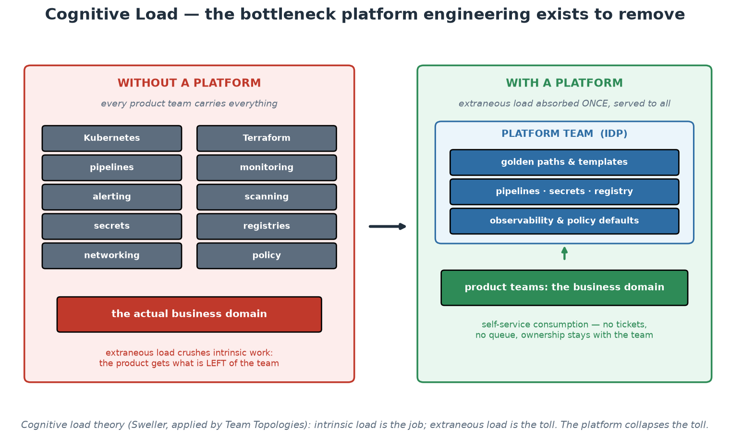
Cognitive Load - Before and After a Platform
The platform absorbs the extraneous load once, so teams can spend capacity on the mandate.
Notes:
Do the counting exercise against the left panel: ask the room to add anything missing for their environment - and in a supervised institution the additions come fast (audit evidence, POPIA handling, records retention, vendor management, network zoning, change records). Every addition strengthens the argument, because the left panel is the tax each team pays before delivering anything. Then the right panel: note that ownership does not move - the product team still runs its service, still carries the consequences - what moves is the obligation to REBUILD the machinery. The arrow between panels is the platform team's entire value proposition, and Module 9 turns it into measurable product KPIs.

Slide 28
In Context: Cognitive Load Across SARB Departments
The load a delivery team carries in a central bank
  Everything on the standard list: runtime, pipelines, IaC, observability, secrets, scanning, policy.
  Plus institution-specific load: network zoning, change records, evidence for audit, records retention.
  Plus data obligations: POPIA handling, classification, masking for test, retention and access control.
  Plus assurance cycles: internal audit, external audit, and supervisory or industry assessments.
What a golden path removes for every team, once
  A scaffolded service: repository, pipeline, build, deployment manifests, dashboards, alerts, runbook stub.
  Controls pre-wired: scanning, policy checks, approvals, immutable logs - compliant because it is the default.
  Standard environments and masked test data provisioned on request instead of requested by ticket.
  Evidence generated automatically as a by-product of delivering - the audit pack builds itself.
Why this matters more, not less, in a regulated institution
  Uniformity is a control: forty hand-built pipelines have forty different weaknesses nobody can enumerate.
  One paved road is inspectable end to end; departmental variety is not, at any reasonable audit cost.
  Scarce specialists (security, SRE, data protection) scale by encoding their expertise into the road.
  The measurable prize: time-to-first-deploy for a new service, from weeks or months to a day.
Notes:
The strongest platform argument in a supervised institution is not developer happiness - it is control uniformity, so lead with that. Forty teams each assembling their own pipeline produces forty different control postures, and no audit function can meaningfully assess forty; one golden path can be assessed once, deeply, and every consumer inherits the result. That reframing turns the platform from an engineering nicety into a risk-reduction programme, which is how it gets funded. The second argument is scarcity: a central bank has a small number of deep specialists in security, data protection and reliability, and the only way their expertise reaches every delivery team is to encode it into defaults rather than schedule it into meetings. Then give the metric - time-to-first-deploy - and ask the room what their honest current answer is for a brand-new internal service; the number is usually measured in weeks or months, and it is the number that makes the case without any further argument. Close by repeating the self-service test, because it is what separates a platform from a new bottleneck: teams must be able to consume it without filing a ticket and waiting.

Slide 29
DevOps vs SRE vs Platform Engineering
DEVOPS (a philosophy)
Whose problem: the org's delivery flow.
Core question: how do we ship faster AND safer together?
Practices: CI/CD, IaC, shared ownership, blameless culture.
SRE (a role/discipline, Google 2003)
Whose problem: reliability at scale.
Core question: how reliable must this be, and what does that cost?
Practices: SLOs, error budgets, toil elimination, incident response.
PLATFORM ENGINEERING (a team + product)
Whose problem: developer cognitive load.
Core question: what paved road lets teams self-serve safely?
Practices: IDP, golden paths, templates, self-service APIs.
They compose, not compete:
SRE defines what reliable means;
the platform makes reliable the default;
DevOps culture makes teams own the result.
Notes:
These three terms cause endless confusion in job adverts; give participants a crisp separation. DevOps is a philosophy of shared ownership - anyone claiming to 'hire a DevOps' is usually hiring a platform or build engineer. SRE (Site Reliability Engineering, from Google) operationalises reliability as an engineering problem: Service Level Objectives quantify how reliable a service must be, error budgets convert the gap to 100% into a spendable resource, and 'toil' (manual, repetitive, automatable operational work) is systematically eliminated - Google caps toil at 50% of an SRE's time. Platform engineering packages both into a product. Concrete example with this course's material: SRE thinking gives us the 99% SLO and burn-rate alerts (Module 8); the platform bakes probes, scanning and dashboards into the golden path (Module 10); DevOps culture means the order-service team still carries responsibility for what they ship.

Slide 30
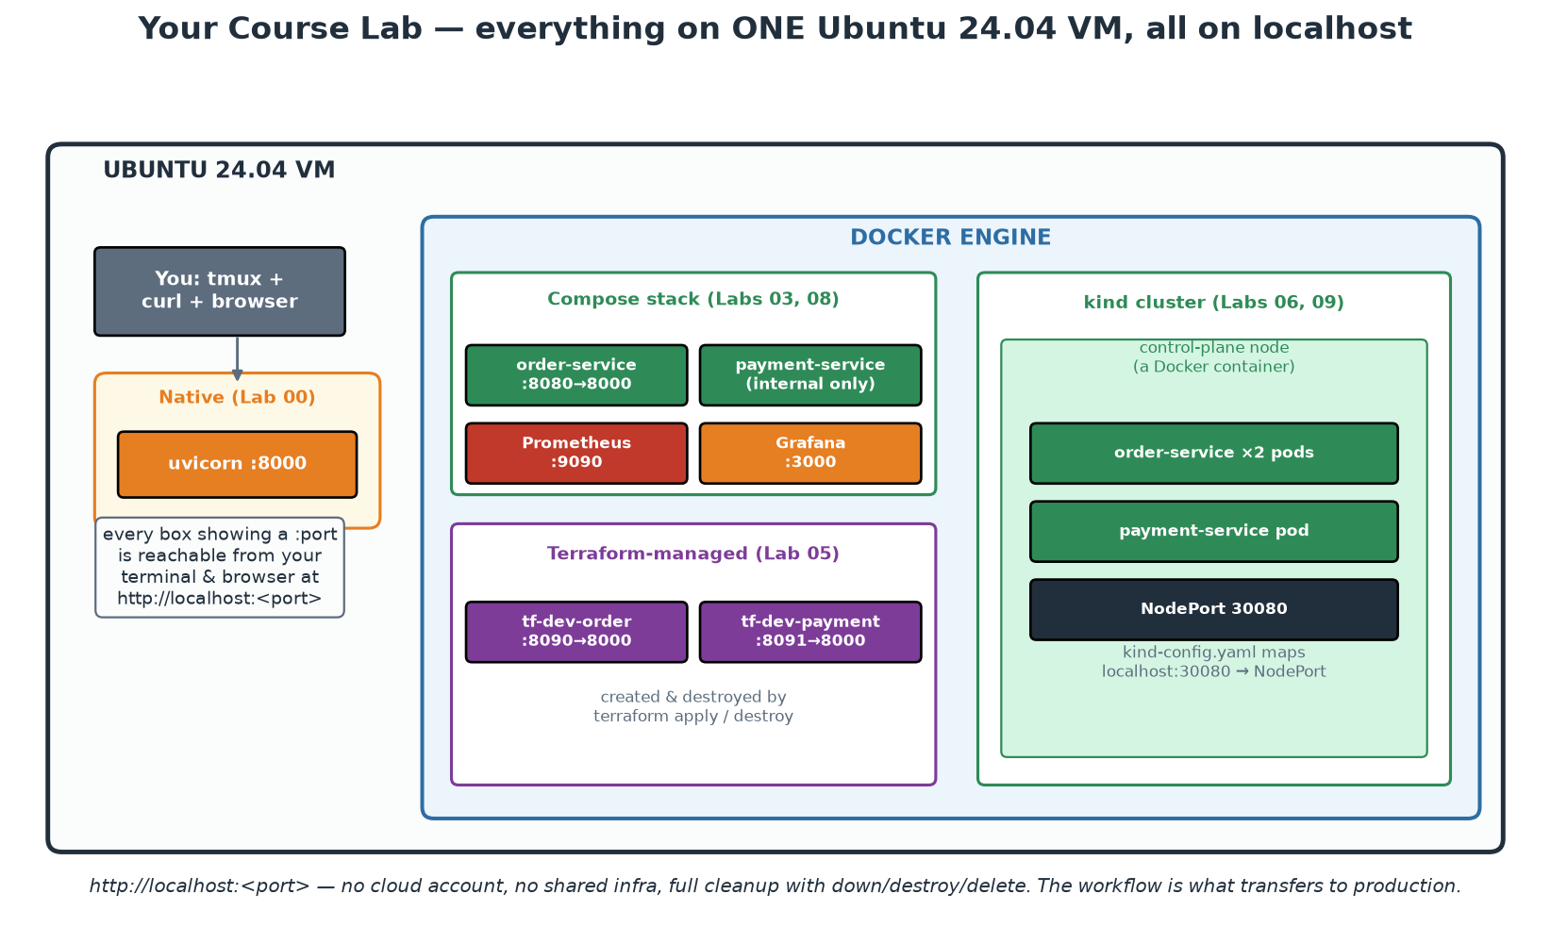
Your Lab Environment for These Two Days
One Ubuntu 24.04 VM per participant - every lab runs on its localhost.
Notes:
Orient participants before any hands-on: native Python (the 5-minute demos), Docker Compose stacks, Terraform-managed containers and a kind Kubernetes cluster all live on one VM, and every URL in the course is http://localhost:<port>. No cloud account, no shared infrastructure, and full cleanup is one command per stack. Make the pedagogical point explicitly: the WORKFLOW is what transfers to production and cloud - swapping localhost Docker for AWS changes one Terraform provider block, not the discipline. DEMO NOW (5 min, from instructor/theory-demos.md): run lab-setup/check-environment.sh together and have everyone confirm an all-PASS table - this is the course's first automated feedback loop.

Slide 31
Module 1 - Key Takeaway
"Platform engineering turns DevOps from a heroic individual effort into a repeatable, scalable organisational capability."
— Course synthesis
Notes:
Pause here and collect from the room: one pain point in their organisation this module gave a name to (wall of confusion, cognitive load, third-silo DevOps team, toil). Write them somewhere visible - Module 9's platform canvas exercise reuses this list as user pain points.

Slide 32
Module 2
Culture and Collaboration
Notes:
60 minutes theory + a 10-minute self-assessment exercise. The research message: culture is not the soft part - it is the strongest statistical predictor of delivery performance. Give it the same rigour as the technical modules.

Slide 33
Culture Is Measurable: the Westrum Typology
PATHOLOGICAL (power-oriented): info hoarded, messengers shot, failure -> scapegoating.
BUREAUCRATIC (rule-oriented): info flows in channels, failure -> process and blame-shifting.
GENERATIVE (performance-oriented): info flows freely, failure -> inquiry and learning.
DORA research: generative culture statistically predicts software delivery performance.
Culture is how the organisation responds to BAD NEWS.
Notes:
Ron Westrum, a sociologist studying safety-critical industries (aviation, healthcare), classified organisational cultures by how information flows - especially unwelcome information. The typology matters to us because the DORA/Accelerate research program found generative culture to be one of the strongest predictors of both delivery performance and organisational performance. The operational test is beautifully simple: what happens when someone brings bad news? Pathological: the messenger is punished, so problems are hidden until they explode. Bureaucratic: the messenger is tolerated, the problem is filed into a process, ownership diffuses. Generative: the messenger is thanked, because the organisation values the information above comfort. Every technical practice this week depends on information flowing: monitoring is worthless if an engineer fears reporting what it shows; postmortems are theatre if attendees protect themselves. EXERCISE (10 min, in theory-demos.md): each participant privately scores their organisation on five Westrum questions, then pairs discuss one concrete behaviour that would move one answer one level.

Slide 34
Deep Dive: Reading the Three Westrum Cultures
PATHOLOGICAL - power-oriented
  Information is a personal asset: knowing something others do not is leverage, so it is hoarded.
  Messengers are shot, so problems surface only when they become undeniable - i.e. as outages.
  Responsibilities are shirked; bridging between departments is discouraged as disloyalty.
  Failure leads to scapegoating; novelty is crushed because it threatens the current order.
  Symptom to listen for: 'who signed off on this?' is the first question after every incident.
BUREAUCRATIC - rule-oriented
  Information travels, but only through official channels and at the speed of the process.
  Messengers are tolerated but not welcomed; responsibility is narrow - 'not my department'.
  Failure leads to justice-seeking and new procedure; novelty creates problems for the rulebook.
  Symptom to listen for: after every incident a new approval step appears and nothing gets faster.
GENERATIVE - performance-oriented
  Information is actively sought because the mission depends on it; bad news is treated as valuable.
  Messengers are trained and thanked; cross-boundary collaboration is rewarded, not policed.
  Risks are shared; failure leads to inquiry into the system; novelty is implemented and evaluated.
  Symptom to listen for: 'what in our system made that outcome likely?' asked before anyone is named.
Notes:
Ron Westrum was studying safety-critical domains - aviation, healthcare - when he classified organisational cultures by how they handle information, particularly unwelcome information. Give the room the three-column model and let them place their own organisation privately; almost everyone lands in bureaucratic, which is worth normalising - most large organisations are bureaucratic by default and the move to generative is a deliberate act. The most useful single line: culture is what happens when bad news arrives. Everything else is decoration. Draw out the bureaucratic failure mode carefully because it looks responsible: after each incident a new approval step is added, so the process grows monotonically, delivery slows, and the actual causes - missing tests, poor observability, brittle deploys - remain untouched. That organisation is optimising for defensibility, not reliability. Note also that DORA's research operationalised Westrum with a small survey instrument, which means culture here is not a vibe - it is measured with questions, and it predicts delivery performance and organisational performance statistically. That fact is the participants' best lever with sceptical leadership: culture work has a measurable return.

Slide 35
Deep Dive: Moving Your Culture One Level
The five questions to score (privately, then discuss)
  1. Is information actively sought here, or do you have to go looking for it yourself?
  2. Are messengers who bring bad news thanked, tolerated, or punished?
  3. Are responsibilities shared across boundaries, or does each group defend its own perimeter?
  4. Is cross-functional collaboration rewarded in practice - promotions, praise, time?
  5. After failure, does the organisation ask what happened, or who did it?
Behaviours that move the needle fastest (leaders first)
  Respond to the first bad-news report of the week with visible gratitude, in public, every single time.
  Say 'I do not know' and 'I was wrong' in front of the team - permission is granted by example.
  Ban the question 'who did it' in incident reviews and replace it with 'what made that seem correct?'
  Publish incident reviews unedited and unrestricted; secrecy signals that failure is shameful.
  Fund the fix: an action item without capacity assigned teaches that reporting changes nothing.
What generative culture buys you technically
  Accurate incident data - so the postmortems describe how the system really fails.
  Early warnings - near-misses reported before they become outages.
  Honest estimates and honest status - because 'this is late' is safe to say.
  Working feedback loops: tests, scans and alerts only help if people act on what they say.
Notes:
EXERCISE (10 minutes, described in instructor/theory-demos.md): each participant scores the five questions privately on paper, 1-5. Then pairs discuss ONE concrete behaviour that would move ONE answer by one point - concrete meaning a specific person doing a specific thing in a specific meeting, not 'improve communication'. Collect three or four out loud. Facilitation warnings: keep the scoring private (people will not honestly score their own manager's organisation aloud), and if a participant's context is genuinely pathological, do not let the room turn it into a pile-on - redirect to what is within their control, usually their own team's micro-culture, which is often measurably better than the organisation's. That is the encouraging finding worth stating: team-level culture is substantially shapeable by team-level behaviour, especially by whoever runs the meetings. Make the closing link explicit to the technical modules: every automated feedback mechanism this course installs is a machine for generating bad news at speed. In a pathological culture those machines get disabled - flaky tests deleted, alerts muted, scanners set to exit-code 0. Culture is not adjacent to the toolchain, it decides whether the toolchain functions.

Slide 36
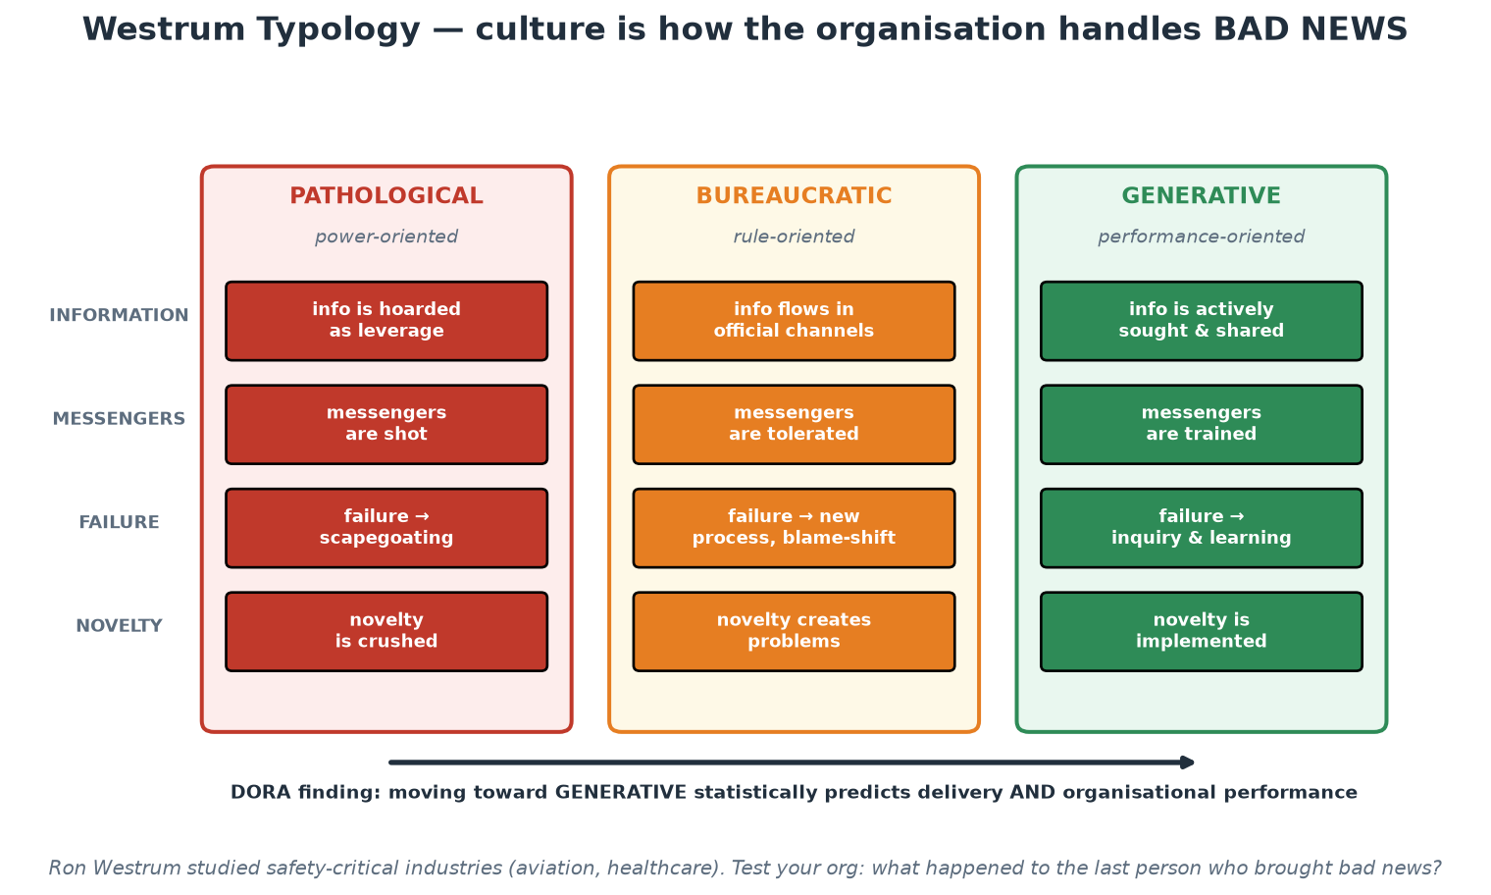
The Westrum Spectrum
Four behaviours, three cultures - and a research-backed direction of travel.
Notes:
Read the table by ROW rather than by column: information, messengers, failure, novelty. Reading down a column invites people to label their organisation with one word, which is both unfair and unhelpful; reading across a row lets them see that most institutions are pathological on one behaviour, bureaucratic on two and generative on another - which is a far more actionable picture. Ask which single row they would most like to move and what one behaviour would move it. In supervised institutions the 'failure' row is usually the hardest, because formal incident reporting obligations sit next to it and people conflate the two - separate them explicitly: the regulatory report answers what happened and what was done, the blameless review answers why it made sense at the time. Both can be true at once.

Slide 37
In Context: Bad News in a Systemically Important Institution
Why information flow matters more here than almost anywhere
  The institution's core products are trust, stability and accurate information - all degraded by hidden problems.
  Industry-facing services mean a suppressed problem becomes several organisations' problem, not just yours.
  Supervisory credibility depends on the institution knowing its own weaknesses before anyone else finds them.
  Near-misses are the cheapest data available - and the first thing an unsafe culture stops producing.
The trap: formal reporting is not the same as free information flow
  Mandatory incident reporting produces a channel; it does not by itself produce candour.
  Bureaucratic reflex after an incident: add an approval step, file the report, close the item - nothing learns.
  Generative reflex: report as required AND investigate the system honestly, then publish what was learned.
  Run both tracks deliberately, with the blameless review feeding facts to the formal one, never the reverse.
Behaviours that move a supervised institution toward generative
  Senior leaders visibly thanking the first person to raise a problem - repeatedly, in public, over months.
  Publishing internal postmortems across departments rather than restricting them to the affected team.
  Rewarding the engineer who reports a near-miss in a control as loudly as the one who ships a feature.
  Making it normal to say 'this deadline is at risk' early - the alternative is discovering it at the window.
Notes:
The nuance to teach here is the difference between a reporting OBLIGATION and an information CULTURE, because supervised institutions frequently have excellent versions of the former and weak versions of the latter, and mistake one for the other. The formal report answers what happened, what the impact was and what was done - it is compliance information, written carefully, with an audience that includes people who can sanction. The blameless review answers what made the actions seem correct at the time - it is engineering information, and it only exists if people believe it will not be used against them. Both are legitimate; the mistake is running only the first and assuming the organisation is learning. Recommend the two-track pattern explicitly: run the blameless review first and fast, then draw the factual timeline into whatever formal report is required, never the other way around, because a document written for a sanctioning audience will not contain the honest 'we didn't understand this system' sentence that actually prevents the next incident. Encourage participants to raise this with their risk colleagues rather than around them - in practice risk functions usually welcome better causal information.

Slide 38
Psychological Safety - the Foundation Layer
Definition (Amy Edmondson): belief that the team is safe for interpersonal risk-taking.
Google's Project Aristotle: THE top factor distinguishing effective teams.
Safe teams surface problems earlier - which looks like MORE errors, and is actually fewer.
Built in small moments: how leaders react to questions, dissent, and mistakes.
Prerequisite for: honest code review, real postmortems, accurate estimates, on-call health.
Notes:
Edmondson's original hospital study found the counterintuitive result that better nursing teams REPORTED more medication errors - not because they made more, but because they were safe enough to report them. That inversion is the whole story: in unsafe teams the error rate looks low because information is suppressed. Google's Project Aristotle (2012-2015, 180+ teams studied) expected to find that great teams were about who was on them; instead the strongest factor was psychological safety - how the team behaved together. For our purposes: every feedback mechanism this course teaches (tests failing, scanners flagging, monitors alerting, reviews commenting) produces bad news by design. An organisation that punishes bad news will neutralise every one of these tools - people will disable flaky tests instead of fixing them, mute alerts instead of investigating, approve reviews without reading. Culture is not adjacent to the tooling; it is the operating system the tooling runs on.

Slide 39
Deep Dive: The Evidence and the Common Misreading
What it is - and what it is not
  Edmondson: a shared belief that the team is safe for interpersonal risk-taking.
  The risks in question: asking a basic question, admitting a mistake, disagreeing, saying 'this is late'.
  It is NOT niceness, comfort, or an absence of conflict - safe teams argue more, not less.
  It is NOT lower standards: safety plus high standards is the learning zone; safety alone is the comfort zone.
The hospital study that inverted the result
  Edmondson expected better nursing teams to report FEWER medication errors; the data showed more.
  Cause: better teams were safe enough to report errors, so their data reflected reality.
  The unsafe teams' low numbers measured silence, not quality - the errors happened, unrecorded.
  Transfer this to your incident data: a suspiciously quiet system is a reporting problem until proven otherwise.
Google's Project Aristotle (2012-2015)
  Studied 180+ teams expecting the answer to be about WHO was on the team - seniority, IQ, tenure.
  The strongest differentiator was psychological safety: how the team behaved together.
  Supporting factors: dependability, structure and clarity, meaning, impact.
  Implication for hiring: team behaviour beats individual brilliance; a strong culture makes average teams good.
Notes:
Handle the two misreadings before they take root, because both are common and both discredit the concept. First, psychological safety is not comfort or politeness - Edmondson's own two-by-two puts safety on one axis and performance standards on the other: high safety with low standards is the comfort zone, low safety with high standards is the anxiety zone, and the learning zone requires both high. Teams with genuine safety have MORE technical disagreement, not less, because dissent is cheap. Second, it is not an excuse for tolerating poor performance - accountability still exists; what changes is that failure produces investigation rather than punishment. The hospital study is the most persuasive thing you can tell a sceptical operations manager: reported error rates measure reporting culture at least as much as they measure error rates, so 'our incident numbers are low' may be excellent news or terrible news, and you cannot tell which without knowing whether people feel safe reporting. Ask the room for the tell-tale: has anyone ever fixed something quietly rather than raising it because raising it would be worse than the bug? Almost every hand goes up eventually, and that admission is the whole argument.

Slide 40
Deep Dive: Building Safety, and What It Unlocks
Built in small moments - the leader's behaviour is the mechanism
  How the senior person reacts to the FIRST naive question sets the price of questions for everyone.
  Frame the work as a learning problem, not an execution problem: 'this is new; we will get things wrong'.
  Model fallibility out loud: 'I missed that', 'I do not know', 'good catch, that was my bug'.
  Invite participation by name and with real questions: 'what are we not seeing here?'
  Respond productively to bad news every time - one public punishment undoes months of invitation.
Practices that make it structural, not personal
  Blameless postmortem format with counterfactuals banned (see the Module 2 postmortem slides).
  Code review norms: comment on the code, ask questions rather than issue verdicts, agreed turnaround times.
  Rotate who speaks first in reviews and retros - juniors before seniors, so anchoring does not silence.
  On-call handoffs and load treated as a team health metric, with fatigue openly discussed.
What it unlocks - the operational payoff
  Honest estimates and honest status reports, so plans reflect reality and slip early instead of late.
  Real postmortems, so the same outage does not recur three times under different names.
  Near-miss reporting - the cheapest safety data any organisation can get.
  Working feedback loops: people investigate red builds and alerts instead of routing around them.
  Retention and on-call sustainability - the least measured, most expensive consequence of unsafe teams.
Notes:
Give participants actionable moves rather than a value statement, because most of them cannot change their organisation but every one of them can change their own meetings. The highest-leverage behaviour is the reaction to the first naive question in a room: answer it seriously and thank the asker, and the price of questions drops for everyone present; sigh or answer curtly, and the room silently learns to stay quiet - and the next thing withheld may be a production concern rather than a question. Leaders modelling fallibility is the second lever, and it is nearly free. Then make it structural, because safety that depends on one good manager evaporates on their next promotion: the formats and norms on this slide encode the behaviour into how the team works. Close with the operational payoff framed in the language of managers - fewer repeat incidents, earlier warning, more accurate plans, lower attrition and healthier on-call. That is how a participant sells this in an organisation where 'psychological safety' would be dismissed as HR vocabulary.

Slide 41
In Context: Safety, Audit and the Fear of Being Named
What suppresses candour in an audited environment
  The reasonable fear that an honest account becomes an audit finding with someone's name attached.
  Formal wording habits: 'the control operated as designed' is safer to write than 'we did not understand it'.
  Hierarchy: in many institutions the most senior voice in the room speaks first and the analysis stops there.
  Consequence: the organisation's written record of failure is accurate about WHAT and silent about WHY.
Practical ways to create safety without weakening accountability
  Separate the tracks: blameless engineering review for causes; formal report for obligations and actions.
  Agree in advance, in writing, that review notes are used to change systems, not to assess individuals.
  In reviews, ask juniors and operators to speak before managers - anchoring silences the best evidence.
  Accountability stays at the level it belongs: the team owns the fix, leadership owns the conditions.
The measurable payoff for a central bank
  Earlier warning on control weaknesses - found internally rather than by an assessment or an incident.
  Accurate estimates and honest status, so delivery risk is visible while there is still time to act.
  Sustainable on-call: people report fatigue and single points of knowledge before they become outages.
  Better data for supervisors and auditors, because the underlying record is truthful.
Notes:
Handle this with care and without naivety: participants work in an environment where written words genuinely carry consequences, so telling them to 'just be open' is useless advice. The workable move is structural separation - a review whose explicit, agreed purpose is system improvement, whose notes are not a personnel record, feeding facts into whatever formal reporting is required. Encourage participants to get that separation agreed in advance with risk and audit colleagues, in writing, rather than assuming it. Say clearly that this is not about hiding anything from oversight: the formal obligations are met in full, and the quality of the information improves, because people can explain what actually confused them. The speaking-order tip is small and unusually effective in hierarchical institutions - the operator who was on the keyboard has the best evidence and is usually the last to speak, by which time the senior interpretation has already framed the discussion. Finally, connect safety to the technical modules once more: every automated signal this course installs generates bad news by design, and the organisation's response to bad news determines whether those signals get investigated or quietly disabled.

Slide 42
Conway's Law - Architecture Mirrors Communication
'Organisations design systems that mirror their own communication structures' (1968).
Four teams building a compiler produced... a four-pass compiler.
Silos in the org chart become seams, queues and outages in the architecture.
REVERSE CONWAY MANEUVER: shape teams to match the architecture you WANT.
This is why microservices without team ownership changes always disappoint.
Notes:
Mel Conway's 1968 observation is one of the most empirically durable laws in software. Mechanism: designing an interface between two components requires communication between their authors; where communication is expensive (different teams, buildings, time zones, reporting lines) interfaces become rigid, minimal and slow to change. Practical consequences participants will recognise: a 'database team' produces systems where every change queues behind DBA tickets; separate QA departments produce testing as an after-the-fact phase; frontend/backend team splits produce chatty, versioned internal APIs with negotiation overhead. The reverse Conway maneuver (popularised by Team Topologies) flips the law from constraint to tool: decide the architecture you want - say, independently deployable services around business domains - then restructure teams to match, and the architecture will follow. This is also why Module 6's microservices content keeps returning to team boundaries: bounded contexts are as much organisational as technical.

Slide 43
Deep Dive: The Mechanism, With Examples You Will Recognise
Why the law holds (the mechanism, not the mysticism)
  Designing an interface between two components requires the authors to communicate.
  Where communication is cheap, interfaces stay fluid and are renegotiated freely.
  Where it is expensive - different teams, buildings, time zones, budgets - interfaces freeze and thicken.
  Conway 1968, 'How Do Committees Invent?': four teams building a compiler produced a four-pass compiler.
Org structures and the architectures they produce
  A separate DBA team -> every schema change queues behind tickets; apps grow logic to avoid the queue.
  A separate QA department -> testing becomes a phase at the end, and quality becomes someone else's job.
  Frontend and backend split by layer -> chatty, over-negotiated internal APIs and cross-team release trains.
  A central 'integration' team -> a strategic ESB that everything must pass through, and a single bottleneck.
  Offshore/onshore time-zone split -> batch handoffs and interfaces designed for a 12-hour round trip.
The seams show up as outages and delays
  Every org boundary becomes a queue in the delivery flow and a fragile seam in the runtime.
  Incidents cluster at the boundaries, because nobody owns the interaction end to end.
  Change that crosses three teams needs three backlogs to agree - so it takes a quarter, not a day.
Notes:
Participants tend to hear Conway's Law as a witty aphorism; make them feel it as a mechanism they can predict with. The causal chain is simple: an interface requires agreement, agreement requires communication, and communication cost is set by organisational distance - so the cheapest-to-agree boundaries are where the architecture will split. Then run the recognition exercise: read out the org-structure examples and watch the room nod. Push it further by asking a participant to describe an architectural oddity in their system that nobody can justify technically ('why does the pricing logic live in the reporting service?'), and then ask what the org chart looked like when it was built. The answer is almost always an organisational story - a team that owned that codebase, a manager who had capacity, a contractor whose scope ended. That exercise converts the law from trivia into a diagnostic. Also name the inverse consequence for Module 6: teams that cannot deploy independently will not produce independently deployable services, no matter how the boxes are drawn on the architecture diagram.

Slide 44
Deep Dive: The Reverse Conway Maneuver in Practice
The move
  Decide the architecture you WANT - say, independently deployable services aligned to business domains.
  Then restructure teams and communication paths to match it, and let the law work for you.
  Give each team end-to-end ownership: build, deploy, run, be paged for, and change without asking permission.
  Align team boundaries with domain boundaries (bounded contexts), not with technology layers.
Preconditions - otherwise it fails
  Each team needs the ability to deploy alone: own pipeline, own environments, own data, own release cadence.
  Interfaces must be explicit and versioned - APIs and events with contracts, not shared database tables.
  The platform must remove the infrastructure cost of independence, or 'independent' means 'each team suffers alone'.
  Team size should stay within a trusted-relationship limit (roughly 7-9) and cognitive load must fit.
Why microservices without org change disappoints
  Services split, teams unchanged: one team owns twelve services and now suffers distributed-systems pain for free.
  A shared release train across services = a distributed monolith - all the cost, none of the independence.
  Shared database between services keeps the tightest coupling of all, whatever the deployment diagram says.
  The honest test: can one team ship a change to production today without another team's calendar?
Notes:
The reverse Conway maneuver, popularised by Team Topologies, flips the law from a constraint into a design tool - and it is the single most practical thing in this module for anyone with organisational influence. Be precise about preconditions, because half-done versions are worse than doing nothing: teams reorganised around domains but still sharing a database, a release train or a single deployment gatekeeper get all the coordination cost of the new structure and none of the autonomy. Give the room the one-question test on the slide - can one team ship today without another team's calendar? - and let them answer for their own system. It usually reveals the real architecture, which is rarely the one on the wall. Connect this forward twice: Module 6 argues that microservice boundaries should be business-domain boundaries (bounded contexts from Domain-Driven Design), which is Conway's Law applied deliberately; and Module 9 shows the platform team's role in this - independence only becomes affordable when every team does not have to rebuild pipelines, environments and observability for themselves.

Slide 45
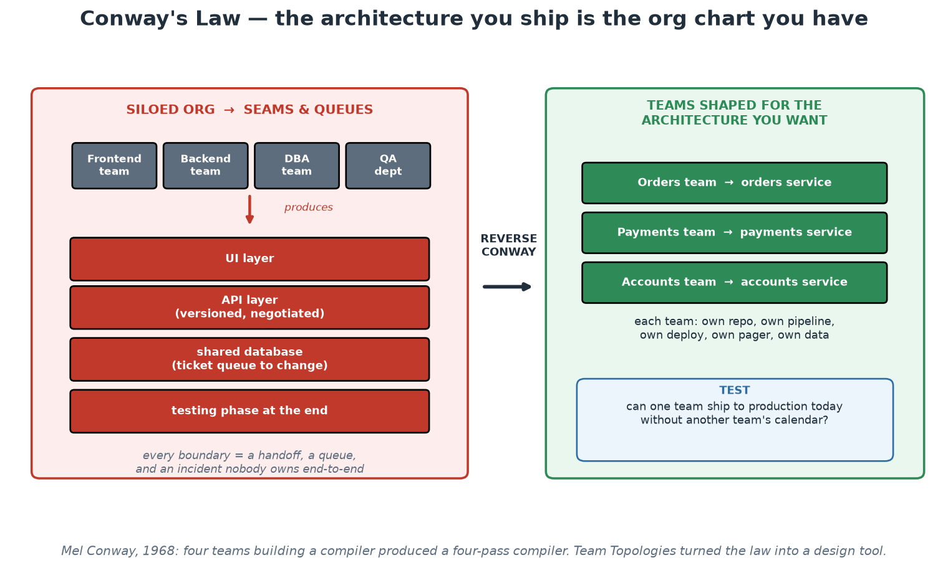
Conway's Law and the Reverse Maneuver
Silos produce seams; teams shaped for the target architecture produce that architecture.
Notes:
Work the left panel first and let the room recognise itself, then ask the diagnostic question in the blue box on the right: can one team ship a change to production today without another team's calendar? In departmental institutions the honest answer is usually no, and the reasons are organisational rather than technical - which is exactly Conway's point. Be careful not to imply that the answer is a reorganisation; those are expensive, disruptive and rarely within participants' control. The realistic move is smaller: identify one system where the seam causes the most pain, and change the INTERFACE rather than the org chart - a documented API with a contract, a shared repository with InnerSource rights, or a temporary embedded engineer. Conway's law responds to communication paths, and those can be changed without moving a single reporting line.

Slide 46
In Context: Conway's Law in a Departmental Institution
Structures that shape central-bank systems
  Departmental ownership by function produces systems that mirror the departmental split, seams included.
  A central data or database function turns every schema change into a queued request across teams.
  Separate delivery and operations functions produce a designed-for-handover architecture with a cliff edge.
  Vendor boundaries are org boundaries too: contracted scope becomes an interface nobody can change quickly.
What to do when reorganising is not on the table
  Change the interface, not the org chart: publish contracts and versioned APIs between departmental systems.
  InnerSource across departmental repositories so a needed change can be proposed instead of requested.
  Temporary embedded engineers to build a capability WITH a team, with an agreed end date.
  Shared platform components remove the most-crossed seams entirely - nobody queues for what they self-serve.
Reverse Conway where you DO get a choice
  New initiatives are the opportunity: shape the team around the service it will own from day one.
  Give that team the full set - repository, pipeline, environments, data, alerts and the operational duty.
  Keep it within cognitive-load limits; if it needs to know everything, the platform is not doing its job.
  Then measure it honestly against the diagnostic: can it ship today without another team's calendar?
Notes:
Most participants cannot reorganise their institution, so the practical value of Conway's Law for them is predictive and tactical rather than structural. Predictive: they can now anticipate where the architecture will resist change, because it will resist exactly where the organisation has expensive communication. Tactical: communication paths can be changed far more cheaply than reporting lines - a published contract, a shared repository with contribution rights, a temporary embedded specialist, or a platform capability that removes the crossing altogether. Spend the most time on the vendor point, because it is under-discussed and very real in this sector: a contract boundary is an organisational boundary, so architecture will crystallise along it, and a scope defined in a procurement document three years ago is still shaping today's system. The implication for participants is to think about contract structure as architecture, and to prefer contracts that deliver artefacts and capability transfer over those that deliver tickets. On the last section, remind them that new work is where Conway's Law can be used deliberately - shaping a new team around a service is far easier than re-cutting an existing estate.

Slide 47
Communication Strategies That Scale
Default to asynchronous + written: decisions travel and survive; meetings do not.
ADRs (Architecture Decision Records): short docs capturing WHAT was decided and WHY.
ChatOps: operations in shared channels - deploys, alerts, incident timelines visible to all.
Working agreements: explicit team norms (review turnaround, on-call handoff, WIP limits).
Documentation is a product: if the platform's docs are bad, the platform is bad.
Notes:
Concrete mechanics, not platitudes. ADRs: a one-page numbered record per significant decision - context, options considered, decision, consequences - stored in the repo next to the code it affects. Their value compounds: two years later, 'why is this a queue and not an API call?' has an answer, and newcomers onboard by reading the decision history. ChatOps means operational events flow through shared, searchable channels: the deploy bot announces releases, alerts land where humans discuss them, and an incident's timeline reconstructs itself from the channel history - which Module 8's postmortems depend on. Working agreements make implicit expectations explicit and negotiable: 'reviews answered within 4 working hours', 'no deploys after 16:00 Friday', 'WIP limit of 2 per person'. And treat documentation with product seriousness - measured, owned, maintained - because in a platform organisation, documentation IS the user interface (Module 9 returns to this). During labs, notice how every artifact in this course - policies, pipelines, infrastructure - is written down in Git: that is communication strategy, not just tooling.

Slide 48
Deep Dive: Written, Asynchronous, Durable
Why async-written beats synchronous-verbal at scale
  A decision made in a meeting reaches the attendees; a decision written down reaches everyone, forever.
  Writing forces precision: vague thinking survives conversation but dies in a paragraph.
  Time zones, part-time colleagues and future joiners can all read; none of them can attend a past meeting.
  Meetings are still right for: disagreement, ambiguity, trust-building, and anything emotionally loaded.
  Rule of thumb: if the outcome must persist, it must be written - the meeting produces the document.
ADRs - Architecture Decision Records
  One short numbered file per significant decision, in the repo, next to the code it governs.
  Sections: context, options considered, decision, status, consequences. One page, not a design document.
  The value is WHY, not what - code shows what was done; only the ADR shows what was rejected and why.
  Immutable: decisions are superseded by a new ADR, never edited into a comfortable retelling.
  Payoff two years later: 'why a queue and not a call?' has an answer, and onboarding reads as a story.
Documentation is a product
  It has users, a maintainer, a review process and a lifecycle - not a wiki page written once in 2019.
  Measure it by outcomes: can a new engineer complete the golden path unaided, in one sitting?
  Docs live in Git alongside the thing they describe, so a PR that changes behaviour changes the docs.
  Platform rule (Module 9): if the platform's docs are bad, the platform is bad - the docs ARE the interface.
Notes:
Make ADRs concrete by showing the shape rather than describing it - a numbered markdown file, five headings, one page. Emphasise the discipline that makes them valuable: capture the options you rejected and the reason, because the expensive question later is never 'what did we build' (the code answers that) but 'did they consider X, and if so why not?' Without ADRs, teams re-litigate settled decisions annually and revert them without knowing why they were made. Emphasise immutability: an ADR is a historical record; when the decision changes you write ADR-0042 superseding ADR-0017, and the pair together tell the truth about how thinking evolved. On async-first, do not overstate it - some things genuinely need a room, and the failure mode of async-everything is unresolved conflict and cold, slow disagreement. The workable rule is on the slide: use the meeting for the argument, use the document for the decision. On documentation-as-product, the participants will meet this again in Module 9 as a measured platform KPI, so plant it here: the platform's docs are not a description of the interface, they ARE the interface, and the honest metric is whether an unaided newcomer succeeds.

Slide 49
Deep Dive: ChatOps and Working Agreements
ChatOps - operations in the open
  Deploys, alerts, pipeline results and incident timelines all land in shared, searchable channels.
  Effects: shared situational awareness, passive learning for newcomers, and an automatic audit trail.
  During an incident the channel IS the timeline - the postmortem reconstructs itself from timestamps.
  Guardrails: sensitive data never in chat; bots act with least privilege; channel per incident, not per person.
  Anti-pattern: private DMs for operational decisions - the knowledge dies with the conversation.
Working agreements - the team's explicit norms
  Examples: PRs reviewed within 4 working hours; WIP limit of 2; no deploys after 16:00 on Friday.
  More examples: on-call handoff includes a written summary; every incident gets a postmortem within 5 days.
  Written down, visible, and revisited in retrospectives - a norm nobody can quote is not a norm.
  Agreed by the team, not imposed: the point is that expectations become explicit and negotiable.
Applying this during the labs
  Every artifact you produce in this course is written and versioned: pipelines, infrastructure, policy, runbooks.
  That is a communication strategy, not just tooling - Git history is the durable record of what changed and why.
  Commit messages and PR descriptions are documentation with the best possible retention rate.
Notes:
ChatOps is easy to demonstrate and easy to get wrong. The genuine benefit is that operational reality becomes ambient: a newcomer who sits in the channel for two weeks absorbs how deploys go, what breaks, who to ask, and what normal looks like - none of which is in any document. It also produces an incident timeline for free, which matters directly for the blameless postmortem practice a few slides later, because arguing about what happened when is the most tedious and least useful part of an incident review. Name the guardrails explicitly since organisations have got this wrong publicly: no secrets in chat, bots with narrowly scoped permissions, and destructive actions requiring confirmation. On working agreements, the trick is to keep them few, specific and testable - three agreements a team actually follows beat fifteen aspirational ones. Recommend the retrospective as the place to add and delete them. Finally, tie it back to the labs: participants may not notice that writing everything into Git is a communication practice as much as an engineering one, so point at it when you get to Terraform and pipeline files - those files answer 'what is our infrastructure and why' for everyone in the organisation, permanently.

Slide 50
In Context: Written Decisions and the Audit Trail
ADRs are governance you get for free
  One page per significant decision: context, options considered, decision, consequences, status.
  Stored in the repository beside the code, versioned, reviewed - so the record cannot drift from reality.
  This is exactly the 'why' evidence auditors and assessors ask for, produced as a by-product of working.
  Two years later it answers 'was this considered?' without depending on who is still in the role.
  Superseded, never edited: ADR-0042 replaces ADR-0017, and the pair shows how thinking evolved.
ChatOps and the incident timeline
  Deploys, alerts and incident discussion in shared channels create a timestamped record automatically.
  That record is the backbone of both the blameless review and any formal incident report.
  Guardrails that matter here: no sensitive data in channels, least-privilege bots, confirmation on destructive actions.
  Watch classification: shared does not mean unrestricted - channel scope should match information sensitivity.
Documentation as a product, in an institution that runs on documents
  The difference is lifecycle: owned, reviewed, versioned with the system, and measured by whether people succeed.
  Runbooks live next to the service and change in the same pull request that changes behaviour.
  Test it the honest way: can a new joiner complete the task unaided, using only the document?
  For a platform, documentation IS the user interface - and Module 9 measures it as a product KPI.
Notes:
In an institution that already produces a great deal of documentation, the ADR argument has to be about a different KIND of document, not more of them: short, decision-scoped, versioned with the code, and immutable once superseded. Make the governance link explicit, because it is the reason this practice gets adopted rather than tolerated - the questions auditors and assessors ask about architectural choices are answered directly by an ADR archive, and the answer is contemporaneous rather than reconstructed. On ChatOps, be pragmatic about classification: the practice is valuable because it produces an automatic timeline, and it must be implemented within the institution's information-classification rules, which usually means restricted channels for restricted work rather than abandoning the pattern. The runbook point deserves emphasis for operations-heavy audiences: a runbook that lives in a separate document store drifts from the system within months, whereas one that lives in the repository and changes in the same pull request as the behaviour stays true - and that reliability is what makes it usable at 03:00.

Slide 51
Breaking Silos Without Breaking the Org
Shared goals: measure Dev AND Ops on the same outcomes (DORA metrics, SLOs).
Shared pain: developers join on-call for their own services - feedback with teeth.
Embedded rotation: ops engineers embed in product teams temporarily (enabling pattern).
Internal open source: any team may propose PRs to another team's repo - platform included.
Do NOT create a 'DevOps team' silo between Dev and Ops - it recreates the wall.
Notes:
Silos persist because they serve real needs - specialisation, clear accountability, career paths - so 'just collaborate more' fails. What works is restructuring incentives and interfaces. Shared goals: if Dev is bonused on features and Ops on uptime, no workshop fixes that; measuring both on lead time AND change-failure rate aligns them structurally. Shared pain: a developer who is paged at 03:00 by their own unhandled exception writes different error handling forever after - this is the feedback loop 'you build it, you run it' creates. Embedded rotation is Team Topologies' enabling pattern: temporary, explicitly time-boxed, with the goal of making the receiving team self-sufficient (not creating dependency). Internal open source (sometimes 'InnerSource') keeps the platform from becoming a bottleneck: when a product team needs a pipeline feature, they can contribute it via PR instead of filing a ticket and waiting. And name the anti-pattern out loud: a 'DevOps team' that owns all pipelines and environments is a third silo - it centralises exactly what DevOps set out to distribute.

Slide 52
Deep Dive: Change the Incentives, Not the Slogans
Why 'collaborate more' fails
  Silos exist for real reasons: specialisation, clear accountability, career paths, budget ownership.
  Exhortation cannot beat an appraisal form - people follow what they are measured and paid on.
  So change the structures: shared goals, shared consequences, shared interfaces. Behaviour follows.
SHARED GOALS - measure both groups on the same outcomes
  Give Dev and Ops the same scoreboard: lead time and deployment frequency AND failure rate and restore time.
  Now neither side can win by hurting the other - speed with breakage fails, stability with paralysis fails.
  Add joint service-level objectives so reliability is a shared budget rather than a shared argument (Module 8).
SHARED PAIN - developers on call for their own services
  The feedback loop with teeth: whoever is paged by an unhandled exception designs differently afterwards.
  Introduce it fairly: adequate runbooks, real dashboards, working alerts, sane rotation, time to fix causes.
  Compensate and cap it - on-call is work; unpaid, unbounded rotations are how good engineers leave.
  Ops does not disappear: their expertise shifts to platform, tooling and reliability engineering.
Notes:
The framing to hold onto is that silos are a rational response to how organisations are structured, so the counter-move must also be structural. Shared goals first, because it is the cheapest and most under-used lever: many organisations discover that Dev's bonus and Ops' bonus are literally in opposition, and simply putting the same four DORA numbers on both scorecards changes meeting behaviour within a quarter. Shared pain is the most contentious item on this slide and you should let the room push back on it - participants who have been on badly-run rotations have earned their scepticism. The honest position: developer on-call is one of the strongest quality feedback loops known, AND it is frequently implemented abusively. The conditions on the slide are non-negotiable prerequisites, not nice-to-haves. A useful compromise pattern for organisations easing into it: developers join the rotation in business hours first, or shadow an experienced responder for a cycle, with a hard rule that fixing the causes of pages ranks above feature work in the following sprint - which is what converts pain into improvement rather than into attrition.

Slide 53
Deep Dive: Interfaces Between Teams - and the Anti-Pattern
EMBEDDED ROTATION - the enabling pattern
  An ops or platform engineer joins a product team temporarily to build a capability WITH them.
  Explicitly time-boxed with a success criterion: the team is self-sufficient and the engineer leaves.
  Success is measured by their absence being fine - permanent embedding recreates dependency.
  Works both ways: developers rotating into the platform team return as informed, sympathetic users.
INTERNAL OPEN SOURCE (InnerSource)
  Any team may raise a PR against another team's repository, including the platform's.
  The owning team keeps review and merge rights - contribution without loss of ownership.
  It replaces 'file a ticket and wait a quarter' with 'send the change and get it reviewed'.
  Requires the basics: readable README, contribution guide, tests that run for outsiders, fast review SLA.
THE ANTI-PATTERN: a 'DevOps team' between Dev and Ops
  It centralises pipelines and environments, so every team's delivery queues behind one team's backlog.
  It is the wall of confusion rebuilt with better tooling - now with two handoffs instead of one.
  The distinguishing test versus a platform team: can teams self-serve, or must they file a ticket and wait?
  Also watch for the rebrand-only version: the sysadmin team renamed, with the same tickets and the same queue.
Notes:
Embedded rotation is Team Topologies' facilitating interaction mode, and the discipline that makes it work is the exit criterion - agreed at the start, in writing, with a date. Without it the embedded engineer becomes the team's permanent infrastructure person, the team never learns, and the platform team slowly dissolves into staff augmentation. Mention the reverse direction too: rotating a product developer into the platform team for a quarter produces the best possible platform user research, free. InnerSource is the pressure valve that keeps a platform from becoming a bottleneck as adoption grows - if the golden path needs a new capability, the consuming team can build it and submit it rather than queue for it. Note the preconditions honestly: it only works if the platform repo is genuinely contributable - documented, tested, with a stated review turnaround - which is more work than most platform teams expect. Then land the anti-pattern hard, because it is the most common structural mistake in this whole course and participants may be about to be assigned to one: state the self-service test as the diagnostic, and if the answer is 'they file tickets', the organisation has built a third silo regardless of what the team is called.

Slide 54
In Context: Shared Goals, Segregation of Duties Intact
Aligning measures without merging responsibilities
  Put the same four DORA numbers in front of delivery AND operations for the same value stream.
  Add shared availability and data-quality objectives for the services the institution is accountable for.
  Neither side can then win by hurting the other - speed with breakage fails, stability with paralysis fails.
  None of this requires changing who approves what; it changes what everyone is trying to improve.
Shared pain, adapted to a supervised environment
  Developers join the response path for their own services - starting in business hours, shadowing first.
  They diagnose and propose; execution in production follows the institution's approval and access rules.
  The feedback loop survives that adaptation intact: whoever explains the outage tends to prevent the next one.
  Non-negotiables: runbooks, dashboards, working alerts, fair rotation, and time to fix the causes of pages.
Interfaces that work between departments
  InnerSource: propose a change to another department's repository instead of raising a request and waiting.
  Time-boxed embedding to transfer a capability, with an explicit end date and a self-sufficiency test.
  And the anti-pattern to name out loud: a central 'DevOps team' that owns every pipeline becomes the new wall.
  The test stays the same: can a team self-serve, or must it file a ticket and wait for someone's backlog?
Notes:
The reconciliation to teach here is that shared GOALS and separated DUTIES are independent choices, and institutions often assume they are the same conversation. You can put identical metrics in front of two functions that retain completely separate approval authority - and doing so removes the structural conflict without touching a single control. That is usually the easiest high-value change available to a participant with any influence. On developer involvement in incident response, present the adapted version rather than the purist one, because the purist version stalls in supervised environments and the adapted version keeps almost all the value: the developer is in the response path as the person who understands the system, diagnoses the cause and proposes the fix, while the execution follows the institution's access rules. Be firm about the prerequisites - anyone asked to carry operational responsibility needs the tools, information and capacity to discharge it, and an institution that skips those is transferring stress rather than ownership. Close on the third-silo warning, since several participants may be sitting inside or near a team recently renamed with 'DevOps' in the title; give them the self-service test as a neutral, non-personal way to assess it.

Slide 55
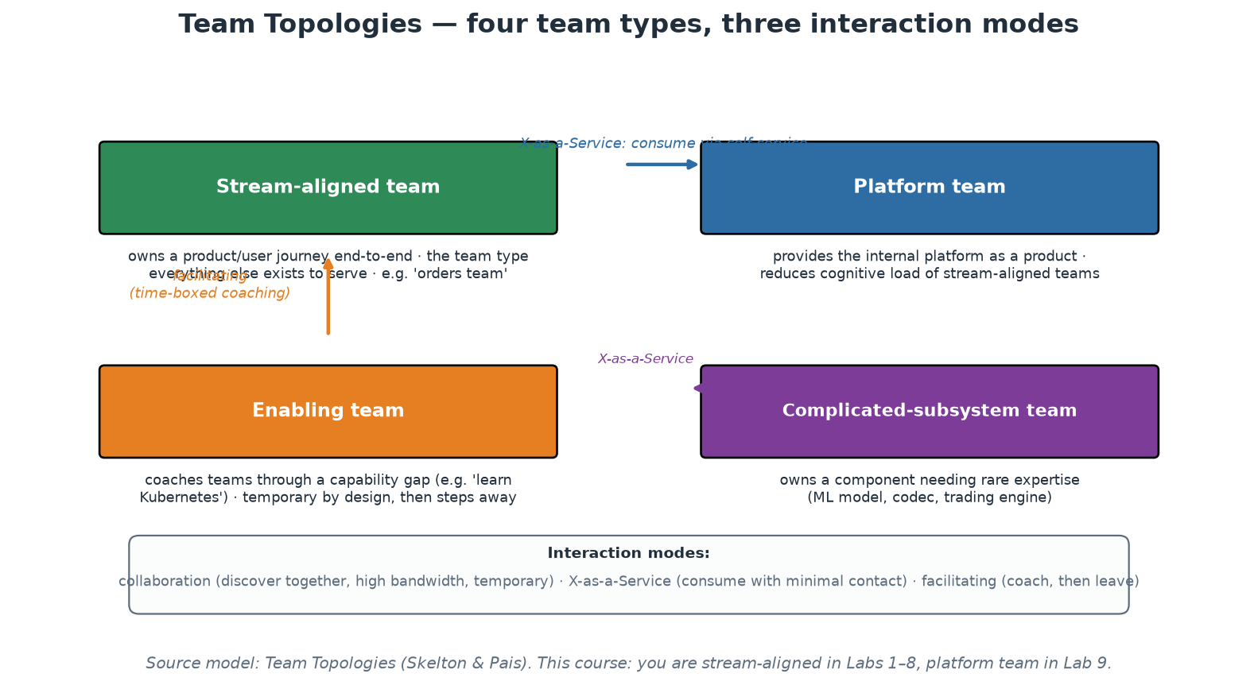
Team Topologies - Organising for Flow
Four team types, three interaction modes (Skelton & Pais).
Notes:
Team Topologies (Matthew Skelton and Manuel Pais, 2019) is the current standard vocabulary for DevOps-era org design; participants will meet these terms in the wild. Stream-aligned teams own a product or user journey end-to-end and are the point of the whole system - every other type exists to help them flow. Platform teams reduce their cognitive load by providing an internal platform as a product. Enabling teams coach through capability gaps and are deliberately temporary - success is stepping away. Complicated-subsystem teams own components genuinely requiring rare expertise (an ML model, a codec). Equally important are the three interaction modes: collaboration (working together closely - powerful but expensive, keep it temporary), X-as-a-Service (consume through an interface with minimal contact - the target state for platform consumption), and facilitating (coaching). A healthy platform relationship EVOLVES: collaboration while discovering what teams need, then X-as-a-Service once the golden path exists. A platform stuck in permanent collaboration mode has failed to productise; one that started at X-as-a-Service without ever collaborating built the wrong thing.

Slide 56
Blameless Postmortems and Retrospectives
Premise: people made reasonable decisions given the information they had at the time.
Ask 'what made that action seem correct?' - never 'who did it?'
Counterfactuals ('should have', 'could have') are banned - they explain nothing.
Output: systemic action items with owners and dates, tracked like feature work.
Retrospectives are the same loop at team cadence - improvement as a habit, not an event.
Notes:
The blameless practice comes from aviation and was brought into software mainly via Etsy (John Allspaw) and Google SRE. The reasoning is hard-nosed, not soft: if the consequence of touching an incident is punishment, engineers will hide information, and you lose the only accurate account of how your system actually fails. 'Human error' is where the investigation STARTS, not where it ends - the question is what context, tooling, documentation or alerting made the error possible or invisible. Ban counterfactuals in the room: 'they should have checked the config' describes an imaginary incident, not this one; ask instead what made not-checking seem fine (it always had been? the config was 4000 lines? the diff tool hid it?). Insist that action items are systemic (add a preflight validation, fix the runbook, page earlier) with owners and due dates in the normal backlog - a postmortem whose action items die in a document was a ritual, not learning. Participants practise a 5-line version of this after the Module 8 demo, and the format is deliberately identical to a real one.

Slide 57
Deep Dive: Why Blameless Is Hard-Nosed, Not Soft
The argument from information
  If touching an incident risks punishment, engineers withhold detail - and you lose the only true account.
  You cannot fix what you cannot see; blame is therefore expensive, whatever it does for feelings.
  Aviation learned it first: confidential, non-punitive reporting is why flying became so safe.
  Etsy and Google SRE brought the practice into software; it is now standard at high-performing organisations.
'Human error' is where the investigation starts
  Nobody comes to work intending to break production - so the action made sense to them at the time.
  Ask: what information did they have? what did the tooling show? what did the docs say? what was normal here?
  Second victim effect: the engineer involved is often the most motivated to fix the system - keep them in the room.
  If one person's mistake can take production down, the SYSTEM has a single point of failure - that is the finding.
Ban counterfactuals - they explain nothing
  'They should have checked the config' describes an incident that did not happen.
  'We could have caught it in review' is a wish, not a cause - and it stops the inquiry early.
  Replace with: what made not-checking reasonable? (it always had been / the diff was 4000 lines / no validation existed)
  Language test for the facilitator: if a sentence contains 'should have', it is a judgement, not an observation.
Notes:
Anchor the practice in self-interest, because 'blameless' sounds like leniency to managers who feel someone must answer for an outage. The argument is informational: the accurate story of how a system failed exists only inside the heads of the people who were there, and punishment guarantees you get a sanitised version. You are choosing between accountability theatre and actually knowing how your system fails. The aviation lineage helps: confidential non-punitive incident reporting transformed flight safety precisely because pilots report near-misses they would otherwise hide. On 'human error', give the room the reframe that changes rooms: if a single engineer's single command could take down production, the interesting fact is not the command - it is that such a command was possible, undetected, unguarded and unrecoverable. That is a system finding with system fixes: validation, staged rollout, permissions, a faster rollback. The counterfactual ban is the most practical facilitation tool on this slide, so give the facilitator a script: when someone says 'should have', ask 'what would have made that the obvious thing to do?' It redirects from judgement to design without shaming the speaker. Participants practise this in Module 8 with the deliberately real five-line format.

Slide 58
Deep Dive: Running the Meeting and Closing the Loop
The postmortem structure that works
  Timeline first, from data: alerts, deploys, chat messages, graphs - facts before interpretation.
  Impact in user terms: who was affected, how, for how long - not just 'the service was degraded'.
  Contributing factors, plural: real incidents have several; 'the root cause' is usually an oversimplification.
  What went WELL: detection, rollback, teamwork - name the things worth keeping deliberately.
  Action items: systemic, owned, dated, and placed in the normal backlog like any other work.
Making the actions real
  Each item names a person, not a team, and a date - unowned actions are decoration.
  Prefer fixes that remove the failure MODE over fixes that remove this instance of it.
  Track completion and report it: an organisation that ignores its own action items has stopped learning.
  If nothing changes, the postmortem was a ritual - and people will start treating it as one.
Retrospectives - the same loop, at team cadence
  Postmortems learn from failures; retros learn from ordinary work, without waiting for an outage.
  Same discipline required: psychological safety, systemic focus, a small number of owned actions.
  One improvement carried to completion per iteration beats ten discussed and abandoned.
  Feed the flow metrics into it: what waited longest this sprint, and what would remove that wait?
Notes:
Give participants the running order because that is what they need on their first attempt: facts, impact, contributing factors, what went well, actions. Two facilitation points make the difference between a useful hour and a defensive one. First, build the timeline from artefacts - alerts, deploy logs, chat history, graphs - before anyone narrates from memory; memory reconstructs incidents to make the narrator look reasonable, and artefacts do not. Second, insist on 'contributing factors' rather than 'the root cause': complex systems fail from combinations - a latent bug plus a config change plus an alert that did not fire plus a runbook that was out of date - and the search for a single cause usually stops at the last human who touched it. Include 'what went well' honestly; teams that only catalogue failures burn out on their own reviews, and knowing that rollback worked in 90 seconds is genuinely actionable information. Then push hardest on the action items, because this is where most organisations fail: named owner, date, tracked in the same backlog as feature work, reported on. Postmortems whose actions never ship train the organisation that reporting incidents accomplishes nothing, which is how you quietly return to a pathological culture with excellent documentation.

Slide 59
In Context: Blameless Reviews Alongside Formal Reporting
Running two tracks that do not fight each other
  Track 1 - blameless engineering review: fast, honest, causal. Purpose: change the system.
  Track 2 - formal incident record: obligations, impact, actions, timelines. Purpose: accountability and reporting.
  Order matters: hold the blameless review FIRST, then draw its factual timeline into the formal record.
  Reverse that order and the honest sentences never get written, because the audience is wrong.
  Agree the separation with risk and audit colleagues in advance, in writing - do not improvise it after an incident.
What a good central-bank postmortem produces
  A timeline built from artefacts: alerts, deploys, chat, graphs, change records - not from memory.
  Impact stated in mandate terms: who was affected, which obligations were at risk, for how long.
  Contributing factors, plural - single-root-cause narratives usually stop at the last person who touched it.
  Systemic actions with named owners and dates, tracked in the normal backlog and reported on.
  What went WELL, named explicitly: detection, rollback, escalation - keep what worked deliberately.
Retrospectives: the same loop without waiting for an outage
  Team cadence, same discipline: safety, systemic focus, a small number of owned improvements.
  Feed the flow data in: what waited longest this cycle, and what would remove that wait next cycle?
  One improvement finished per cycle beats ten discussed - improvement must be scheduled, not squeezed.
Notes:
This is the practical heart of Module 2 for this audience, so give it the time. The two-track model is what makes blameless practice implementable in a supervised institution: nothing about it reduces the formal record, and everything about it improves the quality of the information that record contains. State the sequencing rule and the reason - a document written first for a sanctioning audience will never contain 'we did not understand how this component behaved under load', which is precisely the sentence that prevents recurrence. Push participants to agree the boundary with risk and audit BEFORE their next incident, because negotiating it during one guarantees the cautious default. On the postmortem contents, emphasise building the timeline from artefacts, which is also where ChatOps and pipeline logs pay off, and insist on the plural 'contributing factors' - in complex systems the single-root-cause habit reliably terminates the investigation at the last human action rather than at the conditions that made it likely. Finally, the action items: named owner, date, normal backlog, reported. A review whose actions never ship teaches the organisation that reporting incidents accomplishes nothing, which is how a bureaucratic culture quietly becomes a pathological one.

Slide 60
Module 2 - Key Takeaway
"Culture is what happens when bad news arrives. Every tool in this course produces bad news by design - your culture decides whether that information becomes learning or silence."
— Course synthesis
Notes:
Bridge to Module 3: with the people-system understood, we can now look at the tool landscape - and evaluate tools by whether they strengthen flow, feedback and learning rather than by feature lists.

Slide 61
Module 3
Tools and Technologies
Notes:
45 minutes theory + a 15-minute toolchain-mapping exercise. Goal: participants leave with a MAP of the tool landscape and principles for choosing, not a catalogue of logos. Defuse tool-worship: tools amplify a working system, they do not create one.

Slide 62
The DevOps Toolchain - Categories, Not Brands
Source control (Git) - the single source of truth everything else builds on.
CI/CD - pipeline engines: GitHub Actions, GitLab CI, Jenkins, Tekton, Argo Workflows.
Artifacts - registries for images and packages: GHCR, Docker Hub, Artifactory, Nexus.
IaC + config mgmt - Terraform/OpenTofu, Pulumi | Ansible, Chef, Puppet.
Runtime - Docker, Kubernetes, serverless | Secrets - Vault, cloud KMS, SOPS.
Observability - Prometheus, Grafana, Loki, OpenTelemetry, Datadog | Incident - PagerDuty.
Notes:
Teach the CATEGORIES; brands churn, categories are stable. A complete delivery capability needs an answer in each category - the answer may be 'deliberately nothing yet', but it should be deliberate. Walk the flow of one change through the categories: code lands in source control; CI builds and tests it; the artifact registry stores an immutable, versioned output; IaC shapes the environment it will run in; the runtime executes it; secrets management injects credentials without embedding them; observability watches it; incident management wakes someone when watching finds trouble. Two field notes worth sharing: the CNCF landscape lists well over a thousand projects, which is precisely the cognitive-load problem platform engineering answers - nobody should evaluate a thousand tools to ship a web service; and licence changes are a real category risk (Terraform's 2023 licence change produced the OpenTofu fork under the Linux Foundation) - one more argument for keeping your usage of any tool behind an interface you control.

Slide 63
Deep Dive: The Toolchain by Job to Be Done (1/2)
SOURCE CONTROL - the foundation everything else assumes
  Job: one auditable history of every change, with branching, review and rollback.
  Git won; the choice left is the forge - GitHub, GitLab, Bitbucket, Gitea - and its review and CI integration.
  Everything downstream keys off it: pipelines trigger on commits, GitOps reconciles to a commit, audits cite commits.
  Rule for the course: if it is not in Git, it does not exist - config, policy, infrastructure, docs, runbooks.
CI/CD ENGINES - run work in response to events
  Job: on every commit, build, test, scan, and promote an artifact through environments.
  GitHub Actions / GitLab CI: tightly coupled to the forge, YAML pipelines, hosted or self-hosted runners.
  Jenkins: maximum flexibility and plugins, at the cost of operating a server that becomes a pet.
  Tekton / Argo Workflows: pipelines as Kubernetes custom resources - cloud-native, in-cluster, scalable.
  Choose on hosting model and maintenance burden first; syntax is the smallest difference between them.
ARTIFACT REGISTRIES - the promotion boundary
  Job: store the immutable build output that gets promoted from staging to production unchanged.
  Container images (GHCR, Docker Hub, ECR), packages (npm, PyPI, Maven), charts and modules.
  Also the natural place for supply-chain controls: immutable tags, signatures, provenance, retention.
  If the pipeline rebuilds per environment instead of promoting one artifact, the registry is doing nothing for you.
Notes:
The purpose of these two slides is to give participants a MAP they can use for years, because the specific brands will rotate and the categories will not. Teach it as jobs-to-be-done: name the job, then a few representative tools, then the one property that actually differentiates them. Two points worth dwelling on. First, source control as the substrate: nearly every practice in this course is expressed as 'a file in Git plus something that reacts to it', which is why 'if it is not in Git it does not exist' is a workable law rather than a slogan. Second, the artifact registry is the piece juniors overlook - it is the physical embodiment of build-once-promote-many, and Module 5 will insist on it. A good room exercise here (15 minutes, and the outline's toolchain-mapping activity): have each participant draw the six category boxes and write in what their organisation actually uses, including 'nothing' and 'a person does it manually'. The empty boxes are their backlog; the boxes with three different answers are their standardisation opportunity, and both feed Module 9's platform canvas.

Slide 64
Deep Dive: The Toolchain by Job to Be Done (2/2)
IaC AND CONFIGURATION MANAGEMENT - two different jobs
  Provisioning (Terraform/OpenTofu, Pulumi, CloudFormation): make infrastructure EXIST, declaratively.
  Configuration management (Ansible, Chef, Puppet, Salt): make existing machines CORRECT and keep them so.
  Composition in practice: Terraform creates the VM, Ansible or a baked image configures it (Module 4).
  Containers absorbed much of the second job - a Dockerfile is configuration applied at build time.
RUNTIME AND SECRETS
  Runtime: Docker (single host), Kubernetes (scheduling, self-healing, rollout as APIs), serverless (no servers to run).
  The runtime choice sets your operational model - do not adopt Kubernetes for three services and one team.
  Secrets: Vault, cloud KMS/Secrets Manager, SOPS or Sealed Secrets for Git-stored encrypted values.
  Non-negotiables: no secrets in repos or images, short-lived credentials, rotation, access audited.
OBSERVABILITY AND INCIDENT RESPONSE
  Metrics (Prometheus), dashboards (Grafana), logs (Loki, ELK), traces and instrumentation (OpenTelemetry).
  OpenTelemetry is the important bet: vendor-neutral instrumentation, so the backend becomes swappable.
  Commercial all-in-ones (Datadog, New Relic, Dynatrace) trade cost for integration and less operating burden.
  Incident response (PagerDuty, Opsgenie, Grafana OnCall): routing, escalation, schedules - the human side of the loop.
Notes:
Continue the mapping and add the judgement calls the categories hide. On IaC versus config management, do not let the room believe one replaced the other - they answer different questions, and the modern pattern is provisioning plus immutable images, with config management still essential wherever long-lived mutable machines exist (VM estates, bare metal, network gear, Windows fleets). On runtime, say the unpopular thing clearly: Kubernetes is the right answer at a certain scale and organisational maturity and an expensive mistake below it; a small team running four services is usually better served by containers on a managed platform. That honesty buys credibility for the rest of the course, and it is exactly the sort of judgement the platform team is supposed to make on behalf of everyone else. On secrets, state the non-negotiables as a checklist because it is the most common audit finding in real pipelines. On observability, flag OpenTelemetry as the strategically important choice: instrumentation is the expensive, invasive part, so instrumenting once in a vendor-neutral way is what keeps the backend decision reversible - which is directly the 'exit cost' principle on the next slide.

Slide 65
In Context: The Toolchain a Central Bank Needs
Categories that carry extra weight in this sector
  Source control: the system of record for change - and the evidence base for every audit question.
  Artifact registry: immutable, versioned, scannable - the promotion boundary that proves what shipped.
  Secrets management: centralised, rotated, audited - never in repositories, images, tickets or chat.
  Policy as code: institutional rules expressed as checks that run on every change (Module 7).
  Observability: availability and data-quality evidence for services the institution is accountable for.
Deployment and hosting questions to settle early
  Where may code, data and secrets physically run - and does that differ per classification tier?
  Self-managed runners inside the network versus hosted runners: reachability, data residency, maintenance.
  Vendor concentration and exit: how much of the delivery chain depends on one supplier remaining available?
  Support model and lifecycle: who patches it, who is accountable when it is down during a critical window?
A pragmatic default posture
  Standardise on ONE toolchain per category, with a documented exception path - variety is an audit cost.
  Prefer tools whose entire configuration is code, so the control posture itself is reviewable and diffable.
  Prefer open standards at the expensive layers (instrumentation, containers, IaC) to keep exit affordable.
  Buy where the problem is generic; build only where the institution's mandate makes it genuinely specific.
Notes:
Frame the toolchain conversation in this sector around three questions that differ from a commercial context: where things may run, who is accountable when they break, and how much it costs to leave. Data residency and network reachability decide the hosting model far more often than features do, so put that decision first - it determines whether hosted runners are usable at all and whether the pipeline can reach the environments it must deploy to. Vendor concentration deserves airtime because supervised institutions think about it for their banking counterparties and often not about their own delivery chain: it is a legitimate resilience question to ask what happens if a single supplier's service is unavailable during a critical settlement or publication window. On standardisation, make the audit argument again - each additional tool in a category multiplies the assessment surface, and the institution pays that cost forever. Close with buy-versus-build: the mandate is monetary policy, financial stability, payments oversight and currency, not building pipeline engines, so the default should be to consume generic capability and reserve engineering for what only this institution can do.

Slide 66
Principles for Choosing Tools
Declarative over imperative: describe the destination, let the tool drive (diffable, reviewable).
Everything as code, everything in Git: config you cannot version, review or roll back is risk.
API-first and composable: tools must integrate into pipelines, not demand humans click.
Paved road over mandate: golden defaults teams WANT, with escape hatches.
Total cost = licences + integration + operation + training + EXIT cost.
Notes:
Give participants an evaluation checklist rather than recommendations. Declarative matters because a desired-state description can be diffed, code-reviewed, policy-scanned and drift-detected - an imperative script can only be re-run and hoped about; this single property is why Terraform, Kubernetes manifests and Compose files dominate their categories. 'Everything in Git' is the enabler for every other practice this course teaches: if the pipeline definition, infrastructure and policies live beside the code, then review, audit and rollback come for free. API-first: any tool that requires a human in a GUI to complete a release will eventually BE the release process. Paved road over mandate previews Module 9 - mandated tools breed shadow IT; attractive defaults breed adoption. And insist on counting exit cost up front: data export, config portability, retraining - the cheapest tool to adopt is often the most expensive to leave. Close with the culture point from Module 2: a generative organisation with mediocre tools outperforms a pathological one with the best tools money can buy, because tools amplify whatever system they land in.

Slide 67
Deep Dive: Four Properties That Predict Regret
DECLARATIVE over imperative
  Declarative = describe the destination; the tool computes the path and can re-compute it after drift.
  This one property gives you diffs (terraform plan), reviewable change, policy scanning and drift detection.
  An imperative script can only be run and hoped about - it cannot answer 'what would this change?'
  Test when evaluating: can I see a dry-run diff, and can that diff be attached to a pull request?
EVERYTHING AS CODE, EVERYTHING IN GIT
  Config that cannot be versioned, reviewed or reverted is risk with a friendly GUI.
  Git gives you, for free: history, blame, review, approval records, rollback, and an audit trail auditors accept.
  It also gives newcomers a readable account of how the system got this way.
  Test when evaluating: is the tool's entire configuration expressible as files I can commit?
API-FIRST AND COMPOSABLE
  If a step requires a human in a GUI, that human eventually IS the release process - and their holiday is an outage.
  Prefer tools with a documented API/CLI, sane exit codes, and machine-readable output (JSON, SARIF, JUnit).
  Composability beats feature breadth: small tools that pipe together outlive suites that own everything.
  Test when evaluating: can I drive 100% of it from a pipeline with no clicks?
Notes:
Frame this as a purchasing checklist participants can literally take into a vendor meeting, because the alternative - choosing on feature lists and demos - is how organisations end up with tooling they cannot automate. The declarative property is the highest-value single filter and it is worth explaining why: only a tool that knows the desired state can tell you the difference between desired and actual, and that difference is what makes review, approval, drift detection and reconciliation possible at all. Everything-in-Git is the enabler for the compliance story that Module 7 develops - a pull request with a plan diff and two approvals is stronger evidence than a change-approval-board minute, and increasingly auditors accept it. On API-first, tell the anecdote pattern everyone recognises: the deployment that only Sipho knows how to do, from a console, with a checklist in his head. That is not a people problem to be solved by documentation; it is a tooling choice that made automation impossible. Give the room the four evaluation tests on the slide - they are deliberately phrased as questions to ask a vendor or a proof-of-concept.

Slide 68
Deep Dive: Paved Roads and the True Cost of a Tool
PAVED ROAD over mandate
  A mandate produces compliance, resentment and shadow infrastructure built quietly around it.
  A paved road produces adoption because it is genuinely the fastest way to get to production.
  Always leave escape hatches: unusual needs step off the road and accept carrying what the road handled.
  Adoption rate is therefore the honest scoreboard for a platform team (Module 9 makes it a KPI).
TOTAL COST = licences + integration + operation + training + EXIT
  Licences are the visible, smallest and most negotiated part - and the least predictive of regret.
  Integration: wiring into identity, secrets, pipelines, registries, monitoring, cost reporting.
  Operation: who upgrades it, patches it, restores it, and carries the pager when it is down at 09:00?
  Training and cognitive load: every tool is a thing every engineer must learn - count it as a real cost.
  EXIT cost: how much of your data, config and workflow would you lose if you had to leave in two years?
Practical selection habits
  Prefer boring, widely-adopted tools with a hiring pool and an answer for every error message.
  Standardise deliberately: two CI engines is a tax, five is a tax with interest and no benefit.
  Run a time-boxed proof of concept with real workloads and a written decision record (ADR) at the end.
  Ask 'what problem is this solving, and how will we know it worked?' before any evaluation starts.
Notes:
The paved-road principle is the bridge between this module and the platform half of the course, so state the psychology behind it: engineers route around mandates, and the routing is invisible until an incident exposes it. Roads earn traffic. On total cost, walk the five components with a concrete example the room can price - adopting a new observability vendor is not the licence; it is instrumentation work across every service, dashboards rebuilt, alert rules migrated, engineers retrained, and two years later a migration project if you leave. Exit cost is the one nobody estimates and the one that hurts, which is exactly why OpenTelemetry mattered on the previous slide - it makes the expensive part portable. Finish with the selection habits, especially 'choose boring technology': widely-adopted tools come with an enormous free asset - every error message you will hit is already answered somewhere, and you can hire people who already know it. If time allows, ask the room for a tool they regret adopting and which of the five cost components they under-estimated; the answer is almost never licences.

Slide 69
In Context: Choosing Tools Under Procurement and Assurance
Add these questions to the standard evaluation
  Can 100% of it be driven from a pipeline, with no human clicking a console? (automation and evidence)
  Is the whole configuration expressible as files we can version, review and diff? (control posture as code)
  Does it emit machine-readable output and immutable logs? (evidence, not screenshots)
  What identity, access and audit integration does it support - and does it fit our access model?
  What is the exit cost in data, configuration and retrained people, two years from now?
Procurement realities to plan for, not around
  Evaluation and procurement cycles are long: run a time-boxed proof of concept and record an ADR.
  Total cost includes integration, operation, training and exit - licences are the smallest visible part.
  Support and lifecycle commitments matter more than feature lists when a window cannot move.
  Third-party risk assessment applies to delivery tooling too - your pipeline has production credentials.
Paved road, not mandate - even here
  A mandate produces compliance plus quiet workarounds you will discover during an incident.
  A road that is genuinely the fastest safe path produces adoption, and adoption is measurable.
  Keep an explicit, documented exception path: unusual needs step off and carry what the road handled.
  Adoption rate then becomes an honest control indicator: how much of delivery runs through the assessed path?
Notes:
The five evaluation questions on the first section are deliberately phrased so they can be pasted into a requirements document, and each maps to something the institution already cares about: pipeline-drivability is automation and repeatability, configuration-as-code makes the control posture reviewable, machine-readable output replaces screenshot evidence, identity integration fits the access model, and exit cost is concentration risk. Encourage participants to add them to whatever evaluation template they already use rather than proposing a new process. On procurement, be realistic and sympathetic: cycles are long and cannot be wished away, so the practical advice is to shorten the technical part with a genuinely time-boxed proof of concept against real workloads, and to write the decision down in an ADR so the next evaluation does not start from zero. The last section is worth repeating even in an institution that can mandate: mandates produce shadow practice, which is invisible until it appears in an incident timeline. A measured adoption rate for the paved road is a better control indicator than a policy statement, because it reflects what is actually happening.

Slide 70
Automation and Orchestration Platforms
CI engines differ in hosting model: SaaS runners (Actions) vs self-managed (Jenkins) vs in-cluster (Tekton).
Runtime orchestration: Kubernetes won - scheduling, self-healing, scaling, rollout as APIs.
GitOps: Git as the source of truth for RUNTIME state - agents (Argo CD, Flux) pull and converge.
Push (pipeline applies) vs pull (cluster syncs): pull gives drift-correction + audit for free.
Event-driven automation: webhooks and controllers replace humans as the glue.
Notes:
Distinguish the two automation layers people conflate. Delivery automation (CI/CD engines) runs jobs in response to code events; the meaningful differences are hosting and maintenance burden - GitHub Actions outsources runner management, Jenkins gives total control at the price of becoming a pet server (ask who in the room maintains a Jenkins - there is always one), Tekton and Argo Workflows run pipelines as Kubernetes-native resources. Runtime orchestration is what keeps services running afterwards: Kubernetes' actual innovation is exposing scheduling, self-healing and rollouts as declarative APIs - which is what makes it automatable at all (Module 6 goes deep). GitOps joins the layers elegantly: instead of the pipeline pushing kubectl commands, a manifest repo describes the desired runtime state and an in-cluster agent (Argo CD, Flux) continuously pulls and converges - manual changes are automatically reverted, the audit log is git log, and cluster credentials never leave the cluster. Our labs use the push model for simplicity, but name GitOps as the production-grade evolution; the mental model - desired state in Git, an agent converging - is Terraform's loop applied to runtime.

Slide 71
Deep Dive: Two Layers People Conflate
LAYER 1 - delivery automation (CI/CD engines)
  Job: run jobs in response to code events, and stop the line when a job fails.
  SaaS runners (GitHub Actions, GitLab SaaS): no runner fleet to operate; watch minutes cost and egress.
  Self-managed (Jenkins, self-hosted runners): full control, private network access - and you own the upgrades.
  In-cluster (Tekton, Argo Workflows): pipelines are Kubernetes resources - same RBAC, same scaling, same YAML fatigue.
  Decision drivers: where your code and secrets may run, who operates it, and how it reaches private networks.
LAYER 2 - runtime orchestration (Kubernetes and friends)
  Job: keep the right things running in the right numbers, and change them safely.
  Kubernetes' real contribution: scheduling, self-healing, scaling and rollout exposed as declarative APIs.
  Because they are APIs, everything above them can be automated - operators, controllers, autoscalers, policy.
  Control loop: observe actual state, compare to desired state, act to close the gap. Repeat forever.
How the layers meet
  CI produces an immutable artifact; CD changes the desired state of the runtime; the runtime converges.
  That separation is why rollback is 'set the desired state back', not 'undo a series of steps'.
  Keep the boundary clean: build in the pipeline, deploy by declaring state - not by SSH-ing anywhere.
Notes:
Participants routinely say 'our CI/CD' and 'our orchestration' as if they were one thing, and untangling the two layers makes the rest of the course easier. Layer one is event-driven job execution and its differentiator is the HOSTING model - who runs the compute, where it can reach, and who patches it - not the YAML syntax; ask the room who operates their Jenkins, because there is always one person and they always have opinions. Layer two is a continuously running control loop, and the important conceptual leap is that Kubernetes is not a deployment tool but a reconciliation engine that never stops: you declare intent, controllers keep reality matching it, and self-healing is simply that loop noticing a difference. Module 6 develops this. Make the joining point explicit because it explains the entire modern deployment model: the pipeline's job ends when it has published an immutable artifact and changed a declaration; the runtime's job is to converge on it. Rollback becomes a state change rather than a reverse-engineered undo, which is why elite performers restore service in minutes.

Slide 72
Deep Dive: GitOps and Event-Driven Automation
GitOps - Git as the source of truth for RUNTIME state
  The desired state of every environment lives in a Git repository, declaratively.
  An in-cluster agent (Argo CD, Flux) continuously compares cluster reality to that repository.
  Differences are reported and, if configured, corrected automatically - drift heals itself.
  Deployment becomes a merge; rollback becomes a revert; the audit trail is the commit history.
PUSH versus PULL - what pull buys you
  Push: the pipeline holds cluster credentials and applies changes outward. Simple, and widely used.
  Pull: the agent inside the cluster fetches the desired state - so no cluster credentials leave the cluster.
  Pull adds continuous drift correction: a manual kubectl edit is reverted, not silently kept.
  Pull gives audit for free: what is running is provably what is in the repository, at a known commit.
  Cost: another component to operate, plus discipline - out-of-band changes genuinely stop working.
EVENT-DRIVEN AUTOMATION - controllers instead of humans as glue
  Webhooks, controllers and operators react to events: a merge, an alert, a new resource, a schedule.
  The pattern generalises the control loop: encode the operational response, do not page a human for it.
  Examples: autoscaling on load, certificate renewal, dependency-update PRs, auto-rollback on SLO burn.
  The test of maturity: how many of your routine operational actions still require a person to notice?
Notes:
GitOps is worth precision because the term gets applied to any pipeline that touches Git. The defining properties are: declarative desired state, versioned and immutable in Git, pulled automatically by an agent, and continuously reconciled. The last one is what separates it from 'we run kubectl apply in CI'. Sell the pull model on its two concrete wins - credentials never leave the cluster (a compromised CI runner cannot deploy to production), and drift is corrected rather than accumulated, so the emergency 03:00 kubectl edit that everyone forgets to put back gets reverted by a machine that never forgets. Be honest about the cost: teams must genuinely stop making out-of-band changes, and during an incident that discipline is tested. Then widen to event-driven automation as the general principle behind the whole module: humans are poor glue - slow, expensive, inconsistent, asleep at 03:00 - so encode the routine response and reserve humans for judgement. Close with the maturity question on the slide; it is a good one for participants to take back to their own operations meeting.

Slide 73
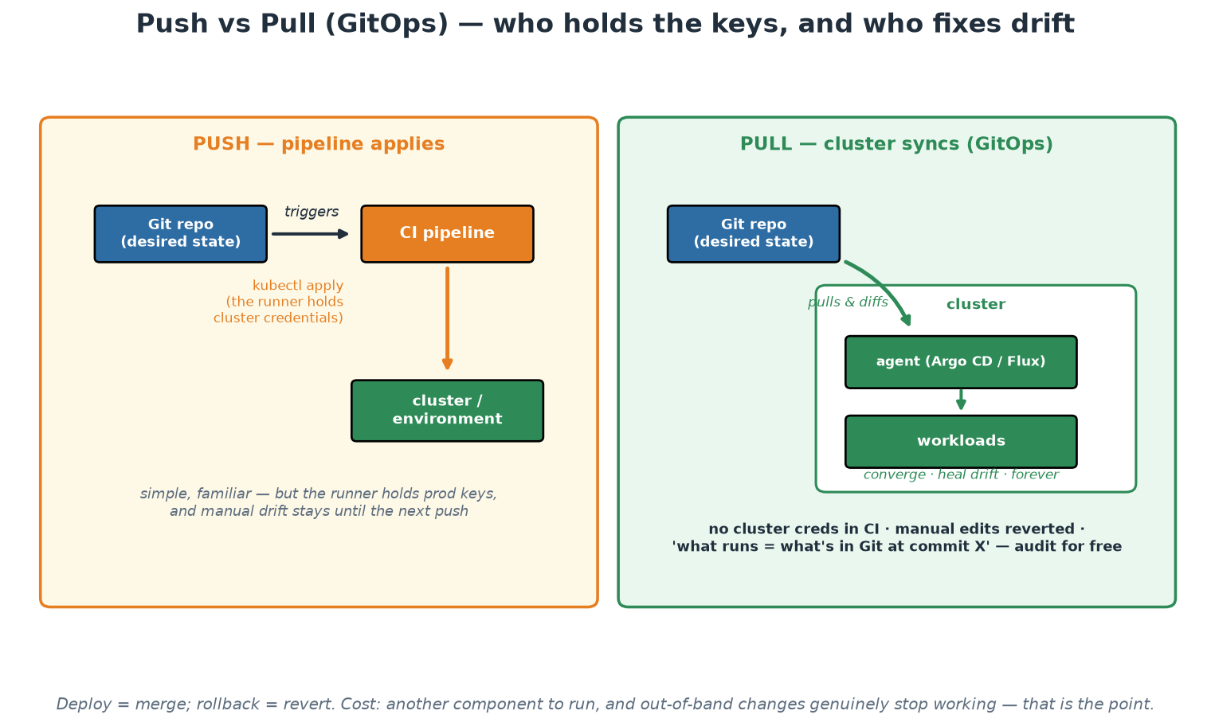
Push vs Pull Deployment (GitOps)
Pull keeps credentials in the cluster, corrects drift, and makes 'what runs' provable.
Notes:
Trace both models and then focus on the three properties that matter in a supervised institution. First, credential location: in the push model a CI runner holds production credentials, in the pull model it does not, and that difference is a genuine reduction in the blast radius of a compromised pipeline. Second, drift: the emergency manual change that everyone intends to put back is reverted automatically rather than remembered, which converts a recurring control weakness into a non-event. Third, provability: 'what is running is what is in Git at commit X' is an assertion a machine can verify continuously, which is a stronger statement than most manual attestations. Be honest about the cost - the agent is another component to operate, and out-of-band changes genuinely stop working, which is uncomfortable during an incident until the team trusts the path.

Slide 74
In Context: GitOps and Segregation of Duties
How the pipeline satisfies separation of author and executor
  The author proposes a change; a different person approves it; the automation executes it. Nobody bypasses.
  Human production credentials become unnecessary for routine change - a control improvement, not a relaxation.
  Every step leaves an immutable record: commit, review, approval, run, artefact digest, deployment result.
  Emergency access still exists, but as a break-glass exception that is logged, alerted and reviewed after.
Why drift correction is a control, not a convenience
  Manual changes made under pressure are the classic source of undocumented divergence between environments.
  A reconciling agent either reverts them or reports them - either way the divergence stops being invisible.
  'What runs equals what is in the repository at commit X' can be verified continuously rather than attested annually.
  Environment parity becomes structural, so a test result predicts production behaviour again.
Where to start in an institution that is not on Kubernetes
  The pattern generalises: declarative desired state in Git plus an agent that converges reality toward it.
  Start with configuration and infrastructure (Terraform, Ansible) reconciled on a schedule from the repository.
  Even a scheduled 'plan and report drift' job creates the visibility, before you enable automatic correction.
  Sequence it: report drift -> agree what is allowed to differ -> then enable correction on the safe categories.
Notes:
This slide converts a technical model into a governance argument, which is how it gets approved. The essential point is that pipeline-executed change is a stronger control than human-executed change: the separation between who writes and who applies is enforced by a machine that cannot be persuaded, tired or in a hurry, and the record is generated automatically rather than assembled afterwards. Say clearly that break-glass access must still exist - a control model with no emergency path gets bypassed informally, which is worse - and that the right treatment is to make it logged, alerted and reviewed rather than to pretend it will not be used. The drift-correction framing is the one to spend time on with operations-heavy audiences: everyone in the room has lived through the temporary change that stayed for a year, and a reconciling agent is simply a mechanism that never forgets. The last section matters because most participants are not running Kubernetes yet: give them the intermediate step of a scheduled drift-report job, which delivers most of the visibility with none of the risk, and makes the case for the next step with data.

Slide 75
Pipeline as Code (1/3): GitHub Actions
The engine most teams meet first. Jobs, dependencies and gates in one file.
# .github/workflows/ci.yml
name: CI
on:
push: { branches: [main] }
pull_request: { branches: [main] }
permissions:
contents: read # least privilege: this token can only read
jobs:
test:
runs-on: ubuntu-latest
steps:
- uses: actions/checkout@v4
- uses: actions/setup-python@v5
with: { python-version: '3.12', cache: pip }
- run: pip install -r labs/app/requirements.txt
- run: pytest
working-directory: labs/app
build:
needs: test # <- the dependency that orders the graph
runs-on: ubuntu-latest
steps:
- uses: actions/checkout@v4
- run: docker build -t order-service:${{ github.sha }} labs/app
→ needs: test is the whole job graph. Everything else is syntax.
Notes:
Read this aloud with the room; it is the file they run in Workshop 1. Three things to point at. First, `on:` - the pipeline is triggered by events, never by a human clicking 'build', which is what makes it a control rather than a convention. Second, `permissions: contents: read` - the default token in many setups can write to the repository, so declaring least privilege here is a one-line security improvement that most pipelines are missing. Third, `needs: test` - this single key is the dependency graph; jobs without it run in parallel, which is how you keep a pipeline fast. Note the SHA tag on the image: the artifact is named after the exact commit that produced it, which is what makes build-once-promote-many possible later. Everything on this slide transfers to GitLab CI and Jenkins with different keywords and identical meaning - the next two slides show the same pipeline in both.

Slide 76
Pipeline as Code (2/3): Jenkins
The same pipeline as a declarative Jenkinsfile - still the most-deployed CI engine in banks.
// Jenkinsfile (declarative syntax, committed with the code)
pipeline {
agent { docker { image 'python:3.12-slim' } } // build runs in a container
options { timestamps(); buildDiscarder(logRotator(numToKeepStr: '30')) }
environment { IMAGE = "order-service:${env.GIT_COMMIT}" }
stages {
stage('Test') {
steps {
sh 'pip install -r labs/app/requirements.txt'
sh 'cd labs/app && pytest --junitxml=results.xml'
}
post { always { junit 'labs/app/results.xml' } }
}
stage('Build') {
steps { sh "docker build -t ${IMAGE} labs/app" }
}
stage('Security gate') {
steps {
sh "trivy image --severity CRITICAL --ignore-unfixed --exit-code 1 ${IMAGE}"
}
}
stage('Deploy to prod') {
input { message 'Promote to production?' } // the delivery/deployment switch
steps { sh './deploy.sh ${IMAGE}' }
}
}
}
→ Same graph, same gate, different keywords - stages instead of jobs, input instead of environments.
Notes:
Include Jenkins deliberately: it remains the most widely deployed CI engine in financial institutions, and several participants will go back to one. Map it to the previous slide term by term - `stages` are `jobs`, `agent` is `runs-on`, `post` blocks are the always/on-failure conditions, and the `input` step is Jenkins' equivalent of a GitHub environment with required approvers, i.e. the exact line where continuous delivery becomes continuous deployment if you delete it. Three Jenkins-specific practices worth stating: keep the Jenkinsfile IN the repository (a job configured through the UI is not pipeline-as-code and cannot be reviewed or rolled back); run builds on ephemeral agents (the `agent { docker { ... } }` block) so no build depends on what a long-lived node happens to have installed; and put shared logic in a Jenkins Shared Library rather than copying Groovy between repos - that library is the platform team's product, exactly like a reusable workflow. The honest trade-off: Jenkins gives total control and runs anywhere, including fully air-gapped, at the cost of you operating it - the plugin surface is large and it becomes a pet server if nobody owns it.

Slide 77
Pipeline as Code (3/3): GitLab CI
Third dialect, same concepts - so you can read any of the three in your organisation.
# .gitlab-ci.yml
stages: [test, build, scan]
variables:
IMAGE: $CI_REGISTRY_IMAGE:$CI_COMMIT_SHA
test:
stage: test
image: python:3.12-slim
script:
- pip install -r labs/app/requirements.txt
- cd labs/app && pytest
build:
stage: build
needs: [test]
script:
- docker build -t $IMAGE labs/app
- docker push $IMAGE
scan:
stage: scan
script:
- trivy image --severity CRITICAL --ignore-unfixed --exit-code 1 $IMAGE
→ Learn the CONCEPTS (trigger, job, dependency, artifact, gate) and every engine becomes readable.
Notes:
The point of showing a third dialect is to inoculate participants against tool anxiety: the concepts are identical and only the vocabulary moves. Trigger, job, dependency, artifact, environment, gate - name those six and any pipeline file in any engine becomes readable within minutes. GitLab specifics worth a mention: `stages` give an implicit sequential order while `needs:` creates a directed graph that can overtake stages (the same optimisation as GitHub's needs), and `include:` pulls in shared pipeline templates, which is GitLab's version of the platform's golden-path pipeline. If your organisation runs Azure DevOps, the same mapping applies again - stages, jobs, steps, and environment approvals. Ask the room which engine they use and have them translate one of these files aloud; that exercise is what converts 'we use something different' into 'I can read this'.

Slide 78
GitHub Actions
CI/CD engine · SaaS-first · YAML workflows · the course's pipeline engine
WHAT IT IS
Event-driven automation built into GitHub: a commit, PR, tag or
schedule triggers workflows defined as YAML in .github/workflows/.
HOW IT WORKS
A workflow contains jobs; jobs contain steps; steps run commands or reusable 'actions'.
Each job gets a fresh runner (GitHub-hosted VM/container, or your own self-hosted).
needs: builds the dependency graph; environments add approvals and secrets.
The Marketplace supplies pre-built actions for almost every tool you will meet.
ADVANTAGES
• Zero setup if your code is already on GitHub - no server to run.
• Huge action ecosystem; most integrations are a three-line step.
• Generous free tier for public repos; OIDC to clouds removes static secrets.
• Reusable workflows make a platform golden path easy to distribute.
WATCH OUT FOR
• Tied to GitHub - migrating away means rewriting your pipelines.
• Debugging traditionally means push-and-see (act fixes this locally - Lab 04).
• Runner minutes cost real money at scale; self-hosted runners shift that to ops.
• Third-party actions are code running with your secrets - pin them (Module 7).
ALTERNATIVES: GitLab CI · Jenkins · Azure Pipelines · CircleCI · Buildkite · Tekton · Argo Workflows · Drone
WHY THIS ONE: Lowest friction if you are already on GitHub, and the largest ready-made action ecosystem.
Notes:
Use the profile cards as a reference format rather than a lecture - walk the WHY THIS ONE line and the two or three most decision-relevant bullets, and let participants read the rest afterwards. For Actions, the decisive factors in practice are: your code is already on GitHub (adoption is then nearly free), and you accept a degree of platform coupling in exchange. Note the honest limitation about debugging, because it is what participants feel first - the traditional loop is commit, push, wait, read logs, repeat, which is why the course puts act in front of it. Two things worth saying in a supervised institution: self-hosted runners are the usual answer when builds must reach private networks or data may not leave the estate, and they move the operating burden back to you; and OIDC federation to a cloud account is the single most valuable security feature here, because it removes long-lived cloud credentials from repository secrets entirely.

Slide 79
Jenkins
CI/CD engine · self-hosted · plugin ecosystem · still the most-deployed engine in banks
WHAT IT IS
An open-source automation server you run yourself. Pipelines are written in
Groovy (declarative or scripted) and committed as a Jenkinsfile.
HOW IT WORKS
A controller schedules work onto agents (static nodes, Docker, or Kubernetes pods).
Everything is a plugin - SCM, credentials, notifications, deployment targets.
Declarative pipeline gives stages/steps/post blocks; input adds manual approval.
Shared Libraries let a platform team publish reusable pipeline logic centrally.
ADVANTAGES
• Runs anywhere, including fully air-gapped estates - no SaaS dependency.
• ~1800 plugins: integrates with legacy tooling nothing else supports.
• Free, mature, and there is a large hiring pool who know it.
• Total control over agents, network placement and data residency.
WATCH OUT FOR
• YOU operate it: upgrades, backups, HA, and the plugin security surface.
• Plugin sprawl and version conflicts are the classic Jenkins failure mode.
• Jobs configured through the UI are not pipeline-as-code - they drift and cannot be reviewed.
• Groovy is a real learning curve, and scripted pipelines rot into unmaintainable code.
ALTERNATIVES: GitHub Actions · GitLab CI · Azure Pipelines · TeamCity · Bamboo · Tekton · Argo Workflows
WHY THIS ONE: Maximum control and reach - the right answer for air-gapped, on-prem or legacy-heavy estates.
Notes:
Give Jenkins a fair hearing, because several participants will return to one and the fashionable dismissal is unhelpful. Its genuine strengths are control and reach: it runs inside any network boundary, it integrates with technology that modern SaaS engines never bothered to support, and nobody can deprecate it out from under you. Its genuine costs are operational: someone must own upgrades, plugin hygiene and the controller's own availability, and if nobody does, it becomes the pet server everyone fears. Give the room three habits that make Jenkins good rather than tolerable: keep the Jenkinsfile in the repository (UI-configured jobs cannot be reviewed, versioned or rolled back, and are the root of most 'nobody knows how this builds' situations); run every build on an ephemeral agent so no job depends on what a long-lived node happens to have installed; and put shared logic into a Shared Library, which is exactly the platform golden-path pattern expressed in Jenkins terms.

Slide 80
GitLab CI
CI/CD engine · integrated DevSecOps suite · SaaS or self-managed
WHAT IT IS
The CI/CD engine built into GitLab, which bundles SCM, CI, registry, security
scanning, issue tracking and deployment in a single application.
HOW IT WORKS
Pipelines are .gitlab-ci.yml: stages give sequence, needs: builds a DAG.
Jobs run on GitLab-managed or self-hosted runners (Docker, shell, Kubernetes).
include: pulls in shared templates - the platform team's distribution mechanism.
Built-in environments, approvals, review apps and a container registry.
ADVANTAGES
• One tool instead of five - less integration work, one permission model, one audit trail.
• Self-managed edition is a genuine option for data-residency requirements.
• Security scanning, dependency and licence compliance ship in the product.
• Strong built-in support for environments, approvals and deployment tracking.
WATCH OUT FOR
• The best features sit in the paid tiers - check which edition you actually have.
• Self-hosting GitLab is a substantial operational commitment on its own.
• All-in-one means deeper lock-in than a standalone CI engine.
• Runner management still needs care for scale and network reach.
ALTERNATIVES: GitHub Actions · Jenkins · Azure DevOps · Bitbucket Pipelines · Tekton
WHY THIS ONE: One integrated application: source, pipelines, registry, security and approvals under one roof.
Notes:
GitLab's differentiator is genuinely the integration story rather than any single feature - when source control, pipelines, the container registry, scanning and deployment approvals share one permission model and one audit trail, an enormous amount of glue work and evidence-gathering simply disappears. That is a real argument in an institution that has to demonstrate control coverage. The two honest caveats: licence tier decides what you actually get, so check before designing around a feature, and self-managing GitLab is a platform commitment in its own right - it is a large application with a database, object storage and upgrade discipline. If participants use GitLab today, point out include: as the equivalent of GitHub's reusable workflows, because that is how their platform team should be distributing the golden path rather than letting every project copy a pipeline file.

Slide 81
Argo CD
GitOps continuous delivery · pull-based reconciliation for Kubernetes
WHAT IT IS
A controller that runs inside your cluster, watches a Git repository of
Kubernetes manifests, and continuously makes the cluster match it.
HOW IT WORKS
An Application resource maps a Git path (+ branch/tag) to a cluster and namespace.
Argo diffs desired state against live state on a loop and reports OutOfSync.
Auto-sync applies the difference; self-heal reverts manual changes automatically.
Supports plain YAML, Kustomize and Helm; app-of-apps scales to many services.
ADVANTAGES
• No cluster credentials in CI - the agent pulls, so a compromised runner cannot deploy.
• Drift is corrected, not accumulated: the 03:00 kubectl edit is reverted.
• 'What runs = what is in Git at commit X' is continuously verifiable - audit for free.
• Rollback is a git revert; the UI shows sync status and history per application.
WATCH OUT FOR
• Another platform component to run, upgrade and monitor.
• Secrets need a companion (Sealed Secrets, SOPS, External Secrets) - Git is not for plaintext.
• Out-of-band changes genuinely stop working, which is uncomfortable during incidents.
• Multi-cluster and multi-tenant setups add real configuration complexity.
ALTERNATIVES: Flux CD · Jenkins X · Spinnaker · Rancher Fleet · plain kubectl from CI (push model)
WHY THIS ONE: Turns 'what is running?' from an assertion into something a machine proves, continuously.
Notes:
Argo CD is the tool that makes the pull-model diagram from Module 3 real. Lead with the control argument for this audience: deployment credentials never leave the cluster, drift is corrected rather than discovered, and the answer to 'what is running in production?' becomes a commit hash a machine verifies continuously rather than an attestation a human signs quarterly. Be equally clear about the costs, because they are the reason adoptions stall. Secrets are the first: manifests live in Git, so secret material needs Sealed Secrets, SOPS or an external secrets operator, and skipping that decision is how credentials end up committed. The second is cultural - once self-heal is on, the emergency manual change is reverted by a controller that does not care that it was an emergency, so teams need an agreed break-glass procedure before they turn it on rather than discovering the friction mid-incident. Flux is the main alternative and is a reasonable choice; Argo's differentiators are its UI and the app-of-apps pattern for managing many applications.

Slide 82
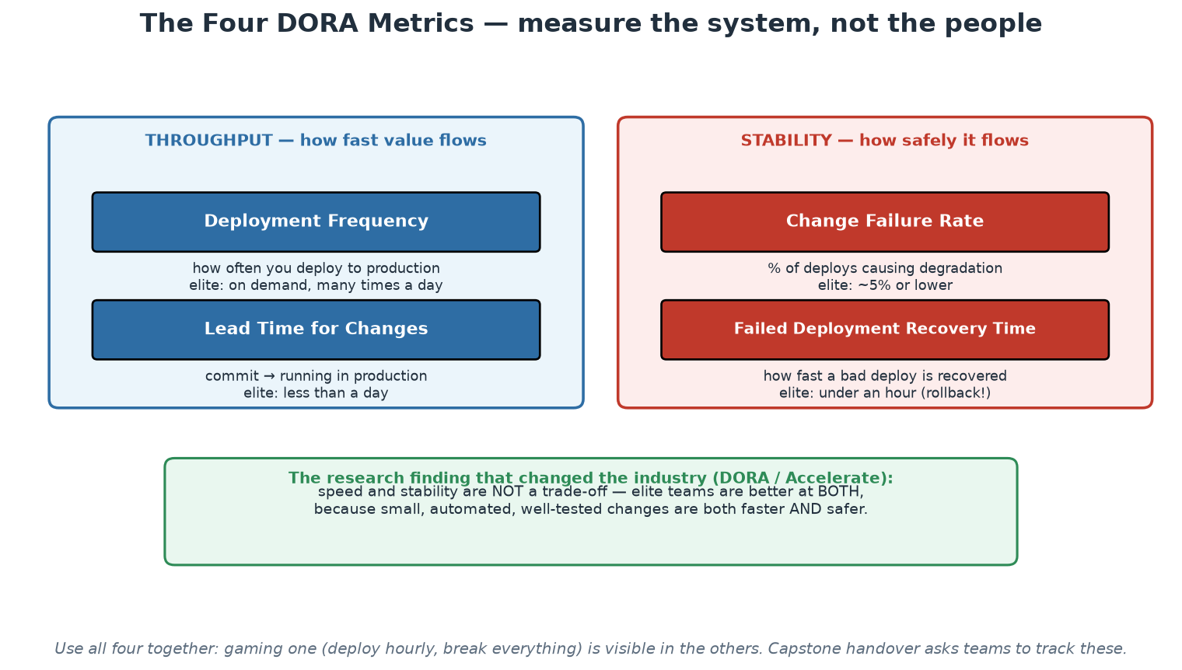
Measurement: the Four DORA Metrics
Two throughput metrics, two stability metrics - always read together.
Notes:
This is the measurement backbone for the whole course - introduce it here, and Modules 8 and 9 will reuse it. The DORA research program (DevOps Research and Assessment; the book 'Accelerate') surveyed tens of thousands of practitioners over a decade and produced the four metrics: deployment frequency and lead time for changes (throughput), change failure rate and failed-deployment recovery time (stability). The landmark finding: speed and stability are NOT a trade-off - elite performers are better at BOTH, because the same mechanisms (small batches, automation, fast feedback) produce speed and safety simultaneously. That single result dissolves the classic Dev-vs-Ops argument ('slow down to be safe') with data. Two warnings that must accompany any metrics talk: measure the SYSTEM, not individuals - the instant DORA metrics appear in performance reviews they will be gamed into meaninglessness; and read all four together - deploy frequency alone is trivially gamed (deploy trivia hourly) and shows up immediately in change-failure rate. EXERCISE (15 min, theory-demos.md): pairs map their own organisation's toolchain onto the categories from this module and estimate their four DORA numbers; collect a show of hands on lead time - the spread across the room is usually the best discussion starter of Day 1.

Slide 83
This Course's Toolchain (and Why)
Git + GitHub Actions - ubiquitous, free tier, local fallback with act.
Docker + Compose - the container standard; Compose for readable multi-service local stacks.
kind + kubectl - real Kubernetes API inside Docker: zero cloud cost, full fidelity.
Terraform + Ansible - both IaC halves: provisioning and configuration management.
Trivy + Conftest/OPA - scanning and policy as code | Prometheus + Grafana - observability.
Every tool here is free, runs on your VM's localhost, and is category-representative.
Notes:
Justify the choices so participants can translate to their own stacks. Each tool was chosen as a representative of its CATEGORY that runs locally at zero cost: what you learn about GitHub Actions' job graph transfers to GitLab CI's stages; kind serves the genuine Kubernetes API, so every kubectl command transfers unchanged to EKS/AKS/GKE; Trivy's severity/fixability triage transfers to any scanner; Rego policies transfer to admission controllers. If the room uses Azure DevOps or Jenkins, the pipeline CONCEPTS (jobs, dependencies, gates, artifact promotion) map one-to-one even where YAML syntax differs. This is also the honest answer to 'why are we not doing this on real cloud?': the workflow is identical, localhost removes cost, account friction and blast radius, and Workshop 3 shows exactly which single file changes when you point Terraform at AWS instead of local Docker.

Slide 84
Deep Dive: Why These Tools, and What Transfers
Selection rules for every tool in this course
  Free and open source, no account, no credit card - so every participant can rebuild the labs at home.
  Runs entirely on one Ubuntu 24.04 VM's localhost - no shared infrastructure, no cloud dependency.
  Category-representative: what you learn is the pattern, not the vendor's dialect.
  Installed once by lab-setup/install-ubuntu24.sh and verified by lab-setup/check-environment.sh.
What transfers to your workplace, tool by tool
  GitHub Actions -> GitLab CI / Azure DevOps / Jenkins: jobs, dependencies, gates, artifacts map one-to-one.
  Docker + Compose -> any container platform: the image contract and the multi-service stack are universal.
  kind + kubectl -> EKS / AKS / GKE: kind serves the real Kubernetes API, so every command transfers unchanged.
  Terraform (docker provider) -> AWS/Azure/GCP: swap the provider block; plan, apply, state and modules are identical.
  Trivy and Conftest/OPA -> any scanner or admission controller: severity triage and policy-as-code are the skills.
  Prometheus + Grafana -> Datadog / Cloud Monitoring: the SLI/SLO reasoning is the part that matters.
The honest answer to 'why not real cloud?'
  Cloud accounts add cost, IAM setup, quota limits and shared-blast-radius risk to a two-day class.
  None of that teaches the WORKFLOW, which is the transferable skill; localhost teaches it with faster feedback.
  You leave with a package you can re-run for free, which is what makes the second, unaided repetition possible.
Notes:
Handle the credibility question directly, because a sceptic in the room is thinking 'this is a toy setup'. The argument has three parts. First, fidelity where it matters: kind runs genuine upstream Kubernetes, so kubectl, manifests, RBAC, probes and rollouts behave exactly as they do on a managed cluster; Terraform's plan/apply/state workflow is provider-independent by design; Trivy's output and triage logic are the same against any registry. Second, feedback speed: a localhost lab has a ten-second cycle and no quota, so participants iterate far more times in two days than a cloud lab would allow, and repetition is what builds skill. Third, ownership: they leave with a package that runs on any Ubuntu machine for free, which is what makes the recommended second unaided run realistic. Say clearly what does NOT transfer, because honesty here is worth more than the claim: cloud IAM, networking, quotas, managed-service specifics and cost management are real skills this course does not teach, and participants should plan to learn them next - the Module 11 next-steps slide names them.

Slide 85
Deep Dive: Your Toolchain Map - a 15-Minute Exercise
Step 1 - draw your current map (5 min, individually)
  Draw eight boxes: source control, CI/CD, artifacts, IaC, config mgmt, runtime, secrets, observability.
  Write in what your organisation ACTUALLY uses - including 'nothing' and 'a person does this by hand'.
  Mark any box where two teams use different tools for the same job.
Step 2 - score each box (5 min)
  Is it declarative? Is its configuration in Git? Can it be driven entirely from a pipeline?
  Who operates it, and what happens if that person is unavailable for two weeks?
  Would a new engineer find it on day one without asking a human?
Step 3 - pick one move (5 min, share with a neighbour)
  Empty boxes are your gaps; boxes with three answers are your standardisation opportunity.
  Boxes marked 'a person does this' are your automation backlog, ordered by how often the person does it.
  Choose ONE change you could start in your first week back, and name what metric would move if it worked.
Notes:
This is the 15-minute toolchain-mapping exercise the module allows for; run it now rather than describing it. Facilitation notes: keep step one strictly individual and honest - the point is the real map, not the architecture diagram from the strategy deck, and the differences between the two are themselves the finding. In step two, the four questions come from the tool-choice principles two slides earlier, so participants are applying the framework rather than opining. In step three, insist on ONE change and on naming the metric, because the failure mode of a mapping exercise is a wish list nobody starts. Collect three or four aloud and note them on the flipchart next to the Module 1 pain points - both lists get reused in Module 9's platform canvas, where they become user needs for a golden path. If the room is from a single organisation, run steps one and two as a group on one shared map instead; the disagreements about what is actually in use are usually the most valuable ten minutes of the module.

Slide 86
In Context: From These Labs to SARB Environments
What transfers unchanged
  The WORKFLOW: propose, review, verify automatically, promote an immutable artefact, observe, roll back.
  Pipeline concepts: jobs, dependencies, gates, environments, approvals - identical across engines.
  Kubernetes API skills from kind: manifests, probes, rollouts, RBAC behave the same on any conformant cluster.
  Terraform's plan/apply/state/modules workflow, whatever the target provider turns out to be.
  Triage discipline for scanners, and policy-as-code thinking for institutional rules.
What you will have to add back at work
  Identity integration, network zoning, and whatever access model your environments require.
  Data protection in practice: classification, masking or synthetic data for test, retention rules.
  Change records and evidence retention wired into the pipeline rather than produced by hand afterwards.
  Availability expectations for industry-facing services, including windows the institution cannot move.
A sensible first target after the course
  Choose an INTERNAL, low-criticality service as the first end-to-end golden path - never settlement-critical.
  Prove the full loop on it: pipeline, IaC, scanning, deploy, dashboard, alert, rollback, postmortem format.
  Then take the evidence - not the enthusiasm - to risk and audit colleagues and agree the pattern.
  Only then extend the pattern toward more critical systems, one control conversation at a time.
Notes:
Set expectations honestly at this point in the day, because participants are about to spend the afternoon in labs on localhost and some will privately wonder how it relates to their estate. Be explicit about the split: the workflow, the concepts and the tool skills transfer directly; the institutional wrapping - identity, zoning, classification, evidence, windows - does not exist in the labs and has to be added deliberately. That admission increases credibility rather than reducing it. The last section is the most useful advice in the module: the way this pattern succeeds in a supervised institution is by proving it end to end on something genuinely low-risk, then presenting evidence rather than argument to the colleagues who own control assurance. Teams that try to start with a critical system spend a year in meetings; teams that arrive with a working pipeline, a reproducible environment, an audit trail that generates itself and a rollback they have demonstrated tend to find the conversation much shorter. Encourage participants to identify a candidate service before they leave.

Slide 87
Module 3 - Key Takeaway
"A fool with a tool is still a fool - but a generative team with a paved road is a force multiplier. Choose categories deliberately; let the platform choose brands once, for everyone."
— Course synthesis (first clause: Grady Booch)
Notes:
Bridge to Module 4: source control and pipelines assume the thing being delivered is code - IaC is what makes the INFRASTRUCTURE itself deliverable the same way.

Slide 88
Module 4
Infrastructure as Code (IaC)
Notes:
75 minutes deep theory + a 10-minute basic demo (terraform plan walk-through). Workshop 3 later today is the full hands-on. Goal: participants understand WHY declarative + state + review beats scripts, and can place Terraform vs Ansible vs images correctly.

Slide 89
The Problem IaC Solves
Snowflake servers: hand-built, undocumented, unreproducible - 'do not reboot #3'.
Configuration drift: environments diverge silently until 'works in staging' means nothing.
ClickOps: console changes leave no diff, no review, no rollback, no audit trail.
Disaster recovery without IaC is archaeology; with IaC it is 'apply' in a new region.
Pets vs cattle: name-and-nurse servers vs numbered, replaceable, rebuildable instances.
Notes:
Ground this in war stories - every ops veteran in the room has a snowflake server memory; invite one. The deep problem is that manually-produced infrastructure is UNKNOWABLE: its true configuration exists only as the accumulated side effects of every hand that touched it, so you cannot review it, reproduce it, or reason about it. Drift is the slow-motion version: staging and production started identical, then three years of hotfixes, one-off firewall rules and 'temporary' changes made 'it works in staging' an empty sentence. ClickOps is the mechanism of both: console changes are invisible to code review, produce no history, and cannot be rolled back - the console is to infrastructure what editing directly on the production server is to code. The pets/cattle metaphor (Bill Baker, popularised by CERN) captures the mindset shift: pets are named, nursed back to health, irreplaceable; cattle are numbered, replaced when sick, and their definition lives elsewhere - in code. Disaster recovery is the acid test to pose to the room: if your data centre or cloud region vanished tonight, is rebuilding a git clone + terraform apply, or six months of archaeology?

Slide 90
Deep Dive: Four Failure Modes of Hand-Built Infrastructure
SNOWFLAKE SERVERS - unknowable by construction
  The true configuration exists only as the accumulated side effects of every hand that ever touched it.
  Nobody can review it, reproduce it, or reason about it - so nobody dares change or reboot it.
  Knowledge lives in individuals; when they leave, the server becomes an artefact to be excavated.
  The tell: a machine with a name, a legend, and an informal rule that only one person may touch it.
CONFIGURATION DRIFT - the slow divergence
  Environments start identical and diverge with every hotfix, 'temporary' rule and manual tweak.
  Eventually 'it works in staging' predicts nothing, and staging stops being a test of anything.
  Drift is silent: there is no alert for it, because nothing declared what correct was supposed to be.
  IaC makes drift detectable - a plan against reality prints the divergence as a diff.
CLICKOPS AND DISASTER RECOVERY
  A console change leaves no diff, no review, no reason, no rollback and no audit trail.
  The console is to infrastructure what editing production files over SSH is to source code.
  Without IaC, recovery in a new region is archaeology: reconstruct from memory, tickets and screenshots.
  With IaC it is 'apply the same code, change the region variable' - and you can rehearse it on a Tuesday.
Notes:
Ground this in war stories - invite one from the room, because every operations veteran has a snowflake memory and the telling does more than any slide. Then make the deep point: hand-built infrastructure is not merely undocumented, it is UNKNOWABLE, because its state is the sum of every undocumented action ever taken on it. That is why the fear of rebooting is rational. Drift deserves the most time because it is the failure participants live with daily and rarely name: the environments diverge invisibly, and the whole value of a staging environment - that passing there predicts passing in production - quietly evaporates. Note the asymmetry that makes IaC powerful here: drift only becomes visible once something has DECLARED the intended state, which is why plan output is a monitoring tool as much as a change tool. On disaster recovery, give the rehearsal framing that sells IaC to management: with code, recovery is a routine you can practise on a scheduled afternoon; without it, it is an untested plan in a binder, and untested plans fail at exactly the moment they are needed.

Slide 91
Deep Dive: Pets vs Cattle, and What IaC Gives You Back
PETS vs CATTLE - the mental shift
  Pets: named, unique, nursed back to health when sick; downtime is a crisis and an all-nighter.
  Cattle: numbered, identical, replaced when sick; failure is routine and handled automatically.
  The shift is not cruelty to servers - it is refusing to keep state and knowledge in a machine's local disk.
  Containers are cattle by default, which is why the discipline came with the cloud-native wave.
  Honest caveat: databases and stateful systems still need care - cattle thinking applies to the compute tier first.
What you get once infrastructure is code
  Reproducibility: identical environments from one definition, differing only by explicit variables.
  Review: infrastructure change goes through pull request, with a diff a colleague can actually read.
  Rollback: revert the commit, apply - the same recovery model as application code.
  Testing and scanning: policy checks and misconfiguration scanners run before anything exists (Module 7).
  Speed with safety: an environment in minutes, and the same path used for the twentieth as for the first.
What IaC does NOT solve
  Bad architecture written in HCL is still bad architecture, now reproduced perfectly at scale.
  State files, credentials and blast radius become new things to manage carefully.
  Skills shift rather than vanish: your team now needs to read code and reason about plans.
  Partial adoption is dangerous: manual changes on top of IaC-managed resources cause the worst surprises.
Notes:
The pets-and-cattle analogy is well known, so add value by stating what it actually demands: no important state on local disk, no manual configuration after boot, no machine that cannot be destroyed and recreated on a whim. Give the practical test - could you terminate any one instance right now, at random, during business hours, and would anything other than a graph move? Netflix's Chaos Monkey exists to enforce exactly that answer. Include the caveat about stateful systems so the room does not over-apply the metaphor; databases are the classic legitimate pet, and treating them as cattle without careful backup, replication and migration design is how people lose data. On the benefits list, emphasise the governance point that plays well with auditors and change boards: a reviewed pull request containing an exact plan diff, with approval recorded, is stronger evidence of controlled change than a meeting minute. Then be honest about limits - this keeps you credible and pre-empts the disappointment of teams who adopt Terraform and expect their architecture problems to disappear. The last bullet is the operationally important one: mixing manual changes with IaC-managed resources produces the worst of both worlds, which is exactly what drift detection and GitOps reconciliation exist to prevent.

Slide 92
In Context: Snowflakes, Drift and DR in a Regulated Estate
The snowflake problem in a long-lived institution
  Systems that have run for a decade accumulate undocumented, hand-applied configuration nobody dares touch.
  The knowledge lives with a few individuals - a concentration risk the institution would never accept elsewhere.
  Environments diverge, so testing loses predictive power exactly where predictability matters most.
  Key-person dependency on infrastructure knowledge is a risk finding waiting to be written.
Disaster recovery: the difference IaC makes
  Without IaC, recovery is reconstruction from memory, tickets and screenshots - untested and slow.
  With IaC, recovery is 'apply the same definitions to a different target' - and it can be REHEARSED.
  Rehearsal is the point: a plan exercised quarterly is a capability; one exercised never is a document.
  The same code that builds production builds the DR environment, so parity is structural, not aspirational.
What auditors and assessors get out of it
  A reviewable definition of the intended configuration, with history, authorship and approvals attached.
  Drift detection: a scheduled plan proves whether reality still matches the approved definition.
  Change evidence generated continuously instead of assembled into a pack once a year.
  Reproducibility: the same environment can be stood up for testing, forensics or recovery on demand.
Notes:
Lead with the risk framing, because in this audience it is both true and persuasive. Undocumented, hand-built infrastructure is a key-person and reconstruction risk of exactly the kind the institution scrutinises in others, and IaC is the mitigation. The disaster-recovery argument is the strongest single business case available for IaC in a central bank: recovery capability is a supervisory and board-level concern, and the difference between a documented plan and a rehearsed capability is enormous. Make the rehearsal point concrete - with infrastructure as code, standing up a parallel environment is a routine operation that can be scheduled on a Tuesday morning, which means the recovery path is exercised by people who are awake, in daylight, with time to fix what does not work. Then the assurance angle: drift detection is genuinely novel for many control environments, because it converts an annual attestation into a continuous, evidenced check. Encourage participants to bring that specific capability to their next control conversation - a scheduled job that proves reality still matches the approved definition is easy to explain and hard to argue with.

Slide 93
Core Principles: Declarative, Idempotent, Immutable
DECLARATIVE: describe desired END STATE; the tool computes how to get there.
-> enables diffing (plan), review, drift detection - a script can do none of these.
IDEMPOTENT: applying twice = applying once; safe to re-run, safe to automate.
IMMUTABLE: never patch in place - build a new artifact, replace the old (like containers).
Version-controlled: the Git history of your infra IS your change management system.
Notes:
These four properties are the module's theoretical heart - everything else is tooling. Declarative vs imperative deserves a careful contrast: an imperative script ('create a network, then start container A, then B') encodes one path from one assumed starting point, so it breaks when reality differs and can never tell you what would change; a declarative definition ('these two containers on this network should exist') lets the tool compare desire against reality and compute the minimal path - which is exactly what terraform plan prints, and why plan output is reviewable in a pull request. Idempotence is what makes automation SAFE: a converging tool can run on every commit or on a timer; a non-idempotent script needs a human to check state first, which reintroduces the human bottleneck. Immutability transfers the container insight to infrastructure: patching a running server accumulates unknowable state, so instead you bake a new image/artifact and replace - rollback becomes 'run the previous version' instead of 'undo the patch and pray'. Version control ties it together into governance regulators actually accept: who changed what, when, reviewed by whom - it is all git log.

Slide 94
Deep Dive: Declarative and Idempotent
DECLARATIVE - describe the destination, not the journey
  Imperative: 'create a network, then start container A, then container B' - one path from one assumed start.
  It breaks whenever reality differs from the assumption, and it can never tell you what it would change.
  Declarative: 'these two containers on this network exist, with these settings' - the tool computes the delta.
  That delta is the whole payoff: plan output, code review of infrastructure, policy checks, drift detection.
  Rule of thumb: if you cannot get a dry-run diff, you are holding an imperative tool.
IDEMPOTENT - applying twice equals applying once
  Safe to re-run: on a timer, in a pipeline, after a partial failure, or by a nervous engineer at 03:00.
  This is what makes automation trustworthy - convergence rather than accumulation of side effects.
  Counter-example: a shell script that appends a firewall rule adds it again on every run, forever.
  Ansible modules are written to be idempotent for this reason; Terraform gets it from desired-state design.
  Test it in the lab: run terraform apply twice and read 'No changes' - that sentence is the principle working.
Why these two properties enable everything else
  Reviewable change: a diff that a colleague can approve BEFORE it touches anything real.
  Continuous reconciliation: GitOps agents can re-apply forever precisely because re-applying is safe.
  Automated remediation: drift can be corrected by machine, because correction is just another apply.
Notes:
These properties are the module's theoretical heart, so make participants feel the difference rather than memorise definitions. The most convincing demonstration is the one they do in the lab: run terraform apply, then run it again and read 'No changes. Your infrastructure matches the configuration.' That message is only possible because the tool holds a model of desired state and compares it to reality - a script fundamentally cannot say it. Use the firewall-rule counter-example for idempotence because everyone has been bitten by an appending script. Be precise about why the pair matters together: declarative gives you the diff, idempotence makes acting on it safe repeatedly, and together they enable the two most valuable modern practices - reviewing infrastructure change as a diff before it happens, and letting an agent continuously reconcile reality without human involvement. Also note the honest edge: idempotence is a property of well-written resources, not a magic guarantee - provisioners running arbitrary shell commands inside Terraform are the classic way people smuggle imperative, non-idempotent behaviour back in, which is why they are a last resort.

Slide 95
Deep Dive: Immutable Infrastructure and Versioned Change
IMMUTABLE - replace, never patch in place
  Mutable: SSH in, patch, restart - and now this machine differs from every other machine, undocumeneted.
  Immutable: build a new artifact (image), deploy it, remove the old one - the change is the artifact.
  Consequences: identical instances, trivial rollback (redeploy the previous image), no configuration archaeology.
  Containers made this the default: you rebuild an image, you do not apt-get upgrade inside a running container.
  Cost: you need a fast, reliable build-and-deploy path - immutability without automation is just slow.
VERSION-CONTROLLED - Git history IS change management
  Every infrastructure change is a commit: who, what, when, why, reviewed by whom.
  Rollback is revert-and-apply; investigation is git log; approval is the PR record.
  This is the compliance story: an exact diff plus recorded approval beats a change-board minute.
  It is also the onboarding story: the history explains how the estate reached its current shape.
Applying the three properties as a review checklist
  Can I see the intended end state in a file, without reading a procedure? (declarative)
  Can I run this again safely, right now, twice? (idempotent)
  Does a change produce a new artifact rather than editing a live one? (immutable)
  Is the change a reviewed commit, and could I revert it in one command? (versioned)
Notes:
Immutability is the property with the biggest cultural resistance because it contradicts a career's worth of operational instinct - fixing the sick machine is what good operators did. Make the trade explicit: immutability buys uniformity and trivially reversible change, and it charges a fast, dependable build-and-deploy pipeline as the price. That is why this course teaches CI/CD before it teaches Kubernetes rollouts; without the pipeline, immutable infrastructure is just a slower way to make changes. Give the concrete pattern: the golden image or container image is built once, versioned, scanned, promoted unchanged, and replaced wholesale on the next change - which is exactly the build-once-promote-many rule from Module 5. On version control, emphasise that participants can use this as an argument in regulated environments: auditors care about evidence of controlled, reviewed, reversible change, and a pull request containing a plan diff with named approvers is better evidence than most manual processes produce. Finish with the four-question checklist on the slide - it is a genuinely useful review lens for any automation a participant meets afterwards, including tooling they did not write.

Slide 96
In Context: Immutability and Change Control
Mapping the principles onto change management
  DECLARATIVE gives you a diff: the change record can contain the exact resources to be added, changed, destroyed.
  IDEMPOTENT makes re-running safe, so recovery and reconciliation are routine rather than risky.
  IMMUTABLE means the artefact promoted to production is the artefact that was tested - provable by digest.
  VERSIONED means the approval, the change and the evidence are the same record, not three systems.
Why 'no patching in place' improves assurance
  Patch-in-place creates a system whose true state is the sum of undocumented interventions.
  Replace-the-artefact keeps every running instance identical to a definition someone reviewed.
  Rollback becomes 'redeploy the previous digest' - a tested state, not a repair under pressure.
  The cost is honest: immutability requires a reliable build-and-deploy path, which is why CI/CD comes first.
A change record that writes itself
  What changed: the plan diff and the artefact digest, both machine-generated.
  Why: the pull request description and the linked ADR or work item.
  Who approved: the recorded review, enforced by branch protection rather than by convention.
  Result: pipeline run, deployment outcome, smoke-test result, and the rollback path if it was used.
Notes:
The third section is the one to leave on screen: it lists, item by item, what a mature change record contains and shows that every element can be produced automatically by the practices in this course. That is a genuinely attractive proposition in an institution where change records are assembled by hand and are therefore both expensive and, quietly, less accurate than everyone would like. Make the honesty point about immutability's cost - it demands a build-and-deploy path that works reliably, and an institution that adopts immutability without investing in that path has simply made changes slower. That is why the course sequences CI/CD before runtime. On declarative and idempotent, the practical demonstration is the one participants will run in the lab: a second apply that reports no changes proves the tool holds a model of intent, and that same mechanism is what makes drift detection and automated recovery possible. Keep tying the principles back to control language - diffable, reviewable, provable, reversible - because those four words are what the risk conversation is actually about.

Slide 97
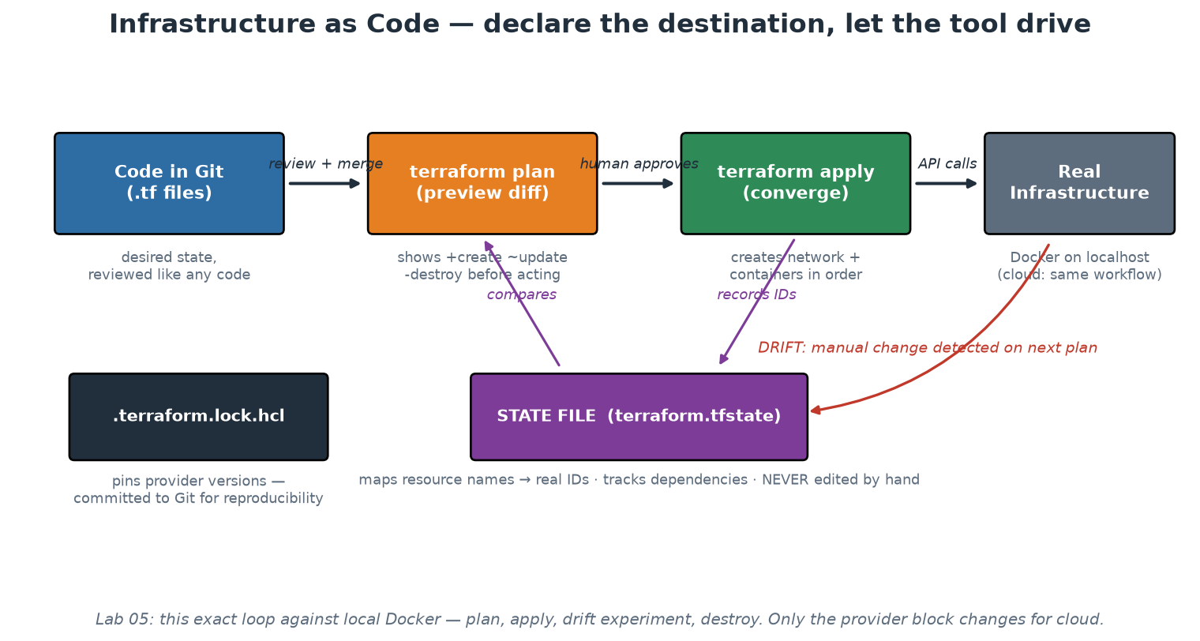
The IaC Loop: Code, Plan, Apply, State, Drift
Desired state in Git; plan previews the diff; state maps names to reality.
Notes:
Walk each element slowly - this diagram is Workshop 3's map. Code in Git: HCL files declaring resources, reviewed like any code. Plan: the safety mechanism - Terraform refreshes reality, compares against desire, and prints +create/~update/-destroy BEFORE anything changes; a human (or CI gate) approves the diff, not the intention. Apply: executes exactly the approved plan. The STATE FILE is the piece newcomers underestimate: it maps resource names in code to real-world IDs (this docker_container resource IS container abc123), which is how Terraform knows an existing container should be updated rather than duplicated - hence the rules: never edit it by hand, store it remotely with locking when a team shares it, and treat it as sensitive (it can contain secrets in plain text). Drift detection falls out naturally: delete a managed container manually and the next plan shows '1 to add' - Terraform noticed reality diverged from state. The lock file (.terraform.lock.hcl) pins provider versions and IS committed - reproducibility across teammates and CI. Participants run this entire loop, including the drift experiment, in Workshop 3.

Slide 98
Provisioning vs Configuration Management
PROVISIONING - Terraform, OpenTofu, Pulumi, CloudFormation, Bicep
Creates/destroys infrastructure: networks, VMs, clusters, DNS, containers.
Declarative model + state file tracking what exists.
Answers: WHAT infrastructure exists?
Cloud-agnostic workflow; provider plugins per platform.
CONFIG MANAGEMENT - Ansible, Chef, Puppet, Salt
Configures existing machines: packages, files, services, users.
Idempotent tasks/modules; Ansible is agentless (SSH), no state file.
Answers: HOW is each machine configured?
Still essential for VMs, bare metal, network devices, appliances.
Notes:
This split answers the outline's 'implementing IaC with configuration management tools' precisely. Provisioning tools make infrastructure exist; configuration management makes existing machines correct. Classic composition: Terraform creates the VM, then Ansible (or cloud-init, or a baked image) configures it. The modern twist: container images have absorbed much of configuration management's old territory - a Dockerfile IS the configuration of the runtime environment, applied at build time instead of continuously - which is why cloud-native shops run less Puppet than 2015 did. But config management remains essential wherever long-lived mutable machines exist: VM fleets, bare metal, network switches, and - as in our bonus lab - workstations. Mention Pulumi as the 'real programming language' alternative to HCL (TypeScript/Python/Go with the same plan/apply model) and OpenTofu as the community fork of Terraform. BASIC DEMO (10 min, theory-demos.md): run the Lab 05 bonus Ansible playbook against the VM's localhost twice - the room watches changed=N become changed=0, which makes idempotence tangible in one minute.

Slide 99
Ansible (1/3): Your First Playbook
Configuration management: make an existing machine correct, and keep it that way.
# inventory.ini - which machines, in which groups
[app_servers]
localhost ansible_connection=local
# site.yml - the desired state of those machines
- name: Configure the order-service host
hosts: app_servers
become: true
vars:
app_port: 8000
tasks:
- name: Required packages are present
ansible.builtin.apt:
name: [python3, python3-venv, curl]
state: present # state, not 'apt-get install'
update_cache: true
- name: Application directory exists
ansible.builtin.file:
path: /opt/order-service
state: directory
owner: appuser
mode: '0750'
- name: Service is enabled and running
ansible.builtin.systemd:
name: order-service
enabled: true
state: started
→ Every task declares a STATE. Ansible decides whether anything needs to change.
Notes:
Ansible answers the outline's 'automation with Ansible' directly, and participants who have written shell scripts will feel the difference immediately. Walk the anatomy: an inventory (which machines, grouped by role), a play (hosts + variables), and tasks (modules with desired state). The critical mental shift is in the `state:` keyword - you are not saying 'run apt-get install', you are saying 'this package should be present', and the module works out whether action is required. That is what makes the playbook safe to run every day. Agentless matters in a regulated estate: Ansible connects over SSH (or WinRM) with no daemon to install, patch or exempt from scanning, which is often the difference between an approved tool and a six-month security review. Point out `become: true` (privilege escalation, auditable in the play rather than hidden in a script) and the file mode/owner on the directory - configuration management is where those small compliance details actually get enforced consistently across a fleet.

Slide 100
Ansible (2/3): Idempotence You Can See
Run it twice. The second run is the proof that the tool converges rather than repeats.
$ ansible-playbook -i inventory.ini site.yml
PLAY [Configure the order-service host] ****************************
TASK [Required packages are present] *******************************
changed: [localhost]
TASK [Application directory exists] ********************************
changed: [localhost]
TASK [Service is enabled and running] ******************************
changed: [localhost]
PLAY RECAP *********************************************************
localhost : ok=3 changed=3 unreachable=0 failed=0
$ ansible-playbook -i inventory.ini site.yml # exactly the same command
PLAY RECAP *********************************************************
localhost : ok=3 changed=0 unreachable=0 failed=0
# ^^^^^^^^^ nothing to do - reality already matches
# Preview mode: what WOULD change, without changing anything
$ ansible-playbook -i inventory.ini site.yml --check --diff
→ changed=0 on the second run is idempotence. A shell script cannot tell you this.
Notes:
This is the slide that makes idempotence concrete rather than theoretical, so slow down here. The first run reports changed=3 because reality did not match the declaration; the second reports changed=0 because it now does. A shell script that appends a line to a config file has no equivalent - run it twice and you get the line twice. That difference is exactly why configuration management tools exist, and why they are safe to run on a schedule. Two operational habits to teach alongside it. First, `--check --diff` is Ansible's dry run: it reports what would change and shows the textual diff, which is the same review affordance that terraform plan gives, and it belongs in a pull request or a change record. Second, changed=0 is a drift DETECTOR: schedule the playbook, alert on any non-zero changed count, and you have continuous assurance that the fleet still matches its declared state - a genuinely strong control that costs almost nothing once the playbook exists.

Slide 101
Ansible (3/3): Structure, and When to Use It
How a real Ansible repository is organised
  inventories/ - one per environment (dev, test, prod); never mix environments in one file.
  roles/ - reusable units: tasks, handlers, templates, defaults, files. The platform team's product.
  group_vars/ and host_vars/ - configuration per group or machine, kept out of the tasks.
  site.yml - the playbook that binds hosts to roles. Small, readable, reviewable.
  ansible-vault for secrets, or better, a lookup into a real secrets manager at run time.
Ansible vs Terraform - different questions
  Terraform: does this infrastructure EXIST? (create/destroy networks, VMs, clusters, DNS)
  Ansible: is this existing machine CORRECT? (packages, files, services, users, tuning)
  Classic composition: Terraform creates the VM, Ansible configures it, both in the pipeline.
  Containers absorbed much of Ansible's old territory - a Dockerfile is build-time configuration.
  Ansible stays essential for: VM fleets, bare metal, network devices, appliances, Windows estates.
Practices that keep playbooks trustworthy
  Run ansible-lint in CI, and run the playbook in --check mode on every pull request.
  Name every task - the name is what appears in the output and in your change evidence.
  Prefer modules over the shell/command module; when you must shell out, add creates:/removes:.
  Tag tasks so an operator can run a slice safely: ansible-playbook site.yml --tags packages.
  Keep playbooks in Git with the same review rules as application code - it IS production change.
Notes:
Close the Ansible block with structure and judgement. On layout, the single most valuable habit is roles: a role is a versioned, reusable unit with a documented interface (its defaults), which makes it the configuration-management equivalent of a Terraform module and therefore a natural platform-team deliverable - 'the standard hardened-host role' encodes the institution's baseline once. On the comparison, give the room the one-sentence test: existence versus correctness. Teams that try to do everything in one tool end up writing awkward provisioning in Ansible or awkward configuration in Terraform provisioners; the composition is cleaner and is what most mature shops run. Be honest that containers have shrunk configuration management's footprint - if a workload is containerised, its configuration lives in the image and the manifest - but also that the long tail of VMs, appliances and network gear is exactly where central banks and other established institutions have most of their estate, so Ansible skills remain directly employable. Finally the practices: --check in CI is the cheapest control on this slide, and naming tasks properly is what turns playbook output into audit evidence.

Slide 102
Ansible
Configuration management + orchestration · agentless over SSH · YAML playbooks
WHAT IT IS
A tool that brings existing machines to a declared state - packages, files,
services, users - and can orchestrate multi-step operations across a fleet.
HOW IT WORKS
An inventory lists hosts and groups; playbooks bind hosts to tasks and roles.
Ansible connects over SSH (or WinRM), copies a module, runs it, removes it - no agent.
Modules are written to be idempotent: they check state and act only if needed.
Roles package tasks, templates, handlers and defaults into reusable units.
ADVANTAGES
• Agentless: nothing to install, patch, scan or exempt on the managed machines.
• Low barrier - YAML that reads like a runbook, so ops teams adopt it quickly.
• Reaches what containers cannot: VM fleets, bare metal, network devices, Windows.
• Doubles as an orchestrator for ordered operations (rolling restarts, patching runs).
WATCH OUT FOR
• No persistent state model, so it detects drift only when you run it (schedule it).
• SSH fan-out gets slow across thousands of hosts without tuning or pull mode.
• Playbooks drift toward imperative scripting once shell/command modules creep in.
• Testing is harder than application code - molecule and --check help, but it is real work.
ALTERNATIVES: Puppet · Chef · Salt · cloud-init / golden images (Packer) · Terraform (different job)
WHY THIS ONE: Agentless and readable - the pragmatic choice for estates that are not all containers.
Notes:
Ansible directly answers the 'automation with Ansible' expectation, and its profile is unusually easy to summarise: agentless and readable. Agentless matters more in a regulated estate than people expect - no daemon means nothing extra to patch, scan, monitor or justify to a security review, which is often the difference between a tool that gets approved in a month and one that takes a year. Readability matters because configuration management sits with operations teams who may not be full-time programmers, and a playbook that reads like a runbook gets maintained. The honest weaknesses: it is not a state engine in the Terraform sense - it converges when you run it and knows nothing between runs, so drift detection means scheduling it and alerting on any changed count; and discipline is required to keep tasks declarative, because every shell: line is a step back toward a bash script. Position it against Terraform one more time: existence versus correctness, and the two compose rather than compete.

Slide 103
Terraform's Mental Model in Five Concepts
PROVIDER: plugin that speaks one platform's API (docker, aws, azurerm, kubernetes...).
RESOURCE: one declared object - a network, a container, a DNS record.
VARIABLES / OUTPUTS: parameterise modules in; export facts out.
STATE: the mapping between declarations and reality (remote + locked in teams).
MODULE: a reusable, versioned package of resources - the platform team's product unit.
Notes:
Five concepts cover 90% of real Terraform reading. Providers are why one workflow spans platforms: our labs use kreuzwerker/docker against the local daemon, and swapping to hashicorp/aws changes the provider block and resource types while plan/apply/state stay identical - THAT is the honest cloud story for this course, and the workshop makes participants prove it to themselves by reading main.tf. Resources declare objects and, crucially, reference each other: our order container's environment references the payment container's name, and from that reference Terraform derives creation ORDER automatically - dependency graphs from data flow, no 'depends_on' choreography needed in most cases. Variables/outputs make configurations reusable across environments (the tfvars file per environment pattern). Modules are the platform-engineering unit: the capstone wraps the whole two-service stack into one module that a consuming team calls with four variables - the module encodes the platform team's decisions once (Module 9's cognitive-load story, realised in HCL). State: covered on the previous slide; in teams it lives remotely (S3+DynamoDB, Terraform Cloud, GitLab) with locking, never in laptops.

Slide 104
Deep Dive: Providers, Resources, Variables and Outputs
PROVIDER - the plugin that speaks one platform's API
  One workflow, many platforms: docker, aws, azurerm, google, kubernetes, github, cloudflare and hundreds more.
  Declared and version-pinned in required_providers; downloaded by terraform init into .terraform/.
  Our labs use kreuzwerker/docker against the local daemon - same workflow, zero cloud cost.
  Moving to AWS changes the provider block and the resource types; plan, apply, state and modules are unchanged.
RESOURCE - one declared object, plus the dependency graph
  resource "docker_container" "order" { ... } declares one object and names it for reference.
  Resources reference each other's attributes, and Terraform DERIVES creation order from those references.
  So you rarely write depends_on - the data flow is the dependency graph.
  Data sources are the read-only sibling: look up something that already exists without owning it.
VARIABLES and OUTPUTS - the module's interface
  Variables parameterise: environment names, image tags, replica counts, ports - with types and defaults.
  Never put secrets in variable defaults or .tfvars in Git; reference a secrets manager instead.
  Outputs export facts for humans and for other configurations (a URL, an ID, a generated name).
  Together they turn a directory of resources into a reusable component with a documented contract.
Notes:
Five concepts cover the overwhelming majority of real Terraform reading, so aim for fluency rather than completeness - participants should be able to open an unfamiliar repository and orient themselves. The provider point is the honest cloud story of this course and it is worth proving rather than asserting: in Workshop 3 have participants open main.tf and identify exactly which lines would change if the target were AWS instead of Docker - it is a small, bounded set, and the discovery is more convincing than any slide. The dependency-graph point is the one that produces genuine 'ah' moments: newcomers assume they must order operations, and the fact that referencing another resource's attribute creates the ordering automatically is what makes Terraform feel declarative in practice. Mention data sources briefly because real codebases are full of them and their distinction from resources - reading versus owning - is a common source of confusion. On variables, plant the secrets warning early and repeat it in the best-practices slide; the most frequent real-world Terraform incident is a credential committed in a .tfvars file.

Slide 105
Deep Dive: State and Modules - the Two That Bite
STATE - the map between your code and reality
  It records that resource docker_container.order IS container abc123 in the real world.
  Without it, Terraform could not tell 'update the existing thing' from 'create a second thing'.
  Rules: never hand-edit it; it may contain secrets, so protect it like a credential.
  For teams: remote backend with LOCKING, so two simultaneous applies cannot corrupt it.
  Recovery tools exist for when reality and state diverge: terraform state list/rm/mv, and import for adoption.
MODULE - the reusable, versioned unit
  A module is a directory of resources with variables in and outputs out - a component with an interface.
  The platform team's product unit: 'the standard service module' encodes networking, tagging, limits and policy.
  Consumers pin a version; improvements ship as a new version, adopted deliberately, not by surprise.
  Design small and composable: a giant root configuration is slow to plan and dangerous to change.
  Blast-radius rule: separate state per environment and per bounded area, so one apply cannot reach everything.
The mental model in one sentence
  Code declares desire, state records reality, plan is the difference, apply closes it, modules make it reusable.
  Every other Terraform feature you meet later is a variation on those five ideas.
Notes:
State is where beginners get hurt, so give it the airtime. Explain what it is with the concrete mapping - a resource address in code to an ID in the real world - and then the consequences fall out naturally: hand-editing it makes Terraform believe things that are not true; losing it makes Terraform think nothing exists and try to create duplicates; sharing it without locking lets two engineers corrupt it simultaneously; and it can contain secrets in plain text, which is why remote state must be encrypted and access-controlled. Mention the recovery commands so participants know a path exists when things go wrong - state list, state rm, state mv, and import for bringing existing hand-built infrastructure under management, which is how most real adoptions begin. Modules are where the platform thread reappears: a versioned module is exactly the 'golden path as a product' idea from Module 9, expressed in Terraform, and the version pin is what lets the platform team improve the default without breaking consumers on a random Tuesday. Close with the one-sentence model on the slide and ask the room to repeat it back - it is the single most useful thing they can carry into Workshop 3.

Slide 106
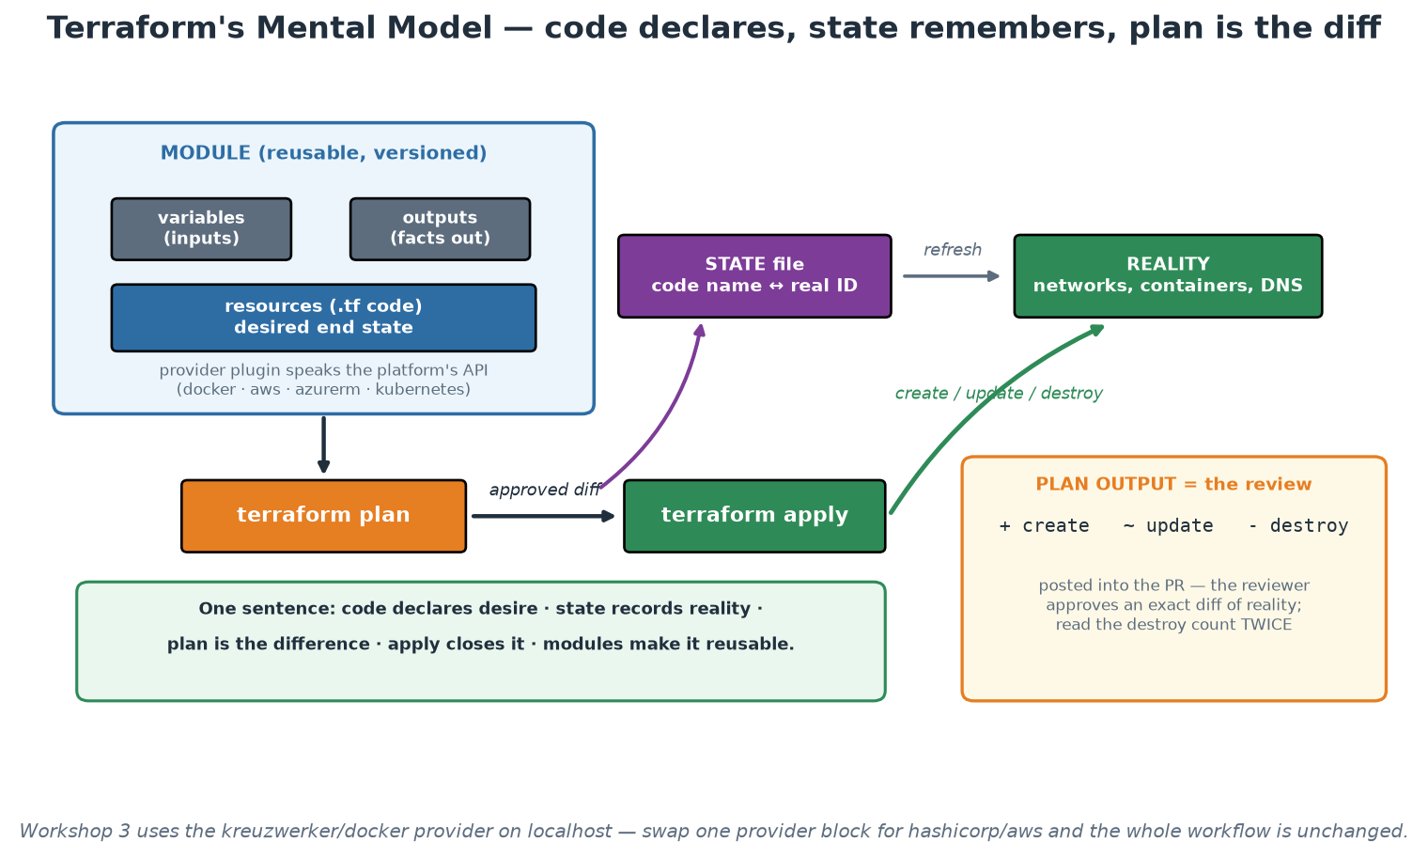
Terraform's Five Concepts
Code declares desire, state records reality, plan is the difference, apply closes it.
Notes:
Use the picture to fix the mental model before anyone touches syntax in Workshop 3. Trace the loop out loud: the module holds resources and a documented interface, the provider translates to a platform API, plan compares desire against the state's view of reality, apply executes the approved difference, and state is updated to match. Then point at the amber panel and give the operational habit that matters most: read plan output defensively, and treat any unexpected destroy count as a stop signal. Many real infrastructure incidents were described accurately in a plan that nobody read carefully. In a supervised institution that habit has a second benefit - the plan diff is exactly the artefact to attach to a change record, so reading it properly is both engineering discipline and governance.

Slide 107
In Context: Terraform in a Bank-Grade Environment
State is a sensitive asset - treat it like one
  State can contain resource attributes in clear text, so it inherits the classification of what it describes.
  Remote backend, encrypted at rest, access-controlled, versioned - never a laptop, never an email attachment.
  Locking prevents two simultaneous applies from corrupting the record of reality.
  Separate state per environment so a staging apply is structurally incapable of touching production.
Modules as the institution's paved road for infrastructure
  The platform team publishes versioned modules that encode zoning, tagging, logging and policy defaults.
  A delivery team consumes a module and gets a compliant-by-default resource set without reading a standard.
  Improvements ship as new versions and are adopted deliberately - consumers pin, so nothing changes by surprise.
  This is the single highest-leverage artefact a platform team can produce for a regulated estate.
Adopting an existing hand-built estate
  Start with terraform import on a bounded, low-criticality area - do not attempt the whole estate at once.
  Verify by producing a plan that reports NO changes; that no-change plan is the proof of an accurate model.
  Then own it: all further change flows through the repository, and manual changes are treated as incidents.
  Sequence areas by risk and by how often they change - frequently-changed, low-risk areas pay back first.
Notes:
Three practical points, all of which prevent real damage. First, state as a classified asset: teams routinely under-protect it because it looks like a working file, and it can contain sensitive attributes of the infrastructure it describes - so it belongs in an encrypted, access-controlled, versioned backend with locking, and separate per environment. The blast-radius argument for separate state is the one that persuades: the goal is that the worst possible mistake in a lower environment cannot reach production, guaranteed structurally rather than by care. Second, versioned modules as the infrastructure golden path - this is where Module 4 and Module 9 meet, and it is the most valuable thing a platform team in a supervised institution can build, because it makes the compliant configuration also the easiest configuration. Third, adoption: almost nobody starts from an empty estate, so give them the import-then-verify-with-a-no-change-plan recipe and the advice to sequence by change frequency, since the areas that change often are where automation pays back fastest and where drift is most damaging.

Slide 108
Terraform (1/2): The Configuration You Will Run
Workshop 3's main.tf - two containers on a network, declared, not scripted.
terraform {
required_version = ">= 1.6"
required_providers {
docker = { source = "kreuzwerker/docker", version = "~> 3.0" }
}
# backend "s3" { ... } # in a team: remote state + locking, never local
}
variable "app_port" { type = number, default = 8000 }
variable "environment" { type = string, default = "dev" }
resource "docker_network" "app" {
name = "order-net-${var.environment}"
}
resource "docker_container" "order" {
name = "order-service-${var.environment}"
image = docker_image.order.image_id # <- reference = dependency
networks_advanced { name = docker_network.app.name }
ports { internal = 8000, external = var.app_port }
env = ["PAYMENT_URL=http://payment-service:8001"]
}
output "order_url" { value = "http://localhost:${var.app_port}" }
→ No creation order is written anywhere - Terraform derives it from the references.
Notes:
Read this as prose, not syntax. The `required_providers` block is the plugin that speaks Docker's API; swapping it for hashicorp/aws plus aws_instance resources is what 'moving to cloud' actually means for this file - the workflow around it does not change at all, and that is the honest answer to 'but we are not using Docker in production'. Variables give the module its interface, and the environment variable feeding the resource names is how one configuration serves dev, test and prod without copy-paste. The line to dwell on is `image = docker_image.order.image_id`: nobody wrote 'create the network first, then the image, then the container'. Terraform builds a dependency graph from these references and orders the work itself, which is what makes declarative infrastructure genuinely different from a provisioning script. Point at the commented-out backend block and connect it to the production checklist: local state is fine for this lab and unacceptable for shared infrastructure.

Slide 109
Terraform (2/2): Plan Output Is the Change Record
The diff a reviewer approves - and the artefact to attach to a change request.
$ terraform plan
Terraform will perform the following actions:
# docker_container.order will be updated in-place
~ resource "docker_container" "order" {
id = "a1b2c3d4e5f6"
name = "order-service-dev"
~ ports {
~ external = 8000 -> 8080
}
}
# docker_container.legacy_worker will be destroyed
- resource "docker_container" "legacy_worker" {
- name = "legacy-worker" -> null
}
Plan: 0 to add, 1 to change, 1 to destroy.
# ^^^^^^^^^^^^^^^^^^^^^^^^^^^ read this line every single time
$ terraform apply -auto-approve tfplan # applies EXACTLY the reviewed plan
$ terraform plan -detailed-exitcode # 0=no drift, 2=drift -> use in a cron job
→ '1 to destroy' on a production plan is a stop-and-think moment, not a scroll-past.
Notes:
This slide teaches a habit that prevents real incidents. Terraform tells you exactly what it will do before it does anything, and a striking number of production infrastructure incidents were described accurately in a plan that nobody read past the first screen. Teach the summary line as the thing you always read: adds are usually safe, changes deserve a look, and destroys deserve a stop. Note the in-place vs replace distinction too - some attribute changes force a resource to be destroyed and recreated, which for a database or a load balancer is an outage hiding inside an innocuous-looking diff. Then two operational tricks. First, plan to a file and apply that file, so the thing approved is the thing executed - between plan and apply, someone else's change can otherwise alter the outcome. Second, `-detailed-exitcode` turns plan into a drift DETECTOR: exit code 2 means reality no longer matches the declaration, so a scheduled job that plans and alerts gives you continuous configuration assurance for almost no effort. That capability is unusually persuasive with audit and risk colleagues.

Slide 110
Terraform (and OpenTofu)
Infrastructure provisioning · declarative HCL · multi-platform via providers
WHAT IT IS
A tool that creates, changes and destroys infrastructure from declarative
configuration, tracking what it manages in a state file.
HOW IT WORKS
Providers are plugins that speak one platform's API (aws, azurerm, docker, kubernetes).
You declare resources; references between them build the dependency graph automatically.
plan diffs desired state against state + reality; apply executes exactly that diff.
Modules package resources into versioned, reusable components with a documented interface.
ADVANTAGES
• One workflow across clouds, SaaS and on-prem - roughly 4000 providers exist.
• plan output is a reviewable change record: the strongest governance win in IaC.
• Modules let a platform team ship compliant-by-default infrastructure.
• Enormous community, so almost every problem you hit is already answered.
WATCH OUT FOR
• State is a real operational burden: remote backend, locking, encryption, access control.
• HCL is deliberately limited - complex logic gets awkward fast.
• Manual changes cause drift; without scheduled plans nobody notices.
• Licence moved to BSL in 2023, which is why the OpenTofu fork exists (Linux Foundation).
ALTERNATIVES: OpenTofu (drop-in fork) · Pulumi (real languages) · CloudFormation/CDK · Bicep · Crossplane · Ansible
WHY THIS ONE: The provider ecosystem plus a reviewable plan diff - it is the default for a reason.
Notes:
Terraform is the category default and participants should understand both why and where it hurts. The two genuine strengths are the provider ecosystem (one workflow and one mental model across every platform the institution uses, including non-cloud things like DNS, GitHub and Vault) and the plan diff, which converts infrastructure change into a reviewable artefact - that is the property that turns IaC from an engineering convenience into a governance improvement. The two genuine costs are state and drift: state must be remote, locked, encrypted and access-controlled, and it can contain sensitive values; drift happens whenever someone changes something by hand, so a scheduled plan with -detailed-exitcode is the control that surfaces it. Mention the licence change honestly, because it comes up in procurement: HashiCorp moved Terraform to the Business Source License in 2023, the community forked it as OpenTofu under the Linux Foundation, and OpenTofu is a drop-in replacement for the workflows in this course. For most institutions the decision is about support and procurement policy rather than technical capability.

Slide 111
IaC Best Practices (the Production Checklist)
Everything through PRs; plan runs in CI and its diff is part of the review.
Remote state with locking; never local state for shared infrastructure.
Commit the lock file; pin provider and module versions deliberately.
Scan IaC like code: trivy config / checkov / tfsec in the pipeline.
No secrets in code OR state-visible places; use a secrets manager reference.
Small, composable modules over one giant configuration; tag everything for cost/ownership.
Notes:
This is the checklist to photograph. PR + plan-in-CI turns infrastructure change management into code review - the reviewer approves an exact diff of reality, which is stronger governance than any change-approval-board meeting, and auditors increasingly agree. Remote state with locking prevents the two-applies-at-once corruption scenario. The lock file gets committed (we practise this) so every machine resolves identical provider builds - the infrastructure equivalent of package-lock.json. IaC scanning catches misconfigurations before they exist: public buckets, missing encryption, permissive security groups, containers without limits - Module 7 wires trivy config into the pipeline and participants see their own Terraform scanned. Secrets: state files can contain resource attributes in plain text, so secrets never go in code AND sensitive values are kept out of state where possible - inject references to a secrets manager (Vault, cloud KMS) instead of values. Small modules: a 5000-line root configuration is unreviewable; compose small modules with narrow interfaces, exactly like functions. Tagging is unglamorous and pays for itself the first time finance asks 'what is this bill?' or an incident asks 'who owns this?'.

Slide 112
Deep Dive: Workflow, State and Versions
EVERYTHING THROUGH PULL REQUESTS, WITH PLAN IN CI
  The pipeline runs fmt, validate, lint and plan on every PR, and posts the plan diff into the review.
  Reviewers approve an exact diff of reality, not an intention - stronger control than any approval meeting.
  Apply runs only from the main branch, from CI, with credentials no human holds locally.
  Nobody applies from a laptop against shared environments - that is how state and reality diverge.
REMOTE STATE WITH LOCKING
  Shared infrastructure never uses local state - one laptop failure should not lose the map of production.
  Locking serialises applies so two people cannot mutate the same state simultaneously.
  Encrypt at rest, restrict access, enable versioning on the backend so you can recover a previous state.
  Separate state per environment: a plan for staging must be structurally incapable of touching production.
PIN VERSIONS DELIBERATELY, COMMIT THE LOCK FILE
  Pin provider and module versions; commit .terraform.lock.hcl so every machine resolves identical builds.
  It is the infrastructure equivalent of package-lock.json - reproducible plans, no surprise upgrades in CI.
  Upgrade as a deliberate, reviewed change with its own plan, not as an accident of a runner's cache.
Notes:
This is the checklist to photograph, so present it as operational practice rather than opinion, and say which items are non-negotiable in production: PR-plus-plan, remote locked state, and separate state per environment. The plan-in-review point deserves emphasis for anyone in a regulated organisation, because it is a genuine upgrade to their control environment - the reviewer sees the precise resources to be created, changed and destroyed, and the approval is recorded against that exact diff. Watch for the destroy count in the plan; teach participants to read plans defensively, because '3 to destroy' on a production plan is the moment to stop and think, and many real incidents were previewed accurately in a plan nobody read. On state separation, give the blast-radius framing: the goal is that the worst possible mistake in a staging apply cannot reach production, which is a structural guarantee rather than a matter of care. The lock file often gets waved away as detail; connect it to a failure participants recognise - the pipeline that suddenly breaks or, worse, silently produces a different plan because a provider released a new minor version overnight.

Slide 113
Deep Dive: Security, Structure and Ownership
SCAN INFRASTRUCTURE CODE LIKE APPLICATION CODE
  trivy config, checkov or tfsec in the pipeline, on every pull request.
  They catch misconfiguration before it exists: public storage, missing encryption, open security groups.
  Also: containers without resource limits, privileged flags, missing tags, unrestricted egress.
  Same report-versus-gate discipline as Module 5 - gate on what a developer can actually fix today.
NO SECRETS IN CODE, OR ANYWHERE STATE CAN SEE
  No credentials in .tf files, .tfvars, defaults, or committed environment files - assume Git is forever.
  Reference a secrets manager (Vault, cloud secret store) or inject at runtime; keep the value out of state.
  Remember state itself may store resource attributes in plain text - encrypt and restrict the backend.
  Rotate anything that ever touched a repository; deletion from Git history does not undo exposure.
STRUCTURE AND OWNERSHIP
  Small composable modules over one giant configuration - faster plans, smaller blast radius, easier review.
  Tag/label everything with owner, environment, cost centre and service - untagged resources become orphans.
  CODEOWNERS on infrastructure directories so the right people are required reviewers automatically.
  A documented adoption path for existing hand-built resources: import, verify with a no-change plan, then own it.
Notes:
Two of these items prevent the incidents that actually happen. First, IaC scanning: the finding is cheap now and expensive later - a misconfigured bucket caught in a pull request costs a comment, and the same misconfiguration caught by a researcher costs a disclosure process. Apply the report-versus-gate pattern from Module 5 so the gate stays trustworthy: fail on the fixable, report the rest, widen deliberately. Second, secrets - state the rule in its strongest form because the half-version fails: anything committed to a repository must be considered compromised and rotated, regardless of whether the commit was reverted or the history rewritten, because clones, forks, caches and CI logs are outside your control. Tagging looks like bureaucracy until the first cost review or the first orphaned-resource cleanup, so give the concrete payoff: tags are how you answer 'who owns this and can we delete it?' without a meeting. Finally, mention the adoption path, because most participants are not starting from an empty account - terraform import plus a verifying no-change plan is the realistic route from a hand-built estate to a managed one, one resource group at a time.

Slide 114
In Context: IaC Controls Your Auditors Will Like
Controls that come free with the workflow
  Four-eyes review enforced by branch protection - not a policy statement, a technical control.
  The exact change diff attached to the approval, so the reviewer approves reality rather than intent.
  Apply executed only from the pipeline, with credentials no individual holds - author and executor separated.
  Immutable history of who changed what, when, why and who approved it, retained as long as the repository.
  Scheduled drift detection proving that production still matches the approved definition.
Where secrets go wrong, and the rule that prevents it
  Never in .tf files, .tfvars, defaults, committed environment files, or pipeline logs - assume Git is forever.
  Reference a secrets manager and inject at runtime; keep values out of state and out of plan output.
  Anything ever committed must be rotated - reverting the commit or rewriting history does not undo exposure.
  Detect automatically: secret scanning on every pull request, not a periodic manual review.
Structure that keeps blast radius small
  Small composable modules over one giant configuration - faster plans, smaller failures, easier review.
  Tag every resource with owner, environment, classification and cost centre - untagged resources become orphans.
  CODEOWNERS so the accountable team is automatically a required reviewer on its own infrastructure.
  IaC scanning (trivy config, checkov) on every pull request, gated on what a team can fix today.
Notes:
The first section is deliberately written in control language so participants can lift it directly into a discussion with internal audit: five controls, each technically enforced, each producing evidence automatically. Compare that honestly with the manual equivalent - a change form, a meeting, a signature and a screenshot pack - and note that the automated version is both cheaper and more truthful, because it cannot be completed after the fact. That comparison is the argument. The secrets section is the one that prevents the most damaging single incident type in IaC adoption, so state the rotation rule in its strongest form and do not soften it: once a credential is committed it must be treated as compromised regardless of whether the commit was reverted or the history rewritten, because clones, forks, caches and logs are beyond anyone's control. Recommend automated secret scanning on pull requests as the only reliable defence, since human review misses it consistently. On structure, the tagging point pays off in the first cost review or estate cleanup, and the classification tag is the one specific to this sector - knowing the classification of what a resource holds is what makes automated policy possible.

Slide 115
IaC in the Pipeline: Plan on PR, Apply on Merge
The control that replaces a change-approval meeting with a reviewed diff.
# .github/workflows/terraform.yml
on:
pull_request: { paths: ['infra/**'] }
push: { branches: [main], paths: ['infra/**'] }
permissions:
contents: read
pull-requests: write # only so the plan can be posted as a comment
jobs:
plan:
runs-on: ubuntu-latest
defaults: { run: { working-directory: infra } }
steps:
- uses: actions/checkout@v4
- uses: hashicorp/setup-terraform@v3
- run: terraform fmt -check # style, fails fast
- run: terraform init
- run: terraform validate # syntax + provider schema
- run: trivy config . # misconfiguration scan (Module 7)
- run: terraform plan -no-color -out=tfplan | tee plan.txt
- uses: actions/github-script@v7 # post the diff into the review
with: { script: 'core.summary.addCodeBlock(...)' }
apply:
if: github.ref == 'refs/heads/main'
needs: plan
environment: production # required reviewers live here
steps: [ { run: terraform apply -auto-approve tfplan } ]
→ Nobody applies from a laptop. The pipeline is the only path, and it leaves evidence.
Notes:
This is the slide to photograph for anyone who has to satisfy a change-management standard. Walk the controls in order and name each one as a control: fmt and validate are cheap quality gates; trivy config is the misconfiguration scan that catches public storage, missing encryption and permissive rules before the resource exists; plan produces the exact diff and posts it into the pull request so the reviewer approves reality rather than intent; and the apply job is gated on the main branch plus a protected environment with required reviewers. The result is separation of duties enforced by machinery - the author proposes, a different person approves, and the automation applies with credentials no human holds. Emphasise `paths:` filtering so infrastructure changes do not trigger on unrelated commits, and the least-privilege permissions block. Mention what is deliberately missing here for brevity: OIDC federation to the cloud provider instead of long-lived secrets, and a concurrency group so two applies cannot race - both belong in the real thing, and both are one-liners.

Slide 116
Module 4 - Key Takeaway
"Infrastructure as Code is not scripts in Git. It is making your infrastructure reviewable, reproducible and disposable - the plan diff is a safety mechanism, and the Git history is your audit trail."
— Course synthesis
Notes:
Bridge to Module 5: with infrastructure now deliverable-as-code, the pipeline can carry BOTH application and infrastructure through the same review-test-deploy discipline - which is what CI/CD generalises.

Slide 117
Module 5
Continuous Integration and Continuous Delivery
Notes:
60 minutes theory; Workshop 1 (late afternoon) builds the real pipeline. Goal: precise definitions (CI vs delivery vs deployment), pipeline anatomy including honest security gates, deployment strategies, and what the platform contributes.

Slide 118
Continuous Integration - Small Batches, Always Green
CI = merge to shared mainline at least daily, verified by automated build + tests.
The enemy is BATCH SIZE: risk grows super-linearly with change size.
Long-lived branches = integration debt: conflicts compound, feedback arrives weeks late.
A red mainline is a stop-the-line event (Toyota andon cord) - fixing it beats all feature work.
Trunk-based development + feature flags = integrate always, release selectively.
Notes:
CI is a PRACTICE, not a server - a Jenkins box building week-old feature branches is not CI. The core insight is about batch size: a 50-line change can be reviewed rigorously, tested meaningfully, and rolled back trivially; a 5000-line merge can only be skimmed and hoped about, and when it breaks, which of its 40 commits caused it? Risk compounds super-linearly, so many small integrations are structurally safer than one big one - the same lean logic as Module 1. Long-lived branches accumulate integration debt: every day unmerged is a day of conflicts building and a day of feedback not arriving. Trunk-based development is the professional consensus (and DORA-correlated with performance): branches live hours to a couple of days, and incomplete features hide behind flags rather than branches. The andon-cord norm makes CI real: when the mainline goes red, the team's top priority is green again - a team that tolerates a red build for days has CI theatre, not CI. Feature flags get a caveat: they decouple deploy from release (powerful, next slide) but are themselves technical debt with a lifecycle - flags need owners and removal dates, or you accumulate a config space nobody can reason about.

Slide 119
Deep Dive: CI Is a Practice, Not a Server
The definition, with its three obligations
  Every engineer merges to the shared mainline at least daily - integration is continuous, not eventual.
  Every merge is verified automatically: build, unit tests, integration tests, static checks, scans.
  A failing mainline is fixed immediately, ahead of any feature work - the whole team's top priority.
  A build server running week-old feature branches satisfies none of these; it is automation, not CI.
Why BATCH SIZE is the real enemy
  A 50-line change can be genuinely reviewed, meaningfully tested and reverted in one command.
  A 5000-line merge can only be skimmed - and when it breaks, which of its 40 commits did it?
  Risk grows faster than size: interactions between changes, not the changes themselves, cause surprises.
  Small batches also shrink recovery: rollback discards minutes of work, not a fortnight of it.
  Practical target: pull requests measured in hundreds of lines and hours-to-days of age, not weeks.
Integration debt on long-lived branches
  Every day unmerged is a day of conflicts accumulating and feedback not arriving.
  The merge at the end is a big-bang release in miniature - the exact pattern DevOps set out to remove.
  Worse, the branch is tested against a mainline that no longer exists by the time it lands.
  The cure is structural: branch for hours, integrate constantly, and hide unfinished work behind flags.
Notes:
Open by separating the practice from the tooling, because most organisations that say 'we do CI' mean 'we own a Jenkins'. Give the three obligations as a test participants can apply on Monday: do people merge daily, is every merge verified automatically, and does a red mainline actually stop other work? Most rooms fail the first and third. The batch-size argument is the intellectual centre of the module and connects straight back to the lean thinking in Module 1: risk is super-linear in change size because the danger lives in interactions, so twenty small integrations are structurally safer than one large one even though the total change is identical. Make it concrete with the review point - ask the room what they actually do when a 3000-line pull request appears, and let someone admit they approve it, because everyone does. That admission is the argument. On integration debt, note the subtle failure people miss: a long-lived branch is validated against a mainline that has moved on, so its green build is a claim about a system that no longer exists.

Slide 120
Deep Dive: Andon Cord, Trunk-Based Development and Flags
A RED MAINLINE IS A STOP-THE-LINE EVENT
  Toyota's andon cord: any worker may halt the line when quality breaks, and fixing it outranks output.
  In software: nobody merges onto a broken mainline, and the fix takes priority over feature work.
  Fix forward or revert fast - reverting is not failure, it is the cheapest way to restore a known-good line.
  Tolerating red for days is CI theatre: the signal stops meaning anything and people learn to ignore it.
  Protect the signal: flaky tests are a defect to be fixed or quarantined, never routinely re-run until green.
TRUNK-BASED DEVELOPMENT
  Short-lived branches (hours to a couple of days) merged into one trunk that is always releasable.
  DORA research consistently associates it with higher delivery performance than long-lived branching models.
  It requires the supporting practices: fast reliable tests, small changes, good review turnaround.
  Review turnaround becomes a team commitment - a working agreement, because a slow review forces long branches.
FEATURE FLAGS - integrate always, release selectively
  Unfinished work ships to production disabled, instead of living on a branch for three weeks.
  Flags also enable canary exposure, per-tenant rollout, and instant kill switches without a deploy.
  They are technical debt with a lifecycle: every flag needs an owner, a purpose and a removal date.
  Left unmanaged, flags multiply into a configuration space nobody can reason about or test.
  Rule of thumb: a release flag lives weeks, not quarters; long-lived flags must be a deliberate decision.
Notes:
The andon-cord norm is what makes CI real, and it is a cultural commitment more than a technical one - which is why it belongs in the same course as Module 2. Give the room the diagnostic: how long has your mainline been red for, at worst, in the last year? Answers measured in days mean the team has already learned that red is survivable, and every automated check they own has lost its authority. Flaky tests deserve their own moment because they are the most common way teams lose that authority accidentally: a test that fails randomly teaches engineers to re-run rather than investigate, and once that habit exists it applies to real failures too. On trunk-based development, expect pushback from teams committed to elaborate branching models; the useful framing is not ideological but mechanical - long branches mean delayed feedback and painful merges, and every practice that shortens them helps. Note the dependency on review turnaround, which is why the working-agreements idea from Module 2 reappears here. On feature flags, give the balanced view: they are the key that separates deploy from release (next slide), and they are a real maintenance burden with real incidents attached - unowned flags have caused outages when someone flipped one nobody understood.

Slide 121
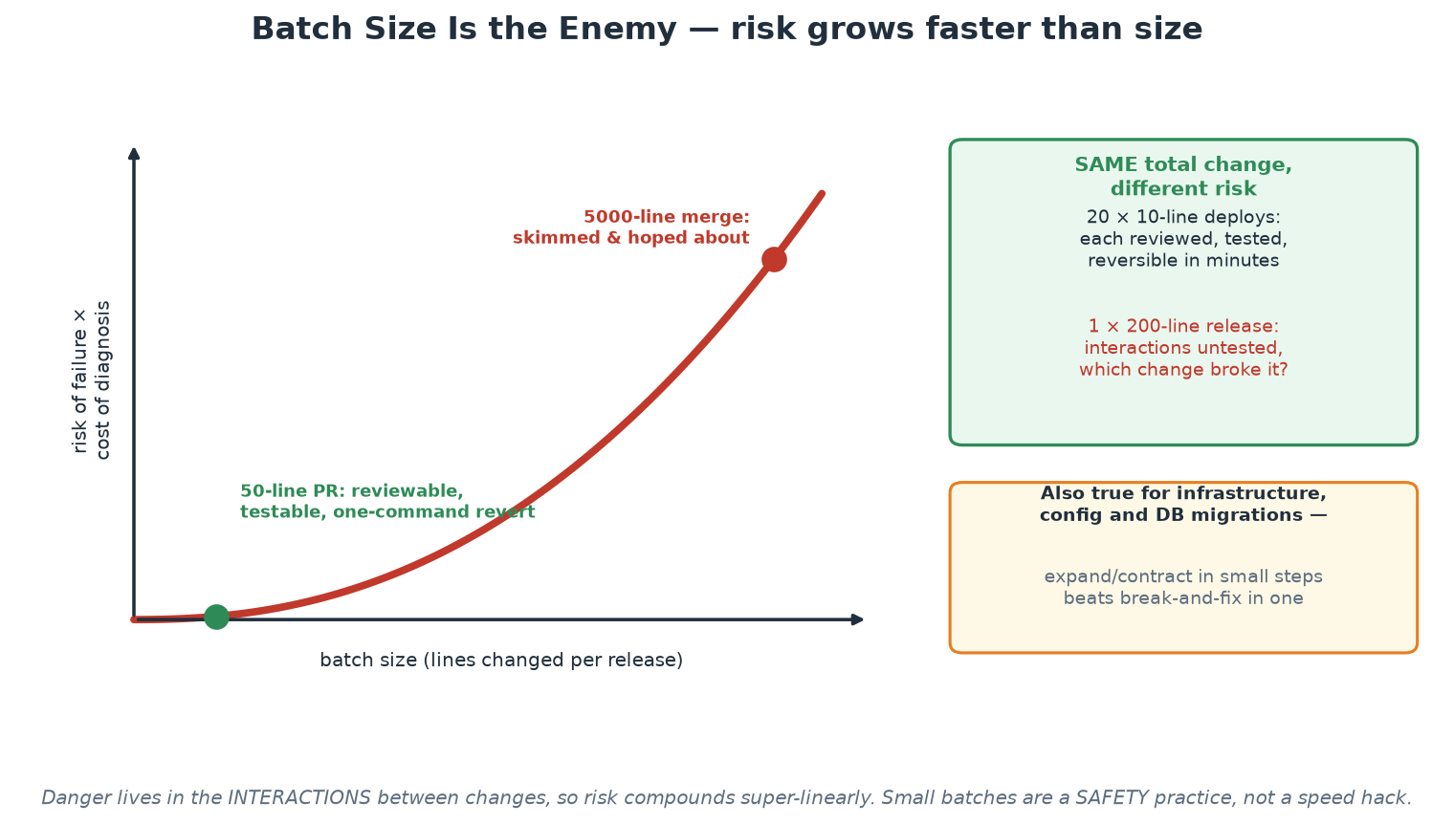
Why Batch Size Is the Enemy
The same total change, split differently, carries radically different risk.
Notes:
This curve is the single most useful picture for a risk-aware audience, because it makes the safety argument visually rather than rhetorically. Walk it from left to right: small changes sit in the flat region where review is genuine, tests are meaningful and reversal is one command; large changes sit in the steep region where review becomes skimming and diagnosis becomes archaeology. Then give the green panel, which is the argument that wins the meeting: the same total volume of change, delivered as twenty small increments rather than one large release, is not merely faster - it is materially safer, because each increment is individually understood and individually reversible. Note the amber panel for infrastructure and database work, where the equivalent discipline is expand/contract: add the new structure, run both, migrate, then remove the old - never break and fix in a single step during a window.

Slide 122
In Context: Small Batches Inside a Window Culture
The genuine constraints - and what they do NOT require
  Some systems can only be CHANGED inside agreed windows: settlement cycles, industry-coordinated releases.
  That constrains WHEN production changes, and says nothing about how large each change must be.
  Integrating daily, testing continuously and keeping the trunk releasable are compatible with any window.
  So the goal becomes: arrive at the window with many small, individually verified, individually reversible changes.
Practices that fit a window culture
  Trunk-based development with short-lived branches - integration debt is what makes windows terrifying.
  Feature flags so unfinished work is deployed dark rather than parked on a branch for a quarter.
  Expand/contract for schema and interface changes, so nothing needs a big-bang cutover inside the window.
  Continuous verification against a production-like environment, built by the same IaC as production.
A red mainline is a stop-the-line event
  If the trunk is broken, the institution has lost its ability to ship a fix - including an urgent one.
  Treat green trunk as an availability control, not a developer preference: it is your route to production.
  Flaky tests are a defect, not an inconvenience - re-running until green trains people to ignore real failures.
  Measure it: how long was the mainline red, at worst, in the last quarter? That number is a risk indicator.
Notes:
Lead with the distinction that unlocks the module for this audience: a release window constrains the timing of production change, not the size of each change or the frequency of integration. Teams in window cultures often conclude that continuous integration does not apply to them, and then arrive at the window with a quarter of unintegrated work, which is precisely the scenario the window was meant to make safe and precisely the one it cannot. The reframing is that CI is how you make the window boring - by the time it arrives, every change has been integrated, tested and, where possible, already deployed dark. The last section reframes the green trunk as an availability control, which is unusually persuasive here: if the mainline is broken, the institution cannot ship anything, including an urgent fix during an incident, so the state of the trunk is an operational risk indicator rather than an engineering hygiene preference. Encourage participants to measure worst-case red duration and put it on the same report as their other operational indicators - it changes how the organisation treats a broken build.

Slide 123
A CI Job That Gives Fast Feedback
The test pyramid in YAML: seconds-fast checks first, expensive ones after.
jobs:
quick: # <60s - runs on every push
runs-on: ubuntu-latest
steps:
- uses: actions/checkout@v4
- uses: actions/setup-python@v5
with: { python-version: '3.12', cache: pip } # cache = fast reruns
- run: pip install -r labs/app/requirements.txt
- run: ruff check . # lint: fails in ~2 seconds
- run: pytest -m 'not slow' -q # unit tests only
full:
needs: quick # do not pay for slow tests on a typo
runs-on: ubuntu-latest
strategy:
fail-fast: false
matrix: { python: ['3.11', '3.12'] } # test the versions you support
steps:
- uses: actions/checkout@v4
- uses: actions/setup-python@v5
with: { python-version: '${{ matrix.python }}' }
- run: pip install -r labs/app/requirements.txt
- run: pytest --cov=. --cov-report=term-missing
# Branch protection makes 'quick' a REQUIRED check - red cannot be merged.
→ Fast feedback is a design decision: order the checks by how quickly they can say no.
Notes:
The design principle here is cheap-and-fast first. A lint error that takes two seconds to surface should never wait behind a six-minute integration suite, because developers context-switch away after roughly a minute and come back to stale results. Splitting into a quick job and a full job costs four lines of YAML and changes the felt speed of the pipeline completely. Point at the pip cache: unglamorous, and often the single biggest reduction in pipeline time. The matrix shows testing across supported runtimes without duplicating the job, and fail-fast: false means one failing combination does not hide the others. Then close on the enforcement point in the comment: none of this matters unless the checks are REQUIRED in branch protection - a pipeline that reports red while merges continue is documentation, not a gate. Ask the room whether their main branch actually blocks merges on a red build; the answers are usually revealing.

Slide 124
Delivery vs Deployment - and Deploy vs Release
Continuous DELIVERY: every commit leaves the pipeline deployABLE; a human chooses when.
Continuous DEPLOYMENT: green pipeline -> production automatically; no human in the loop.
DEPLOY = bits are running. RELEASE = users can see it. Flags/canaries separate the two.
Build ONCE, promote the same immutable artifact through every environment.
If deploys hurt, do them more often - frequency forces the pain to be automated away.
Notes:
Precision here prevents years of confused meetings. Continuous delivery is a state of READINESS: the pipeline proves every commit deployable, and shipping becomes a business decision that can be taken any afternoon - most organisations should target this. Continuous deployment removes the human trigger entirely and is appropriate once test confidence, monitoring and rollback are strong (and change approval regulation permits). The deploy/release distinction is the modern unlock: code can be deployed to production dark (flagged off, or receiving only canary traffic) and released later by flipping a flag - which turns release into a reversible, low-drama act and enables testing in production safely. Build-once-promote is the artifact discipline: the image tested in staging is bit-for-bit the image that reaches production (SHA-tagged, immutable) - rebuilding per environment invites 'works in staging' bugs from dependency drift; our pipeline SHA-tags for exactly this reason. The closing aphorism (Martin Fowler's 'if it hurts, do it more often') is the module's cultural core: pain under frequency is a signal pointing at what to automate next - the organisations deploying daily did not start painless; they started frequent.

Slide 125
Deep Dive: Four Terms People Use Interchangeably
CONTINUOUS DELIVERY - a state of readiness
  Every commit that passes the pipeline is proven deployable and sits ready as an immutable artifact.
  A human decides WHEN to ship, but never whether it would work - the pipeline already answered that.
  Shipping becomes a business decision available any afternoon, instead of an engineering event.
  This is the right target for most organisations, including regulated ones.
CONTINUOUS DEPLOYMENT - no human in the loop
  Green pipeline goes to production automatically; the last human decision was the code review.
  Prerequisites: trustworthy tests, real observability, automated rollback, and small changes by default.
  It is a capability, not a virtue - plenty of excellent teams deliberately keep a human gate.
  In GitHub Actions the difference is literally one setting: required reviewers on the production environment.
DEPLOY vs RELEASE - the distinction that unlocks the rest
  DEPLOY: the bits are running in production. RELEASE: users can actually see the behaviour.
  Separating them turns release into a reversible, low-drama act - flip a flag, shift a percentage.
  It enables dark launches, canaries, per-tenant rollout, kill switches and testing in production safely.
  It also decouples engineering cadence from marketing dates, which removes a whole category of arguments.
Notes:
Precision here prevents years of confused meetings, so make participants say the definitions back. The most valuable one commercially is continuous delivery as READINESS: it changes the conversation with the business from 'when can engineering ship?' to 'when do we want it visible?', and that is a shift most product organisations would pay for. Be careful not to present continuous deployment as the superior end state - it is a capability appropriate to certain contexts, and organisations with regulatory approval requirements or very high blast radius reasonably retain a human decision. The deploy-versus-release distinction is the one that most often produces a visible shift in the room: once people see that code can be in production but not exposed, a whole set of previously impossible options appears - testing with real production data and traffic, gradual exposure, instant rollback without a deployment, and dark launching a rewrite alongside the original. Point at the GitHub Actions environment setting as the concrete artefact so the distinction stops being theoretical: participants will see exactly that gate in the capstone.

Slide 126
Deep Dive: Build Once, Promote Many - and the Frequency Rule
BUILD ONCE, PROMOTE THE SAME ARTIFACT
  The image tested in staging must be bit-for-bit the image that reaches production - same digest.
  Tag by commit SHA (immutable), not by 'latest' - a moving tag makes deployments unreproducible.
  Rebuilding per environment reintroduces dependency drift: a base image or package can change between builds.
  Environment differences belong in CONFIGURATION injected at runtime, never in separate builds.
  Rollback then means redeploying a previous digest that has already been tested - not rebuilding history.
'IF IT HURTS, DO IT MORE OFTEN'
  Martin Fowler's rule turns pain into a signal: the painful step is the one to automate next.
  Rare deploys stay manual, undocumented and frightening; frequent deploys force the pain out of the system.
  Frequency also shrinks batch size automatically, which shrinks risk - the two reinforce each other.
  Organisations deploying daily did not begin painless; they began frequent and fixed what hurt each time.
  The same logic applies to restores, failovers, certificate rotations and disaster recovery drills.
How this shows up in the labs
  The workshop pipeline builds one SHA-tagged image and promotes it - watch the tag flow through the stages.
  The production step sits behind an environment gate: continuous delivery today, deployment by removing it.
  The smoke test after deploy proves the deployed artifact actually serves - a green deploy is not proof.
Notes:
Build-once-promote-many is a discipline that sounds obvious and is violated constantly, usually by pipelines that run a docker build in each environment's job. Explain the failure it prevents concretely: two builds from the same commit can differ because a base image was updated, a package index moved, or a transitive dependency published a new patch - so the artifact you tested is not the artifact you shipped, and 'works in staging' becomes unreliable in a way that is very hard to debug. The rule also gives rollback its speed: redeploying a known digest is seconds and carries no build risk. Then the frequency aphorism, which is the cultural core of the module: pain is diagnostic information pointing precisely at the next thing to automate, and the instinct to reduce frequency because deploys hurt is exactly backwards - it preserves the pain and grows the batch. Extend it beyond deploys, because the same reasoning applies to every rare, frightening operation an organisation performs: restores, failovers, key rotations, region evacuations. Anything practised annually is, in practice, untested. Finish by pointing at the workshop artefacts so participants know where to look when they build it.

Slide 127
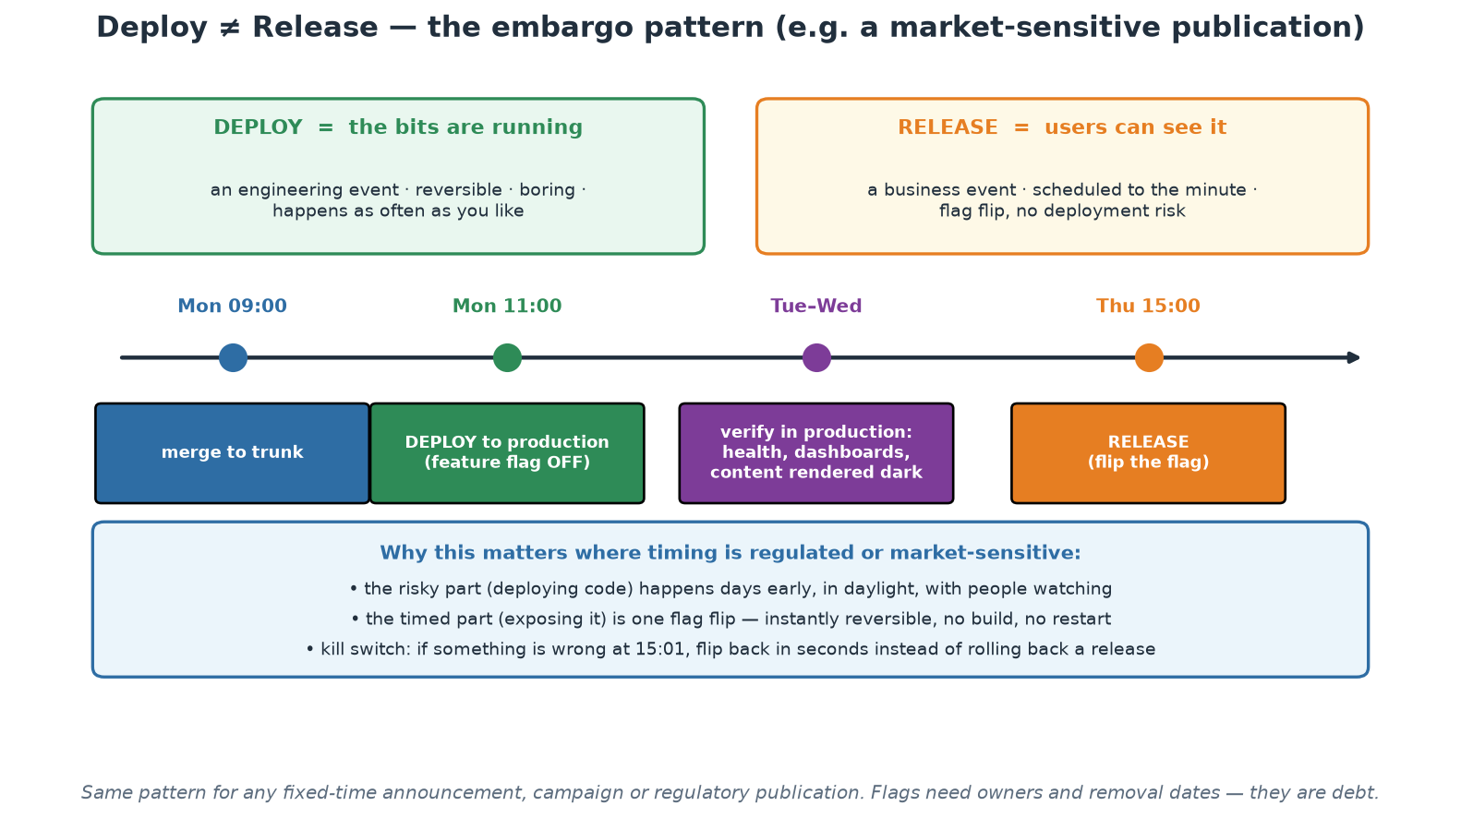
Deploy vs Release - the Embargo Pattern
Deploy days early in daylight; release at the appointed minute with a flag flip.
Notes:
This pattern is worth the time because it maps so directly onto work where the timing of publication is fixed and consequential - a scheduled announcement, a statistical release, an industry-coordinated change. The current default in most institutions is to do the risky thing (deploying software) at the same moment as the timed thing (making it visible), usually late at night, under pressure, with no margin. The pattern separates them: deploy on Monday morning with everyone awake, verify in production while the content stays dark, and let the timed moment be a flag flip that carries no build, no restart and no deployment risk - and that can be reversed in seconds if something is wrong at one minute past. Also flag the discipline requirement on screen: flags are debt, so each one needs an owner and a removal date, and dark content must be genuinely unreachable, which is a security review question rather than an assumption.

Slide 128
In Context: Delivery, Deployment and Embargoes
Continuous DELIVERY is the realistic target here
  Every change is proven deployable by the pipeline; a human still chooses when it goes.
  That keeps approval authority exactly where the institution wants it, while removing the technical uncertainty.
  'Can we ship this?' stops being an engineering question and becomes a scheduling and risk decision.
  Continuous DEPLOYMENT (no human trigger) is a later, service-by-service choice - not a prerequisite for any of this.
Build once, promote the same artefact - and prove it
  The image tested in the lower environment must be the one that reaches production, verified by digest.
  Rebuilding per environment reintroduces drift: a base image or dependency can change between builds.
  Environment differences belong in injected configuration, never in a separate build.
  The digest is also the evidence: the change record can state exactly which artefact was promoted where.
Frequency as a risk-reduction strategy
  'If it hurts, do it more often' applies hardest to the operations everyone dreads: restores, failovers, cutovers.
  An operation performed annually is untested; one performed monthly is a capability with known duration.
  Rehearsal converts unknown recovery time into a measured number you can put in a resilience report.
  Start with the safest rehearsal available - restore a backup into an IaC-built environment and time it.
Notes:
Position continuous delivery, not continuous deployment, as the target for this audience, and say so plainly - it removes the objection that this course is asking a systemically important institution to let machines ship to production unattended. The distinction is precise and worth repeating: continuous delivery means the pipeline has proven the change deployable and a human decides when, which preserves every approval authority the institution has while eliminating the technical uncertainty that makes those approvals stressful. The build-once-promote point has an evidence dimension that is specific to regulated environments: an artefact digest is a stronger statement about what was deployed than any build log, and it belongs in the change record. Finally, extend the frequency argument beyond deployment to the operations this sector genuinely dreads - restores, failovers, DR invocations, industry cutovers. Ask the room when their last unrehearsed recovery took place and how long it took; if the answer is 'we have never timed it', that is the first improvement, and it is one they can start without any tooling investment.

Slide 129
Build Once, Promote by Digest
The artefact discipline that makes 'it passed in staging' mean something.
# BUILD - once, tagged by commit, and record the immutable digest
docker build -t ghcr.io/org/order-service:$GIT_SHA labs/app
docker push ghcr.io/org/order-service:$GIT_SHA
DIGEST=$(docker inspect --format='{{index .RepoDigests 0}}' \
ghcr.io/org/order-service:$GIT_SHA)
echo "$DIGEST" > artifact.txt # sha256:9f2c... - this is the evidence
# PROMOTE - the same bytes move through environments; nothing is rebuilt
kubectl set image deployment/order order=$DIGEST -n staging
# ... smoke tests pass ...
kubectl set image deployment/order order=$DIGEST -n production
# ROLLBACK - redeploy a digest that was already tested, in seconds
kubectl rollout undo deployment/order -n production
# ANTI-PATTERN - a fresh build per environment:
# docker build -t order:staging . # base image may have moved
# docker build -t order:prod . # different bytes, untested
→ Deploy the digest, not the tag. Tags move; digests are the thing you actually tested.
Notes:
This slide fixes a habit that quietly breaks environment parity in many organisations. Two builds from one commit can differ - a base image was rebuilt overnight, a package index served a new patch, a transitive dependency published - so if each environment builds its own image, the artefact you tested is not the artefact you shipped, and the resulting bugs are miserable to diagnose. Building once and promoting the same bytes removes that entire class of problem. Make the tag-versus-digest distinction explicit because it is the practical core: a tag is a mutable pointer and can be moved by anyone with push access, while a digest is a content hash and cannot. Deploying by digest is therefore both a reproducibility and a supply-chain control, and the digest is exactly the line to put in a change record - it answers 'what precisely is running in production?' unambiguously. Finish on rollback: because the previous digest was already built and already tested, reverting is a seconds-long state change rather than a rebuild under pressure at 03:00.

Slide 130
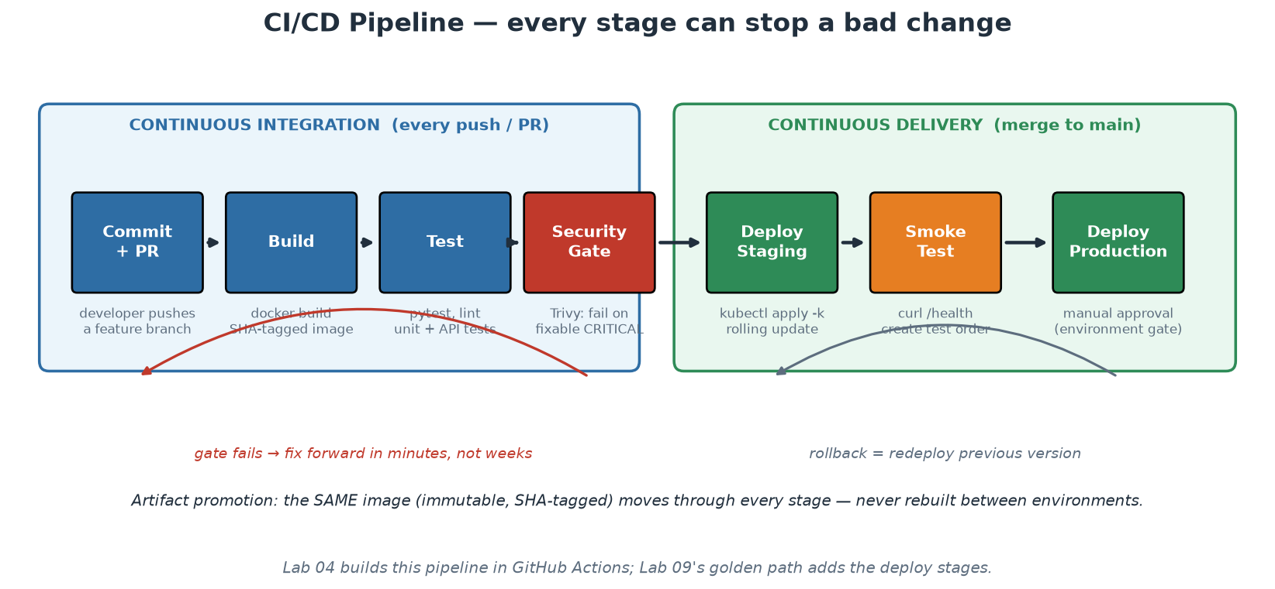
Anatomy of the Pipeline
CI proves the change; CD promotes the artifact; every stage can say no.
Notes:
Trace one commit through the diagram end to end, because Workshop 1 builds the left half and the capstone adds the right. Commit/PR triggers everything - no manual pipeline starts. Build produces the SHA-tagged image once. Test executes the test pyramid (unit tests in seconds first, then API tests - fast feedback before expensive feedback). The security gate scans the artifact and can genuinely fail the build (next slide is dedicated to this, because most real pipelines get it wrong). Deploy-to-staging exercises the real deployment mechanics; the smoke test proves the deployed thing actually serves (our capstone curls /health and creates an order - a deploy that 'succeeded' but serves 500s is a failure the pipeline must catch). Production sits behind an environment gate - in GitHub Actions, an 'environment' with required approvers gives continuous DELIVERY; removing the approval gives continuous DEPLOYMENT: the difference is one setting, which makes the previous slide's distinction concrete. The feedback arrows matter as much as the forward flow: a red stage stops the line and fixing forward takes minutes because the batch is small; rollback on the right is 'redeploy the previous immutable artifact', not surgery.

Slide 131
A Scan Is Not a Gate
Report step: results visible, build stays green (exit-code 0) - awareness only.
Gate step: build FAILS on actionable findings (exit-code 1) - behaviour change.
Gate on FIXABLE criticals; failing on unfixable CVEs teaches people to ignore red.
Pin third-party pipeline actions to versions - your pipeline is supply chain too.
Least-privilege pipeline tokens: 'permissions: contents: read' unless proven otherwise.
Notes:
The most common security-in-CI failure is a scanner wired with exit-code 0 and called a 'gate' in the audit deck - it is a dashboard nobody looks at, and it changes nothing. Teach the two-step pattern participants will build in Workshop 1: a REPORT step (HIGH+CRITICAL, exit-code 0) keeps full visibility for triage, and a GATE step (CRITICAL only, ignore-unfixed, exit-code 1) actually stops the line - but only for findings a developer can act on TODAY, because a gate that fails on unfixable upstream CVEs blocks all delivery indefinitely and gets bypassed within a week, taking the team's respect for red builds with it. Gates must be trustworthy to be tolerated: start narrow (fixable criticals), widen deliberately as the backlog clears. The two supply-chain lines preview Module 7 but belong in every pipeline from day one: a third-party action pinned to @master means an upstream compromise runs instantly with YOUR repository's credentials - pin versions; and default tokens with write access mean any compromised step can push code - declare least-privilege permissions explicitly. Both patterns are already in the workshop's workflow file; point at them when you get there.

Slide 132
Deep Dive: Report vs Gate, and Gating Without Losing the Room
The two-step pattern you will build in Workshop 1
  REPORT step: scan at HIGH and CRITICAL, print everything, exit 0 - full visibility, build stays green.
  GATE step: scan CRITICAL only, ignore-unfixed, exit 1 - the build genuinely stops.
  Report gives triage data; gate changes behaviour. A scanner with exit 0 alone changes nothing.
  Publish machine-readable output (SARIF/JSON) so findings land in the security dashboard, not only in logs.
GATE ON WHAT A DEVELOPER CAN FIX TODAY
  Fixable means an upgraded package or base image exists right now - the fix is a version bump.
  Gating on unfixable upstream CVEs blocks all delivery indefinitely and will be bypassed within a week.
  The real cost of a bad gate is not the delay - it is teaching the team that red builds are negotiable.
  Start narrow and widen deliberately: fixable criticals first, then highs, as the backlog actually clears.
  Provide an explicit, audited exception path with an expiry date, or people will invent an unaudited one.
Making findings actionable rather than decorative
  Every finding needs an owner, a severity that means something locally, and a route to a fix.
  Reduce noise at the source: slim base images (distroless, alpine) shrink the CVE surface dramatically.
  Automate the boring fixes: dependency-update bots turn most findings into a reviewed pull request.
  Track the trend, not the absolute number - is the fixable-critical backlog shrinking week on week?
Notes:
This slide describes the single most common security-in-CI failure, so be blunt about it: a scanner wired with exit code 0, described in the audit deck as a gate, producing a report that nobody opens. It creates the appearance of control while changing nothing, which is worse than having no scanner, because the organisation believes it is covered. The two-step pattern is what participants will actually build, and the design intent behind it is worth stating: keep the visibility broad and the enforcement narrow. Then dwell on trust, because it is the part teams get wrong: gates are tolerated only when they are fair and actionable, and the fastest way to destroy the authority of every automated check you own is to block delivery on something the developer cannot fix. Once people learn to bypass one gate, they have learned to bypass gates. Give the exception path as a practical requirement rather than a concession - a documented, time-limited, reviewed exception is how mature organisations keep the gate honest while remaining shippable. Finally, the noise-reduction advice is where the real leverage lives: a slimmer base image can remove dozens of findings at once, which does more for the backlog than any triage meeting.

Slide 133
Deep Dive: Your Pipeline Is Supply Chain Too
PIN THIRD-PARTY PIPELINE ACTIONS
  An action referenced as @master runs whatever its author pushes, inside YOUR pipeline, today.
  That code sees your repository, your secrets and your registry credentials - it is a full trust relationship.
  Pin to a released version at minimum; pin to a commit SHA for anything touching secrets or publishing.
  Real incidents have followed exactly this path - a compromised popular action exfiltrating CI secrets.
  Review new actions like dependencies: who maintains it, how many stars is not the question, what does it do?
LEAST-PRIVILEGE PIPELINE TOKENS
  Default tokens are often far more powerful than any single job needs - frequently write access to the repo.
  Declare permissions explicitly (contents: read) and add only what a job proves it needs.
  Scope secrets to the job and the environment that uses them, never repository-wide by default.
  Prefer short-lived OIDC federation to long-lived static cloud credentials stored as secrets.
  Assume every step can read every secret it is given - so give each step as little as possible.
Other pipeline hygiene worth adopting on day one
  Never echo secrets; be careful with debug modes and with printing environment variables in logs.
  Treat pull requests from forks as untrusted - do not expose secrets to workflows they can trigger.
  Protect the main branch: required reviews, required status checks, no force pushes.
  Record what you built: image digests, SBOMs and provenance make later questions answerable (Module 7).
Notes:
The framing that lands here: your pipeline has production credentials, so it IS production, and everything it executes is code you have chosen to trust. Most teams review application dependencies far more carefully than the third-party actions they wire into their workflows, which is backwards given what those actions can reach. Explain the mechanism plainly - a floating reference like @master or @v3 on a mutable tag means the code executed tomorrow is whatever the maintainer pushes tonight, and if that account is compromised, the attacker's code runs with your secrets. Pinning to a commit SHA removes that class of risk entirely for the cost of a dependency-bot pull request now and then. On permissions, make the point that this is one line of YAML and it is the cheapest security improvement available - most jobs need only read access, and declaring it explicitly means a compromised step cannot push code or publish images. OIDC federation deserves a mention as the strategic direction: short-lived, workload-scoped credentials remove the standing secret entirely. Both patterns are already present in the workshop's workflow file, so point at them when you get there rather than only describing them - participants remember the file they ran.

Slide 134
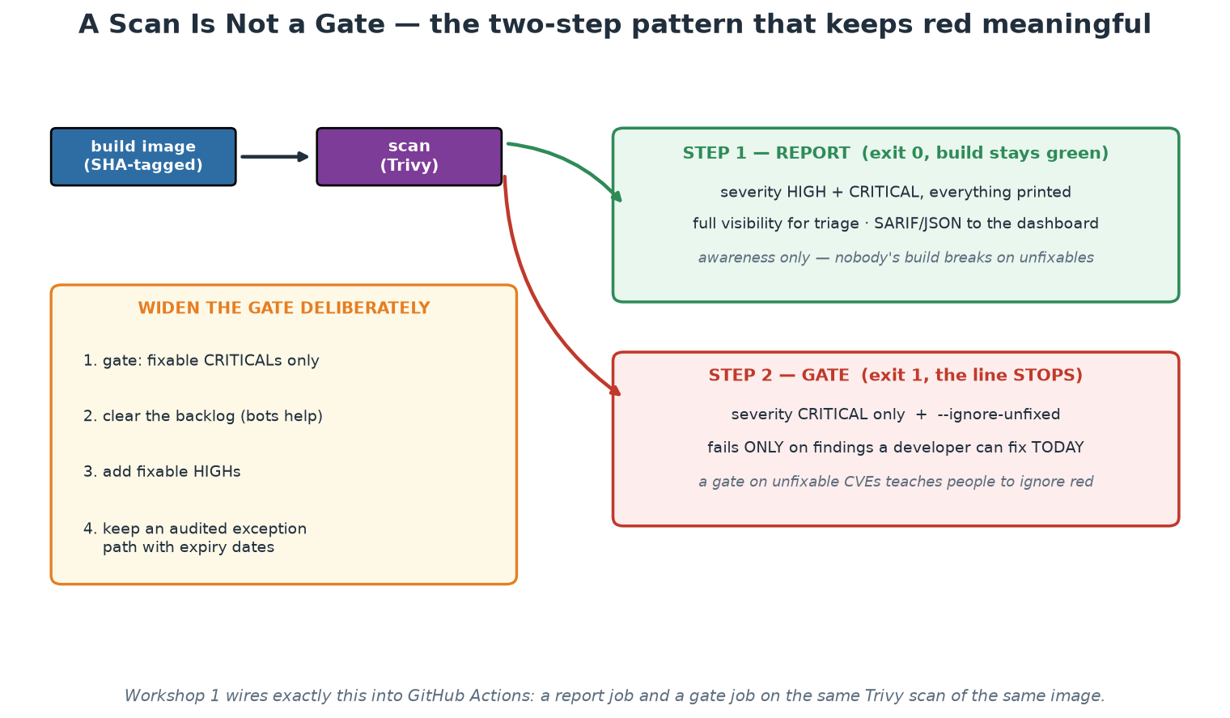
Report vs Gate
Broad visibility, narrow enforcement - the only way a gate stays trusted.
Notes:
Show the two branches and be blunt about which one most organisations actually have: a scanner wired with exit code 0, described in the assurance pack as a control, producing a report nobody opens. That is a control in name only, and naming it plainly gives the room permission to check their own pipelines this week. Then the design principle: keep visibility broad and enforcement narrow, gate only on findings a developer can act on today, and widen deliberately as the backlog clears. The amber panel is the adoption sequence, and the fourth item - an audited exception path with expiry dates - is the one that keeps the gate honest in a regulated institution: without a sanctioned exception route, teams invent an unsanctioned one, and then the control exists on paper only.

Slide 135
In Context: Gates, Evidence and Supervisory Expectations
Turning scanning into an assurable control
  A report step proves visibility; a gate step proves enforcement - assurance needs both, and they are different.
  Machine-readable output (SARIF/JSON) retained per build IS your evidence - screenshots are not.
  Exceptions must be explicit, owned, time-limited and reviewed, or the gate becomes decorative within weeks.
  Report the trend: is the fixable-critical backlog shrinking? That is the indicator worth putting in a pack.
Your pipeline is part of the supply chain
  Pin third-party pipeline actions to a version, and to a commit digest for anything touching secrets.
  An action referenced by a moving tag runs whatever its maintainer pushes tonight, with your credentials.
  Declare least-privilege permissions per job explicitly; default tokens are usually far too powerful.
  Prefer short-lived federated credentials over long-lived static secrets stored in the pipeline.
  Treat fork-originated pull requests as untrusted, and never expose secrets to workflows they can trigger.
Where this connects to institutional obligations
  Change and vulnerability management expectations are satisfied more convincingly by automated evidence.
  Supplier and third-party risk thinking applies to your delivery toolchain, not only to business vendors.
  Software inventory (SBOM) answers 'are we exposed to this component?' in minutes rather than weeks.
  Confirm the specifics with your risk, security and compliance colleagues - patterns here, not legal advice.
Notes:
Two arguments to make and one caution. First, the assurance argument: a scanner that cannot fail a build is not a control, and calling it one in an assurance pack is a finding waiting to happen; the two-step pattern gives genuine enforcement while keeping the gate fair enough to survive. Push the evidence point too - retained machine-readable scan output per build is stronger, cheaper and more complete than the screenshot practice many teams still use. Second, the supply-chain argument, which is under-appreciated: the delivery pipeline holds production credentials and executes third-party code on every run, so it deserves the same third-party risk thinking the institution applies to its business suppliers. The SBOM point lands well with anyone who lived through a widespread vulnerability disclosure - the difference between answering 'are we exposed?' in minutes versus weeks is entirely a function of whether the inventory was generated automatically. The caution: be explicit that you are teaching engineering patterns, not interpreting the institution's regulatory obligations, and that participants must validate specifics with their own risk, security and compliance colleagues.

Slide 136
Deployment Strategies
ROLLING (Kubernetes default)
Replace instances gradually; zero downtime; both versions serve briefly.
Cheap; needs backwards-compatible changes.
BLUE-GREEN
Two full environments; switch traffic atomically; rollback = switch back.
Instant reversal; double infrastructure cost; watch stateful cutover.
CANARY
Route 1-5-25-100% of traffic to the new version, watching metrics between steps.
Limits blast radius; needs traffic control + good metrics; automatable (progressive delivery).
SHADOW / DARK
Mirror real traffic to the new version, discard responses.
Production validation with zero user risk; costs double compute for the path.
Notes:
Deployment strategies are risk-management instruments; choose per service, not per fashion. Rolling is the sensible default and what Kubernetes does out of the box - participants watch a rolling update replace pods one by one in Workshop 2 and roll it back with one command. Its constraint deserves emphasis: during the roll, old and new versions serve simultaneously, so changes must be backwards-compatible - which drives the expand/contract pattern for database migrations (add the new column first, deploy code that handles both, remove the old column later; never break-and-fix in one step). Blue-green buys atomic cutover and instant rollback at the price of doubled infrastructure - attractive for monoliths and regulated cutovers. Canary is the elite pattern: real production traffic in controlled percentages, with promotion gated on metrics (error rate, latency) between steps - tools like Argo Rollouts and Flagger automate the progression, which is called progressive delivery; note the dependency on Module 8's observability - a canary without good metrics is just a slow deploy. Shadow testing validates against real traffic patterns with zero user exposure - powerful for rewrites, expensive to mirror safely (beware side effects: shadowed writes must not hit real systems twice).

Slide 137
What the Platform Contributes to CI/CD
Templated/reusable pipelines: teams inherit test-build-scan-deploy, not copy-paste YAML.
Secrets management: pipeline credentials injected by the platform, never in repos.
Runners, registries, environments: operated once, consumed as a service.
Policy hooks: the golden-path pipeline enforces org rules invisibly (Module 7).
Result: a new service reaches production on day one via the paved road.
Notes:
This slide connects Module 5 to the course's platform thread. Without a platform, every team hand-rolls pipelines: quality varies wildly, security steps are omitted under deadline pressure, and pipeline maintenance becomes distributed toil across every team. The platform play is centralise-and-serve: reusable workflows (GitHub Actions' workflow_call, GitLab includes, shared Jenkins libraries) let a team's entire CI file be ten lines that inherit the golden path - and when the platform team improves the scan step, every consuming team gets it on the next run without a single ticket. Secrets follow the same logic: the platform wires OIDC or a secrets manager into the pipeline so credentials never appear in repositories or logs. 'Reaches production on day one' is the platform's headline metric (time-to-first-deploy) and Module 9 will treat it as a product KPI. Real-world patterns worth naming for the room: Netflix's Spinnaker, Shopify's deployment platform, and the State of DevOps reports' consistent finding that elite performers standardise their delivery tooling - the capstone's golden path is a miniature of exactly this.

Slide 138
Deep Dive: From Copy-Paste YAML to an Inherited Path
The problem without a platform
  Every team hand-rolls a pipeline; quality varies with whoever happened to write it.
  Security steps are the first thing dropped under deadline pressure, silently and per team.
  Pipeline maintenance becomes distributed toil - the same upgrade performed forty times, badly.
  A fix discovered by one team never reaches the other thirty-nine.
TEMPLATED, REUSABLE PIPELINES
  Mechanisms: GitHub Actions reusable workflows (workflow_call), GitLab includes, Jenkins shared libraries.
  A consuming team's CI file becomes ten lines that inherit test, build, scan, sign and deploy.
  When the platform improves the scan step, every consumer gets it on their next run - no tickets, no migration.
  Version the templates so consumers can pin and upgrade deliberately, exactly like a library.
SECRETS, RUNNERS, REGISTRIES AND ENVIRONMENTS AS A SERVICE
  Credentials are injected by the platform via OIDC or a managed secrets store - never pasted into repos.
  Runners, registries and environment definitions are operated once and consumed by everyone.
  Environment promotion, approvals and audit records come with the path rather than being reinvented.
  Result: a team gets production-grade delivery mechanics without employing a delivery expert.
Notes:
This slide connects the CI/CD module to the platform thread that Day 2 develops, so make the economics explicit. Without a platform, pipeline work is duplicated across every team and the duplication is not merely wasteful - it is uneven, and the unevenness is invisible until an incident or an audit exposes which team quietly dropped the scanning step in a busy quarter. The reusable-workflow mechanism is the practical answer and it is worth showing the shape: a ten-line workflow file that calls a versioned platform workflow, with a handful of inputs. Emphasise the compounding property, because it is the real argument: an improvement made once by the platform team propagates to every consumer without a migration project, which is the opposite of how copy-pasted pipelines behave. Mention versioning of templates so participants do not swing to the other failure - a platform that changes shared behaviour without warning breaks trust just as fast as no platform at all. Then the services around the pipeline: secrets, runners, registries and environments are exactly the things each team should not be operating, and centralising them is what makes least-privilege and audit achievable at all.

Slide 139
Deep Dive: Policy in the Path, and Production on Day One
POLICY HOOKS - org rules enforced invisibly
  The golden path carries the rules: signed images, scanned dependencies, resource limits, required labels.
  Teams comply by using the road, not by reading a standards document and remembering it.
  Backstop at admission: policy re-checked where it is enforceable, so off-road work cannot bypass it (Module 7).
  Compliance evidence becomes a by-product of the pipeline - artifacts, approvals and scans, all recorded.
PRODUCTION ON DAY ONE - the headline metric
  Time-to-first-deploy for a new service is the platform's clearest product KPI (Module 9 measures it).
  The target experience: scaffold, commit, and a running, monitored, scanned service exists within a day.
  Compare honestly with your own organisation's current answer - most are measured in weeks.
  Every week saved is repeated for every new service, forever - that is where the platform ROI comes from.
Guardrails so the platform does not become the new bottleneck
  Self-service is the test: if teams file tickets and wait, you have built a silo with better branding.
  Escape hatches are mandatory: unusual services may leave the road and carry the extra weight knowingly.
  InnerSource the platform repos so consuming teams can contribute the capability they need.
  Measure adoption and satisfaction, not mandate compliance - a road nobody chooses is a failed product.
Notes:
Policy-in-the-path is the idea that makes security and compliance sustainable, so state it as the design principle it is: the easiest way to do the work should also be the compliant way, because standards documents do not survive a deadline and paved roads do. Note the necessary backstop - enforcement at admission or in the platform itself - since a golden path alone only governs those who use it, which is why Module 7 pairs pipeline policy with admission control. The compliance-as-by-product point is worth spelling out for anyone in a regulated organisation: the pipeline naturally produces the evidence auditors ask for - what was built, from which commit, scanned with what result, approved by whom, deployed when - and producing it automatically is both cheaper and more truthful than assembling it by hand at audit time. Then the day-one metric, which is the most persuasive number a platform team can publish: ask the room what their organisation's current time-to-first-deploy is for a brand new service, and let the answers land. Close on the guardrails, because they are the difference between a platform and a bottleneck, and repeat the self-service test one final time - it is the sentence you most want participants to remember from the platform thread of Day 1.

Slide 140
In Context: A Golden Path for SARB Delivery Teams
What the paved road would carry in this institution
  A scaffolded service: repository, pipeline, build, deploy manifests, dashboard, alerts, runbook stub.
  Controls pre-wired: scanning, policy checks, four-eyes enforcement, immutable logs, evidence retention.
  Standard environments from versioned IaC modules, with zoning, tagging and classification already correct.
  Secrets injected by the platform; no team ever handles a production credential to deploy.
  Change records and audit evidence generated by the pipeline rather than assembled by people afterwards.
Why this is a control programme, not a convenience programme
  One assessed path beats forty hand-built ones: uniformity is what makes assurance affordable at all.
  Improvements propagate: when the platform hardens a step, every consumer inherits it on the next run.
  Scarce expertise (security, reliability, data protection) scales by being encoded, not by being scheduled.
  Adoption rate becomes a meaningful indicator: how much delivery flows through the assessed path?
Keeping the platform from becoming the new bottleneck
  Self-service is the test - if teams file tickets and wait, the wall has been rebuilt with better tooling.
  Escape hatches stay open and documented: step off the road, and carry what the road was handling.
  InnerSource the platform repositories so consuming teams contribute capability instead of queueing for it.
  Measure time-to-first-deploy for a new service - it is the platform's clearest product KPI (Module 9).
Notes:
Close Day 1 by pulling the two threads together, because this slide is the bridge into Day 2 and into the workshops. The central argument for a supervised institution is control uniformity: a single assessed golden path can be examined once, deeply, and every service that uses it inherits the result, whereas forty independently assembled pipelines cannot be assessed at any affordable cost. That reframing is what turns a platform initiative from an engineering preference into a fundable risk programme, and participants should take that sentence with them. The second point - propagation - is the compounding benefit: a hardening applied once reaches every consumer on their next run, which is the opposite of how copy-pasted pipelines behave. Then repeat the self-service test one final time, because it is the single most important idea in the platform half of the course and the easiest to lose: a platform that teams must queue for is a silo with better branding. Finish by naming time-to-first-deploy as the metric to baseline, and ask participants to find out their institution's current answer before Day 2 - it makes Module 9's platform canvas exercise concrete rather than theoretical.

Slide 141
Module 5 - Key Takeaway
"The pipeline is the only path to production - and that is a feature. Everything it checks is checked every time; everything it deploys can be rolled back; everything it does is written down."
— Course synthesis
Notes:
Set up Workshop 1 (next block): participants build the test-build-scan pipeline for the order service and run it ON THEIR OWN VM with act - the left half of today's diagram, for real, with no GitHub account and a 30-second feedback loop. Pushing the same workflow to GitHub is an optional last part; the file is identical, only the runner changes. Day 2 then containerises deeper (Module 6) and extends the pipeline's reach to Kubernetes.

