Slide 1
DevOps & Platform Engineering
Day 2 — Containers, Security, Observability & Platform Thinking · delivery deck
Notes:
DELIVERY DECK - this is the version to present. It carries the headline for each topic, every diagram, and the code examples that lead into a lab. The full deck (same name without '-Deliver') holds the deep dives, the central-bank worked examples and the tool profiles; hand that out as the participant reference. Pace: about 2 minutes per slide leaves room for discussion and the demos.

Slide 2
Module 6
Microservices and Containerization
Notes:
75 minutes theory; Workshop 2 (mid-morning) is the big hands-on: build, compose and deploy the microservice to Kubernetes. Theory goal: when microservices are worth their cost, what containers actually are, and the Kubernetes mental model.

Slide 3
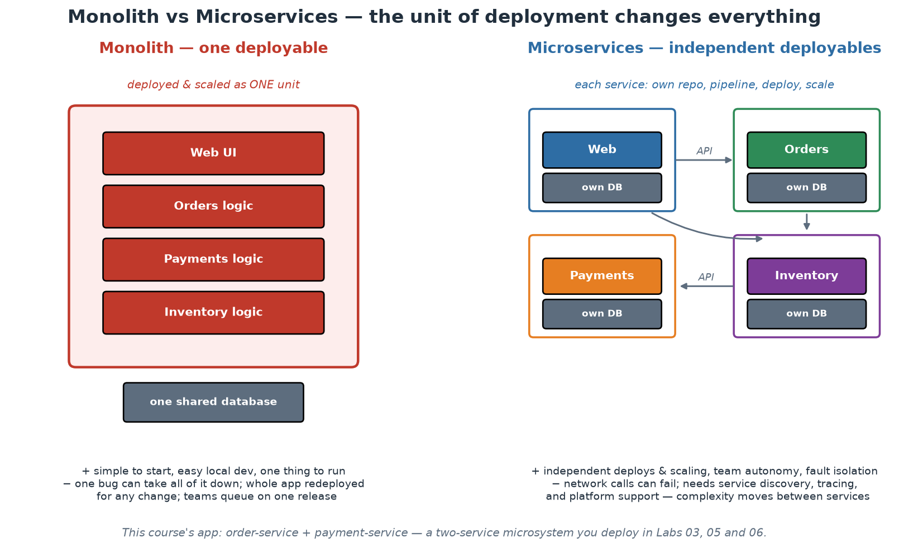
Monolith vs Microservices - the Real Trade-off
The unit of deployment changes everything - in both directions.
Notes:
Frame this as a genuine trade-off, not an upgrade path. A monolith is ONE deployable: simple to run, debug and test locally; transactions are easy; refactoring across the whole domain is an IDE operation. Its costs arrive with scale - of teams more than of traffic: every change redeploys everything, teams queue on one release train, one memory leak takes down all functionality, and technology choices are global. Microservices invert the trade: independent deploy/scale/fail per service and per team - but every arrow in the right-hand picture is a network call that can fail, be slow, or arrive out of order; transactions become sagas; debugging becomes distributed tracing; and 'run it locally' becomes a platform feature. Quote Martin Fowler's 'monolith first' honestly: most successful microservice systems were extracted from monoliths whose seams had become visible; starting greenfield with twenty services means guessing twenty boundaries you will guess wrong. And connect back to Conway (Module 2): the RIGHT reason to split is team autonomy along business domains - if one team owns everything, microservices give you distributed-systems pain with no autonomy payoff. Our two-service app is deliberately minimal: one seam (order calls payment), enough to exhibit every distributed-systems lesson without drowning in them.

Slide 4
Microservice Design Principles
Boundaries follow BUSINESS domains (bounded contexts), not technical layers.
Independent deployability is the acid test - if two services always ship together, they are one.
Database per service: no shared tables; integration through APIs and events only.
Smart endpoints, dumb pipes: logic in services, not in a clever bus.
Design for partial failure: timeouts, retries with backoff, circuit breakers, graceful degradation.
Notes:
Bounded context comes from Domain-Driven Design (Eric Evans): a boundary within which a model and its language are consistent - 'order' means one precise thing inside the ordering context. Services cut along these seams change for one business reason at a time; services cut along technical layers (a 'database service', an 'API layer service') change with every feature and force lockstep deploys. Independent deployability is the honest test of any decomposition: if releasing service A always requires releasing B, you have a distributed monolith - all of the network pain, none of the autonomy. Database-per-service is what makes independence real: shared tables are the tightest possible coupling (any schema change breaks unknown others); integration happens through published APIs or events, and yes, that means accepting eventual consistency at boundaries - a price, paid consciously. 'Smart endpoints, dumb pipes' (Fowler/Lewis) encodes the ESB lesson: burying business logic in a clever middleware recreated the monolith in the worst place; keep transport simple (HTTP, plain queues) and logic in owned services. Partial failure is the defining reality: our order service demonstrates the pattern minimally - a 2-second timeout on the payment call, and a degraded-but-alive answer (payment status 'unavailable') when the dependency is down. Participants SEE this behaviour in Workshop 2 and break it on purpose in the Module 8 demo.

Slide 5
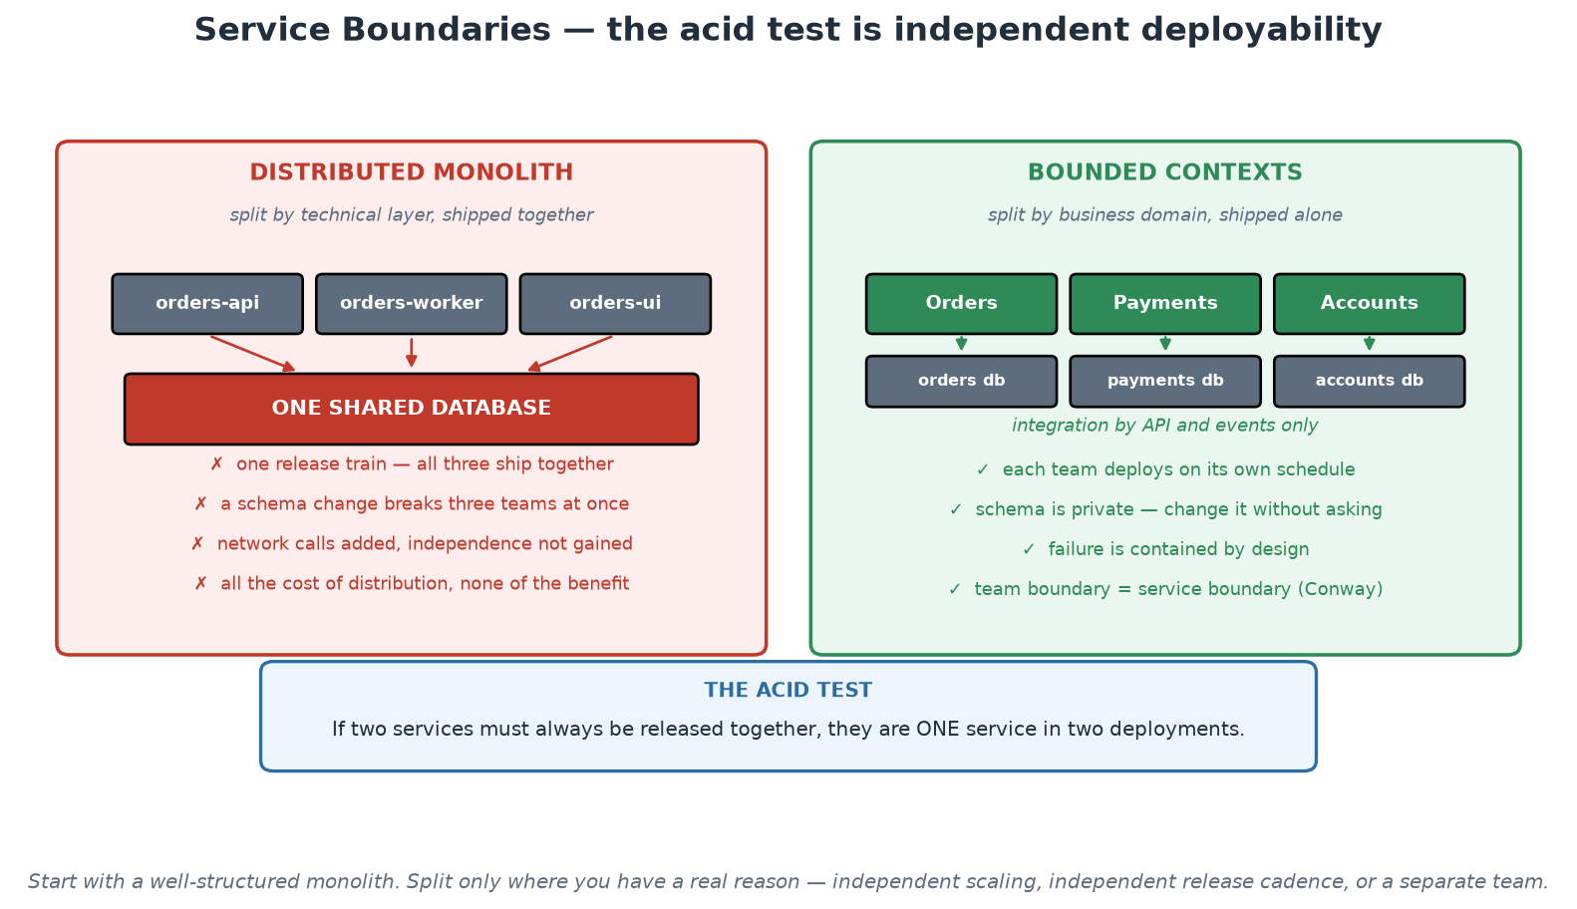
Service Boundaries - Bounded Contexts vs Distributed Monolith
Split by business domain and the split buys independence; split by layer and it buys only latency.
Notes:
Work the left panel first, because it is where most disappointing microservice programmes end up: services split by technical layer, sharing one database, released together. Every cost of distribution has been paid and no independence has been bought. Then the right panel: domains with private data, integrating through APIs and events, each team shipping alone. Land on the acid test in the blue box and let the room apply it to their own systems - if two services must always be released together, they are one service in two deployments. Close with the footnote, which is the responsible engineering advice: start with a well-structured monolith and split where you have a specific reason, because a distributed system is a permanent tax that should buy something concrete.

Slide 6
Twelve-Factor Apps - the Portability Contract
Config in the ENVIRONMENT, never in the artifact - one image runs everywhere.
Stateless processes: state lives in backing services, so replicas are interchangeable.
Logs to stdout as event streams - the platform aggregates, the app does not manage files.
Fast startup, graceful shutdown - disposability is what makes orchestration possible.
Dev/prod parity: the same artifact and shape from laptop to production.
Notes:
The Twelve-Factor App (Heroku, 2011) remains the practical contract between applications and platforms - highlight the five factors that carry the most weight and show where OUR app honours each. Config in environment: the same order-service image reports env 'production' under docker run, 'compose' in the Compose stack, and 'kubernetes' under kind, because APP_ENV and PAYMENT_SERVICE_URL are injected at runtime - the artifact never changes, only its environment does; participants verify this repeatedly via /health. Stateless processes: our in-memory order list is a DELIBERATE violation - in Workshop 2, scaling the payment service to two replicas visibly splits state between them, which is the most convincing statelessness lesson available: real state belongs in a backing service (database, cache), so any replica can serve any request and scaling/rescheduling is free. Logs to stdout: docker logs and kubectl logs work because the app writes to stdout and manages no log files - the platform owns aggregation. Disposability: fast boot and clean SIGTERM handling are what let orchestrators do rolling updates and self-healing - a service that takes three minutes to boot or corrupts on kill fights its platform. Dev/prod parity is the summary factor: identical images, same ports, same probes, laptop to production.

Slide 7
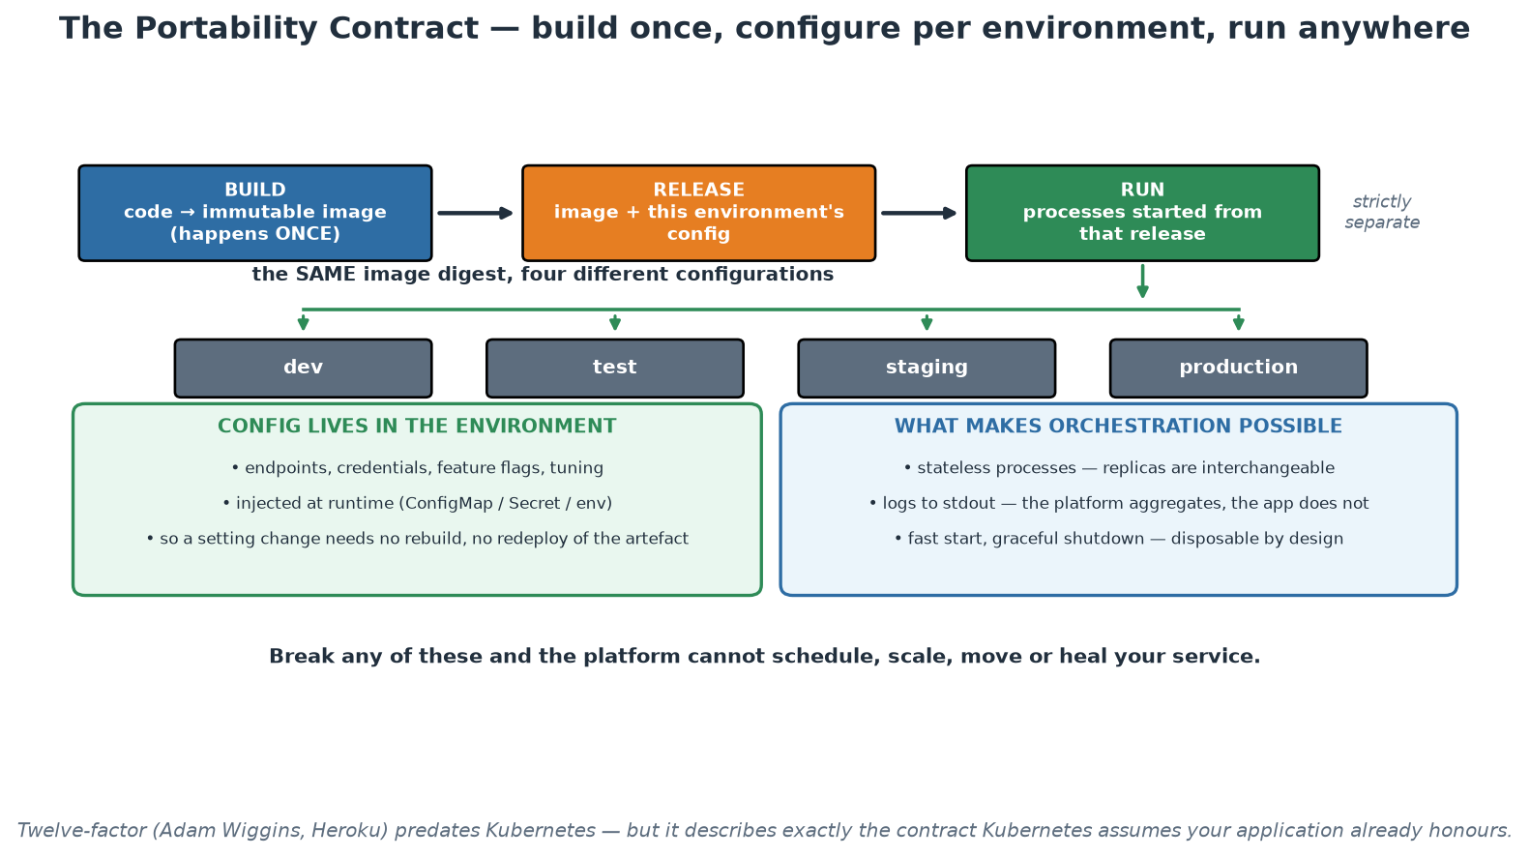
Build, Release, Run - the Portability Contract
One image digest, four configurations - and the properties that let a platform operate it.
Notes:
Use the top row to reinforce the Day 1 build-once-promote-many discipline, now with the reason spelled out: build produces the artefact, release binds it to an environment's configuration, and run starts processes from that release - strictly separate, so the artefact never changes as it moves. The fan-out to four environments is the payoff: the same digest everywhere, differing only in injected values, which is what makes a test result predictive and an artefact digest meaningful as change evidence. The two panels at the bottom are the properties Kubernetes assumes, so present them as prerequisites rather than advice - a stateful, slow-starting service that writes its own log files cannot be scheduled, scaled or healed, whatever the manifests say.

Slide 8
What a Container Actually Is
NOT a VM: no guest OS - processes on the host kernel, isolated by namespaces + cgroups.
Namespaces = what you can SEE (processes, network, filesystem); cgroups = what you can USE.
An image is a stack of immutable layers + metadata (OCI standard); a container is a running instance.
Layers are content-addressed and shared - 50 services on one base image store it once.
Registries distribute images by digest: the SHA is the identity, tags are mutable pointers.
Notes:
Demystify the technology - containers stop being magic in about three minutes. A VM virtualises hardware and boots a full guest OS (minutes, gigabytes); a container is ordinary Linux processes wearing isolation: NAMESPACES restrict what the process can see (its own PID tree, network stack, filesystem mounts, users) and CGROUPS meter what it can consume (CPU, memory - the numbers our Kubernetes limits set in Workshop 2). That is why containers start in milliseconds and share the host kernel - and why container security differs from VM security (Module 7: a kernel exploit escapes ALL containers on the host, hence non-root and seccomp defaults). Images: an immutable, content-addressed stack of filesystem layers plus metadata (entrypoint, env, ports), standardised by the OCI so any runtime runs any image. Layer sharing is the economic magic: every image FROM python:3.12-slim shares those base layers on disk and over the network - which is also why layer ORDER matters in Dockerfiles (dependencies before source code = cache hits on every code-only rebuild; participants see this in Workshop 2 when the second build takes seconds). Tags vs digests: a tag like :lab02 is a mutable pointer, the sha256 digest is the true identity - which is why production systems pin digests and why our no-latest-tag policy exists (Module 7).

Slide 9
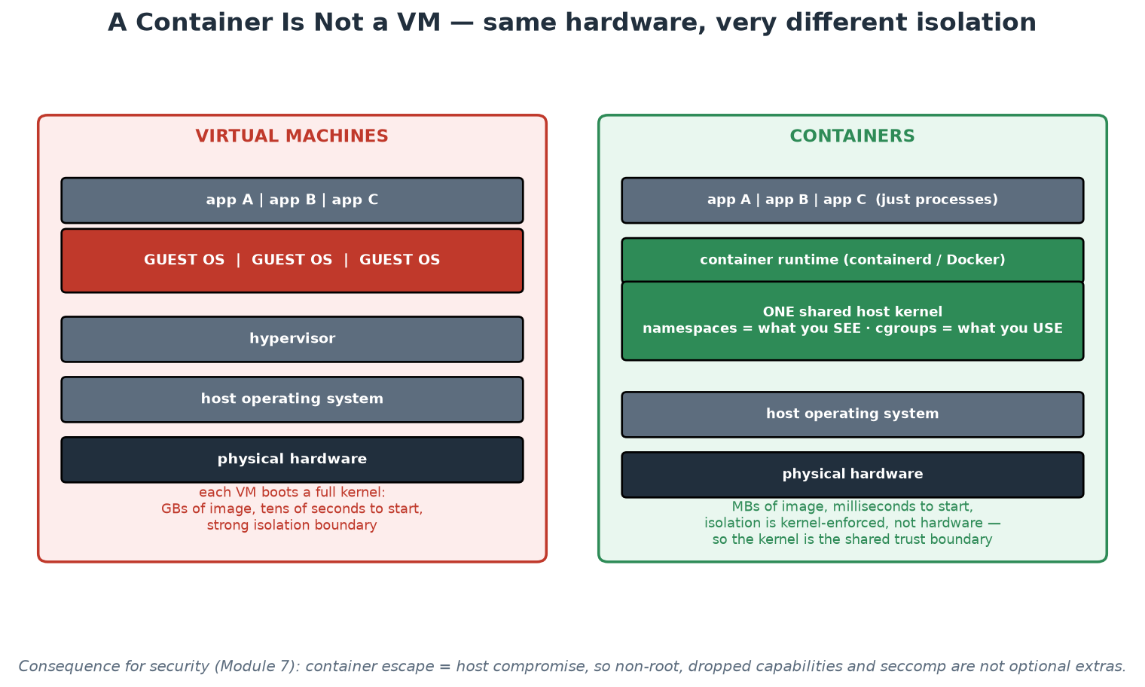
Container vs Virtual Machine
No guest OS: processes on a shared kernel, isolated by namespaces and cgroups.
Notes:
Put the two stacks side by side and let the missing layer do the teaching: there is no guest operating system in the container stack, which is why images are megabytes rather than gigabytes and why start-up is milliseconds rather than tens of seconds. Then make the security consequence explicit, because it is the reason for everything in Module 7's hardening slide: the kernel is shared, so it is the trust boundary, and a container escape means host compromise rather than a hypervisor breakout. In an institution that runs mixed workloads with different sensitivity, that is a genuine design input - VM-level isolation remains the stronger boundary, and choosing between them is a risk decision rather than a fashion decision.

Slide 10
Building Good Images
Multi-stage builds: compile/install in a builder stage, ship only the runtime slice.
Run as non-root; smallest sensible base (slim/distroless); pin base versions.
Order layers for cache: dependency manifest first, source code last.
HEALTHCHECK + graceful shutdown make the image orchestrator-friendly.
.dockerignore: the build context is not your whole repository.
Notes:
Every line here is implemented in the course's two Dockerfiles - open Dockerfile in labs/app on screen and point as you talk. Multi-stage: the builder stage pip-installs with full tooling; the final stage copies only the installed packages - smaller images pull faster, cold-start faster, and expose fewer packages to CVE scanners (participants compare Trivy findings against slim bases in the Module 7 demo). Non-root: our images create appuser (UID 1001) and USER-switch before CMD, so a container escape lands unprivileged - participants verify with whoami in Workshop 2, and Kubernetes enforces it again via runAsNonRoot (defence in depth). Base choice: slim over full (fewer packages, fewer CVEs), distroless as the next step (no shell - harder to debug, harder to exploit), alpine with the musl caveat for Python wheels. Cache ordering is the daily-life win: COPY requirements.txt + install BEFORE COPY source means editing code never re-installs dependencies. HEALTHCHECK lets Compose gate startup ordering (our depends_on: service_healthy) and mirrors the probes Kubernetes will run. The .dockerignore keeps venvs, .git and caches out of the build context - build speed and no accidental secrets in layers.

Slide 11
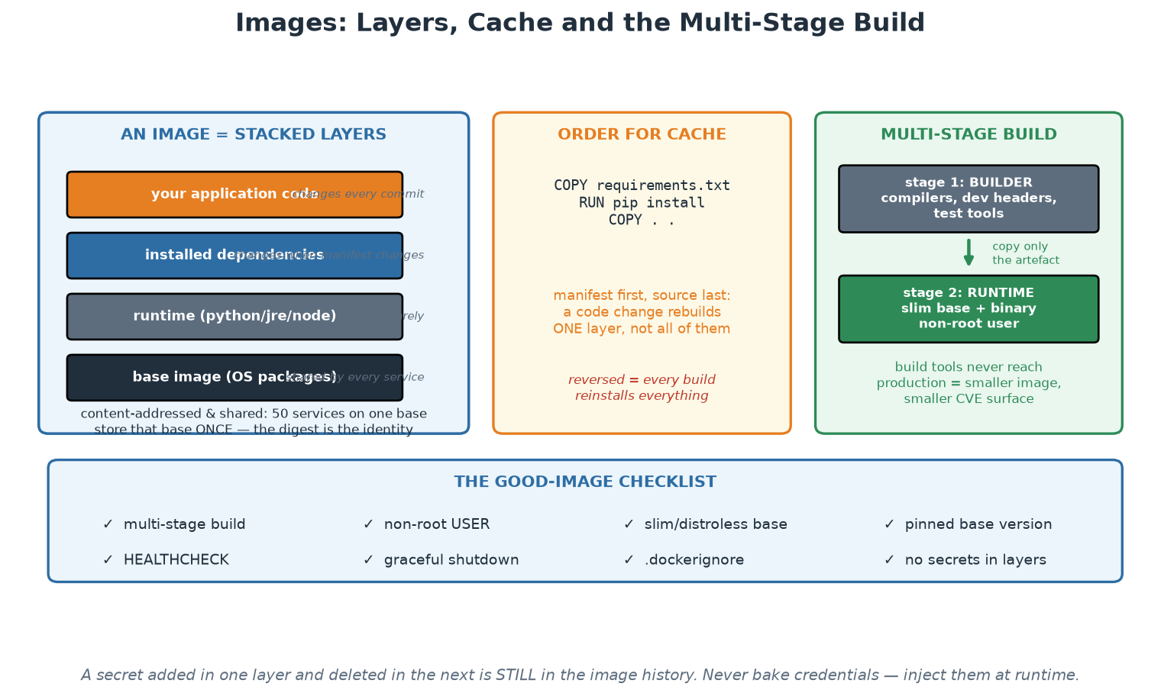
Image Layers, Cache Order and Multi-Stage Builds
Ship the runtime slice, not the workshop - and order layers so the cache actually works.
Notes:
Three ideas on one page. The layer stack explains sharing and why base image choice matters so much - fifty services on one base store that base once, and every CVE in it is inherited fifty times. The cache-ordering panel is the one participants feel immediately in the labs, because it is the difference between a ten-second and a three-minute rebuild on every commit. The multi-stage panel is the one with the largest security payoff: build tools, compilers and test dependencies never reach production, which both shrinks the image and removes the tooling an attacker would otherwise find waiting inside. Finish on the checklist, and point out the footnote about layer history - a secret added and then deleted is still in the image, which surprises almost everyone the first time.

Slide 12
Dockerfile: the Version You Ship
Multi-stage, slim, non-root, cache-friendly - the same app, an order of magnitude smaller.
# ---------- build stage: has the toolchain, never shipped ----------
FROM python:3.12-slim AS build
WORKDIR /app
COPY requirements.txt . # deps first: this layer caches
RUN pip install --no-cache-dir --prefix=/install -r requirements.txt
# ---------- runtime stage: only what the app needs to RUN ----------
FROM python:3.12-slim
RUN useradd --create-home --uid 10001 appuser
WORKDIR /app
COPY --from=build /install /usr/local # just the built dependencies
COPY --chown=appuser:appuser . .
USER 10001 # non-root, numeric so K8s can verify it
EXPOSE 8000
HEALTHCHECK --interval=30s --timeout=3s \
CMD python -c "import httpx;httpx.get('http://localhost:8000/health')"
# exec form: PID 1 is python, so SIGTERM reaches it and shutdown is graceful
CMD ["uvicorn", "main:app", "--host", "0.0.0.0", "--port", "8000"]
# ~180 MB, far fewer CVEs, no secrets, non-root, rebuilds in seconds
# when only application code changed.
→ Secrets come from the runtime (env/secret store), never from a layer. Layers are forever.
Notes:
Walk the fixes against the previous slide one by one so the improvement is causal rather than aesthetic. Multi-stage: the compiler and build tooling exist only in the first stage and never reach production, which is the single biggest reduction in both size and attack surface. Dependency-first copying restores layer caching, so a one-line code change rebuilds in seconds instead of minutes - that is a flow improvement, not just a comfort. The numeric UID matters specifically for Kubernetes: runAsNonRoot can only be enforced when the user is numeric, because the kubelet cannot resolve a username. HEALTHCHECK gives Docker a liveness signal, and its Kubernetes equivalents (readiness and liveness probes) come in the next module. The exec-form CMD is the graceful-shutdown fix. Finish with the layer point: `docker history` reveals every layer, so a secret added in one layer and deleted in the next is still extractable - secrets belong in the runtime environment or a secret store, and any that were ever baked in must be rotated.

Slide 13
Why Orchestration - What Kubernetes Actually Does
One host + docker run does not: reschedule on failure, scale, roll out, load-balance, heal.
Kubernetes = a RECONCILIATION engine: you declare desired state, controllers converge reality.
Scheduling: pods placed by resource requests, spread and affinity across nodes.
Self-healing: failed pods replaced, failed probes remove pods from traffic - automatically.
The same declarative + converge model as Terraform, applied continuously at runtime.
Notes:
Motivate orchestration from the gap participants have personally felt by now: Compose runs a stack on one machine, but who restarts the container at 03:00, moves it when the node dies, adds replicas under load, or shifts traffic during an update? Kubernetes' core idea - the one that makes everything else make sense - is RECONCILIATION: you write desired state (a Deployment saying 'two replicas of this image'), and controllers run an endless loop of observe-diff-act until reality matches, forever. Delete a pod and it reappears; not because something restarted it as a special case, but because the controller noticed reality (1 pod) diverged from desire (2). Connect this explicitly to Module 4: it is Terraform's declare-and-converge model, running continuously at runtime instead of on demand - one mental model, two timescales. Scheduling uses the resource REQUESTS on each container (our manifests set them) to bin-pack pods across nodes; LIMITS cap consumption via cgroups from two slides ago. Self-healing goes beyond restarts: a failing READINESS probe removes a pod from Service load-balancing without killing it; a failing LIVENESS probe restarts it - participants configure both in Workshop 2 and watch them act during the rolling update.

Slide 14
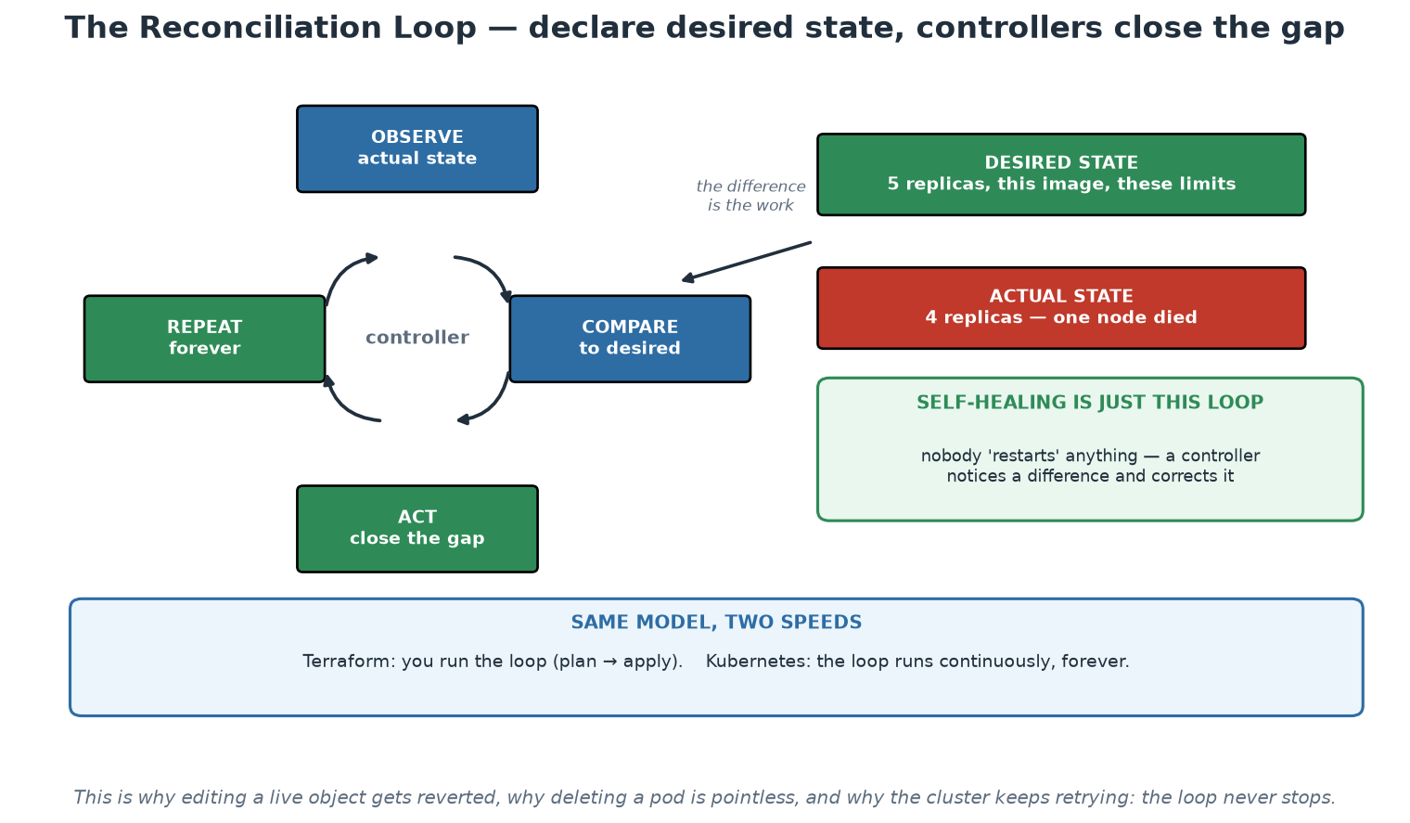
The Reconciliation Loop
Declare the desired state; controllers observe, compare and act - continuously, forever.
Notes:
This is the mental model that makes Kubernetes predictable rather than mysterious. Trace the loop, then use the right-hand example: desired is five replicas, actual is four because a node died, and the difference is the work the controller does without anyone being paged. Say explicitly that self-healing is not a feature bolted on top - it is this loop noticing a difference. The bottom panel ties it back to Day 1: Terraform runs the same model on demand when a human types apply, and Kubernetes runs it continuously. Once participants hold that model, the surprising behaviours become obvious: a manually edited object gets reverted, a deleted pod comes back, and the cluster keeps retrying because the loop has no end state.

Slide 15
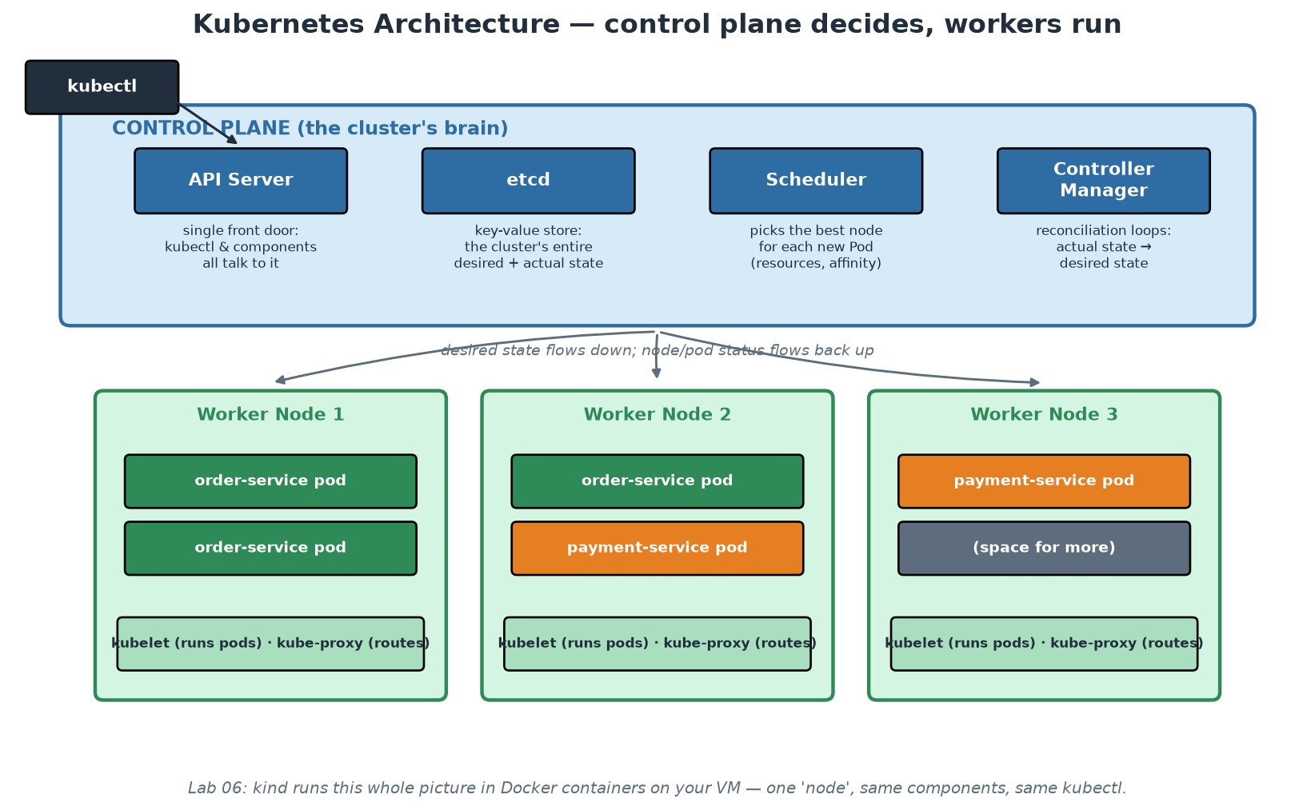
Kubernetes Architecture
Control plane decides; workers run; everything talks to the API server.
Notes:
Keep the tour tight and functional - the exam-level detail is less important than the shape. Control plane: the API SERVER is the single front door (kubectl, controllers, kubelets all speak to it - which is why RBAC on the API server is THE security boundary, Module 7); ETCD stores the entire cluster state (desired and observed - lose etcd without backup, lose the cluster's memory); the SCHEDULER assigns new pods to nodes; the CONTROLLER MANAGER runs the reconciliation loops from the previous slide. Workers: the KUBELET on each node makes assigned pods actually run and reports status back; KUBE-PROXY programs the routing that makes Services work. Emphasise the communication pattern: desired state flows down, observed status flows back up, and NOTHING talks directly to anything except through the API server - that uniformity is what makes Kubernetes extensible (operators, admission controllers) and auditable. Then the kind reveal: in Workshop 2, this entire picture runs inside one Docker container on the participant's VM - same API, same components, same kubectl; which is the course's fidelity claim: everything they practise transfers verbatim to EKS/AKS/GKE, where the control plane is simply someone else's problem (managed).

Slide 16
The Working Vocabulary: Objects You Will Touch
Pod: smallest unit - one or more containers sharing network/storage; mortal by design.
Deployment: desired replicas + template; owns rolling updates and rollback history.
Service: stable name + virtual IP load-balancing over pods selected by LABELS.
ConfigMap / Secret: configuration injected at runtime (12-factor, realised).
Probes + requests/limits: how the platform knows a pod is well and what it may consume.
Notes:
Five objects cover Workshop 2 completely. Pods are mortal - never hand-create them; they die and are replaced, and their IPs change, which is WHY Services exist. Deployments are what you actually write: replicas + pod template; kubectl set image triggers a rolling update (new ReplicaSet scaled up as old scales down, gated by readiness probes), and kubectl rollout undo is the one-command rollback - participants run both and watch build_id change and change back via /health. Services solve discovery: a stable DNS name (payment-service) and virtual IP, load-balancing across whatever pods currently match the label selector - the Compose DNS idea, made dynamic; label selectors are the glue, and a selector/label mismatch is the classic 'why is my service empty' bug (it is in the workshop's troubleshooting table). ConfigMaps/Secrets inject environment per-cluster while the image stays identical - our app-config supplies APP_ENV=kubernetes, and /health proves it. Probes: readiness gates traffic, liveness triggers restart - configure them differently or a slow startup becomes a restart loop. Requests/limits: requests inform scheduling, limits enforce via cgroups; both are set in our manifests and both are what Module 7's config scanner checks for.

Slide 17
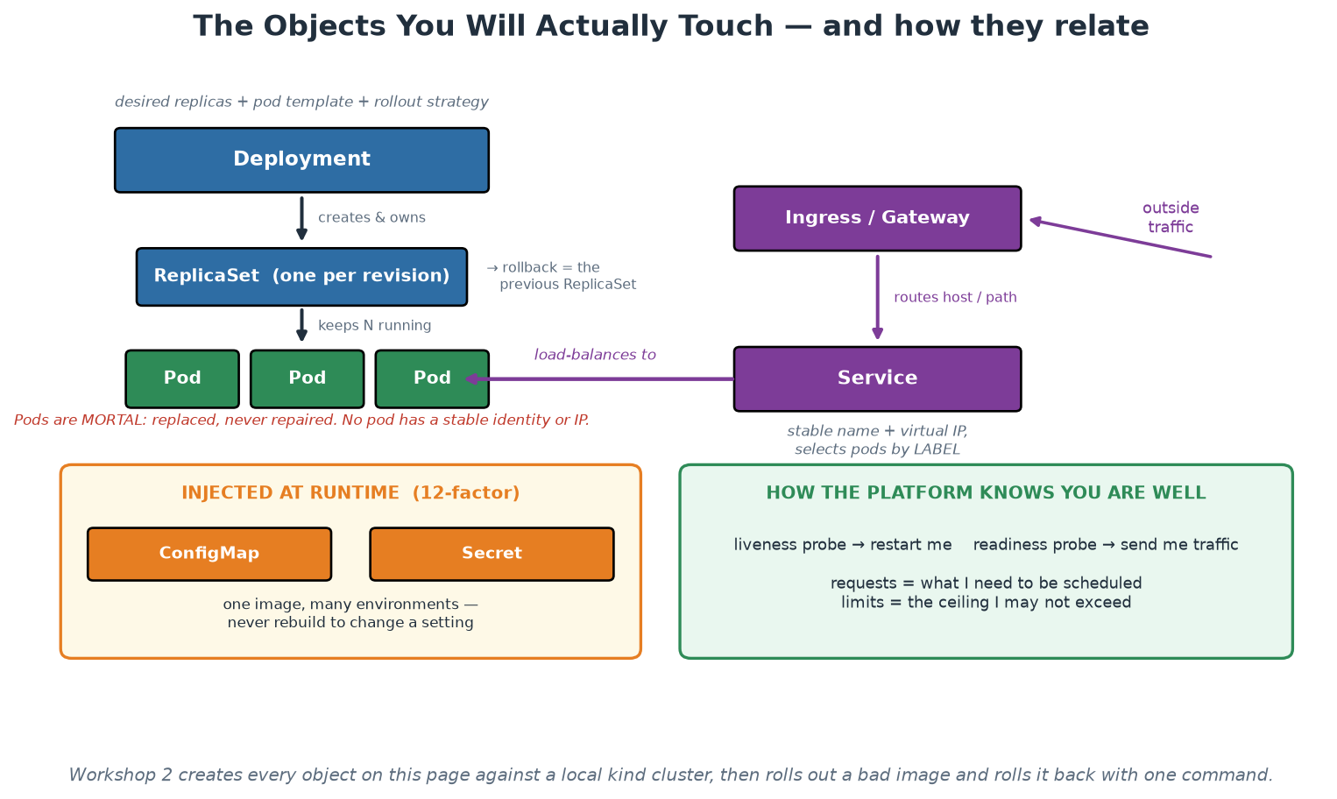
The Objects and How They Relate
Deployment owns ReplicaSets, ReplicaSets keep Pods, Services find Pods by label.
Notes:
Teach the ownership chain from this picture and have the room say it back: a Deployment owns ReplicaSets, a ReplicaSet keeps N Pods running, and a Service load-balances over Pods selected by label. Nearly every confusing behaviour becomes obvious from that chain - why rollback is instant (the previous ReplicaSet still exists), why deleting a pod achieves nothing, and why a Service silently serves nothing when a label is misspelled. The two bottom panels carry the operational content: configuration injected at runtime, and the probe/resource contract that tells the platform whether you are well and what you may consume. Workshop 2 creates every object on this page, and deliberately breaks a label selector, which is the fastest way to make the label-matching rule permanent.

Slide 18
A Deployment That Behaves in Production
Probes, limits and security context - the four blocks that separate a demo from a service.
apiVersion: apps/v1
kind: Deployment
metadata: { name: order-service, labels: { app: order-service } }
spec:
replicas: 3
selector: { matchLabels: { app: order-service } }
strategy:
rollingUpdate: { maxSurge: 1, maxUnavailable: 0 } # no capacity dip
template:
metadata: { labels: { app: order-service } }
spec:
securityContext: { runAsNonRoot: true, runAsUser: 10001 }
containers:
- name: order
image: ghcr.io/org/order-service@sha256:9f2c... # digest, not tag
ports: [ { containerPort: 8000 } ]
resources:
requests: { cpu: 100m, memory: 128Mi } # what the scheduler reserves
limits: { cpu: 500m, memory: 256Mi } # what it may never exceed
readinessProbe: # ready for TRAFFIC?
httpGet: { path: /health, port: 8000 }
initialDelaySeconds: 3, periodSeconds: 5
livenessProbe: # ALIVE, or restart me?
httpGet: { path: /health, port: 8000 }
initialDelaySeconds: 15, periodSeconds: 20
securityContext:
allowPrivilegeEscalation: false
readOnlyRootFilesystem: true
capabilities: { drop: [ALL] }
→ Readiness controls traffic; liveness controls restarts. Confusing them causes restart storms.
Notes:
This single manifest carries most of what separates a working demo from an operable service, so give it time. Probes first, and be precise because the distinction is genuinely misunderstood: readiness answers 'should this pod receive traffic right now?' and failing it removes the pod from the Service endpoints without killing it; liveness answers 'is this process wedged?' and failing it restarts the container. Pointing both at a health endpoint that checks downstream dependencies is a classic outage amplifier - when the database slows, every pod fails liveness, every pod restarts, and a degradation becomes an outage. Keep liveness shallow and readiness meaningful. Resources next: requests drive scheduling and limits drive enforcement, and a container with no limits can starve its neighbours - which is why the platform's policy engine (Module 7) usually rejects manifests without them. Then the security context, which is free hardening: non-root, no privilege escalation, read-only root filesystem, all capabilities dropped. Finally the image digest rather than a tag, tying back to build-once-promote-many: you deploy the bytes you tested.

Slide 19
Managing Services at Scale
Autoscaling: HPA scales pods on metrics; cluster autoscaler scales nodes; VPA right-sizes.
Service mesh (Istio, Linkerd): mTLS, retries, traffic-splitting as platform features - at a cost.
GitOps deployment (Argo CD/Flux): the cluster converges on a Git repo; drift auto-corrects.
Multi-cluster/multi-region: blast-radius isolation before exotic scaling.
Scale problems are PLATFORM problems - product teams should inherit the answers.
Notes:
Close the module by sketching the horizon honestly - name what exists, what it costs, and who should own it. Horizontal Pod Autoscaler scales replicas on CPU or custom metrics (a direct payoff of Module 8's metrics work); the cluster autoscaler adds nodes when pods cannot schedule; note the interplay - HPA without cluster autoscaling hits a ceiling. Service meshes inject a proxy sidecar next to every pod and centralise mTLS between services, retries/timeouts, and percentage traffic-splitting (the canary mechanics from Module 5) - real capabilities with real operational cost; the honest guidance is to adopt a mesh when you need at least two of its features, not because a diagram looked good. GitOps (from Module 3) matures deployment at scale: clusters converge on declarative repos, so 'what is running in production' has a Git answer and manual drift self-corrects. Multi-cluster is usually about blast radius and data residency before raw scale. The last bullet is the module's platform thread: none of these decisions should be made twenty times by twenty teams - the platform decides once, encodes it in the golden path, and product teams inherit scale-readiness. Workshop 2 is next: build the image, compose the stack, deploy to kind, scale it, roll it, roll it back.

Slide 20
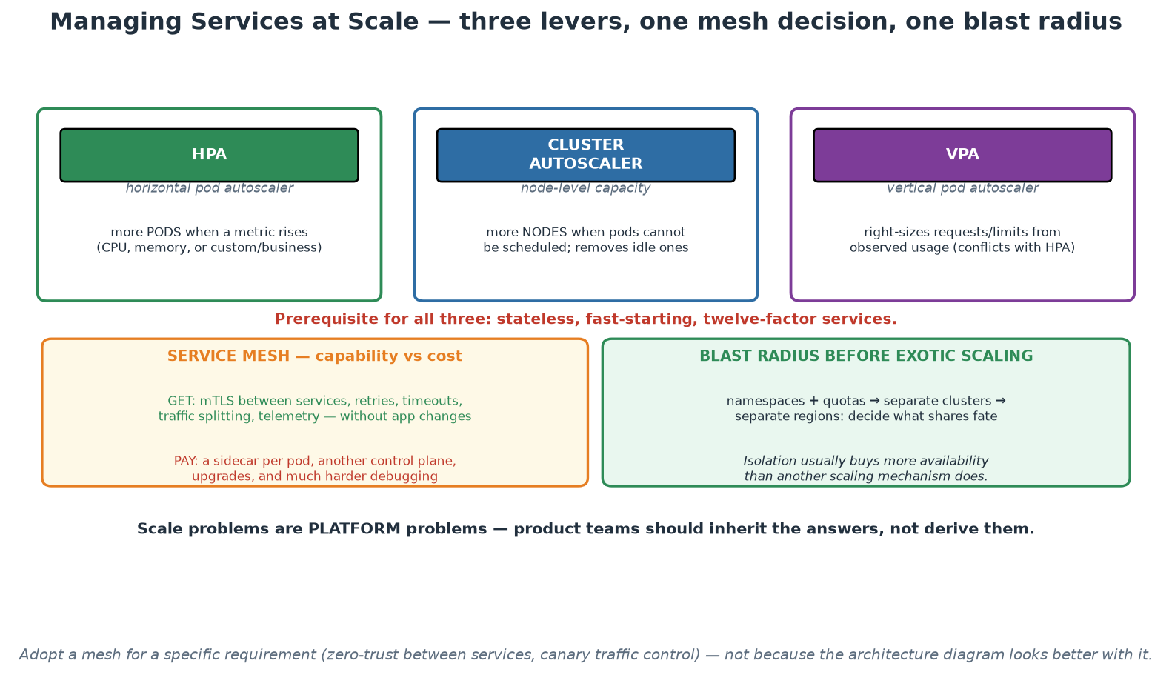
Scaling Levers, Mesh Trade-offs and Blast Radius
Three autoscaling levers, one expensive mesh decision, and isolation before exotic scaling.
Notes:
Take the three levers in turn and stress the shared prerequisite in red: none of them work on a service that is stateful or slow to start, so twelve-factor is the entry ticket to scaling. Mention the HPA/VPA conflict, because teams enable both on the same metric and are baffled by the result. On the mesh panel, keep the balance explicit - genuine capability on one side, a sidecar per pod and another control plane on the other - and give the decision rule: adopt for a specific requirement such as service-to-service mTLS or fine-grained traffic control, not for architectural completeness. The blast-radius panel carries the most valuable point for this audience: isolation usually buys more availability than another scaling mechanism, and deciding what shares fate with what is an availability design decision most institutions make by accident.

Slide 21
Module 7
Security and Compliance (DevSecOps)
Notes:
45 minutes theory + a 10-minute basic demo (Trivy scan + one Conftest policy). Goal: shift-left economics, the scanner taxonomy, supply-chain awareness, policy as code, and triage discipline - security as a platform default, not a checkpoint.

Slide 22
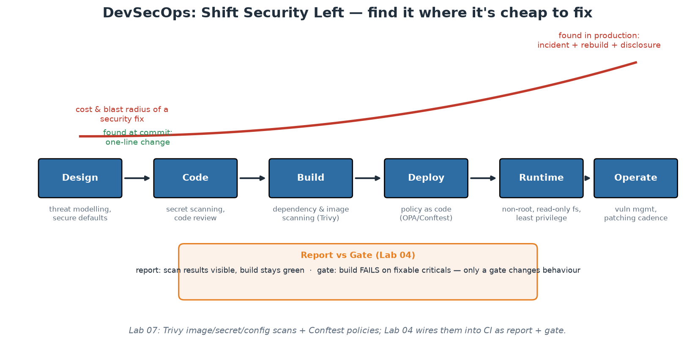
Shift Left - the Economics of Early
The later a flaw is found, the more it costs - and the bigger its blast radius.
Notes:
DevSecOps in one curve: a vulnerable dependency caught at commit time is a one-line bump chosen calmly; the same flaw found in production is an incident - emergency patching across a fleet, forensics on whether it was exploited, possibly disclosure. The traditional model (a security review before release) failed for a structural reason participants now understand from Module 5: it put a slow, manual, low-context checkpoint at the END of a fast pipeline - so security became the department of 'no', teams routed around it, and reviews happened too late to change designs anyway. Shift-left redistributes security along the whole lifecycle as fast, automated feedback: threat modelling at design ('what can go wrong here?' asked in planning - even 15 informal minutes pays), secret and dependency scanning at commit, image and IaC scanning at build, policy checks at deploy, and hardened defaults at runtime. Note what shift-left does NOT mean: it does not abolish security specialists - it changes their job from gatekeeping every release to building guardrails and platform defaults (curating rules, tuning gates, handling escalations), which scales in a way manual review never can. Every stage on this diagram maps to something concrete participants touch today.

Slide 23
The Scanner Taxonomy - What Checks What, When
SAST: reads your source for flaw patterns (injection, crypto misuse) - at PR time.
SCA: inventories dependencies against CVE databases - most real-world risk lives here.
Secret scanning: credentials in code/history - at commit AND continuously.
Container/image scanning: OS + language packages in the artifact (Trivy) - at build.
IaC/config scanning: misconfigurations in Terraform/K8s (trivy config) - at PR.
DAST: probes the RUNNING app from outside - staging, scheduled.
Notes:
Give participants the map so vendor noise cannot confuse them: each scanner class answers a different question at a different pipeline stage, and a mature setup layers several - they overlap little. SAST parses your first-party code for dangerous patterns; its curse is false-positive volume, so tune rulesets or teams learn to ignore it. SCA (software composition analysis) is where modern risk concentrates, because a typical service is overwhelmingly third-party code by volume - Log4Shell was an SCA problem, present in thousands of codebases that had written no vulnerable line themselves. Secret scanning runs twice: as a pre-commit/PR check (cheap prevention) and continuously over history, because a secret once pushed lives in Git history forever - the remediation is ROTATION, never just deletion; our demo plants a fake AWS key and watches Trivy catch it. Image scanning inspects the built artifact - base-image OS packages plus language dependencies - which is why slim bases (Module 6) directly shrink findings. IaC scanning catches the cloud-breach classics (public buckets, missing encryption, permissive roles, no resource limits) before anything exists; participants scan the course's own Terraform and manifests. DAST probes the running application from outside, catching what only manifests at runtime (auth flows, headers, injections through the real stack) - slower, so staging on a schedule rather than every commit.

Slide 24
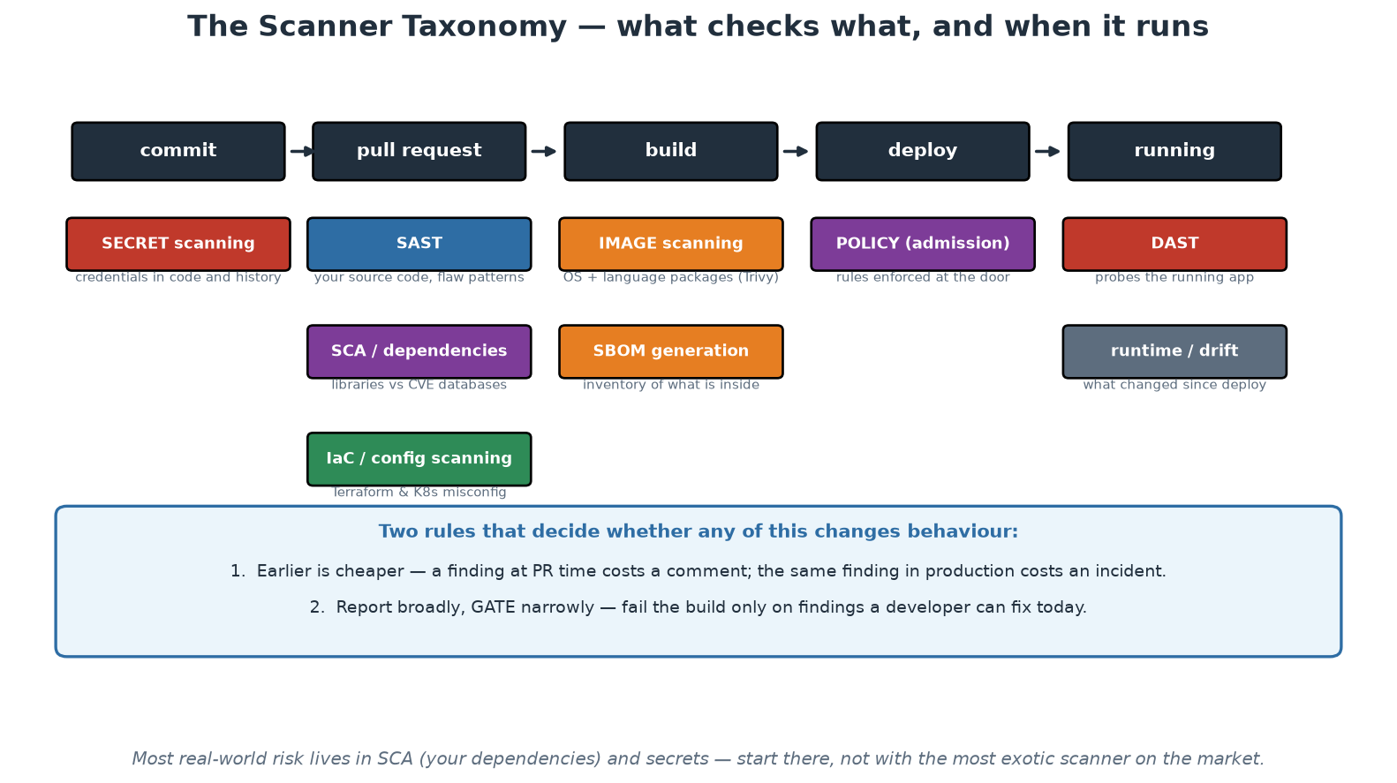
Where Each Scanner Runs
Six different questions, six different moments - and two rules that decide whether any of it matters.
Notes:
Read the pipeline left to right and place each scanner at the moment it answers its question. The two rules at the bottom are the ones to repeat: earlier is cheaper, and report broadly while gating narrowly. Point out that the taxonomy also exposes gaps - most institutions have image scanning because it is easy to buy, and are much weaker on secret scanning of history and on IaC scanning, which are cheaper and often catch more consequential problems. Use the footnote to redirect effort: dependencies and secrets carry most real-world risk, so an organisation with limited capacity should start there rather than with the most sophisticated tool available.

Slide 25
Trivy: One Tool, Four Questions
The scanner you use in the labs, and what each mode actually answers.
# 1. DEPENDENCIES - what did we inherit from other people's code? (SCA)
trivy fs --scanners vuln labs/app
# 2. IMAGE - OS packages + language deps inside the artefact we ship
trivy image --severity HIGH,CRITICAL order-service:$GIT_SHA
# 3. MISCONFIGURATION - IaC mistakes, before the resource exists
trivy config labs/lab05-iac-terraform/
# -> "Container is running without memory limit" etc.
# 4. SECRETS - credentials committed by accident
trivy fs --scanners secret .
# -> aws-access-key-id main.tf:14 AKIA****************
# INVENTORY - what is actually inside the artefact (answers 'are we exposed?')
trivy image --format cyclonedx --output sbom.json order-service:$GIT_SHA
# --- the two-step CI pattern from Module 5 -------------------------
trivy image --severity HIGH,CRITICAL --exit-code 0 $IMAGE # REPORT: visible
trivy image --severity CRITICAL --ignore-unfixed \
--exit-code 1 $IMAGE # GATE: blocks
→ Same binary, four different questions. Know which question you are asking.
Notes:
Participants meet a wall of scanner vendors, so anchor the taxonomy in one tool they will actually run. Each mode answers a different question at a different stage: fs/vuln is software composition analysis on your dependency tree (this is where modern risk concentrates - a typical service is overwhelmingly third-party code by volume, and Log4Shell was an SCA problem for thousands of teams who had written no vulnerable line themselves); image scanning covers the artefact you ship including its base OS packages, which is why the slim base image from the Dockerfile slide directly reduces findings; config scanning catches infrastructure misconfiguration before anything is created; and secret scanning catches credentials, where the remediation is always ROTATION, never just deletion, because history and clones are beyond your control. The SBOM line deserves a sentence of its own: when the next widespread vulnerability is disclosed, an organisation with SBOMs answers 'are we exposed and where?' in minutes, and one without spends weeks. Close by pointing at the two-step report/gate pattern they already built in Workshop 1.

Slide 26
Supply Chain Security - Your Pipeline Is a Target
SolarWinds: the BUILD SYSTEM was compromised - customers shipped the attacker's code.
Attack surface: dependencies, base images, CI actions, registries, build infrastructure.
SBOM: a machine-readable inventory of everything inside your artifact (Trivy can emit one).
Countermeasures: pin versions AND digests, sign artifacts (cosign), least-privilege tokens.
SLSA: a maturity ladder for build integrity - know which level you need.
Notes:
Supply chain attacks target the factory rather than the product, and they scale terrifyingly: compromise one build system or one popular package and you compromise every downstream consumer at once. SolarWinds (2020) is the canonical case - attackers modified the vendor's build process so signed, official updates carried the implant to ~18,000 organisations. The dependency-level versions arrive constantly: typosquatted packages, maintainer-account takeovers, malicious updates to abandoned libraries. Walk the attack surface as a checklist of what participants' own pipelines contain: third-party dependencies (SCA scanning), base images (pin them; prefer minimal), CI actions (our @master-vs-pinned-version lesson from Module 5 - an upstream compromise of an unpinned action runs with your repo's token immediately), registries (who can push to the image your cluster pulls?), and the build system itself. SBOMs (SPDX/CycloneDX formats) answer the Log4Shell-day question - 'which of our 400 services contains this library?' - in minutes instead of weeks, and are increasingly demanded contractually and by regulation (US EO 14028, EU CRA). Signing (Sigstore/cosign) plus admission-time verification closes the loop: only artifacts provably built by YOUR pipeline run in production. SLSA gives the maturity vocabulary; most organisations should first reach 'builds are scripted, provenance exists, tokens are least-privilege' before chasing higher levels.

Slide 27
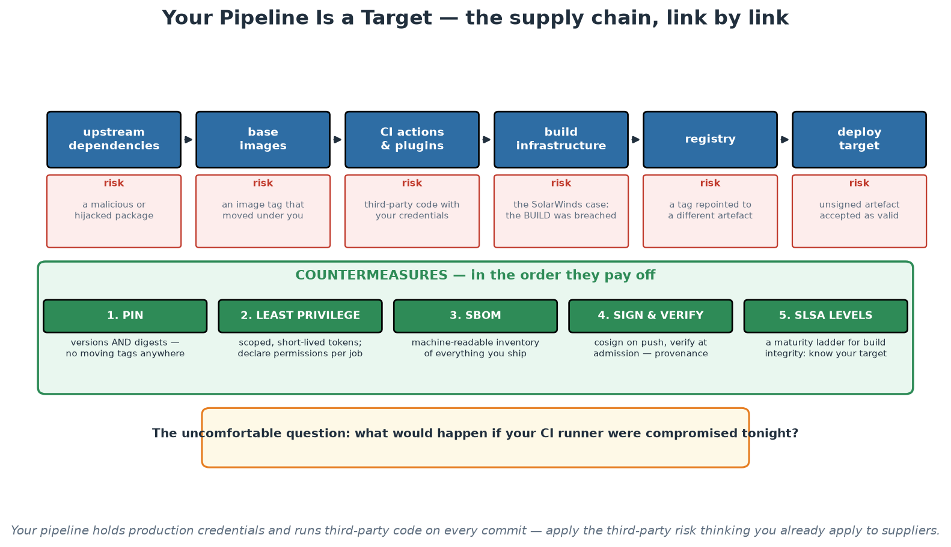
The Supply Chain, Link by Link
Every link is code you execute with production credentials - and five countermeasures in payoff order.
Notes:
Walk the links and ask the room, honestly, which ones they could enumerate today for one of their own pipelines - most institutions cannot list the third-party actions running in CI, and that inability is itself the finding. Then the countermeasures in payoff order: pinning and least privilege are cheap and remove standing exposure immediately, SBOM makes the next disclosure survivable, and signing with verification closes the loop between what the pipeline built and what the runtime will accept. The amber box at the bottom is the question to leave in the room: what would happen if your CI runner were compromised tonight? In a supervised institution, that is a legitimate third-party and operational risk question, and it usually has not been asked.

Slide 28
Compliance as Code (OPA, Rego, Conftest)
Wiki rules are wishes; encoded policies are guarantees - evaluated on every change.
OPA/Rego: a general policy engine - one language for K8s, Terraform, pipelines, APIs.
Conftest in CI tests rendered configs; admission controllers enforce at the cluster door.
Test what SHIPS: rendered output, not raw files (labels added at render time!).
Audit evidence becomes: the policy file + Git history + pipeline logs. Auditors love it.
Notes:
Compliance as code closes the gap between what the standards document says and what production does. The traditional cycle - write a standard, hope, audit annually, discover drift, remediate in a panic - fails because enforcement is manual and sampling is sparse. Encoding the rule makes enforcement continuous and total: every deployment must carry an owner label, no container may run as root, no image may use :latest - each becomes a policy evaluated automatically on every single change, and the standards document stops being fiction. OPA (Open Policy Agent, a CNCF-graduated engine) with its Rego language is the common denominator: the same policy skills apply to Kubernetes manifests, Terraform plans, CI pipelines and even application authorisation. Enforcement lives at two doors: Conftest in the pipeline (shift-left - developers get policy feedback at PR time, cheap to fix) and admission controllers in the cluster (Gatekeeper/Kyverno - nothing enters the API server unchecked, catching whatever bypassed CI). The render-time subtlety is today's demo punchline: our raw manifests FAIL the required-label policy while the Kustomize-rendered output PASSES, because labels are stamped at render time - so policies must test what actually ships. The audit story lands especially well with anyone who has suffered an audit: evidence stops being screenshots and interviews and becomes the policy file, its Git history, and pipeline logs showing every evaluation.

Slide 29
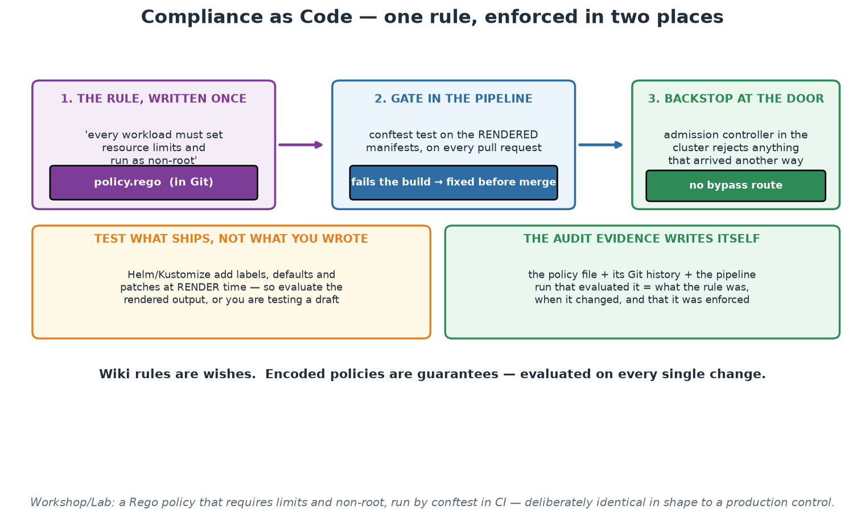
One Rule, Two Enforcement Points
Written once, gated in the pipeline, backstopped at the cluster door - and the evidence writes itself.
Notes:
Follow the rule from left to right: written once in Git, evaluated in CI against the rendered output so the developer fixes it cheaply, and enforced again at admission so nothing that arrived another way can bypass it. The two-enforcement-point design is what makes the control complete - CI alone governs only those who use CI, and admission alone gives feedback far too late. The render-first panel prevents a subtle false-confidence failure, since templating adds exactly the labels and defaults that policies check. Land on the evidence panel, which is the reason this practice is worth the effort in a supervised institution: the rule, its history, every evaluation of it, and every exception, all produced as a by-product of working rather than assembled for an audit.

Slide 30
Runtime Hardening - Platform Defaults, Not Team Chores
Containers: non-root user, read-only root filesystem, drop ALL capabilities, seccomp.
Cluster: RBAC least-privilege, NetworkPolicies (default-deny), no wildcard admin bindings.
Secrets: a manager (Vault/KMS/external-secrets), rotation, never env-dumped or committed.
Least privilege EVERYWHERE: pipeline tokens, service accounts, registry access.
The golden path ships hardened - teams inherit security instead of re-deriving it.
Notes:
Runtime hardening is defence in depth for the day the earlier layers miss something. Container level - and every item here is LIVE in the course manifests, so open deployment-order.yaml and point: runAsNonRoot (an escaped attacker lands unprivileged), readOnlyRootFilesystem (nothing can be written or planted - our own app runs happily under it, proving well-built services tolerate hardening), capabilities drop ALL (Linux root is a bundle of distinct powers; drop everything not needed), seccompProfile RuntimeDefault (filters the kernel syscall surface - the shared-kernel risk from Module 6, mitigated). Cluster level: RBAC on the API server is the security boundary that matters most - least-privilege service accounts, no default-namespace sprawl, and audit any cluster-admin binding; NetworkPolicies turn the flat pod network into default-deny with explicit allowed flows (our order->payment call would be an explicit rule). Secrets deserve their own breath: base64 in a manifest is encoding, not encryption - real setups use a manager with rotation, injected via CSI or external-secrets operators. The final bullet is the module's thesis and the platform thread again: none of this should be twenty teams' homework - the golden path's templates ship hardened, so the secure configuration is the DEFAULT configuration, and teams opt out with justification rather than opting in with expertise. BASIC DEMO (10 min, theory-demos.md): trivy image on the course's own image, then the raw-vs-rendered Conftest comparison.

Slide 31
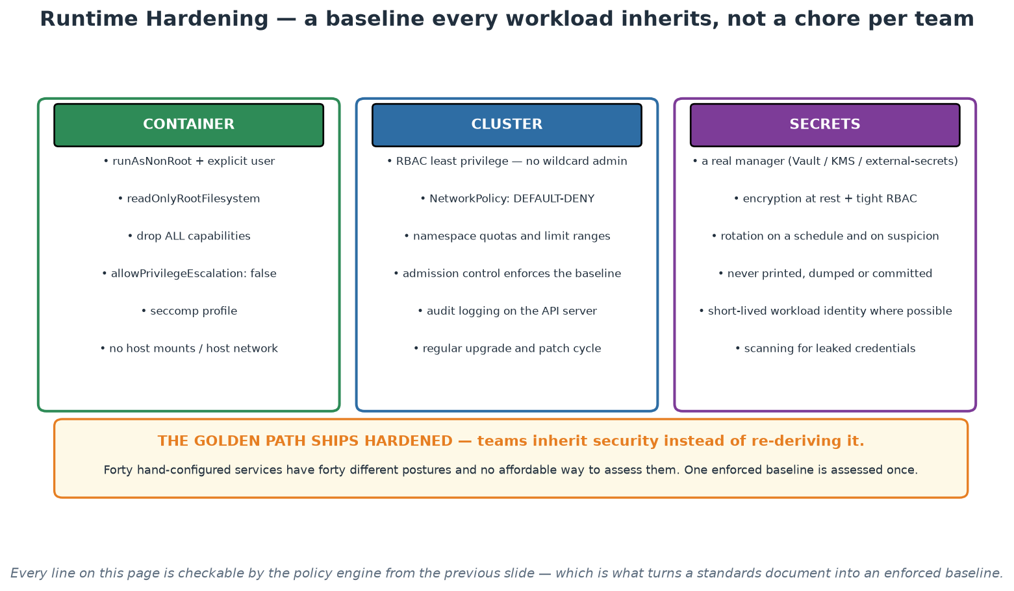
Hardening in Three Layers
Container, cluster and secrets - specified once, enforced by policy, inherited by every team.
Notes:
Present this as a specification for the golden path rather than a checklist for each team, because that is the argument: forty independently hardened services have forty different postures, and one enforced baseline is assessed once and inherited everywhere. Highlight two items that surprise people. Default-deny network policy: without it every pod can reach every other pod, which contradicts the mental model of anyone whose background is network zoning. And the secrets column, where the base64 misunderstanding lives - encoded is not encrypted, so encryption at rest, tight RBAC and a real secrets manager are all required. Everything on the page is checkable by the policy engine from the previous slide, which is what turns it from advice into an enforced baseline.

Slide 32
Triage Discipline - Living With Scanner Output
Severity (CVSS) is not risk: context - exposure, reachability, data - changes everything.
First questions: is it FIXABLE? is the vulnerable path even reachable in our usage?
--ignore-unfixed in gates: block only what a developer can action today.
Accepted risks get an owner and an EXPIRY date - never a permanent ignore file.
Track vulnerability debt like tech debt; watch the trend, not just today's count.
Notes:
The first real scan of any mature image returns dozens of findings, and the untrained reactions - panic, or numb dismissal - are equally wrong; triage is the professional skill, and it is teachable in one slide. CVSS scores measure theoretical severity in a vacuum; RISK is severity multiplied by context: a critical RCE in an internal batch tool behind a VPN is a different animal from a medium-severity flaw in your internet-facing auth service. The triage tree: Is a fixed version released? - upgrade, usually a one-line change caught at ideal cost (the shift-left curve). No fix yet? - assess reachability: is the vulnerable function even invoked in your usage? Vendor advisories and reachability analysis help; often the honest answer is 'not exploitable in our configuration', which is an ACCEPTANCE decision - and acceptances get an owner and an expiry date, because 'ignore forever' files rot into blindness. This is exactly why the Workshop 1 gate uses --ignore-unfixed on criticals: a gate must only block what someone can action today, or it gets bypassed and takes the team's respect for red builds with it (Module 5's lesson, applied). Finally, zoom out: individual findings matter less than the TREND of vulnerability debt - a platform that auto-bumps base images weekly beats any amount of heroic patching.

Slide 33
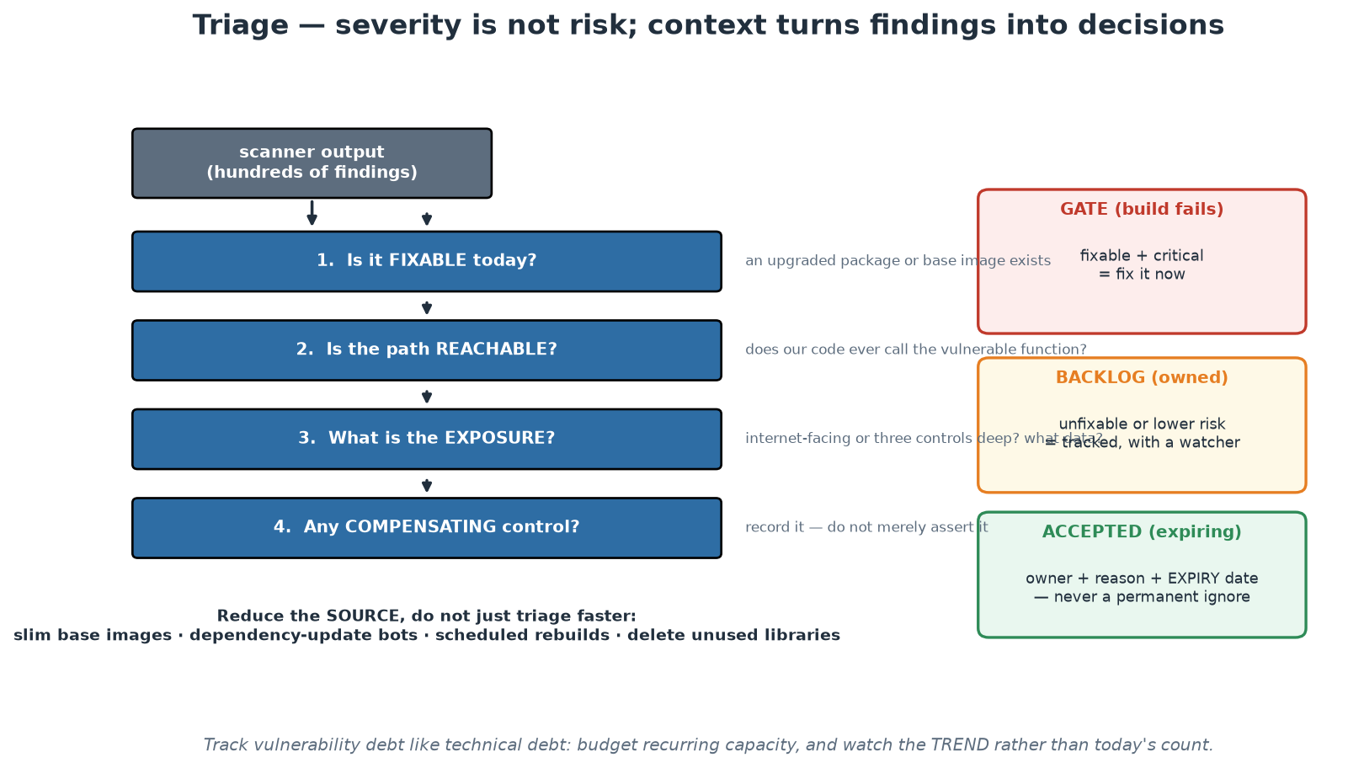
From Findings to Decisions
Four questions turn hundreds of findings into three actionable buckets.
Notes:
The funnel converts an unmanageable list into three decisions: fix now, track with an owner, or accept with an expiry. Walk the four questions in order and stress the first two, because they remove most of the noise - fixable findings are usually a version bump, and unreachable code paths are genuinely lower risk however alarming the score. The three outcome boxes are the operational content: the gate blocks only the fixable and critical, the backlog is owned and watched, and acceptances carry an owner, a reason and an expiry date. Finish on the reduction line at the bottom, because it is where the leverage is - slimmer bases, dependency bots and scheduled rebuilds remove more findings than any amount of triage meeting time.

Slide 34
Module 7 - Key Takeaway
"Make the secure path the easy path. Scanners inform, gates enforce, policies encode the rules, and the platform ships it all as the default - so security happens even on a deadline."
— Course synthesis
Notes:
Bridge to Module 8: hardening reduces the odds of failure; observability is how you find out anyway - because something always gets through.

Slide 35
Module 8
Observability and Reliability
Notes:
45 minutes theory + a 15-minute basic demo (Prometheus + Grafana on localhost, then a mini incident). Goal: pillars with real depth, SLI/SLO/error budgets, alerting that respects humans, and reliability patterns - measurement in service of learning.

Slide 36
Monitoring Asks Known Questions; Observability Answers New Ones
Monitoring: predefined checks for failures you ANTICIPATED (disk full, service down).
Observability: can you interrogate the system about failures you NEVER predicted?
Distributed systems fail in emergent ways - the interesting outage is always novel.
Property of the system: rich telemetry with labels/context you can slice ad hoc.
Test: 'orders from one customer segment are slow - why?' answerable without a new deploy?
Notes:
The distinction is practical, not pedantic. Monitoring is a set of questions you wrote down in advance - is the disk full, is the process up, is latency under 500ms - and it is necessary but bounded by your imagination at dashboard-design time. In a distributed system (Module 6's world), the failures that hurt are EMERGENT: a retry storm amplifying a slow dependency, one customer's pathological request pattern, a cache stampede after a deploy - none of which had a pre-built dashboard. Observability (the term borrowed from control theory: inferring internal state from outputs) is the property of emitting telemetry rich enough to answer questions you formulate DURING the incident: metrics with meaningful labels (endpoint, status, customer-tier), structured logs with correlation IDs, traces stitching a request across services. The litmus test on the slide is worth reading aloud twice - if answering a novel question requires adding instrumentation and redeploying, you have monitoring; if you can slice existing telemetry ad hoc, you have observability. High-cardinality labels are what make slicing possible, and also what makes naive metric systems explode - a real design tension to name honestly (metrics for aggregates, logs/traces for high-cardinality detail).

Slide 37
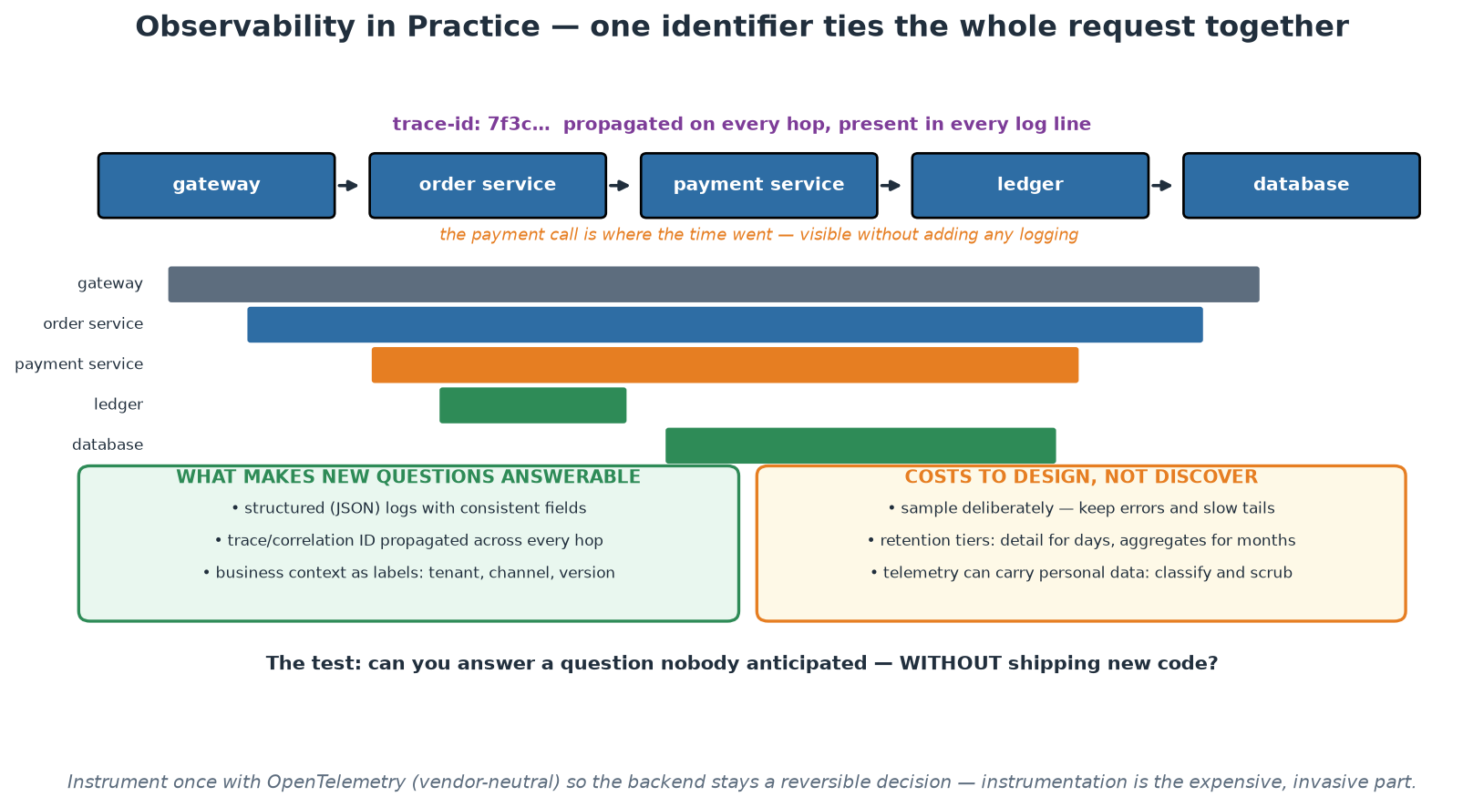
One Request, One Trace
A propagated trace ID turns five services' logs into one answerable story.
Notes:
The waterfall makes the value obvious in a way that no definition does: one identifier, propagated across every hop, shows exactly where the time went - and the answer required no new logging and no deploy. Ask the room how they would answer the same question today, and the usual honest answer is 'add logging and redeploy', which is precisely the gap. The two bottom panels split the work into what makes new questions answerable (structured logs, propagated IDs, business context as labels) and what must be designed rather than discovered (sampling, retention tiers, and personal data in telemetry). That last point matters here: telemetry carrying personal data is a data-protection question, and it is far cheaper to design for than to remediate.

Slide 38
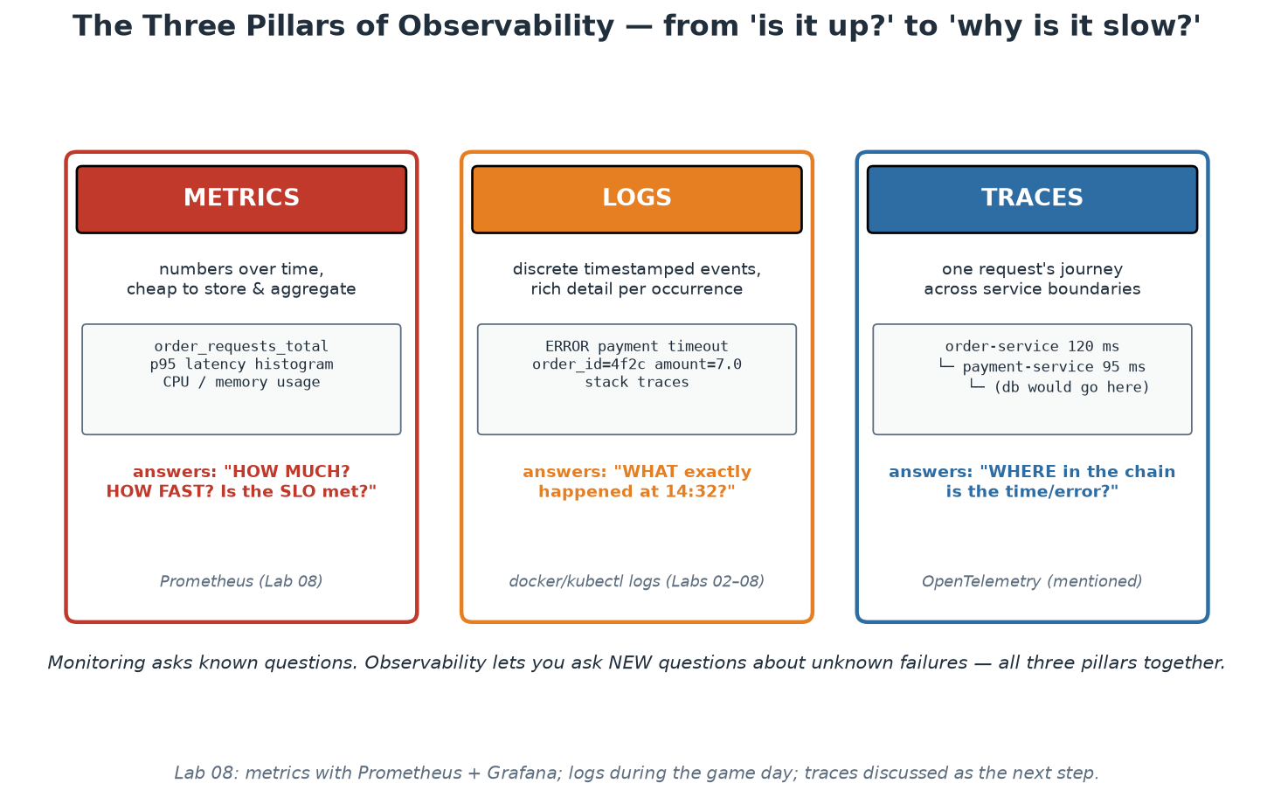
The Three Pillars in Depth
Metrics: how much/how fast. Logs: what exactly. Traces: where in the chain.
Notes:
Give each pillar its engineering personality, because they are complements, not alternatives. METRICS are cheap aggregates over time - counters and histograms whose cost is independent of traffic volume - perfect for dashboards, alerts and SLOs; our app's middleware counts every request into order_requests_total with method/endpoint/status labels and times it into a histogram; two method points worth teaching: RED (Rate, Errors, Duration) is the request-service checklist, USE (Utilisation, Saturation, Errors) the resource-level one - and averages LIE, which is why histograms exist: mean latency of 50ms is compatible with a p99 of 4 seconds, and your unluckiest users live in the tail, so we quantile from histogram buckets (participants build the p95 panel in the demo). LOGS are discrete events with unbounded detail - the place for stack traces and request context; structure them (JSON) and carry correlation IDs so one request's story is greppable across services; they answer 'what exactly happened at 14:32'. TRACES follow ONE request across service boundaries - spans with timing per hop - answering 'WHERE in the chain did the time or error come from'; OpenTelemetry is the vendor-neutral standard worth naming (one instrumentation, any backend). Workflow in practice: a metric alert says SOMETHING is wrong, traces localise WHERE, logs explain WHY - the demo walks exactly this path.

Slide 39
SLI, SLO, SLA - and the Error Budget
SLI: a measured indicator of user experience (success rate, p95 latency).
SLO: your internal target for it (99% of /orders requests succeed, 30-day window).
SLA: the external CONTRACT with penalties - always looser than the SLO.
Error budget: 100% minus SLO = permitted failure. 99% over 30 days = ~7.2 hours.
Budget healthy: ship fast. Budget spent: reliability work wins - by prior agreement.
100% is the wrong target: each nine multiplies cost, and users cannot tell past a point.
Notes:
This is SRE's crown jewel: it converts 'how reliable should we be?' from an emotional argument into an engineering budget. SLIs must measure USER experience, not machinery - 'successful responses to real requests' beats 'CPU below 80%' (users do not experience your CPU); choose 2-3 per service, typically availability and latency. Two subtleties participants hit in the course material: exclude health-check traffic from the SLI (it is high-volume and almost always succeeds, so it dilutes real user pain - our slo.md does this deliberately and says why), and measure at the point closest to the user you can. SLOs are internal targets with explicit windows; SLAs are contracts with lawyers and penalties, set LOOSER than the SLO so you breach internally before you breach contractually. The error budget reframes everything: a 99% monthly SLO GRANTS ~7.2 hours of failure - reliability stops being 'as much as possible' and becomes a resource to SPEND on velocity (deploys, experiments, migrations). The policy must be agreed BEFORE it is needed: budget healthy means ship; budget exhausted means feature work yields to reliability work - agreed in calm, enforced without a fight in crisis. The last bullet defuses the 100% instinct: each extra nine multiplies cost (redundancy, complexity, on-call) while user-perceived value flattens - your mobile user's network is less reliable than your 99.9% anyway. Ask the room what THEIR services' unwritten SLO currently is; the silence is the lesson.

Slide 40
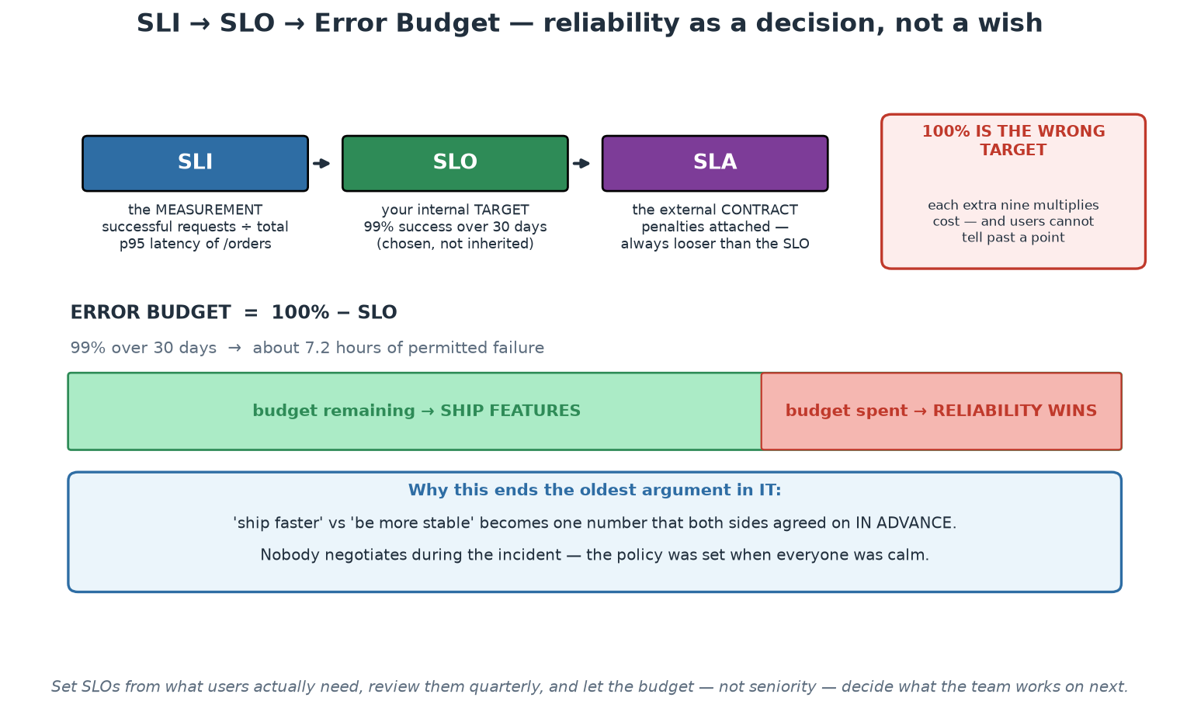
SLI, SLO and the Error Budget
Reliability becomes a spendable, agreed number instead of an argument between temperaments.
Notes:
Walk the ladder - measurement, internal target, external contract - and stress that the SLO is chosen rather than inherited, which is where most of the value lies. The budget bar is the idea to leave in the room: the gap between the target and 100% is a resource that may be deliberately spent on change, and when it is exhausted, reliability work takes priority by prior agreement. Emphasise 'prior agreement' - the policy is set while everyone is calm, so nobody negotiates during an incident. The red box on the right is worth arguing for explicitly in a risk-averse institution: 100% is not a target, it is an unfunded aspiration, and each additional nine multiplies cost while users often cannot perceive the difference.

Slide 41
SLOs in PromQL: from Metric to Error Budget
Turning the instrumentation on the previous slide into a number you can manage.
# SLI - availability: the proportion of requests that did NOT fail (last 30d)
sum(rate(http_requests_total{job="order",code!~"5.."}[30d]))
/
sum(rate(http_requests_total{job="order"}[30d]))
# SLI - latency: proportion served faster than 300ms (a 'good event' ratio)
sum(rate(http_request_duration_seconds_bucket{job="order",le="0.3"}[30d]))
/
sum(rate(http_request_duration_seconds_count{job="order"}[30d]))
# SLO : 99.9% of requests succeed over 30 days
# BUDGET : 0.1% may fail -> 43.2 minutes of failure per 30 days
# BURN RATE: how fast you are spending it. 1.0 = exactly on budget.
(1 - (sum(rate(http_requests_total{job="order",code!~"5.."}[1h]))
/ sum(rate(http_requests_total{job="order"}[1h]))))
/ 0.001
# 99.9% over 30 days = 43m | 99.95% = 21m | 99.99% = 4m 19s
# Each extra nine multiplies the engineering cost. Choose deliberately.
→ The budget converts an argument about risk appetite into arithmetic everyone can check.
Notes:
This slide is where reliability stops being a feeling. Define the terms cleanly: the SLI is the measurement, the SLO is the target you commit to internally, the SLA is the contractual promise with consequences (and should always be looser than the SLO, so you breach your own target before you breach a customer's contract). The error budget is the arithmetic that follows: 99.9% over thirty days means 43.2 minutes of allowed failure, which is a spendable resource rather than a vague aspiration. That reframing is what changes conversations - 'we have burned 70% of the budget in nine days' is a fact both engineers and product managers can act on, and it makes the classic feature-versus-stability argument mechanical: budget remaining, ship; budget exhausted, reliability work takes priority. Emphasise the last two lines: each additional nine multiplies cost, so choosing 99.99% for an internal reporting service is an expensive decision usually made by accident. Ask the room what their most critical service's real target is and whether anyone has ever calculated the corresponding minutes.

Slide 42
Alerting That Respects Humans
Page on SYMPTOMS (users hurting), ticket on causes (disk trending full).
Alert on error-budget BURN RATE, not raw thresholds - two windows: fast and slow.
Every page must be: actionable, urgent, and novel. Otherwise it is noise.
Alert fatigue is a safety failure: ignored pages are how big outages get missed.
Every alert links a runbook; every false page gets tuned or deleted - budget your alerts too.
Notes:
Alerting is where observability meets human factors, and most organisations get it wrong in the direction of MORE. The symptom/cause split: page a human when users are hurting (error rate up, latency exploding) because that always deserves urgency; causes that are not yet symptoms (a disk filling over days, a certificate expiring next week) become tickets - urgent-but-async work. Naive threshold alerts ('availability below 95% for 5 minutes') fail in both directions: too slow for a total outage, too twitchy for a brief blip that self-heals. Burn-RATE alerting fixes this by asking 'how fast is the error budget being consumed?': a fast-burn rule (e.g. burning at 14x budget rate over 1 hour AND 5 minutes - the two windows suppress flapping) pages because the monthly budget dies in days; a slow-burn rule (3x over 24 hours) tickets because there is time to think. Our slo.md contains these exact rules with the arithmetic worked out - point participants at it. The 'actionable, urgent, novel' test kills most existing alerts on contact, and that is the point: alert fatigue is not an annoyance but a SAFETY failure - the on-call who silences their tenth false page tonight is the one who sleeps through the real one; Module 2's psychological safety applies to machines paging humans, too. Runbook links and a standing rule that every false page produces a tuning change keep the alert set trustworthy over time.

Slide 43
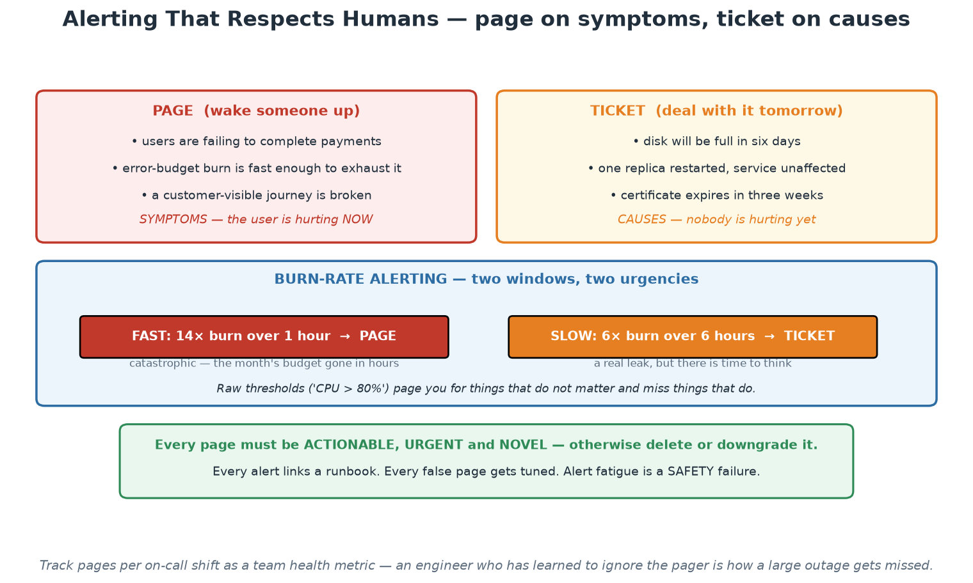
Page on Symptoms, Ticket on Causes
Two windows, two urgencies - and three tests every page must pass.
Notes:
The left/right split is the heuristic to take home, and the burn-rate panel is the modern refinement: a fast window catches the sudden outage and pages, a slow window catches the steady leak and raises a ticket, and neither fires for a brief harmless blip. Tie each page back to the error budget so that every interruption is connected to something the organisation already agreed matters. The three tests at the bottom - actionable, urgent, novel - are a review tool participants can apply to their existing alert set this month, and the exercise typically removes a large share of their pages while improving detection. Close on the last line and mean it: alert fatigue is a safety failure, not a personal resilience problem.

Slide 44
Designing for Failure - Reliability Patterns
Assume dependencies WILL fail; the design question is what happens then.
Timeouts everywhere (no infinite waits) + retries with backoff AND jitter - budgeted.
Circuit breakers: stop hammering a sick dependency; probe for recovery.
Graceful degradation: reduced service beats no service (our 'payment unavailable').
Redundancy + fast rollback: recovery speed often beats failure prevention.
Notes:
Reliability is designed, not hoped for - and every pattern here is visible in the course's tiny app, which is the teaching trick: point at labs/app/main.py on screen. Timeouts: our payment call carries timeout=2.0 - without it, a hung dependency consumes order-service threads until IT dies too, which is how failures cascade upward. Retries help with transient blips but are dangerous at scale: a thousand clients retrying immediately is a self-inflicted DDoS on a recovering service - hence exponential backoff with JITTER (randomisation so retries do not synchronise into waves), and retry budgets to cap amplification. Circuit breakers formalise 'stop asking': after N failures the breaker opens and calls fail fast without touching the sick dependency, then a half-open probe tests recovery - protecting both caller (no wasted waits) and callee (breathing room). Graceful degradation is the design PHILOSOPHY the mechanisms serve: decide per feature what reduced service looks like - our order service accepts the order with payment status 'unavailable' rather than erroring, a product decision (accept-and-reconcile vs reject) that engineering alone cannot make; participants watched this behaviour in Lab 00 without the payment service and will trigger it deliberately in the incident demo. The last bullet reframes the goal with DORA's stability metrics: since failure is inevitable, RECOVERY TIME is often the better investment than ever-more prevention - which is why rollback practice (Workshop 2) matters as much as tests.

Slide 45
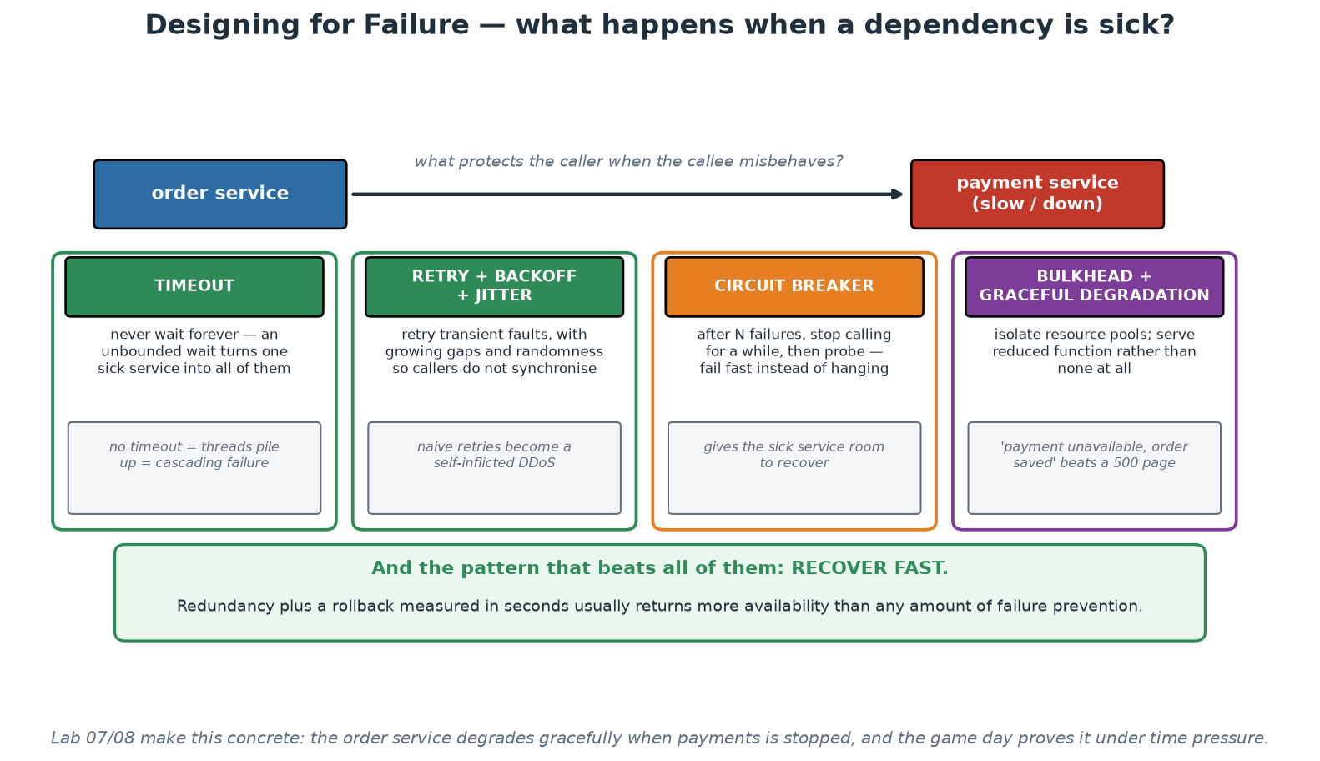
Patterns for Partial Failure
Timeouts, retries with jitter, circuit breakers, bulkheads - and recovering fast beats all of them.
Notes:
Take the four patterns in order and give each its failure mode as well as its purpose, because each one can make things worse when applied naively - especially retries, which have turned many minor incidents into major ones by multiplying load on a struggling dependency. The sentence to repeat is on the first card: slow is worse than down, because a dead dependency fails fast while a sick one holds your threads and connections until you fall over too. The green panel at the bottom is the strategic point and connects Day 1 to Day 2: redundancy plus a rollback measured in seconds returns more availability than another layer of prevention, which is why immutable artefacts and one-command rollback are reliability engineering rather than merely delivery convenience.

Slide 46
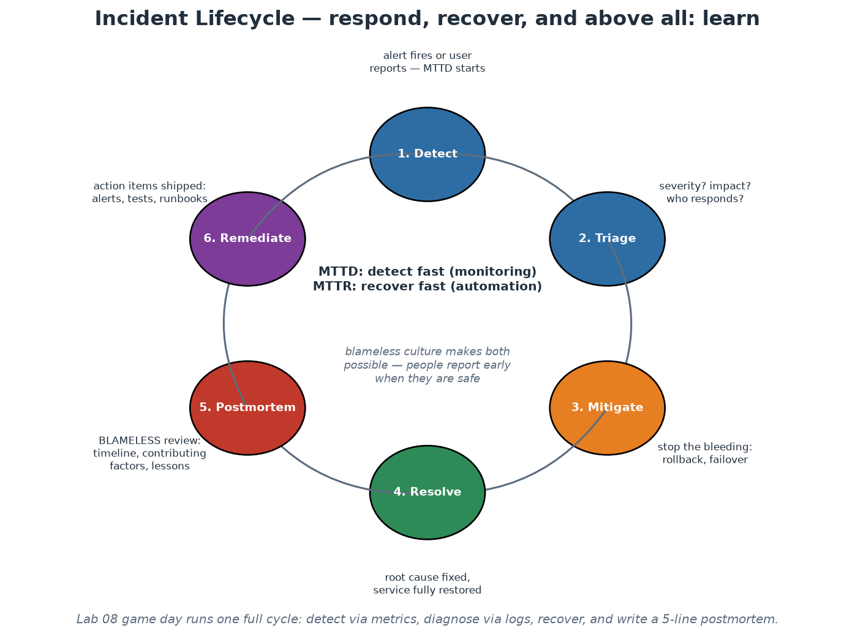
The Incident Lifecycle - and Practising It
Detect, triage, mitigate, resolve - then the learning half: postmortem, remediate.
Notes:
Walk the ring with emphasis on the two clocks and the learning half. MTTD (detection) is bought with Module 8's alerting - the gap between 'users hurting' and 'we know' should be minutes, not a customer email later. Triage assigns severity and a clear incident-commander role (someone coordinates, others investigate - structure beats heroics). MITIGATE before you understand: stop the bleeding with rollback, failover or a flag flip - root cause can wait; this ordering feels wrong to engineers who want to understand first, and is right anyway. Resolve fixes the cause properly. Then the half most organisations skip: the blameless POSTMORTEM (Module 2's practice, now in context) and REMEDIATE - action items shipped as real backlog work, closing the loop back to 'detect' with better alerts, runbooks and guards. This is the Third Way from Module 1: incidents as the system teaching you about itself. BASIC DEMO NOW (15 min, theory-demos.md): bring up the observability stack on localhost, generate traffic, see the dashboard - then the instructor quietly stops the payment container; the room notices via payment status flipping to 'unavailable' and the Prometheus target going down, localises it, restarts it, watches recovery, and writes a 5-line postmortem together. One full lifecycle lap, at lab scale, on localhost. Game days (rehearsed versions of exactly this) are the habit to take home.

Slide 47
Module 9
Platform as a Product
Notes:
45 minutes theory + the platform canvas exercise (25 min, instructor/platform-canvas.md). This module converts the whole course's platform thread into product discipline: users, golden paths, metrics, ROI - and what to deliberately NOT build.

Slide 48
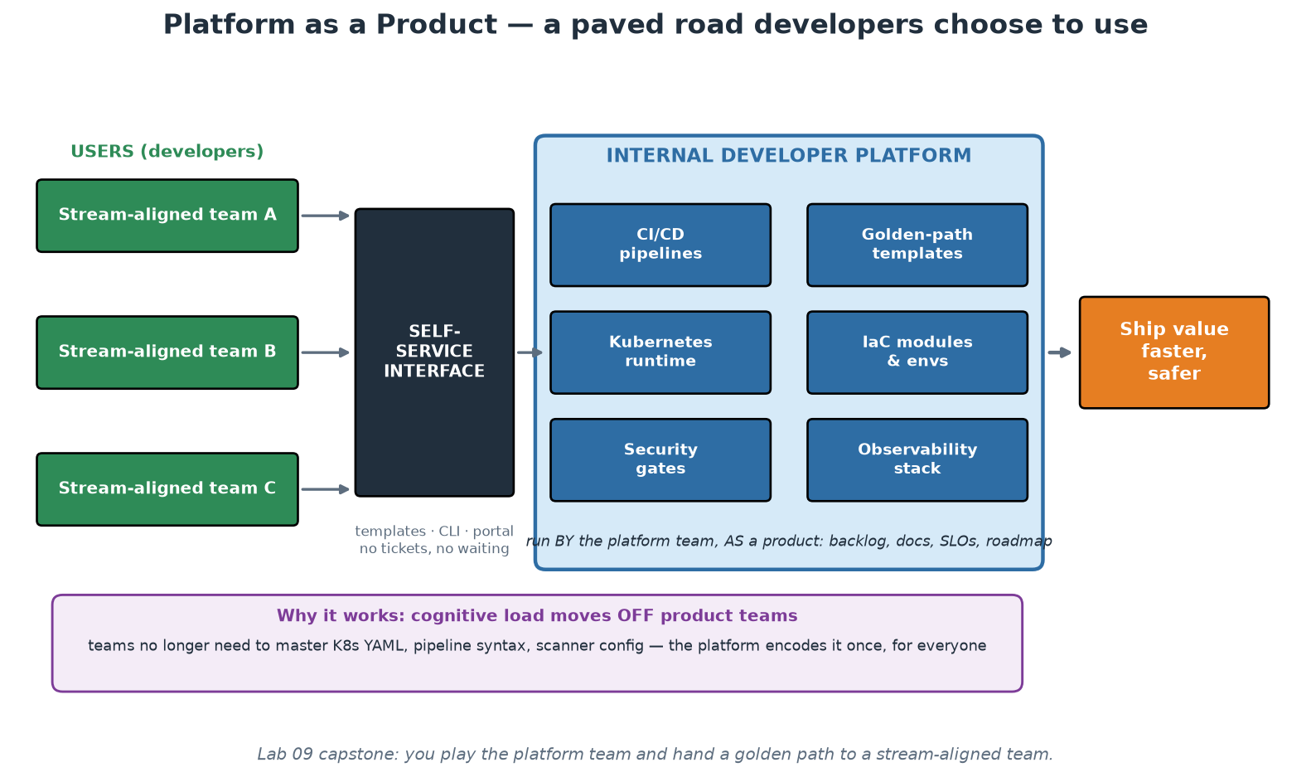
The Internal Developer Platform
A paved road developers CHOOSE - because it is genuinely the best way to ship.
Notes:
Anchor the module: an Internal Developer Platform is the productised sum of everything this course covered - templates, pipelines, runtime, IaC modules, security gates, observability - behind a self-service interface, so stream-aligned teams consume capabilities instead of building them. The product framing is the load-bearing idea: a platform has USERS (your developers), COMPETITORS (do-it-yourself, shadow IT, that one team that loves its own Jenkins), and it lives or dies by voluntary ADOPTION. The moment a platform must be mandated, it has failed as a product - mandates breed resentful compliance and workarounds; attraction breeds pull. Contrast the two failure modes participants have likely met: the rebranded ops team (a ticket queue with a new name - no self-service, no product thinking, just the old bottleneck) and the ivory-tower platform (built in isolation for a year, launched to users who never asked for it - Field of Dreams engineering). The healthy pattern, via Team Topologies' interaction modes from Module 2: COLLABORATE with two or three pilot teams to discover what is actually painful, productise that into X-as-a-Service, repeat. Cognitive load (Module 1) is the value proposition throughout: every capability the platform absorbs is capacity returned to product teams for their actual domain.

Slide 49
What a Golden Path Feels Like
The developer experience the platform is selling. Everything below is generated.
$ platform new service --name pricing --template python-api --team risk
[1/6] repository github.com/org/pricing created
[2/6] pipeline test -> build -> scan -> deploy wired
[3/6] environments dev, staging, production provisioned
[4/6] observability dashboard + 4 SLO alerts registered
[5/6] security image signing, policy, secrets enabled
[6/6] on-call PagerDuty schedule 'risk' linked
Your service is live: https://pricing.dev.internal
Dashboard: https://grafana.internal/d/pricing
Next: git clone github.com/org/pricing && make dev
Time to first deploy: 4 minutes 12 seconds
# The team wrote no YAML. The platform team wrote it once, and owns it.
# Compliance is inherited, not remembered: scanning, policy, approvals,
# resource limits, non-root, audit trail - all already in the generated path.
# Escape hatch: --eject writes the underlying config into the repo,
# and the team then owns what the platform was maintaining for them.
→ Measure this: time-to-first-deploy is the platform's clearest product KPI.
Notes:
Make the developer experience concrete, because 'golden path' otherwise stays abstract. Everything in this output is generated by templates the platform team maintains - repository, pipeline, environments, dashboards, alerts, secrets wiring, on-call linkage - and the consuming team wrote no YAML at all. Then make the governance argument, which is what funds the platform in a supervised institution: compliance is inherited rather than remembered. Scanning, policy checks, four-eyes enforcement, resource limits, non-root execution and the audit trail are all already in the generated path, so the easiest way to build a service is also the compliant way. Contrast that with a standards document, which competes with a deadline every time. Two details to emphasise. First, the timing line - time-to-first-deploy is the KPI that makes the platform's value legible to leadership, and most organisations' honest current answer is weeks. Second, `--eject`: the escape hatch is what keeps the road voluntary. A team with a genuinely unusual requirement can step off and take ownership of what the platform was handling, which is a fair, transparent trade rather than a fight with a mandate.

Slide 50
User-Centric Design for Internal Platforms
Your users are developers - so do real product discovery: interviews, journey maps, personas.
Measure the journey: time-to-first-deploy for a NEW team is the flagship UX metric.
Documentation IS the interface: quickstarts, copy-paste examples, honest error messages.
Golden paths (Spotify's term): the supported, delightful default - with escape hatches.
Start from the Thinnest Viable Platform; grow by demand, not by roadmap fantasy.
Notes:
Treat developers with the same UX seriousness a product team gives customers - it feels strange the first time and pays immediately. Discovery: interview teams about their path to production and map the journey (idea -> repo -> pipeline -> deploy -> observe); every wait, ticket and confusion point is a product opportunity - Module 1's cognitive-load pains, now itemised. Time-to-first-deploy is the flagship metric because it compresses the whole experience into one number a CTO understands: from 'new team formed' to 'hello-world serving in production' - weeks in ticket-driven organisations, minutes on a good platform (our capstone's golden path is a working miniature: template + pipeline + runtime, and participants time it). Documentation as interface is literal: for most consumers the platform IS its docs and templates - a capable platform with poor docs is, from the user's chair, a poor platform; invest accordingly (quickstarts over reference dumps, tested copy-paste examples, error messages that say what to DO next). Golden paths, Spotify's coinage: the blessed path is supported, maintained and delightful, but not a cage - teams can step off it, accepting they then own what they leave behind; escape hatches prevent the mandate failure mode. TVP (Team Topologies): start with the smallest platform that helps - maybe one great template and one pipeline - and let real demand pull the roadmap; platforms built big-bang from imagined requirements join the ivory-tower graveyard.

Slide 51
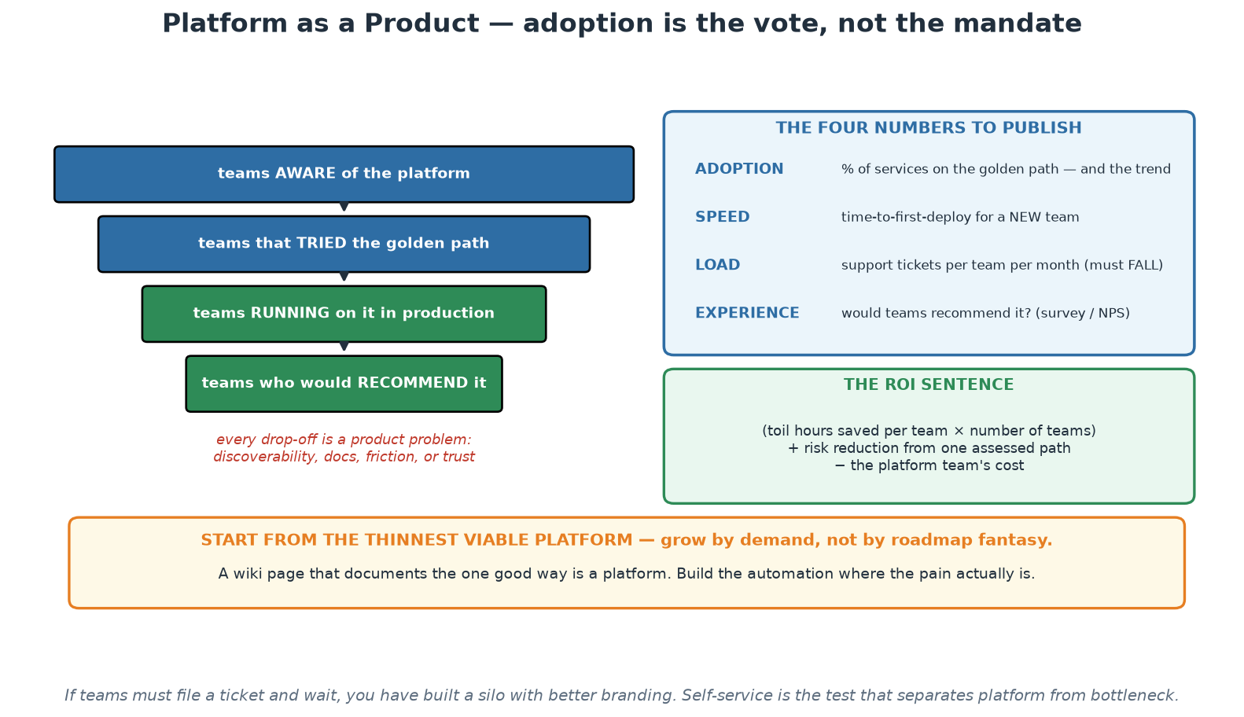
Platform as a Product
An adoption funnel, four published numbers, and the ROI sentence.
Notes:
The funnel is the frame: aware, tried, running in production, would recommend. Every drop-off between those stages is a product problem with a specific cause - discoverability, friction, documentation or trust - and locating the drop-off tells the platform team what to fix next, which is far more useful than a roadmap written from architectural preference. The four numbers on the right are what a platform team should publish every quarter, and the ROI sentence underneath is how the work gets funded. Close on the orange band: start from the thinnest viable platform, because the most expensive failure in this space is two years of building followed by no adoption.

Slide 52
Measuring Success and ROI
Adoption: % of services on the golden path - and the trend. Voluntary adoption is the vote.
Speed: time-to-first-deploy; DORA metrics OF CONSUMING TEAMS (the platform's real output).
Load: support tickets per team per month should FALL as self-service rises.
Experience: developer NPS / quarterly surveys - would they recommend the platform?
ROI story: (per-team toil hours saved x teams) + risk reduction vs platform team cost.
Notes:
A platform consumes real headcount, so it must demonstrate value in numbers leadership respects - give participants the funding conversation on one slide. Adoption is the honest north star precisely because your platform is optional: teams choosing the paved road is a continuous referendum on whether it is actually better than DIY; falling adoption is user feedback, not user disloyalty. Speed: measure DORA metrics (Module 3) of the TEAMS USING the platform - the platform's output is not its own uptime but its customers' delivery performance; if consuming teams do not deploy more often with fewer failures, the platform is decoration. Support load falling while adoption rises is the self-service proof - a rising ticket count means you built a ticket queue with extra steps. Developer NPS and lightweight quarterly surveys catch what metrics miss; the free-text answers are roadmap gold. The ROI arithmetic is simple enough for a slide and strong enough for a budget meeting: hours of infrastructure toil saved per team per month, times number of teams, priced at loaded cost - typically dwarfing a platform team's cost at even modest scale - plus the harder-to-price but very real risk term (one prevented breach or one halved recovery time). Close the loop with Module 9's warning label: measure the SYSTEM, never individuals, and never let platform metrics become team report cards - Module 3's gaming lesson applies doubly here.

Slide 53
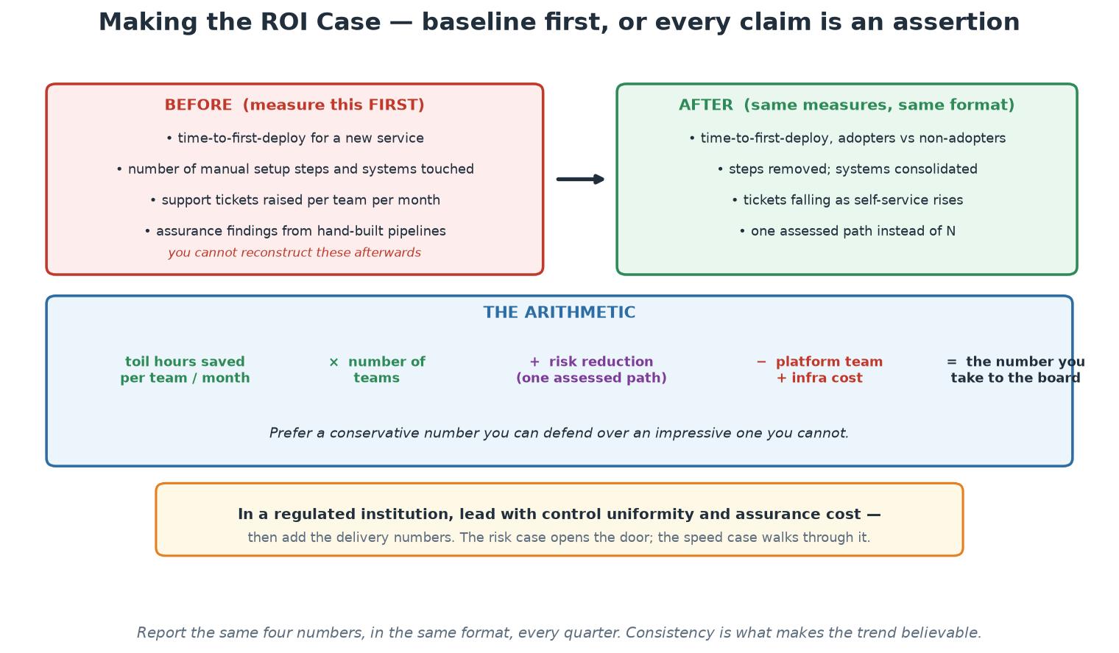
Baseline First, Then Prove It
You cannot reconstruct the before-picture afterwards - measure it while it still exists.
Notes:
The single most important instruction on this slide is the red panel: measure the before-picture now, because it cannot be reconstructed later and without it every subsequent claim is an assertion. Agreeing those numbers with the delivery teams themselves also makes the later comparison credible rather than self-reported. The arithmetic band is deliberately simple so it survives a finance conversation, and the advice to prefer a conservative defensible number over an impressive fragile one is worth repeating. Close on the amber band, which is the framing for this institution: lead with control uniformity and assurance cost, then add the delivery numbers - the risk case opens the door, and the speed case walks through it.

Slide 54
The Platform Business Case, on One Slide
The arithmetic that gets a platform team funded - and keeps it funded.
COST (what the platform consumes)
4 platform engineers R 6 000 000 / year
infrastructure, licences, tooling R 1 500 000 / year
---------------------------------------------------------------
TOTAL R 7 500 000 / year
BENEFIT (measured, not estimated)
1. Onboarding: 25 teams x 3 weeks saved x R 45k/wk R 3 375 000
2. Toil removed: 25 teams x 4 hrs/wk x 46 wks x R 900/hr R 4 140 000
3. Incidents: 30% fewer change failures R 2 100 000
(18 -> 12 major incidents x ~R 350k average impact)
4. Duplication avoided: 25 pipelines built once, not 25x R 1 800 000
---------------------------------------------------------------
TOTAL R 11 415 000
NET + R 3 915 000 / year (ROI ~52%)
# The numbers that make this defensible are the ones you baseline BEFORE:
# time-to-first-deploy | lead time | change-failure rate | adoption %
# developer satisfaction (survey) | hours of toil per team per week
→ If you cannot state the baseline, you cannot claim the improvement. Measure first, build second.
Notes:
This directly answers the 'business case driven platform engineering' expectation, and it is the slide senior participants will care most about. The structure matters more than the specific figures, which are illustrative and should be replaced with the institution's own: cost is easy and visible, so the work is on the benefit side, and each benefit line must be traceable to a metric someone measured rather than a number someone felt. Walk them: onboarding time saved is measurable as time-to-first-deploy before and after; toil removed comes from asking teams how many hours a week they spend on delivery mechanics; incident reduction comes from change-failure rate, which DORA gives you; duplication avoided is the count of teams who would otherwise each build a pipeline. Stress the sequencing point at the bottom, because it is the most common failure of platform initiatives: teams build for a year and then cannot prove value, because nobody recorded the before. Baselining costs a week and protects the programme. Finally, note that adoption percentage is both a value metric and an early warning - a platform nobody chooses is not saving anything, whatever the model says.

Slide 55
Operating Model - and What NOT to Build
Product-fund the platform (a team with a roadmap), not project-fund (a deliverable that 'ends').
The platform has SLOs and support hours - it is production, with customers.
Deprecation policy: versioned templates, migration windows, no rug-pulls.
Say NO deliberately: exotic needs stay with the teams that have them (escape hatch, not feature).
The platform team is a stream-aligned team whose product is the platform.
Notes:
Operating-model failures kill more platforms than technical ones - four traps and their answers. Funding: a project-funded platform 'finishes', its team disbands, and the artifact rots into the legacy it was meant to replace; product funding (a standing team, a roadmap, ongoing discovery) matches the reality that a platform is never done. Production discipline: the platform sits under every team's delivery path, so it needs SLOs (Module 8, applied to yourself), an on-call story, and honest support hours - a platform that goes dark at 17:00 while its consumers are on call is not a product, and eating your own dog food here builds credibility faster than any roadshow. Deprecation: platform churn is a tax on every consumer, so version templates, announce windows, provide migration tooling - trust, once rug-pulled, does not return. Saying no is a product skill: the platform serves the COMMON 80% brilliantly; the exotic 20% uses the escape hatch and owns its choice - a platform that chases every request becomes an unmaintainable everything-store (this is canvas box 9, and it is the box groups struggle with most, which is exactly why it is there). EXERCISE NOW (25 min + debrief, instructor/platform-canvas.md): groups design a platform for an organisation someone at the table knows - then present in two minutes; debrief on boxes 8 and 9, and on whether developers would CHOOSE their platform.

Slide 56
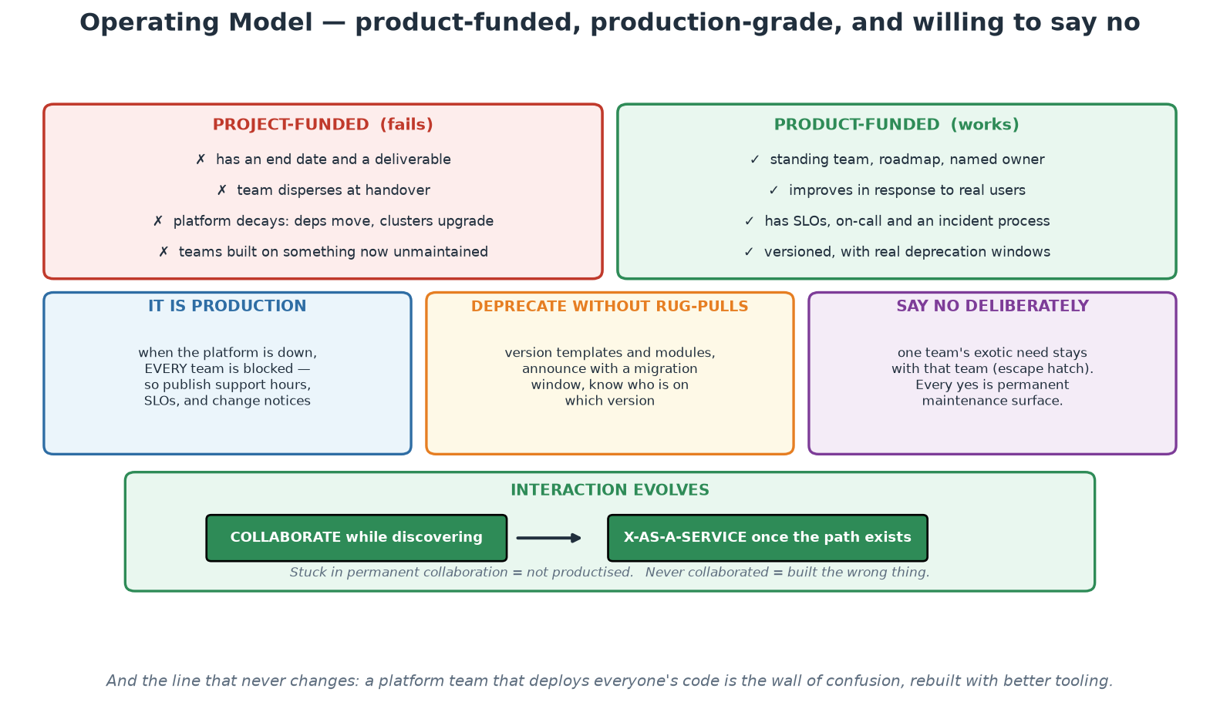
Funding, Running and Evolving the Platform
Product-funded, production-grade, deprecating carefully, and willing to say no.
Notes:
The left/right comparison at the top is the structural decision that determines whether a platform survives: project funding produces a deliverable and then leaves it to decay, while product funding sustains a team that keeps it alive. The three middle panels are the operating disciplines - the platform is production, deprecation needs versioning and migration windows, and saying no is a product skill rather than unhelpfulness. The bottom band is the Team Topologies point: the relationship with each team should evolve from collaboration during discovery to a self-service relationship once the path exists, and being stuck at either end is a diagnosable failure. Close on the footnote - a platform team that deploys everyone's code has rebuilt the wall with better tooling.

Slide 57
Module 10
Hands-On Workshops
Notes:
This module IS the hands-on core of the course, exactly as the outline promises: a basic DevOps pipeline, a microservice built and deployed, and IaC implemented - all on the participant's Ubuntu VM, all on localhost, tied together by the capstone golden path.

Slide 58
The Three Workshops - Map
W1 (Day 1 pm): Setting up a basic DevOps pipeline - GitHub Actions: test, build, scan+gate.
W2 (Day 2 am): Building and deploying a microservice - Docker -> Compose -> Kubernetes.
W3 (Day 2 pm): Implementing IaC - Terraform init/plan/apply/destroy + drift, on local Docker.
Same application throughout: the order+payment services you know from the demos.
Finale: the capstone runs all three as ONE golden path (workshops/ folder has the guides).
Notes:
Set expectations before the first workshop: these three blocks are where theory becomes muscle memory, and they use one continuous application so context never resets. Workshop 1 realises Module 5: participants copy the CI workflow into place, read it critically (job graph, permissions, pinned actions, the report-vs-gate Trivy pair), run it locally with act (act -l, then job by job, then the whole graph), deliberately make the security gate fail and restore it, and watch it go green - Day 1 ends with a working pipeline on every participant's VM, which matters emotionally as much as technically. Pushing it to GitHub is an optional extra part for anyone with an account. Workshop 2 realises Module 6 end-to-end: build the image and inspect its layers, compose the two-service stack and watch service discovery work, then kind-deploy with probes and limits, scale, roll forward, roll back - the complete container journey in one morning. Workshop 3 realises Module 4: the full Terraform loop against local Docker including the drift experiment, plus the Ansible idempotence bonus - and the explicit read-through of what changes for cloud (one provider block). Timing guidance for the instructor: each workshop guide (workshops/ folder) marks a core path sized to fit the slot and stretch parts for fast finishers; insist on the verification checklists - done means checked, not time elapsed.

Slide 59
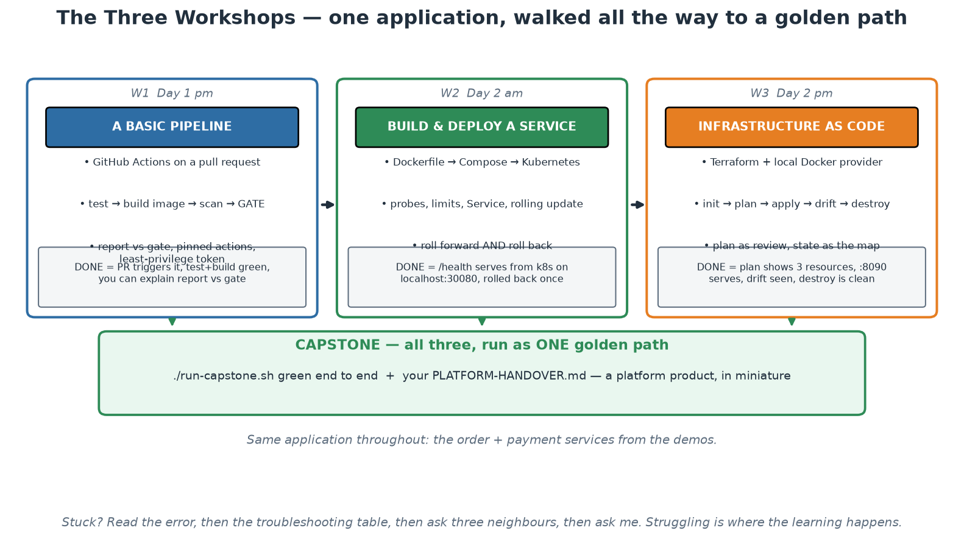
The Three Workshops and the Capstone
One application, three workshops, one golden path at the end.
Notes:
Use this as the map for the rest of the course. Each column states what participants build, the concepts it makes real, and the explicit success criterion - and the criteria are deliberately observable, because 'done' in this course means demonstrable rather than 'I ran the commands'. The arrows into the capstone are the point: the three workshops are not separate exercises but the three halves of one delivery path, assembled at the end into something that resembles a golden path with a handover document. Remind the room of the working method in the footnote before they start - read the error, check the troubleshooting table, ask three neighbours, then ask you.

Slide 60
Workshop Success Criteria
W1 done = PR triggers pipeline; test+build green; you can explain report vs gate.
W2 done = /health serves from Kubernetes on localhost:30080; rolled forward AND back.
W3 done = plan shows 3 resources; apply serves on :8090; drift detected; destroy leaves nothing.
Capstone done = ./run-capstone.sh green end-to-end + your PLATFORM-HANDOVER.md.
Struggling is the point - use the troubleshooting tables, then ask three, then ask me.
Notes:
Publish the definition of done up front so nobody optimises for 'got to the end of the page'. Each criterion is testable by the participant themselves - the pipeline is green or it is not, localhost:30080 answers or it does not, terraform destroy leaves zero tf- containers or it does not - which mirrors the whole course's philosophy: verification is automated, not vibes. The capstone at Day 2's end is the integration test of the human, not just the system: running the golden path script exercises every workshop's material in sequence (tests -> images -> scan -> cluster -> deploy -> smoke test), and the PLATFORM-HANDOVER.md document forces the platform-as-product thinking of Module 9 into writing. The last bullet sets lab culture deliberately: hitting errors is designed-in learning, the troubleshooting tables in each guide resolve the common 90%, the ask-three-before-me rule builds peer debugging habits, and instructors circulate rather than lecture. Fast finishers take the stretch goals (they are real: GHCR push, ingress, Terraform modules) rather than idling.

Slide 61
Module 11
Summary and Next Steps
Notes:
Close the course deliberately: recap what was built, hand participants a learning roadmap, and make the first week back at work concrete.

Slide 62
What You Built in Two Days
A microservice tested, containerised and orchestrated (demos + Workshop 2).
A CI pipeline with a real security gate (Workshop 1).
Infrastructure declared as code, with drift detection (Workshop 3).
A Kubernetes deployment with probes, limits and rolling updates - rolled back on command.
Policies, scans, dashboards, an SLO - and one survived incident (module demos).
A golden path handed over as a platform product (capstone).
Notes:
Walk the list slowly - this is the payoff slide. Every item ran on the participant's own VM and every artifact is in the course repository they keep. Invite one or two participants to say which module or workshop changed how they think about their current work.

Slide 63
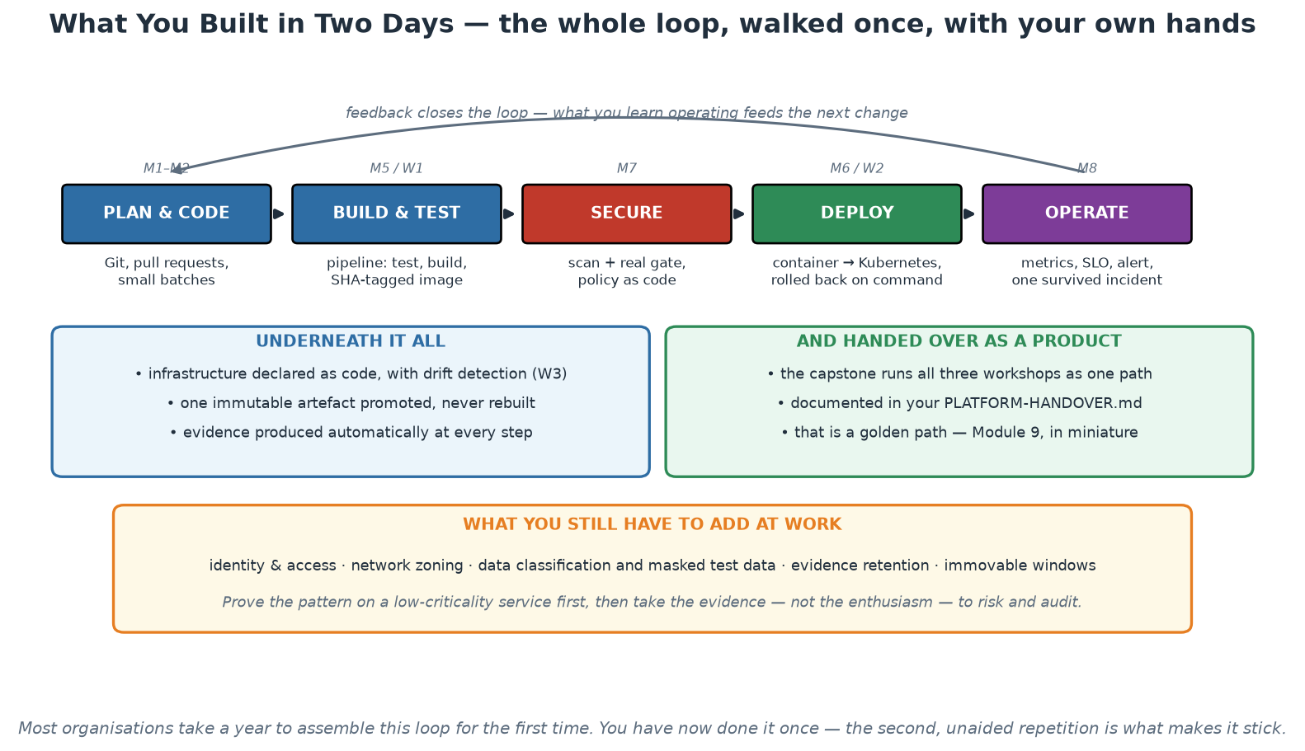
The Loop You Walked
Plan, build, secure, deploy, operate - once, end to end, with your own hands.
Notes:
Walk the loop and name the module and workshop behind each step, so two days of separate exercises become one coherent story participants can retell. Emphasise the two items people undersell: they rolled a deployment back on command, and they survived a deliberately induced incident - recovery demonstrated rather than assumed, which is the difference between a demo and a capability. The amber band at the bottom is the honest part, and it should not be skipped: identity, zoning, data classification, evidence retention and immovable windows are the institutional wrapping this lab deliberately omitted, and adding them is the real work waiting at home. Finish on the advice in the band - prove the pattern on something low-criticality, then bring evidence rather than enthusiasm to the assurance conversation.

Slide 64
Continuing the Journey
Kubernetes: CKAD / CKA certifications; kind and minikube for practice.
IaC: HashiCorp Terraform Associate; Ansible for configuration management.
CI/CD: GitHub Actions docs and the act local runner you already installed.
Reading: Accelerate (DORA), Team Topologies, The Phoenix Project, Google SRE books (free online).
Communities: platformengineering.org, CNCF projects, local DevOps meetups.
Notes:
Participants keep the slides, the labs and the sample application - everything reruns on any Ubuntu 24.04 machine via lab-setup/install-ubuntu24.sh. Encourage them to re-run the capstone from scratch within two weeks; retention comes from the second unaided repetition. The reading list is ordered deliberately: Phoenix Project for narrative buy-in (give it to managers), Accelerate for the evidence, Team Topologies for org design, SRE books for depth on Module 8.

Slide 65
Your First Week Back at Work
Pick ONE painful manual path and automate it end to end - small and finished beats big and abandoned.
Add a real gate to an existing pipeline: tests or a fixable-critical scan.
Write the first blameless postmortem after your next incident - and share it.
Measure a baseline: your team's deployment frequency and lead time this month.
Start the platform conversation: which golden path would help the most teams?
Notes:
End with commitments: ask each participant to write down the one action they will take in the first week and share it with the room - spoken commitments stick. Hand out the feedback survey, answer final questions, and run the Day 2 quiz if not already done.

Slide 66
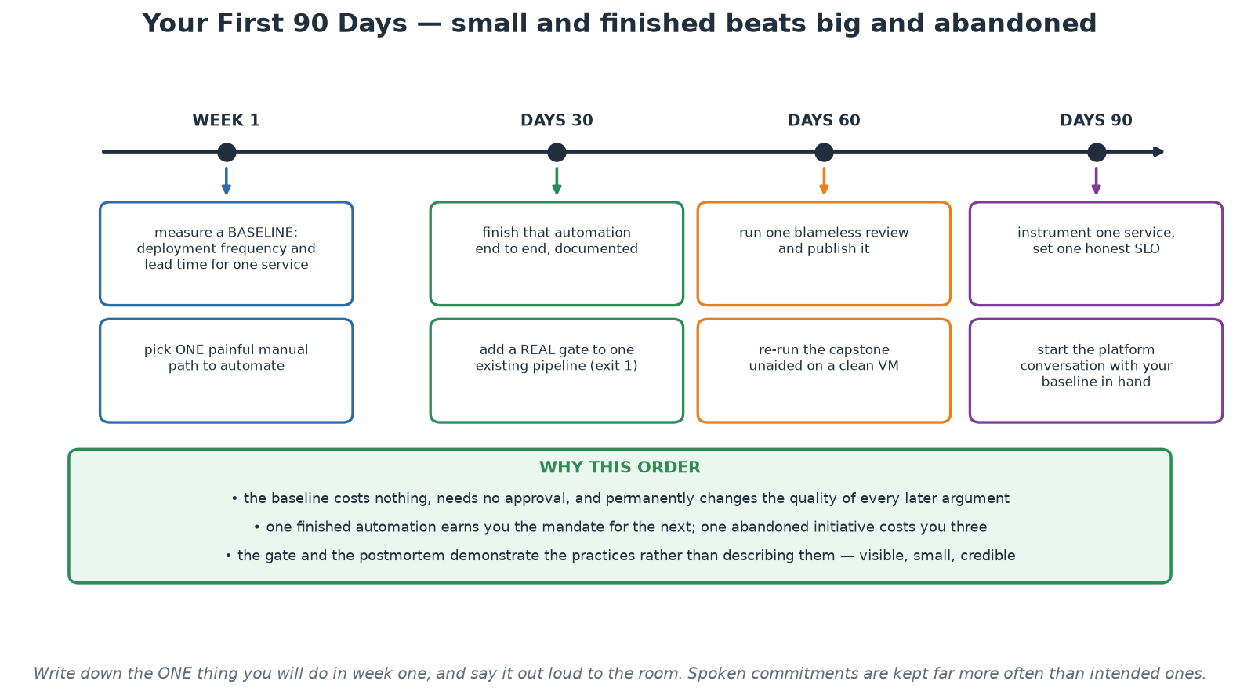
Your First 90 Days
Baseline, automate one thing, gate one pipeline, publish one review, then start the platform conversation.
Notes:
Close the course on this. The sequence is deliberate and the reasoning is in the green band: the baseline costs nothing and permanently improves every later argument, one finished automation earns the mandate for the next while one abandoned initiative costs three, and the gate plus the published review demonstrate the practices rather than describing them. Ask each participant to pick the ONE item they will start in week one and say it out loud - spoken commitments are kept far more often than intended ones, and hearing colleagues commit makes the next person more likely to follow through. Then hand out the feedback survey and close.

