Slide 1
DevOps & Platform Engineering
Day 1 — Foundations, Culture, Tools, IaC & CI/CD · delivery deck
Notes:
DELIVERY DECK - this is the version to present. It carries the headline for each topic, every diagram, and the code examples that lead into a lab. The full deck (same name without '-Deliver') holds the deep dives, the central-bank worked examples and the tool profiles; hand that out as the participant reference. Pace: about 2 minutes per slide leaves room for discussion and the demos.

Slide 2
Module 1
Introduction to DevOps and Platform Engineering
Notes:
75 minutes of theory with one 5-minute demo. Goal: participants can define DevOps precisely (not 'a team' or 'a tool'), explain why platform engineering emerged, and describe how the two relate. The depth lives in these notes - they are the participant reference.

Slide 3
Where DevOps Came From
Pre-2009: Dev measured on change delivered, Ops measured on stability.
Opposing incentives created the 'wall of confusion' - throw releases over it.
Result: quarterly big-bang releases, weekend war rooms, mutual blame.
2009: '10+ Deploys per Day' (Flickr) and the first devopsdays (Patrick Debois).
The insight: the conflict is a SYSTEM problem, not a people problem.
Notes:
Spend time on the incentive conflict - it explains everything that follows. Developers were rewarded for shipping change; operations for preventing change (uptime). Both behaved rationally and the organisation suffered: infrequent, enormous, risky releases, handled by ticket queues and handoffs. The 2009 Velocity talk by John Allspaw and Paul Hammond showed Dev and Ops at Flickr cooperating to deploy more than ten times a day - unthinkable then, and it reframed frequent deployment as a SAFETY practice: small changes are easier to review, test and roll back. Patrick Debois coined 'DevOps' with the first devopsdays conference in Ghent the same year. Ask the room: how long does a change take to reach production in your organisation today, and how much of that is waiting?

Slide 4
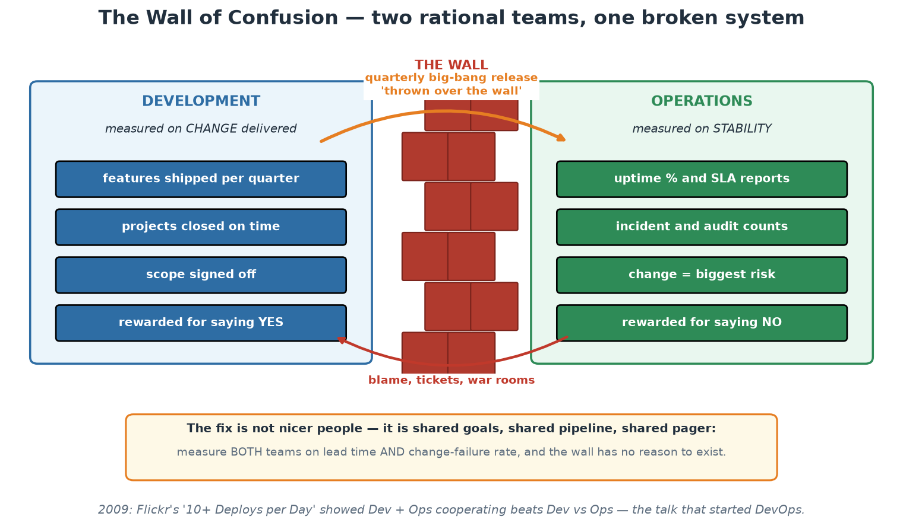
The Wall of Confusion
Two teams behaving rationally under opposing measures - the system is the problem.
Notes:
Use the picture to make the incentive argument physical. Point at the two measurement lists and ask the room which of the two they are measured on today - in most institutions the split is real and visible in the KPIs. Then point at the orange arrow: the release crossing the wall is where all the risk concentrates, because it is large, rare, rehearsed nowhere, and handled by people who did not build it. Finally the red arrow back: blame is the only feedback that crosses in the other direction, and it carries no information anyone can act on. Close on the amber panel - the fix is structural (shared measures, shared pipeline, shared pager), not attitudinal.

Slide 5
What DevOps Is (and Is Not)
A set of practices + a culture that unify development and operations around flow of value.
Goal: shorten lead time from idea to production WITHOUT sacrificing stability.
It is NOT: a job title, a team you hire, a tool you buy, or 'Ops with Jenkins'.
'You build it, you run it' (Werner Vogels, Amazon 2006) - ownership follows the code.
DevOps applies lean manufacturing thinking to software delivery.
Notes:
Definitions matter because 'DevOps' is the most abused word in IT. The common anti-pattern is creating a third silo called 'the DevOps team' that owns pipelines and becomes a new bottleneck between Dev and Ops - the exact problem DevOps set out to remove. The Amazon principle 'you build it, you run it' captures the ownership shift: the team that writes a service carries the pager for it, which closes the feedback loop between code quality and operational pain. The lean lineage is real, not decorative: small batch sizes, limiting work in progress, pulling quality forward, and reducing handoffs come directly from manufacturing (Toyota Production System) via the book 'The Phoenix Project'. When someone in the room says 'we have a DevOps engineer', explore what that person actually does - often they are a platform engineer (Module 1, later) or a build engineer.

Slide 6
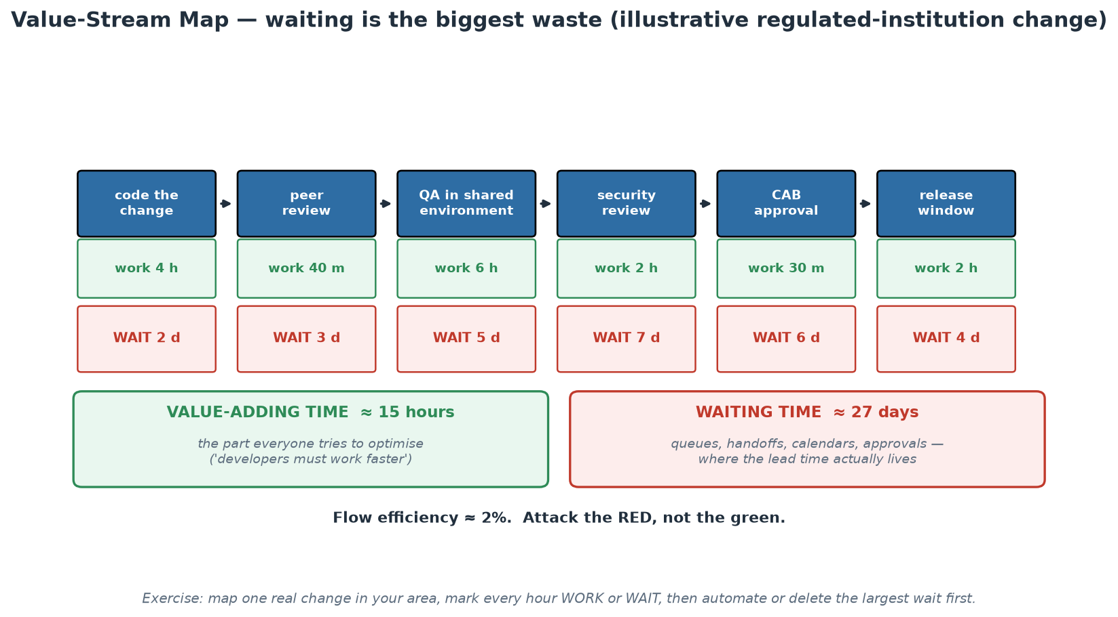
Where the Lead Time Actually Goes
Flow efficiency around 2% - the improvement is in the red boxes, not the green ones.
Notes:
Walk the map left to right and let the arithmetic do the work: roughly 15 hours of value-adding effort spread across roughly 27 elapsed days, giving a flow efficiency of about 2%. Then make the point that changes behaviour: pressure is almost always applied to the green boxes ('developers must deliver faster'), which are already the smallest term in the equation. Halving all coding time saves under a day; removing one seven-day queue saves a week. Ask the room to estimate their own numbers roughly - people usually guess their flow efficiency is around 30-40% and are startled when the map lands at single digits. The follow-up question is the useful one: which of these waits exists because of a genuine control requirement, and which exists because of calendars, capacity and habit? Controls can usually be automated into the pipeline (evidence produced continuously); calendars usually cannot be defended once they are visible on a chart like this.

Slide 7
The Three Ways (The Phoenix Project / DevOps Handbook)
1. FLOW: optimise the whole left-to-right stream - small batches, limit WIP, remove handoffs.
2. FEEDBACK: fast right-to-left signals - tests, monitoring, pager, customer telemetry.
3. CONTINUAL LEARNING: experiment safely, practise failure, turn incidents into improvement.
Every practice in this course implements one of the Three Ways.
Notes:
The Three Ways (Gene Kim) are the theoretical backbone; use them as a classification tool all week. Flow: CI/CD pipelines, trunk-based development, IaC - anything that moves change left-to-right faster and in smaller pieces. Feedback: automated tests, security scans, observability, SLOs - anything that tells you quickly that something is wrong, as close to the cause as possible. Continual learning: blameless postmortems, game days, error budgets - anything that converts failure into system improvement rather than fear. A good exercise: name any practice ('code review?', 'canary deploys?', 'chaos engineering?') and have the room place it. Code review is feedback; canary is flow AND feedback; chaos engineering is learning. If a practice serves none of the three ways, question why you do it.

Slide 8
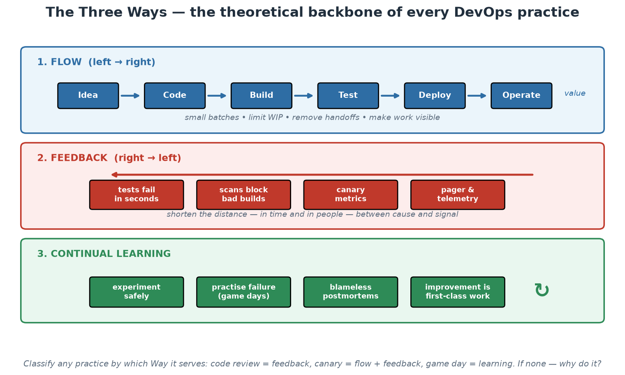
The Three Ways at a Glance
Flow left to right, feedback right to left, learning around the whole loop.
Notes:
Use this as the classification exercise rather than a lecture slide. Call out practices at random - code review, canary release, error budget, change advisory board, game day, dependency scanning, on-call rotation - and have the room place each one in a band. Two answers are worth arguing about deliberately. A change advisory board is intended as feedback but usually functions as a queue, so it belongs in the flow band as a constraint; that is a useful, non-confrontational way to discuss it. And a canary release is both flow and feedback, which shows the bands are lenses rather than boxes. Finish with the footnote question: if a practice serves none of the three, why does the institution pay for it? Ask that gently - the point is to examine inherited process, not to attack colleagues who maintain it.

Slide 9
CALMS - the Five Dimensions of DevOps
Culture - shared ownership, psychological safety, blameless learning (Module 2).
Automation - pipelines, IaC, tests: make the machine do the repeatable work (Modules 4-5).
Lean - small batches, limit WIP, eliminate waste (waiting is the biggest waste).
Measurement - DORA metrics, SLOs: decide with data, not anecdotes (Modules 3, 8).
Sharing - internal open source, documentation, demos, postmortems published widely.
Notes:
CALMS (Jez Humble, building on Damon Edwards and John Willis) is a health-check model: organisations routinely over-invest in Automation and under-invest in Culture and Measurement, then wonder why the tooling did not change outcomes. Walk each letter with a concrete failure mode. Culture failure: pipelines exist but every deploy still needs a change-approval board meeting. Automation failure: 'we automated the deploy' but test coverage is so thin nobody trusts it, so deploys still happen quarterly. Lean failure: one release train carrying 200 changes - when it derails, which change caused it? Measurement failure: teams argue from anecdotes ('deploys feel risky') with no data. Sharing failure: three teams each build their own deployment scripts, solving the same problem three times. This course touches every letter and the notes say where.

Slide 10
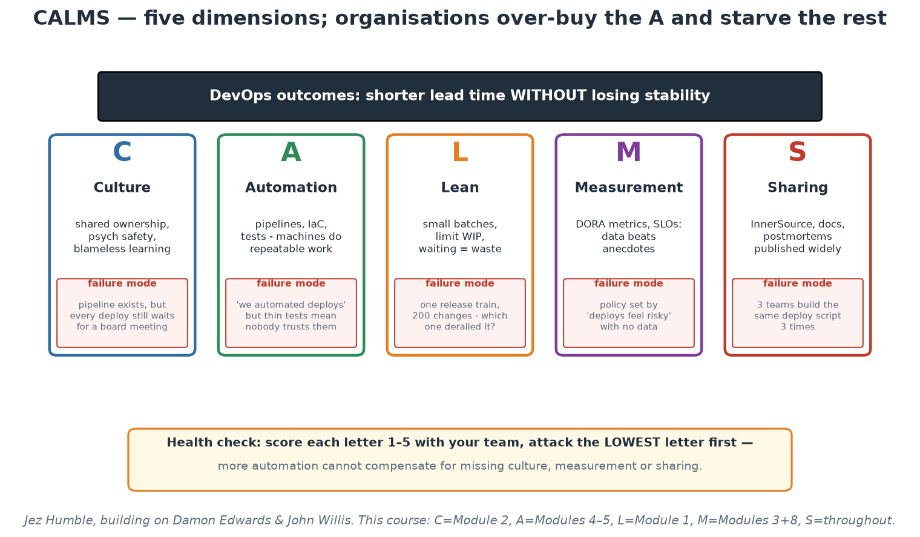
CALMS - Five Dimensions, Five Failure Modes
Score each pillar honestly; the lowest letter is your constraint, not the one you are buying.
Notes:
Run the scoring live if time allows: read each letter, ask for a private 1-5, then show of hands per band. The near-universal pattern - Automation highest, Measurement and Sharing lowest - is the diagnosis, and it explains the complaint that tooling investment did not change outcomes. Note the failure-mode boxes are deliberately drawn as the SAME size as the virtues: each pillar fails in a specific, recognisable way, and naming the failure is how a team spots itself on the chart. In a central-bank context, the Culture failure mode on the slide - a fully automated pipeline whose output still waits weeks for an approval meeting - is the one that lands hardest, because it is so common and so measurable.

Slide 11
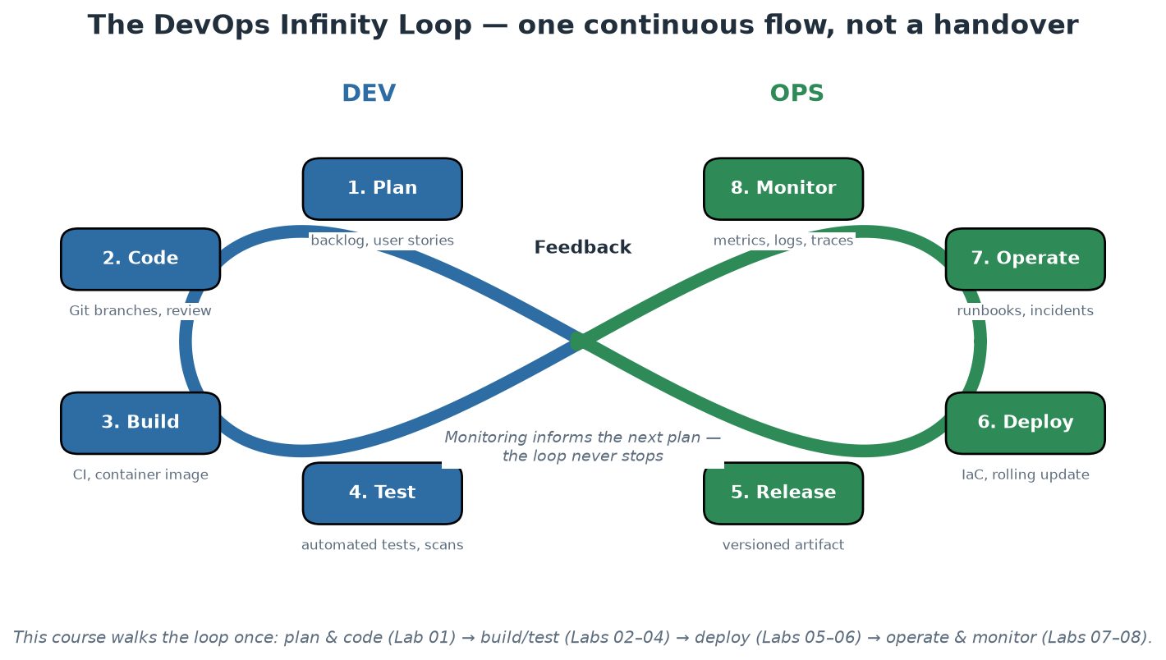
The DevOps Infinity Loop
Eight phases, one continuous flow - monitoring feeds the next plan.
Notes:
Walk the loop phase by phase and stress two things. First, it is a loop, not a pipeline with an end: what you learn operating and monitoring the system feeds the next planning cycle - that closing of the loop IS DevOps. Second, in a handover organisation this picture is cut in the middle: Dev owns the left half, Ops the right half, and information dies at the boundary. During the course participants traverse the whole loop once with the same small application, so by Day 2 afternoon this diagram describes what they have personally done, not an abstraction.

Slide 12
Why Platform Engineering Emerged
'You build it, you run it' collided with the cloud-native explosion (CNCF landscape: 1000+ tools).
Every product team needed Kubernetes + Terraform + pipelines + observability + security skills.
COGNITIVE LOAD became the bottleneck: too much to know before shipping any value.
Platform engineering: a dedicated team builds an Internal Developer Platform (IDP)
so product teams get golden paths instead of blank YAML files.
Notes:
The theory here is cognitive load (from cognitive psychology, applied by Team Topologies): intrinsic load is the essence of the team's actual problem (their business domain); extraneous load is everything else they must wrestle with to ship (cluster setup, pipeline syntax, scanner configuration); germane load is productive learning. Pure DevOps taken literally means every team carries all the extraneous load themselves - eight teams each becoming Kubernetes experts is waste, and worse, it crowds out the intrinsic work you actually hired them for. A platform team absorbs the extraneous load ONCE and serves it as a product: templates, pipelines, runtime, observability, security defaults. Important framing: platform engineering is not a rejection of DevOps but its industrialisation - the goal (teams own their services end to end) is unchanged; the platform makes that ownership affordable.

Slide 13
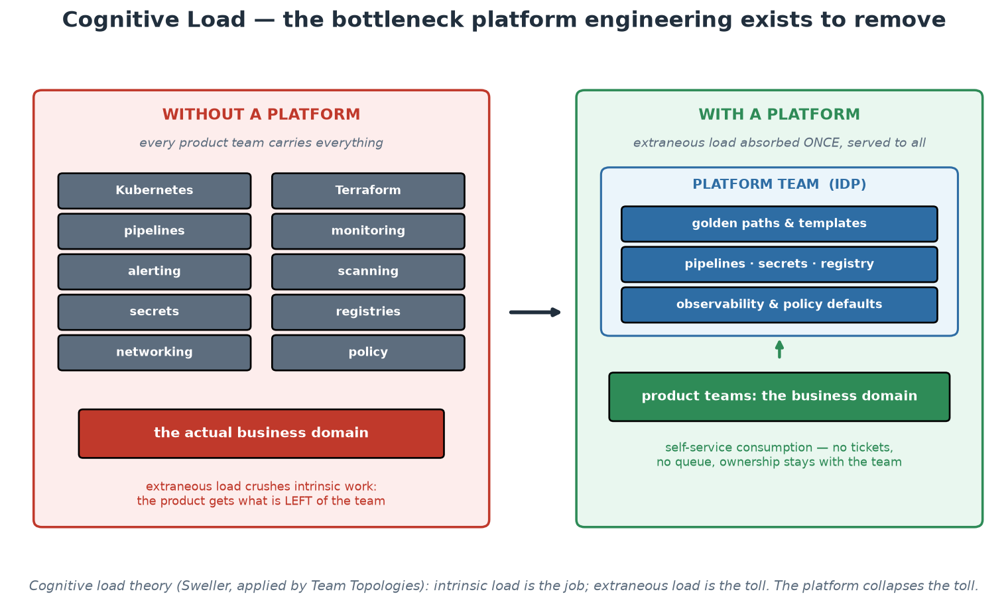
Cognitive Load - Before and After a Platform
The platform absorbs the extraneous load once, so teams can spend capacity on the mandate.
Notes:
Do the counting exercise against the left panel: ask the room to add anything missing for their environment - and in a supervised institution the additions come fast (audit evidence, POPIA handling, records retention, vendor management, network zoning, change records). Every addition strengthens the argument, because the left panel is the tax each team pays before delivering anything. Then the right panel: note that ownership does not move - the product team still runs its service, still carries the consequences - what moves is the obligation to REBUILD the machinery. The arrow between panels is the platform team's entire value proposition, and Module 9 turns it into measurable product KPIs.

Slide 14
DevOps vs SRE vs Platform Engineering
DEVOPS (a philosophy)
Whose problem: the org's delivery flow.
Core question: how do we ship faster AND safer together?
Practices: CI/CD, IaC, shared ownership, blameless culture.
SRE (a role/discipline, Google 2003)
Whose problem: reliability at scale.
Core question: how reliable must this be, and what does that cost?
Practices: SLOs, error budgets, toil elimination, incident response.
PLATFORM ENGINEERING (a team + product)
Whose problem: developer cognitive load.
Core question: what paved road lets teams self-serve safely?
Practices: IDP, golden paths, templates, self-service APIs.
They compose, not compete:
SRE defines what reliable means;
the platform makes reliable the default;
DevOps culture makes teams own the result.
Notes:
These three terms cause endless confusion in job adverts; give participants a crisp separation. DevOps is a philosophy of shared ownership - anyone claiming to 'hire a DevOps' is usually hiring a platform or build engineer. SRE (Site Reliability Engineering, from Google) operationalises reliability as an engineering problem: Service Level Objectives quantify how reliable a service must be, error budgets convert the gap to 100% into a spendable resource, and 'toil' (manual, repetitive, automatable operational work) is systematically eliminated - Google caps toil at 50% of an SRE's time. Platform engineering packages both into a product. Concrete example with this course's material: SRE thinking gives us the 99% SLO and burn-rate alerts (Module 8); the platform bakes probes, scanning and dashboards into the golden path (Module 10); DevOps culture means the order-service team still carries responsibility for what they ship.

Slide 15
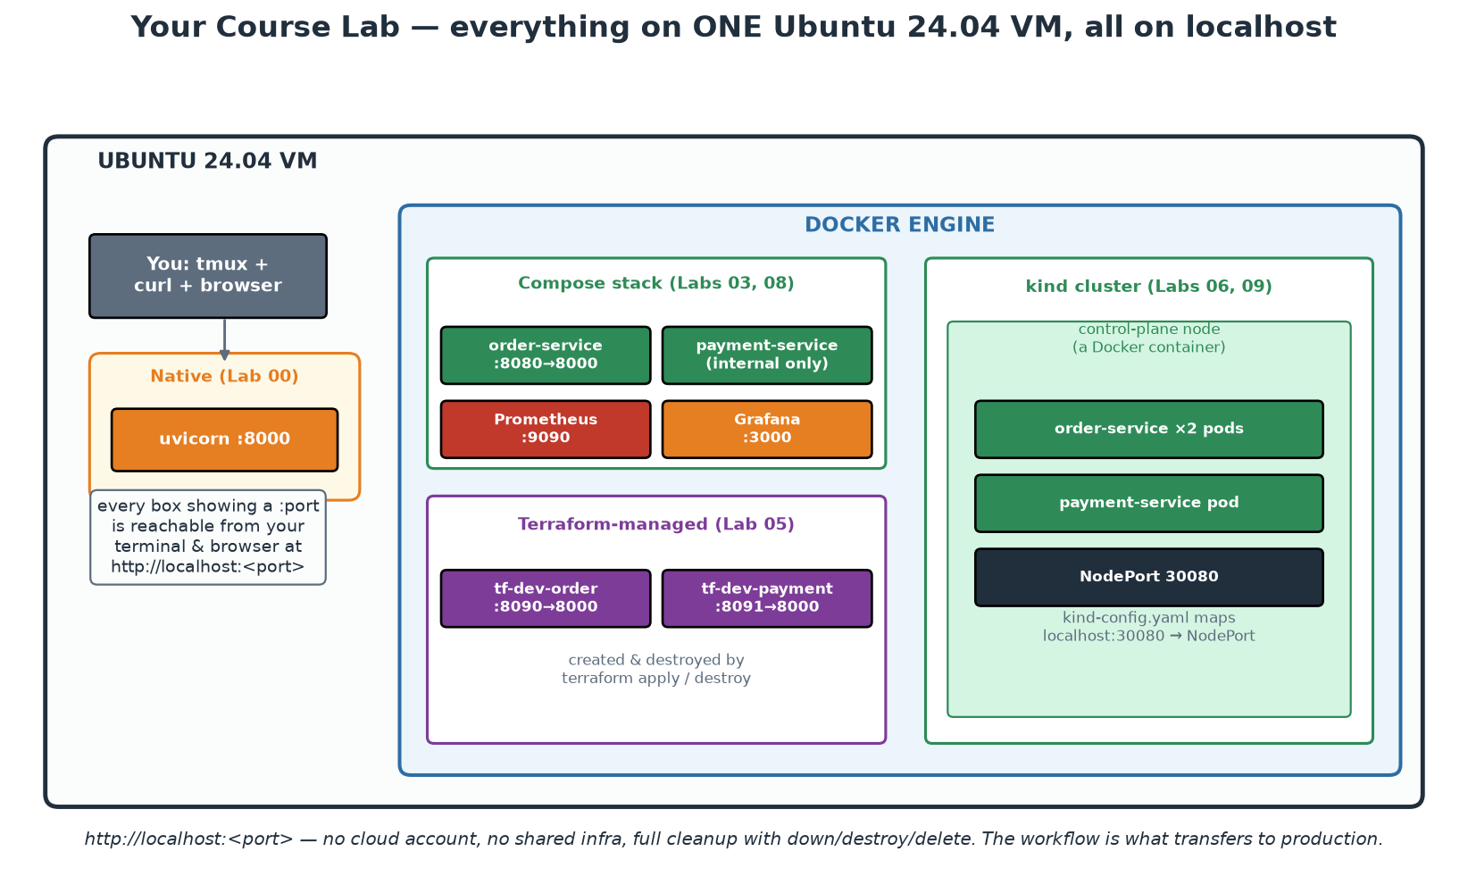
Your Lab Environment for These Two Days
One Ubuntu 24.04 VM per participant - every lab runs on its localhost.
Notes:
Orient participants before any hands-on: native Python (the 5-minute demos), Docker Compose stacks, Terraform-managed containers and a kind Kubernetes cluster all live on one VM, and every URL in the course is http://localhost:<port>. No cloud account, no shared infrastructure, and full cleanup is one command per stack. Make the pedagogical point explicitly: the WORKFLOW is what transfers to production and cloud - swapping localhost Docker for AWS changes one Terraform provider block, not the discipline. DEMO NOW (5 min, from instructor/theory-demos.md): run lab-setup/check-environment.sh together and have everyone confirm an all-PASS table - this is the course's first automated feedback loop.

Slide 16
Module 1 - Key Takeaway
"Platform engineering turns DevOps from a heroic individual effort into a repeatable, scalable organisational capability."
— Course synthesis
Notes:
Pause here and collect from the room: one pain point in their organisation this module gave a name to (wall of confusion, cognitive load, third-silo DevOps team, toil). Write them somewhere visible - Module 9's platform canvas exercise reuses this list as user pain points.

Slide 17
Module 2
Culture and Collaboration
Notes:
60 minutes theory + a 10-minute self-assessment exercise. The research message: culture is not the soft part - it is the strongest statistical predictor of delivery performance. Give it the same rigour as the technical modules.

Slide 18
Culture Is Measurable: the Westrum Typology
PATHOLOGICAL (power-oriented): info hoarded, messengers shot, failure -> scapegoating.
BUREAUCRATIC (rule-oriented): info flows in channels, failure -> process and blame-shifting.
GENERATIVE (performance-oriented): info flows freely, failure -> inquiry and learning.
DORA research: generative culture statistically predicts software delivery performance.
Culture is how the organisation responds to BAD NEWS.
Notes:
Ron Westrum, a sociologist studying safety-critical industries (aviation, healthcare), classified organisational cultures by how information flows - especially unwelcome information. The typology matters to us because the DORA/Accelerate research program found generative culture to be one of the strongest predictors of both delivery performance and organisational performance. The operational test is beautifully simple: what happens when someone brings bad news? Pathological: the messenger is punished, so problems are hidden until they explode. Bureaucratic: the messenger is tolerated, the problem is filed into a process, ownership diffuses. Generative: the messenger is thanked, because the organisation values the information above comfort. Every technical practice this week depends on information flowing: monitoring is worthless if an engineer fears reporting what it shows; postmortems are theatre if attendees protect themselves. EXERCISE (10 min, in theory-demos.md): each participant privately scores their organisation on five Westrum questions, then pairs discuss one concrete behaviour that would move one answer one level.

Slide 19
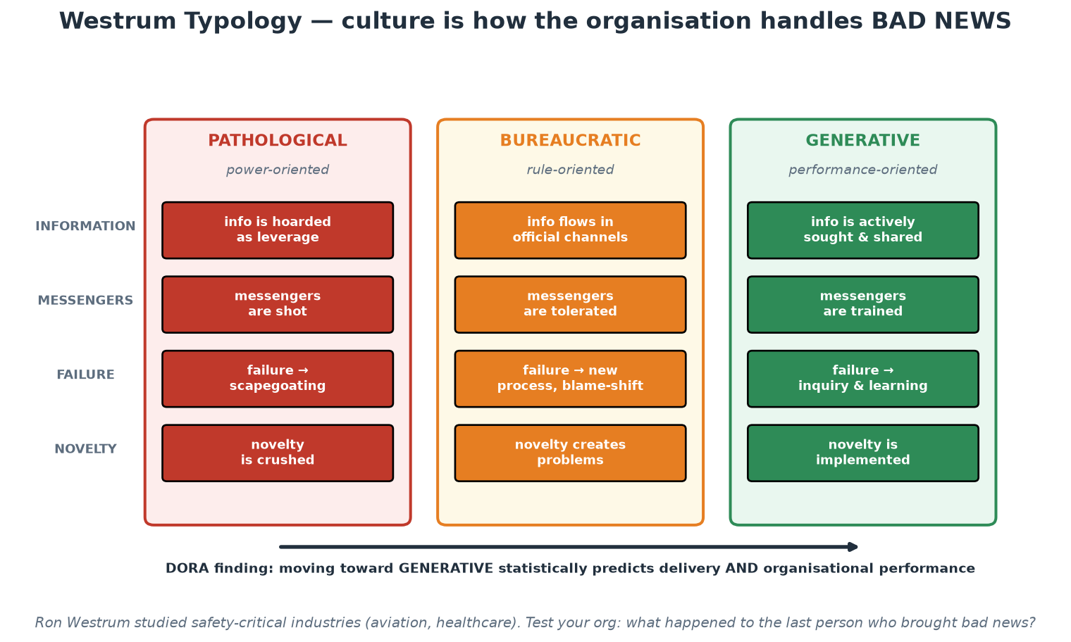
The Westrum Spectrum
Four behaviours, three cultures - and a research-backed direction of travel.
Notes:
Read the table by ROW rather than by column: information, messengers, failure, novelty. Reading down a column invites people to label their organisation with one word, which is both unfair and unhelpful; reading across a row lets them see that most institutions are pathological on one behaviour, bureaucratic on two and generative on another - which is a far more actionable picture. Ask which single row they would most like to move and what one behaviour would move it. In supervised institutions the 'failure' row is usually the hardest, because formal incident reporting obligations sit next to it and people conflate the two - separate them explicitly: the regulatory report answers what happened and what was done, the blameless review answers why it made sense at the time. Both can be true at once.

Slide 20
Psychological Safety - the Foundation Layer
Definition (Amy Edmondson): belief that the team is safe for interpersonal risk-taking.
Google's Project Aristotle: THE top factor distinguishing effective teams.
Safe teams surface problems earlier - which looks like MORE errors, and is actually fewer.
Built in small moments: how leaders react to questions, dissent, and mistakes.
Prerequisite for: honest code review, real postmortems, accurate estimates, on-call health.
Notes:
Edmondson's original hospital study found the counterintuitive result that better nursing teams REPORTED more medication errors - not because they made more, but because they were safe enough to report them. That inversion is the whole story: in unsafe teams the error rate looks low because information is suppressed. Google's Project Aristotle (2012-2015, 180+ teams studied) expected to find that great teams were about who was on them; instead the strongest factor was psychological safety - how the team behaved together. For our purposes: every feedback mechanism this course teaches (tests failing, scanners flagging, monitors alerting, reviews commenting) produces bad news by design. An organisation that punishes bad news will neutralise every one of these tools - people will disable flaky tests instead of fixing them, mute alerts instead of investigating, approve reviews without reading. Culture is not adjacent to the tooling; it is the operating system the tooling runs on.

Slide 21
Conway's Law - Architecture Mirrors Communication
'Organisations design systems that mirror their own communication structures' (1968).
Four teams building a compiler produced... a four-pass compiler.
Silos in the org chart become seams, queues and outages in the architecture.
REVERSE CONWAY MANEUVER: shape teams to match the architecture you WANT.
This is why microservices without team ownership changes always disappoint.
Notes:
Mel Conway's 1968 observation is one of the most empirically durable laws in software. Mechanism: designing an interface between two components requires communication between their authors; where communication is expensive (different teams, buildings, time zones, reporting lines) interfaces become rigid, minimal and slow to change. Practical consequences participants will recognise: a 'database team' produces systems where every change queues behind DBA tickets; separate QA departments produce testing as an after-the-fact phase; frontend/backend team splits produce chatty, versioned internal APIs with negotiation overhead. The reverse Conway maneuver (popularised by Team Topologies) flips the law from constraint to tool: decide the architecture you want - say, independently deployable services around business domains - then restructure teams to match, and the architecture will follow. This is also why Module 6's microservices content keeps returning to team boundaries: bounded contexts are as much organisational as technical.

Slide 22
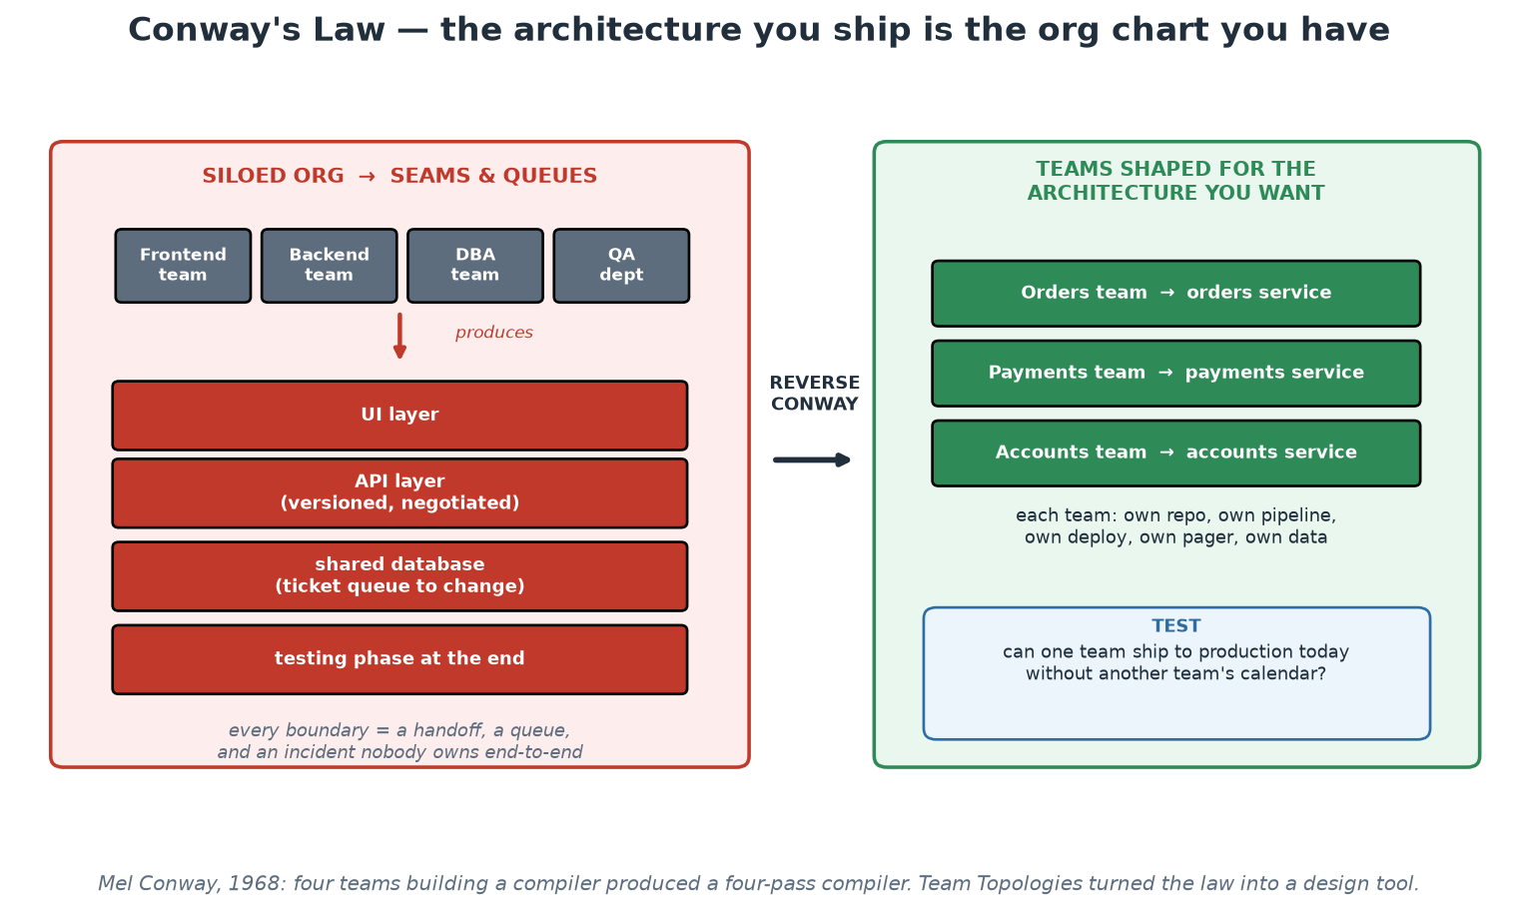
Conway's Law and the Reverse Maneuver
Silos produce seams; teams shaped for the target architecture produce that architecture.
Notes:
Work the left panel first and let the room recognise itself, then ask the diagnostic question in the blue box on the right: can one team ship a change to production today without another team's calendar? In departmental institutions the honest answer is usually no, and the reasons are organisational rather than technical - which is exactly Conway's point. Be careful not to imply that the answer is a reorganisation; those are expensive, disruptive and rarely within participants' control. The realistic move is smaller: identify one system where the seam causes the most pain, and change the INTERFACE rather than the org chart - a documented API with a contract, a shared repository with InnerSource rights, or a temporary embedded engineer. Conway's law responds to communication paths, and those can be changed without moving a single reporting line.

Slide 23
Communication Strategies That Scale
Default to asynchronous + written: decisions travel and survive; meetings do not.
ADRs (Architecture Decision Records): short docs capturing WHAT was decided and WHY.
ChatOps: operations in shared channels - deploys, alerts, incident timelines visible to all.
Working agreements: explicit team norms (review turnaround, on-call handoff, WIP limits).
Documentation is a product: if the platform's docs are bad, the platform is bad.
Notes:
Concrete mechanics, not platitudes. ADRs: a one-page numbered record per significant decision - context, options considered, decision, consequences - stored in the repo next to the code it affects. Their value compounds: two years later, 'why is this a queue and not an API call?' has an answer, and newcomers onboard by reading the decision history. ChatOps means operational events flow through shared, searchable channels: the deploy bot announces releases, alerts land where humans discuss them, and an incident's timeline reconstructs itself from the channel history - which Module 8's postmortems depend on. Working agreements make implicit expectations explicit and negotiable: 'reviews answered within 4 working hours', 'no deploys after 16:00 Friday', 'WIP limit of 2 per person'. And treat documentation with product seriousness - measured, owned, maintained - because in a platform organisation, documentation IS the user interface (Module 9 returns to this). During labs, notice how every artifact in this course - policies, pipelines, infrastructure - is written down in Git: that is communication strategy, not just tooling.

Slide 24
Breaking Silos Without Breaking the Org
Shared goals: measure Dev AND Ops on the same outcomes (DORA metrics, SLOs).
Shared pain: developers join on-call for their own services - feedback with teeth.
Embedded rotation: ops engineers embed in product teams temporarily (enabling pattern).
Internal open source: any team may propose PRs to another team's repo - platform included.
Do NOT create a 'DevOps team' silo between Dev and Ops - it recreates the wall.
Notes:
Silos persist because they serve real needs - specialisation, clear accountability, career paths - so 'just collaborate more' fails. What works is restructuring incentives and interfaces. Shared goals: if Dev is bonused on features and Ops on uptime, no workshop fixes that; measuring both on lead time AND change-failure rate aligns them structurally. Shared pain: a developer who is paged at 03:00 by their own unhandled exception writes different error handling forever after - this is the feedback loop 'you build it, you run it' creates. Embedded rotation is Team Topologies' enabling pattern: temporary, explicitly time-boxed, with the goal of making the receiving team self-sufficient (not creating dependency). Internal open source (sometimes 'InnerSource') keeps the platform from becoming a bottleneck: when a product team needs a pipeline feature, they can contribute it via PR instead of filing a ticket and waiting. And name the anti-pattern out loud: a 'DevOps team' that owns all pipelines and environments is a third silo - it centralises exactly what DevOps set out to distribute.

Slide 25
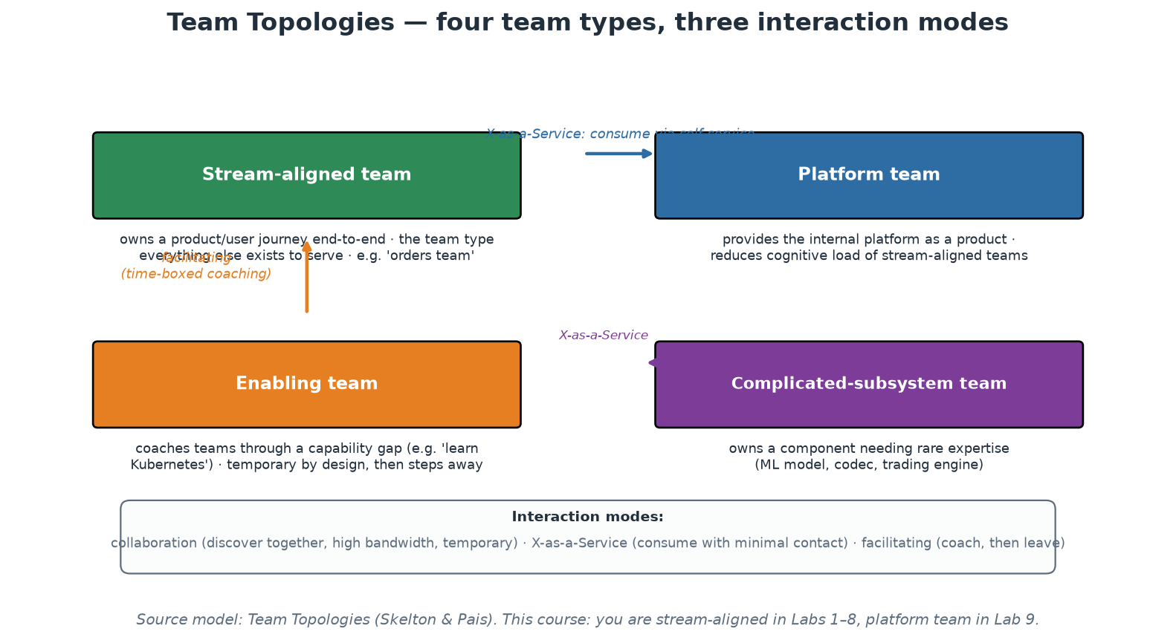
Team Topologies - Organising for Flow
Four team types, three interaction modes (Skelton & Pais).
Notes:
Team Topologies (Matthew Skelton and Manuel Pais, 2019) is the current standard vocabulary for DevOps-era org design; participants will meet these terms in the wild. Stream-aligned teams own a product or user journey end-to-end and are the point of the whole system - every other type exists to help them flow. Platform teams reduce their cognitive load by providing an internal platform as a product. Enabling teams coach through capability gaps and are deliberately temporary - success is stepping away. Complicated-subsystem teams own components genuinely requiring rare expertise (an ML model, a codec). Equally important are the three interaction modes: collaboration (working together closely - powerful but expensive, keep it temporary), X-as-a-Service (consume through an interface with minimal contact - the target state for platform consumption), and facilitating (coaching). A healthy platform relationship EVOLVES: collaboration while discovering what teams need, then X-as-a-Service once the golden path exists. A platform stuck in permanent collaboration mode has failed to productise; one that started at X-as-a-Service without ever collaborating built the wrong thing.

Slide 26
Blameless Postmortems and Retrospectives
Premise: people made reasonable decisions given the information they had at the time.
Ask 'what made that action seem correct?' - never 'who did it?'
Counterfactuals ('should have', 'could have') are banned - they explain nothing.
Output: systemic action items with owners and dates, tracked like feature work.
Retrospectives are the same loop at team cadence - improvement as a habit, not an event.
Notes:
The blameless practice comes from aviation and was brought into software mainly via Etsy (John Allspaw) and Google SRE. The reasoning is hard-nosed, not soft: if the consequence of touching an incident is punishment, engineers will hide information, and you lose the only accurate account of how your system actually fails. 'Human error' is where the investigation STARTS, not where it ends - the question is what context, tooling, documentation or alerting made the error possible or invisible. Ban counterfactuals in the room: 'they should have checked the config' describes an imaginary incident, not this one; ask instead what made not-checking seem fine (it always had been? the config was 4000 lines? the diff tool hid it?). Insist that action items are systemic (add a preflight validation, fix the runbook, page earlier) with owners and due dates in the normal backlog - a postmortem whose action items die in a document was a ritual, not learning. Participants practise a 5-line version of this after the Module 8 demo, and the format is deliberately identical to a real one.

Slide 27
Module 2 - Key Takeaway
"Culture is what happens when bad news arrives. Every tool in this course produces bad news by design - your culture decides whether that information becomes learning or silence."
— Course synthesis
Notes:
Bridge to Module 3: with the people-system understood, we can now look at the tool landscape - and evaluate tools by whether they strengthen flow, feedback and learning rather than by feature lists.

Slide 28
Module 3
Tools and Technologies
Notes:
45 minutes theory + a 15-minute toolchain-mapping exercise. Goal: participants leave with a MAP of the tool landscape and principles for choosing, not a catalogue of logos. Defuse tool-worship: tools amplify a working system, they do not create one.

Slide 29
The DevOps Toolchain - Categories, Not Brands
Source control (Git) - the single source of truth everything else builds on.
CI/CD - pipeline engines: GitHub Actions, GitLab CI, Jenkins, Tekton, Argo Workflows.
Artifacts - registries for images and packages: GHCR, Docker Hub, Artifactory, Nexus.
IaC + config mgmt - Terraform/OpenTofu, Pulumi | Ansible, Chef, Puppet.
Runtime - Docker, Kubernetes, serverless | Secrets - Vault, cloud KMS, SOPS.
Observability - Prometheus, Grafana, Loki, OpenTelemetry, Datadog | Incident - PagerDuty.
Notes:
Teach the CATEGORIES; brands churn, categories are stable. A complete delivery capability needs an answer in each category - the answer may be 'deliberately nothing yet', but it should be deliberate. Walk the flow of one change through the categories: code lands in source control; CI builds and tests it; the artifact registry stores an immutable, versioned output; IaC shapes the environment it will run in; the runtime executes it; secrets management injects credentials without embedding them; observability watches it; incident management wakes someone when watching finds trouble. Two field notes worth sharing: the CNCF landscape lists well over a thousand projects, which is precisely the cognitive-load problem platform engineering answers - nobody should evaluate a thousand tools to ship a web service; and licence changes are a real category risk (Terraform's 2023 licence change produced the OpenTofu fork under the Linux Foundation) - one more argument for keeping your usage of any tool behind an interface you control.

Slide 30
Principles for Choosing Tools
Declarative over imperative: describe the destination, let the tool drive (diffable, reviewable).
Everything as code, everything in Git: config you cannot version, review or roll back is risk.
API-first and composable: tools must integrate into pipelines, not demand humans click.
Paved road over mandate: golden defaults teams WANT, with escape hatches.
Total cost = licences + integration + operation + training + EXIT cost.
Notes:
Give participants an evaluation checklist rather than recommendations. Declarative matters because a desired-state description can be diffed, code-reviewed, policy-scanned and drift-detected - an imperative script can only be re-run and hoped about; this single property is why Terraform, Kubernetes manifests and Compose files dominate their categories. 'Everything in Git' is the enabler for every other practice this course teaches: if the pipeline definition, infrastructure and policies live beside the code, then review, audit and rollback come for free. API-first: any tool that requires a human in a GUI to complete a release will eventually BE the release process. Paved road over mandate previews Module 9 - mandated tools breed shadow IT; attractive defaults breed adoption. And insist on counting exit cost up front: data export, config portability, retraining - the cheapest tool to adopt is often the most expensive to leave. Close with the culture point from Module 2: a generative organisation with mediocre tools outperforms a pathological one with the best tools money can buy, because tools amplify whatever system they land in.

Slide 31
Automation and Orchestration Platforms
CI engines differ in hosting model: SaaS runners (Actions) vs self-managed (Jenkins) vs in-cluster (Tekton).
Runtime orchestration: Kubernetes won - scheduling, self-healing, scaling, rollout as APIs.
GitOps: Git as the source of truth for RUNTIME state - agents (Argo CD, Flux) pull and converge.
Push (pipeline applies) vs pull (cluster syncs): pull gives drift-correction + audit for free.
Event-driven automation: webhooks and controllers replace humans as the glue.
Notes:
Distinguish the two automation layers people conflate. Delivery automation (CI/CD engines) runs jobs in response to code events; the meaningful differences are hosting and maintenance burden - GitHub Actions outsources runner management, Jenkins gives total control at the price of becoming a pet server (ask who in the room maintains a Jenkins - there is always one), Tekton and Argo Workflows run pipelines as Kubernetes-native resources. Runtime orchestration is what keeps services running afterwards: Kubernetes' actual innovation is exposing scheduling, self-healing and rollouts as declarative APIs - which is what makes it automatable at all (Module 6 goes deep). GitOps joins the layers elegantly: instead of the pipeline pushing kubectl commands, a manifest repo describes the desired runtime state and an in-cluster agent (Argo CD, Flux) continuously pulls and converges - manual changes are automatically reverted, the audit log is git log, and cluster credentials never leave the cluster. Our labs use the push model for simplicity, but name GitOps as the production-grade evolution; the mental model - desired state in Git, an agent converging - is Terraform's loop applied to runtime.

Slide 32
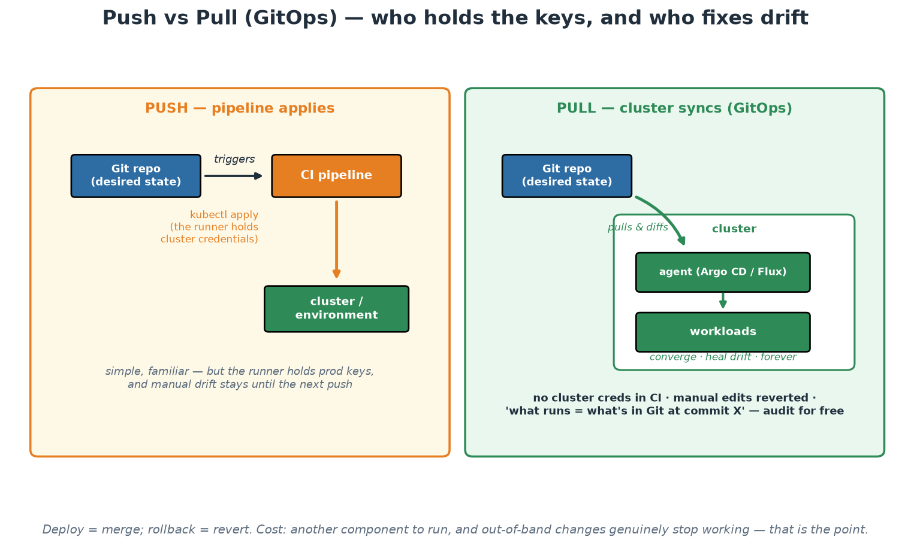
Push vs Pull Deployment (GitOps)
Pull keeps credentials in the cluster, corrects drift, and makes 'what runs' provable.
Notes:
Trace both models and then focus on the three properties that matter in a supervised institution. First, credential location: in the push model a CI runner holds production credentials, in the pull model it does not, and that difference is a genuine reduction in the blast radius of a compromised pipeline. Second, drift: the emergency manual change that everyone intends to put back is reverted automatically rather than remembered, which converts a recurring control weakness into a non-event. Third, provability: 'what is running is what is in Git at commit X' is an assertion a machine can verify continuously, which is a stronger statement than most manual attestations. Be honest about the cost - the agent is another component to operate, and out-of-band changes genuinely stop working, which is uncomfortable during an incident until the team trusts the path.

Slide 33
Pipeline as Code (1/3): GitHub Actions
The engine most teams meet first. Jobs, dependencies and gates in one file.
# .github/workflows/ci.yml
name: CI
on:
push: { branches: [main] }
pull_request: { branches: [main] }
permissions:
contents: read # least privilege: this token can only read
jobs:
test:
runs-on: ubuntu-latest
steps:
- uses: actions/checkout@v4
- uses: actions/setup-python@v5
with: { python-version: '3.12', cache: pip }
- run: pip install -r labs/app/requirements.txt
- run: pytest
working-directory: labs/app
build:
needs: test # <- the dependency that orders the graph
runs-on: ubuntu-latest
steps:
- uses: actions/checkout@v4
- run: docker build -t order-service:${{ github.sha }} labs/app
→ needs: test is the whole job graph. Everything else is syntax.
Notes:
Read this aloud with the room; it is the file they run in Workshop 1. Three things to point at. First, `on:` - the pipeline is triggered by events, never by a human clicking 'build', which is what makes it a control rather than a convention. Second, `permissions: contents: read` - the default token in many setups can write to the repository, so declaring least privilege here is a one-line security improvement that most pipelines are missing. Third, `needs: test` - this single key is the dependency graph; jobs without it run in parallel, which is how you keep a pipeline fast. Note the SHA tag on the image: the artifact is named after the exact commit that produced it, which is what makes build-once-promote-many possible later. Everything on this slide transfers to GitLab CI and Jenkins with different keywords and identical meaning - the next two slides show the same pipeline in both.

Slide 34
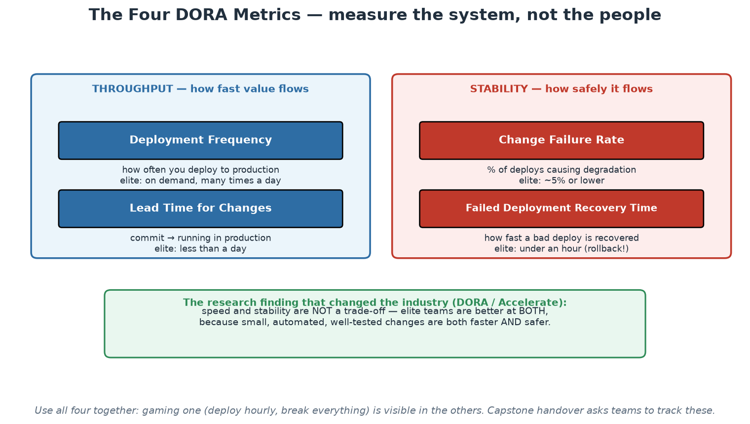
Measurement: the Four DORA Metrics
Two throughput metrics, two stability metrics - always read together.
Notes:
This is the measurement backbone for the whole course - introduce it here, and Modules 8 and 9 will reuse it. The DORA research program (DevOps Research and Assessment; the book 'Accelerate') surveyed tens of thousands of practitioners over a decade and produced the four metrics: deployment frequency and lead time for changes (throughput), change failure rate and failed-deployment recovery time (stability). The landmark finding: speed and stability are NOT a trade-off - elite performers are better at BOTH, because the same mechanisms (small batches, automation, fast feedback) produce speed and safety simultaneously. That single result dissolves the classic Dev-vs-Ops argument ('slow down to be safe') with data. Two warnings that must accompany any metrics talk: measure the SYSTEM, not individuals - the instant DORA metrics appear in performance reviews they will be gamed into meaninglessness; and read all four together - deploy frequency alone is trivially gamed (deploy trivia hourly) and shows up immediately in change-failure rate. EXERCISE (15 min, theory-demos.md): pairs map their own organisation's toolchain onto the categories from this module and estimate their four DORA numbers; collect a show of hands on lead time - the spread across the room is usually the best discussion starter of Day 1.

Slide 35
This Course's Toolchain (and Why)
Git + GitHub Actions - ubiquitous, free tier, local fallback with act.
Docker + Compose - the container standard; Compose for readable multi-service local stacks.
kind + kubectl - real Kubernetes API inside Docker: zero cloud cost, full fidelity.
Terraform + Ansible - both IaC halves: provisioning and configuration management.
Trivy + Conftest/OPA - scanning and policy as code | Prometheus + Grafana - observability.
Every tool here is free, runs on your VM's localhost, and is category-representative.
Notes:
Justify the choices so participants can translate to their own stacks. Each tool was chosen as a representative of its CATEGORY that runs locally at zero cost: what you learn about GitHub Actions' job graph transfers to GitLab CI's stages; kind serves the genuine Kubernetes API, so every kubectl command transfers unchanged to EKS/AKS/GKE; Trivy's severity/fixability triage transfers to any scanner; Rego policies transfer to admission controllers. If the room uses Azure DevOps or Jenkins, the pipeline CONCEPTS (jobs, dependencies, gates, artifact promotion) map one-to-one even where YAML syntax differs. This is also the honest answer to 'why are we not doing this on real cloud?': the workflow is identical, localhost removes cost, account friction and blast radius, and Workshop 3 shows exactly which single file changes when you point Terraform at AWS instead of local Docker.

Slide 36
Module 3 - Key Takeaway
"A fool with a tool is still a fool - but a generative team with a paved road is a force multiplier. Choose categories deliberately; let the platform choose brands once, for everyone."
— Course synthesis (first clause: Grady Booch)
Notes:
Bridge to Module 4: source control and pipelines assume the thing being delivered is code - IaC is what makes the INFRASTRUCTURE itself deliverable the same way.

Slide 37
Module 4
Infrastructure as Code (IaC)
Notes:
75 minutes deep theory + a 10-minute basic demo (terraform plan walk-through). Workshop 3 later today is the full hands-on. Goal: participants understand WHY declarative + state + review beats scripts, and can place Terraform vs Ansible vs images correctly.

Slide 38
The Problem IaC Solves
Snowflake servers: hand-built, undocumented, unreproducible - 'do not reboot #3'.
Configuration drift: environments diverge silently until 'works in staging' means nothing.
ClickOps: console changes leave no diff, no review, no rollback, no audit trail.
Disaster recovery without IaC is archaeology; with IaC it is 'apply' in a new region.
Pets vs cattle: name-and-nurse servers vs numbered, replaceable, rebuildable instances.
Notes:
Ground this in war stories - every ops veteran in the room has a snowflake server memory; invite one. The deep problem is that manually-produced infrastructure is UNKNOWABLE: its true configuration exists only as the accumulated side effects of every hand that touched it, so you cannot review it, reproduce it, or reason about it. Drift is the slow-motion version: staging and production started identical, then three years of hotfixes, one-off firewall rules and 'temporary' changes made 'it works in staging' an empty sentence. ClickOps is the mechanism of both: console changes are invisible to code review, produce no history, and cannot be rolled back - the console is to infrastructure what editing directly on the production server is to code. The pets/cattle metaphor (Bill Baker, popularised by CERN) captures the mindset shift: pets are named, nursed back to health, irreplaceable; cattle are numbered, replaced when sick, and their definition lives elsewhere - in code. Disaster recovery is the acid test to pose to the room: if your data centre or cloud region vanished tonight, is rebuilding a git clone + terraform apply, or six months of archaeology?

Slide 39
Core Principles: Declarative, Idempotent, Immutable
DECLARATIVE: describe desired END STATE; the tool computes how to get there.
-> enables diffing (plan), review, drift detection - a script can do none of these.
IDEMPOTENT: applying twice = applying once; safe to re-run, safe to automate.
IMMUTABLE: never patch in place - build a new artifact, replace the old (like containers).
Version-controlled: the Git history of your infra IS your change management system.
Notes:
These four properties are the module's theoretical heart - everything else is tooling. Declarative vs imperative deserves a careful contrast: an imperative script ('create a network, then start container A, then B') encodes one path from one assumed starting point, so it breaks when reality differs and can never tell you what would change; a declarative definition ('these two containers on this network should exist') lets the tool compare desire against reality and compute the minimal path - which is exactly what terraform plan prints, and why plan output is reviewable in a pull request. Idempotence is what makes automation SAFE: a converging tool can run on every commit or on a timer; a non-idempotent script needs a human to check state first, which reintroduces the human bottleneck. Immutability transfers the container insight to infrastructure: patching a running server accumulates unknowable state, so instead you bake a new image/artifact and replace - rollback becomes 'run the previous version' instead of 'undo the patch and pray'. Version control ties it together into governance regulators actually accept: who changed what, when, reviewed by whom - it is all git log.

Slide 40
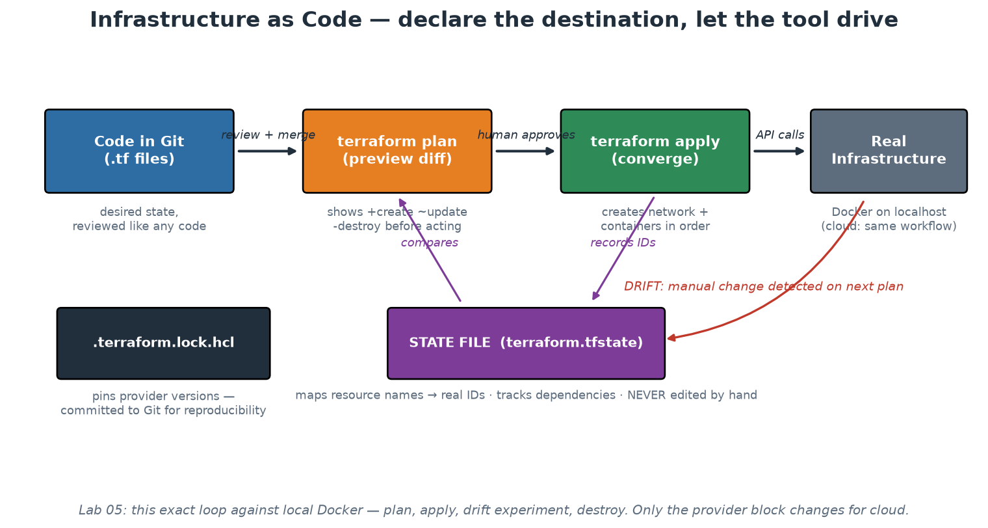
The IaC Loop: Code, Plan, Apply, State, Drift
Desired state in Git; plan previews the diff; state maps names to reality.
Notes:
Walk each element slowly - this diagram is Workshop 3's map. Code in Git: HCL files declaring resources, reviewed like any code. Plan: the safety mechanism - Terraform refreshes reality, compares against desire, and prints +create/~update/-destroy BEFORE anything changes; a human (or CI gate) approves the diff, not the intention. Apply: executes exactly the approved plan. The STATE FILE is the piece newcomers underestimate: it maps resource names in code to real-world IDs (this docker_container resource IS container abc123), which is how Terraform knows an existing container should be updated rather than duplicated - hence the rules: never edit it by hand, store it remotely with locking when a team shares it, and treat it as sensitive (it can contain secrets in plain text). Drift detection falls out naturally: delete a managed container manually and the next plan shows '1 to add' - Terraform noticed reality diverged from state. The lock file (.terraform.lock.hcl) pins provider versions and IS committed - reproducibility across teammates and CI. Participants run this entire loop, including the drift experiment, in Workshop 3.

Slide 41
Provisioning vs Configuration Management
PROVISIONING - Terraform, OpenTofu, Pulumi, CloudFormation, Bicep
Creates/destroys infrastructure: networks, VMs, clusters, DNS, containers.
Declarative model + state file tracking what exists.
Answers: WHAT infrastructure exists?
Cloud-agnostic workflow; provider plugins per platform.
CONFIG MANAGEMENT - Ansible, Chef, Puppet, Salt
Configures existing machines: packages, files, services, users.
Idempotent tasks/modules; Ansible is agentless (SSH), no state file.
Answers: HOW is each machine configured?
Still essential for VMs, bare metal, network devices, appliances.
Notes:
This split answers the outline's 'implementing IaC with configuration management tools' precisely. Provisioning tools make infrastructure exist; configuration management makes existing machines correct. Classic composition: Terraform creates the VM, then Ansible (or cloud-init, or a baked image) configures it. The modern twist: container images have absorbed much of configuration management's old territory - a Dockerfile IS the configuration of the runtime environment, applied at build time instead of continuously - which is why cloud-native shops run less Puppet than 2015 did. But config management remains essential wherever long-lived mutable machines exist: VM fleets, bare metal, network switches, and - as in our bonus lab - workstations. Mention Pulumi as the 'real programming language' alternative to HCL (TypeScript/Python/Go with the same plan/apply model) and OpenTofu as the community fork of Terraform. BASIC DEMO (10 min, theory-demos.md): run the Lab 05 bonus Ansible playbook against the VM's localhost twice - the room watches changed=N become changed=0, which makes idempotence tangible in one minute.

Slide 42
Ansible (2/3): Idempotence You Can See
Run it twice. The second run is the proof that the tool converges rather than repeats.
$ ansible-playbook -i inventory.ini site.yml
PLAY [Configure the order-service host] ****************************
TASK [Required packages are present] *******************************
changed: [localhost]
TASK [Application directory exists] ********************************
changed: [localhost]
TASK [Service is enabled and running] ******************************
changed: [localhost]
PLAY RECAP *********************************************************
localhost : ok=3 changed=3 unreachable=0 failed=0
$ ansible-playbook -i inventory.ini site.yml # exactly the same command
PLAY RECAP *********************************************************
localhost : ok=3 changed=0 unreachable=0 failed=0
# ^^^^^^^^^ nothing to do - reality already matches
# Preview mode: what WOULD change, without changing anything
$ ansible-playbook -i inventory.ini site.yml --check --diff
→ changed=0 on the second run is idempotence. A shell script cannot tell you this.
Notes:
This is the slide that makes idempotence concrete rather than theoretical, so slow down here. The first run reports changed=3 because reality did not match the declaration; the second reports changed=0 because it now does. A shell script that appends a line to a config file has no equivalent - run it twice and you get the line twice. That difference is exactly why configuration management tools exist, and why they are safe to run on a schedule. Two operational habits to teach alongside it. First, `--check --diff` is Ansible's dry run: it reports what would change and shows the textual diff, which is the same review affordance that terraform plan gives, and it belongs in a pull request or a change record. Second, changed=0 is a drift DETECTOR: schedule the playbook, alert on any non-zero changed count, and you have continuous assurance that the fleet still matches its declared state - a genuinely strong control that costs almost nothing once the playbook exists.

Slide 43
Terraform's Mental Model in Five Concepts
PROVIDER: plugin that speaks one platform's API (docker, aws, azurerm, kubernetes...).
RESOURCE: one declared object - a network, a container, a DNS record.
VARIABLES / OUTPUTS: parameterise modules in; export facts out.
STATE: the mapping between declarations and reality (remote + locked in teams).
MODULE: a reusable, versioned package of resources - the platform team's product unit.
Notes:
Five concepts cover 90% of real Terraform reading. Providers are why one workflow spans platforms: our labs use kreuzwerker/docker against the local daemon, and swapping to hashicorp/aws changes the provider block and resource types while plan/apply/state stay identical - THAT is the honest cloud story for this course, and the workshop makes participants prove it to themselves by reading main.tf. Resources declare objects and, crucially, reference each other: our order container's environment references the payment container's name, and from that reference Terraform derives creation ORDER automatically - dependency graphs from data flow, no 'depends_on' choreography needed in most cases. Variables/outputs make configurations reusable across environments (the tfvars file per environment pattern). Modules are the platform-engineering unit: the capstone wraps the whole two-service stack into one module that a consuming team calls with four variables - the module encodes the platform team's decisions once (Module 9's cognitive-load story, realised in HCL). State: covered on the previous slide; in teams it lives remotely (S3+DynamoDB, Terraform Cloud, GitLab) with locking, never in laptops.

Slide 44
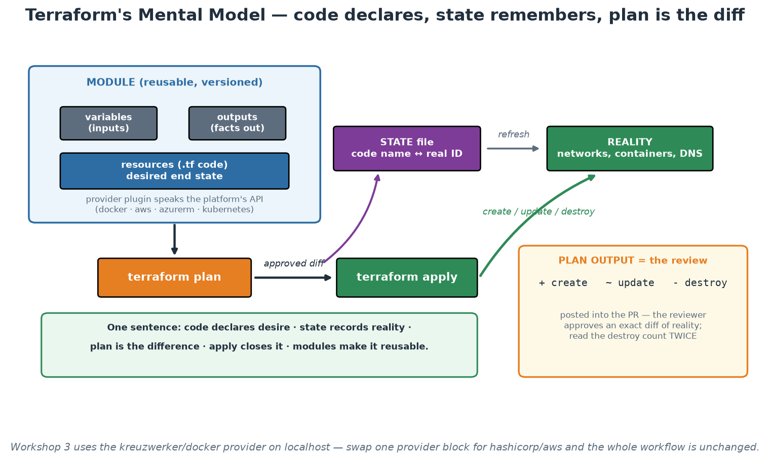
Terraform's Five Concepts
Code declares desire, state records reality, plan is the difference, apply closes it.
Notes:
Use the picture to fix the mental model before anyone touches syntax in Workshop 3. Trace the loop out loud: the module holds resources and a documented interface, the provider translates to a platform API, plan compares desire against the state's view of reality, apply executes the approved difference, and state is updated to match. Then point at the amber panel and give the operational habit that matters most: read plan output defensively, and treat any unexpected destroy count as a stop signal. Many real infrastructure incidents were described accurately in a plan that nobody read carefully. In a supervised institution that habit has a second benefit - the plan diff is exactly the artefact to attach to a change record, so reading it properly is both engineering discipline and governance.

Slide 45
Terraform (2/2): Plan Output Is the Change Record
The diff a reviewer approves - and the artefact to attach to a change request.
$ terraform plan
Terraform will perform the following actions:
# docker_container.order will be updated in-place
~ resource "docker_container" "order" {
id = "a1b2c3d4e5f6"
name = "order-service-dev"
~ ports {
~ external = 8000 -> 8080
}
}
# docker_container.legacy_worker will be destroyed
- resource "docker_container" "legacy_worker" {
- name = "legacy-worker" -> null
}
Plan: 0 to add, 1 to change, 1 to destroy.
# ^^^^^^^^^^^^^^^^^^^^^^^^^^^ read this line every single time
$ terraform apply -auto-approve tfplan # applies EXACTLY the reviewed plan
$ terraform plan -detailed-exitcode # 0=no drift, 2=drift -> use in a cron job
→ '1 to destroy' on a production plan is a stop-and-think moment, not a scroll-past.
Notes:
This slide teaches a habit that prevents real incidents. Terraform tells you exactly what it will do before it does anything, and a striking number of production infrastructure incidents were described accurately in a plan that nobody read past the first screen. Teach the summary line as the thing you always read: adds are usually safe, changes deserve a look, and destroys deserve a stop. Note the in-place vs replace distinction too - some attribute changes force a resource to be destroyed and recreated, which for a database or a load balancer is an outage hiding inside an innocuous-looking diff. Then two operational tricks. First, plan to a file and apply that file, so the thing approved is the thing executed - between plan and apply, someone else's change can otherwise alter the outcome. Second, `-detailed-exitcode` turns plan into a drift DETECTOR: exit code 2 means reality no longer matches the declaration, so a scheduled job that plans and alerts gives you continuous configuration assurance for almost no effort. That capability is unusually persuasive with audit and risk colleagues.

Slide 46
IaC Best Practices (the Production Checklist)
Everything through PRs; plan runs in CI and its diff is part of the review.
Remote state with locking; never local state for shared infrastructure.
Commit the lock file; pin provider and module versions deliberately.
Scan IaC like code: trivy config / checkov / tfsec in the pipeline.
No secrets in code OR state-visible places; use a secrets manager reference.
Small, composable modules over one giant configuration; tag everything for cost/ownership.
Notes:
This is the checklist to photograph. PR + plan-in-CI turns infrastructure change management into code review - the reviewer approves an exact diff of reality, which is stronger governance than any change-approval-board meeting, and auditors increasingly agree. Remote state with locking prevents the two-applies-at-once corruption scenario. The lock file gets committed (we practise this) so every machine resolves identical provider builds - the infrastructure equivalent of package-lock.json. IaC scanning catches misconfigurations before they exist: public buckets, missing encryption, permissive security groups, containers without limits - Module 7 wires trivy config into the pipeline and participants see their own Terraform scanned. Secrets: state files can contain resource attributes in plain text, so secrets never go in code AND sensitive values are kept out of state where possible - inject references to a secrets manager (Vault, cloud KMS) instead of values. Small modules: a 5000-line root configuration is unreviewable; compose small modules with narrow interfaces, exactly like functions. Tagging is unglamorous and pays for itself the first time finance asks 'what is this bill?' or an incident asks 'who owns this?'.

Slide 47
Module 4 - Key Takeaway
"Infrastructure as Code is not scripts in Git. It is making your infrastructure reviewable, reproducible and disposable - the plan diff is a safety mechanism, and the Git history is your audit trail."
— Course synthesis
Notes:
Bridge to Module 5: with infrastructure now deliverable-as-code, the pipeline can carry BOTH application and infrastructure through the same review-test-deploy discipline - which is what CI/CD generalises.

Slide 48
Module 5
Continuous Integration and Continuous Delivery
Notes:
60 minutes theory; Workshop 1 (late afternoon) builds the real pipeline. Goal: precise definitions (CI vs delivery vs deployment), pipeline anatomy including honest security gates, deployment strategies, and what the platform contributes.

Slide 49
Continuous Integration - Small Batches, Always Green
CI = merge to shared mainline at least daily, verified by automated build + tests.
The enemy is BATCH SIZE: risk grows super-linearly with change size.
Long-lived branches = integration debt: conflicts compound, feedback arrives weeks late.
A red mainline is a stop-the-line event (Toyota andon cord) - fixing it beats all feature work.
Trunk-based development + feature flags = integrate always, release selectively.
Notes:
CI is a PRACTICE, not a server - a Jenkins box building week-old feature branches is not CI. The core insight is about batch size: a 50-line change can be reviewed rigorously, tested meaningfully, and rolled back trivially; a 5000-line merge can only be skimmed and hoped about, and when it breaks, which of its 40 commits caused it? Risk compounds super-linearly, so many small integrations are structurally safer than one big one - the same lean logic as Module 1. Long-lived branches accumulate integration debt: every day unmerged is a day of conflicts building and a day of feedback not arriving. Trunk-based development is the professional consensus (and DORA-correlated with performance): branches live hours to a couple of days, and incomplete features hide behind flags rather than branches. The andon-cord norm makes CI real: when the mainline goes red, the team's top priority is green again - a team that tolerates a red build for days has CI theatre, not CI. Feature flags get a caveat: they decouple deploy from release (powerful, next slide) but are themselves technical debt with a lifecycle - flags need owners and removal dates, or you accumulate a config space nobody can reason about.

Slide 50
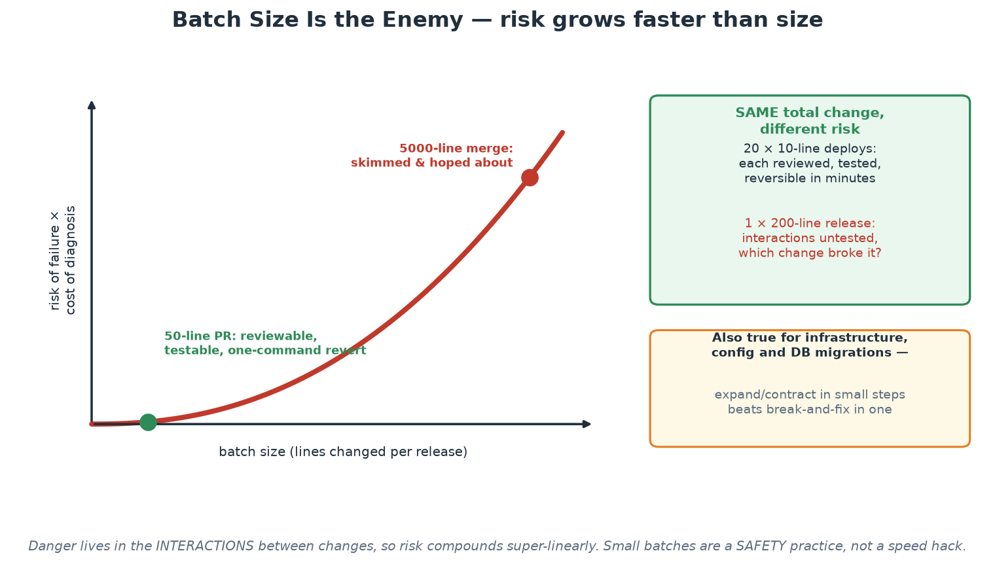
Why Batch Size Is the Enemy
The same total change, split differently, carries radically different risk.
Notes:
This curve is the single most useful picture for a risk-aware audience, because it makes the safety argument visually rather than rhetorically. Walk it from left to right: small changes sit in the flat region where review is genuine, tests are meaningful and reversal is one command; large changes sit in the steep region where review becomes skimming and diagnosis becomes archaeology. Then give the green panel, which is the argument that wins the meeting: the same total volume of change, delivered as twenty small increments rather than one large release, is not merely faster - it is materially safer, because each increment is individually understood and individually reversible. Note the amber panel for infrastructure and database work, where the equivalent discipline is expand/contract: add the new structure, run both, migrate, then remove the old - never break and fix in a single step during a window.

Slide 51
Delivery vs Deployment - and Deploy vs Release
Continuous DELIVERY: every commit leaves the pipeline deployABLE; a human chooses when.
Continuous DEPLOYMENT: green pipeline -> production automatically; no human in the loop.
DEPLOY = bits are running. RELEASE = users can see it. Flags/canaries separate the two.
Build ONCE, promote the same immutable artifact through every environment.
If deploys hurt, do them more often - frequency forces the pain to be automated away.
Notes:
Precision here prevents years of confused meetings. Continuous delivery is a state of READINESS: the pipeline proves every commit deployable, and shipping becomes a business decision that can be taken any afternoon - most organisations should target this. Continuous deployment removes the human trigger entirely and is appropriate once test confidence, monitoring and rollback are strong (and change approval regulation permits). The deploy/release distinction is the modern unlock: code can be deployed to production dark (flagged off, or receiving only canary traffic) and released later by flipping a flag - which turns release into a reversible, low-drama act and enables testing in production safely. Build-once-promote is the artifact discipline: the image tested in staging is bit-for-bit the image that reaches production (SHA-tagged, immutable) - rebuilding per environment invites 'works in staging' bugs from dependency drift; our pipeline SHA-tags for exactly this reason. The closing aphorism (Martin Fowler's 'if it hurts, do it more often') is the module's cultural core: pain under frequency is a signal pointing at what to automate next - the organisations deploying daily did not start painless; they started frequent.

Slide 52
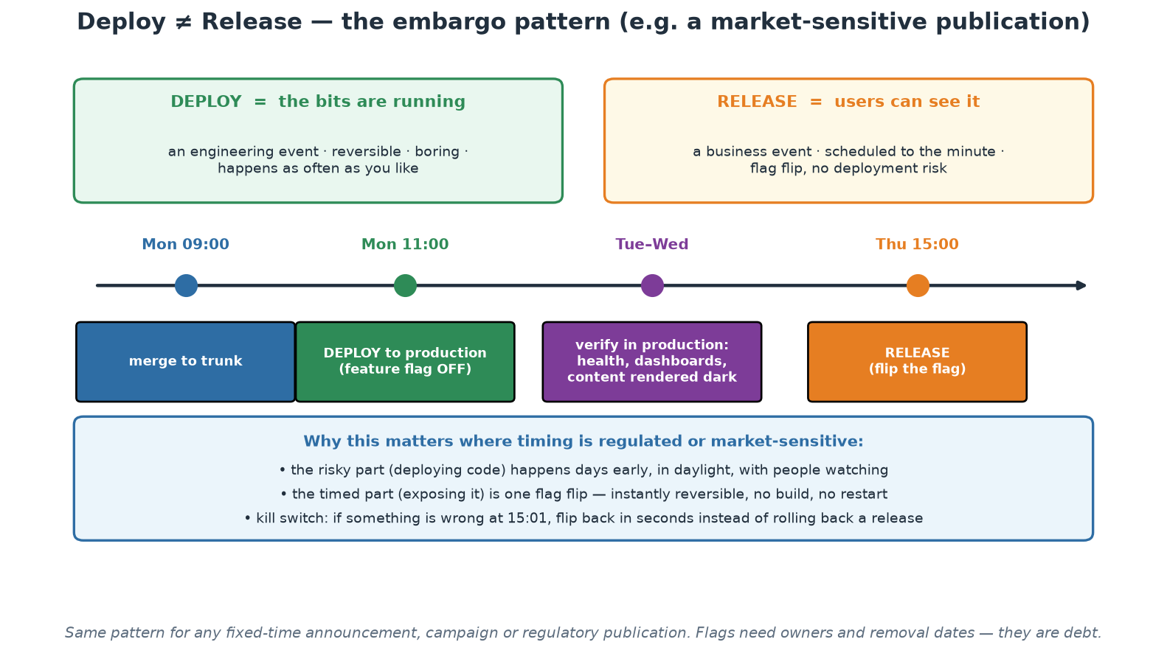
Deploy vs Release - the Embargo Pattern
Deploy days early in daylight; release at the appointed minute with a flag flip.
Notes:
This pattern is worth the time because it maps so directly onto work where the timing of publication is fixed and consequential - a scheduled announcement, a statistical release, an industry-coordinated change. The current default in most institutions is to do the risky thing (deploying software) at the same moment as the timed thing (making it visible), usually late at night, under pressure, with no margin. The pattern separates them: deploy on Monday morning with everyone awake, verify in production while the content stays dark, and let the timed moment be a flag flip that carries no build, no restart and no deployment risk - and that can be reversed in seconds if something is wrong at one minute past. Also flag the discipline requirement on screen: flags are debt, so each one needs an owner and a removal date, and dark content must be genuinely unreachable, which is a security review question rather than an assumption.

Slide 53
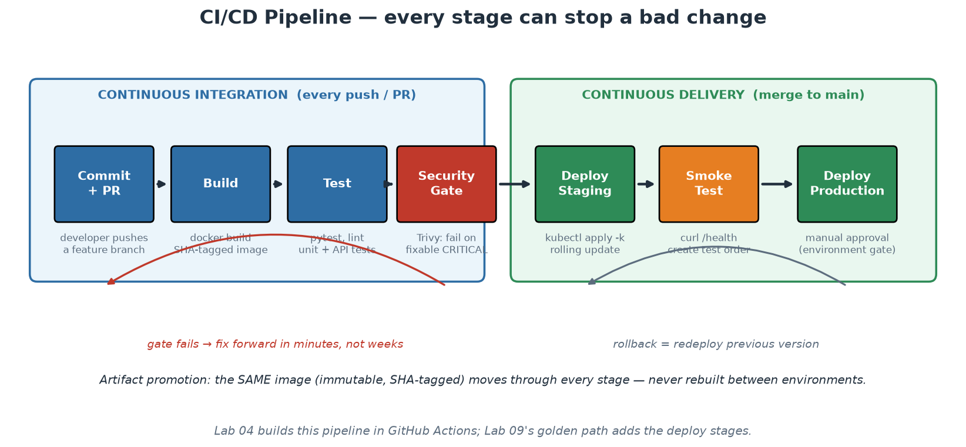
Anatomy of the Pipeline
CI proves the change; CD promotes the artifact; every stage can say no.
Notes:
Trace one commit through the diagram end to end, because Workshop 1 builds the left half and the capstone adds the right. Commit/PR triggers everything - no manual pipeline starts. Build produces the SHA-tagged image once. Test executes the test pyramid (unit tests in seconds first, then API tests - fast feedback before expensive feedback). The security gate scans the artifact and can genuinely fail the build (next slide is dedicated to this, because most real pipelines get it wrong). Deploy-to-staging exercises the real deployment mechanics; the smoke test proves the deployed thing actually serves (our capstone curls /health and creates an order - a deploy that 'succeeded' but serves 500s is a failure the pipeline must catch). Production sits behind an environment gate - in GitHub Actions, an 'environment' with required approvers gives continuous DELIVERY; removing the approval gives continuous DEPLOYMENT: the difference is one setting, which makes the previous slide's distinction concrete. The feedback arrows matter as much as the forward flow: a red stage stops the line and fixing forward takes minutes because the batch is small; rollback on the right is 'redeploy the previous immutable artifact', not surgery.

Slide 54
A Scan Is Not a Gate
Report step: results visible, build stays green (exit-code 0) - awareness only.
Gate step: build FAILS on actionable findings (exit-code 1) - behaviour change.
Gate on FIXABLE criticals; failing on unfixable CVEs teaches people to ignore red.
Pin third-party pipeline actions to versions - your pipeline is supply chain too.
Least-privilege pipeline tokens: 'permissions: contents: read' unless proven otherwise.
Notes:
The most common security-in-CI failure is a scanner wired with exit-code 0 and called a 'gate' in the audit deck - it is a dashboard nobody looks at, and it changes nothing. Teach the two-step pattern participants will build in Workshop 1: a REPORT step (HIGH+CRITICAL, exit-code 0) keeps full visibility for triage, and a GATE step (CRITICAL only, ignore-unfixed, exit-code 1) actually stops the line - but only for findings a developer can act on TODAY, because a gate that fails on unfixable upstream CVEs blocks all delivery indefinitely and gets bypassed within a week, taking the team's respect for red builds with it. Gates must be trustworthy to be tolerated: start narrow (fixable criticals), widen deliberately as the backlog clears. The two supply-chain lines preview Module 7 but belong in every pipeline from day one: a third-party action pinned to @master means an upstream compromise runs instantly with YOUR repository's credentials - pin versions; and default tokens with write access mean any compromised step can push code - declare least-privilege permissions explicitly. Both patterns are already in the workshop's workflow file; point at them when you get there.

Slide 55
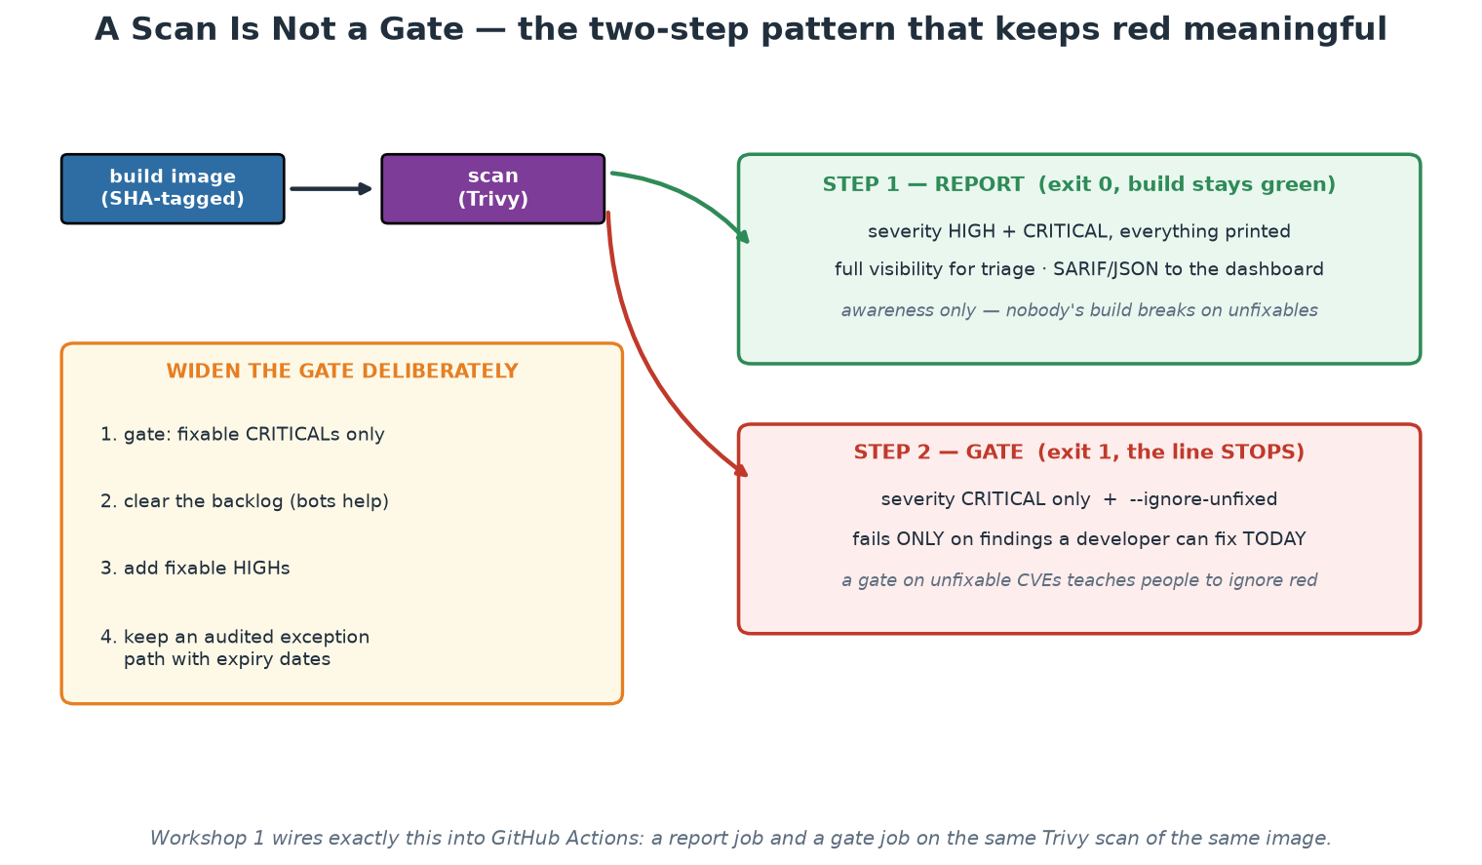
Report vs Gate
Broad visibility, narrow enforcement - the only way a gate stays trusted.
Notes:
Show the two branches and be blunt about which one most organisations actually have: a scanner wired with exit code 0, described in the assurance pack as a control, producing a report nobody opens. That is a control in name only, and naming it plainly gives the room permission to check their own pipelines this week. Then the design principle: keep visibility broad and enforcement narrow, gate only on findings a developer can act on today, and widen deliberately as the backlog clears. The amber panel is the adoption sequence, and the fourth item - an audited exception path with expiry dates - is the one that keeps the gate honest in a regulated institution: without a sanctioned exception route, teams invent an unsanctioned one, and then the control exists on paper only.

Slide 56
Deployment Strategies
ROLLING (Kubernetes default)
Replace instances gradually; zero downtime; both versions serve briefly.
Cheap; needs backwards-compatible changes.
BLUE-GREEN
Two full environments; switch traffic atomically; rollback = switch back.
Instant reversal; double infrastructure cost; watch stateful cutover.
CANARY
Route 1-5-25-100% of traffic to the new version, watching metrics between steps.
Limits blast radius; needs traffic control + good metrics; automatable (progressive delivery).
SHADOW / DARK
Mirror real traffic to the new version, discard responses.
Production validation with zero user risk; costs double compute for the path.
Notes:
Deployment strategies are risk-management instruments; choose per service, not per fashion. Rolling is the sensible default and what Kubernetes does out of the box - participants watch a rolling update replace pods one by one in Workshop 2 and roll it back with one command. Its constraint deserves emphasis: during the roll, old and new versions serve simultaneously, so changes must be backwards-compatible - which drives the expand/contract pattern for database migrations (add the new column first, deploy code that handles both, remove the old column later; never break-and-fix in one step). Blue-green buys atomic cutover and instant rollback at the price of doubled infrastructure - attractive for monoliths and regulated cutovers. Canary is the elite pattern: real production traffic in controlled percentages, with promotion gated on metrics (error rate, latency) between steps - tools like Argo Rollouts and Flagger automate the progression, which is called progressive delivery; note the dependency on Module 8's observability - a canary without good metrics is just a slow deploy. Shadow testing validates against real traffic patterns with zero user exposure - powerful for rewrites, expensive to mirror safely (beware side effects: shadowed writes must not hit real systems twice).

Slide 57
What the Platform Contributes to CI/CD
Templated/reusable pipelines: teams inherit test-build-scan-deploy, not copy-paste YAML.
Secrets management: pipeline credentials injected by the platform, never in repos.
Runners, registries, environments: operated once, consumed as a service.
Policy hooks: the golden-path pipeline enforces org rules invisibly (Module 7).
Result: a new service reaches production on day one via the paved road.
Notes:
This slide connects Module 5 to the course's platform thread. Without a platform, every team hand-rolls pipelines: quality varies wildly, security steps are omitted under deadline pressure, and pipeline maintenance becomes distributed toil across every team. The platform play is centralise-and-serve: reusable workflows (GitHub Actions' workflow_call, GitLab includes, shared Jenkins libraries) let a team's entire CI file be ten lines that inherit the golden path - and when the platform team improves the scan step, every consuming team gets it on the next run without a single ticket. Secrets follow the same logic: the platform wires OIDC or a secrets manager into the pipeline so credentials never appear in repositories or logs. 'Reaches production on day one' is the platform's headline metric (time-to-first-deploy) and Module 9 will treat it as a product KPI. Real-world patterns worth naming for the room: Netflix's Spinnaker, Shopify's deployment platform, and the State of DevOps reports' consistent finding that elite performers standardise their delivery tooling - the capstone's golden path is a miniature of exactly this.

Slide 58
Module 5 - Key Takeaway
"The pipeline is the only path to production - and that is a feature. Everything it checks is checked every time; everything it deploys can be rolled back; everything it does is written down."
— Course synthesis
Notes:
Set up Workshop 1 (next block): participants build the test-build-scan pipeline for the order service and run it ON THEIR OWN VM with act - the left half of today's diagram, for real, with no GitHub account and a 30-second feedback loop. Pushing the same workflow to GitHub is an optional last part; the file is identical, only the runner changes. Day 2 then containerises deeper (Module 6) and extends the pipeline's reach to Kubernetes.

