Slide 1
Getting data into R using SQL interface
Steve Simon, Department of Biomedical and Health Informatics, UMKC

Slide 2
A bad counting joke
There are 10 types of programmers, those who understand binary and those who don’t
The heart of most EHR research is counting.
Count -> Percentage -> Odds ratio -> Logistic regression -> ???
Logistic regression and beyond requires SAS, SPSS, R, etc.
How do you get data into R?
SQL interface

Slide 3
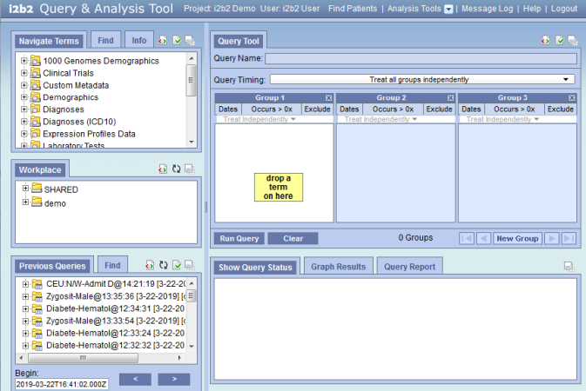
Access via i2b2 software

Slide 4
Features of i2b2 software
Point and click interface
Easy to find things
Save, share, and re-use queries
Data builder
Creates and stores SQLite files

Slide 5
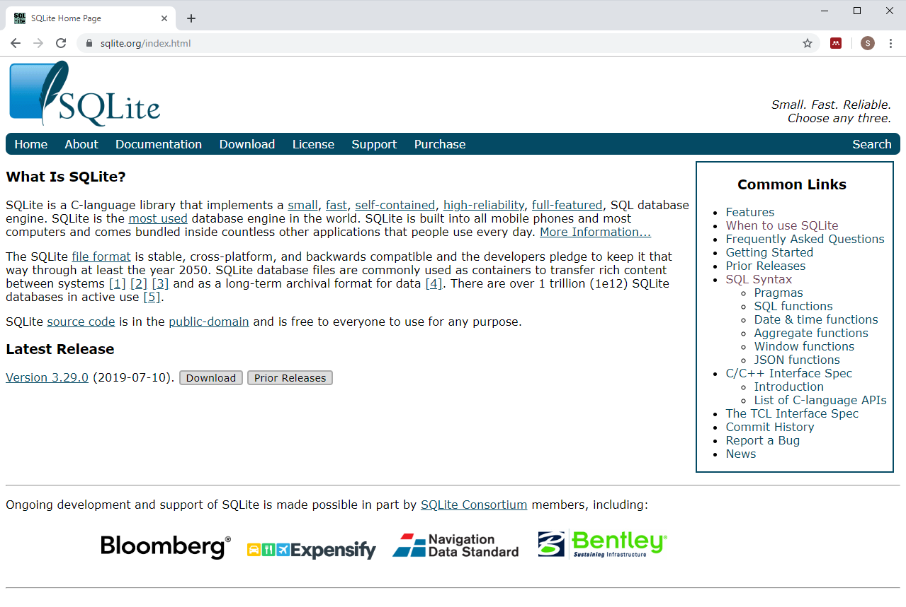
What is SQLite?

Slide 6
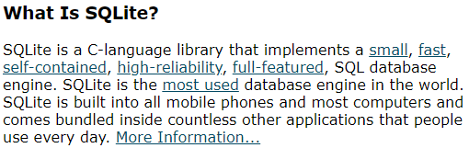
SQLite description

Slide 7
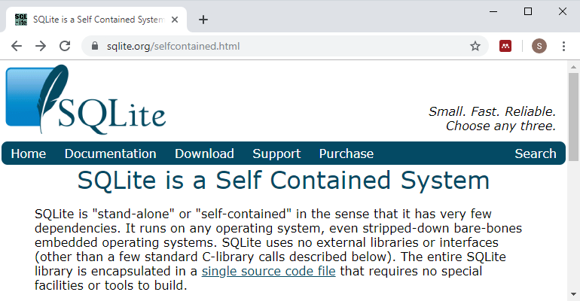
SQLite is self-contained

Slide 8
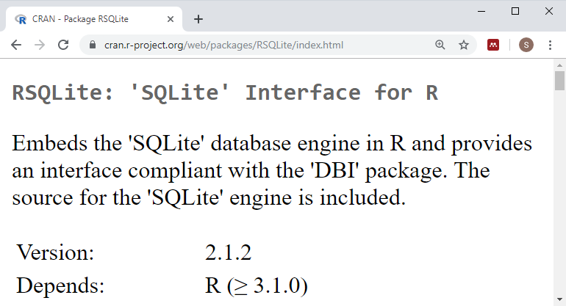
RSQLite package

Slide 9
Sample R code
library(RSQLite) db_name <- table_name <- sql_query <- paste("select * from", table_name) conn_site <- dbConnect(SQLite(), dbname=db_name) imported_data <- dbGetQuery(conn_site, sql_query)

Slide 10
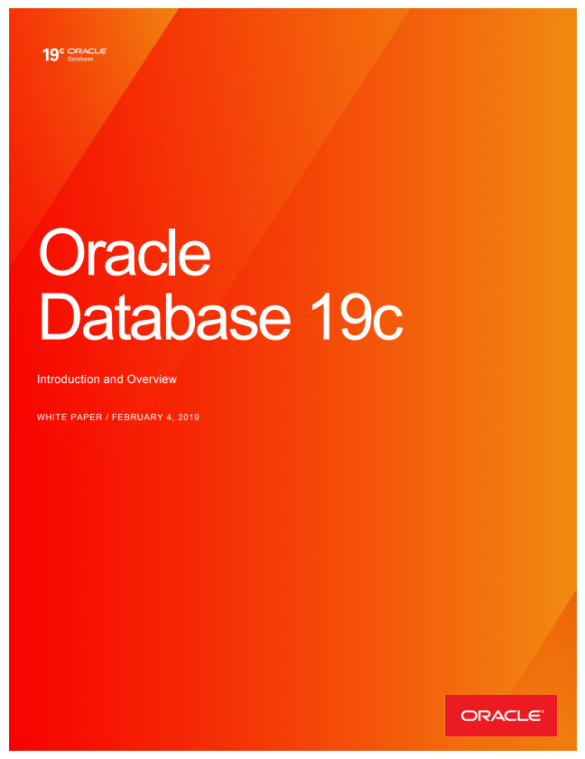
Oracle description

Slide 11
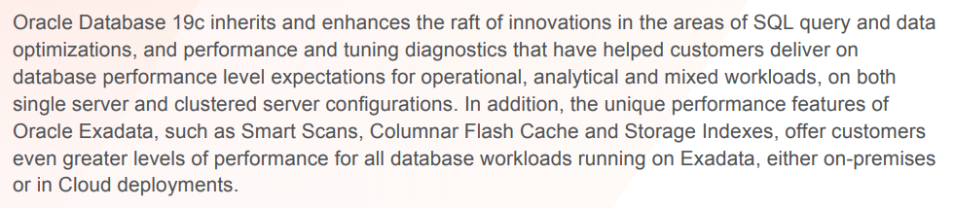
Oracle is a sophisticated server application

Slide 12
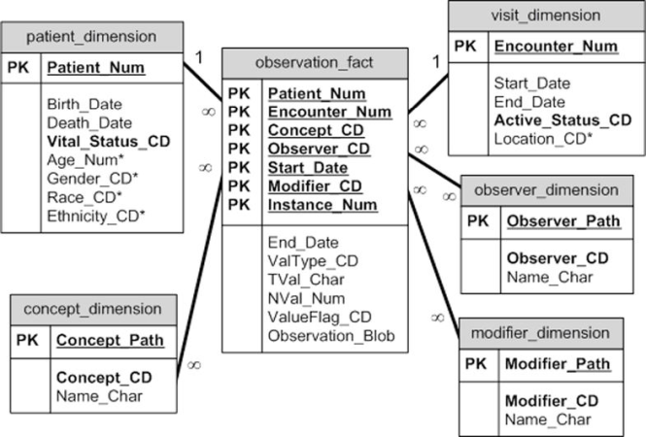
The i2b2 database schema

Slide 13
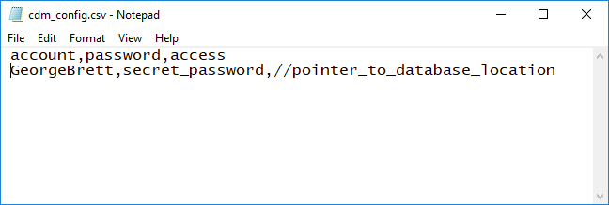
Sample R code (1/5)

Slide 14
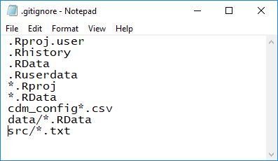
Sample R code (2/5)

Slide 15
Sample R code (3/5)
``{r login-to-oracle} library("ROracle") cdm_config <- read.csv('../cdm_config.csv', stringsAsFactors=FALSE) c_connect <- dbConnect( Oracle(), cdm_config$account, cdm_config$password, cdm_config$access) ``

Slide 16
Sample R code (4/5)
``{r simple-test} dbGetQuery(c_connect, "SELECT COUNT(patient_num) FROM blueherondata.observation_fact") ``

Slide 17
Sample R code (5/5)
``{sql test-direct-access, connection=c_connect, output.var="total_count"} SELECT COUNT(patient_num) FROM blueherondata.observation_fact ``

Slide 18
When to use what
Databuilder and RSQLite
Well-defined hypothesis
Single static dataset
Small and moderate sized
Oracle and ROracle
Exploratory analyses
Multiple dynamic datasets
Large size

Slide 19
Other consideratons for Oracle and ROracle
Do as much as you can in SQL
Baby steps
Watch your timing
Sys.time()
tictoc library
Be prepared to approach differently

Slide 20
Where you can find a copy of this talk.
This presentation was developed using R Markdown. You can find all the important stuff at
https://github.com/kumc-bmi/heron-i2b2-analytics
In particular, look for
talks/sql-into-r/slides.pptx

