Slide 1
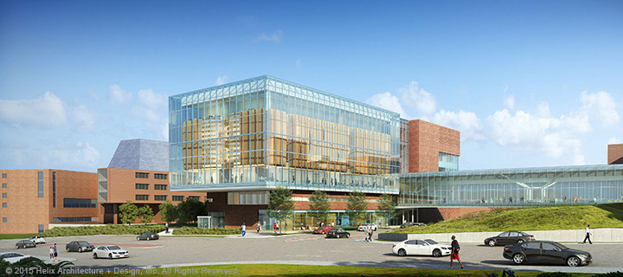
Frontiers Informatics Meetup
Using Open Clinical Data Analytic Platforms
May 23, 2019
4 p.m. – 6 p.m.
LOCATION:
Health Education Building (HEB 2223)
3901 Rainbow Boulevard, Kansas City, KS 66160
EVENT HIGHLIGHTS:
The objective of this meetup is to engage researchers around the greater Kansas City area to learn about using open tools for accessing i2b2-based clinical data repositories at KUMC, UMKC, UM-Columbia, St. Luke’s, and Cerner. Topics to be covered in the first meeting include:
Introduction to i2b2 for building study specific patient cohorts
Obtaining data via DataBuilder for targeted analyses
Conducting advanced data mining with examples of disease risk prediction
INTENDED AUDIENCE:
Anyone who is interested in leveraging big data analytics, biomedical informatics, and health informatics. You may be a clinical researcher, statistician, informatician or engaged in developing and supporting health information technology or interested in evaluating healthcare delivery and quality.
ORGANIZED BY:
Steve Simon (UMKC) and Mei Liu (KUMC)
Learn more about:
HERON at http://www.kumc.edu/miea/medical-informatics/heron.html
Green HERON at http://www.kumc.edu/miea/medical-informatics/green-heron.html
Register here: https://redcap.kumc.edu/surveys/?s=N4WX8X3348
Parking: P4 Bluff Garage

