Slide 1
Getting data into R using SQL interface
Steve Simon, Department of Biomedical and Health Informatics, UMKC

Slide 2
A bad counting joke
There are 10 types of programmers, those who understand binary and those who don’t
The heart of most EHR research is counting.
Count -> Percentage -> Odds ratio -> Logistic regression -> ???
Logistic regression and beyond requires SAS, SPSS, R, etc.
How do you get data into R?
SQL interface

Slide 3
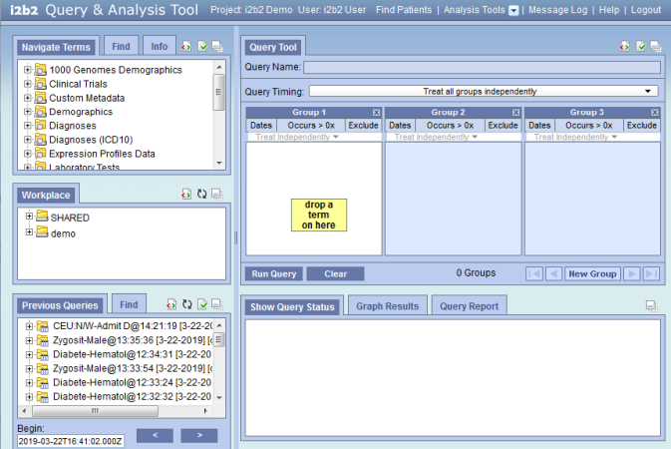
Access via i2b2 software

Slide 4
Features of i2b2 software
Point and click interface
Easy to find things
Save, share, and re-use queries
Data builder
Creates and stores SQLite files

Slide 5
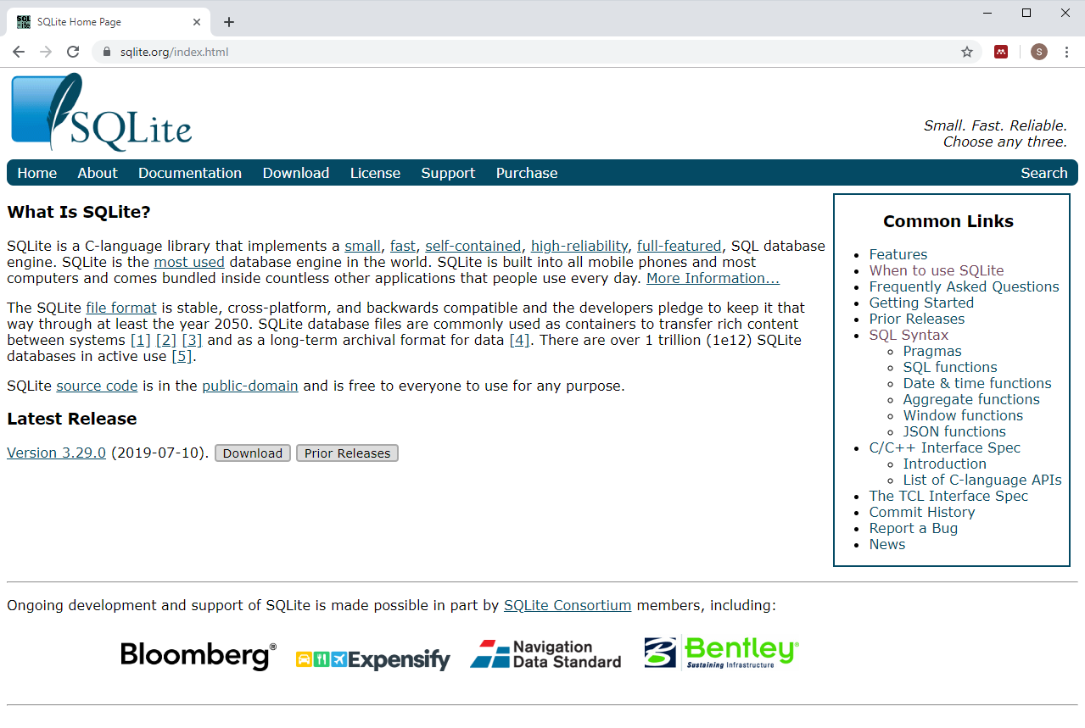
What is SQLite?

Slide 6
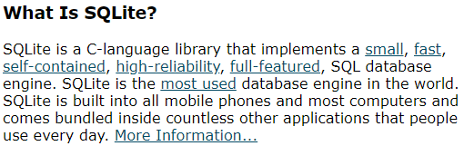
SQLite description

Slide 7
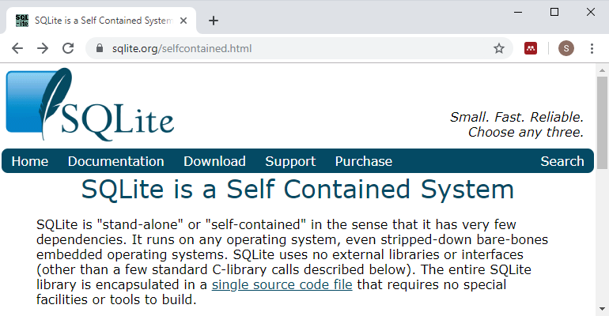
SQLite is self-contained

Slide 8
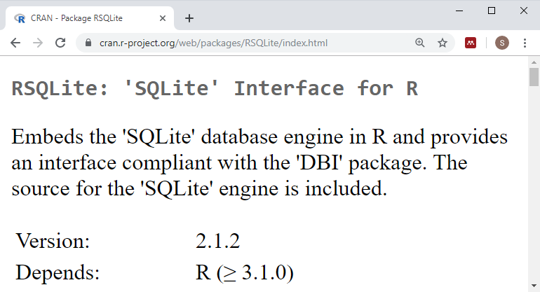
RSQLite package

Slide 9
Sample R code
library(RSQLite) db_name <- table_name <- sql_query <- paste("select * from", table_name) conn_site <- dbConnect(SQLite(), dbname=db_name) imported_data <- dbGetQuery(conn_site, sql_query)

Slide 10
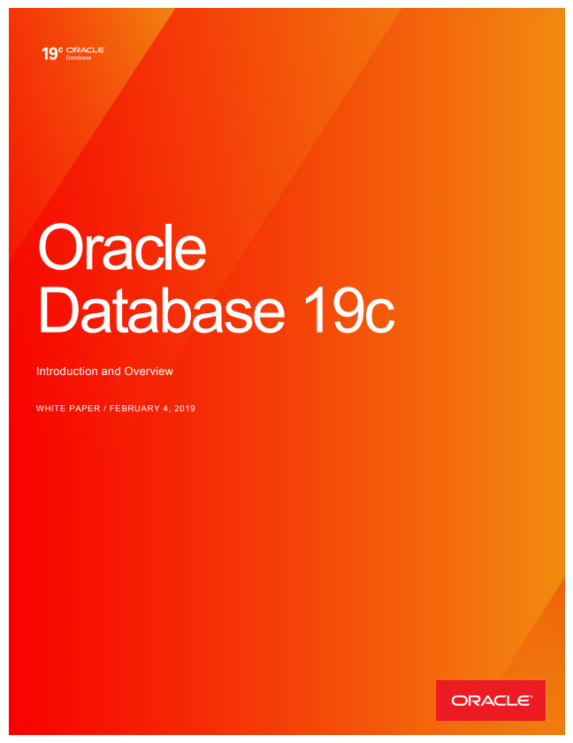
Oracle description

Slide 11
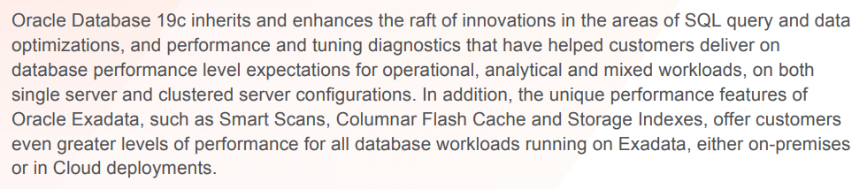
Oracle is a sophisticated server application

Slide 12
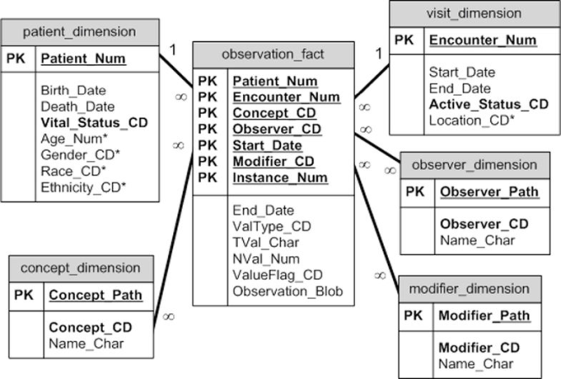
The i2b2 database schema

Slide 13
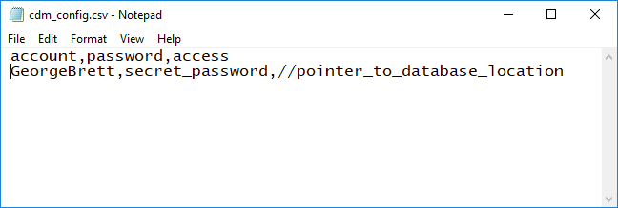
Sample R code (1/5)

Slide 14
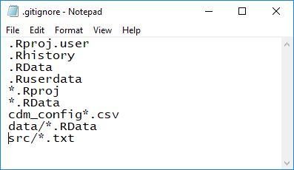
Sample R code (2/5)

Slide 15
Sample R code (3/5)
``{r login-to-oracle} library("ROracle") cdm_config <- read.csv('../cdm_config_A1.csv', stringsAsFactors=FALSE) c_connect <- dbConnect(Oracle(), cdm_config$account, cdm_config$password, cdm_config$access) ``

Slide 16
Sample R code (4/5)
``{r simple-test} n <- dbGetQuery(c_connect, "SELECT COUNT(patient_num) FROM blueherondata.observation_fact") format(n, big.mark=",") ``

Slide 17
Sample R code (5/5)
``{sql direct-access, connection=c_connect, output.var="total_count"} SELECT COUNT(patient_num) FROM blueherondata.observation_fact ``

Slide 18
Where you can find a copy of this talk.
This presentation was developed using R Markdown. You can find all the important stuff at
https://github.com/kumc-bmi/heron-i2b2-analytics
In particular, look for
talks/sql-into-r/slides.pptx
talks/sql-into-r/speaker-notes.pdf

