Slide 1


Classification of reddit entrepreneur and investing posts
By N Kumeresh, DSI 18

Slide 2

Contents
Problem statement
Data scrapping and cleaning
Exploratory Data Analysis
Model Creation
Model results
Conclusion and recommendation

Slide 3
Problem Statement
As a data scientist working in reddit, I’m tasked to assist the moderators of the entrepreneur subreddit with filtering posts that are from the investing subreddit. The problem is solved through creating a classification-based model to separate these posts.
Notes:
There are posts that are from the investing subreddit. Sometimes, there are new users are not able to differentiate business ideas and business investing strategies.

Slide 4
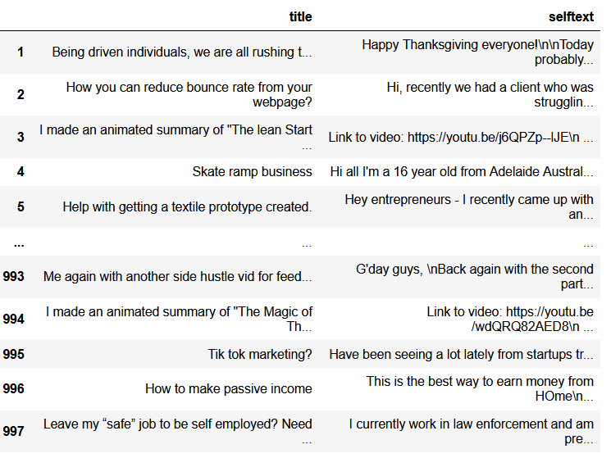

Scrapping the data
Function was created to scrap 1,000 posts using the requests library for each subreddit
Title and selftext were extracted

Slide 5
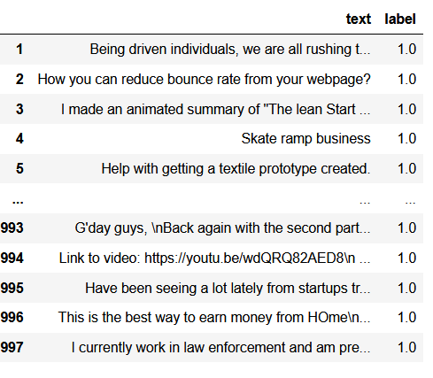
Merging the title and post
The title and selftext were concatenated as ‘text’ column.
Label column was created with 1 with the entrepreneur subreddit and 0 being the investing subreddit.

Slide 6
Cleaning the dataset
Function was created to clean the post
Using regex and Natural Language Toolkit (NLTK) library to clean the posts
Words are lemmatized
Generally removing words that have special characters and punctuations, website links, stop words
Duplicates are dropped as well
Do you ever feel the same as well?\n\nEven when I am sitting with my loved ones, and my family, the bugs to solve, the investors to talk to, and the consumers to reach out are in my head always.\n\nIronically, the company I started, [https://www.lishash.com](https://www.lishash.com), is all about harmony, and not getting too lost in our hustle of life haha
Cleaned
ever feel well even sitting loved one family bug solve or talk consumer reach head always ironically company started even interesting used avoid conflict distraction
Notes:
Stop words: Words that are common words
Lemmantizer: To bring the word to their base form using a dictionary and retain the meaning of the words

Slide 7
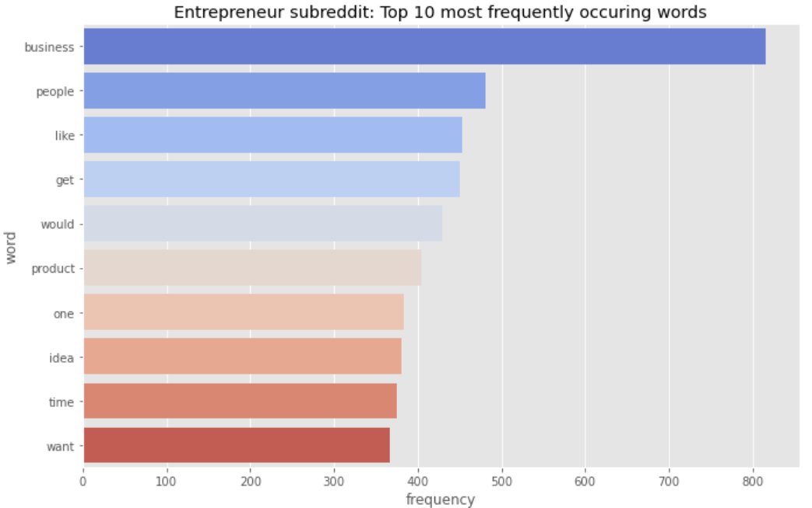
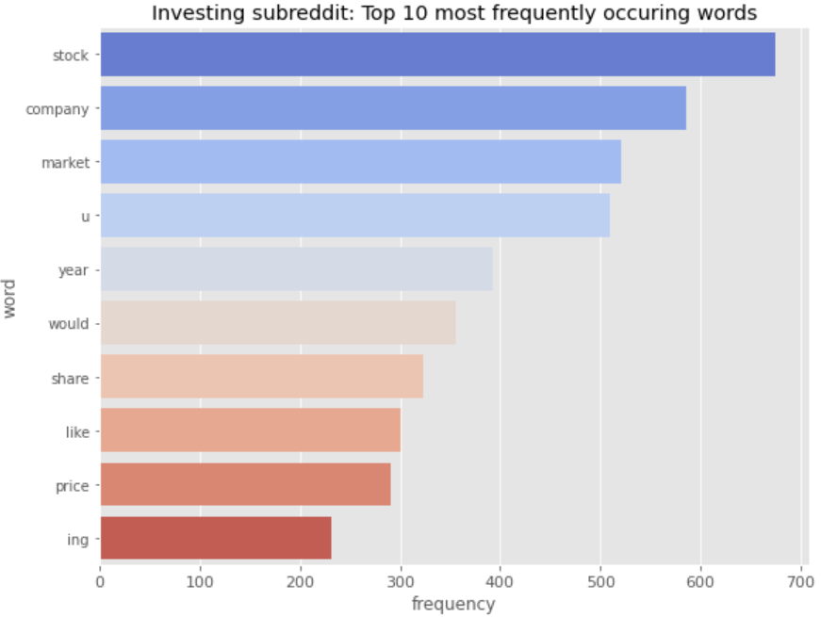
Exploratory Data Analysis: Most frequently occurring word
Notes:
The top words are unique ensuring that the models will not have issues differentiating the posts

Slide 8
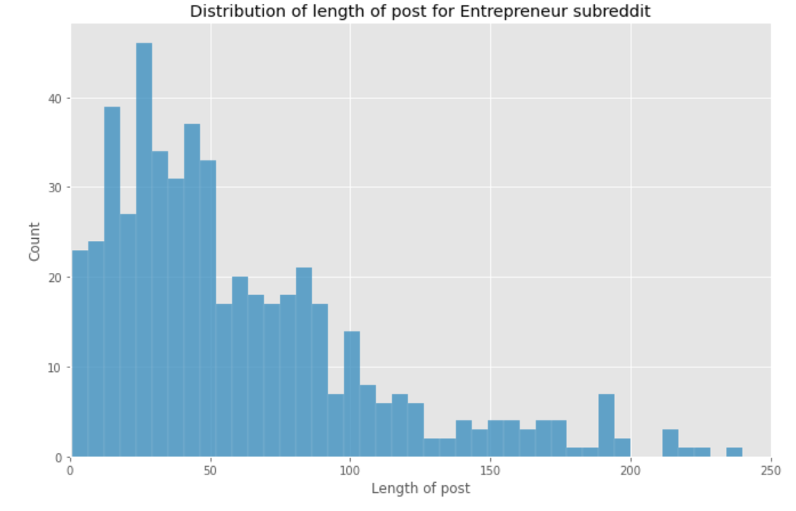
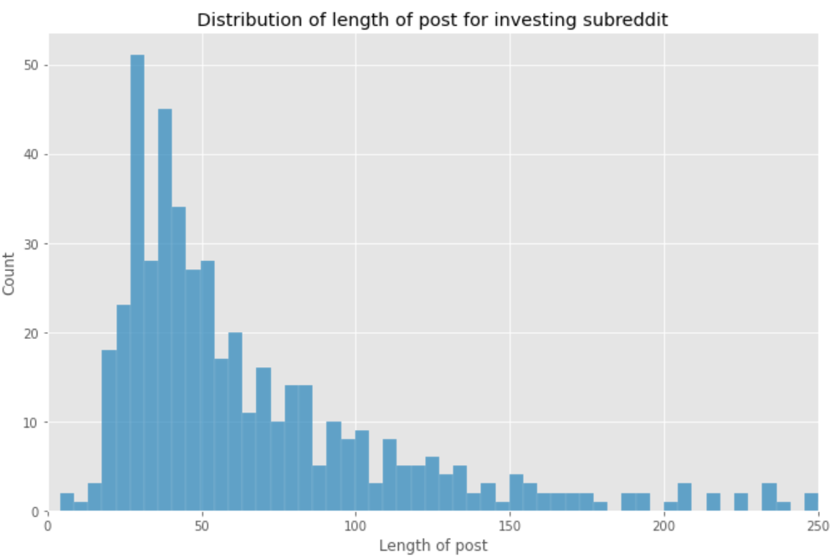
Exploratory Data Analysis: Length of post distribution
Both show a right skewed posts, with an average 25 words per post

Slide 9
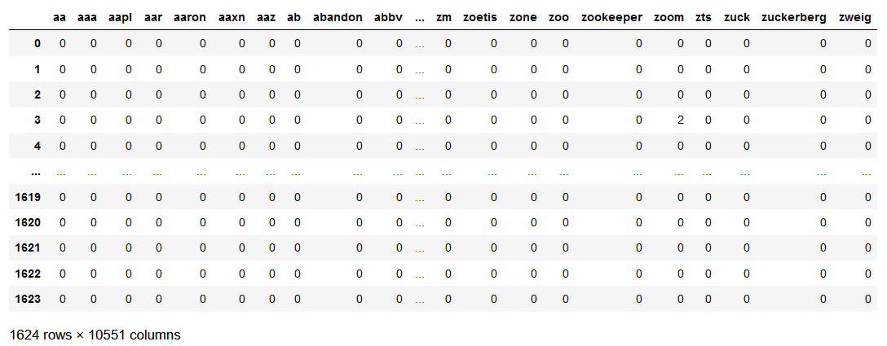
Preprocessing
Used train test split before creating the model
Used both Count Vectorizer and Term Frequency Inverse Document Frequency (TFIDF) to transform the dataset into their bag of words
2 models were used
Logistics Regression model
Multi-nominal Bayes Model
Count Vectorizer DataFrame

Slide 10
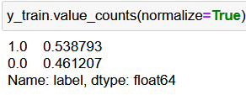
Baseline accuracy Score
Baseline Score is the predicted accuracy score for the test set.
As the majority class is the entrepreneur subreddit, which is class 1, 0.5387 will be the baseline score.

Slide 11
Logistics Regression performance
Accuracy Scores
Confusion Matrix
Actual Class
Count Vectorizer
Training Score | Test Score
0.9587 | 0.9114
TFIDF Vectorizer
Training Score | Test Score
0.9778 | 0.9336
 | Positive | Negative
Positive | 275 | 17
Negative | 19 | 231
Predicted Class
The model is shown to perform well with an accuracy of above 0.9.
However, the model is overfitting given that the test score is lower than the training set score for both vectorizers.
TFIDF Vectorizer is ahead with a test score of 0.9336 compared with the Count Vectorizer with a score of 0.9114.
Most observations were correctly classified
A total of 36 observations were misclassified
Notes:
Confusion Matrix, breaking it down into actual numbers.
Confusion matrix is for TFIDF as it’s the better score

Slide 12
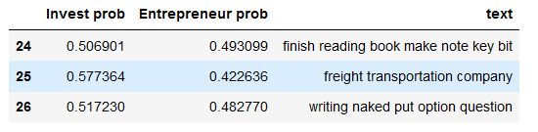
Logistics Regression misclassified posts
There are certain posts and titles that were misclassified
These posts have words with strong coefficient values in them as seen in the table on the right
Posts that have a few words in them also resulted in the model misclassifying and this results in very close probabilities for the classes.
Tokens | Coefficients
company | 0.715682
bank | 0.843094
revenue | 0.906703
going | 0.897782
business | 3.105827
need | 1.268695
Notes:
Words such as business are shown to have strong coefficient values.

Slide 13
Logistics Regression coefficients
Token | Coefficient Values
business | 3.105842
idea | 2.274079
product | 1.670806
startup | 1.629434
marketing | 1.468577
start | 1.467827
website | 1.443048
work | 1.420705
help | 1.378544
want | 1.359277
Token | Coefficient Values
long | 0.708171
market | 0.700378
portfolio | 0.696942
palantir | 0.693791
fund | 0.693695
buy | 0.639452
ment | 0.637895
etf | 0.617715
ing | 0.423179
stock | 0.272998
These are the top coefficients for the model
These tokens are more likely to represent the Entrepreneur class than the investing class
These are the bottom coefficients for the model
These tokens are more likely to represent the Investing class than the entrepreneur class
Notes:
Example: For every unit increase in the business token, the post is 3.1 times likely to represent the entrepreneur class.

Slide 14
Multi-nominal Naive Bayes performance
Accuracy Scores
Confusion Matrix
Actual Class
Count Vectorizer
Training Score | Test Score
0.9667 | 0.9354
TFIDF Vectorizer
Training Score | Test Score
0.9864 | 0.9428
 | Positive | Negative
Positive | 230 | 10
Negative | 20 | 282
Predicted Class
The model is shown to perform well with an accuracy of above 0.9.
However, the model is overfitting given that the test score is lower than the training set score for both vectorizers.
TFIDF Vectorizer is ahead with a test score of 0.9428 compared with the Count Vectorizer with a score of 0.9354.
Most observations were correctly classified
A total of 30 observations were misclassified
Notes:
Confusion Matrix, breaking it down into actual numbers.
All of them outperformed the baseline score of 0.58

Slide 15
Multi-nominal Naive Bayes token probabilities
Token | Probabilities
business | -4.600525
people | -5.066310
would | -5.155679
like | -5.161361
get | -5.214005
one | -5.311721
idea | -5.321704
work | -5.338568
time | -5.345394
product | -5.352267
Token | Probabilities
stock | -4.62529
company | -4.7621
market | -4.86576
year | -5.09377
would | -5.19981
share | -5.28098
price | -5.39785
like | -5.53968
ing | -5.66643
inc | -5.71063
These tokens have the highest probability for the positive class, which is the entrepreneur class
These are more important for the positive class.
These tokens have the highest probability for the negative class, which is the investing class
These are more important for the negative class.
Notes:
The values are the log probabilities of the features given the class, (Either positive or negative).
The higher values mean more important features for the positive/negative class.

Slide 16
Conclusions and Recommendations
Posts and title that were transformed with TFIDF Vectorizer were shown to perform slightly better than the posts transformed with the Count Vectorizer.
Although both models showed comparable performance, Multi-nominal Naïve Bayes (MNNB) performed slightly better than Logistics Regression with a test set accuracy score of 0.9428 while the Logistics Regression test had a score of 0.9336.
Both models beat the baseline accuracy score of 0.5387.
I would recommend deploying the MNNB model as it’s shown to have a very high accuracy in distinguishing the entrepreneur and investing subreddit posts and this would help to save time and energy for the moderators of the subreddit

Slide 17


END
Any questions?

Slide 18
Appendix

Slide 19
Logistics Regression hyperparameter tunning
Using GridSearchCV, the most optimal hyperparameters were calculated
Count vectorizer
Hyperparameter | Value
countvec__max_df | 0.8
countvec__max_features | 4000
countvec__min_df | 2
countvec__ngram_range | (1,1)
Logistics Regression
Hyperparameter | Value
Solver | saga
Alpha | 0.1
Notes:
Out of the 10,551 columns, only 4000 of the best features were used

