Slide 1

ai.bhoga.com
Building Of Generative AI
GenAI: LLMOps
Venka Reddy.B
2024 BOGA AI, Inc.

Slide 2
Generative AI Journey
GenAI Apps Architectures
(IR & RAG)
Prompt Engineering
Frameworks
GenAI Intro
01
03
05
07
02
04
06
08
Foundation Models
Vector Databases
Model Compression &
Fine-tuning
Applications/APIs/Agents
2024 BOGA AI, Inc.

Slide 3
Course Details
Introduction
AI Context: GenAI
Traditional AI Practice: MLOps
GenAI Practice: LLMOps
GenAI Use Case Categories
Foundational Models: Meta Llama 3, OpenAI GPT, Google Gemini, Mistral, Claude , Ollama(local)
Prompt Engineering: Prompt Design & Prompt Templates
Vector databases: PineCone, Faiss, Chroma, Vector Search
Compression/Quantization: GPTQ, AWQ, LoRA(Low Rank Adaptation)
Frameworks: LangChain,vLLM, H20 LLM Studio
GenAI Usage Architectures: IR & RAG
APIs: Fast, Flask & gRPC
Application: UI & CLI (Build App using all the above concepts)
Agents: Crewai Framework crewAI - Platform for Multi AI Agents Systems
2024 BOGA AI, Inc.

Slide 4
Introduction
2024 BOGA AI, Inc.

Slide 5

AI is the new electricity
100 Years ago, electricity
transformed the world.
Now, AI will bring equally
big transformation.
AI
2024 BOGA AI, Inc.

Slide 6
Is AI for everyone?
2024 BOGA AI, Inc.

Slide 7
Yes and it’s Everywhere
AI for individual
AI for world’s Peace or Danger ??
AI for Healthcare
AI for Education
AI for community
AI for Society
AI for Technologies
(hardware,network,Software, services)
AI for everything..
AI for Planet
AI for Enterprises
AI FACTORY
HW + SW+TOOLS+
Solutions
AI for Government
(sovereign)
AI for Industries
(Manufacturing,logistics,finance, retail, sports, media, entertainment)
AI for Humanity
2024 BOGA AI, Inc.
Notes:
Society: Advancements in science and research . Economic Growth; community:Better connectivity, Optimize public resources,transportation, waste management,emergency response , new jobs
Neg: Isolation, Fake info, job displacement
Humanity: Improved Quality of life (positive), Economic growth. (-) : Jobs displacement and Bias and Discrimination

Slide 8
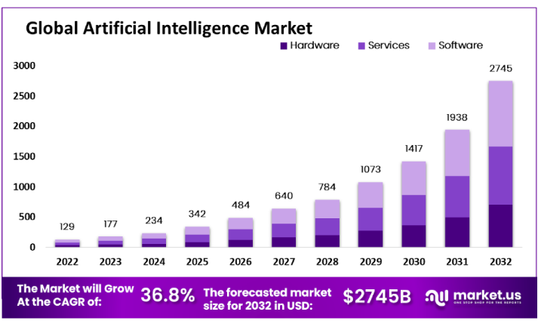
AI Global Market: 10 Years
Economic Output: $16T
$4.3T
Japan
$4.4T
Germany
$3.4T
India
$3.3T
UK
2024 BOGA AI, Inc.

Slide 9

AI Benefits & Advantages: Value
Accelerate Productivity
Reduce Human Errors
Increased Efficiency
Drive Process Automation
Personalized Experiences
Speed up Innovation & Discovery and Reduced cost
Solve complex problems
Suggest Next Best Actions
2024 BOGA AI, Inc.

Slide 10
AI context: GenAI
Generative artificial intelligence - Wikipedia
Artificial Intelligence (AI)
Systems that learn and reason like humans
AI risks depends on type of use and type of AI.
Generative AI puts more emphasis on usage governance for various use cases that will be used and it varies across different industries
Focus is on model build, training,evaluation
Model explainability
Model bias
Model governance
Machine Learning (ML)
Suite of Algorithms that can learn from data without being explicitly programmed
Deep Learning (DL)
Uses Artificial neural networks that adapt and learn from vast amount of data
Predictive AI
GenAI for Individual
GenAI for Businesses
GenAI for Government
GenAI
Transformer based neural networks models that can generate new content given the user input usings learned patterns
Generative AI
Focus is on foundational models validation and certification, input and output(response)
Parameter fine-tuning, compression
Prompt Engineering
Generated content validation
Eliminate/minimize of Hallucinations
2024 BOGA AI, Inc.

Slide 11
AI = Collection of tools
Generative AI
Unsupervised learning
(Clustering things)
Supervised learning
(Labeling things)
AI = Code + Data
Reinforcement learning
2024 BOGA AI, Inc.
Notes:
Type of Machine learning where an agent learns by interacting with its environment and take actions. Learns using trial and error methods. In this system is rewarded if it gets right and penalty if it gets wrong.. Eventually it learns /
Example: Robots can learn to perform tasks by navigating complex environments.;
AI can learn to make trading decisions.
AI can learn to personalize treatment plans for patients

Slide 12
RISE of AI
AI: General(AGI)
AI: Generative
Broad range of intellectual tasks
Learns and adapts to new situations
Human-like or surpassing
God like :)
AI: Predictive
Creates new data(multi-modality)
Focus on creativity- human like
Wide range of applications
Text/Audio/video
General Intelligence: Limited
Modeling: Predictive
Learns from data
Make predictions
Focused specific tasks
Text based output
General Intelligence: Limited
Rule-based
Deterministic (predictable output)
Limited adaptability
Text based output
General Intelligence: None
2024 BOGA AI, Inc.

Slide 13
AI Solutions
High Level Use Case categories
Predict future events based on historical patterns learned from data
Customer churn prediction
Stock Market Predictions
Home price predictions, Forecast volumes and etc..
Prediction
Detection
Detect anomalies or abnormalities from large swaths of data
Network Intrusion
Manufacturing defects
Transactional Fraud detection
Objects detection,
Facial detection, Self-Driving cars etc
Optimization
Finding best possible solutions in business processes, decisions, actions, and resource allocation
Optimized Marketing Campaigns
Efficient funds or resource allocation
Recommending best products
Optimizing Engineering Designs
Suggest reasoning or causes for specific events or outcomes
customer defaults on this loan
Climate prediction – based on key factors
Website optimization for better conversion rates
Diagnostics
Produce new information based on patterns learned from vast amount of
Data
Text, audio, video generation, Summarization, write stories, emails
Generate code
Reasoning, Math solutions, Planning & Execution of tasks
Generation
2024 BOGA AI, Inc.

Slide 14
GenAI Capabilities
Generative AI Capabilities are Evolving from words to Multimodal
Words
Code
Visuals
Beyond
Natural Language
Programming & Database
Audio/Video
Designs
Generating Stories
Summarizing text
Extractive Summaries
Q&A
Extracting Sentiment
Code Generation
Synthetic data generation for training
SQL code generation
Autonomous databases
Generating Images,Videos
Art
Drawings
Generate Music
Generate Faces/bodies
Generating 3D models
Generating Process flows
Product designs
Generating specifications for drugs, infrastructure and buildings

Slide 15
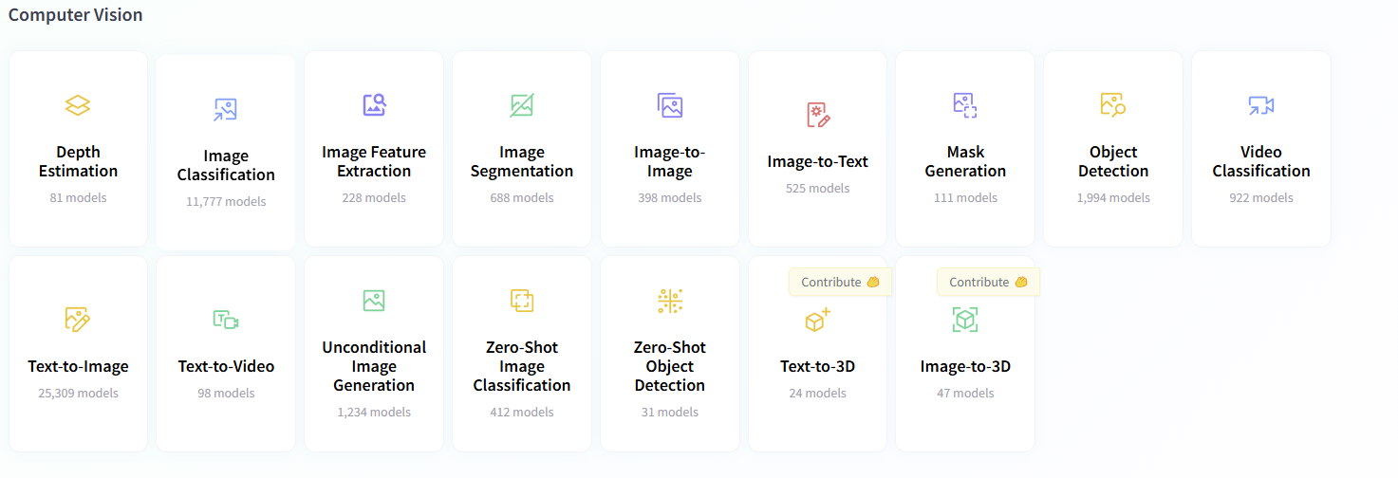

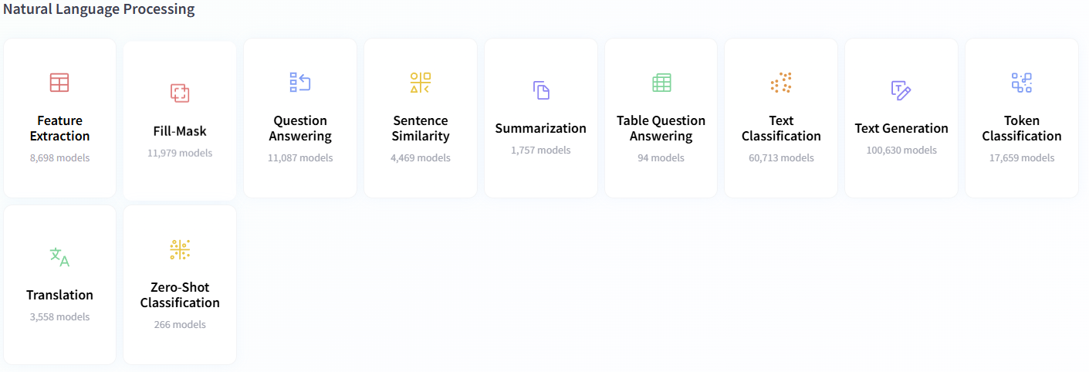
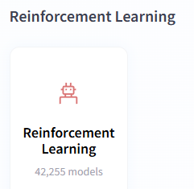
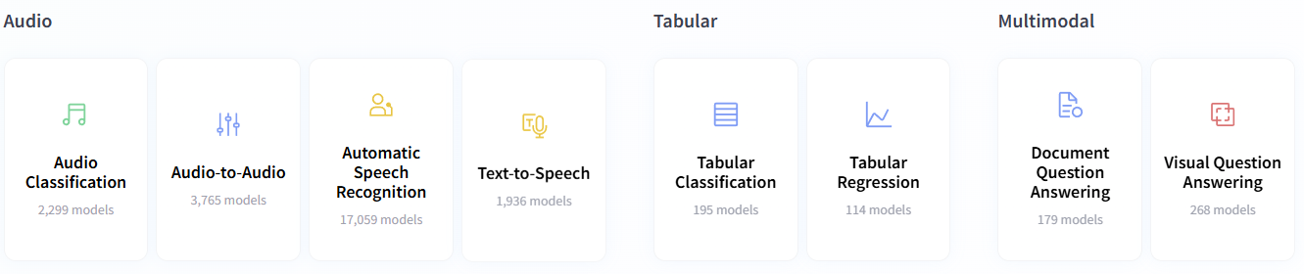
GenAI Tasks
High Level GenAI Tasks
2024 BOGA AI, Inc.

Slide 16
Supervised Learning (labeling things)
Input
Output
(X)
(Y)
Input Text labeling
Train a Model
Deploy a Model
Get Predictions
Predictive AI Model
2024 BOGA AI, Inc.

Slide 17
Supervised Learning (labeling things)
Input(X)
Output(Y)
Applications
Spam detection
Email
Spam? (Y/N)
Advertising
Ad, User Info
Click? (1/0)
Visual inspection
Phone Image
Defect (Y/N)
Customer Satisfaction
Customer Reviews
Sentiment(pos/neg)
Transaction fraud Detection
Card transaction
Fraud (0/1)
2024 BOGA AI, Inc.

Slide 18
Transition to Large Language Models (2010-20)
Large AI models
Performance
Small AI models
Amount of data(Billions of words)
2024 BOGA AI, Inc.

Slide 19
GenAI (2021-)
Content generation process
How does it works
GenAI is built based on supervised learning that predict next word (X →Y) repeatedly
Love eating bagels
prompt
(X)
(Y)
..simply because there's nothing quite like a good bagel, and that's enough to make me happy.
..especially warm from oven with perfect crust that sings to teeth
1. Love eating bagels
simply
2.Love eating bagels simply
because
3. Love eating bagels simply because
there’s
response
4. Love eating bagels imply because there’s
nothing …
response
When AI systems are trained on large amount of data we get large models like Bard
2024 BOGA AI, Inc.

Slide 20
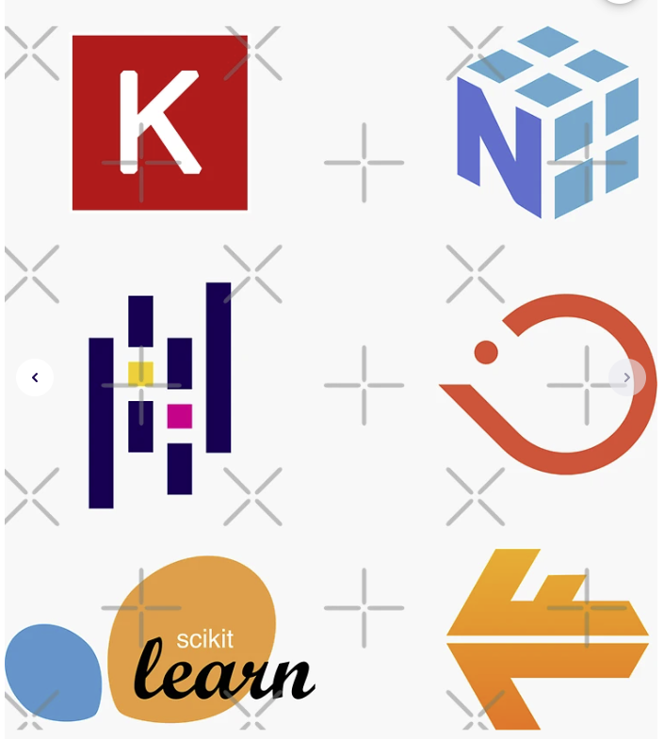

GenAI: App development
Predictive AI
Input Text labeling
Train a Model
Deploy a Model
Get Predictions
3 to 6 months
Generative AI
User Input
(Prompt)
Deploy/Select a Model
Get Predictions
Focus
Hours to days
2024 BOGA AI, Inc.

Slide 21

LLMOps
Focuses on operational capabilities and infrastructure needed to fine-tune foundational models and then deploy models into production.
It’s a discipline that uses set of practices and/or techniques i.e prompt engineering, deploying LLM agents and Monitoring and observability to optimize LLMs for a set of tasks so that expect output is given to users.
Steps:
Select the foundational model
Fine-tune the model -Adapting to specific tasks
Evaluate the model for Responsible AI.
Deploy the model
Monitor the models(Observability metrics Model drift, Performance,Accuracy)
2024 BOGA AI, Inc.

Slide 22
LLMOps
A Beginners Guide to LLMOps For Machine Learning Engineering
Training
data
Model Registry
Domain specific data
User Apps
Fine-tune
Select base model
2
Evaluate Model
Deploy
model
Deploy Agents
1
3
4
Context
(query + prompt)
Monitoring
Security
Prompt based tuning
Source data
5
Data process
Prompts
2024 BOGA AI, Inc.

Slide 23
GenAI Roles:Future
GenAI XAI Specialist
(Explainable AI/Ethics)
01
GENAI Model Trainer
Understanding of Generative AI algorithms
machine learning expertise
FM fine-tuning skills, Adjust Model parameters
Working with data (structured & Unstructured)
02
GENAI LLMOps Engineer
Understanding of using GenAI TechStack
DevOps Experience, MLOps Experience, API experience, Deployment and Operations
Observability experience, Prompt engineering
Scriptings skill for automation, collaborative skills
08. XAI specialists will work on making Gen AI models more transparent and interpretable, ensuring users trust and understand the AI's decision-making process.
Background in ethics, philosophy, or law, combined with an understanding of AI technology and its potential societal impact.
09. Ethicists will develop frameworks and guidelines for responsible development and deployment of Gen AI, considering issues like bias, fairness, and potential misuse.
03
GENAI Vector database Engineer
Understanding of using GenAI TechStack
Data engineering/pipelines experience(unstructured data)
Embedding Models, AI/ML experience
Database management, performance, operations
04
GENAI Prompt Engineering
Understanding of using GenAI TechStack
In-depth understanding of prompt engineering,Design,templates, Prompt frameworks
Business Domain Knowledge
05
GENAI Application Developer
Fullstack GenAI Techstack (skills from above 4 roles)
UI/UX experience helps.
DevOps Experience
06
GENAI UX Experience Developer
Familiarity with GenAI capabilities
UI/UX Design principles and experience
Strong communication skills
07
GENAI Product/Management
High level Understanding of GenAI tools & technology, different use cases
domain/Industry knowledge
product/manager/director experience.
2024 BOGA AI, Inc.

Slide 24
Demo
Setting up GCP Vertex AI Free-Trial
&
Google Colab Environment
https://colab.research.google.com/
https://console.cloud.google.com/
2024 BOGA AI, Inc.

