Slide 1
Frameworks
2024 BOGA AI, Inc.

Slide 2
GenAI Frameworks
Foundational
Models
DATA/ VectorDB
Frame
works
Agents,
Observability
(Logging/Monitoring)
Fine-tuning
Models
Prompt Engineering
2024 BOGA AI, Inc.

Slide 3
GenAI Applications
Foundational
/Fine-tuned
Models
GenAI Apps
APIs,UX,
Agents
DATA VectorDB
Frameworks
Prompt Engineering
2024 BOGA AI, Inc.

Slide 4
What are the Frameworks
llmops
Provides a foundation for building software applications.
Reusable components/Libraries
Frameworks simplify/speed the process of Productionize of LLMs deployment/Operation
Set of Practices, Techniques and Tools used for developing & operating GenAI apps in production environments.
2024 BOGA AI, Inc.

Slide 5
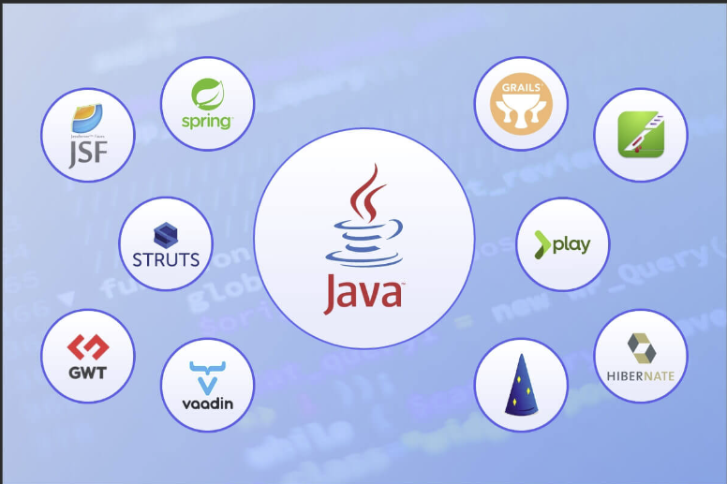
Why LLM Frameworks
Provides a solid base to build Apps
Reusable components, Tools and
Guidelines
Reduce the time and effort
for building Apps
Greatly Improves quality.
Improves Standards, eliminate
Duplicate effort
2024 BOGA AI, Inc.

Slide 6

LLM Repositories (Model Garden)
Host open source Large Language models for public use.
Like GITHUB for Models
Use APIs consumptions model
HuggingFace huggingface-models
Replicate replicate modes repo
NVIDIA NIM Try NVIDIA NIM APIs
2024 BOGA AI, Inc.

Slide 7
Popular Frameworks
LANGCHAIN
LangChain
LLM Apps
LlamaIndex
LlamaIndex - LlamaIndex
VLLM
vllm
Inference
FRAMEWORKS
deepspeed-mii
DeepSpeed-mii
TGI
TGI
UI/UX
Vercel
Nvidia NIM
nvidia nim
Agentic
CrewAI
crewai
n8n - nocode
n8n
Autogen Studio & Many other
AutoGen
2024 BOGA AI, Inc.

Slide 8
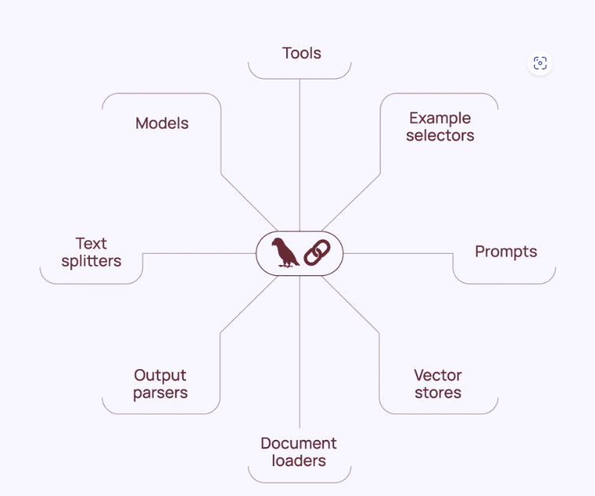
Langchain Framework
Introduction | 🦜️🔗 Langchain
Toolkit for building LLM applications.
Unified interface to interact with open source Embedding Models, LLMs, Vector databases and etc..
Build Chains, Agents & RAGs very easily with disparate LLMs providers
2024 BOGA AI, Inc.

Slide 9
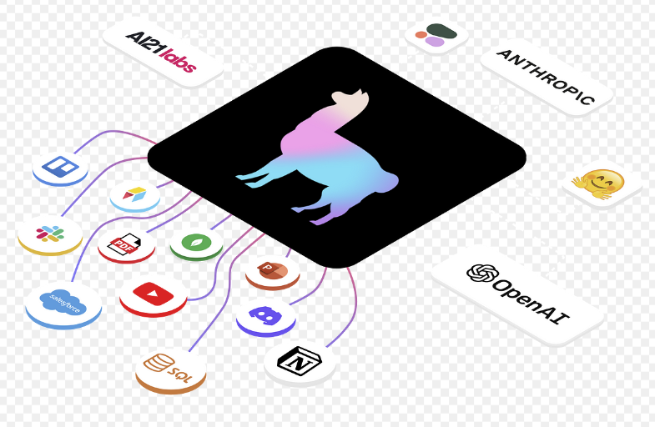
LlamaIndex Framework
LlamaIndex - LlamaIndex
Toolkit for building LLM applications.
Unified interface to interact with open source Embedding Models, LLMs, Vector databases and etc..
Build Chains, Agents & RAGs very easily with disparate LLMs providers
2024 BOGA AI, Inc.

Slide 10

Inference Frameworks benefits
Hosting LLM Models On-prem/
Locally
Data Privacy and Security
Sensitive and confidential data
Performance
Throughput /Latency
COST
Offline functionality
2024 BOGA AI, Inc.

Slide 11
Demo
llmops-frameworks-llamaindex-groq.ipynb - Colab (google.com) — Interact with llm using llamaindex
llmops-frameworks-llamaindex-pinecone-QA-01 - Colab (google.com) — Query the Vectorbase Index using llamaindex
llmops-frameworks-langchain-chat_groq.ipynb - Colab (google.com) – Interact with llm using langchain
llmops-frameworks-llminference-vllm.ipynb - Colab (google.com) – deploy local model using vllm
Vscode demo using crewai agentic framework
Copyright © 2024 BOGA AI, Inc. All rights reserved.

