Slide 1
Correlation of bridge component conditions with physical and environmental factors from 1992 to 2020
Prepared by: Kumil Ali

Slide 2
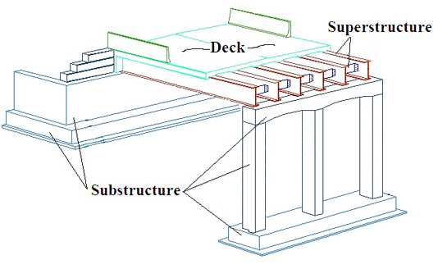
Project Purpose
Main Objective: Utilize bridge inspection data to develop a model that predicts the condition of bridge components through a variety of initial parameters
Compare and apply the concepts of PCA, regression, and classification to visualize and explain the relationships of these parameters
Determine if there any meaningful differences in multiple models developed during the project
Source: Michigan DOT

Slide 3
Differences from previous developments
Methods such as Markov chains and neural networks have been used to estimate the lifespan of existing bridges under predetermined conditions
Unlike other deterministic models, this focused on exploring the whole collection of bridges within individual US states.
Discussion and comparisons between models would be made at the macroscopic level, which could affect decision making for bridge design, construction at the macroscopic level

Slide 4
Prior work
Condition based bridge management with SHM integration: A novel approach to remaining life estimation of bridges
Report by: Sameera Tharanga Jayathilaka (Iowa State University)
A piece from the abstract:
Bridge Deterioration and aging are important problems in the United States. According to the infrastructure report card from the American Society of Civil Engineers, as of 2016, almost one in 11 (9.1%) of bridges are structurally deficient and approximately 4 out of 10 (40%) bridges are older than 50 years. There are many bridge management systems in the world. All these lack of an integrated Structural Health Monitoring System and are subject to criticism for being subjective. Condition-Based Maintenance coupled with the Structural Health Monitoring data can be used to actively manage bridges while minimizing subjective effects.

Slide 5
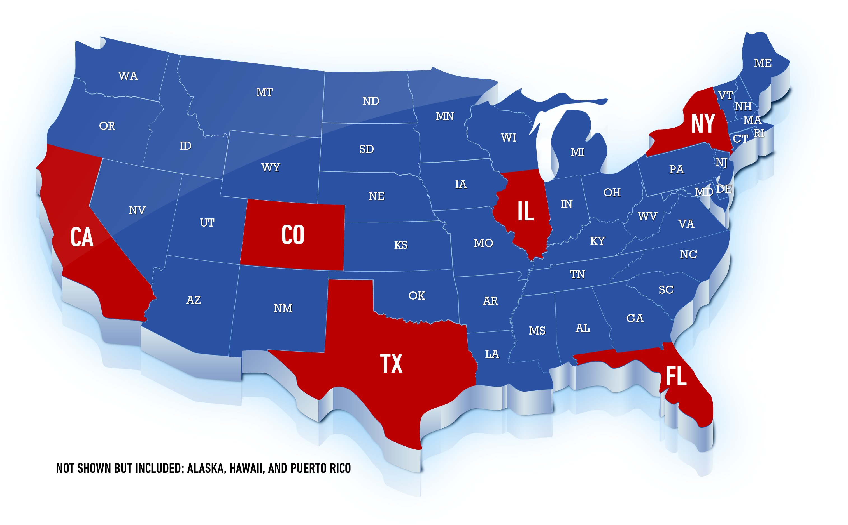
Scope of work
States included in study were Alaska, California, Colorado, Florida, Hawaii, Illinois, New York, Puerto Rico, and Texas
Number of bridges in a state ranged from 1136 (HI) to 52223 (TX)

Slide 6
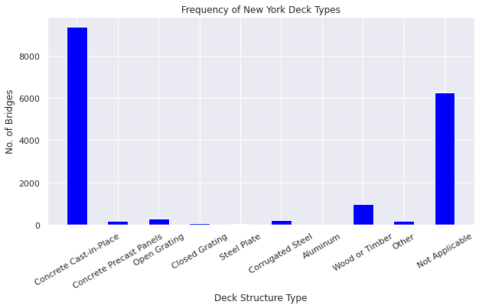
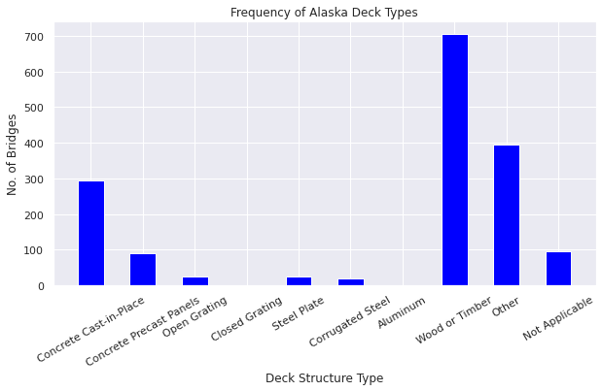
Data
The 9 states used for this study were chosen to represent the range in weather patterns, traffic types/size, and building materials used in highway bridges.

Slide 7
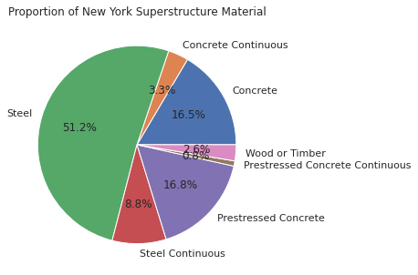
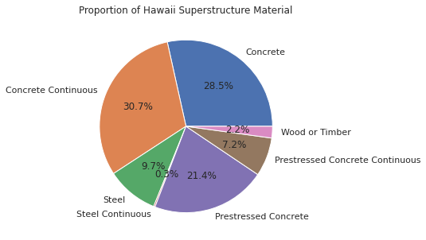
Data

Slide 8
data
Most data for this study was obtained from the FHWA National Bridge Inventory, which has been keeping electronic record of US bridge inspectors since 1992.
All public transportation bridges are within this dataset, with inspections usually occurring every 1 or 2 years
Most of the data utilized involved the physical of a bridge which could pose an effect on the deterioration of a bridge. These would include bridge age, average daily traffic, span length, etc.
The response variables used to simulate deterioration were the condition ratings of a bridge's deck, superstructure and substructure, ranging from 0 (worst condition) to 9 (best condition)
Additional weather parameters, notably average temperature and yearly precipitation, were obtained from the National Ocean and Atmospheric Administration (NOAA) website through a developed API in Python.

Slide 9
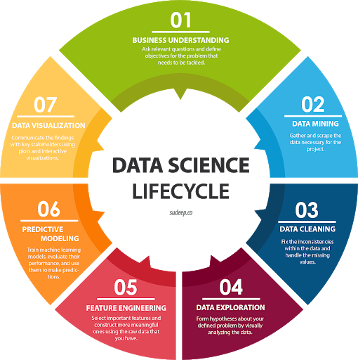
Methods of analysis
Data Summary and Visualization
Regression and Classification
Principal Component Analysis
Feature Engineering
Data Cleaning
Source: https://www.omnisci.com/learn/data-science

Slide 10
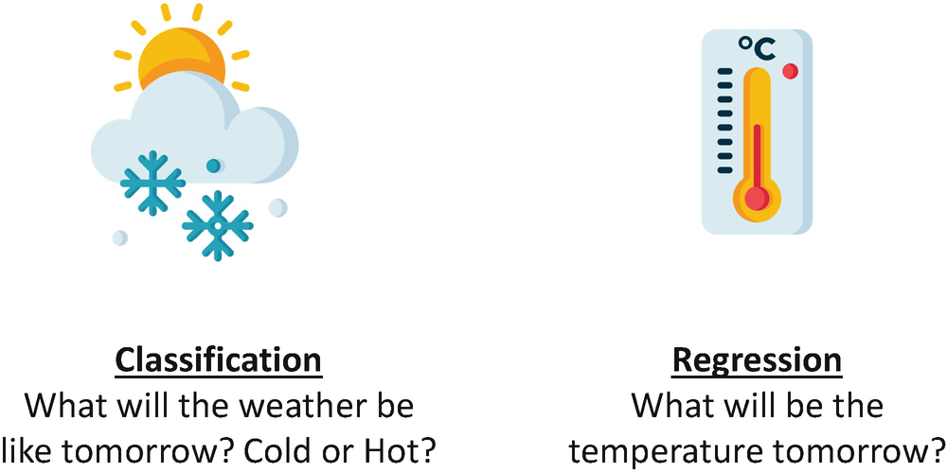
Regression vs. classification
Regression
Classification
Mapping Functions will be chosen of a type that can align the values to continuous output
The nature of the predicted data is ordered
Root Mean Square Error will be calculated to identify the best fit of the data set
Mapping functions will be chosen of type which can align the values to the predefined classes
Predicted data belongs to the category of discrete values
The nature of the predicted data is unordered
Accuracy will be calculated to identify the best fit of the data set.

Slide 11
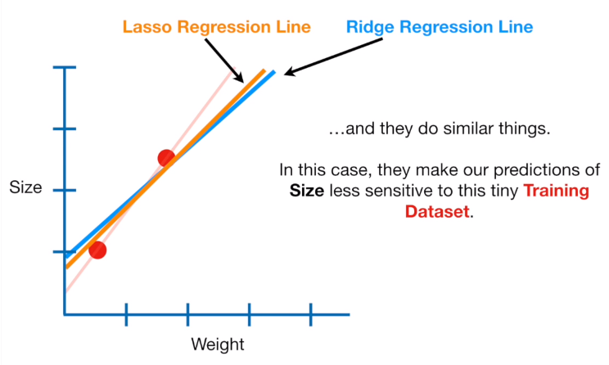

Regression models used
Lasso Regression
Ridge Regression
Polynomial Linear Regression
Linear Regression
(Least Absolute Shrinkage and Selection Operator)
Simplest and most well-known algorithm in statistics and machine learning
A model that assumes a linear relationship between input variables (x) and output variable (y)
Performs L1-Norm regularization (Adds a penalty equivalent to the absolute value of the magnitude of coefficients)
Goal is to minimize the prediction error for a quantitative response variable
Performs L2-Norm regularization (Adds a Penalty equivalent to the square of the magnitude of coefficients)
Goal is to shrink the coefficient for input variables that do not contribute much to the prediction error
Fits a polynomial function of the predictor variables to predict the response variable
Source: https://www.andreaperlato.com/theorypost/ridge-and-lasso-regression/
Notes:
Ridge and Lasso regression are powerful techniques generally used for creating parsimonious models in presence of a ‘large’ number of features. Here ‘large’ can typically mean either of two things:
Large enough to enhance the tendency of a model to overfit (as low as 10 variables might cause overfitting)
Large enough to cause computational challenges. With modern systems, this situation might arise in case of millions or billions of features
Though Ridge and Lasso might appear to work towards a common goal, the inherent properties and practical use cases differ substantially. If you’ve heard of them before, you must know that they work by penalizing the magnitude of coefficients of features along with minimizing the error between predicted and actual observations. These are called ‘regularization’ techniques. The key difference is in how they assign penalty to the coefficients:

Slide 12
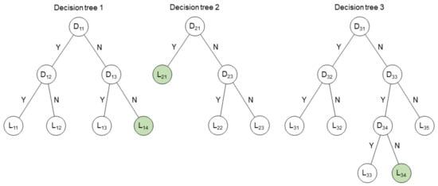
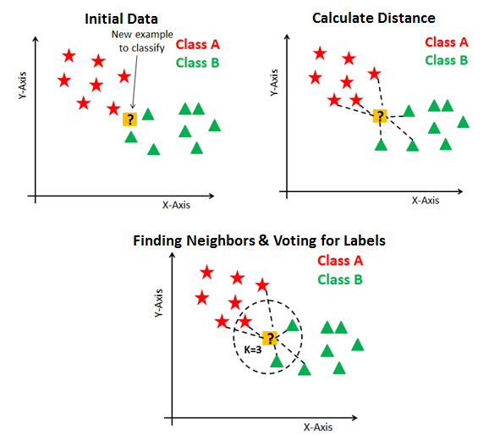
CLASSIFICATION models used
Multinomial Logistic Regression
Gradient Boosting Trees
K-Nearest Neighbors
Support Vector Machines
Used to predict probability of categorical dependent variables
Fits boosted decision trees by minimizing an error gradient.
Trees are added one at a time to an ensemble and fit to correct the prediction error in previous models.
Supervised learning model
Stores all available cases and classifies new cases based on a similarity measure
Effective in high-dimensional spaces
Memory Efficient
Capable of performing binary and multi-class classification
https://www.mdpi.com/2073-4441/12/6/1703/htm
Source: https://www.datacamp.com/community/tutorials/k-nearest-neighbor-classification-scikit-learn
Notes:
Gradient Boosting Overview
Gradient boosting refers to a class of ensemble machine learning algorithms that can be used for classification or regression predictive modeling problems.
Gradient boosting is also known as gradient tree boosting, stochastic gradient boosting (an extension), and gradient boosting machines, or GBM for short.
Ensembles are constructed from decision tree models. Trees are added one at a time to the ensemble and fit to correct the prediction errors made by prior models. This is a type of ensemble machine learning model referred to as boosting.
Models are fit using any arbitrary differentiable loss function and gradient descent optimization algorithm. This gives the technique its name, “gradient boosting,” as the loss gradient is minimized as the model is fit, much like a neural network.
Gradient boosting is an effective machine learning algorithm and is often the main, or one of the main, algorithms used to win machine learning competitions (like Kaggle) on tabular and similar structured datasets.
Note: We will not be going into the theory behind how the gradient boosting algorithm works in this tutorial.

Slide 13
Classification model accuracy per state
State | Deck Condition | Superstructure Condition | Substructure Condition
New York | 50.76% | 51.88% | 51.58%
Texas | 50.82% | 49.39% | 52.93%
California | 50.92% | 56.08% | 69.47%
Florida | 66.92% | 62.97% | 58.91%
Puerto Rico | 71.18% | 72.56% | 74.03%
Alaska | 50.86% | 50.44% | 48.29%
Illinois | 49.99% | 50.56% | 52.21%
Colorado | 59.44% | 61.53% | 46.94%
Hawaii | 68.56% | 70.80% | 72.94%

Slide 14
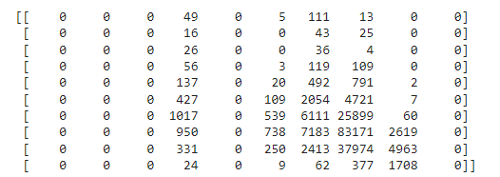
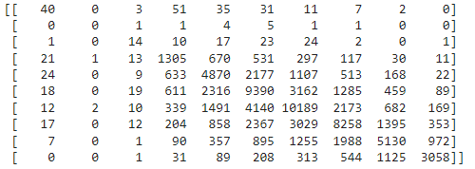
Model Accuracy: Confusion matrix
Texas Bridge Deck Confusion Matrix
The general predictions of the model were further assessed with a set of confusion matrices (Top left is 0 rating and Bottom right is 9 rating)
With slight differences depending on the state, only portions of the 0-9 rating scale are really utilized by the majority of bridges
Higher values on or near the diagonal terms of the confusion represent correct or near correct predictions. As can be seen in New York, most of the wrong evaluations are within 2 condition ratings of the correct one.
New York Superstructure Confusion Matrix

Slide 15
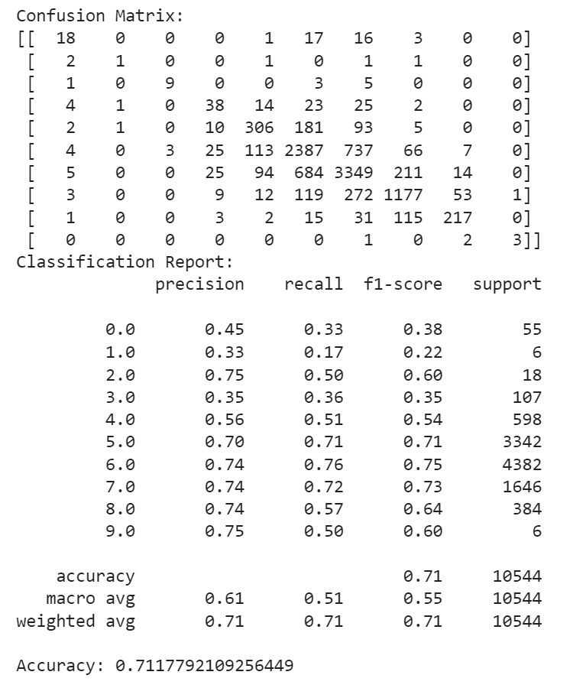
Model Accuracy: Classification report
Puerto Rico Deck Classification Report
The classification report outlines the specific effectiveness of the model in obtaining specific condition ratings.
Precision:#TP / (#TP + #FP)
Recall: #TP / (#TP + #FN)

Slide 16
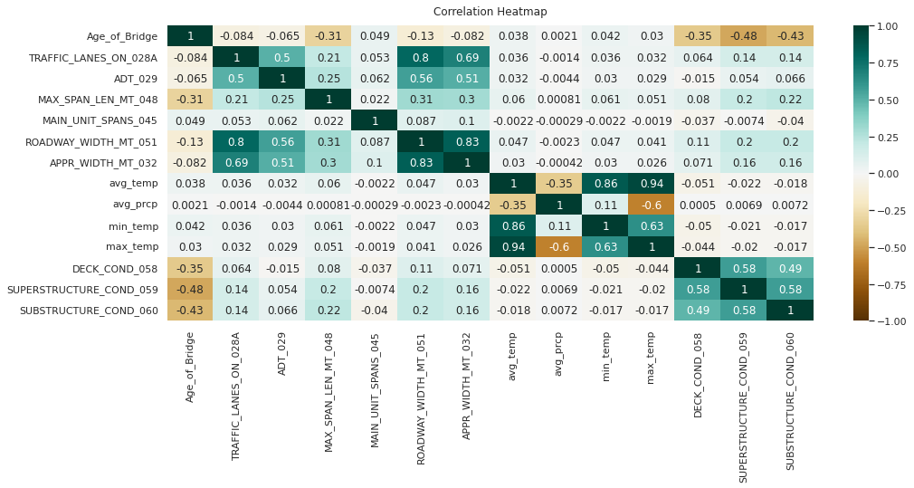
Correlation analysis
In this instance there exists a negative correlation between the Deck, Substructure, Superstructure Condition and the Age of Bridge
Sometimes parameters seem negligible in several instances
Correlation Heatmap for State of Texas

Slide 17
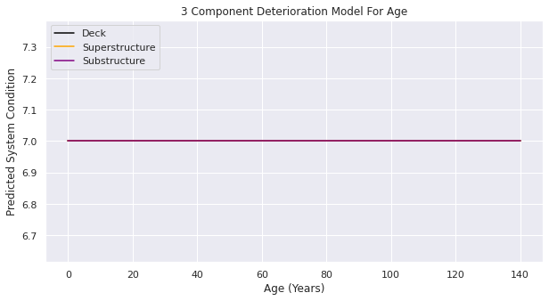
Model predictions
Hawaii
Classification models were tested to predict a state's average condition rating through variation in structure age, average daily traffic, temperature and precipitation
Due to the model being a classification model with most of the bridges in a state trending around the same condition rating, straight lines were prevalent in the results

Slide 18
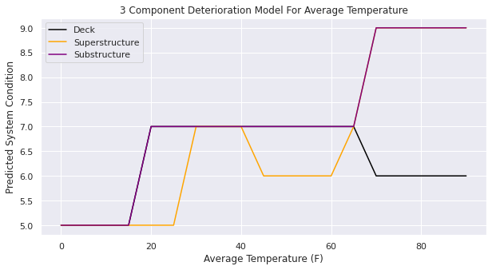
Model Predictions
In some cases, more favorable results were obtained
In this case, it could be assumed that bridges in colder temperatures would maintain lower condition ratings than in higher temperatures
Alaska

Slide 19
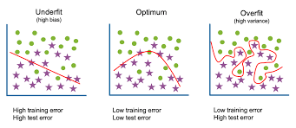
Problems associated and limitations
Inability to run multiple states
Large amounts of data
Memory Intensive Classifiers
Long Computational wait
Missing data
Overfitting
Time Frame between data gathering
https://www.researchgate.net/post/Impact_for_overfitting

Slide 20
Ways to improve and future work
Add more data
Add new features to decrease bias
Choose better and more important features in the model
Utilize more algorithms
Tune Algorithms with more parameters
Cross validate

Slide 21
Thank you!
Questions?

