Slide 1
Parallel Programming
Brief overview

Slide 2
MPI(Message Passing Interface)
MPI is a specification for the developers and users of message passing libraries.
Portability - There is no need to modify your source code when you port your application to a different platform that supports (and is compliant with) the MPI standard
In practice, MPI is a set of functions or subroutines used for exchanging data between processes.
MPI has around 6 basic functions, and around 440+ [in MPI-3] functions/routines in total.
Interface specifications have been defined for C/C++ and Fortran programs.

Slide 3
MPI Function/Subroutine
MPI_Init (): is the 1st function to call, initialize MPI variables. Creates MPI_COMM_WORLD communicator, which is list of all the connections among nodes.
MPI_Finilize(): This is the last function to call which cleans up any job left by MPI.
Example:
  #include "mpi.h“ // INCLUDE "mpif.h“ for fortran
  #include <stdio.h> // part of regular c program
  void main(argc, argv)
  {
  MPI_Init( &argc, &argv ); // Starts MPI
  ………….
  ………….
  MPI_Finalize(); // Ends MPI
  }

Slide 4
MPI Function/Subroutine (Contd.)
MPI_Comm_size( MPI_COMM_WORLD, nprocs, ierror) //ierror is not in C, but in fortran
- returns the number of nodes that the code is running on, as specified in the mpirun command (eg mpirun -np 8 myprog | tee output.txt)
MPI_Comm_rank ( MPI_COMM_WORLD, myproc, ierror): returns node number, range 0 to (np-1).
MPI_Send (...) and MPI_Recv(...): For sending and receiving messages.
MPI_Bcast (...) : broadcasts data from one node to all others. (Similar, MPI_Scatter)
MPI_Reduce (...): Reverse of broadcast, all processors send to a single processor (similar, MPI_Gather).
MPI_Barrier (MPI_COMM_WORLD, ierror): force synchronization.

Slide 5
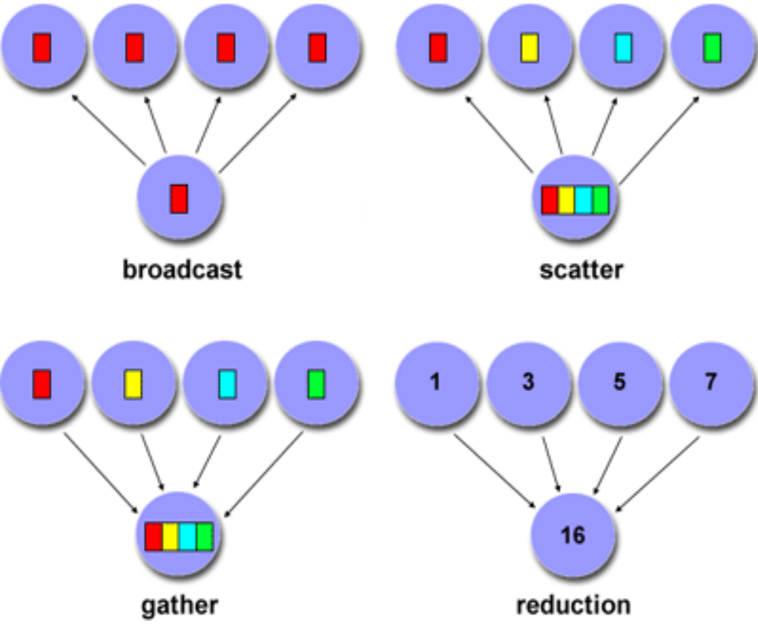
Bcast, Scatter, Gather, Reduction

Slide 6
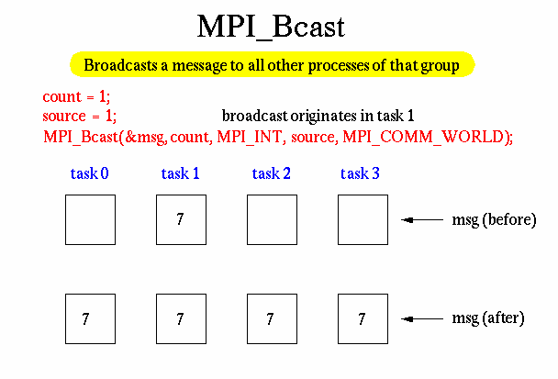

Slide 7
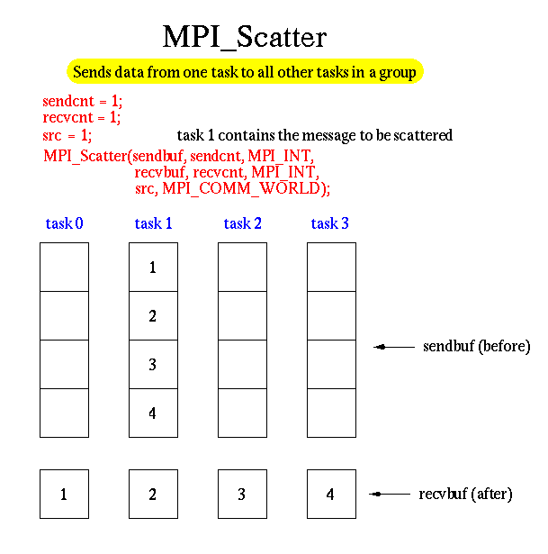

Slide 8
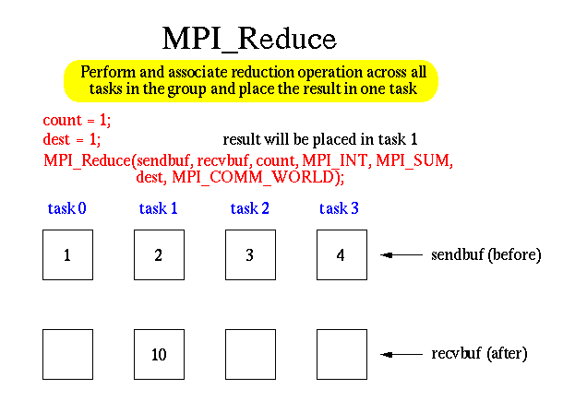

Slide 9
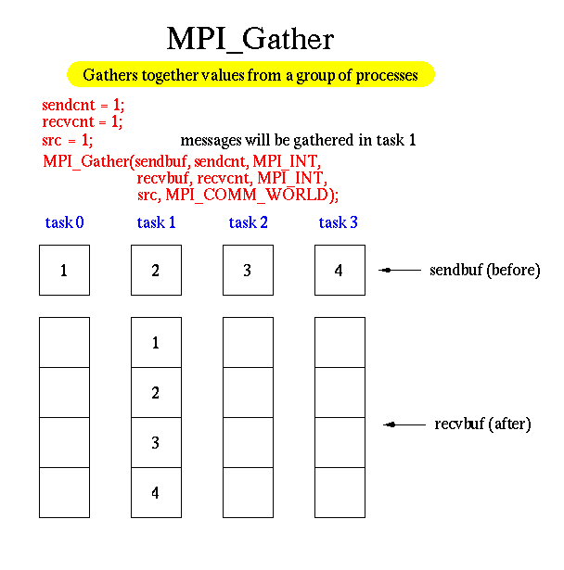

Slide 10
MPI Data Type
Be familiar with MPI data type. Example:
MPI_CHAR
MPI_BYTE
MPI_SHORT
MPI_INT
….. <more>
Compiling …
mpicc -o hello_world hello-world.c
Or, mpicc -o hello_world hello-world.c –lm // to link math library
–mpicc //c
–mpif90 //fotran 90
–mpiCC // C++
–mpif77 //fortran 77
Running…
mpirun -np 8 hello_world

Slide 11
Internet Resources
There are many sites, few are mentioned here:
For MPI:
https://computing.llnl.gov/tutorials/mpi/
http://www.mcs.anl.gov/research/projects/mpi/tutorial/gropp/talk.html
And http://www.mcs.anl.gov/research/projects/mpi/tutorial/
For Pthreads or, POSIX Thread:
https://computing.llnl.gov/tutorials/pthreads/
http://www.yolinux.com/TUTORIALS/LinuxTutorialPosixThreads.html
+ example(s) in the text book.

Slide 12
Example: mpi_hello.c
#include <mpi.h>
#include <stdio.h>
#include <math.h>
int main (int argc, char* argv[])
{
int rank, size, i, j;
MPI_Init (&argc, &argv); /* Initialization step to start MPI */
MPI_Comm_rank (MPI_COMM_WORLD, &rank); /* get the id of the current process */
MPI_Comm_size (MPI_COMM_WORLD, &size); /* get the number of processes involved */
srand((int)time(NULL)); /* calling random number(RN) */
int r = rand() % 20000;
double y = r* sin((size-rank+1)*r); /* using sin to vary RN arbitrarily */
r = abs(y);
for (i=0; i<=r; i++) /* To make random delay */
{
j=i*i*i;
}
printf( "Hello world from process %d of %d\n", rank, size);
MPI_Finalize(); /* Terminates MPI execution environment */
return 0;
}

