Slide 1
Cats and Dogs Audio VAE
Mengxiang Jiang

Slide 2
Problem Statement
Given audio of dogs and cats, generate more audio of dogs and cats
Solution: Process the audio data into the frequency domain using a Fourier transform and then use the data to train a variational autoencoder (VAE)

Slide 3
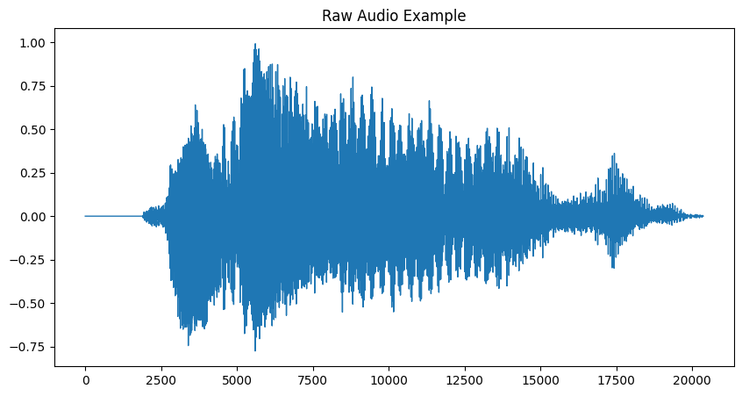
Time Domain

Slide 4
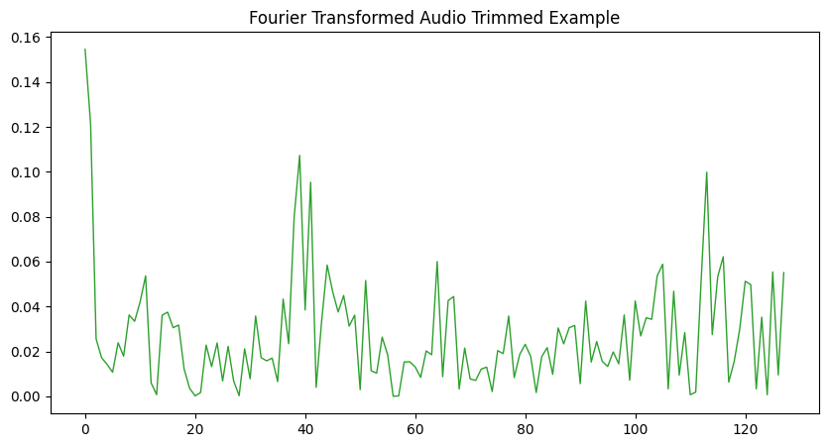
Frequency Domain

Slide 5
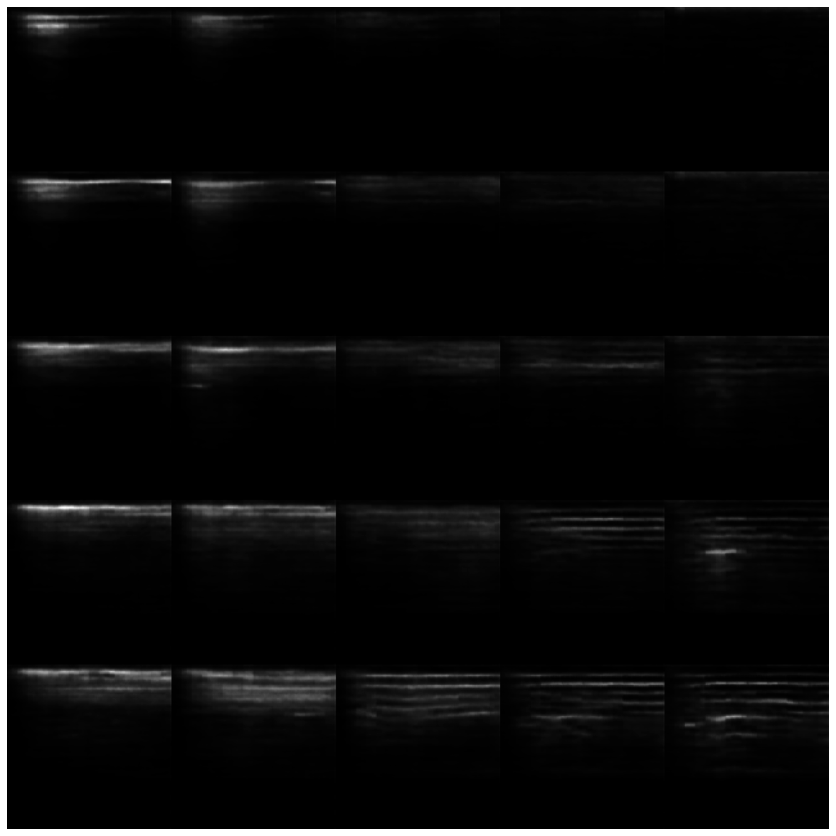
Results

Slide 6
Demo
To generate a random cat/dog sound, pick a pair of random floats between -1.0 and 1.0, feed it into the decoder and you get a frequency domain signal back. Use the inverse Fourier transform to convert it back to time domain and then you can play the sound.

