Slide 1


Slide 2
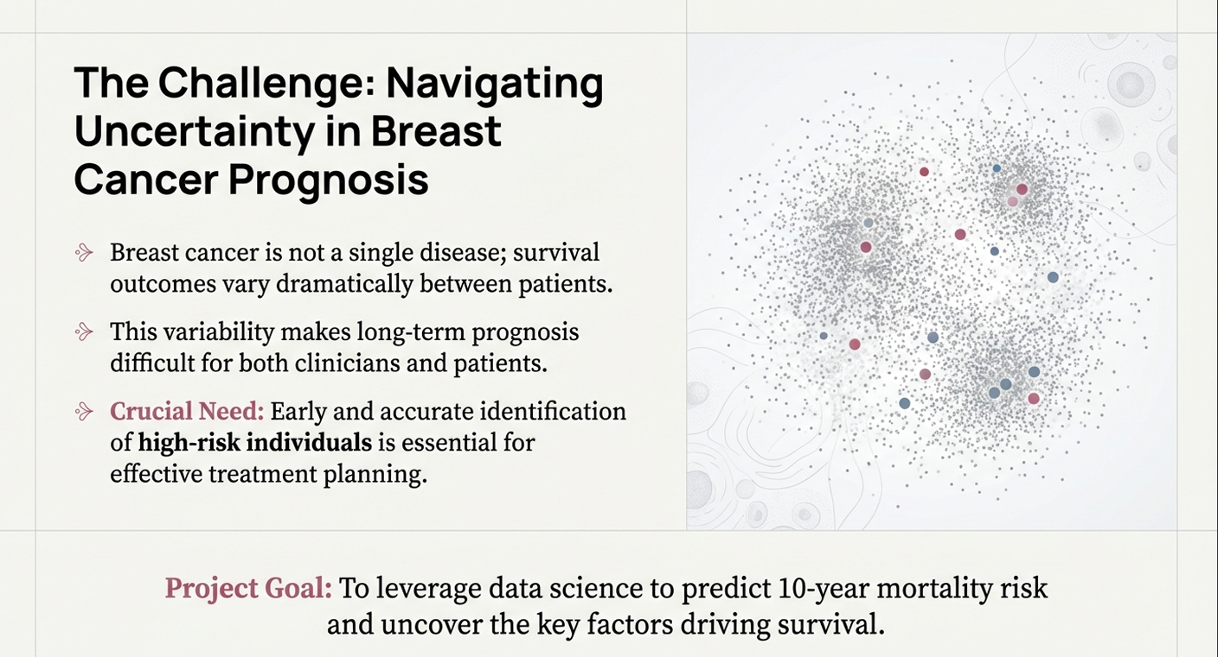

Slide 3
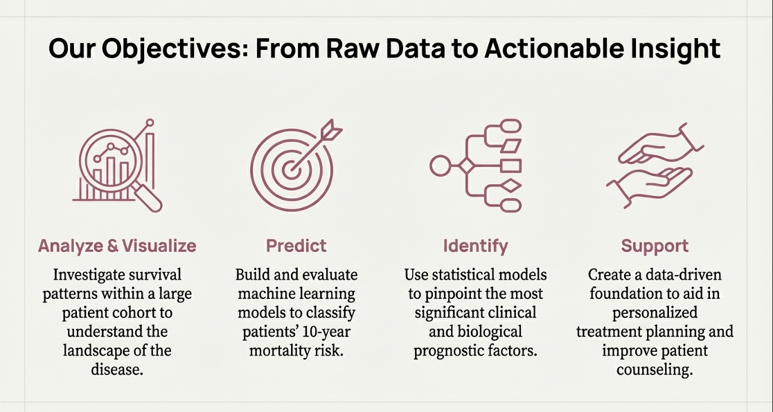

Slide 4
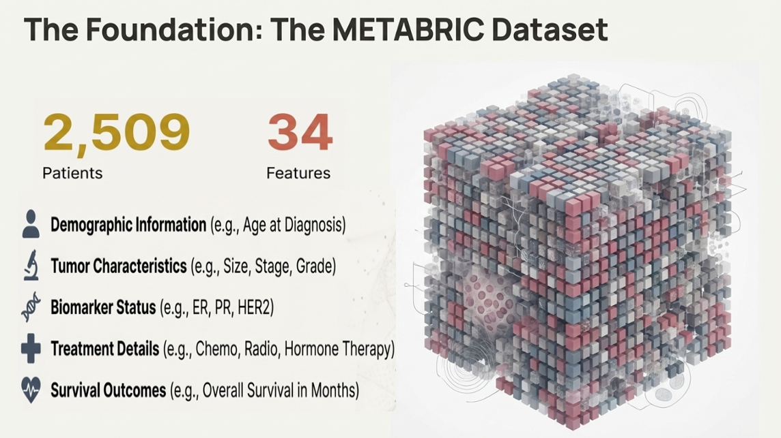

Slide 5
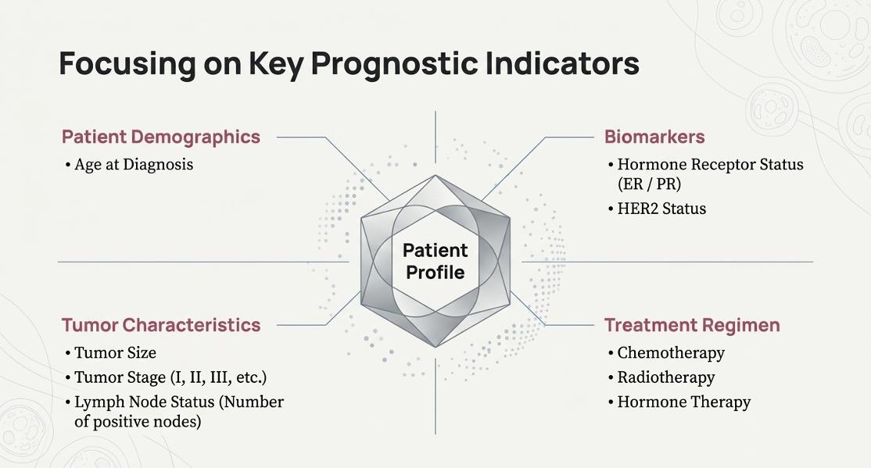

Slide 6
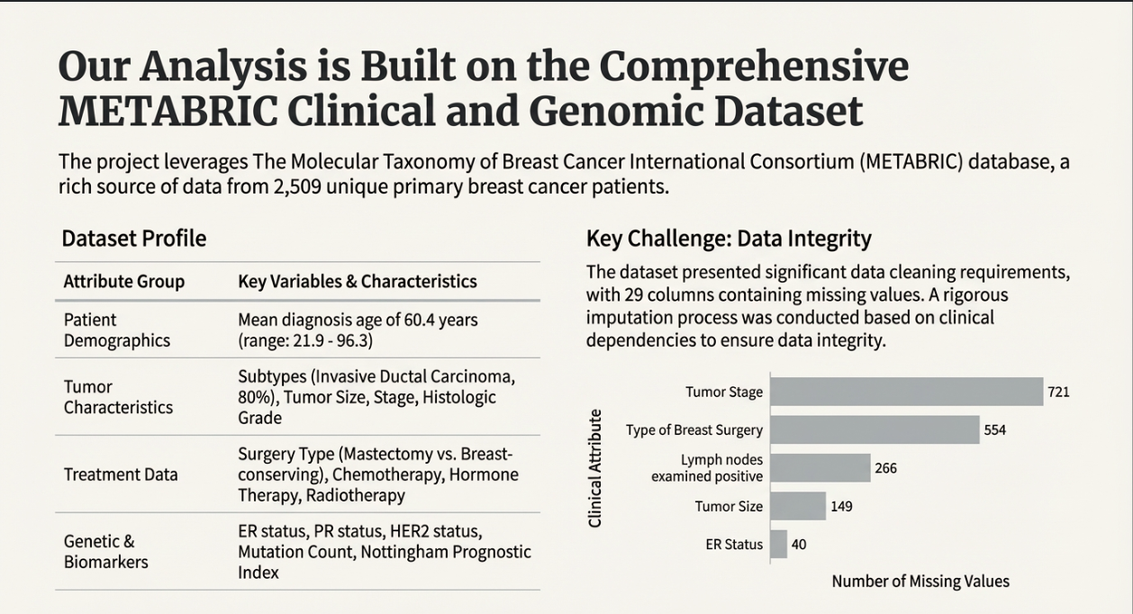

Slide 7
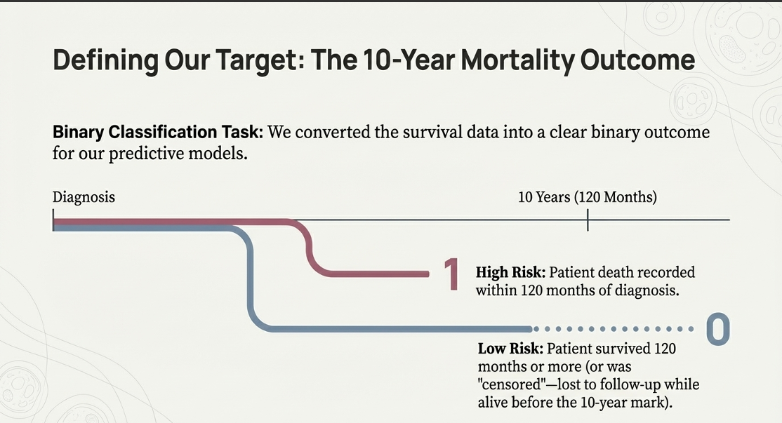

Slide 8
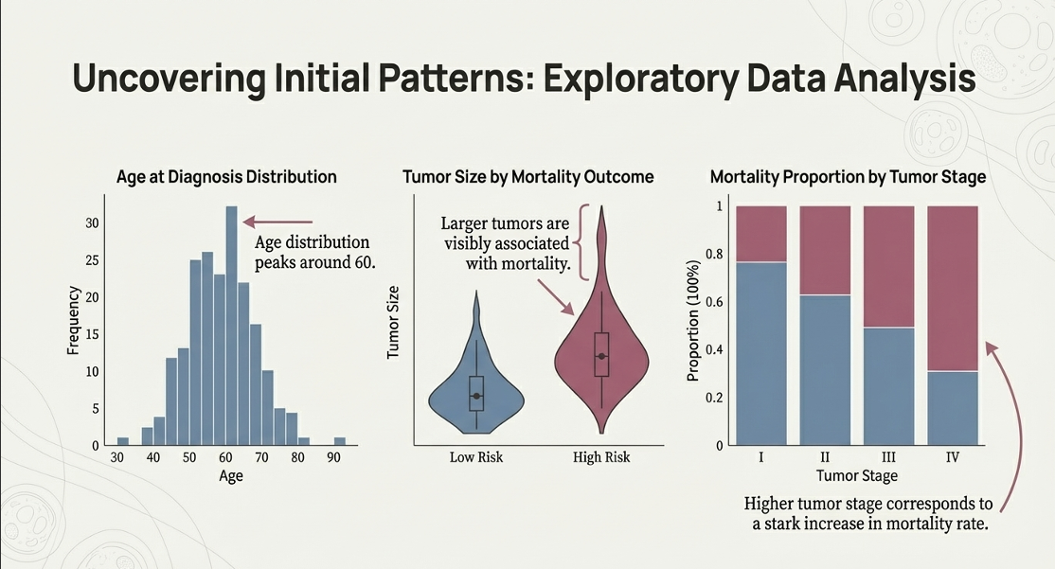

Slide 9
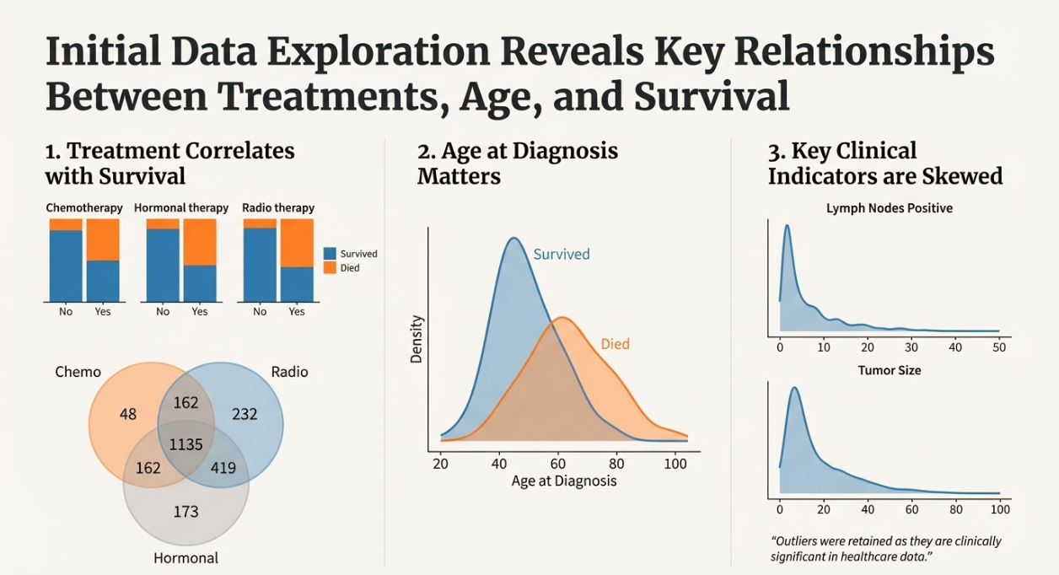

Slide 10
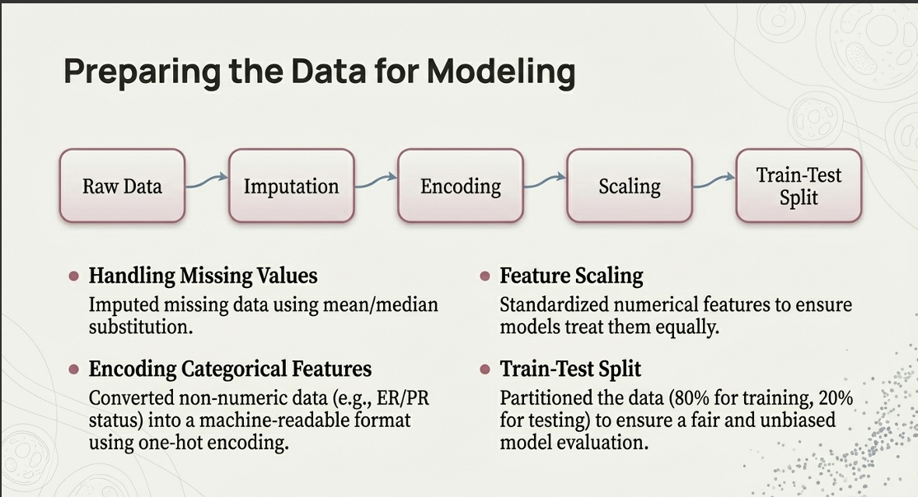

Slide 11


Slide 12


Slide 13
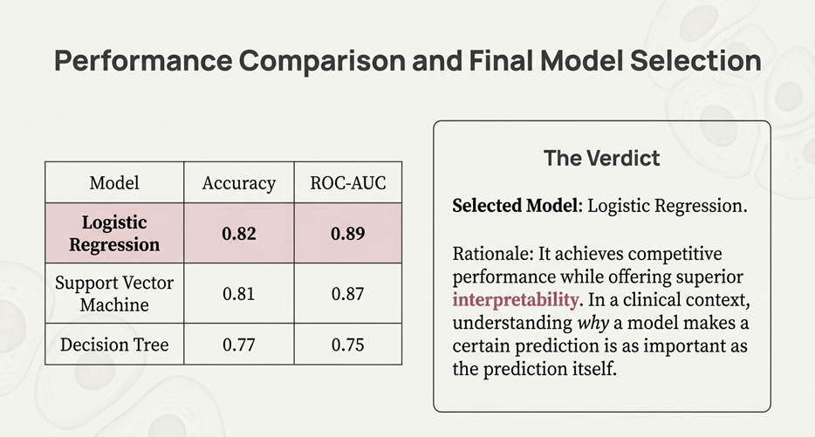
0.95
0.99
0.95
0.98
0.95
0.97

Slide 14
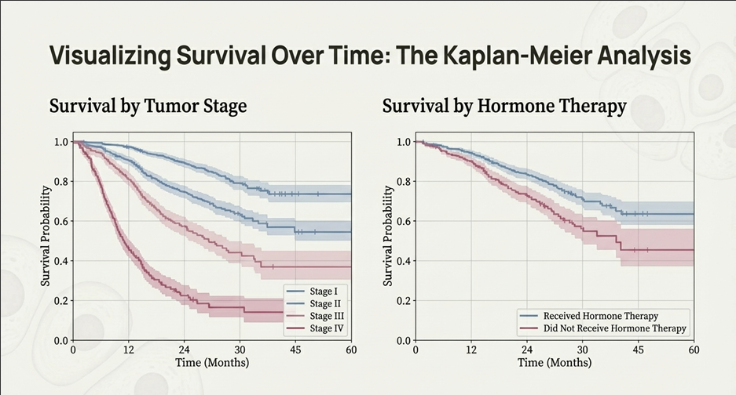

Slide 15
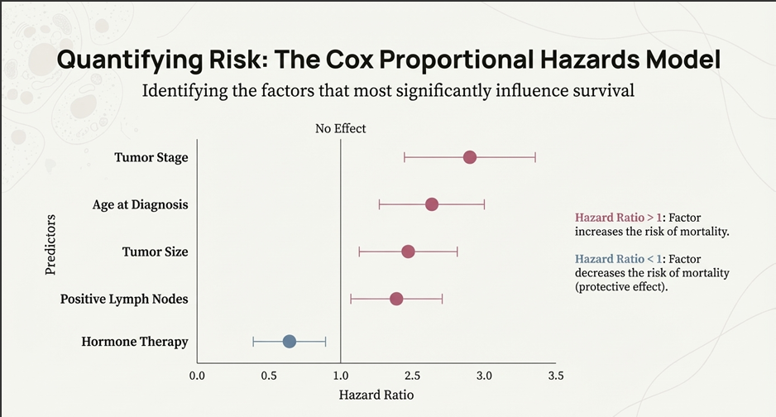

Slide 16


Slide 17
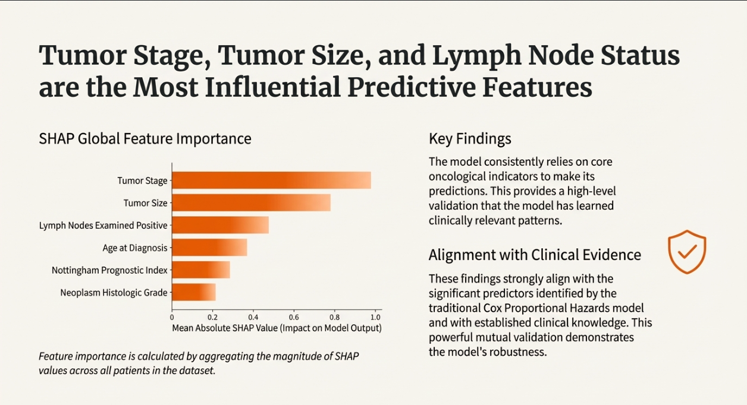

Slide 18
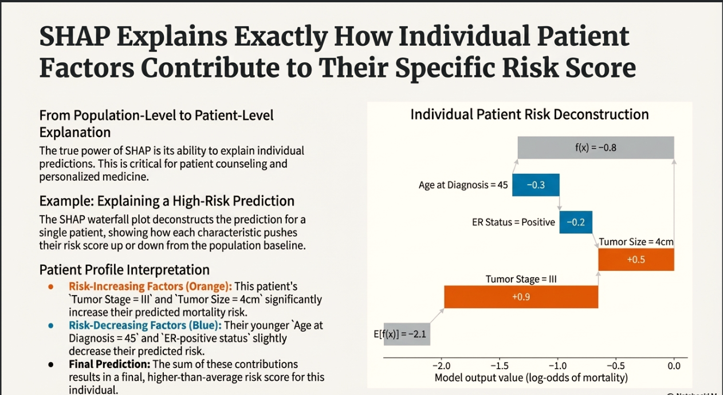

Slide 19


Slide 20
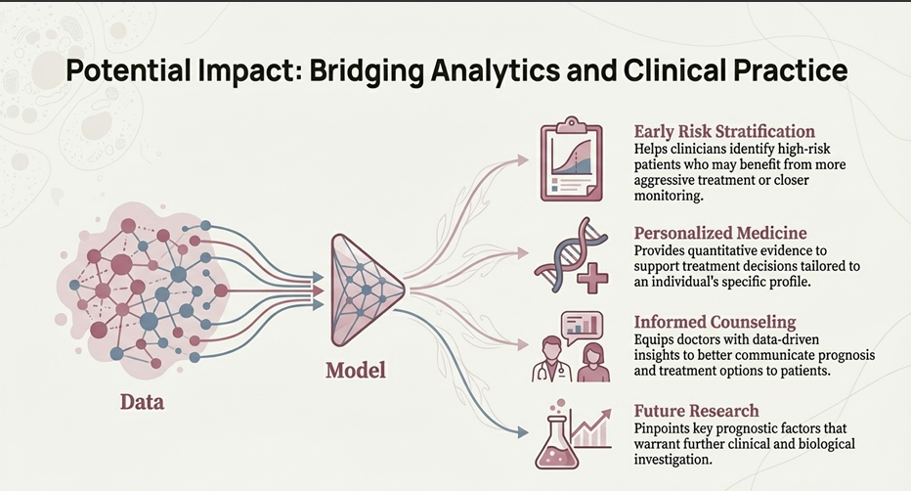

Slide 21
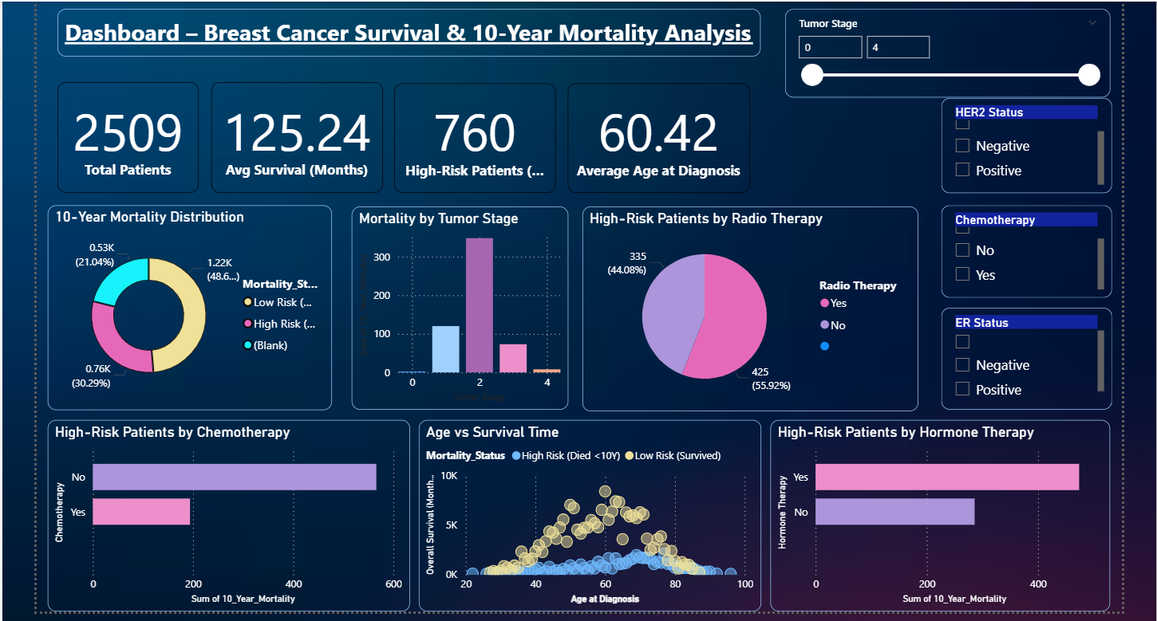
Power BI Dashboard
This Power BI dashboard provides an interactive view of breast cancer survival and 10-year mortality risk, highlighting key clinical and treatment factors influencing patient outcomes.

Slide 22
Thank You!
Questions & Discussion?

