Slide 1



DriveCast
Presented By: Kumkum K
GitHub Repo: Link

Slide 2

Learning Objectives
Develop machine learning models to accurately predict EV energy consumption based on real-world driving and environmental factors.
Perform comprehensive data preprocessing and exploratory data analysis to understand key variables influencing EV energy usage.
Apply and evaluate multiple regression algorithms and select the optimal model using advanced hyperparameter tuning with Optuna.
Build an interactive What-If Analysis tool that simulates different driving conditions and demonstrates the practical applicability of ML predictions.
Deploy the final trained model through a user-friendly Gradio interface for real-time EV energy forecasting and scenario simulation.
GOAL

Slide 3
Tools and Technology used
1. Programming Language
Python – Core language for data processing, modelling, and simulation.
2. Data Handling & Analysis
Pandas – Data cleaning, preprocessing, and manipulation
NumPy – Numerical computations and feature preparation
3. Machine Learning & Modelling
Scikit-Learn – Regression models, preprocessing pipelines, evaluation metrics
XGBoost / Random Forest – Advanced ML algorithms used for energy prediction
Optuna – Automated hyperparameter tuning for selecting the best model
4. Visualization Tools
Matplotlib – Line charts, scatter plots, trend visuals
Seaborn – Heatmaps and statistical visualizations
5. Deployment & User Interaction
Gradio – Interactive UI for What-If Analysis and real-time energy prediction
6. Development Environment
Google Colab – Experimentation, model training, documentation
7. Version Control
GitHub – Code management and project hosting

Slide 4
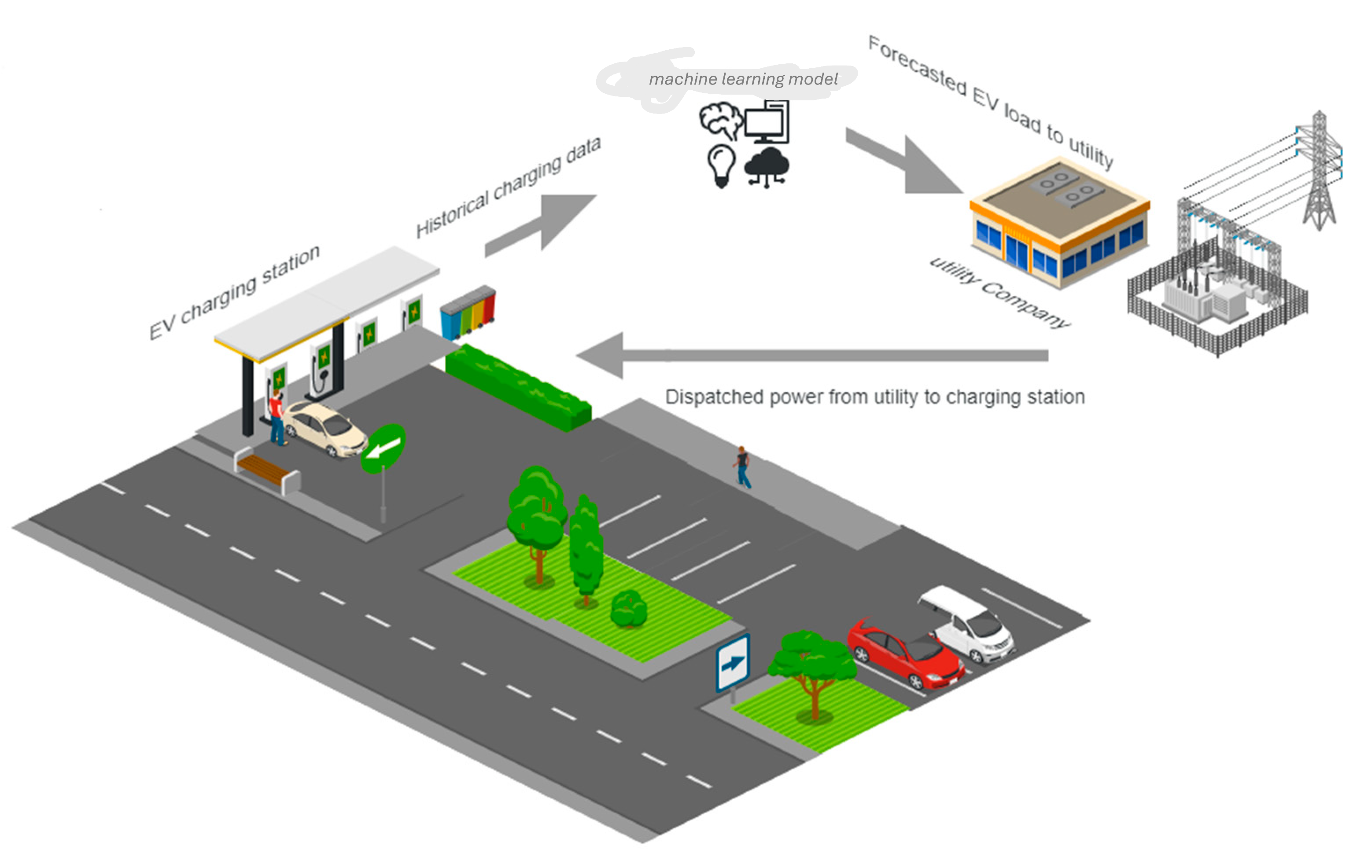
Methodology
1. Data Collection & Understanding
Loaded EV Energy Consumption dataset (5,000+ records, 19 features).
Studied key variables: speed, distance, temperature, terrain, load, wind speed, etc.
2. Data Preprocessing
Handled missing values, duplicates, and outliers.
Encoded categorical features and scaled numerical data.
Split dataset into training and testing sets.
3. Exploratory Data Analysis (EDA)
Visualized feature distributions and correlations.
Identified factors most influencing energy consumption.
Derived insights for model selection and tuning.

Slide 5
4. Model Development
Trained multiple regression models (Elastic Net, Random Forest, KNN, XGBoost, Support Vector).
Evaluated using RMSE, and R² score.
5. Hyperparameter Optimization
Used Optuna to tune model parameters.
Selected the best-performing model based on test R² and error metrics.
6. What-If Scenario Simulation
Built a Gradio-based interface to input driving conditions (speed, weight, terrain, temperature).
Model predicts energy consumption under custom conditions.
7. Deployment & Evaluation
Integrated final ML model into user-friendly Gradio UI.
Validated predictions by comparing actual vs predicted values.

Slide 6
Problem Statement:
⚡ Rising EV Adoption, Uncertain Energy Needs
With the rapid shift toward electric mobility, EV users still struggle with inaccurate range predictions and unpredictable energy consumption due to varying driving behaviors, weather conditions, and terrain.
🚗 Key Challenges Faced by Stakeholders
EV Owners: Experience range anxiety and difficulty planning long trips.
Fleet Managers: Cannot accurately estimate energy usage, increasing operational costs.
EV Manufacturers: Lack tools to analyze how real-world conditions affect battery performance.
Charging Infrastructure Providers: Struggle to predict charging demand at different locations and times.
🌍 Sustainability Impact
Inefficient predictions lead to:
Overcharging and unnecessary energy waste
Poor route planning and higher grid load
Reduced battery lifespan due to inefficient usage patterns

Slide 7
Solution:
🔍 AI-Powered EV Energy Forecasting System
A machine learning–driven solution that predicts EV energy consumption using factors like speed, distance, weight, weather, road type, and driving style.
💡 Key Features
Accurate Energy Forecasting using optimized ML models
What-If Analysis to simulate different real-world driving scenarios
Insights for Sustainable Driving (reduces energy waste and promotes green mobility)
🌱 Green Skills Contribution
Promotes energy-efficient driving
Enables data-driven sustainability decisions
Supports greener transportation systems using AI technology

Slide 8
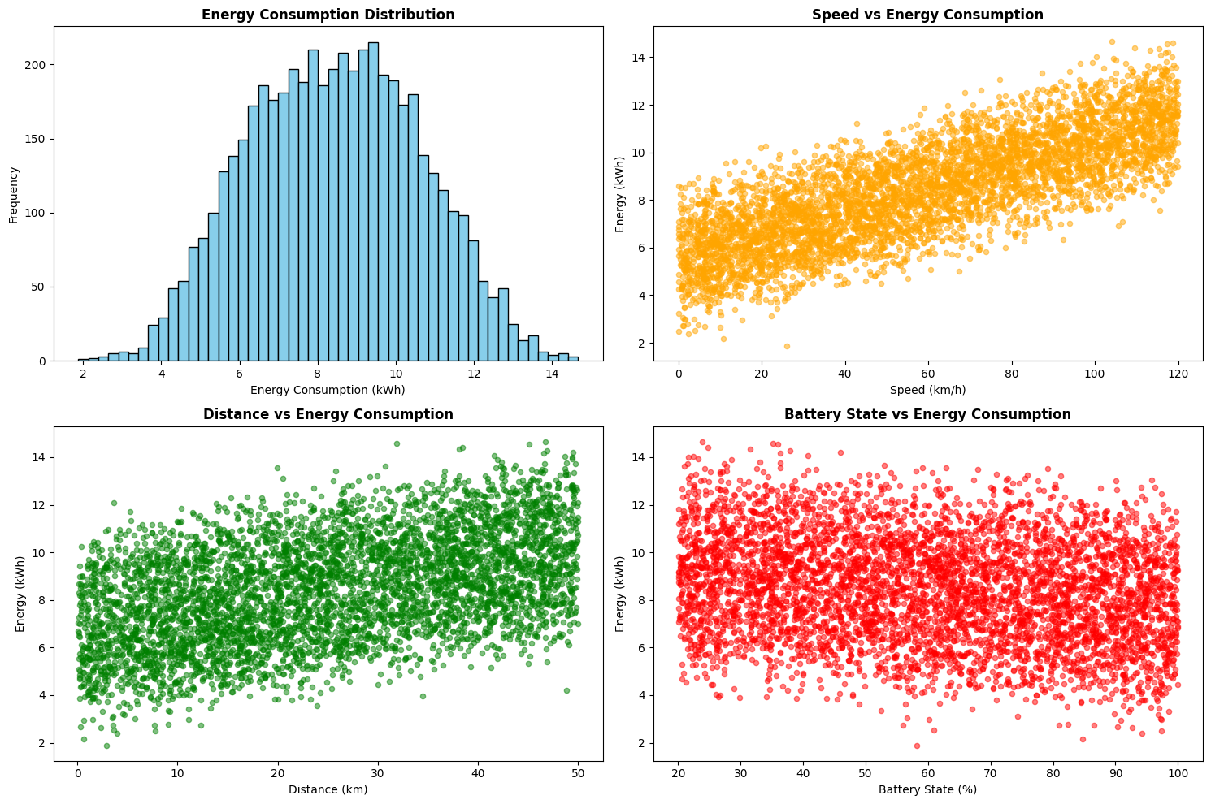
Screenshot of Output:
Exploratory Data Analysis

Slide 9
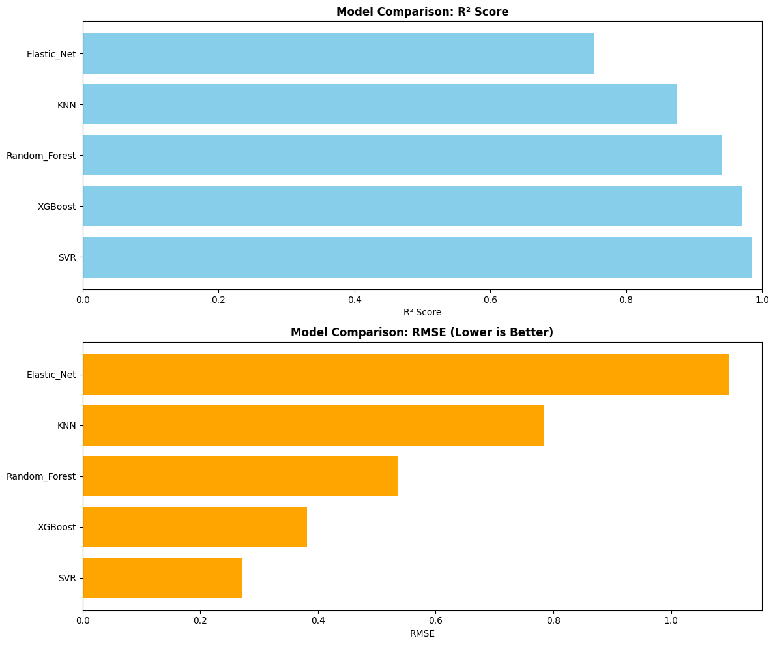
Model Comparison Visualisation

Slide 10
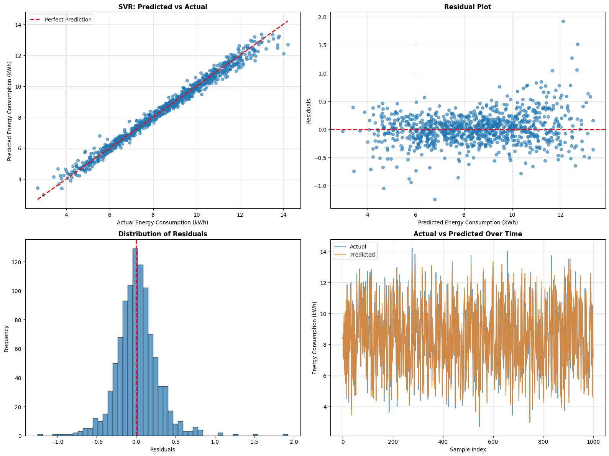
Best Model Actual Vs Predicted EV

Slide 11
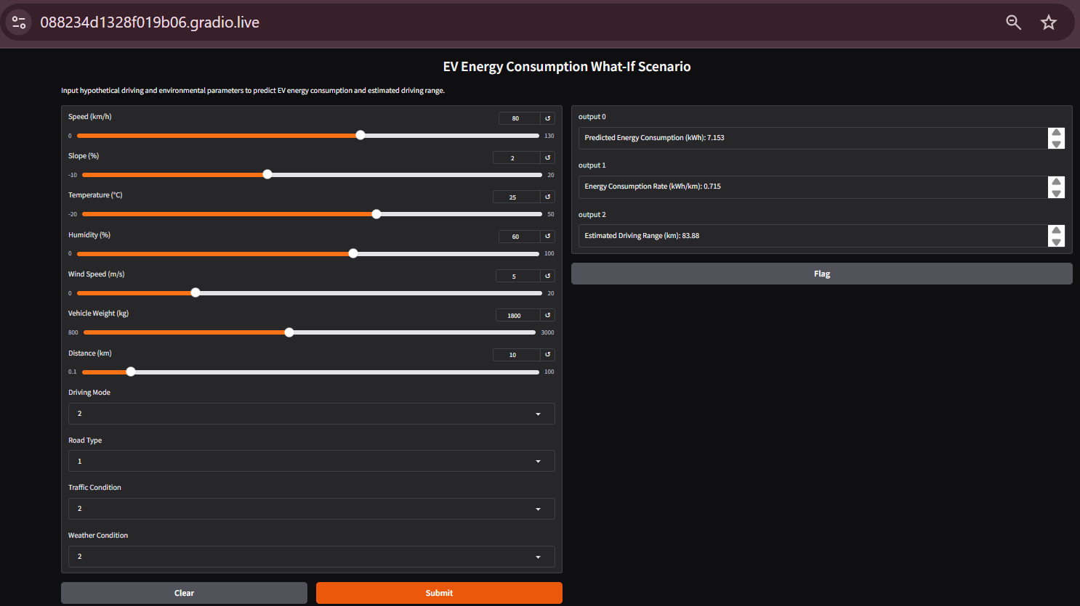
Interactive What-If Scenario

Slide 12
Conclusion:
This project delivers an AI-driven EV Energy Forecasting system that provides accurate and reliable predictions of energy consumption under real-world driving conditions.
By enabling users to explore different scenarios through the What-If Analysis tool, the system enhances decision-making for sustainable and cost-efficient EV usage.
The solution directly benefits key stakeholders:
EV Owners: Better trip planning, reduced range anxiety
Fleet Operators: Optimized routes and significantly lower operational energy costs
Manufacturers & Researchers: Deeper insights into battery performance for designing more efficient EVs
Charging Stations & Smart City Planners: Improved forecasting of charging demand, reducing grid stress
Environment & Society: Lower energy consumption, enhanced EV efficiency, and reduced carbon footprint
Overall, this project showcases how AI and green skills can drive sustainable mobility, support energy-efficient transportation systems, and contribute to a cleaner future.

