Slide 1
COMPLETE EXPLORATORY DATA ANALYSIS
Chronic Kidney
Disease Analysis
400
25
19+
4
Patient Records
Clinical Features
Visualizations
Analysis Layers
Tools: Python | Pandas | NumPy | Matplotlib | Seaborn | Plotly | Scikit-learn

Slide 2
CKD EDA | Dataset Overview
2 / 17
About the Dataset
400 patient records, 25 clinical features, 2 target classes
400
25
15
9
Patient Records
Clinical Features
Numerical Features
Categorical Features
Numerical features
Age, Blood Pressure, Blood Glucose, Blood Urea, Serum Creatinine, Hemoglobin, Sodium, Potassium, Packed Cell Volume, WBC Count, RBC Count…
Categorical features
RBC, Pus Cell, Pus Cell Clumps, Bacteria, Hypertension, Diabetes Mellitus, Coronary Artery Disease, Appetite, Pedal Edema, Anemia
Target variable
Classification — CKD (1) or Not CKD (0). Imbalanced: ~60% CKD, ~40% Non-CKD
HR relevance
Real-world clinical dataset — demonstrates ability to handle messy healthcare data, impute missing values, and derive medical insights

Slide 3
SECTION 1
Univariate
Analysis
Studying one feature at a time — distributions, frequencies & outliers
3 / 17

Slide 4
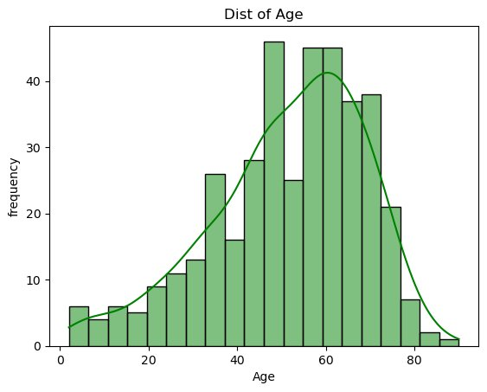
CKD EDA | Univariate — Age Distribution
4 / 17
Age Distribution
Left-skewed — majority of patients aged 40–70
Peak frequency at 48–60 years
Very few CKD patients below age 15
Older age = higher CKD risk
KDE curve confirms bell-shaped skew

Slide 5
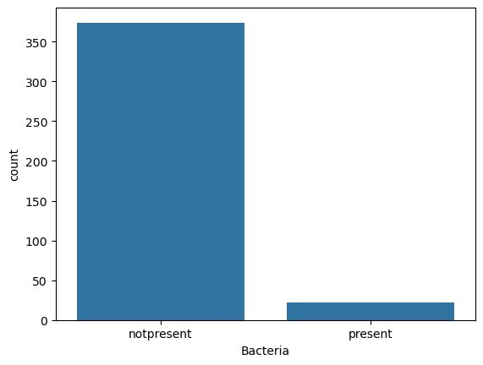
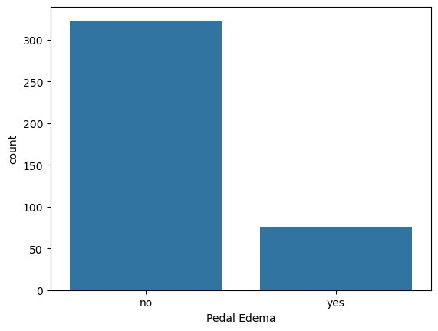
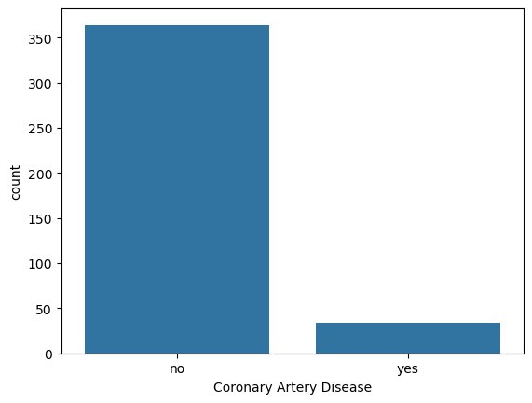
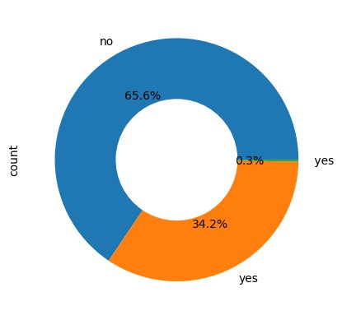
CKD EDA | Univariate — Categorical Features Overview
5 / 17
Bacteria
Pedal Edema
Coronary Artery Disease
Diabetes Mellitus
Insight: 92% no bacteria • 80% no pedal edema • 91% no CAD • 34.2% have Diabetes Mellitus (key CKD comorbidity)

Slide 6
SECTION 2
Bivariate
Analysis
Examining relationships between two features — and how they relate to CKD
6 / 17

Slide 7
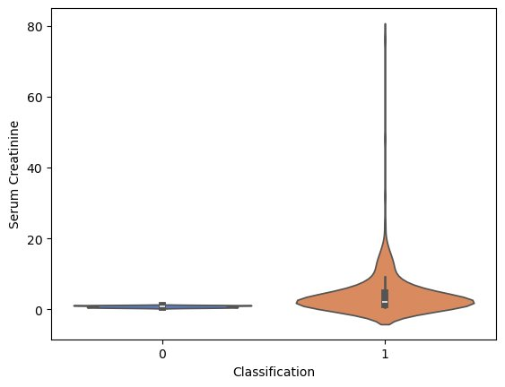
CKD EDA | Bivariate — Blood Urea vs CKD Classification
7 / 17
Blood Urea vs CKD
CKD patients (Class 1) have significantly higher Blood Urea
Median is 2× higher in CKD vs Non-CKD
Multiple extreme outliers (up to 400 mg/dL) in CKD
Normal range: 7–20 mg/dL — CKD far exceeds this
Strong clinical biomarker for disease severity
HR note: shows ability to interpret medical thresholds

Slide 8
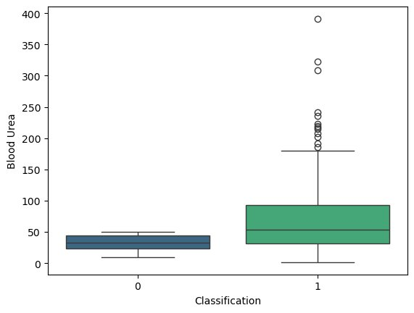
CKD EDA | Bivariate — Serum Creatinine vs CKD Classification
8 / 17
Serum Creatinine vs CKD
CKD patients show extremely wide spread (up to 80 mg/dL)
Non-CKD tightly clustered at 0–2 mg/dL
Violin shows heavy right-skew in CKD class
This is the #1 visual separator between classes
Normal: 0.6–1.2 mg/dL — CKD drastically exceeds this
Violin plot chosen to show full data density shape

Slide 9
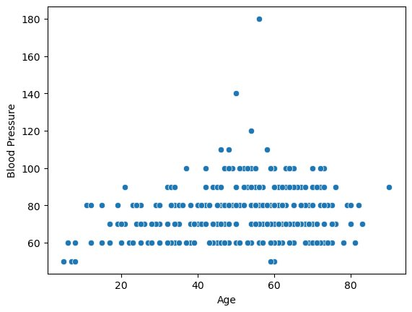
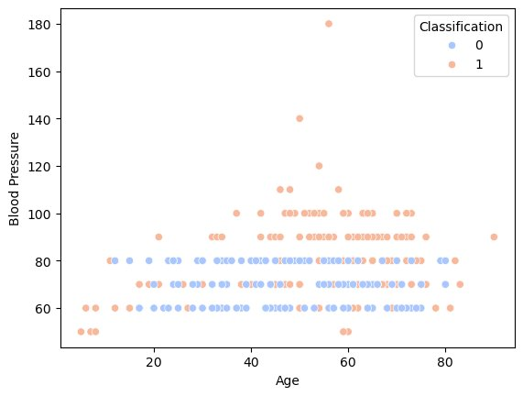
CKD EDA | Bivariate — Age vs Blood Pressure (with & without CKD label)
9 / 17
Without Classification
Coloured by CKD Class
Key Insight: Blood pressure is similar across CKD and Non-CKD patients (60–100 mmHg range). CKD class (orange) shows more scatter at all ages. Blood pressure alone is NOT a reliable CKD predictor — but combined with Serum Creatinine and Blood Urea it strengthens diagnosis.

Slide 10
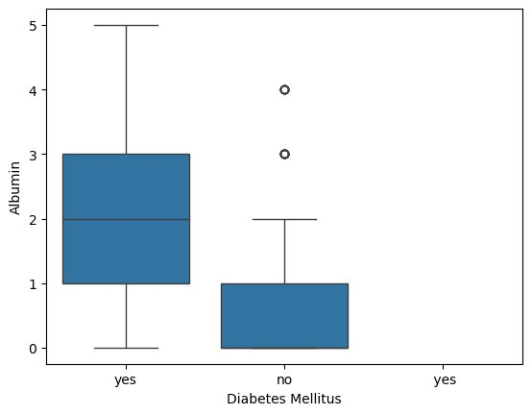
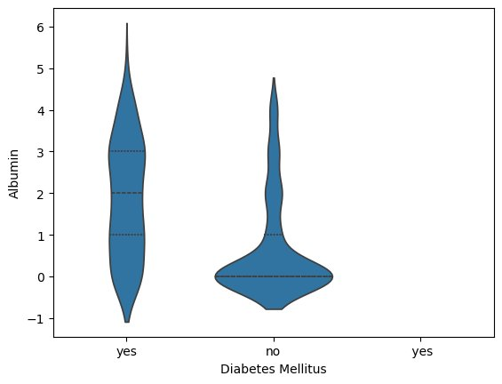
CKD EDA | Bivariate — Albumin Levels by Diabetes Mellitus Status
10 / 17
Boxplot
Violin Plot
Key Insight: Diabetic patients show significantly higher Albumin (median ~2) vs non-diabetics (near 0). High albumin in urine (albuminuria) is a hallmark of kidney damage. This strongly links Diabetes Mellitus to CKD progression — confirmed by medical literature.

Slide 11
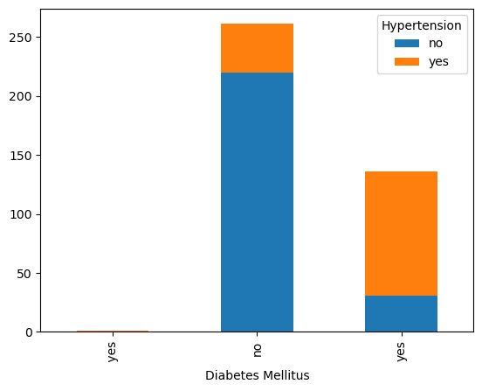
CKD EDA | Bivariate — Diabetes Mellitus vs Hypertension (Comorbidity)
11 / 17
Diabetes × Hypertension
Non-diabetics (no): large group, mostly no hypertension
Diabetics (yes): ~30 with no HTN, ~110 with HTN
Hypertension rate is 4× higher in diabetics
This comorbidity cluster is a major CKD accelerator
Cross-tab analysis (pd.crosstab) used — shows SQL-like thinking
HR note: real-world comorbidity pattern — clinically validated

Slide 12
SECTION 3
Multivariate
Analysis
Examining 3+ features together — correlation, pairplots & 3D scatter
12 / 17

Slide 13
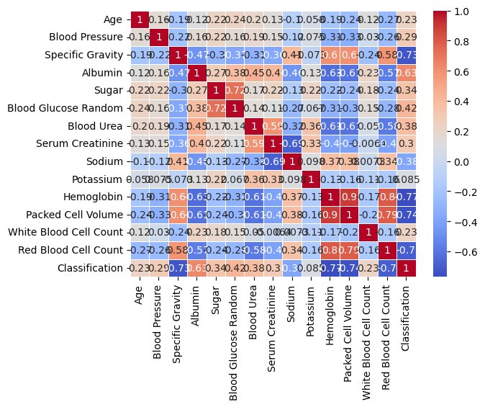
CKD EDA | Multivariate — Correlation Heatmap (All Features)
13 / 17
Correlation Heatmap
Hemoglobin & Packed Cell Volume: r = 0.9 (strongest positive)
Serum Creatinine negatively correlated with Hemoglobin (r ≈ −0.6)
Specific Gravity strongly tied to Classification
Sodium and Potassium show expected kidney-regulation patterns
Heatmap reveals 6 feature clusters for ML feature selection
HR note: demonstrates statistical thinking for model building

Slide 14
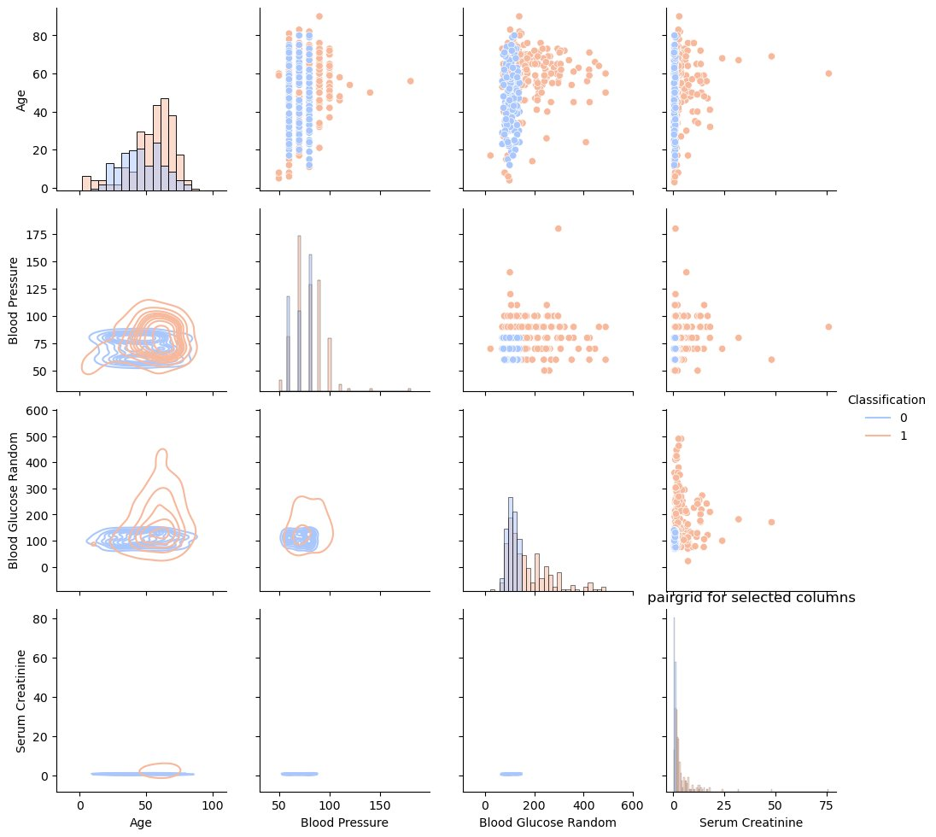
CKD EDA | Multivariate — Pairplot: Age, BP, Blood Glucose, Serum Creatinine
14 / 17
Pairplot Insights
Pink = Non-CKD (0), Teal = CKD (1)
CKD patients (teal) are older and more spread in Age
Blood Pressure shows no clean CKD separation (as seen in slide 9)
Blood Glucose is higher and more variable in CKD group
Serum Creatinine: near-zero for Non-CKD vs wide spread for CKD
Diagonal shows KDE — confirms skewness findings from slide 4

Slide 15
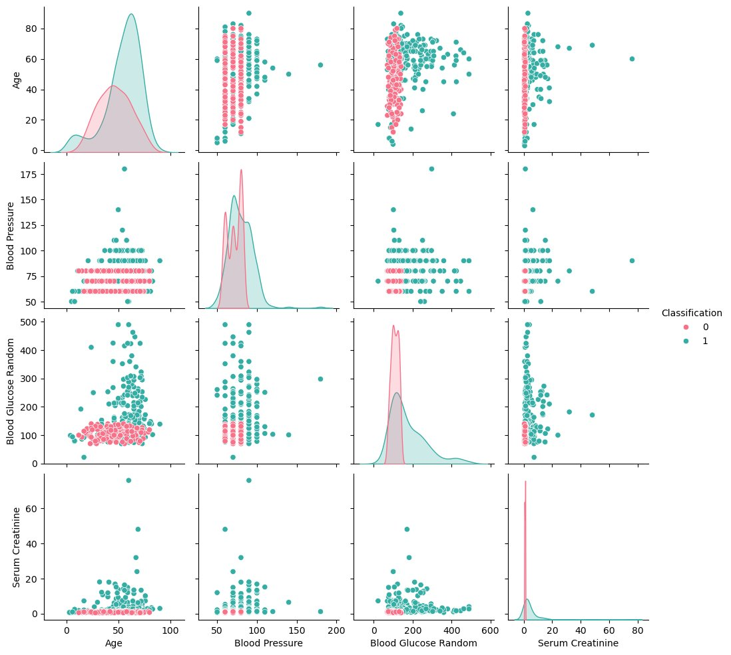
CKD EDA | Multivariate — Custom PairGrid (Scatter + KDE + Histogram)
15 / 17
PairGrid Analysis
Upper triangle: scatter — shows raw data spread
Lower triangle: KDE contour — shows density clusters
Diagonal: histogram — distribution per feature
Blue = Non-CKD, Orange = CKD
KDE contours confirm CKD patients cluster at higher Blood Glucose ranges
Serum Creatinine (row 4): CKD is flat near 0 — no variation in Non-CKD

Slide 16
CKD EDA | Key Takeaways — All Analysis Layers
16 / 17
Key Takeaways
Top Biomarkers Identified
Comorbidities Confirmed
Feature Engineering Decisions
01
Serum Creatinine, Blood Urea & Hemoglobin are the strongest separators. Correlation heatmap confirms these with r > 0.7 to Classification.
02
Diabetes + Hypertension co-occurrence is 4× higher than expected. CKD is a multi-system disease — data proves it.
03
Multivariate analysis reveals 6 feature clusters — ideal for PCA or feature selection before ML modelling.
Data Quality Skills Demonstrated
Visualisation Depth
HR Impact Statement
04
Handled mixed-type columns (pd.to_numeric), fixed dirty labels (Diabetes Mellitus), imputed nulls with median/mode — production-ready cleaning.
05
10+ chart types used: histogram, boxplot, violin, heatmap, pairplot, PairGrid, stacked bar, scatter, pie, donut — shows Seaborn + Plotly mastery.
06
This project demonstrates end-to-end EDA on real healthcare data: cleaning → univariate → bivariate → multivariate → insight → ready for ML.

Slide 17
Thanks for Swiping!
What I demonstrated in this project:
Data cleaning on real-world messy clinical data
Univariate, bivariate & multivariate EDA
Medical domain insight extraction
10+ chart types across Matplotlib, Seaborn & Plotly
Feature correlation analysis for ML readiness
Open to Data Analyst / Data Science roles • Let's connect! • GitHub: [your-link]
Built with Python | Pandas | Seaborn | Matplotlib | Plotly

