Slide 1


MediVision AI
CNN + ViT + XAI
MEDIVISION AI
Presented by
Supervisor
Year
Project 604
Sweta Sri
2026

Slide 2


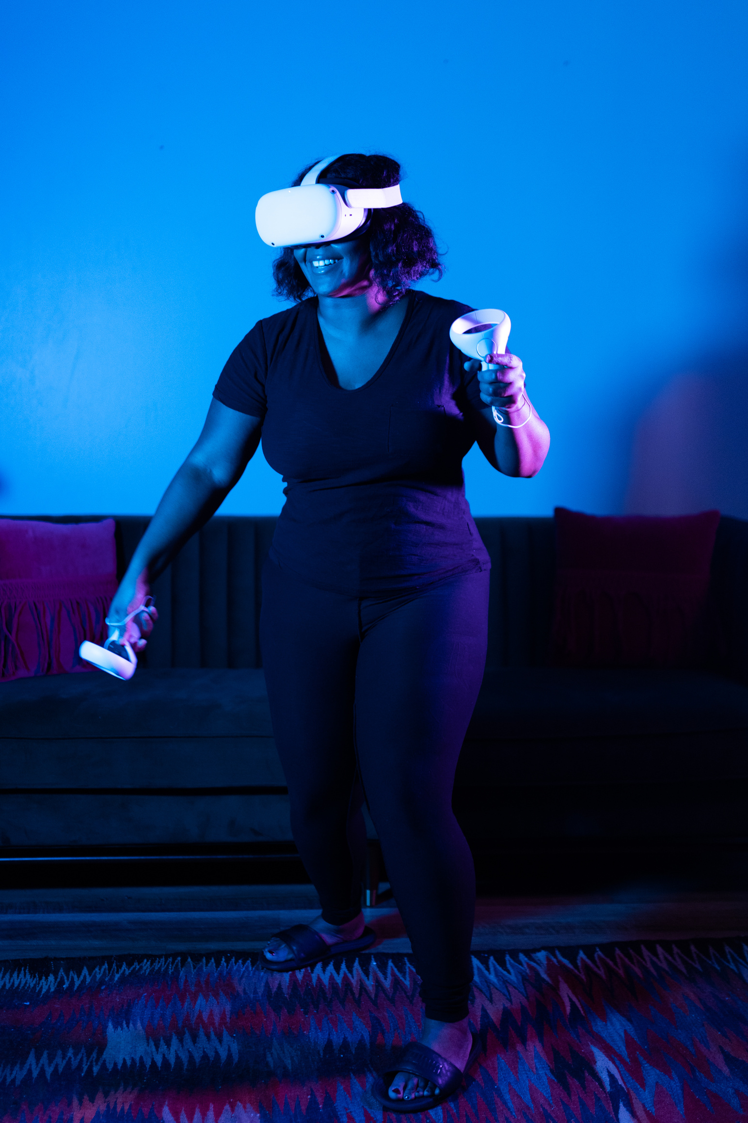
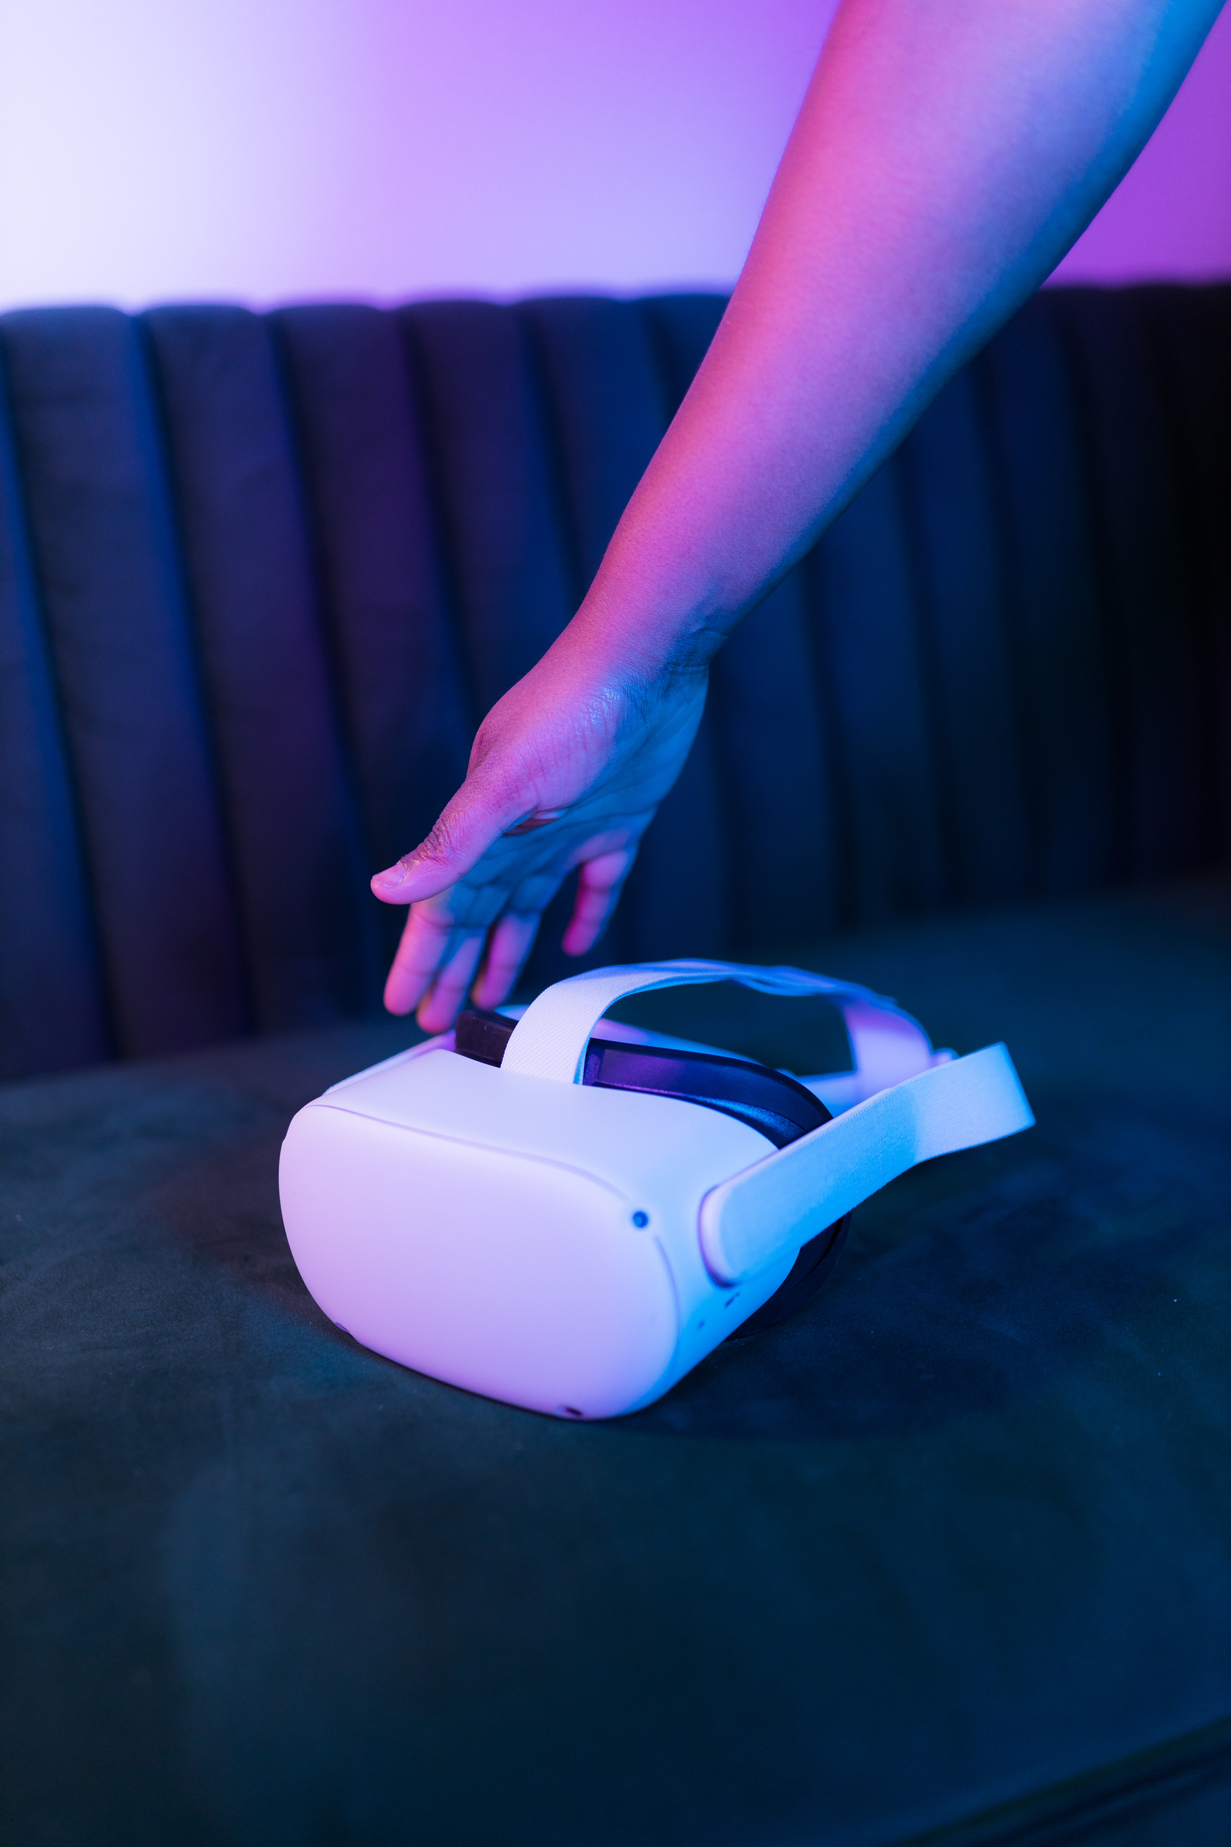
THE AIM
MediVision AI classifies brain MRI images into four classes using a CNN baseline and a Vision Transformer. Explainable AI shows which image regions influenced each prediction. It is an academic prototype with a web interface, not a clinical diagnostic tool.
CNN baseline classifier
Vision Transformer model
Explainable AI heatmaps

Slide 3

PROBLEM STATEMENT
Complex MRI patterns
Need for model comparison
No visual explanation
Brain MRI contains complex visual patterns, and manual image-level analysis is slow and needs domain expertise. A class label alone does not show what influenced it. MediVision AI compares two model families and adds visual explanations.

Slide 4



DATASET & CLASSES
Four classes (glioma, meningioma, pituitary, no tumor) with labeled Training and Testing folders. Images are converted to grayscale, resized to 128×128 and normalized. A stratified 85/15 train/validation split keeps the Testing set held out.
7,200 MRI images
400 held-out test images per class
4 tumor classes

Slide 5
SYSTEM WORKFLOW
1. Upload MRI image
2. Grayscale, resize, normalize
3. Classify with CNN or ViT
The user uploads one MRI image. It is preprocessed, classified by the selected model and explained with a heatmap. Uploaded images are processed in memory and are not saved.
4. Prediction + explanation

Slide 6

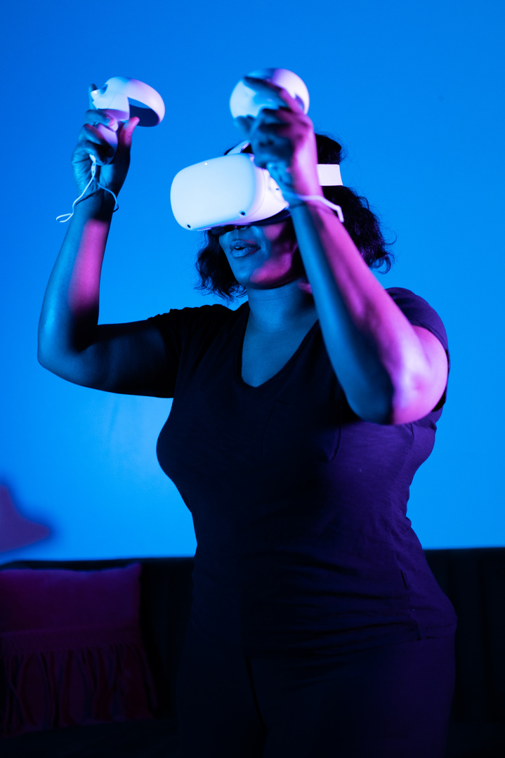


MODELS & EXPLAINABILITY
CNN baseline with Grad-CAM
EfficientNet-B0 transfer learning
Vision Transformer on image patches
ViT attention visualization

Slide 7
EVALUATION PLAN
Every model uses the same seed, split and held-out Testing set. Metrics are reported only from actual training runs.
Classification metrics
Confusion matrix
CNN vs ViT comparison
Accuracy, precision, recall and macro F1 on the held-out Testing split.
Shows class-wise correct and incorrect predictions for each model.
The same evaluation protocol is used for every model.

Slide 8
DATA MODEL
Conceptual model: User, MRI Study, Prediction, Explanation and Model. Key fields include image reference, predicted class, confidence, heatmap and model version. The current prototype processes images in memory and does not store them.
User uploads an MRI Study
MRI Study produces a Prediction
Prediction has an Explanation
Model generates each Prediction

Slide 9
PROGRESS & RESULTS
75.94%
CNN test accuracy
75.25%
CNN test macro F1
Measured results
83.33%
Validation accuracy
The CNN baseline was trained on CPU (seed 42, stopped early after 7 epochs) and tested on the held-out Testing split. The 97% accuracy target has not been achieved. EfficientNet-B0 and ViT results will be added after training.

Slide 10
PROJECT TIMELINE
Synopsis schedule: 13 July 2026 to 20 November 2026. Phase dates are indicative.
Jul – Aug
Sep – Oct
November
Problem definition, literature survey, dataset analysis, preprocessing and CNN baseline.
ViT implementation, training and tuning, XAI, evaluation, FastAPI backend and web interface.
Final testing, project report and presentation.

Slide 11
MediVision AI
Supervisor: Sweta Sri
THANK YOU
Kumkum Gupta • 2501640130039
Riya Choudhary • 2501640130056
Shatakshi Gupta • 2501640130062
Piyush Kumar Singh • 2501640130048

