Slide 1
ITagDB
IUriDB
TagCanvasCtrl-canvas
TagGraphCanvas
TagCanvasCtrl-canvas2
MainWindow
SearchResultListBox
autoTextBox
RichTxtBox

Slide 2
ITagDB
IUriDB
TagCanvasCtrl-canvas
TagGraphCanvas
TagCanvasCtrl-canvas2
MainWindow
SearchResultListBox
autoTextBox
RichTxtBox

Slide 3
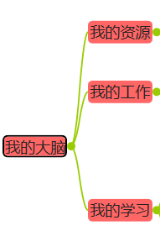
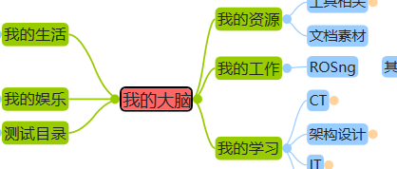
各个矩形范围的含义
XContentPadding/2
YContentPadding/2
txt
txt
txt
LayoutXPadding
txt
txt
LayoutYPadding

